Slide 1

Property Value and Land Use Impacts of Large-Scale Solar Facilities in New York State
Wendong Zhang
Associate Professor, Dyson School of Applied Economics and Management, Cornell University wendongz@cornell.edu
(607) 254-3231
https://wendongzhang.weebly.com/
2026 Dyson Agricultural and Food Business Outlook, Ithaca, NY, January 12, 2026

Slide 2
Research & Extension Program Themes
Theme I: Agriculture & the Environment
Theme II: Land Value, Land Ownership, Land Tenure, Land Use
Theme III: Chinese Agriculture & its Global Trade Implications
Other Useful information:
Appointment: 50% Research & 50% Extension Joined Cornell Dyson School & CCE in July 2022
Faculty Affiliate, Cornell Institute for China Economic Research (CICER)
Faculty Fellow, Cornell Atkinson Center for Sustainability
Academic Vice President, American Society of Farm Managers and Rural Appraisers
Member, NYSERDA RAISE (Regional Agronomic Impacts from Solar Impacts) Specialist committee
Assistant and Associate Professor at Iowa State 2015-2022
Led Iowa land value survey; co-founded the ISU China Ag Center

Slide 3
Outline
Policy Background in New York State
Housing Price Impacts of Large-Scale Solar
Farmland Price Impacts of Large-Scale Solar
Land Use Impacts of Large-Scale Solar
Concluding Thoughts

Slide 4
I. Policy Background in the New York State

Slide 5
Motivation: Energy transition in the US
National goal: net-zero carbon emissions by 2050.
A growing number of states have implemented policy to encourage development of large-scale solar projects (at least 1MW or larger)
Large-scale solar projects require a significant amount of land for solar installations.
A 1MW solar farm: ~6-8 acres.
Projected increase: ~7 million acres in the US by 2040 (Sorensen et al. 2022).
The 500+ existing large-scale solar developments have taken about 10,000 acres of NYS land, with 56% previously used for agriculture (Peter Woodbury, Cornell)

Slide 6
The New York Climate Leadership and Community Protection Act (CLCPA) 2019
is an ambitious piece of climate legislation that:
Requires the NYS energy grid to be entirely decarbonized by 2040; and achieve 30% renewable energy by 2030
New Capacity Needed: 65GW (65,000 MW)
Mandates decarbonization of key sectors such as transportation and space heating
Mandates that the entire state reach net-zero carbon emissions by 2050.
Source: Peter Woodbury (Cornell) pbw1@cornell.edu

Slide 7
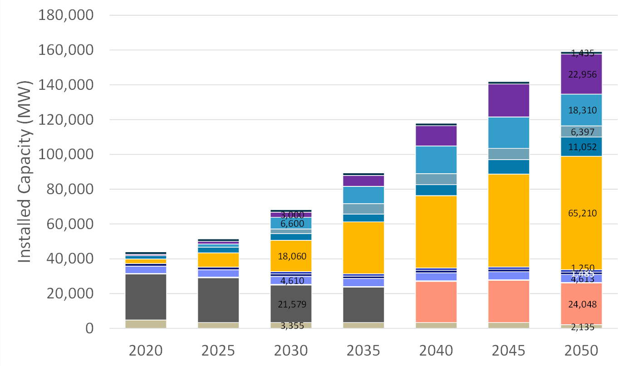
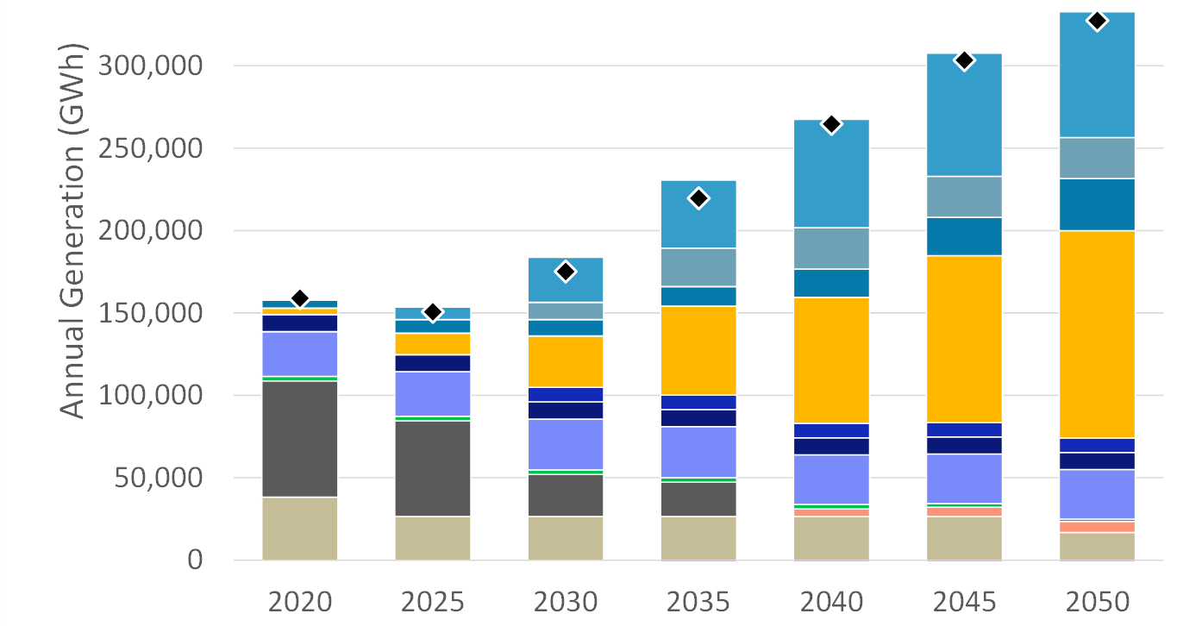
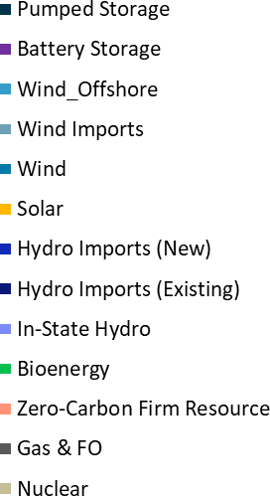

Utility scale solar is expected to play dominant role in meeting CLCPA renewable energy targets
Source: Peter Woodbury (Cornell) pbw1@cornell.edu

Slide 8
More Recent NYS LEGISLATION
The Accelerated Renewable Energy Growth and Community Benefit Act (2020)
Established new rules for siting electricity generating facilities
20-25 MW or larger
New authority for NY Power authority (NYPA)
develop renewable power facilities (in addition to hydropower)
RAPID (Renewable Action through Project Interconnection and Deployment) Act
Transferred the Office of Renewable Energy Siting (ORES) from the Department of State to the Department of Public Service
Adds new functions, powers, duties, and obligations related to major electric transmission siting
Source: David Kay (Cornell)

Slide 9
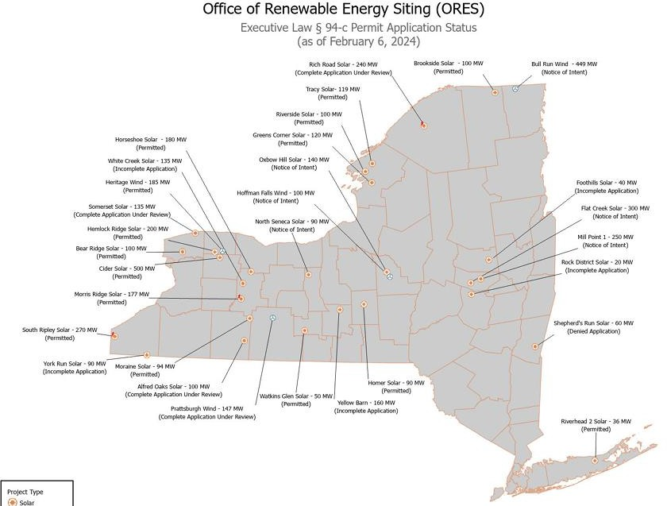

Lots of activity, but mostly very
early stage.
Avg proposed project size:
> 100MW
St. Lawrence
Washington
Genesee
Source:
Permits from the Office of Renewable Energy Siting (ORES governs projects >20-25 MW)
Source: David Kay (Cornell)

Slide 10
II. Housing Price Impacts of Solar

Slide 11
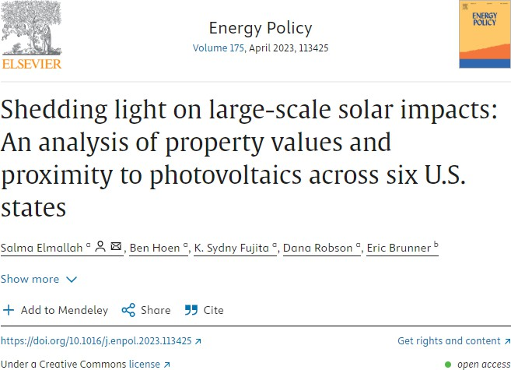
We find that homes within 0.5 mi of a large- scale solar project experience an average home price reduction of 1.5% compared to homes 2–4 mi away; statistically significant effects are not measurable over 1 mi from a LSPVP.
CA, CT, MA show no difference in sale price, while MN, NJ, NC show a reduction.

Slide 12
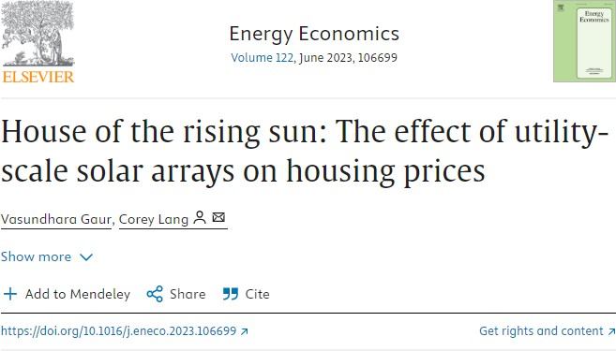
•
results suggest that houses within 0.6 miles [of solar developments] depreciate 1.5–3.6% following construction of a solar array … primarily driven by solar developments on farm and forest lands and in rural areas, which is intuitive given the composite impact of solar, loss of open space, and loss of rural character.
We study the states of Massachusetts and Rhode Island, which have high population densities and ambitious renewable energy goals.

Slide 13
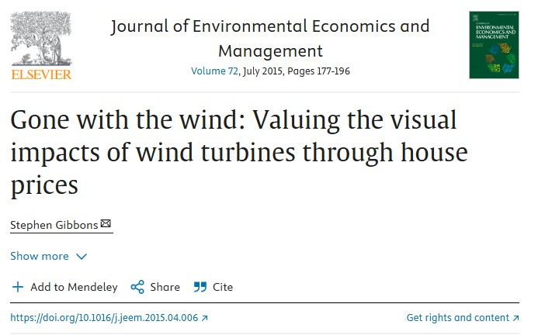
Home price reduction is around 5–6% on average for housing with a visible wind farm within 2 km, falling to under 2% between 2 and 4 km, and to near zero between 8 and 14 km, which is at the limit of likely visibility. No price declines for houses close to wind farms, but where wind farms are less visible suggests that the price reductions are associated with turbine visibility.
England and Wales

Slide 14
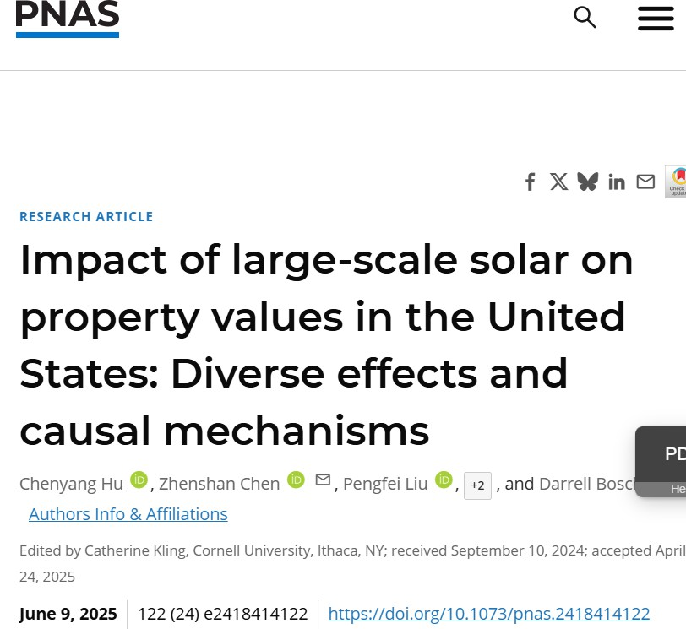


Slide 15
Based on a nationwide dataset combining property transactions and large-scale solar photovoltaic (LSSPV) sites, we analyze the heterogeneous effects of LSSPV on property prices and the associated causal pathways.
Difference-in-differences estimates show that LSSPV significantly increases agricultural or vacant land value by about 19.4% within a 2-mile radius of solar sites
LSSPV simultaneously reducing residential property values within 3 miles by about 4.8%. The estimated average negative impact on home values is primarily driven by site proximity and diminishes with both distance and time.

Slide 16
III. Farmland Price Impacts of Solar
& Electricity Transmission Infrastructure

Slide 17
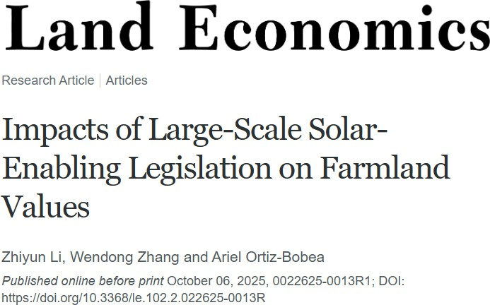

https://papers.ssrn.com/sol3/papers.cfm?abstract_id=4942012

Slide 18
Research Question
How have the state-level renewable energy developments and policies impacted farmland values?
A novel identification strategy: higher option value for farmland parcels
closer to critical energy infrastructure (e.g., substations & electric transmission lines)
This is in contrast with earlier studies (e.g., Abashidze and Taylor 2022) which
compares the farmland parcels “near” the solar farms versus those “farther away” from the solar farms
Application to NY State’s Shared Renewable Policy (2015)
“community net-metering” for community solar & other large-scale-solar enabling policy incentives for large-scale solar in 2019-2021
E.g., creation of new tiers of renewable energy credits for existing renewable energy facilities (referred to as Tier 2) in 2019-20

Slide 19
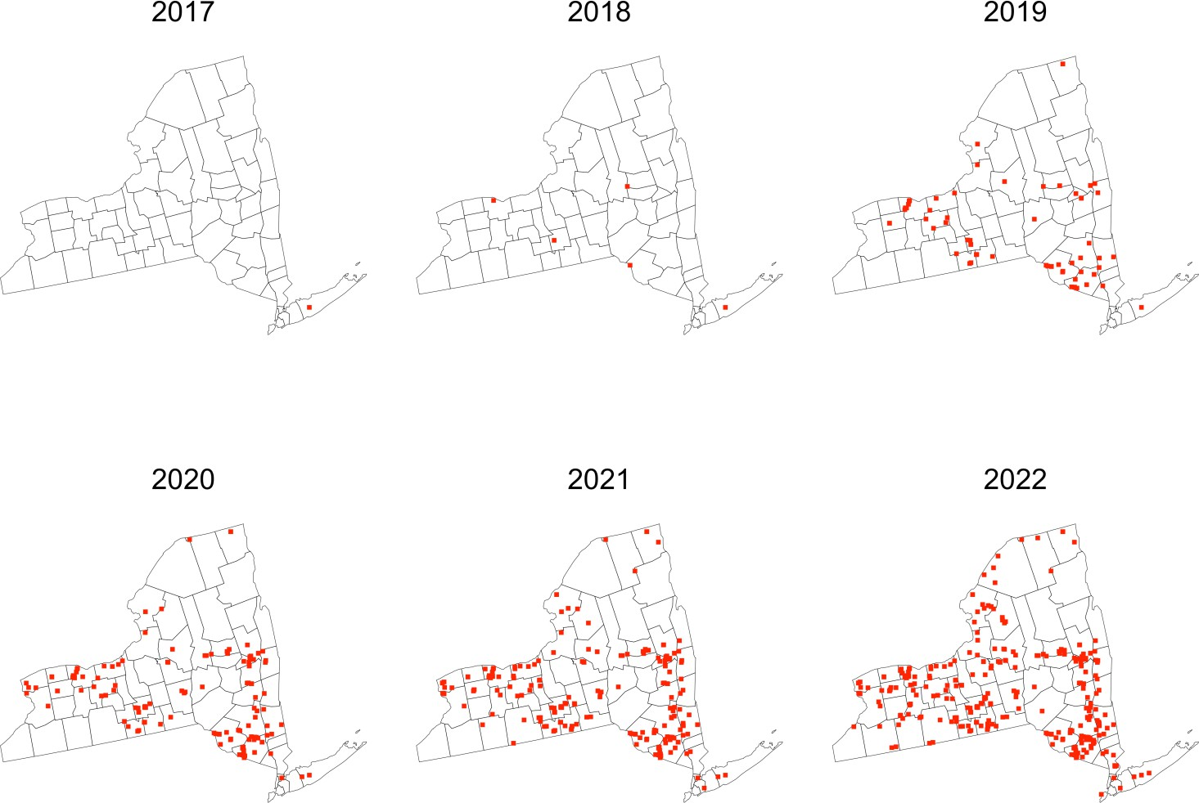
Location of installed community solar projects (>1 MW) supported by NYSERDA

Slide 20
Research design:
The renewable energy policy brought clarity on the expected probability of solar development, and increased the option value of ALL farmland parcels close to energy infrastructure.
NOT focus on the localized effects of solar developments themselves

Slide 21
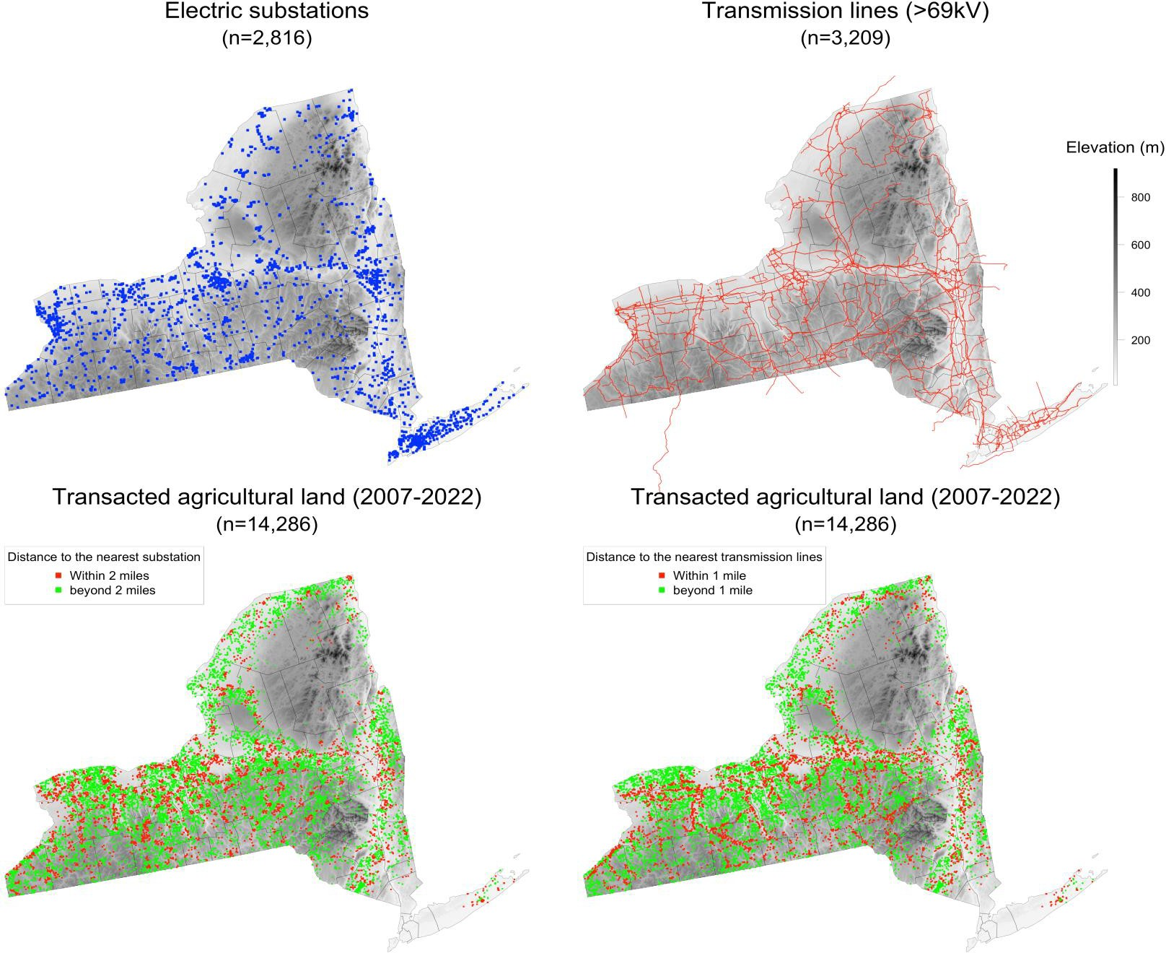
Data: spatial distribution of
the electricity grid and
11,374 farmland sales
2007-2022
Solar developers:
within 2 miles from a substation
or
within 1 mile from a 69kV+
transmission
line
➔ treated group: red parcels control group: green parcels

Slide 22








Old method
Compare land sales closer to solar developments versus those farther away
New method (this paper)
Compare land sales close to transmission lines versus land sales farther away

Slide 23
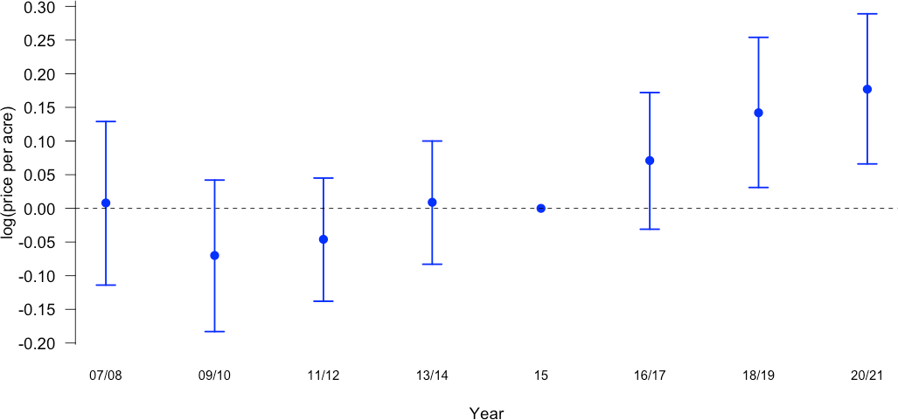
Main Results
Farmland parcels within 2 miles of substations enjoyed 10-15% price premium from 2018-2021, but not evident for 2016-17

Slide 24
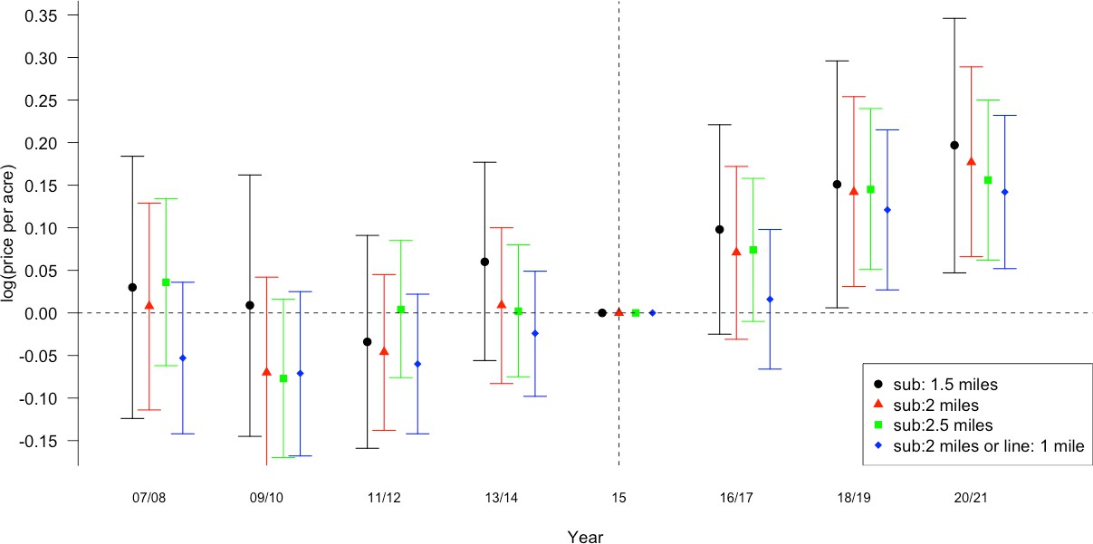
Robustness check: alternative distance cutoffs
within 1.5 or 2.5 miles of substations, and/or within 1 mile of TMLs

Slide 25
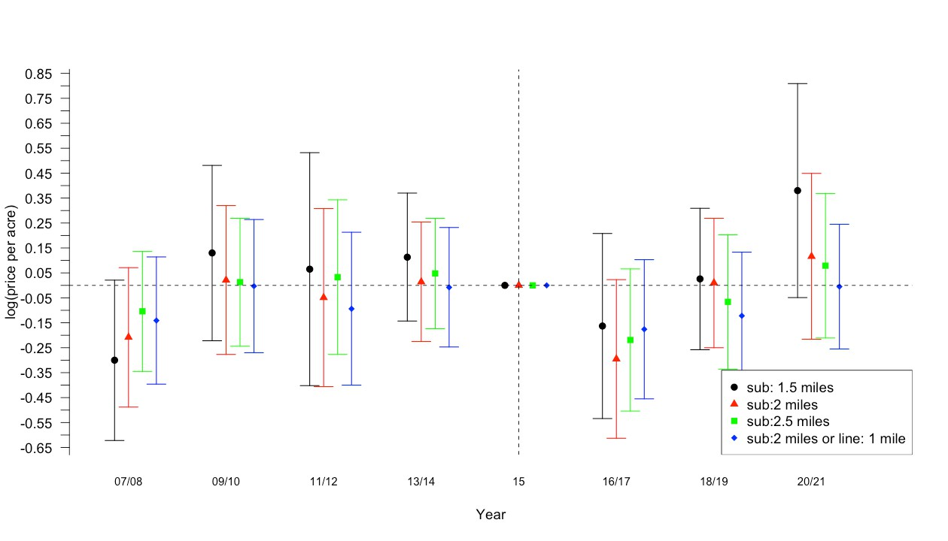
Placebo test: No premium for small parcels (<10 acres) that are not suitable for solar development

Slide 26
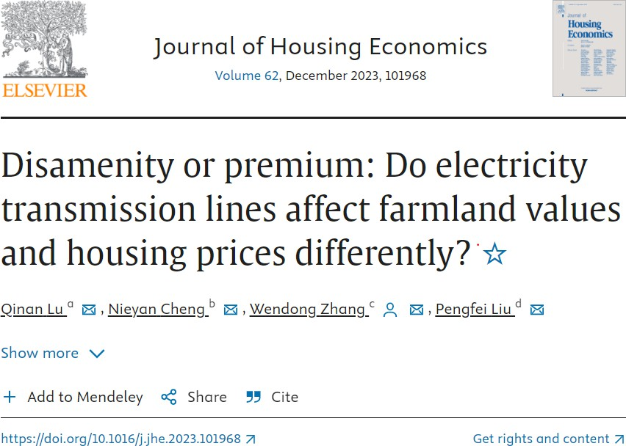
Energy Infrastructure Matters! One Related Example

Slide 27
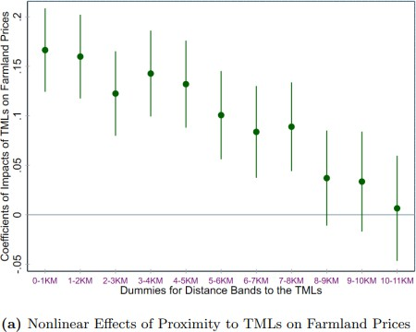
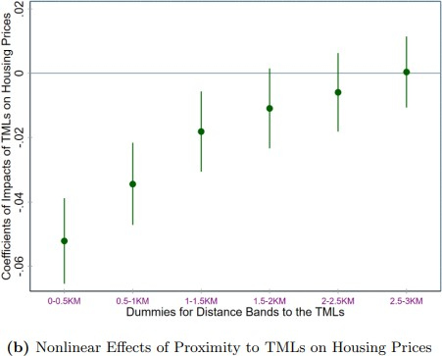
TMLs: premium for farmland prices disamenity for residential housing prices
15% price premium for parcels within 2km of TMLs
6% price discounts
for residential homes within 0.5km of TMLs

Slide 28
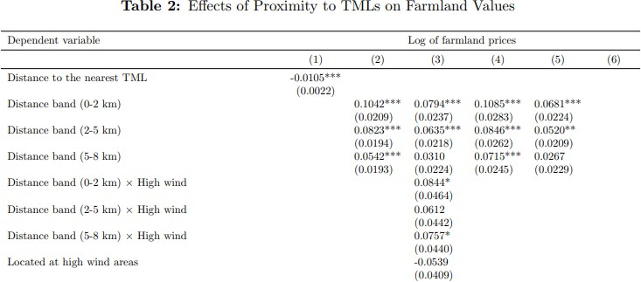
TMLs bring more premium in high-wind-potential areas

Slide 29
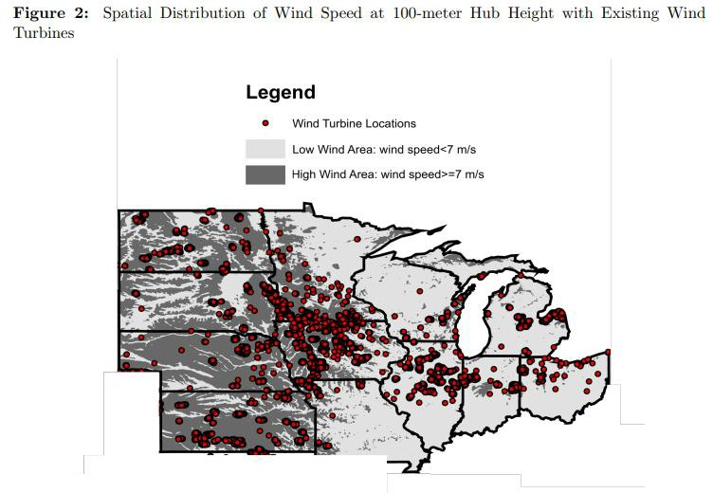

Slide 30
IV. Land Use Impacts of Large-Scale Solar

Slide 31
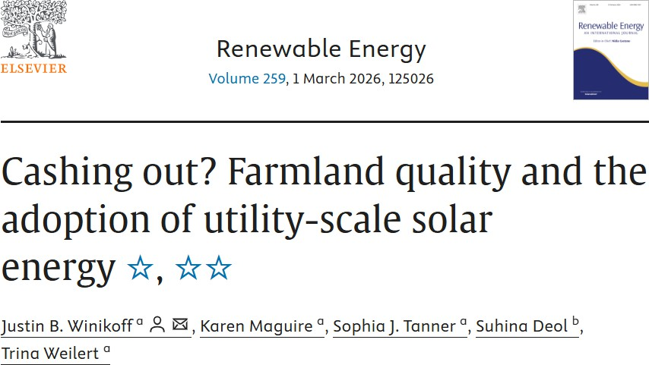
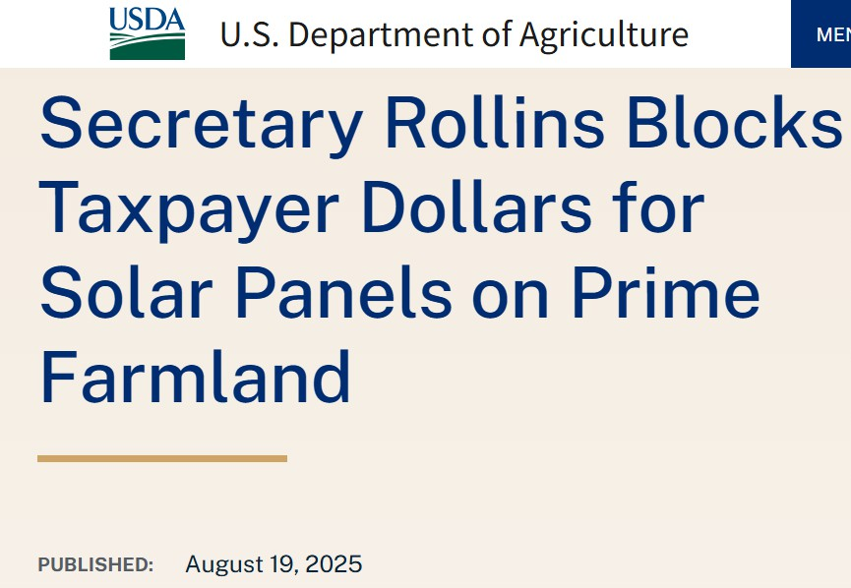
Using a national, parcel-level analysis and multiple indices for farmland quality, this paper examines whether solar energy is more likely to be located on high-quality farmland across the United States. We find little correlation between the share of Prime farmland and solar development on parcels, but solar development was more likely on farmland that is not Prime but categorized as “Important” by state or local officials.

Slide 32
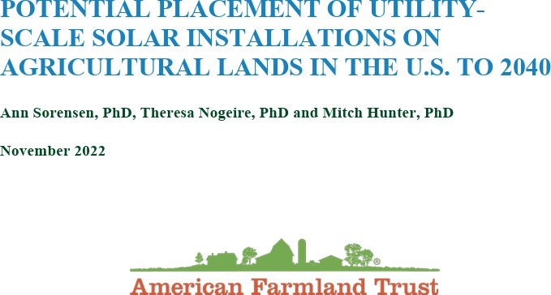

Slide 33
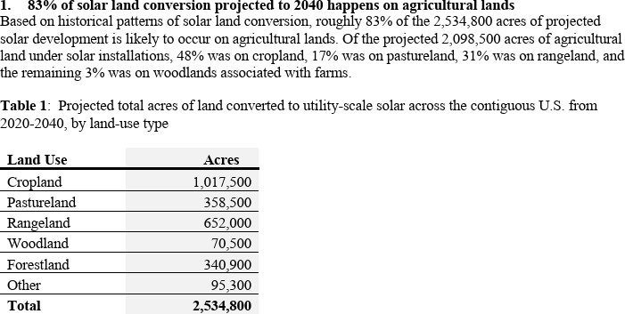
From 2020-2040, New York State is forecasted to lose 45k acres to solar
+ 450k acres to high & low-density urban development

Slide 34
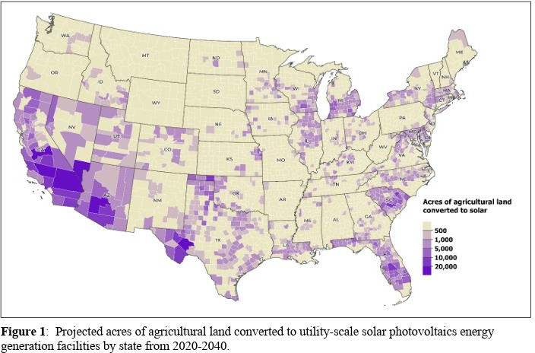

Slide 35
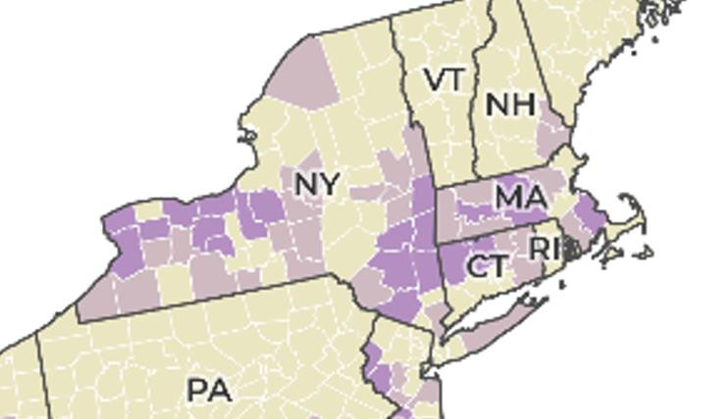

Slide 36
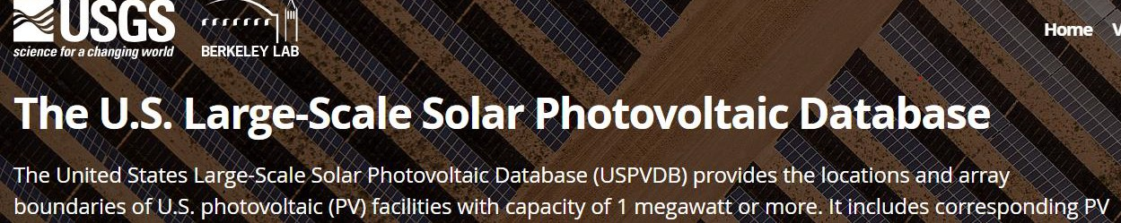
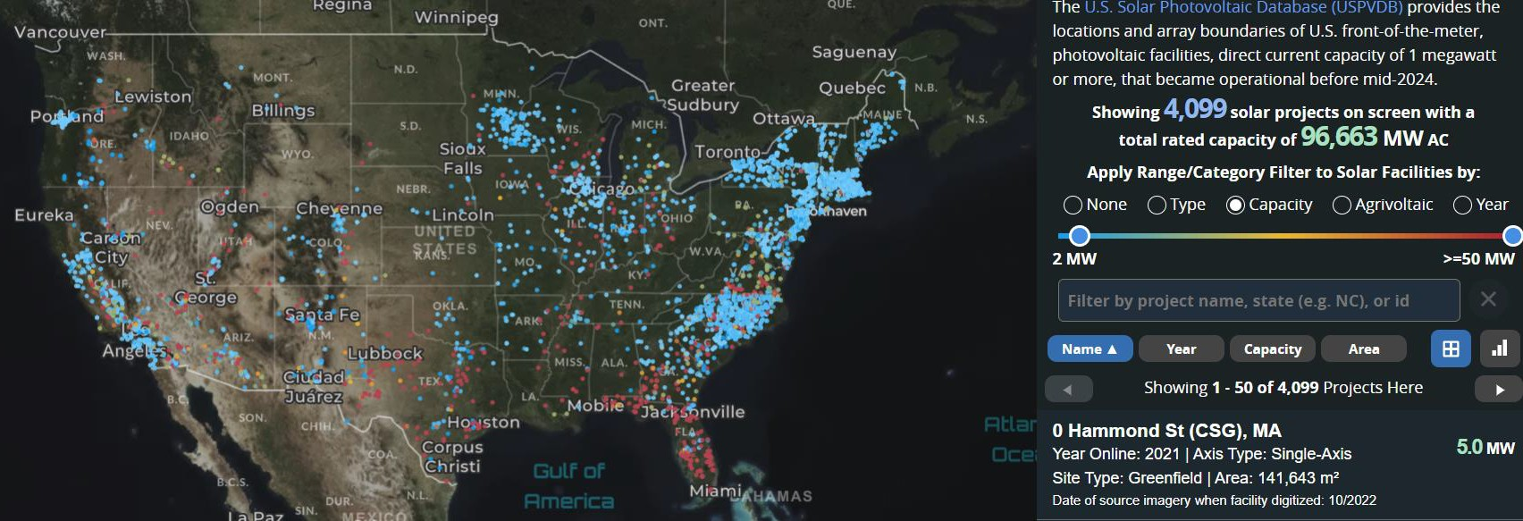
https://energy.usgs.gov/uspvdb/

Slide 37
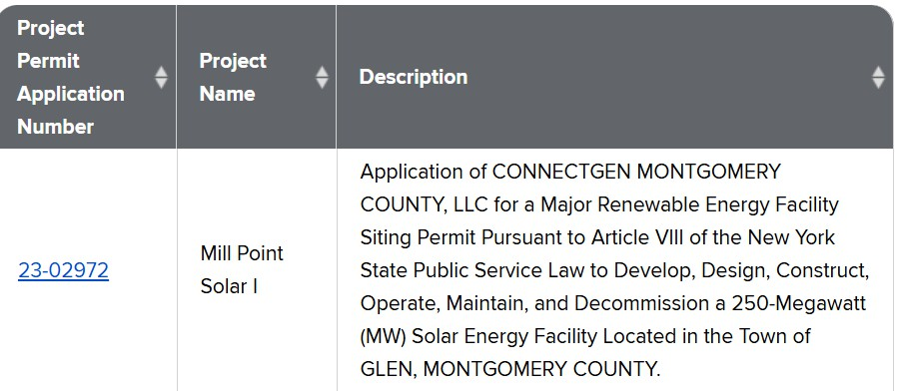
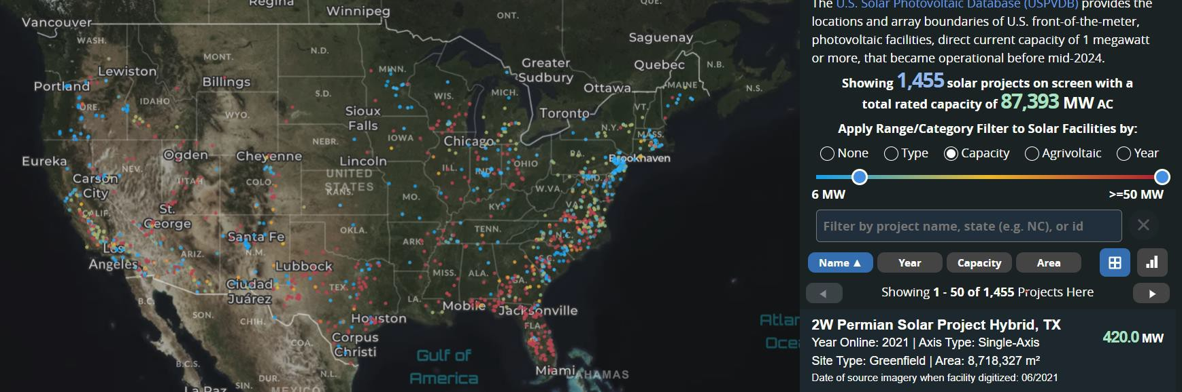
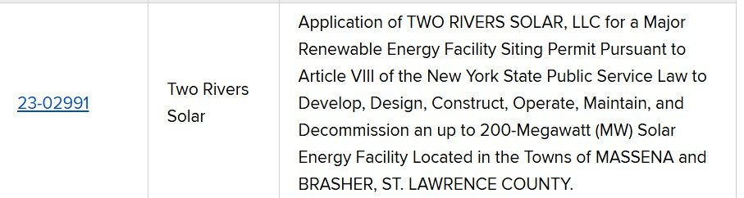
New York State did not have much 5MW+ projects, but will have a lot more
https://dps.ny.gov/ores-permit-applications

Slide 38

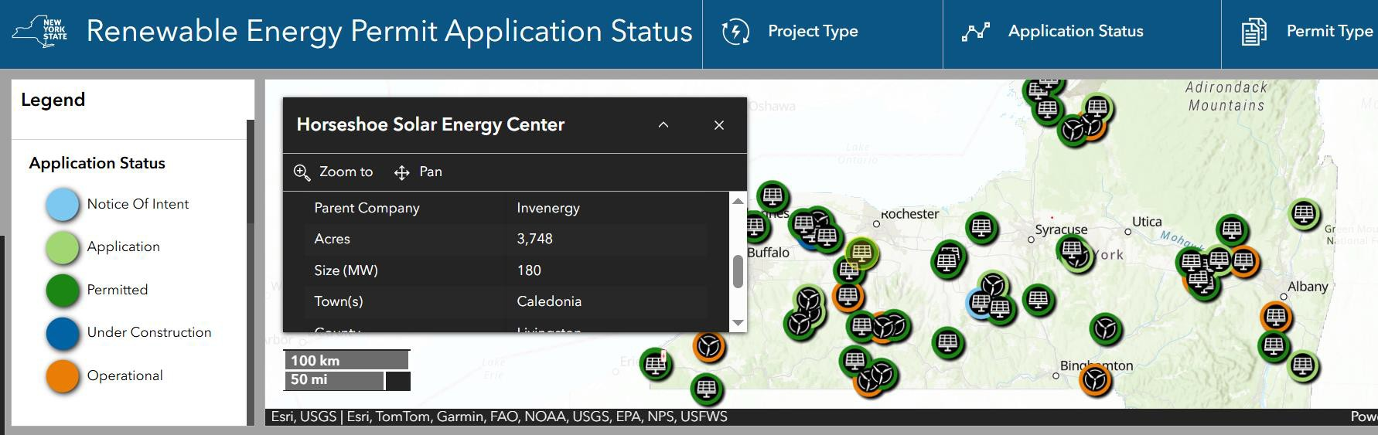
New York State did not have much 5MW+ projects, but will have a lot more https://dps.ny.gov/ores-permit-applications

Slide 39
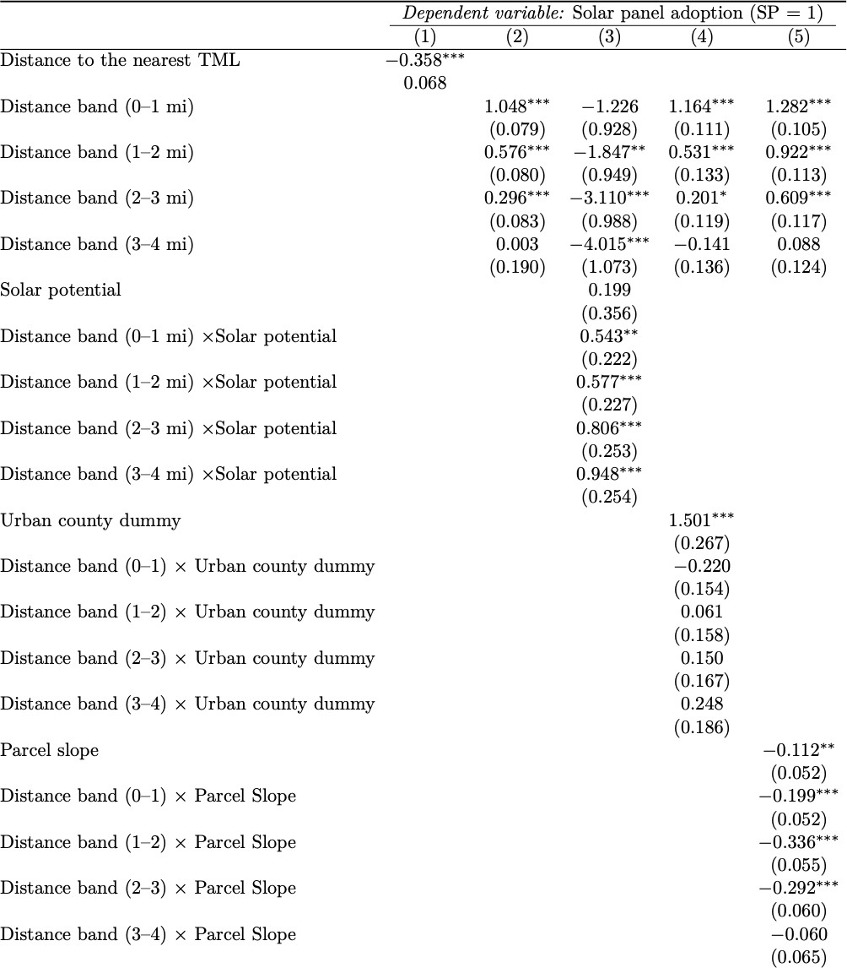
Our work-in-progress shows that the large-scale solar projects are more likely to be sited in farmland parcels within 3 miles of transmission lines and less likely to be on parcels with steeper slopes.
Ongoing research with Allan Pinto, Jasmin Wehner, and Ziyang Long

Slide 40
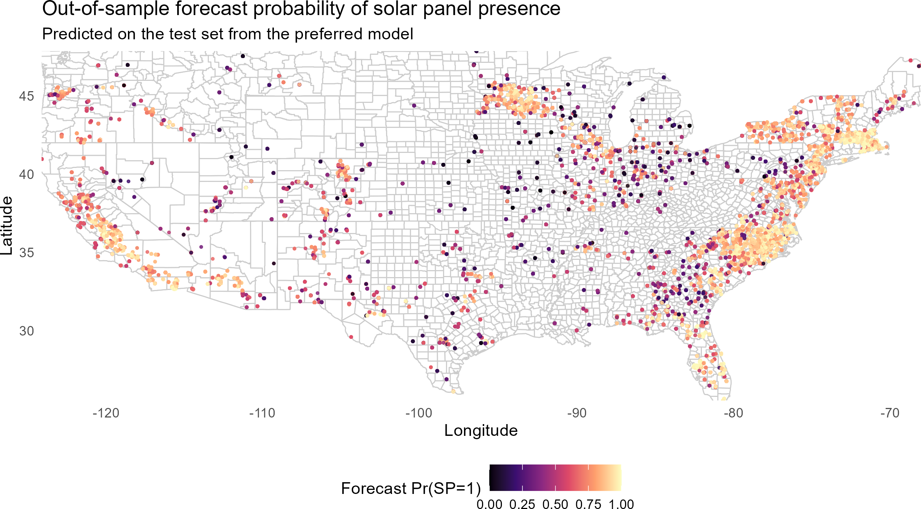

Slide 41
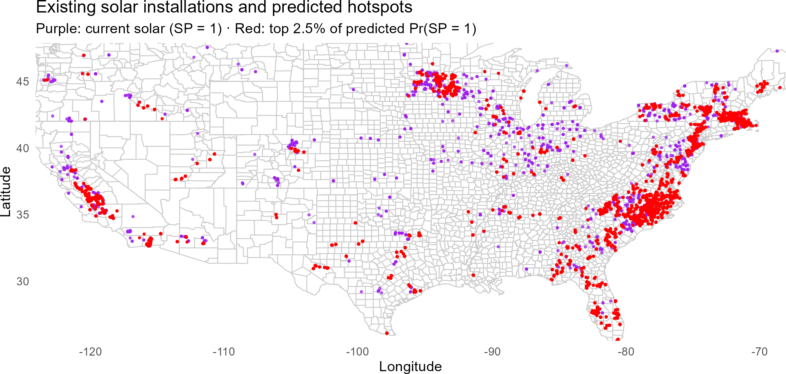

Slide 42
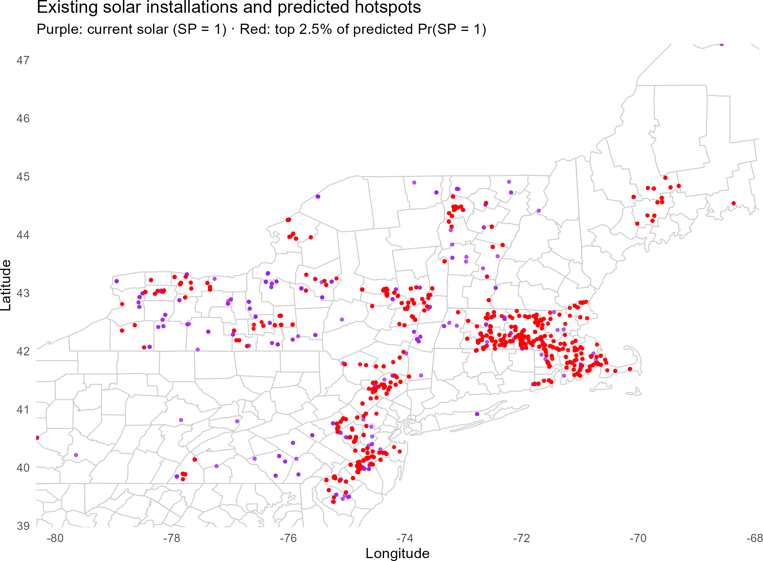
Red represents the 700k acres most Likely to convert to solar

Slide 43
Concluding Thoughts
LARGE-scale solar projects will become even more important in NYS
Residential home prices close to large-scale solar project sites will likely suffer price declines
Farmland parcels closer to electricity transmission lines or substations will enjoy price premium due to solar, and their owners will be approached more
Rural and ag communities are concerned about loss of farmland & rural character to solar
NYS & Cornell are also working on agrivoltaics projects that more explicitly allow for dual use of ag and solar

Slide 44
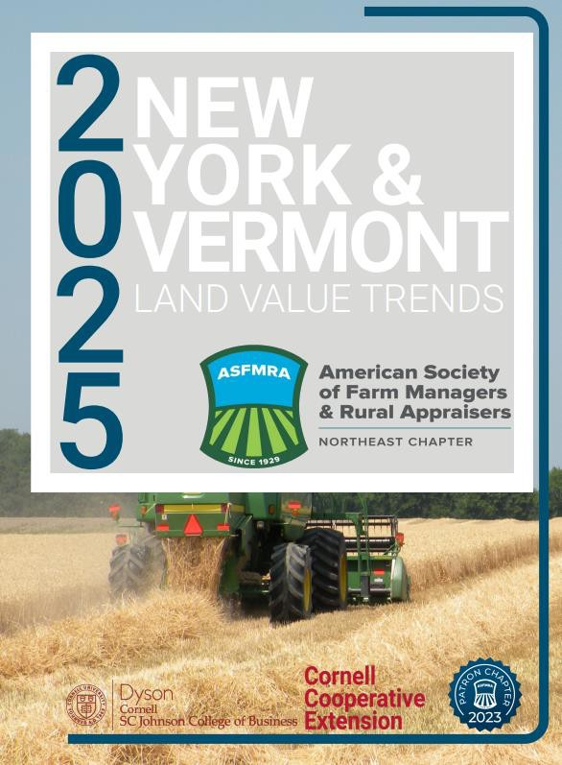
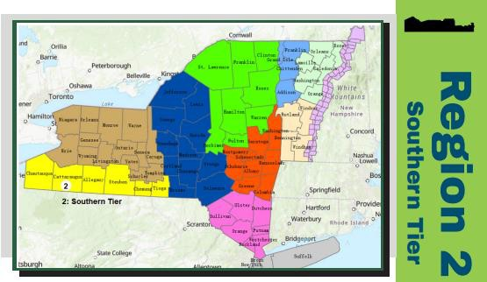
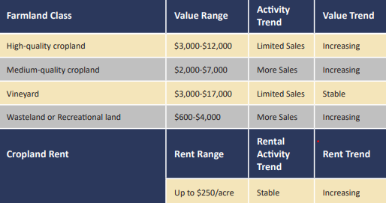
https://ssrn.com/abstract=5402595

Slide 45
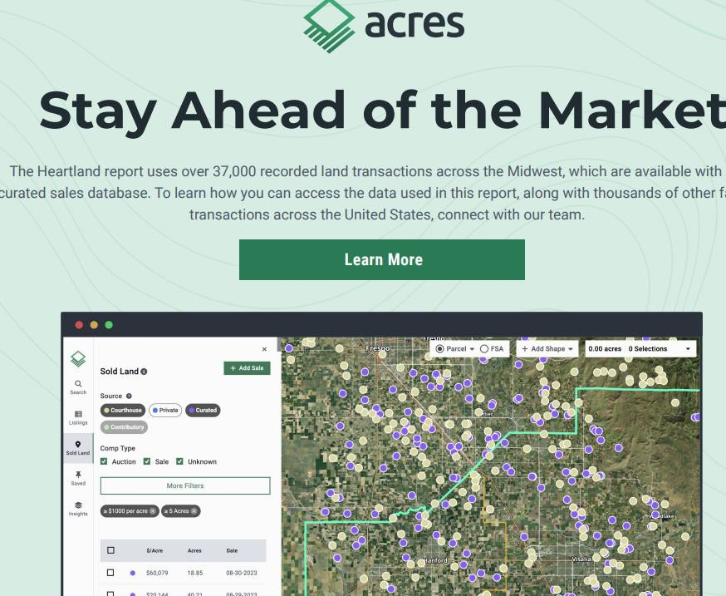
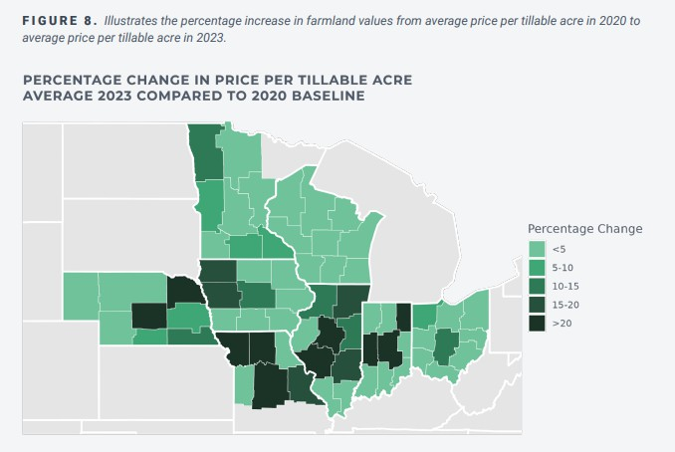
Alan Hinds and I are collaborating with Acres.com to generate annual land value trends report using actual sales

Slide 46

Thank you!
Wendong Zhang 614-558-5346
wendongz@cornell.edu
https://wendongzhang.weebly.com/

Slide 47
V. Community Attitudes & Willingness to Host Large-Scale Solar & Agrivoltaics

Slide 48
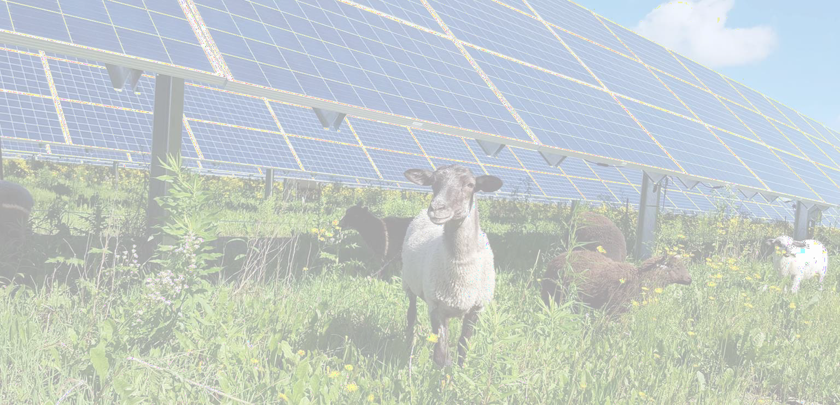



Assessing Landowner Willingness to Host Agrivoltaic Systems in NYS
PI: Richard Stedman. Team: Katie Walsh, David Kay, Bruce Lauber, Wendong Zhang
MIXED-METHODS, CASE STUDY APPROACH
Case study of Western New York
Interviews and focus groups with landowners/agricultural
We aim to learn how landowners understand AV, the constraints they perceive, under what conditions and to what extent they would consider AV, and how it would change the nature of their current operations
producers to learn about their perceptions, preferences, and priorities for AV
Randomized mail survey (n=2400) of landowners near
proposed/existing solar facilities with classified agricultural land
Systematic review of Farmland Protection Plans supplemented by interviews with Farmland Protection Board members
Case Study Selection
Interviews & Focus Groups
Qualitative Analysis
Mail Survey
Disseminating Results
Quantitative
Analysis
Systematic Review
Disseminating Results
2024
2025
2026

Slide 49
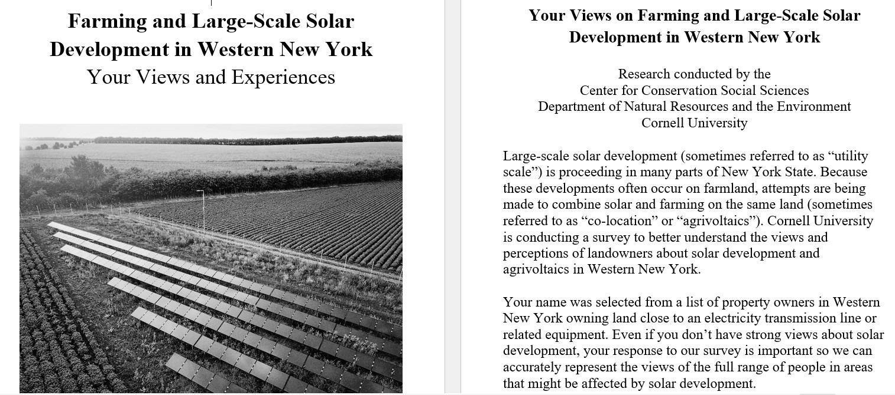

Slide 50
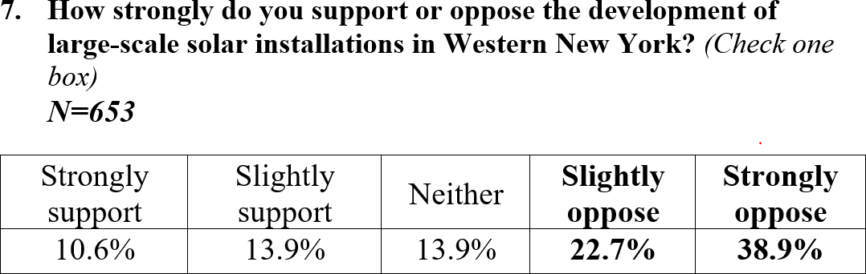
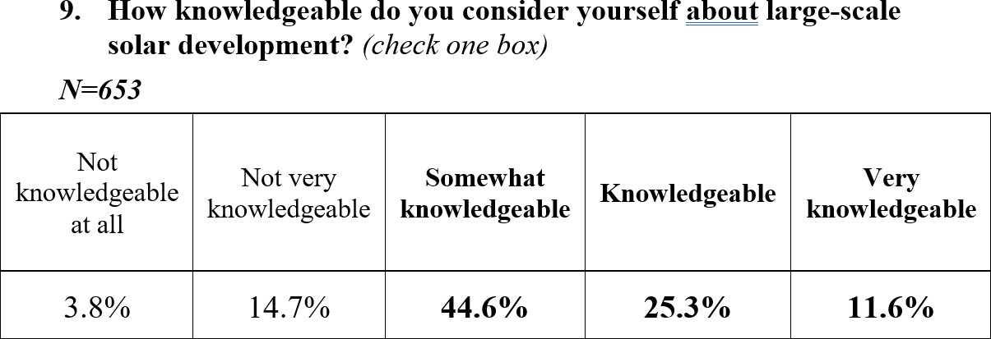

Slide 51
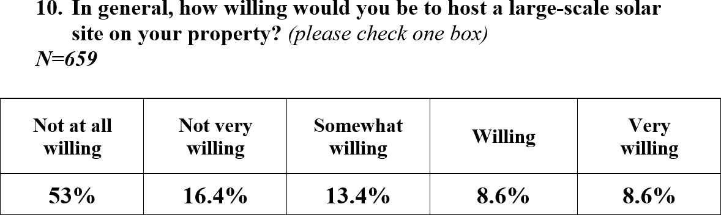
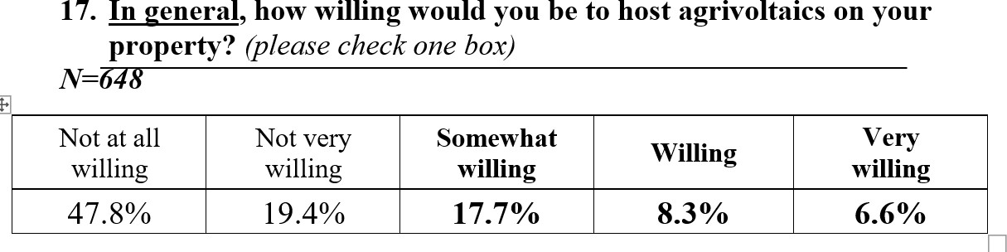

Slide 52
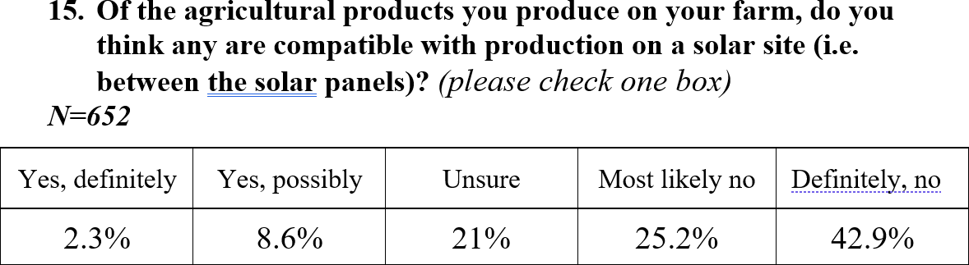
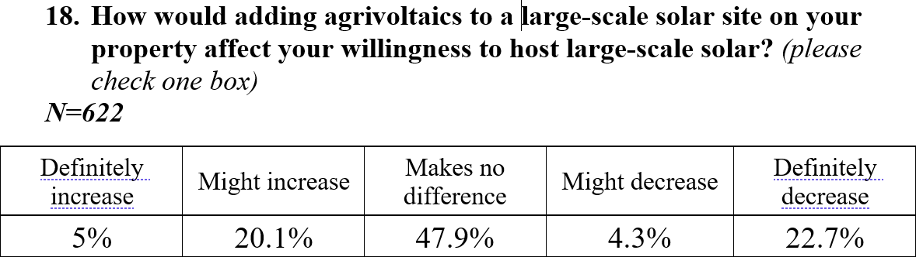

Slide 53
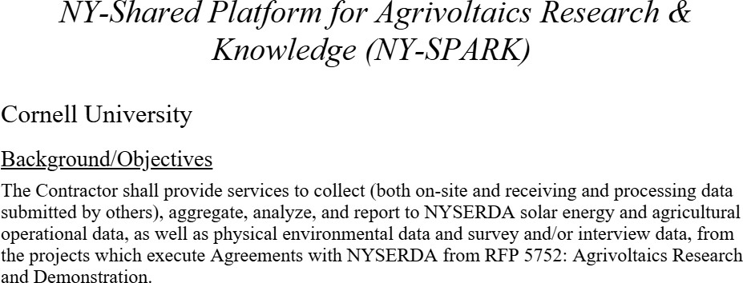
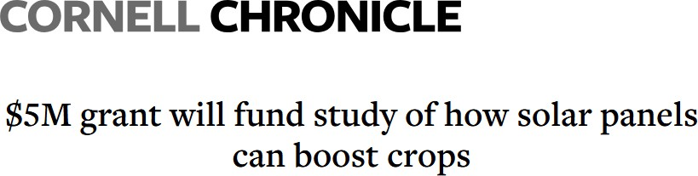
NYSERDA has awarded Cornell’s
College of Agriculture and Life Sciences
$5 million to build solar arrays at university farms in Ithaca and the Hudson Valley, enabling research in agrivoltaics – the practice of co-locating food and energy production.

Slide 54


