Slide 1




2026 US
Dairy Market Situation & Outlook
Christopher A. Wolf
E.V. Baker Professor of Agricultural Economics Dyson School of Applied Economics and Management
Cornell University
January 12, 2026
C. Wolf
1

Slide 2





Beverage dairy milk consumption
260.00
240.00
220.00
Total Beverage Milk (lbs/person)
200.00
180.00
160.00
Per capita beverage dairy
140.00
milk consumption declined an average of 2.32%
120.00
annually since 2010
100.00

Slide 3







Dairy Product Consumption
45 42.336
40
35
30
25
20
Pounds per capita
15
13.804
10
6.513
5
0
cheese
butter
yogurt

Slide 4







US per capita Dairy Product Consumption
680
660
640
620
600
580
560
pounds per capita
We have added an average
540
of 2.5 lbs per capita fat equivalent annually
520
since 1975
500

Slide 5
Per capita consumption all dairy
680.0
660.0
640.0
620.0
600.0
580.0
560.0
540.0
520.0
lbs per capita
500.0
2011 2012 2013 2014 2015 2016 2017 2018 2019 2020 2021 2022 2023 2024
fat basis skim basis

Slide 6
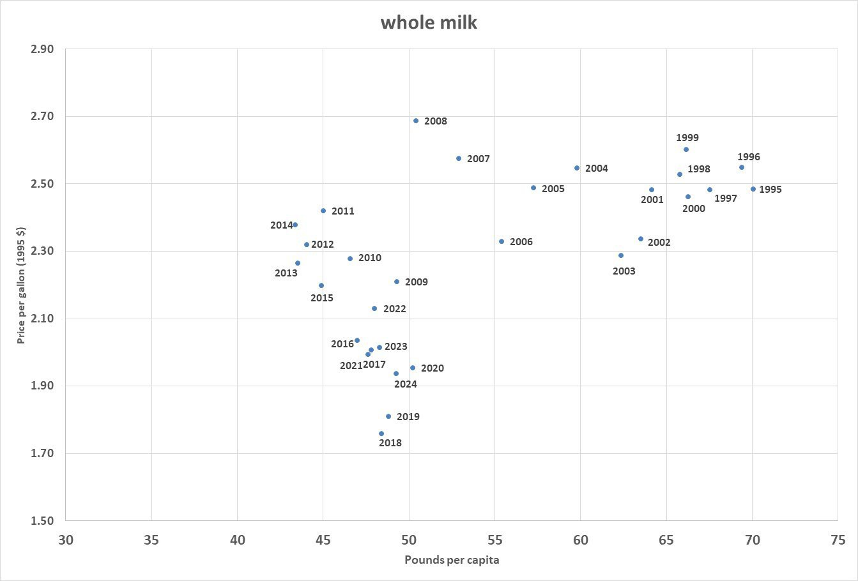

Slide 7
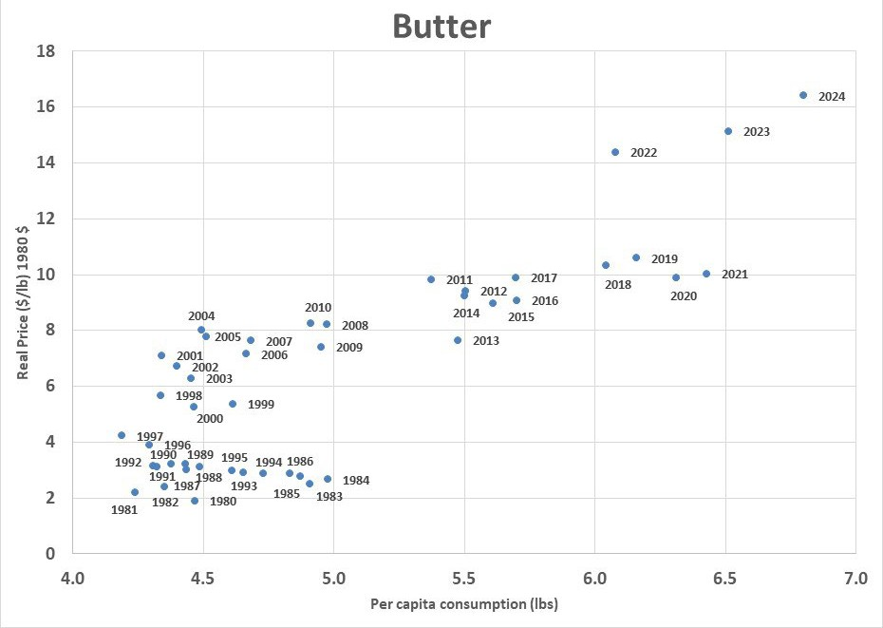

Slide 8
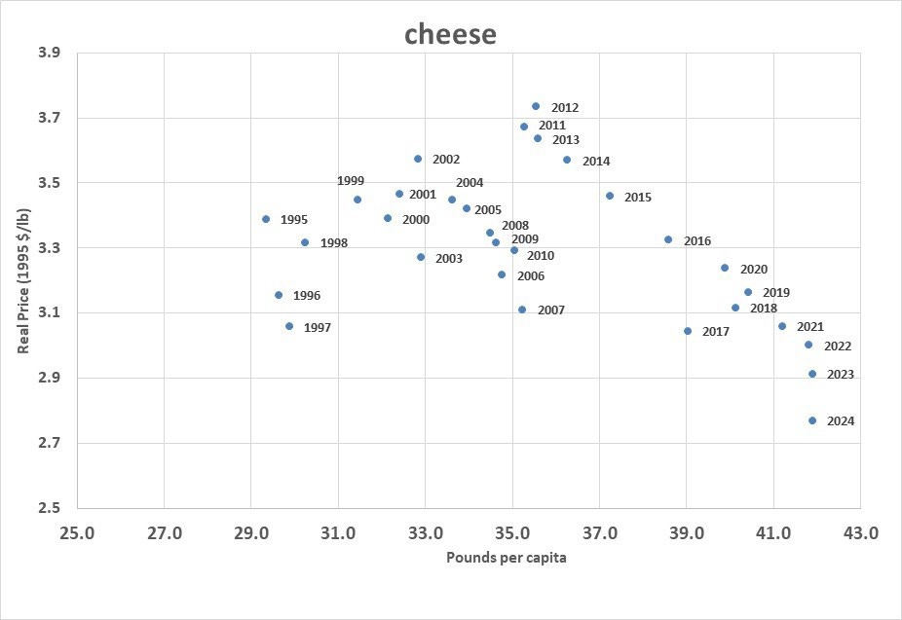

Slide 9
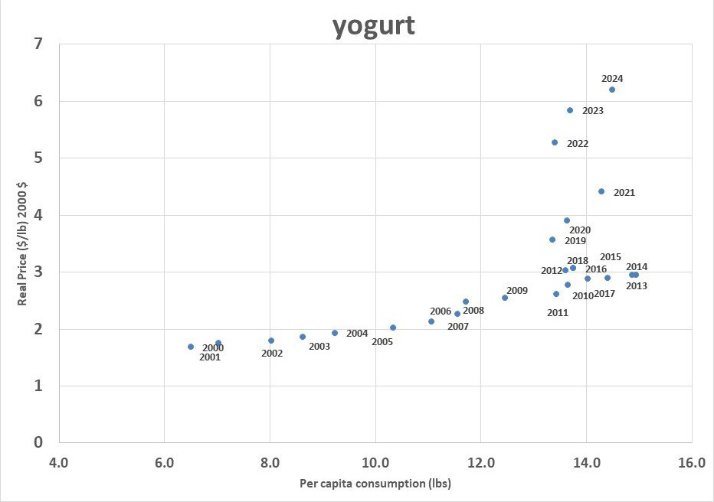

Slide 10
New York Dairy Situation
2024: 16.1 billion pounds milk
New plants + expansions 5-6 billion lbs
In 2024, ~3.9 billion pounds left NYS for processing

Slide 11
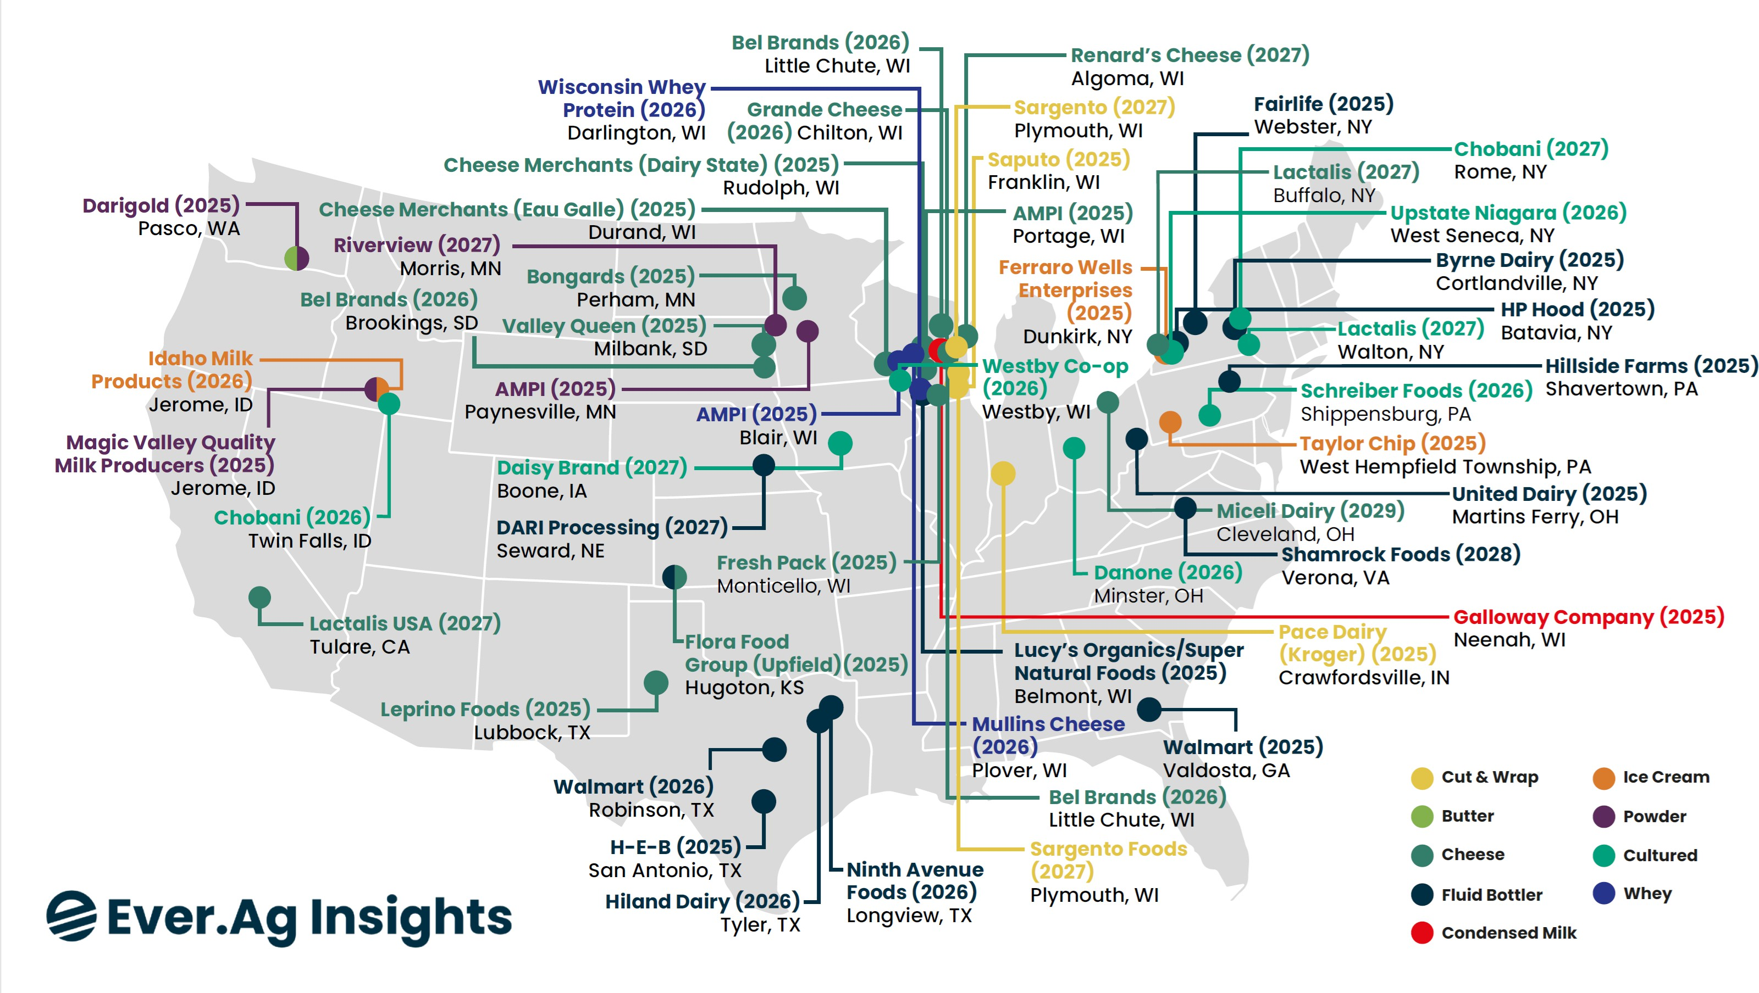

Slide 12
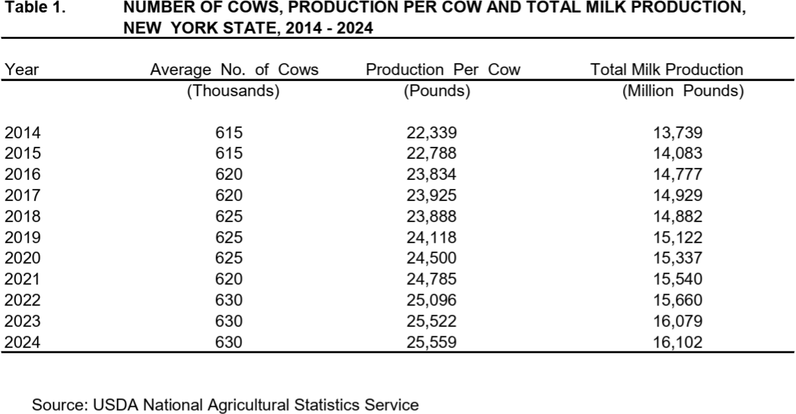

Slide 13
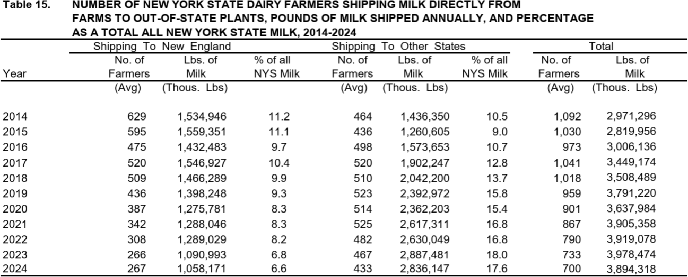

Slide 14

2024-2025
26
24
22
20
18
16
14
12
10
$/cwt
PIII PIV NY mailbox

Slide 15
Income Over Feed Cost Margin
30.00
25.00
20.00
15.00
10.00
5.00
0.00
$/cwt
2020
2021 2022
All Milk Price ($/cwt)
2023 2024
Feed Cost ($/cwt)
2025
margin

Slide 16
Annual Average Dairy Margin Coverage Program IOFC
 |  | All Milk Price | Feed Cost | IOFC
 |  | $/cwt
2020 |  | 18.32 | 8.87 | 9.45
2021 |  | 18.69 | 11.78 | 6.92
2022 |  | 25.56 | 14.85 | 10.71
2023 |  | 20.48 | 13.76 | 6.71
2024 |  | 22.93 | 10.51 | 12.42
2025 |  | 21.14 | 10.04 | 11.10

Slide 17
Cornell DFBS
 | Milk Price | ROA (w/out appreciation)
2021 | 19.83 | 4.2
2022 | 27.05 | 11.7
2023 | 22.72 | 3.8
2024 | 24.54 | 8.2

Slide 18
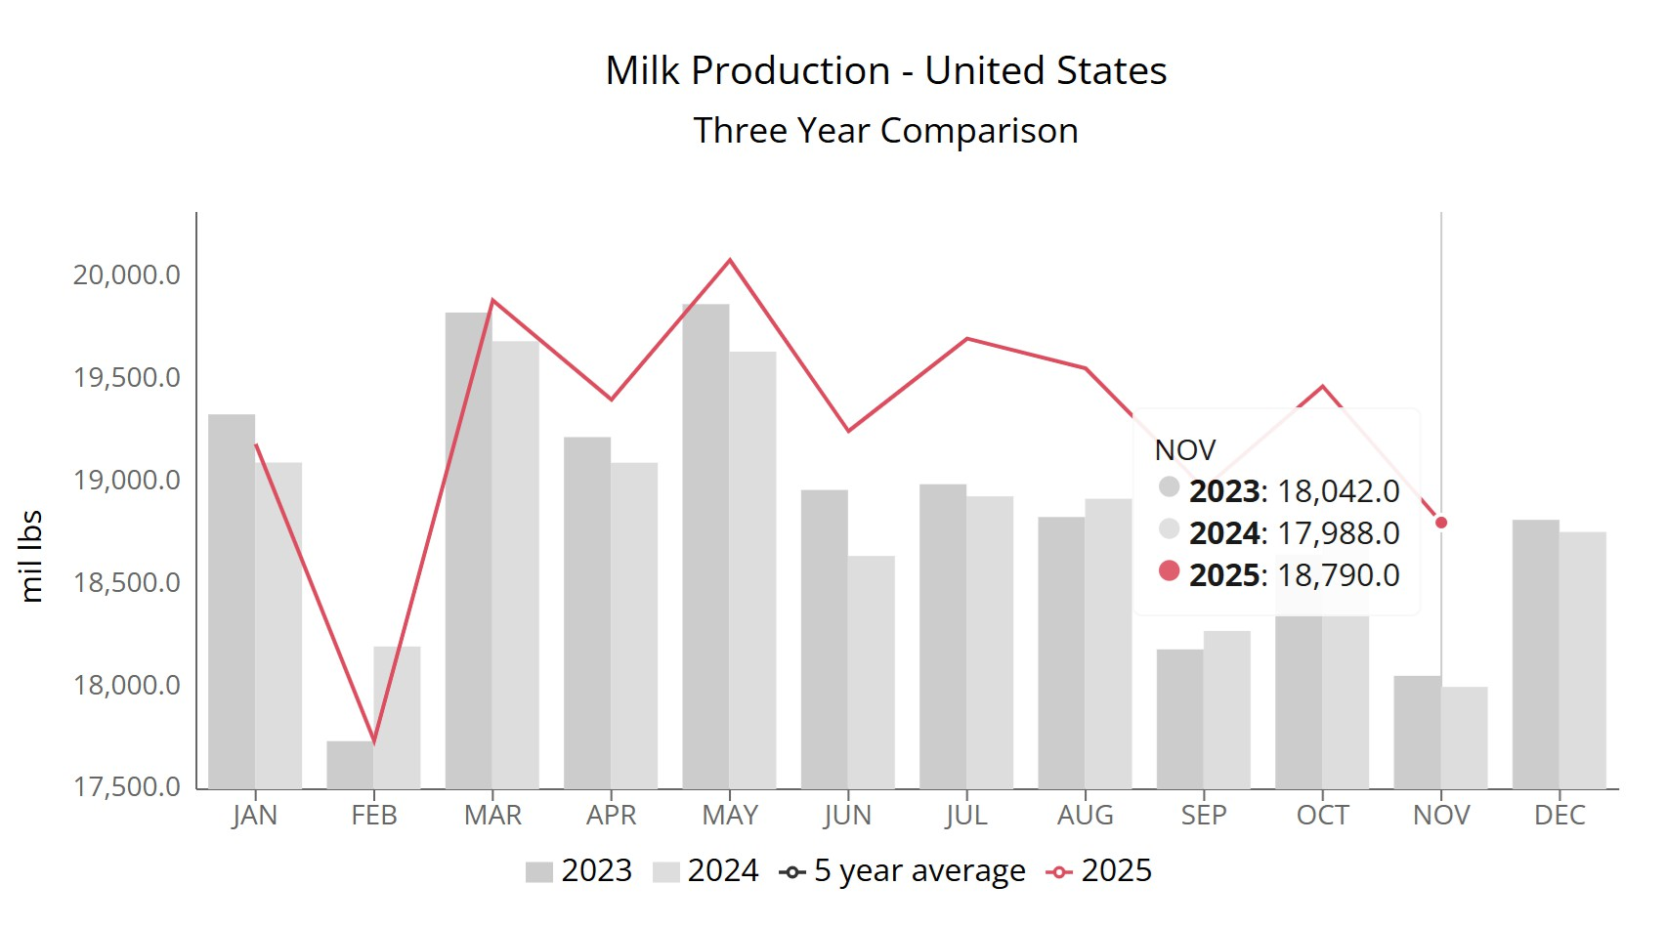
US Milk Production
Nov 2025
+4.46% YoY
Source: UDM

Slide 19
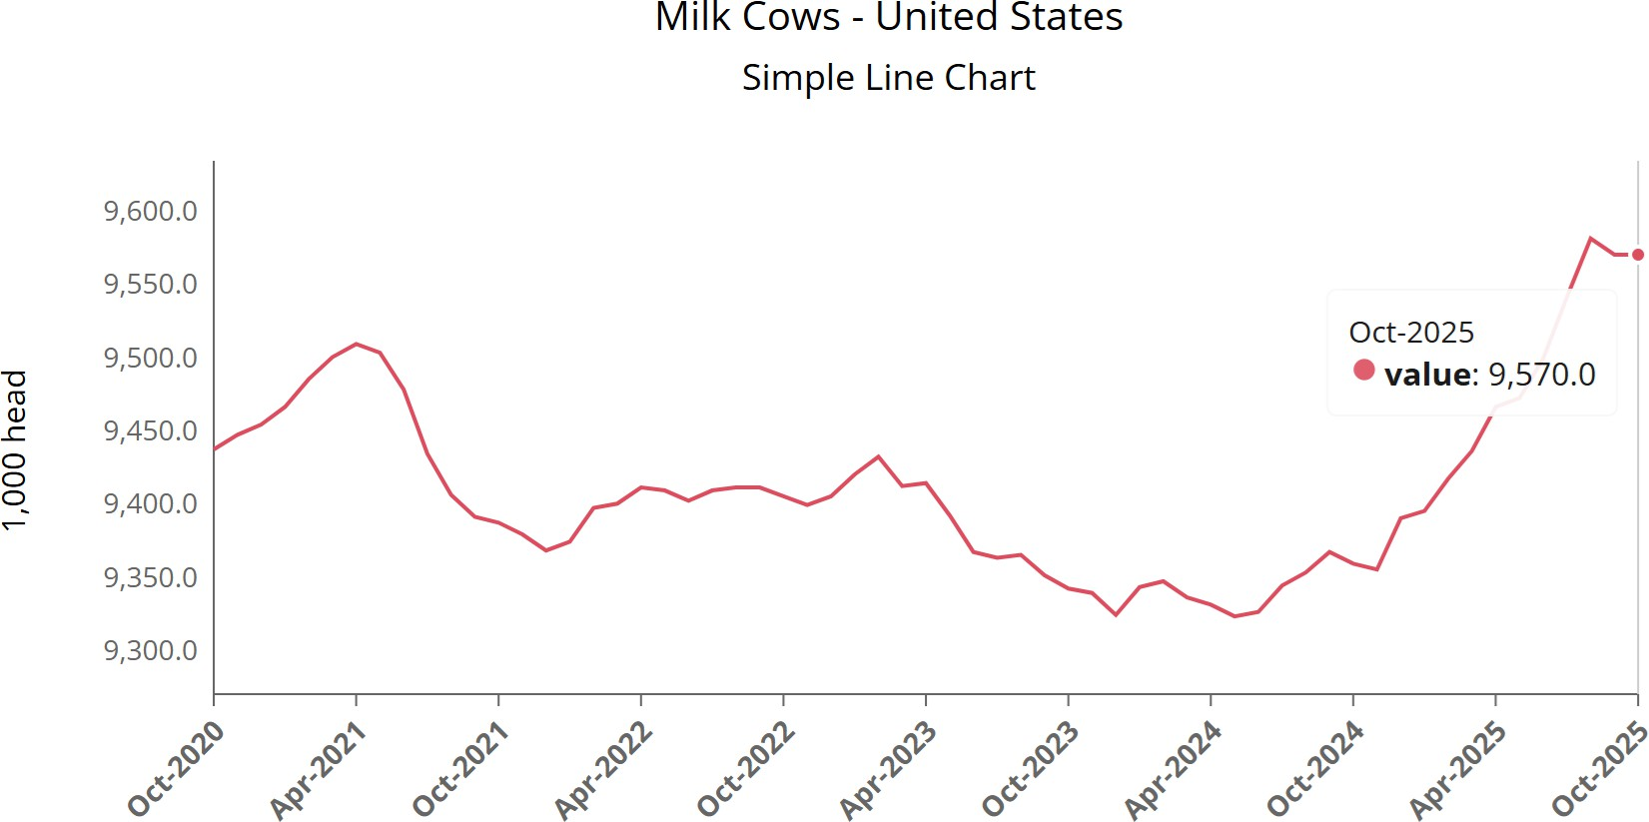
US Milk Cows
November 2025 9.57million
+211,000 YoY
Source: UDM

Slide 20
US Milk Cows, 1998-2025
9700
9600
9500
9400
9300
9200
9100
9000
8900
Thousand cows
1/1/1998
3/1/1999
5/1/2000
7/1/2001
9/1/2002
11/1/2003
1/1/2005
3/1/2006
5/1/2007
7/1/2008
9/1/2009
11/1/2010
1/1/2012
3/1/2013
5/1/2014
7/1/2015
9/1/2016
11/1/2017
1/1/2019
3/1/2020
5/1/2021
7/1/2022
9/1/2023
11/1/2024

Slide 21
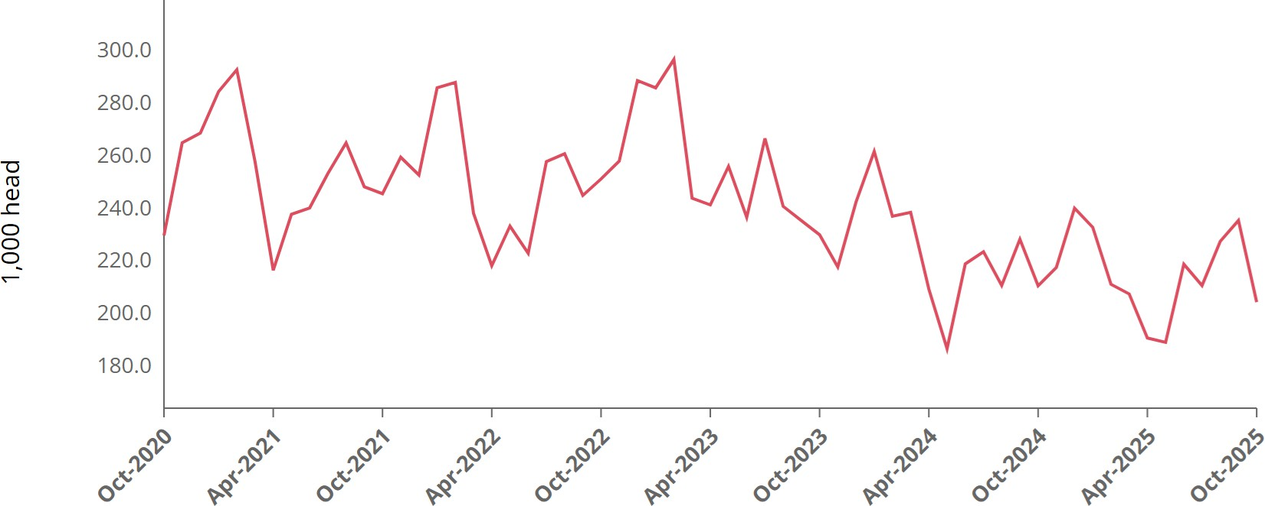
Dairy Cow Slaughter

Slide 22
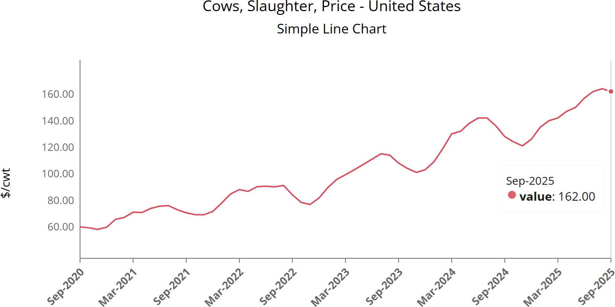
Cull Cow Price
Source: UDM

Slide 23
Cornell Dairy Farm Business Summary
Operating Receipts, 2015-2024
 |  | 2015 |  | 2016 |  | 2017 |  | 2018 |  | 2019 |  | 2020 |  | 2021 |  | 2022 |  | 2023 |  | 2024
 |  | $/cwt
Milk |  | 18.32 |  | 17.06 |  | 18.48 |  | 17.24 |  | 19.41 |  | 18.55 |  | 19.83 |  | 27.11 |  | 22.72 |  | 24.54
Cull cattle |  | 1.88 |  | 1.55 |  | 1.52 |  | 1.21 |  | 1.11 |  | 1.01 |  | 1.01 |  | 1.28 |  | 1.47 |  | 1.99
Calves |  |  | 0.45 |  | 0.20 |  | 0.19 |  | 0.09 |  | 0.08 |  | 0.15 |  | 0.24 |  | 0.37 |  | 0.62 |  | 1.28
Other livestock |  | 0.06 |  | 0.04 |  | 0.05 |  | 0.09 |  | 0.04 |  | 0.05 |  | 0.09 |  | 0.08 |  | 0.05 |  | 0.08
Crops |  | 0.39 |  | 0.31 |  | 0.49 |  | 0.40 |  | 0.19 |  | 0.30 |  | 0.90 |  | 0.54 |  | 0.72 |  | 0.63
Miscellaneous |  | 0.59 |  | 0.62 |  | 0.59 |  | 0.67 |  | 0.73 |  | 2.80 |  | 0.57 |  | 0.52 |  | 0.60 |  | 0.64
Total |  | 21.69 |  | 19.78 |  | 21.32 |  | 19.70 |  | 21.56 |  | 22.86 |  | 22.64 |  | 29.90 |  | 26.18 |  | 29.16

Slide 24
US Semen Sales
Annual Units Sold
12M
11M
10M
Gender-sorted dairy
9M
8M
Beef on dairy
7M
6M
Conventional dairy
5M
4M
2020 2021
Source: National Association of Animal Breeders
2022
2023
2024

Slide 25
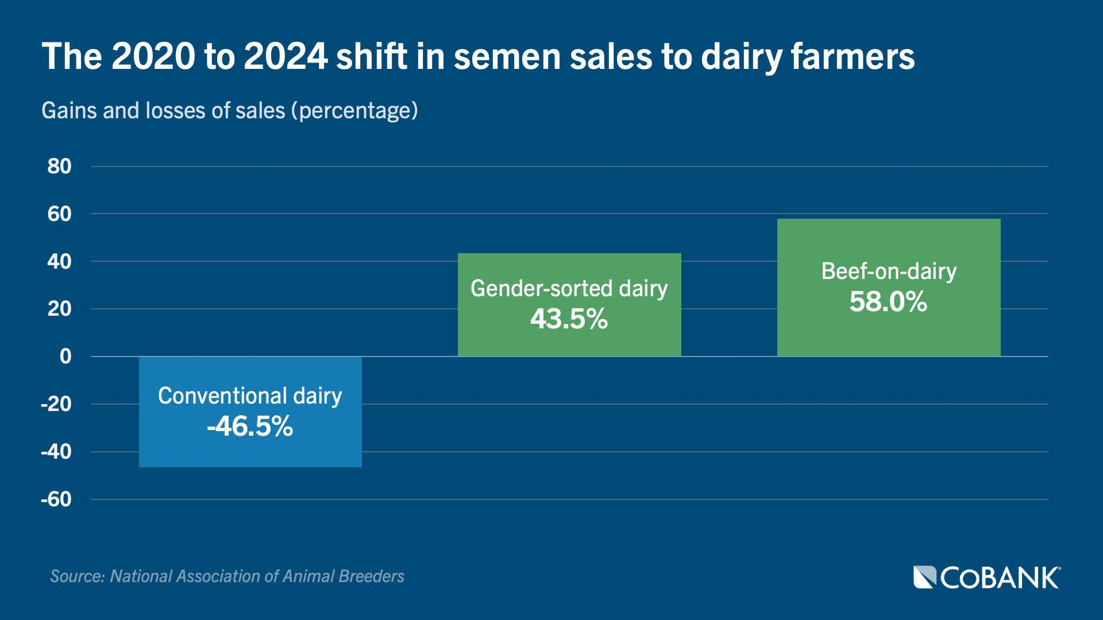

Slide 26
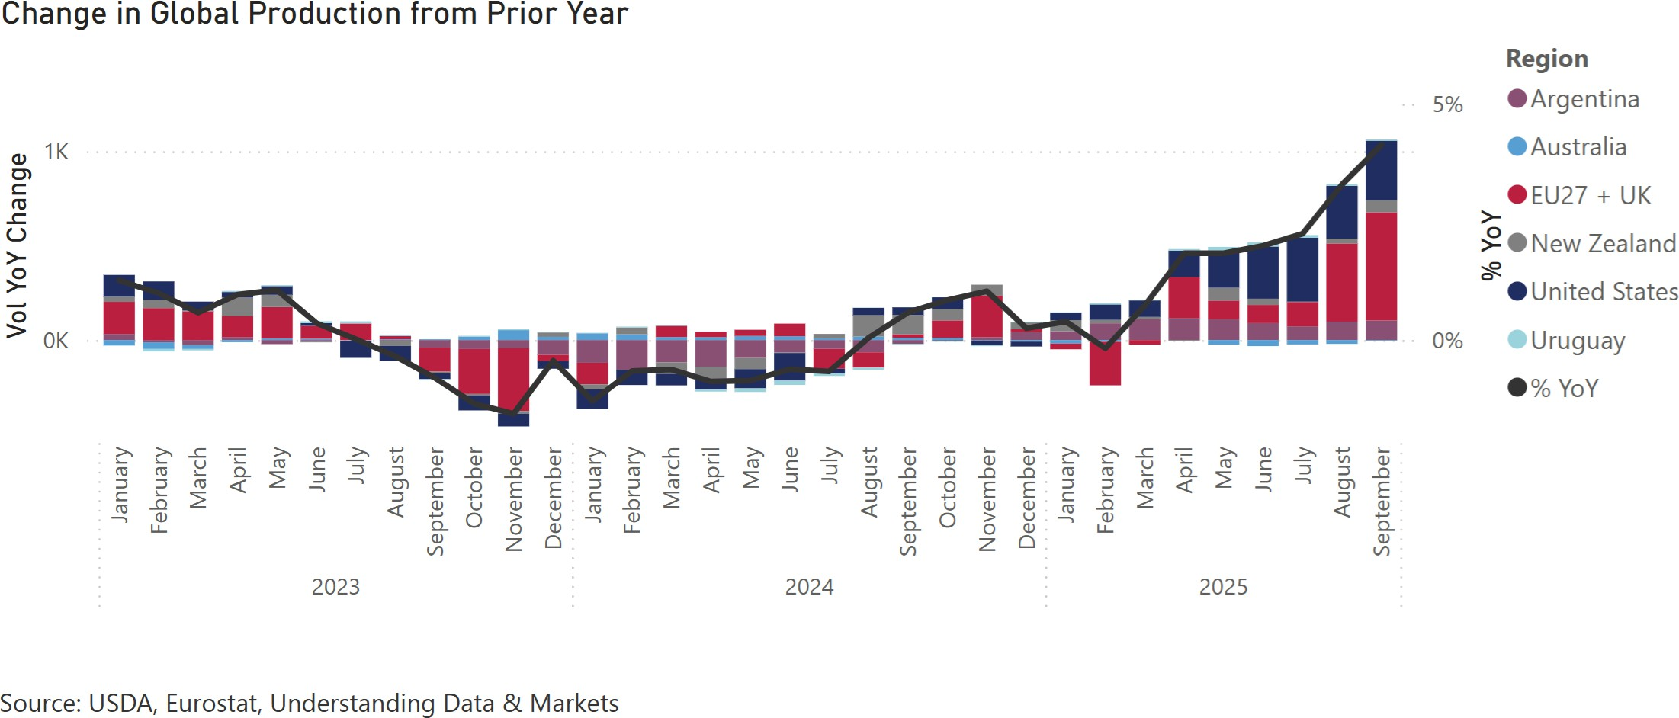

Slide 27
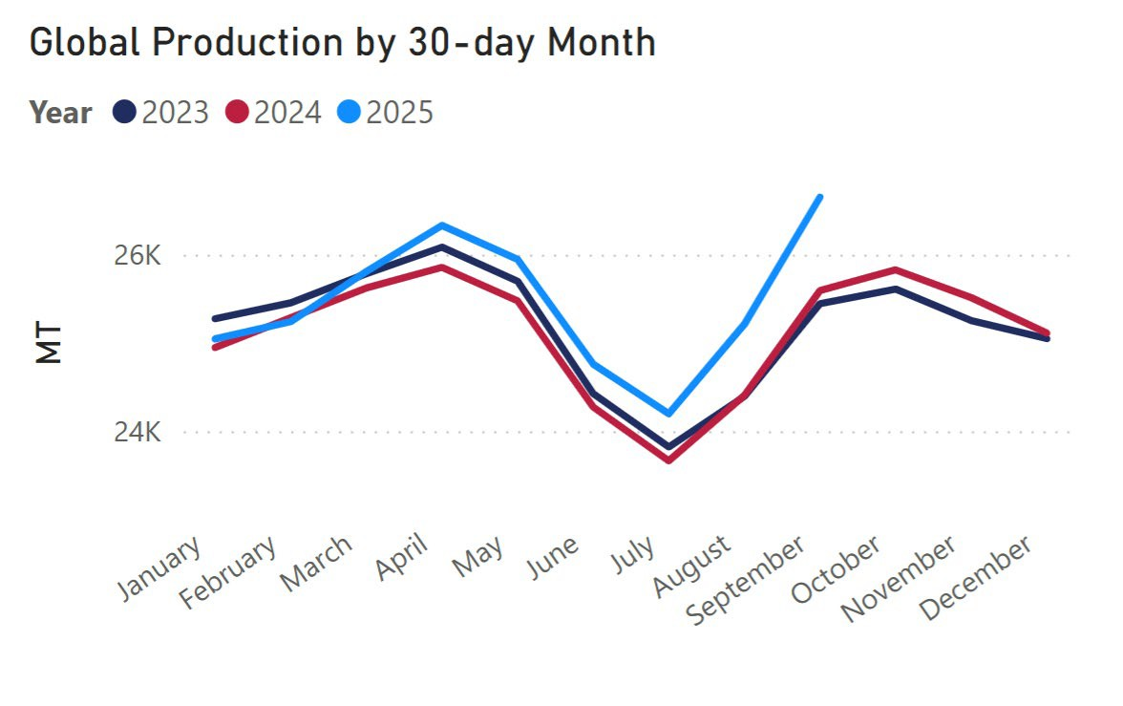

Slide 28
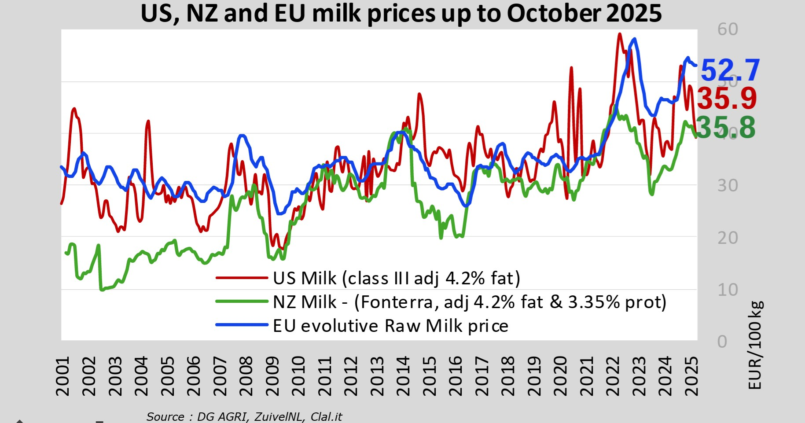

Slide 29
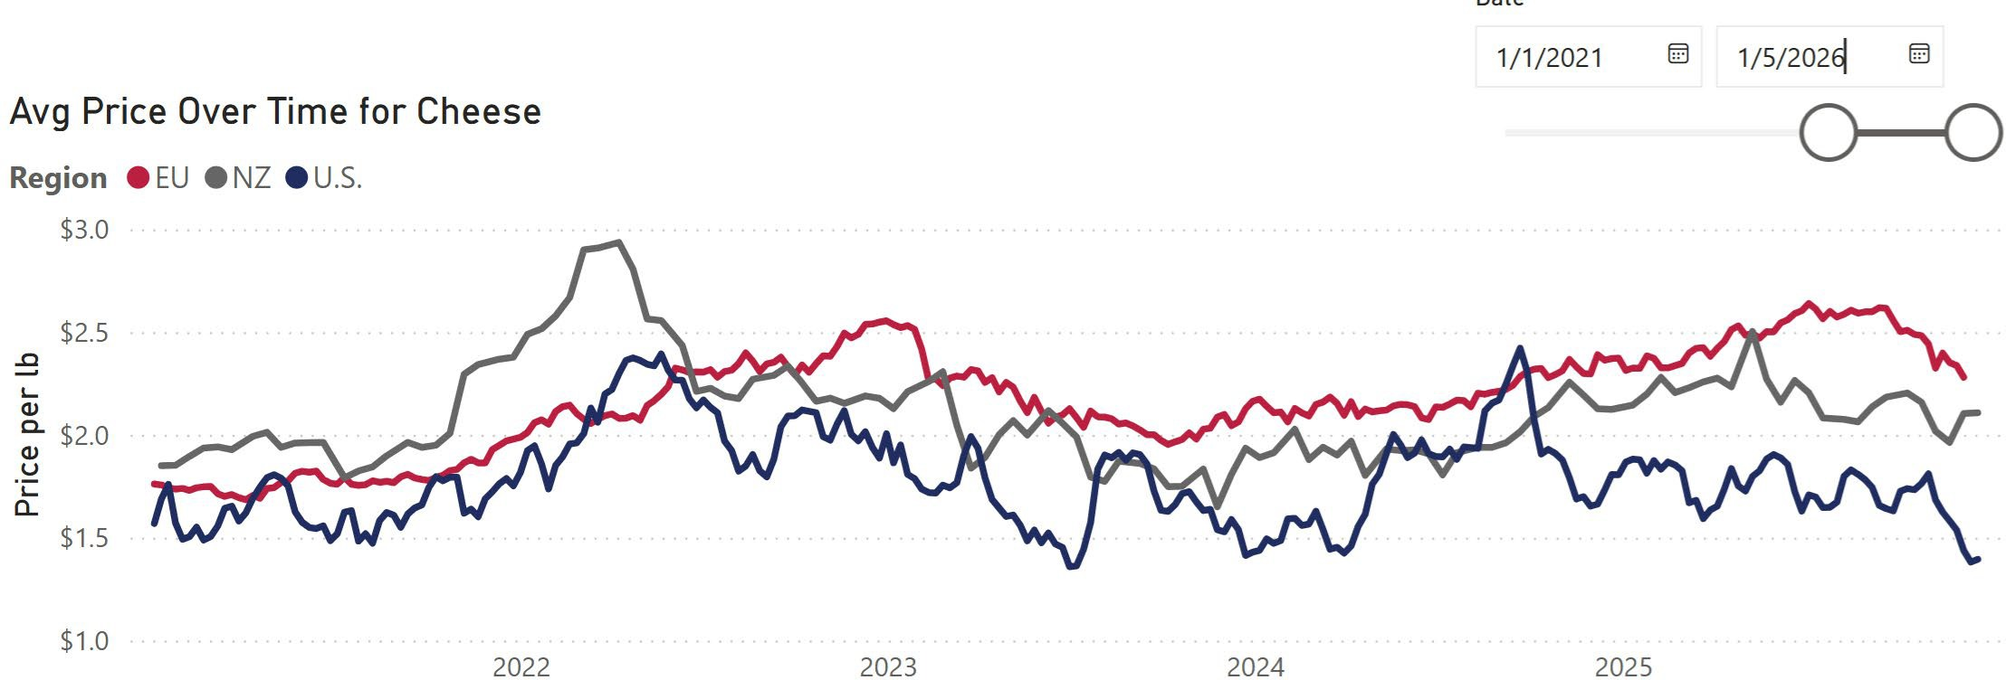
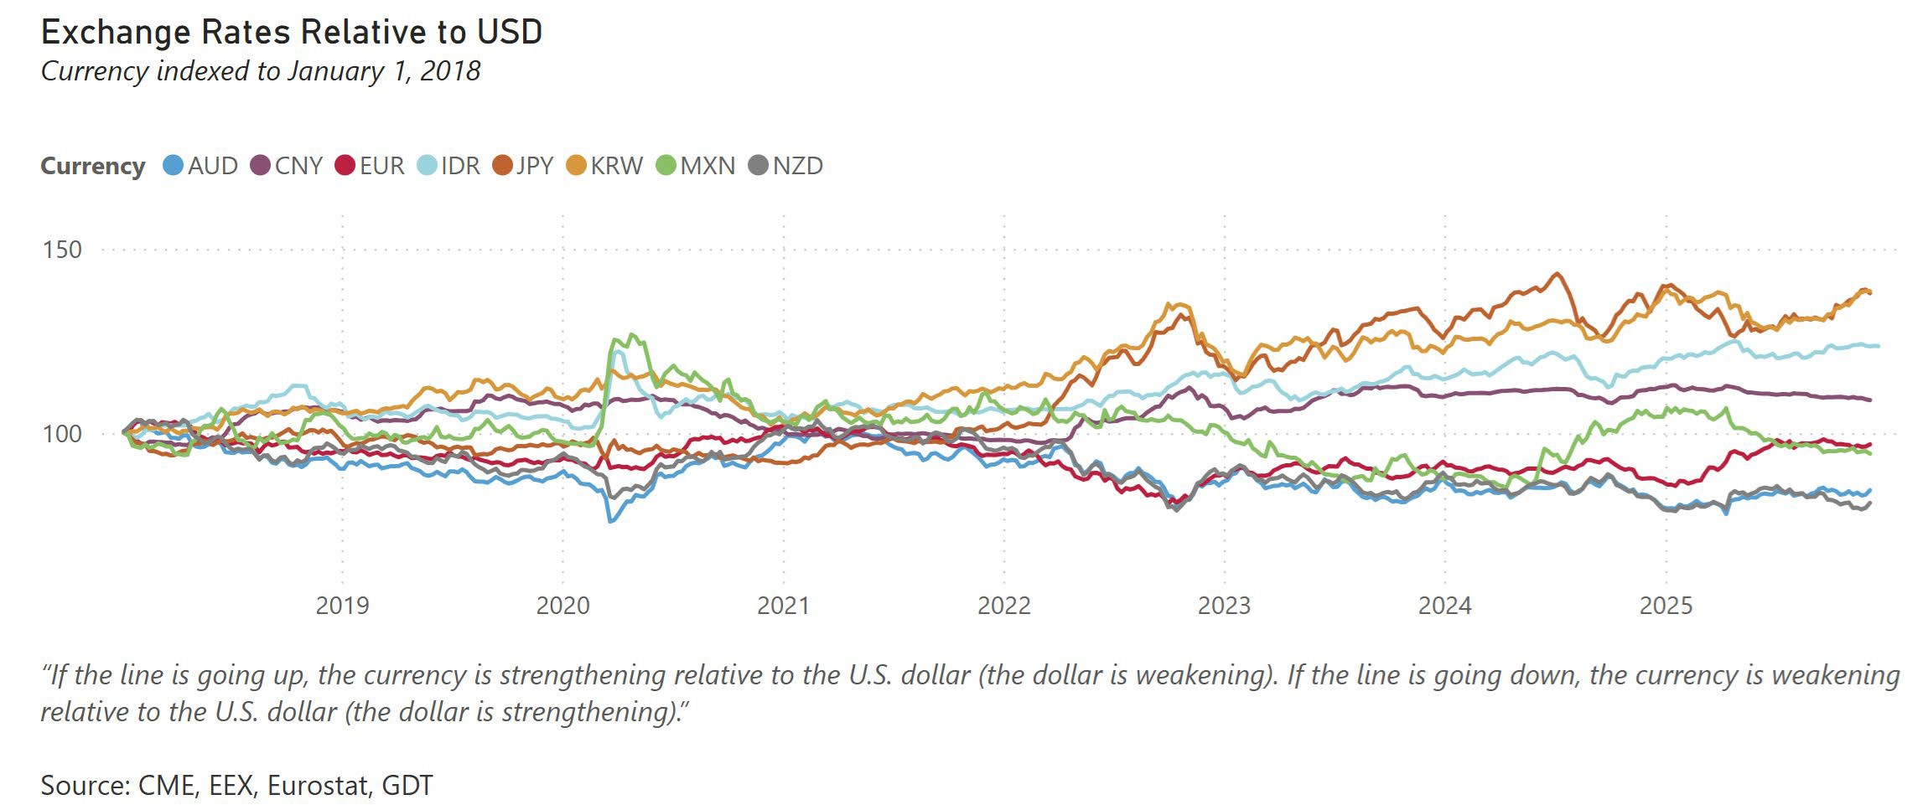

Slide 30
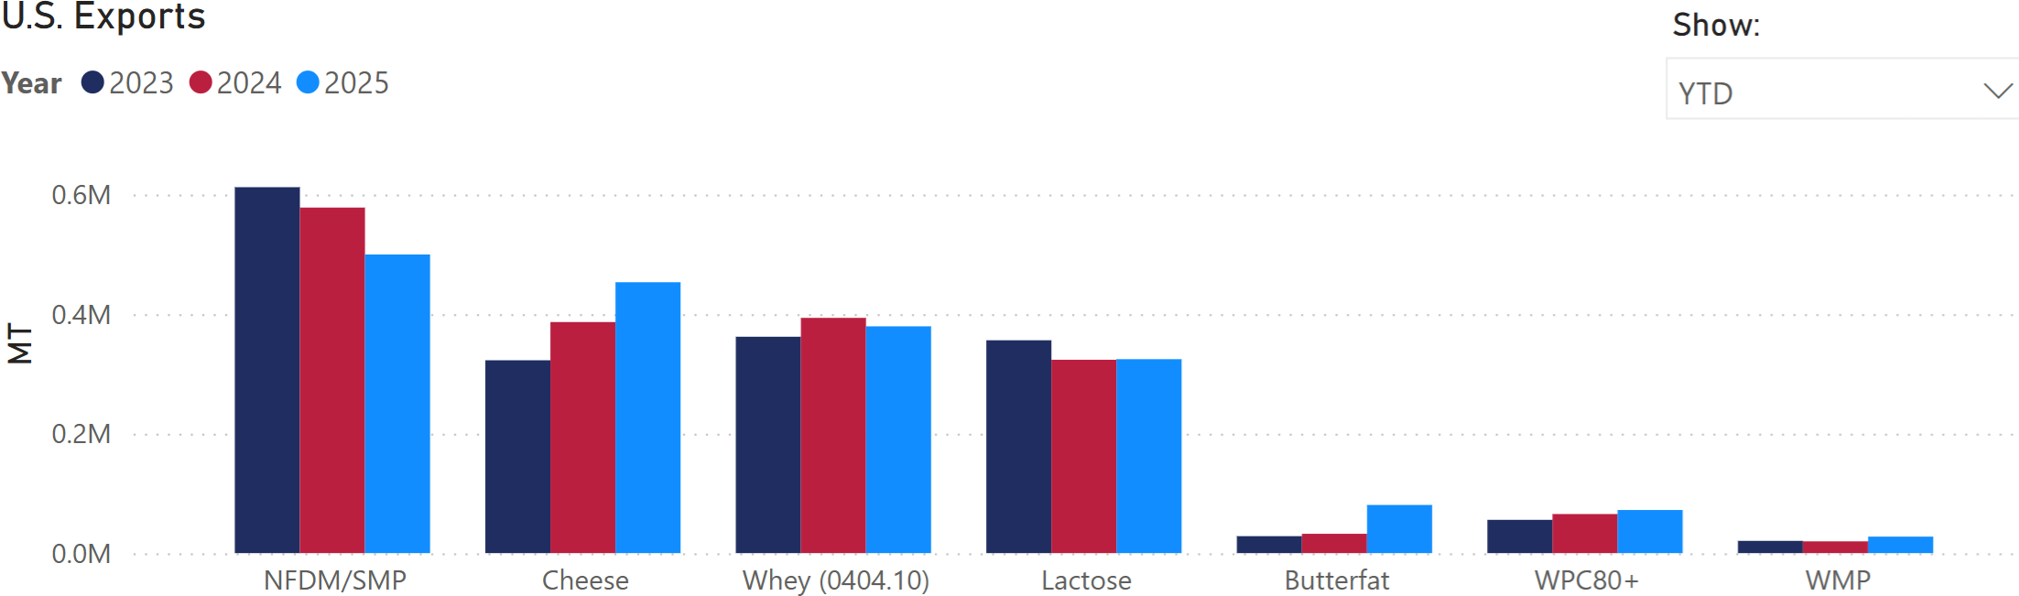
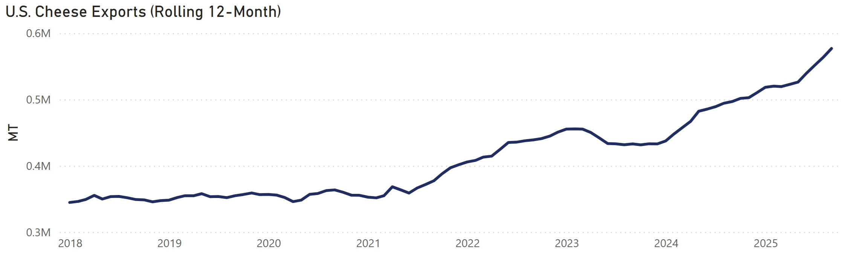
Exports

Slide 31
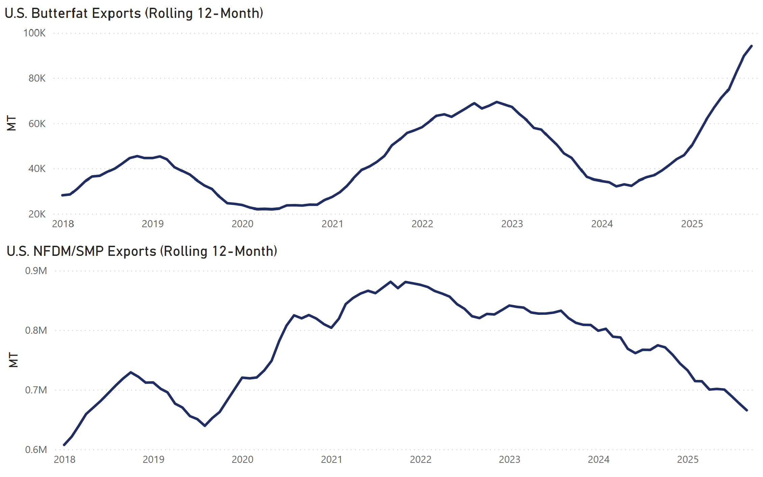
Exports

Slide 32
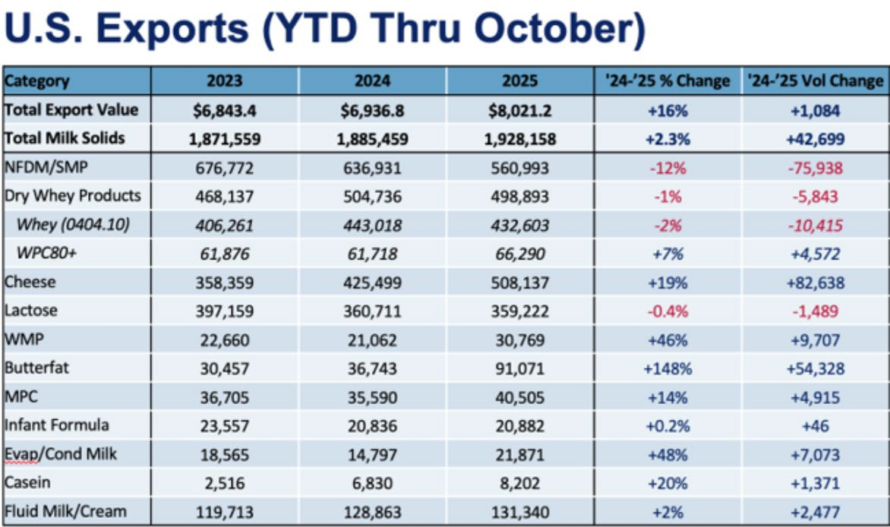
Source: USDEC
C. Wolf 32

Slide 33
Economic Research Service (ERS) September 2025 Forecast
In 2025, overall food prices are anticipated to rise faster than the historical average rate of growth. In 2025, prices for all food are predicted to increase 3.0 percent, with a prediction interval of 2.6 to 3.4 percent. Food-at-home prices are predicted to increase 2.4 percent, with a prediction interval of 1.8 to 2.9 percent. Food-away-from-home prices are predicted to increase 3.9 percent, with a prediction interval of
3.6 to 4.1 percent.
In 2026, overall food prices are expected to increase more slowly than the historical average rate of growth. In 2026, prices for all food are predicted to increase 2.7 percent, with a prediction interval of -1.8 to
7.5 percent. Food-at-home prices are predicted to increase 2.3 percent, with a prediction interval of -4.3 to 9.6 percent, and food-away-from-home prices are predicted to increase 3.3 percent, with a prediction interval of 0.7 to 5.8 percent.

Slide 34
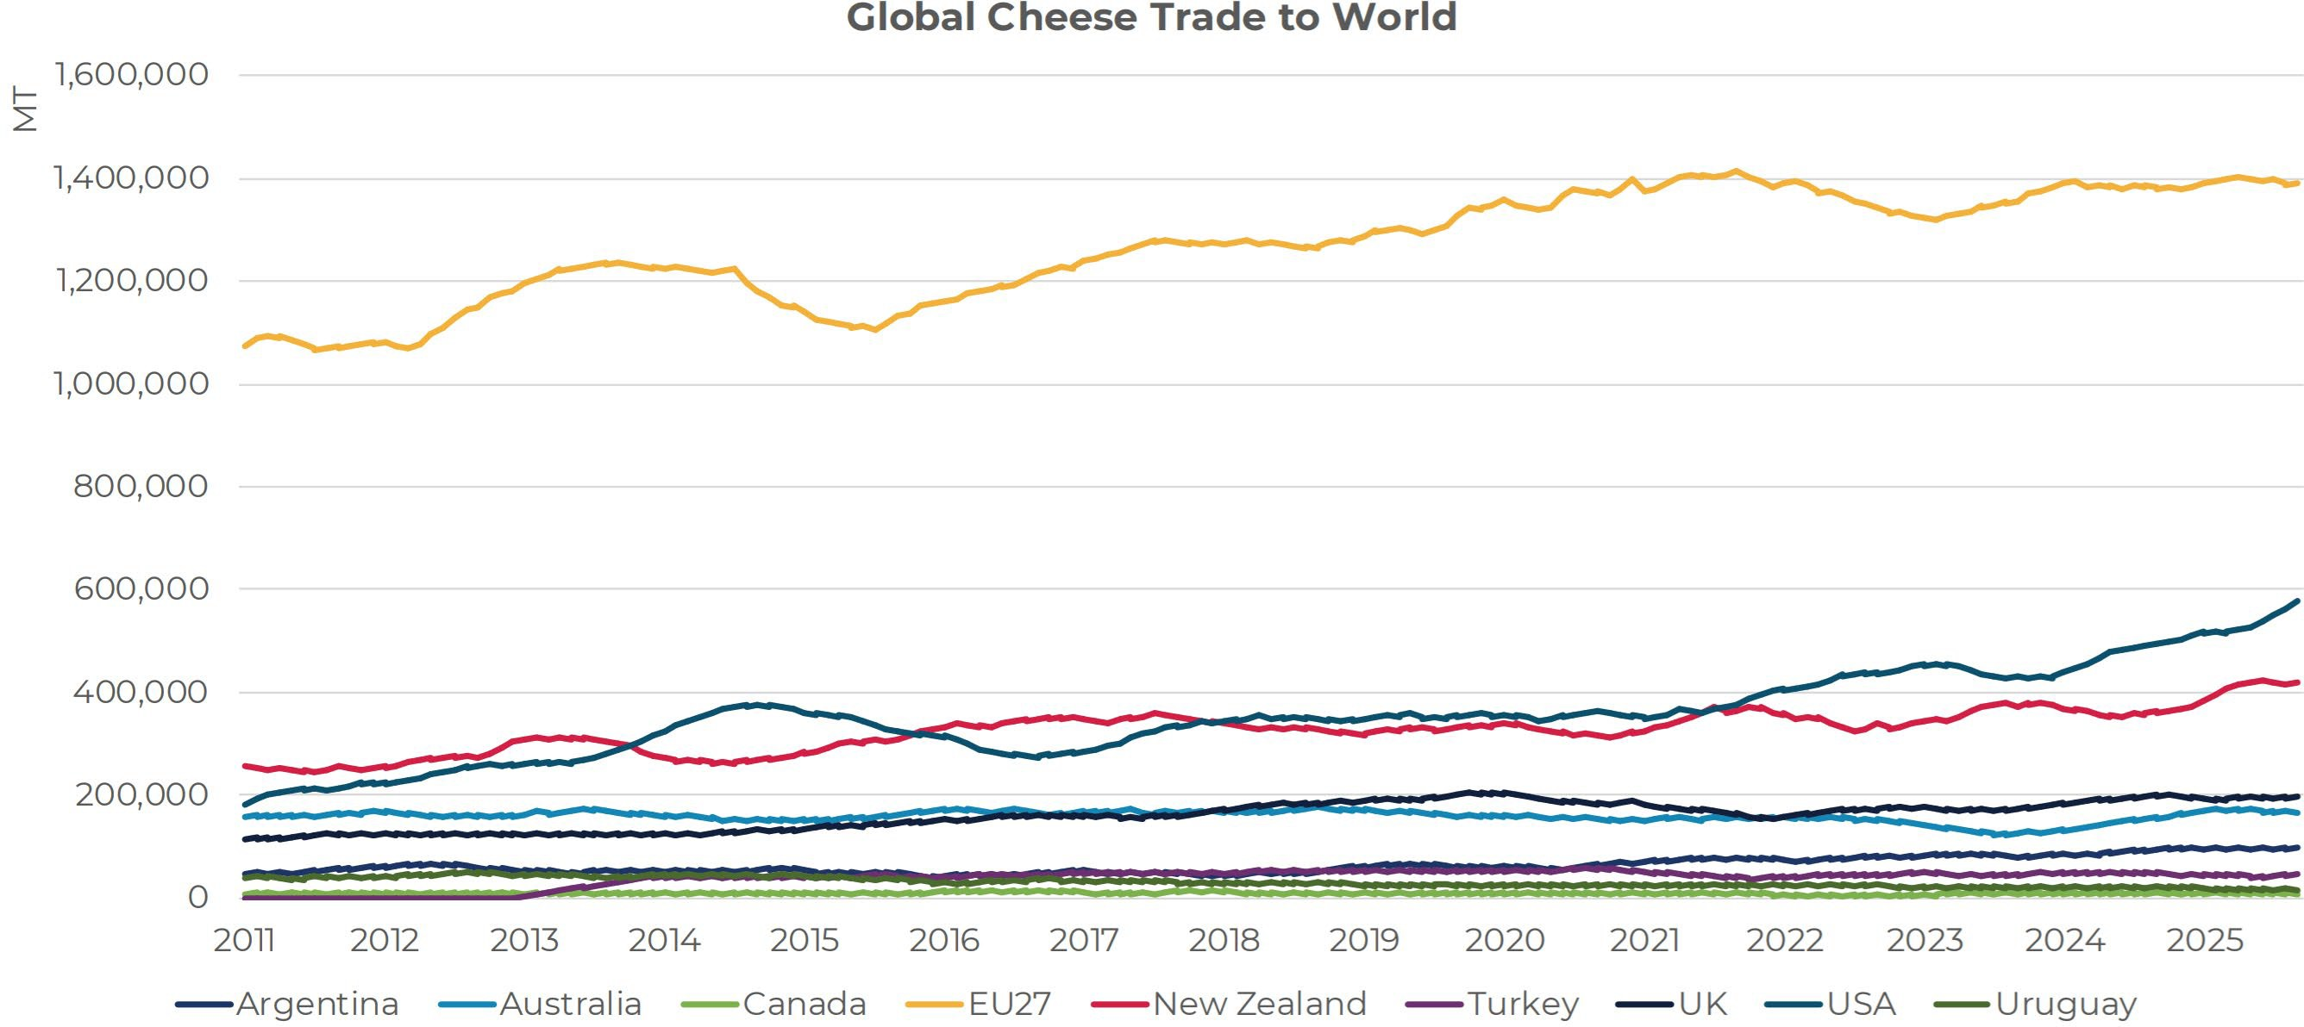
Source: USDEC

Slide 35
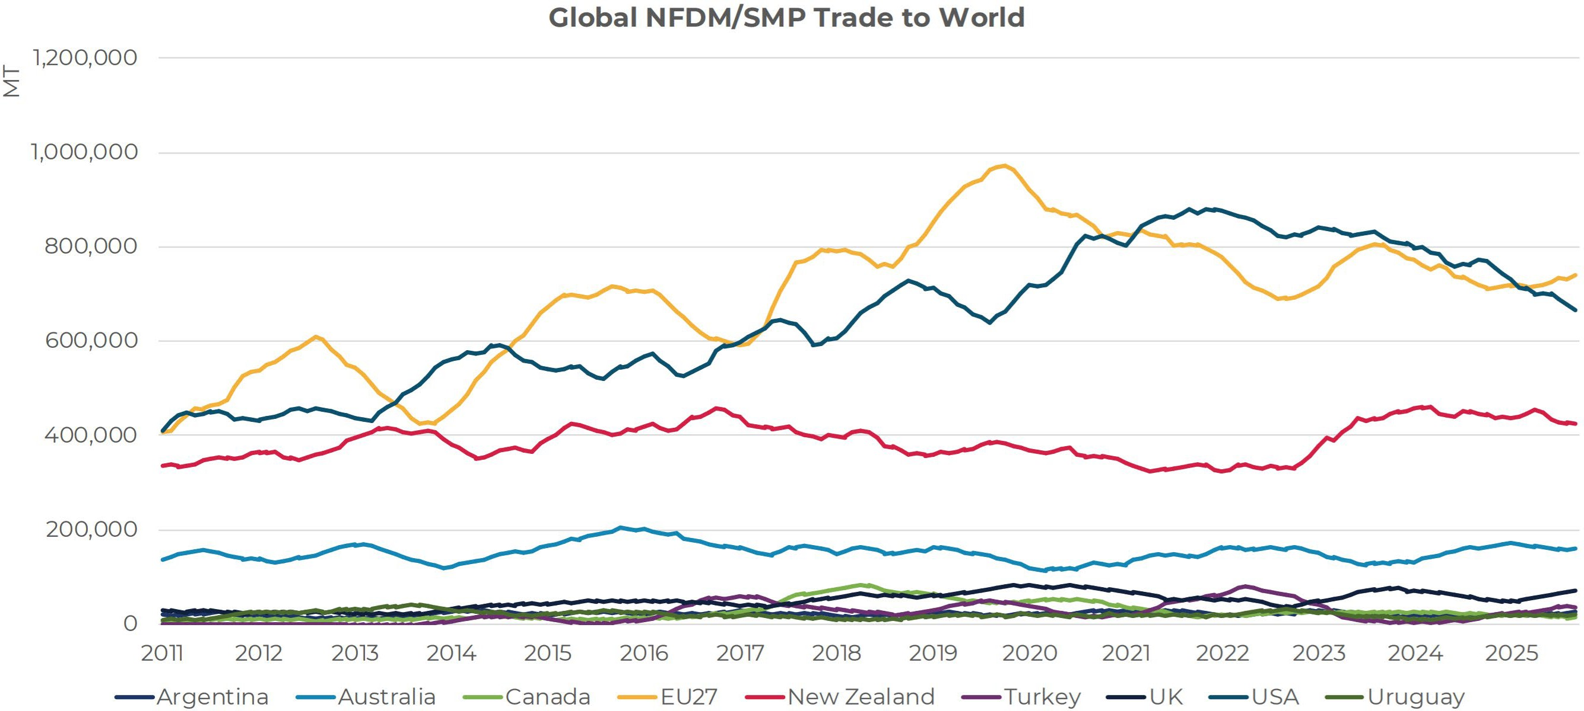
Source: USDEC

Slide 36
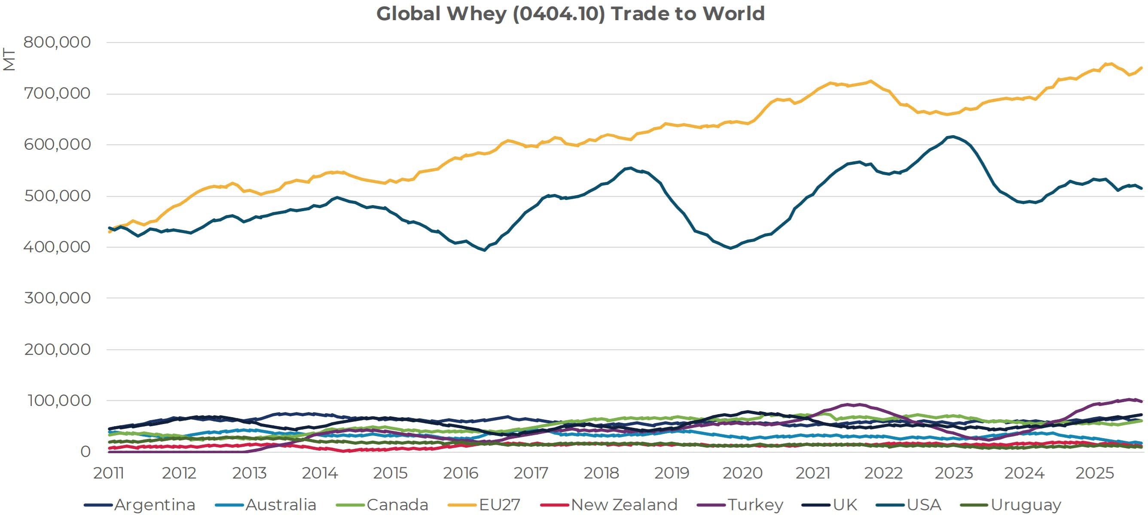
Source: USDEC

Slide 37
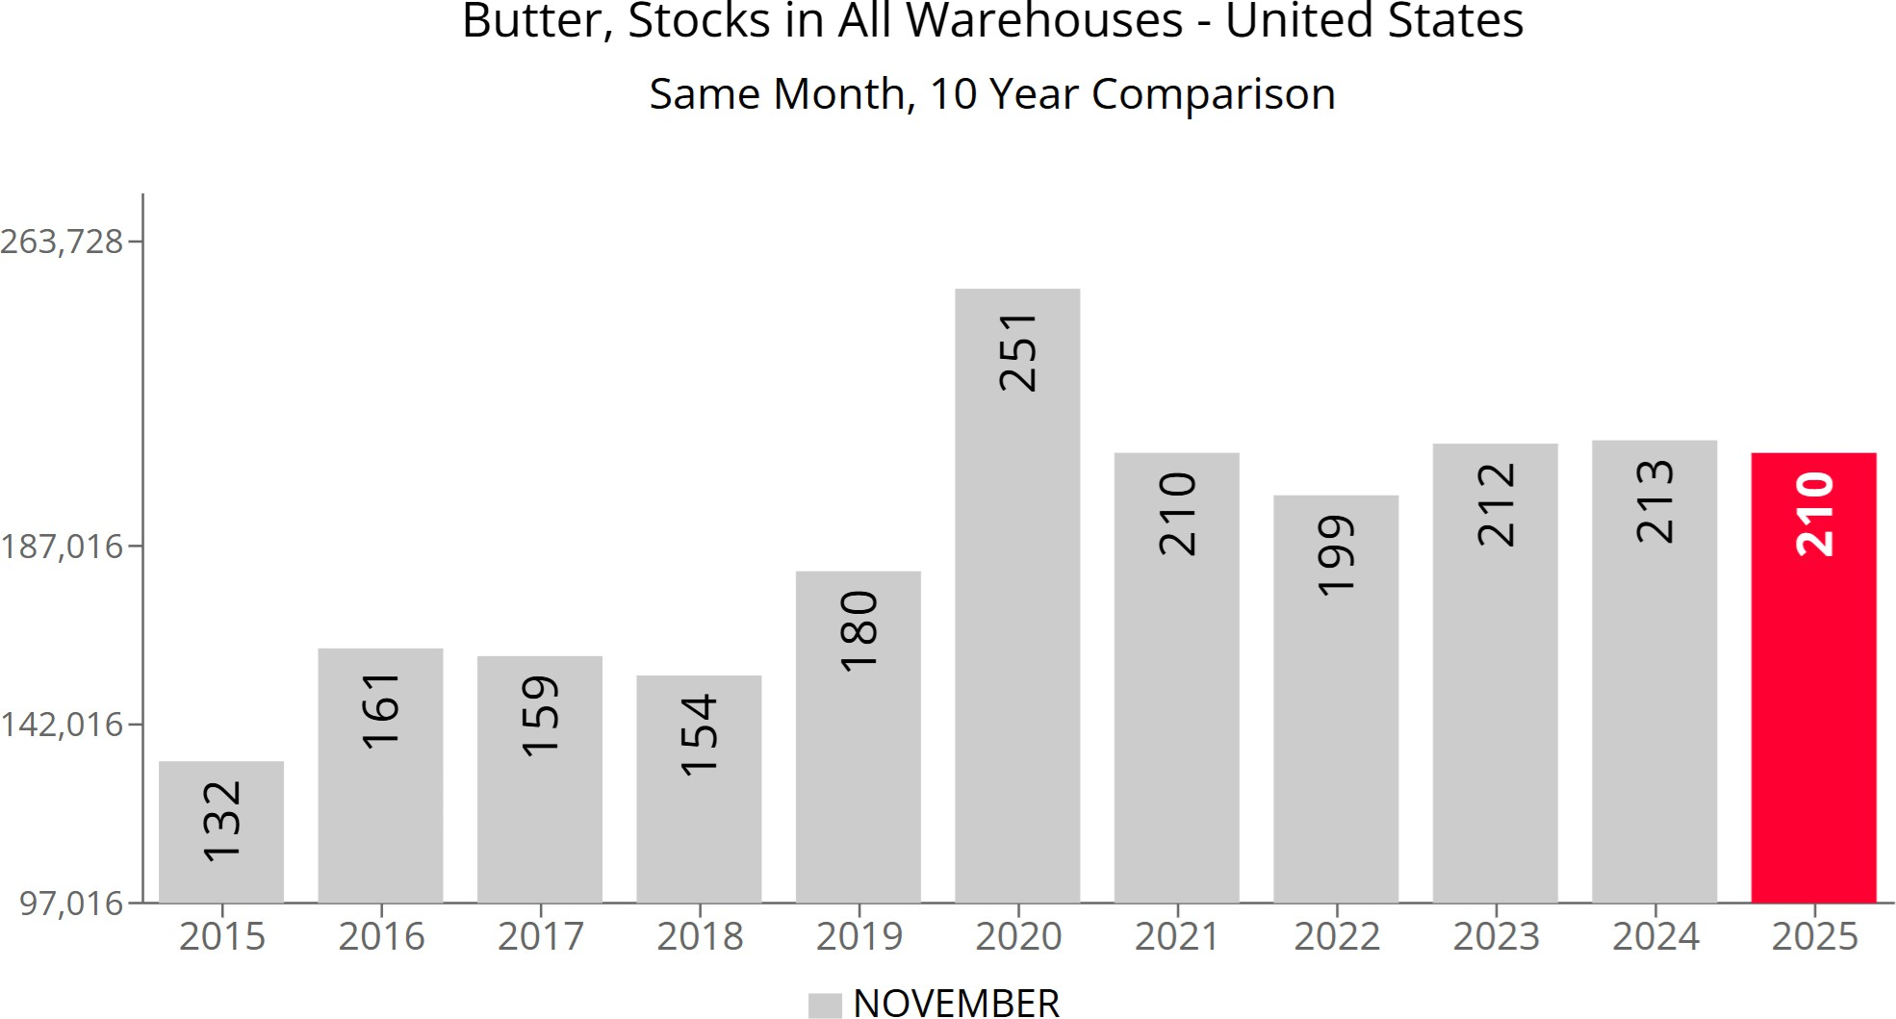
Butter Stocks
Nov -1.4% YoY
C. Wolf 37
Source: UDM

Slide 38
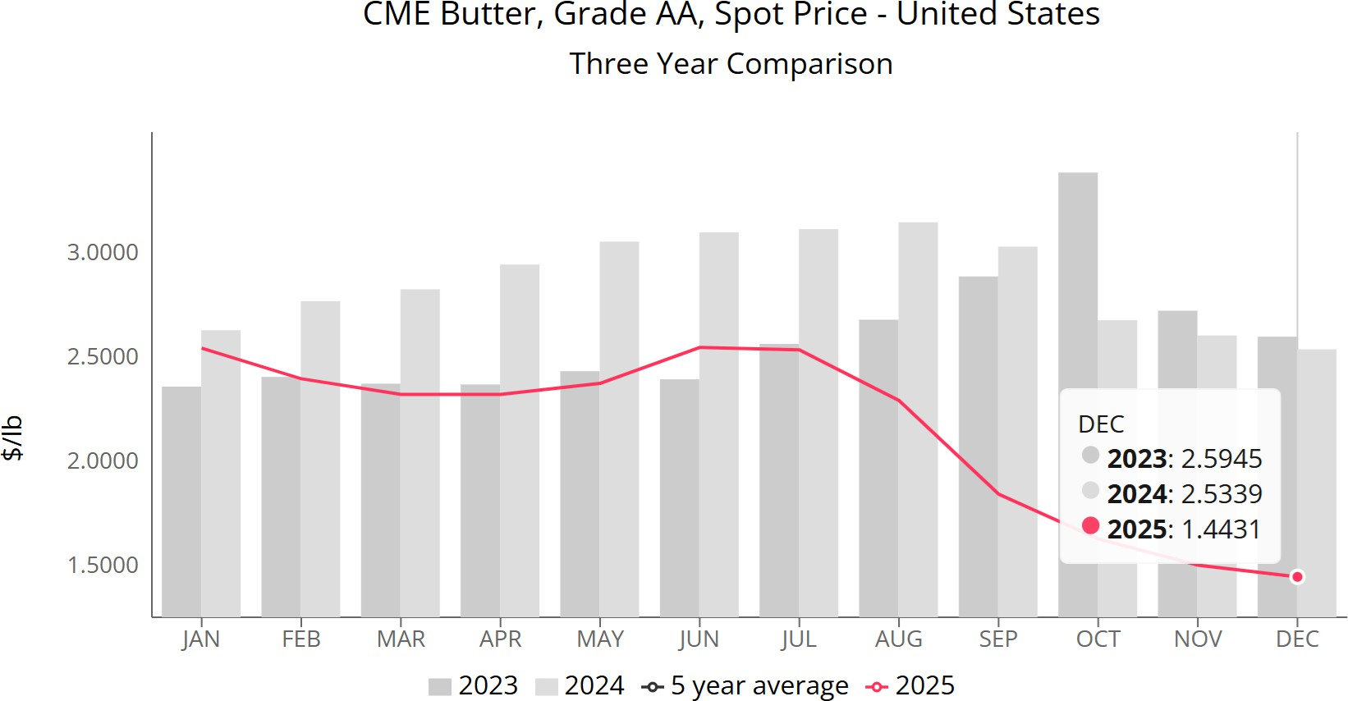
Butter Spot Price
-43%

Slide 39
US Average Butterfat Test
4.3
4.2
4.1
4
3.9
3.8
3.7
3.6
3.5
3.4
3.3
+1.47% YoY
in 2024
percent
fat %

Slide 40
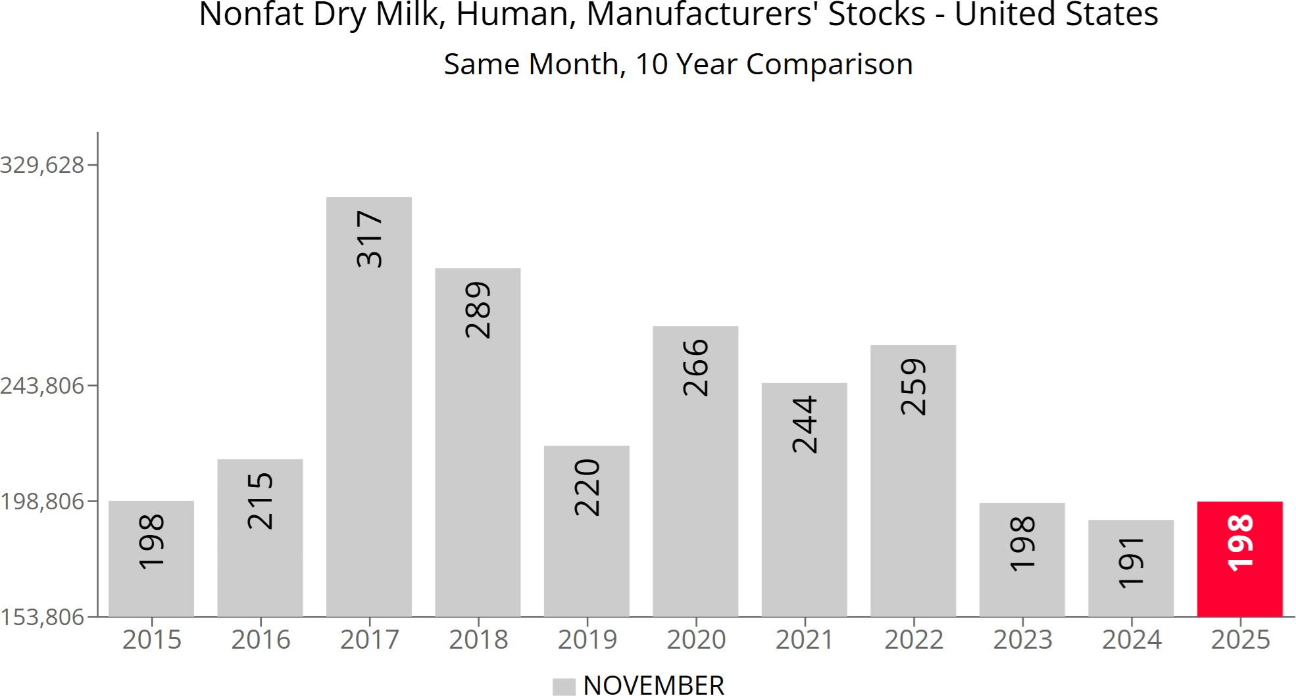
Nonfat Dry Milk
Nov +3.7% YoY
Source: UDM

Slide 41
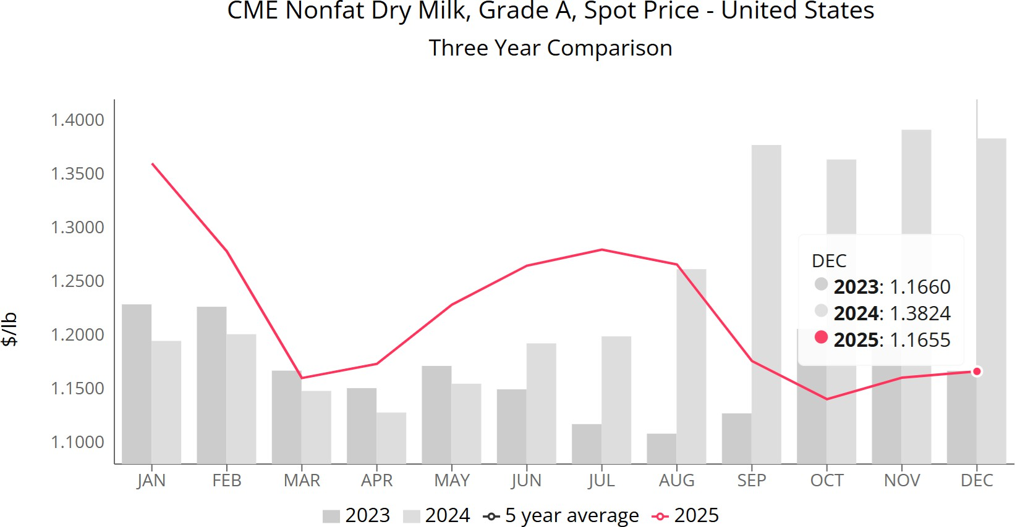
Nonfat Dry Milk Spot Price

Slide 42
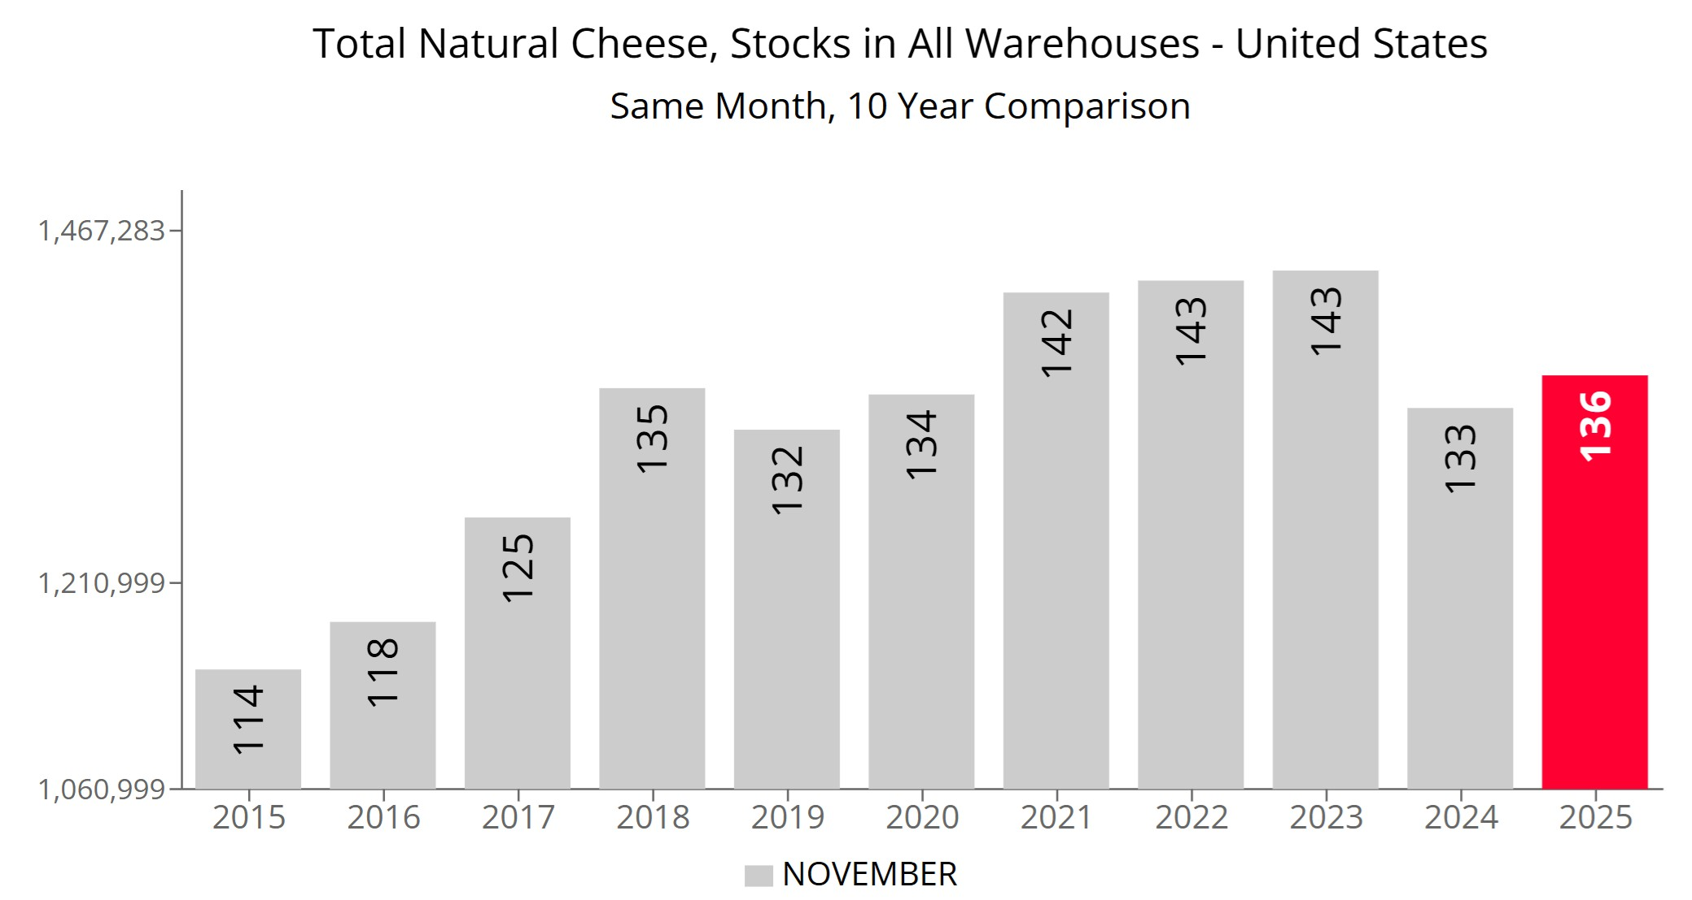
Natural Cheese Stocks
December -6.0% YoY
Nov +2.3% YoY
Source: UDM

Slide 43
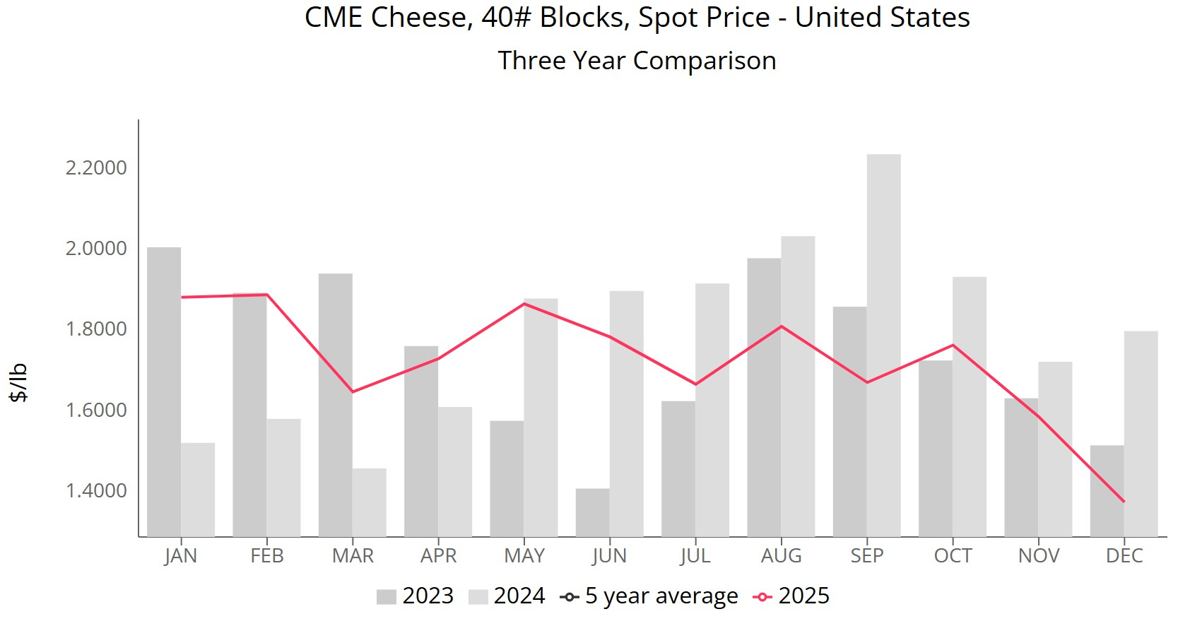
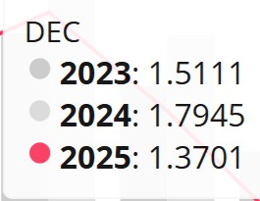
Cheese Spot Price
-23%

Slide 44
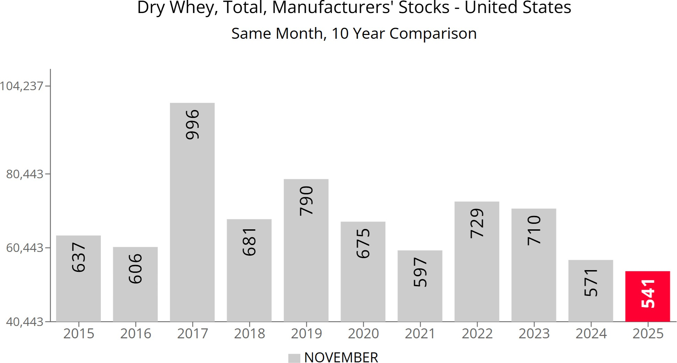
Dry Whey
November -5.3% YoY
Source: UDM

Slide 45
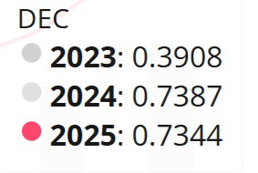
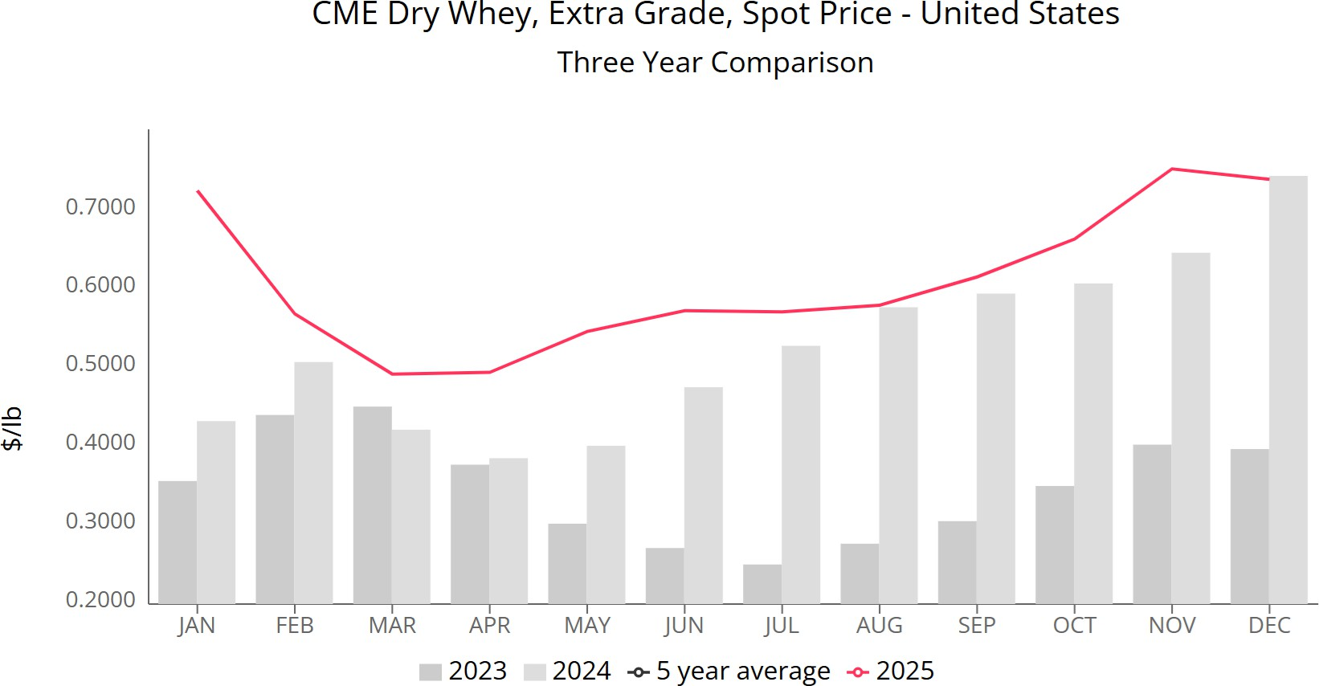
Dry Whey Spot Price

Slide 46
Dairy Cow Slaughter
330
2024 -11.9% vs 2023
2025 -4.3% vs 2024
310
290
270
1,000 head
y = -0.023x + 1279.5
250
230
210
190
170
150
1/1/2020
4/1/2020
7/1/2020
10/1/2020
1/1/2021
4/1/2021
7/1/2021
10/1/2021
1/1/2022
4/1/2022
7/1/2022
10/1/2022
1/1/2023
4/1/2023
7/1/2023
10/1/2023
1/1/2024
4/1/2024
7/1/2024
10/1/2024
1/1/2025
4/1/2025
7/1/2025
10/1/2025
C. Wolf 46
Source: UDM

Slide 47
Heifers
6000
0.6
5000
0.5
0.42
4000
0.4
Heifer/cow Ratio
(000)
Heifers
3000
0.3
2000
0.2
1000
0.1
0
0
2000
2001
2002
2003
2004
2005
2006
2007
2008
2009
2010
2011
2012
2013
2014
2015
2016
2017
2018
2019
2020
2021
2022
2023
2024
2025
heifers
heifers/cows

Slide 48
US Replacement Prices
3,000
2,500
2,000
1,500
1,000
500
0
$/head
2000
2001
2002
2003
2004
2005
2006
2007
2008
2009
2010
2011
2012
2013
2014
2015
2016
2017
2018
2019
2020
2021
2022
2023
2024

Slide 49
Beef and Dairy Cows
50
45
40
35
30
25
20
15
10
5
0
 | Smallest beef cow
 | herd since 1961
million cows
27.8635
9.3493
1924
1928
1932
1936
1940
1944
1948
1952
1956
1960
1964
1968
1972
1976
1980
1984
1988
1992
1996
2000
2004
2008
2012
2016
2020
2024
milk cows
beef cows

Slide 50
US Cattle 2000-2025
34,000,000
y = -123.27x³ + 5095.4x² - 44001x + 9E+06
9,500,000
33,000,000
9,400,000
9,300,000
32,000,000
9,200,000
Beef cows
31,000,000
Milk cows
9,100,000
30,000,000
9,000,000
29,000,000
8,900,000
28,000,000
y = -179970x + 3E+07
8,800,000
27,000,000
8,700,000
2000
2001
2002
2003
2004
2005
2006
2007
2008
2009
2010
2011
2012
2013
2014
2015
2016
2017
2018
2019
2020
2021
2022
2023
2024
2025
Beef cows
Milk cows
Linear (Beef cows)
Poly. (Milk cows)

Slide 51
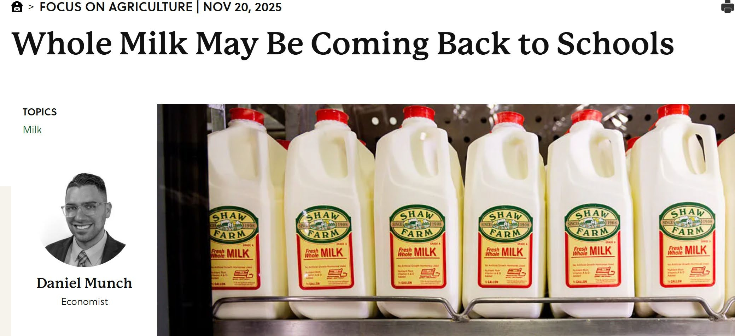

Slide 52
Whole milk in schools
Schools account for ~7% of fluid milk consumption
In 2024 4.9 billion meals served with 85% taking milk
Allows schools to serve whole, 2%, 1%, skim, flavored or plain milk as reimbursable
Excludes milk from calorie and saturated fat standards in school meals

Slide 53
Whole Milk in Schools?
Weekly milk servings per student fell 15% between 2008 and 2018
Universal adoption of whole milk would increase US butterfat consumption by 2-3%

Slide 54
Dairy Margin Coverage
Tier 1 increased from 5 to 6 million lbs/year
Participants establish new production history
= max(2021,2022,2023)
If lock in coverage level and percentage from 2026-2031 (6 years) then 25% premium discount

Slide 55
DMC Margin Forecasts
16
14
12
10
8
6
4
2
0
$/cwt
Jan-25
Feb Mar Apr May Jun Jul Aug Sep Oct Nov Dec Jan-26
Feb Mar Apr May Jun Jul Aug Sep Oct Nov Dec

Slide 56
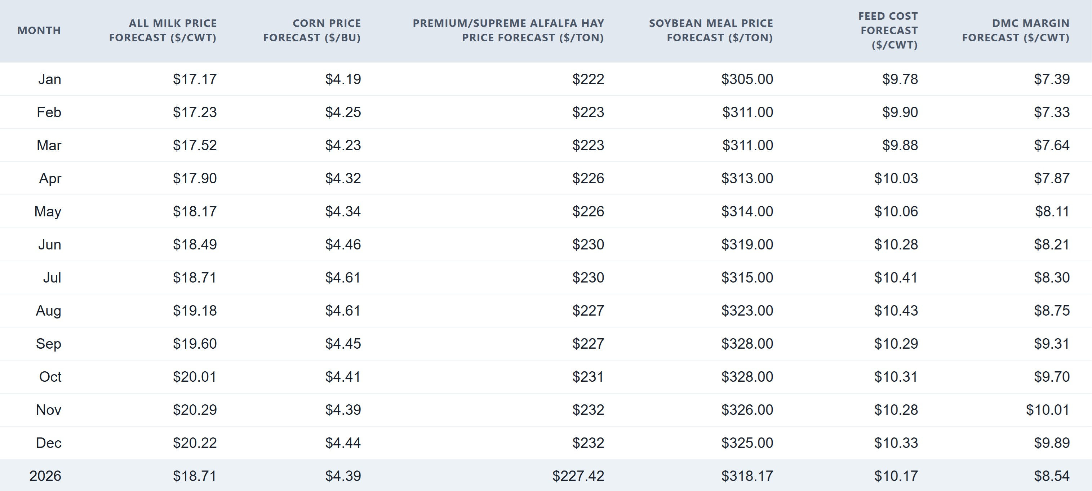
Dairy Margin Coverage

Slide 57
Milk Prices 2026
January 9 Futures
19.00
18.00
17.00
16.00
15.00
14.00
13.00
12.00
$/cwt
Jan Feb Mar Apr May Jun
Jul Aug Sep Oct Nov Dec
Class III
Class IV

Slide 58
Forecast Prices
January 2026 WASDE and Jan 9 Futures
Commodity | 2023/24 | 2024/25 | 2025/26F | ‘26 futures
Corn | $4.55/bu | $4.24/bu | $4.00/bu | $4.54/bu
Soybeans | $12.40/bu | $10.00/bu | $10.50/bu | $10.71/bu
Soybean meal | $384/ton | $300/ton | $300/ton | $310/ton
 | 2024 | 2025 | 2026F | 2026F
All Milk | $22.65/cwt | $21.00/cwt | $18.75/cwt | $19.14/cwt
Class III | $18.90/cwt | $18.10/cwt | $17.05/cwt | $16.64/cwt
Class IV | $20.75/cwt | $17.40/cwt | $14.40/cwt | $15.30/cwt C. Wolf 58

Slide 59
Thank You
Chris Wolf cwolf@cornell.edu
C. Wolf 59

