Slide 1


Update on Dairy Policy and Trade
Dyson Agricultural and Food Business Outlook January 12, 2026
Chuck Nicholson
Penn State Smeal College of Business cfn10@psu.edu

Slide 2
2025: An Active Year for (Dairy) Policy!
And already working on an active 2026
2025
2026
Initial tariff increases
Increased ICE raids
Big Beautiful Bill Passed (SNAP funding cuts)
Bridge Funding Announced
New Dietary Guidelines
USMCA
Renegotiation
“Liberation Day” Tariffs
January
April
July
October
January
FMMO
Referendum approved by dairy producers
New FMMO
pricing formulas implemented
Modification to FMMO
composition implemented
Milk Loss Program signups begin
To support his plan to increase tariffs, President Donald Trump has repeatedly said that the Canadian government charges
U.S. farmers a 250% or 270% tariff on dairy products exported to Canada.

Slide 3
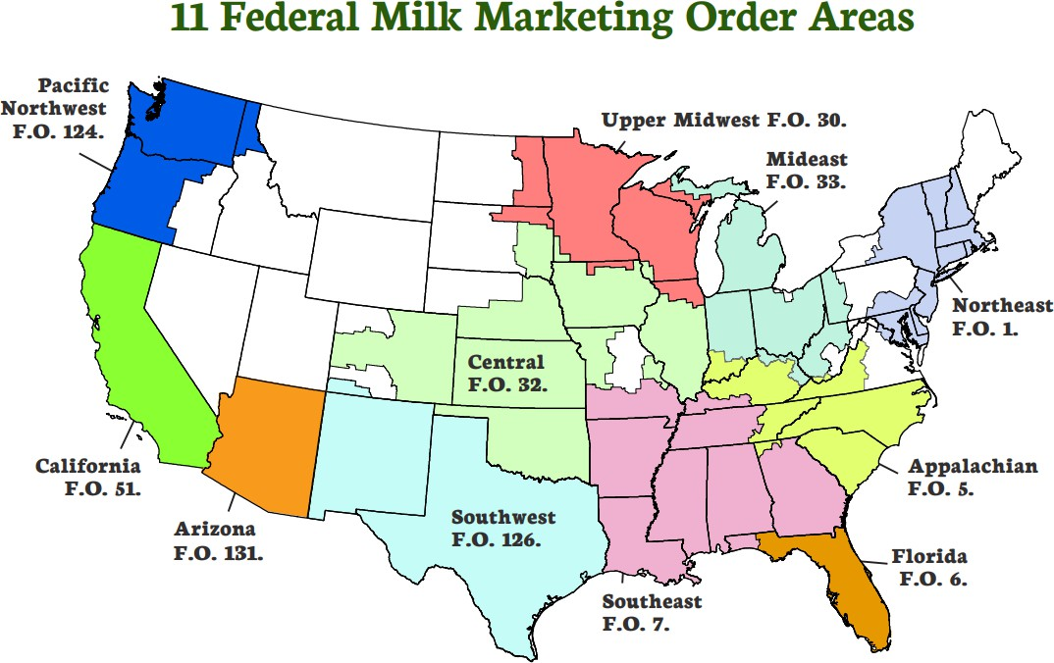
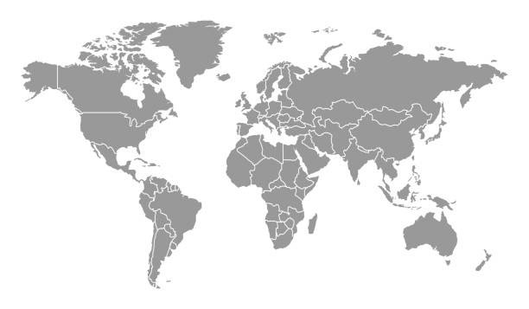
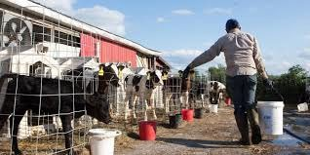

Agenda
FMMO Pricing Changes
Policy Environment
Trade
Immigration
Food & Nutrition Program Spending
(Related Uncertainty)
Program Payments
Dietary Guidelines

Slide 4
Most Orders: Component-based Pricing
Not all areas are covered.
Not all milk is required to be “pooled” and priced.
Butterfat and Skim Pricing
FMMO Changes

Slide 5
Key Elements of USDA’s Final Decision
Increase Make Allowances for cheese, butter, NDM, dry whey
Used in Class III and IV pricing
$0.05 to $0.07 per lb increase
Increase butterfat retention factor in cheese
Increase Class I differentials
Increase in WI of about $1.20/cwt
Retain $1.60/cwt minimum differential value
Change standard milk composition
Protein 3.3% (up from 3.1%)
Other Solids 6.0% (up from 5.9%)
Nonfat Solids 9.3% (up from 9.0%)
Remove Cheese Barrels from Class III Pricing
Revert to “Higher of” Advanced Class III or Class IV Skim milk price for Class I Skim price
Provisions to adjust the Class I price for ESL milk
FMMO Changes

Slide 6
Farm Milk Price is Based on Dairy Product Prices
Want to set a minimum price for this
Ingredients
Milk
Cheese
Key products from cheesemaking
Sweet Cream
Whey
Dried Whey
How can we relate the price of farm milk to the price of dairy products made with it?
Whey Cream
WPC
Permeate
Butter
Lactose
FMMO Changes

Slide 7
Pricing Farm Milk for Cheese:
A Formula Based on Milk Component Values
Monthly Market Prices, from USDA
Product Prices
Butter Price
Cheddar Cheese Price Dry Whey Price
Component Values
Other Solids Price
Butterfat Price
Protein Price
Minimum Price for Farm Milk Used in Cheese
Value of all the components = value of milk! In a component pricing FMMO
FMMO Changes

Slide 8
Pricing Farm Milk for Cheese in a Butterfat-Skim FMMO
Monthly Market Prices, from USDA
Product Prices
Butter Price
Cheddar Cheese Price Dry Whey Price
Component Values
Other Solids Price
Butterfat Price
Protein Price
Skim Milk Price
Minimum Price for Farm Milk Used in Cheese
Value of the butterfat + skim = value of milk!
FMMO Changes

Slide 9

Product Price Formula Example: Butter
Butterfat Price = (Butter Price - 0.1715) x 1.211
Make Allowance - What does it cost you to transform milk into 1 pound of butter?
Yield Factor - How many pounds of butter can you make from 1 pound of butterfat?
FMMO Changes

Slide 10
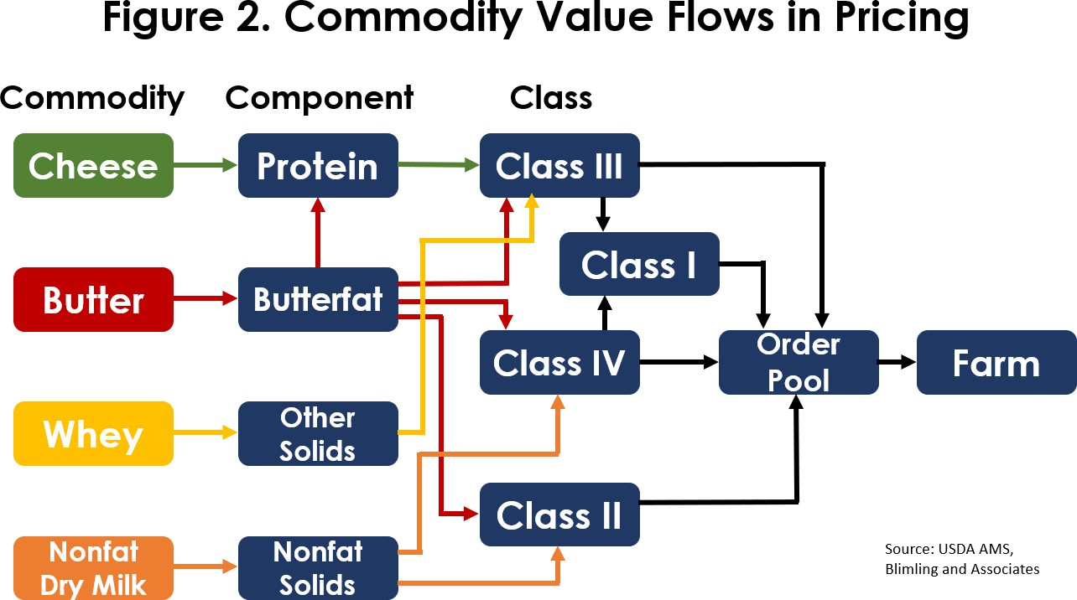
Changes to Class Pricing Formulas
Increase make allowances for products
Modify retention factors
Change which cheese prices are included in the product price
Change standard composition of milk
Values are “pooled” across all uses. Pool value is shared among farms.
FMMO Changes

Slide 11
Product Price Formula Example: Butter
Butterfat Price = (Butter Price - 0.1715) x 1.211
Make Allowance - What does it cost you to transform milk into 1 pound of butter?
Yield Factor - How many pounds
of butter can you make from 1 pound of butterfat?
FMMO Changes

Slide 12
Product Price Formula Example: Butter
Butterfat Price = (Butter Price - 0.2272) x 1.211
Make Allowance - What does it cost you to transform milk into 1 pound of butter?
Yield Factor - How many pounds
of butter can you make from 1 pound of butterfat?
FMMO Changes

Slide 13
Price Impacts of Make Allowance Changes
For milk pooled under FMMOs calculated component values will decrease
Milk or Component Value | Impact of the changes in Make Allowances | Comment
Class III butterfat price, $/lb | -0.0675 | Lower butterfat price @ same butter price
Class III protein price, $/lb | -0.0985 | Lower protein price @ same cheese price
Class III other solids price, $/lb | -0.0697 | Lower OS price @ same dry whey price
Class III components (Pool value), $/cwt | -0.91 | Component values at standard test
Class III Price (Reported value), $/cwt | -0.32 | Includes composition change to 3.3% protein and 6.0% other solids
Class IV nonfat solids price, $/lb | -0.0708 | Lower NFS prices @ same NDM price
Class IV Components (Pool value) | -0.74/cwt | Component values at standard test
Class IV Price (Reported value) | -0.43/cwt | Includes composition change to 9.3% other solids
FMMO Changes

Slide 14
Price Impacts of Make Allowance Changes
The net impact of make allowance changes on farm milk prices isn’t well known and may not be large for some farm
Milk or Component Value | Impact of the changes in Make Allowances | Comment
Class III butterfat price, $/lb | -0.0675 | Lower butterfat price @ same butter price
Class III protein price, $/lb | -0.0985 | Lower protein price @ same cheese price
Class III other solids price, $/lb | -0.0697 | Lower OS price @ same dry whey price
Class III components (Pool value), $/cwt | -0.91 | Component values at standard test
Class III Price (Reported value), $/cwt | -0.32 | Includes composition change
Class IV nonfat solids price, $/lb | -0.0708 | Lower NFS prices @ same NDM price
Class IV Components (Pool value) | -0.74/cwt | Component values at standard test
Class IV Price (Reported value) | -0.43/cwt | Includes composition change
Milk not currently pooled | ? | Could increase if premiums return or milk is pooled
Milk currently pooled by a cooperative but with re-blending (deducts) | ? | May not change very much?
FMMO Changes

Slide 15
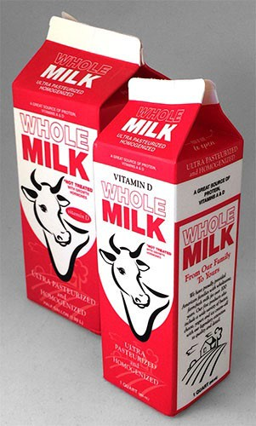
Class I Differentials: Another Key Change
Class I differentials are the additional amount paid by buyers of milk for beverage use and provide incentives to move milk to deficit areas
Increase Class I differentials
Higher values in each county
Retain $1.60/cwt minimum differential value
FMMO Changes

Slide 16
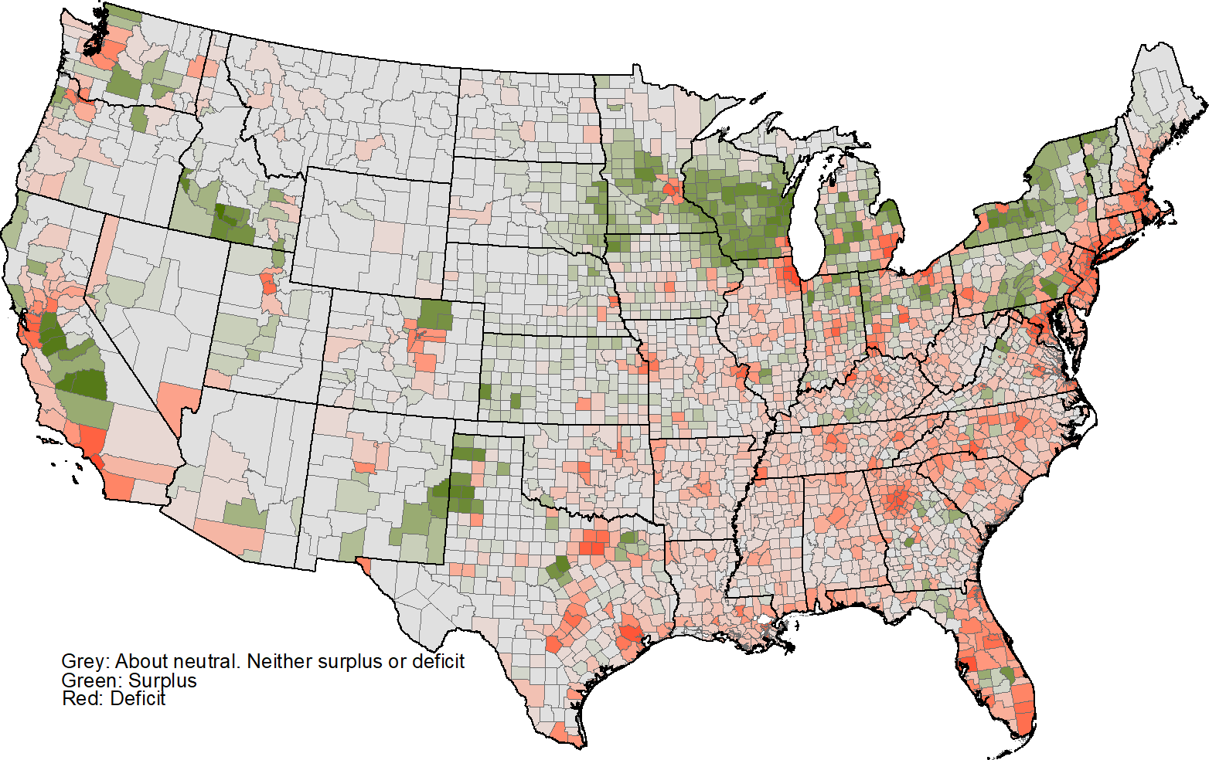
Milk Deficit and Milk Surplus Counties, 2021 Data
WI/MN is “milk surplus”
CA is “milk surplus”
The southeastern US is “milk deficit”—incentives needed to supply or transport milk there
FMMO Changes

Slide 17
Class I Differentials: One Piece of the Class I Price
Higher of
0.2272
Class I Price at a Location = Base Class I Price + Location-Specific Class I Differential
FMMO Changes

Slide 18
What are the Changes to Class I Differentials?
$0.00-$0.50/cwt
$0.70 - $1.60/cwt
Previous: $2.63/cwt Updated: $3.87/cwt Average value of $1.24/cwt
$1.70 - $2.60/cwt
FMMO Changes

Slide 19
Class I Differentials: Another Key Change
Class I differentials are the additional amount paid by buyers of milk for beverage use and provide incentives to move milk to deficit areas
Increase Class I differentials
Higher values in each county
Increase in WI of about $1.20/cwt
Retain $1.60/cwt minimum differential value
Implications:
Increased value of the Order pool
Increase in Statistical Uniform (Blend) Price, PPD, and All Milk Price
Larger impact in orders with Class I utilization (more fluid milk processing)
Change in annual value at
$1.24/cwt: $527 million/year
Decrease in Class I Utilization
Higher retail fluid milk prices
$0.11/gallon
FMMO Changes

Slide 20
Impacts in a Butterfat-Skim Pricing Order
Estimated Impacts for September 2025 on Milk Component Values and Milk Price in Southeast Order (FO 7)
FMMO Changes

Slide 21
What are Impacts of FMMO Pricing Changes?
Symptoms of a problem: Expected Impacts
De-pooling (less pooling) Declines in premiums Cooperative ‘re-blending’ Negative PPDs
Increased pooling
Increased PPDs
Increased over-order premiums
What’s the evidence about how these have changed since June 2025?
Admittedly limited evidence base to date
FMMO Changes

Slide 22
The Effects Will Play Out Over Time
Increased Make Allowance
Lower Farm Milk Price (pooled milk)
More Milk Pooled
Increased Demand Farm Milk for Cheese
Adjustments to Milk Production
Offsetting Positive Effect on Farm Pay Price (PPD)
Milk Supply Demand Balance Affected
Pressure for Premiums
FMMO Changes

Slide 23
Producer Milk Pooled, Selected Orders, 2022-2025
3,500
16,000
Producer Milk Pooled, million lbs/month
14,000
3,000
2,500
12,000
10,000
2,000
8,000
1,500
6,000
1,000
4,000
500
2,000
0
Jan-22
0
Jan-23
Jan-24
Jan-25
Northeast Florida Upper Midwest California Arizona
All Orders
Through September: Pooled milk increased, but it’s too early to tell about future de-pooling events
FMMO Changes

Slide 24
Producer Milk Pooled, Selected Orders, 2022-2025
3,500
16,000
Producer Milk Pooled, million lbs/month
14,000
3,000
2,500
12,000
10,000
2,000
8,000
1,500
6,000
1,000
4,000
500
2,000
0
Jan-22
0
Jan-23
Jan-24
Jan-25
Northeast
Florida
Upper Midwest
California
Arizona
All Orders
Through November: A de-pooling event
FMMO Changes

Slide 25
Producer Price Differentials, Selected Orders, 2022-2025
6
5
4
3
2
1
0
Producer Milk Pooled, million lbs/month
Jan-22
Jan-23
Jan-24
Jan-25
-1
-2
-3
Upper Midwest Mideast Order 33 California
Northeast
Pacific Northwest
Through September: PPD values increased from what they were in prior months
FMMO Changes

Slide 26
Producer Price Differentials, Selected Orders, 2022-2025
6
5
4
3
2
1
0
Producer Milk Pooled, million lbs/month
Jan-22
Jan-23
Jan-24
Jan-25
-1
-2
-3
Upper Midwest Mideast
Order 33
California
Northeast
Pacific Northwest
Through November: Negative PPDs returned
FMMO Changes

Slide 27
Changes in Cheese Manufacturing Input Cost Index and Implied Premiums, 2016-2025
3.00
220
2.50
Manufacturing PPI and OOPs are negatively correlated
200
2.00
Cheese Manufacturing PPI
Implied Premium, $/cwt
1.50
180
1.00
160
0.50
0.00
140
Jan-16
Jan-17
Jan-18
Jan-19
Jan-20
Jan-21
Jan-22
Jan-23
Jan-24
Jan-25
-0.50
120
-1.00
-1.50
100
FO30 Implied Premium NY Special Premiums Cheese PPI
PPI for Cheese Manufacturing from US Bureau of Labor Statistics (includes milk cost)
WI premium is Order 30 Mailbox Milk Price less Blend Price at Test, NY premiums as reported by NYDA&M
FMMO Changes

Slide 28
Difference in Order 30 Pool Value and WI All-Milk Price
Better alignment between pool value and all milk price (although not necessarily premium increases)
Before changes to formulas
After changes to formulas
0.60
0.40
0.20
0.00
-0.20
-0.40
-0.60
-0.80
-1.00
Jan-24
Mar-24
May-24
Jul-24
Sep-24
Nov-24
Jan-25
Mar-25
May-25
Jul-25
Sep-25
Nov-25
FMMO Changes

Slide 29
Summary of Impacts (Seven Months In)
Impact on | Expected Change with New Pricing | Evidence to Date
Amount of Milk Pooled | Increase | Increased before de-pooling
Producer Price Differentials | Increase | Increased before de-pooling
Alignment of order and all-milk prices | Increase | Increased in Order 30
Over-order premiums | Increase | Not much evidence yet
FMMO Changes

Slide 30
Why are possible policies important for US dairy?
Tariffs
Immigration
Food and Nutrition Programs
The US exports nearly one-fifth of dairy components (mostly non-fat solids)
Exports have been the main source of industry growth in the past decade
Key export markets are Mexico, Canada, China
Accounted for about 40% of the total value of US dairy exports in 2024
Policy Environment

Slide 31
Why are tariffs important for US dairy?
CF Nicholson, UW-Madison
Policy Environment

Slide 32
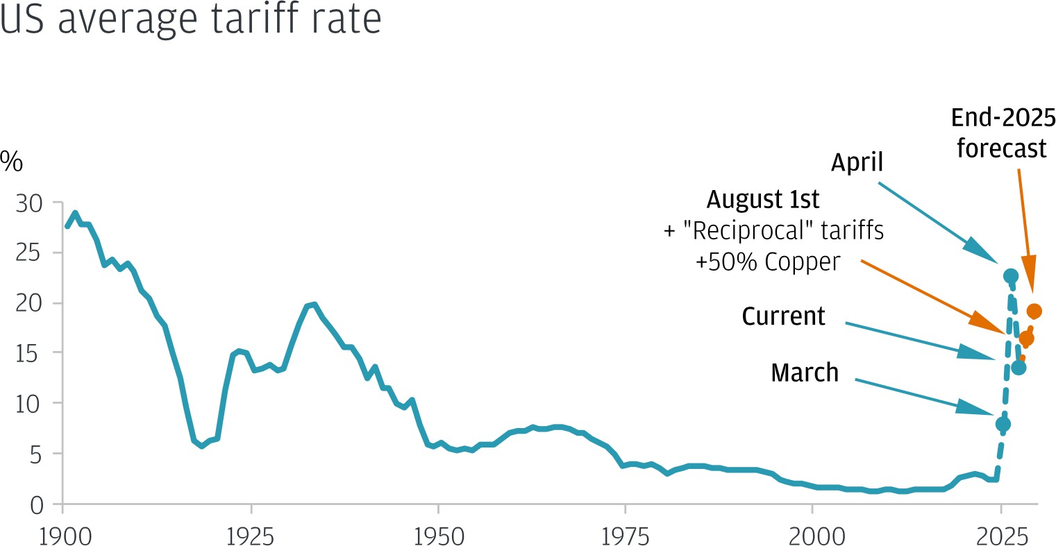
Why are tariffs important for US dairy?
CF Nicholson, UW-Madison
Policy Environment

Slide 34
Why are possible policies important for US dairy?
Tariffs
Immigration
Food and Nutrition Programs
Hired labor is a key productive input and cost on many dairy farms and dairy processing plants
Non-US citizens provide a large share of this hired labor
Policy impacts could include labor shortages, higher wage costs and lower productivity per worker during transition periods
Policy Environment

Slide 35
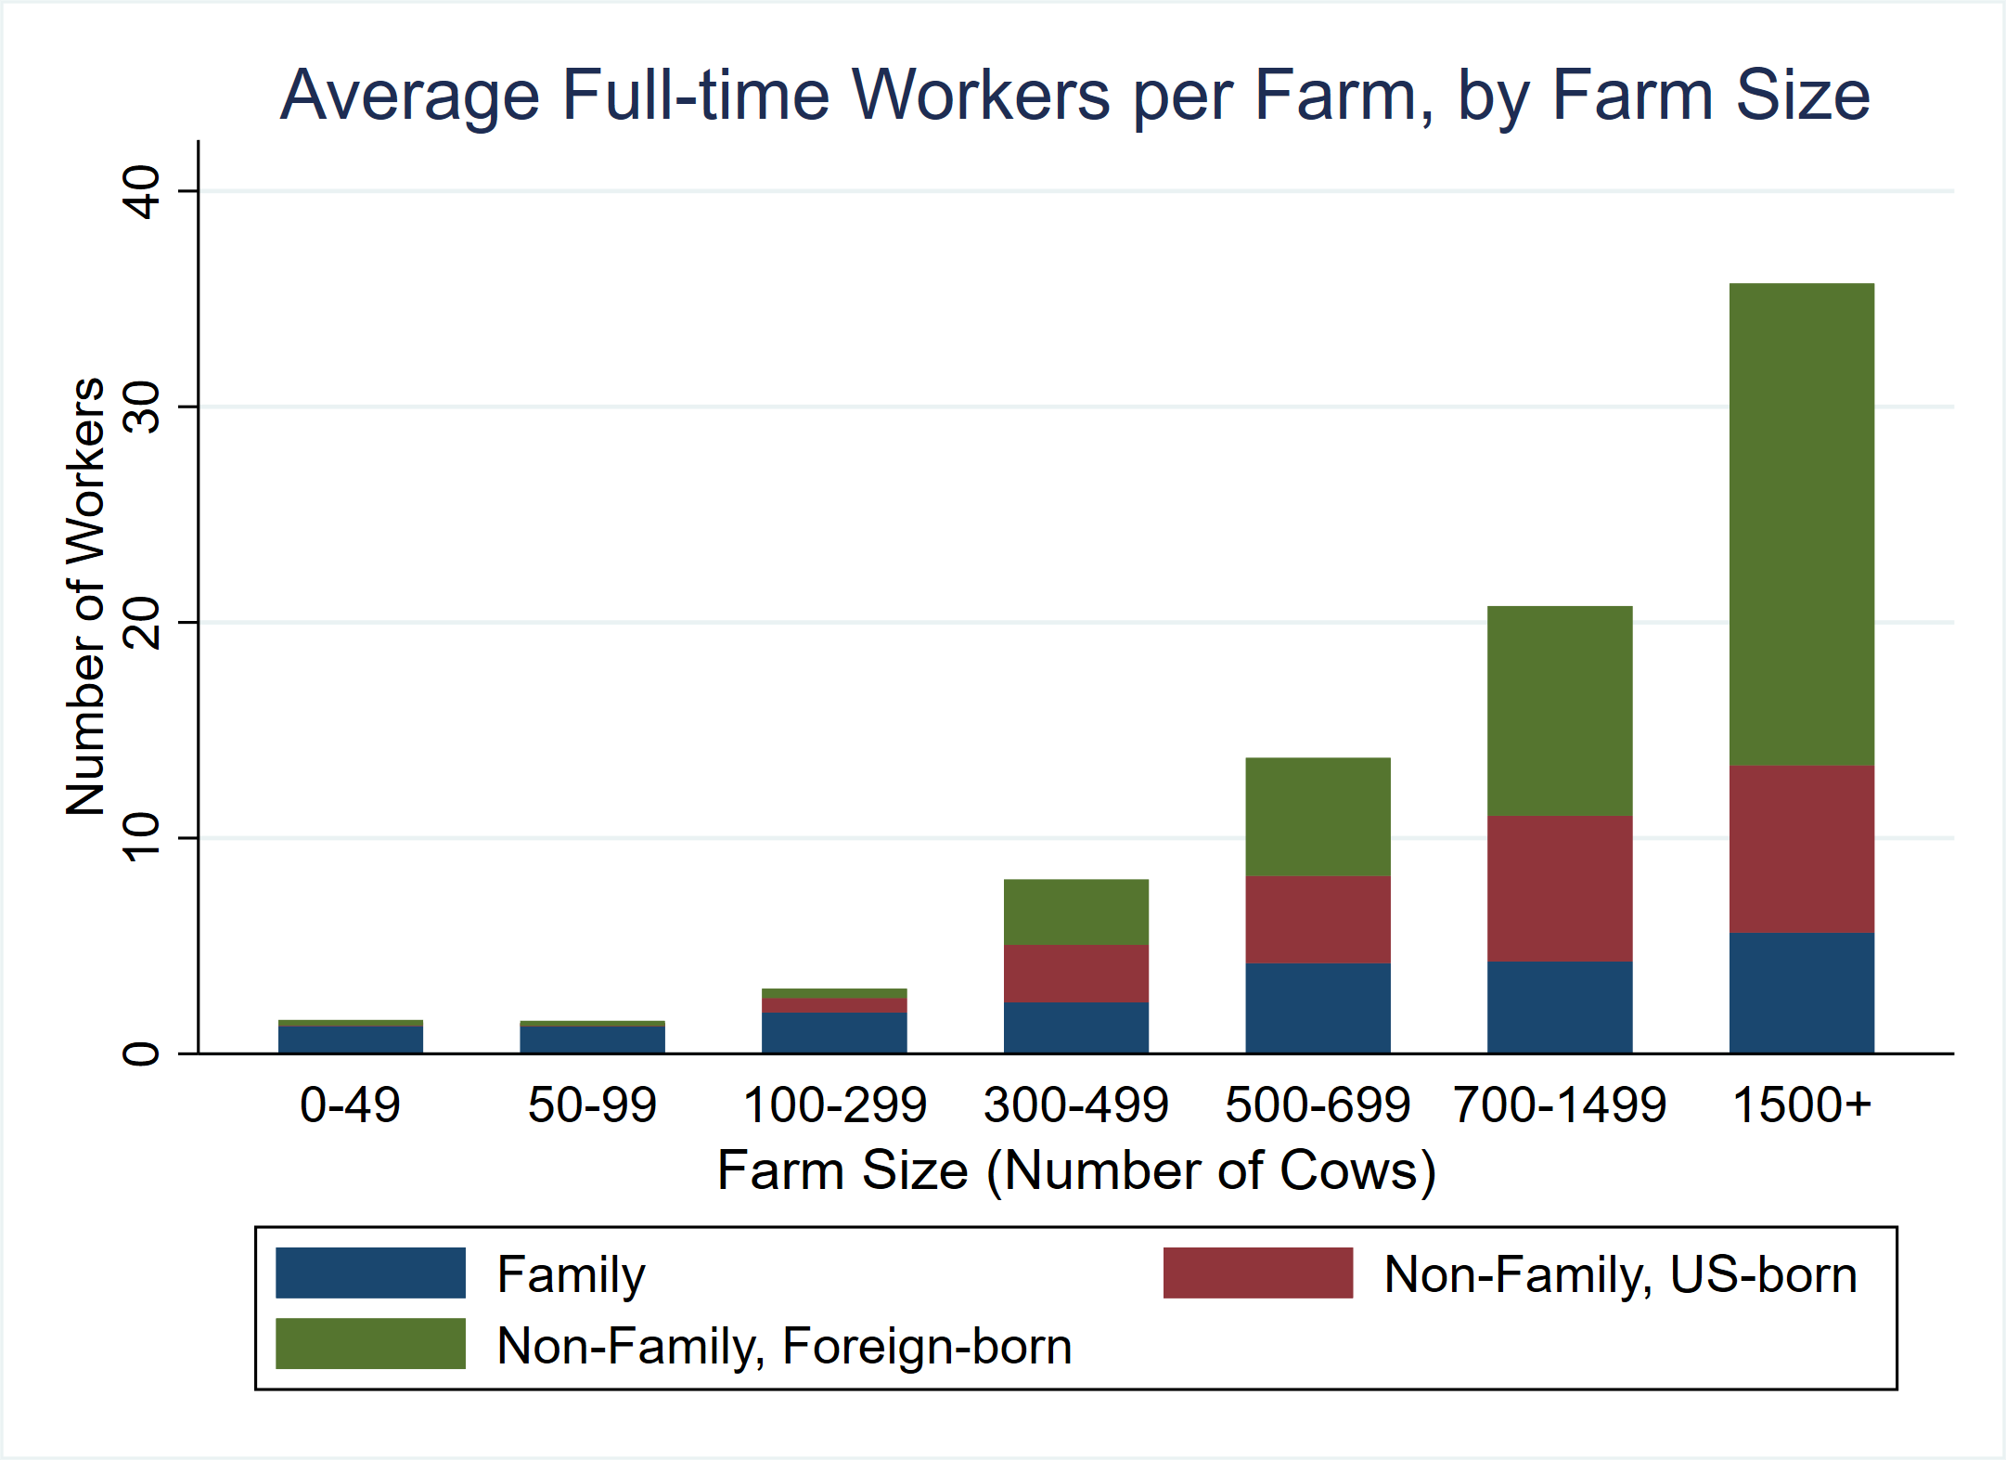
2024 WI Dairy Workforce Composition
The vast majority of workers, like the majority of the cows, are on large (500+ cows) farms.
Foltz, J. and T. Mittelberg. 2025. Understanding the state of labor on dairy farms in Wisconsin. Presentation at the Dairy Symposium, Madison, WI, May 14, 2025.
Policy Environment

Slide 36
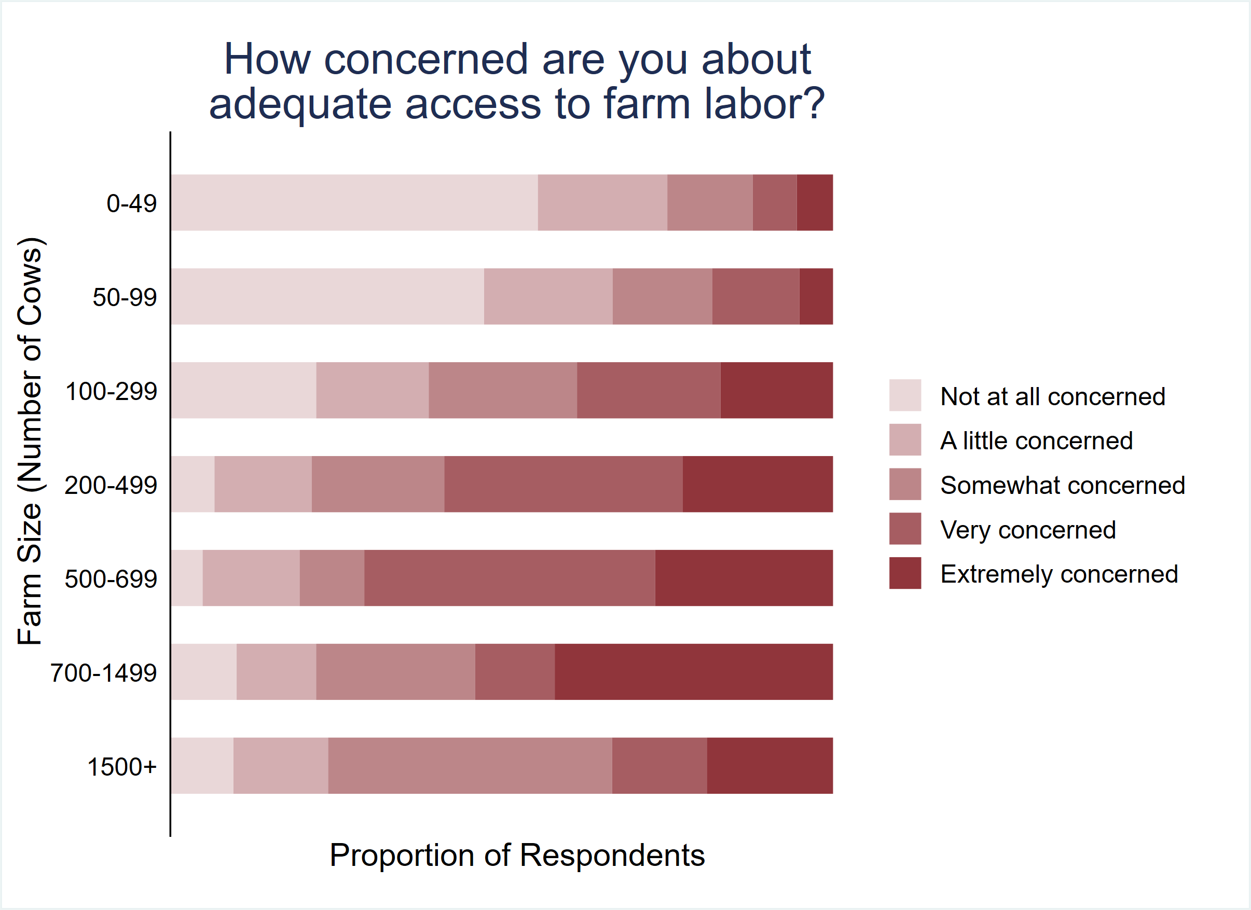
Dairy farmers are conce about adequate labor
rned
Farm labor concerns exist across the board.
Midsized to large farms 300 – 1,500 cows, are most concerned about labor.
More
300-499
Foltz, J. and T. Mittelberg. 2025. Understanding the state of labor on dairy farms in Wisconsin. Presentation at the Dairy Symposium, Madison, WI, May 14, 2025.
Policy Environment

Slide 37
Why are possible policies important for US dairy?
Tariffs
Immigration
Food and Nutrition Programs
Programs like the Supplemental Nutrition Assistance Program (SNAP), School Lunch and Breakfast Programs, and the Healthy Fluid Milk Initiative contribute notably to domestic demand for dairy products.
Estimated that ~10% of fluid milk in the US is consumed through school- based programs
Policy Environment

Slide 38
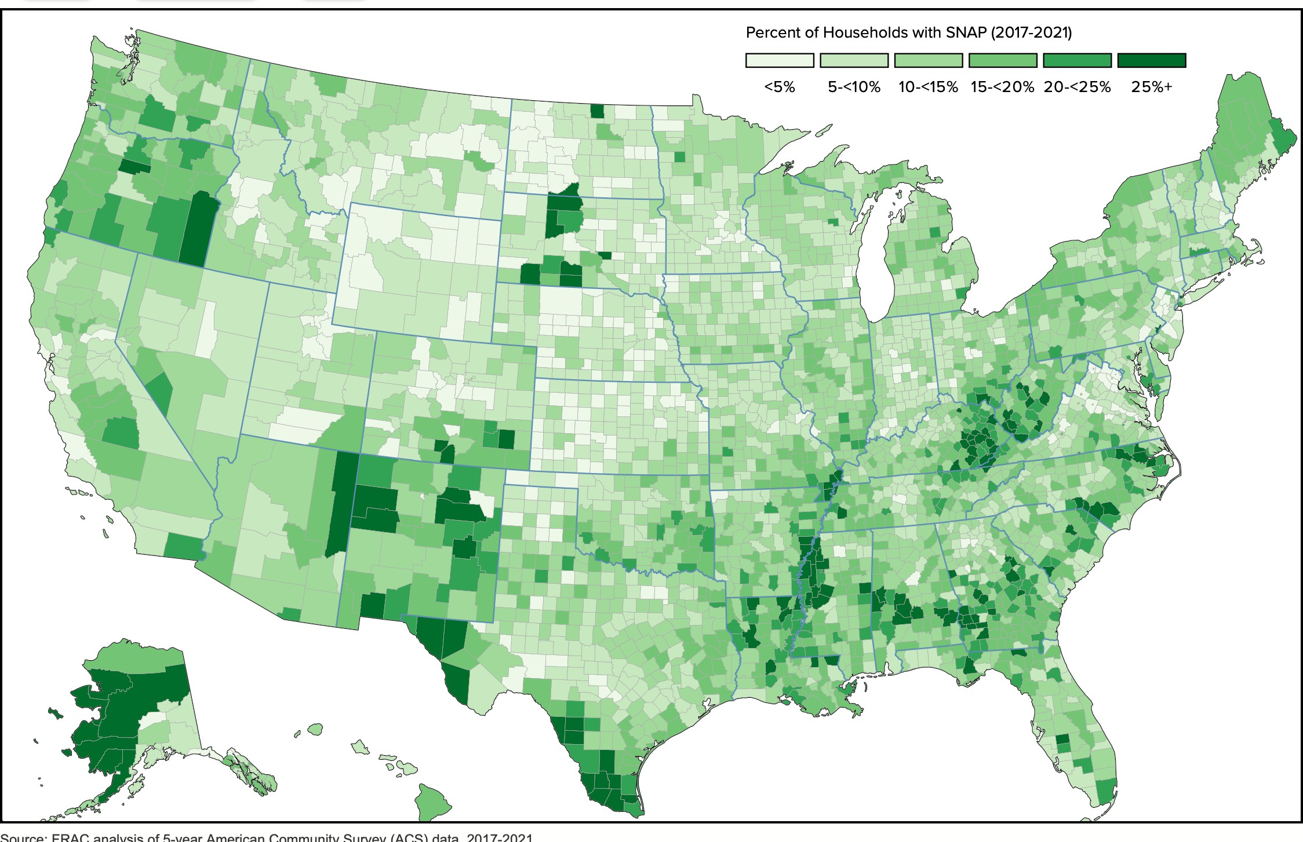
SNAP Program Benefits Map
Policy Environment

Slide 39
Previous Publications
Policy Environment

Slide 40
What has been the pattern to date?
Tariffs: Lots of jostling and threats, some deals, some retaliation, some removals of retaliatory tariffs
Labor: Some notable immigration raids, but not widespread
Food & Nutrition: Spending cuts of >$200 million in the “Big Beautiful Bill” (to states)
Uncertainty continues to be an issue for decision makers
We haven’t seen major impacts (yet)
Policy Environment

Slide 41
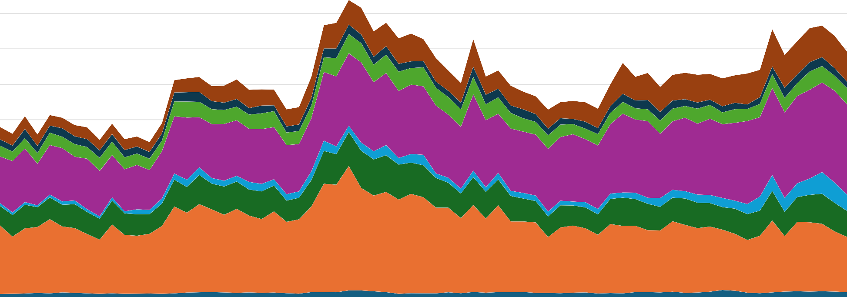
Value of US Dairy Exports, 2020-2025
Through September 2025
900.0
Source: USITC Dataweb
800.0
700.0
600.0
500.0
400.0
300.0
200.0
100.0
$ million/month
0.0
Jan-20 Jul-20
Milk & Related
% Change YTD +15%
Jan-21
Conc Milk
Jul-21 Jan-22
Whey Products
Jul-22 Jan-23
Butter & Related
Jul-23
Cheese
Jan-24
Lactose
Jul-24
Ice Cream
Jan-25
Casein/MPC
Jul-25
-5%
+7%
+137%
+23%
+20%
+4%
+27%
Policy Environment

Slide 42
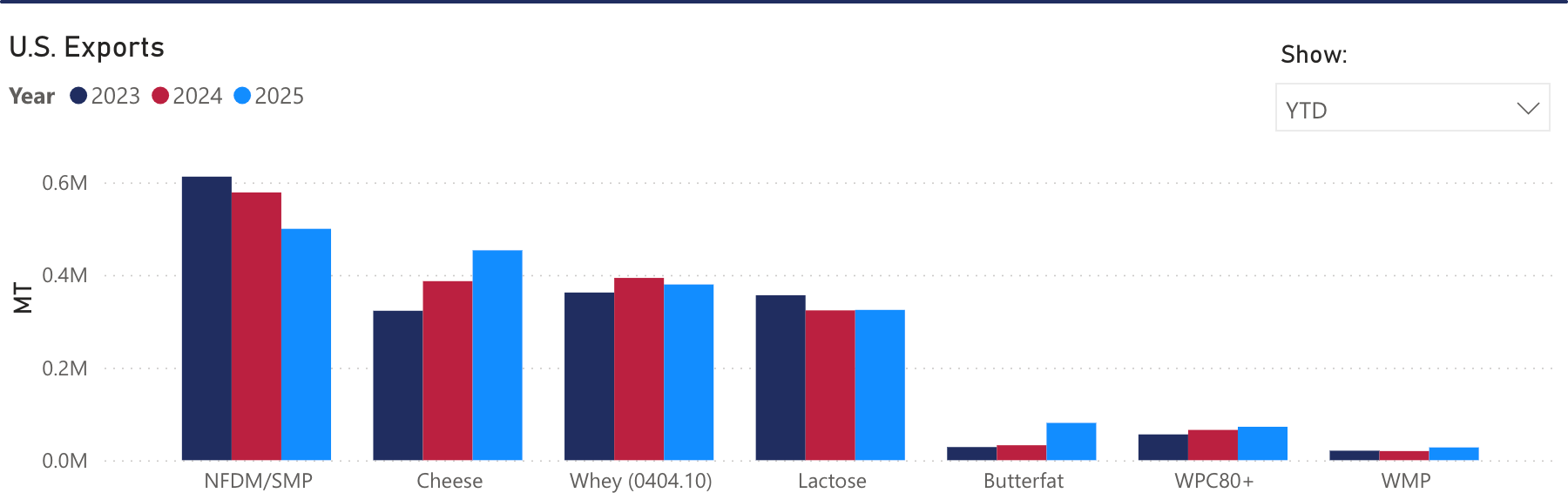
Volume of US Dairy Exports, 2023 to 2025 YTD
Cheese and butterfat export volumes up, NDM, Whey, Lactose export volumes down.
Source: USDEC
Policy Environment

Slide 43
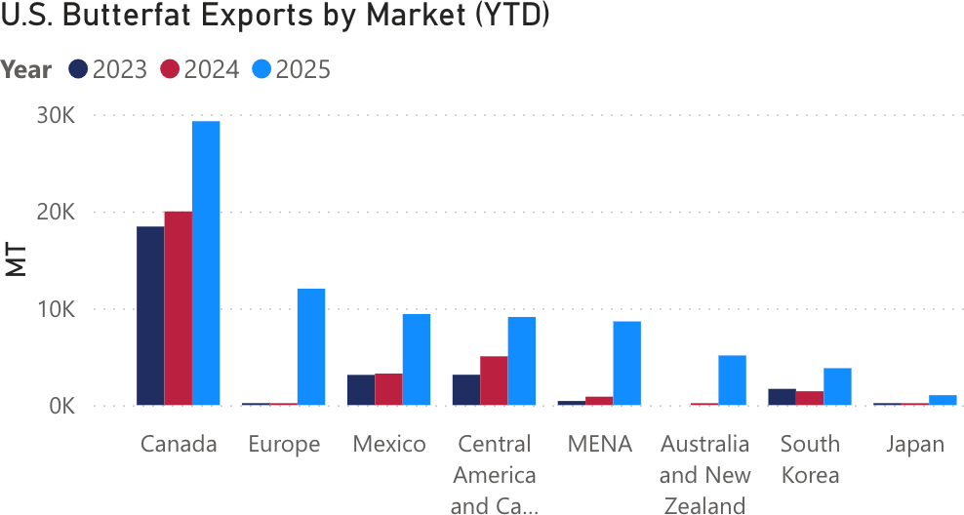
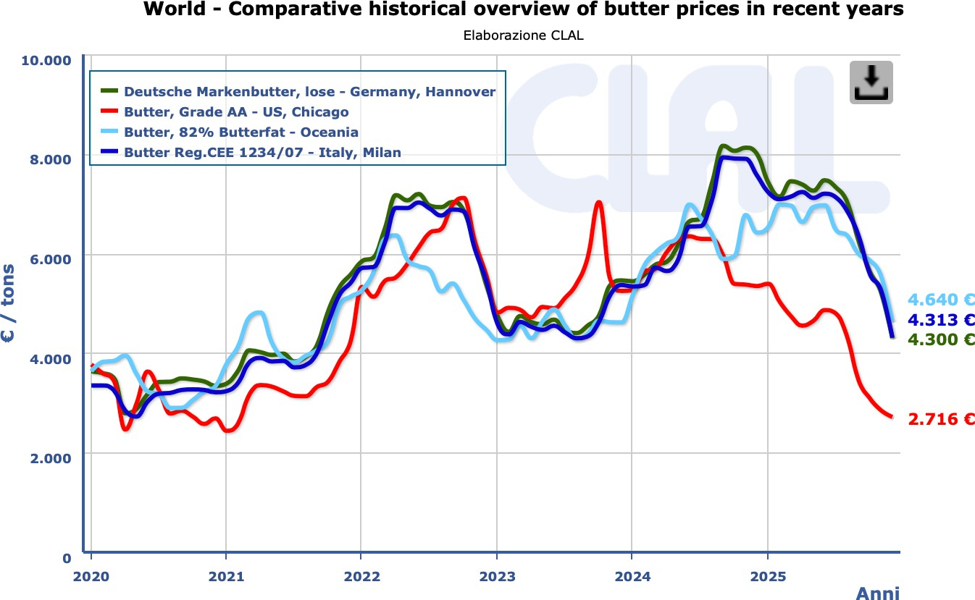
Volume of US Butterfat Exports, 2023 to 2025 YTD
The world wanted US butterfat due to large price differentials throughout 2025 (due to US supply response)
Source: USDEC
Source: CLAL
Policy Environment

Slide 44
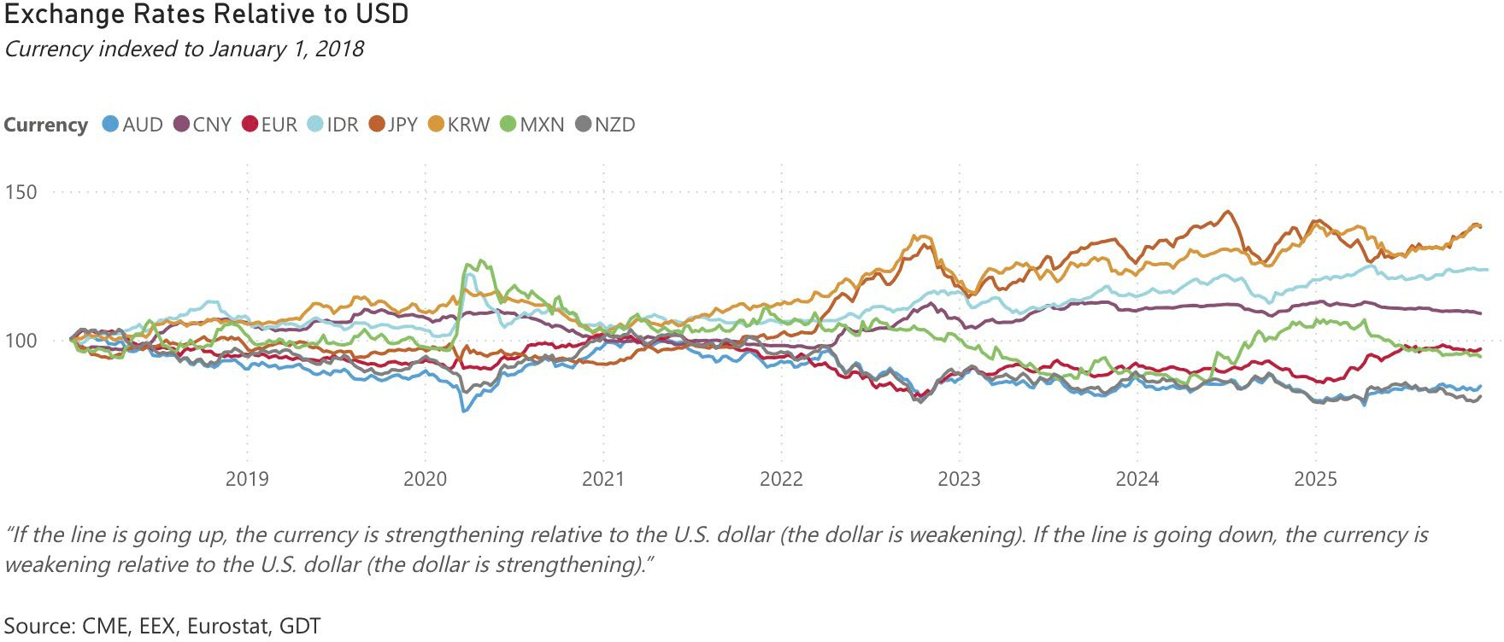
US Dollar Exchange Rates
Dollar depreciated against the Euro, Yen and Won, appreciated against the Peso and not much change with the Yuan.
Policy Environment
Source: USDEC website and sources listed above.

Slide 45
US Dairy Product Prices
Initial price reductions with tariff announcements, then recovery, then supply-demand balance drove prices lower.
Policy Environment
Source: UPPER MIDWEST DAIRY NEWS, December 2025

Slide 46
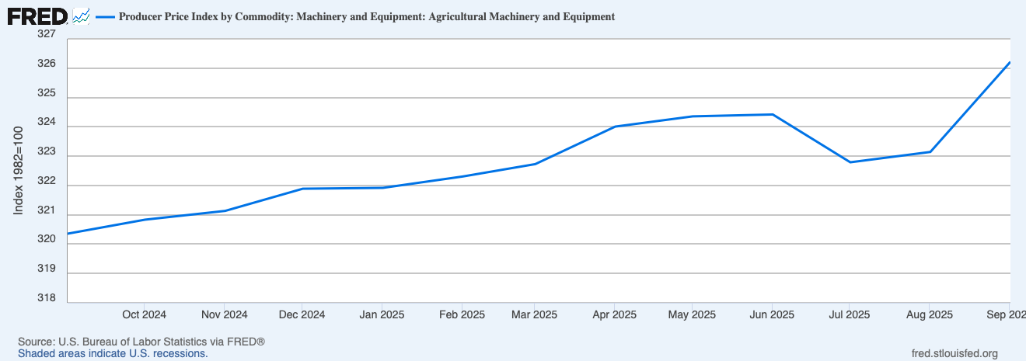
Farm Equipment PPI, Sep 2024 to Sep 2025
Increases in equipment costs (some tariff related)
Policy Environment

Slide 47
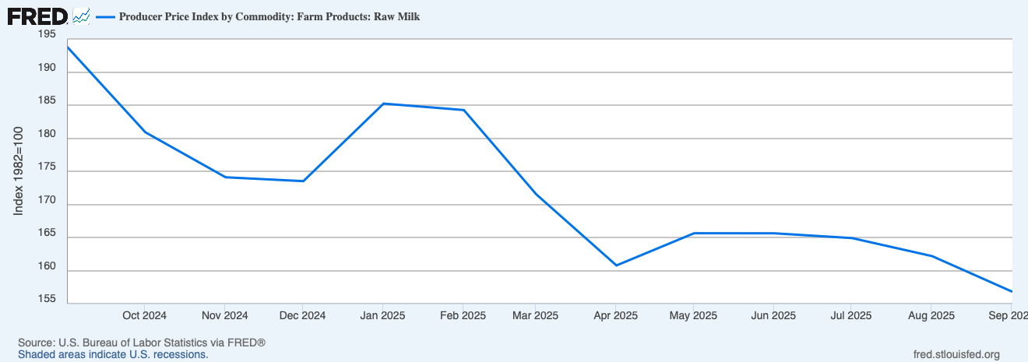
Milk Production PPI, Sep 2024 to Sep 2025
Reductions in milk production cost index (due to feed costs) but some mid-year increases.
Policy Environment

Slide 48
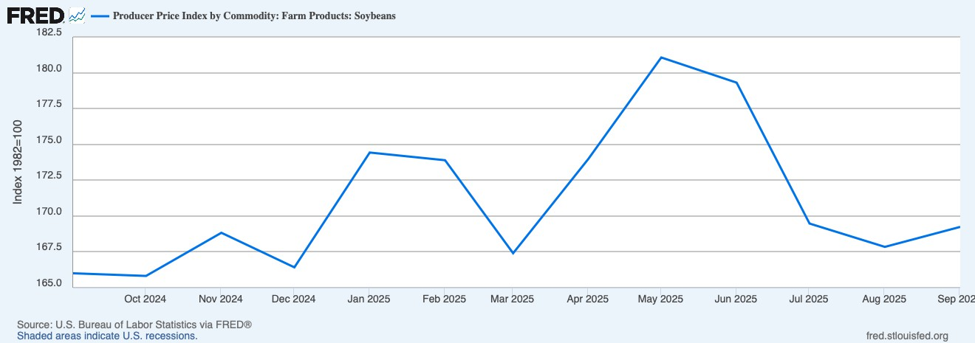
Soybean Production PPI, Sep 2024 to Sep 2025
Large mid-year production cost increases, now tempered
Policy Environment

Slide 49
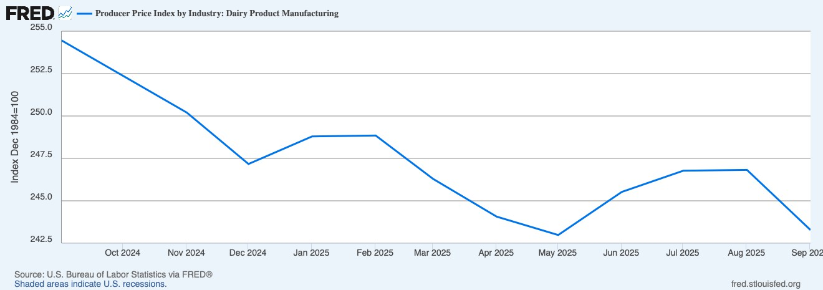
Dairy Product Manufacturing PPI, Sep 2024 to Sep 2025
Mid-year increases in manufacturing costs, now tempered
Policy Environment

Slide 50
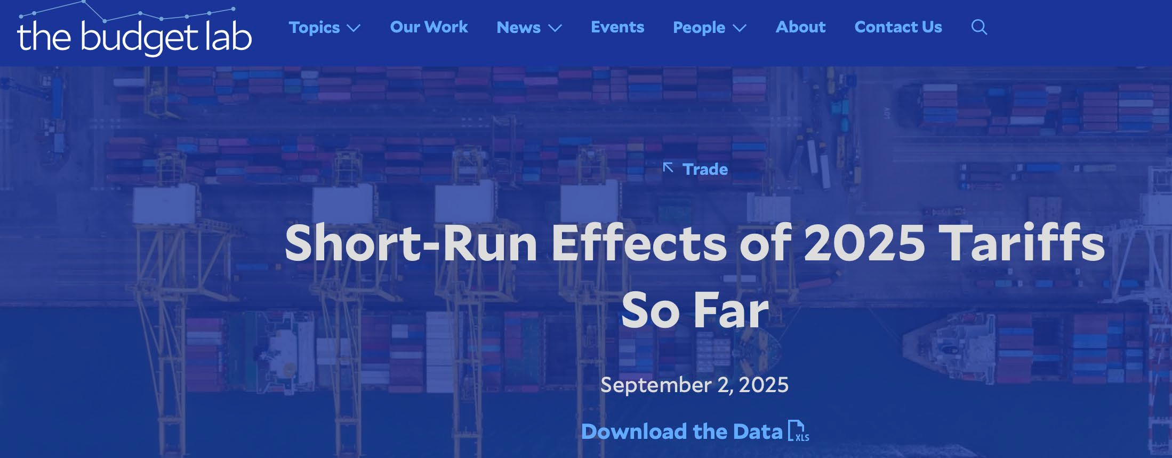
Impacts of Trade Policies Through September
Goods Prices: There is suggestive evidence that tariffs are raising goods prices. Core goods prices were 1.9% above pre-2025 trend as of June, with window & floor coverings, appliances, and electronics particularly elevated
TBL estimates 61-80% of the new 2025 tariffs were passed through to consumer core goods prices
The dollar has weakened appreciably, down more than 7% since December and down
½% from a year ago. This is the opposite of what theory would predict in the face of higher tariffs
Policy Environment

Slide 51
In parts of America’s economy, the pain is real. Prices of durable goods, a category that includes appliances and cars, rose by over 3% at an annual rate in the second quarter of 2025, the fastest since the early 1990s (excluding the covid-19 pandemic). The price of toys, mostly from China, is growing at nearly 5%, a similarly unusual pace. All told, our estimates suggest that tariffs are adding around 0.3 percentage points to inflation. Employment has weakened, too, in tariff-exposed sectors such as manufacturing and retail; bosses blame higher costs and uncertainty. Consumer sentiment in September was a fifth below its level a year ago. Relative to a world without tariffs, America is worse off.
Yet six months on the full reckoning has not arrived. There is no runaway inflation. America’s economy grew by 3.8% at an annualised rate in the second quarter; the Atlanta branch of the Federal Reserve expects similar in the third. Consumers are spending, firms investing and the stockmarket booming. The outlook has also improved elsewhere. In September the oecd lifted its forecast for global growth to 3.2%, up from 2.9% three months earlier.
Why? Tariffs ‘gentler’ than advertised, lags in implementation due to uncertainty, carve-outs, USMCA exemptions.

Slide 52
Current Status of Dairy Trade Policies, Selected Countries
Country | Current Status of US Tariffs on Dairy Imports | Current Status of Agreements or Reciprocal Tariffs on US Dairy Exports
Canada | USMCA provisions; 35% otherwise | USMCA provisions; 25% reciprocal removed 9/25
China** |  | 10% under temporary truce
Mexico | USMCA provisions; 25% otherwise | USMCA provisions
European Union** | Max of MFN Rate or 15% | Preferential treatment; does not clarify which tariffs will be reduced or geographic indicators
Japan* |  | Modified 9/25 "enhance US market access"; USJTA in 2020
South Korea* |  | Agreement 8/25; KORUS FTA in 2012
Vietnam* |  | Agreement 8/25; Eliminated tariffs of 0-35%
Philippines* |  | Agreement 8/25; Eliminated tariffs of 3-6%
Indonesia* |  | Agreement 8/25 "eliminate approximately 99 percent of tariff barriers"
Brazil |  | Threatened reciprocal 50%; MFN max 28%
* Agreement reached under Trump 2.0
** Temporary or unresolved details
Sources: https://www.tradecomplianceresourcehub.com/2025/10/01/trump-2-0-tariff-tracker/ and WTO Trade and Tariff Platform; https://ttd.wto.org/en
Policy Environment

Slide 53

Are We Out of the Woods?
TD Economics - Global Trade Disrupted: Early Impacts of U.S. Tariffs
Policy Environment

Slide 54
CF Nicholson, UW-Madison
Simulated Impacts of Combined Policies, 2025-2029
Outcome | Combined Policies
US All-milk Price, $/cwt | -0.55
Net Farm Operating Income, Medium-sized Farm, $/farm/year | -15,106
Cumulative NFOI for US dairy farms, through 2029, $ billion | -7.9
Value of US dairy product exports, $ billion per year | -2.6
Source: Simulation with the Dynamic Global Dairy Supply Chain Model, Change from previous policies during October 2025 to January 2029.
Policy Environment

Slide 55
CF Nicholson, UW-Madison
Simulated Impacts of Combined Policies with Compensatory Payments, 2025-2029
Outcome | Combined Policies | Combined Policies with $0.25/cwt Payment*
US All-milk Price, $/cwt | -0.55 | -0.70
Net Farm Operating Income, Medium-sized Farm, $/farm/year | -15,106 | -6,082
Cumulative NFOI for US dairy farms, through 2029, $ billion | -7.9 | -6.7
Value of US dairy product exports, $ billion per year | -2.6 | -2.5
Source: Simulation with the Dynamic Global Dairy Supply Chain Model
*Program cost = $2.3 billion
Policy Environment

Slide 56
USDA Bridge Funding: Focus on Field Crops
(Washington, D.C., December 31, 2025) – Today, U.S. Secretary of Agriculture Brooke L. Rollins announced the next phase in the Farmer Bridge Assistance Program (FBA), the eligible commodity per-acre payment rates. As announced earlier this month by President Trump and Secretary Rollins, $12 billion will be paid to American farmers in 2026. Of that amount,
$11 billion consists of one-time FBA program
payments. This is in response to four years of disastrous Biden administration policies that created record-high input and production costs, zero new trade deals, and a forgotten rural America.
Below are the payment rates for the FBA eligible commodities that triggered a payment.
Commodity, Per Acre Payment Rates
Barley: $20.51
Canola: $23.57
Chickpeas (Large): $26.46
Chickpeas (Small): $33.36
Corn: $44.36
Cotton: $117.35
Flax: $8.05
Lentils: $23.98
Mustard: $23.21
Oats: $81.75
Peanuts: $55.65
Peas: $19.60
Rice: $132.89
Safflower: $24.86
Sesame: $13.68
Sorghum: $48.11
Soybeans: $30.88
Sunflower: $17.32
Wheat: $39.35
https://www.usda.gov/about-usda/news/press-releases/2025/12/31/usda-announces-commodity-payment-rates-farmer-bridge-assistance-program
Policy Environment

Slide 57
FSA Milk Loss Program
Who Is Eligible
Dairy operations that dumped or removed milk, without compensation, from the commercial milk market due to a qualifying weather event that impacted the delivery or storage of milk (e.g., power outages, impassable roads, infrastructure losses, etc.) during calendar years 2023 and 2024 may be eligible for assistance.
Qualifying disaster events include droughts, wildfires, hurricanes, floods, derechos, excessive heat, tornadoes, excessive moisture, winter storms, freeze (including a polar vortex) and smoke exposure that occurred in 2023 and/or 2024.
“If program participation exceeds the
$1.65 million in available MLP funding, payments will be prorated based on the sum of eligible payments and available funds.”
Policy Environment

Slide 58
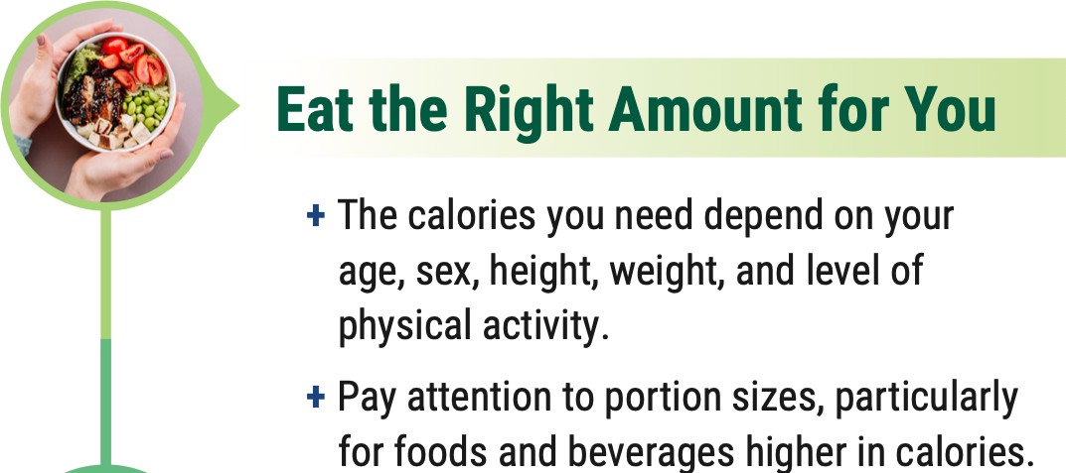

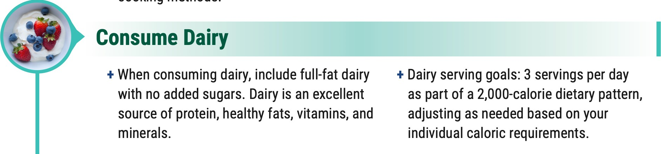
New Dietary Guidelines
Per Capita Values @ 3 servings: Cheese: 68 lbs/yr (currently 40 lbs/yr) Fluid Milk: 68 gal/yr (currently 14 gal/yr)
For a 1600-calorie diet, 3 cheese servings equals about 25% of total caloric intake
“It will be interesting to see how USDA operationalizes the new Guideline for federal subsidized meal programs. Presumably, the table showing “Daily Servings by Calorie Level” is somehow normative, but without specific caloric intakes specified for the groups covered by this or that feeding program, there is nothing here that helps determine compliance with the guidelines.” -- Andy Novaković
Policy Environment

Slide 59
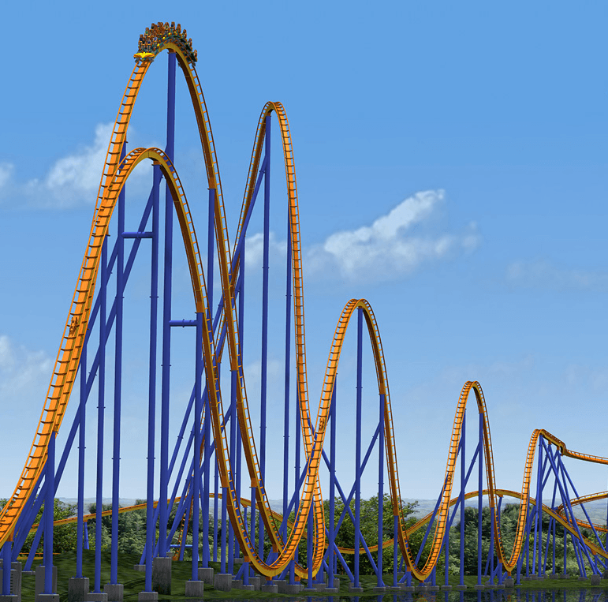
Outlook for 2026
Likely more uncertainty
More tariff-related impacts
USMCA revision
Farm Bill?
Policy Environment
https://www.architecturaldigest.com/gallery/roller-coaster-designs

Slide 60


Thank you for your attention!
Chuck Nicholson
Penn State Smeal College of Business Email: cfn10@psu.edu

