Slide 1
Trends in Local and Regional Food System
2026 Agricultural Economic Outlook Conference Ithaca, NY
January 12, 2026
Becca B.R. Jablonski & Allie Bauman
Dyson School of Applied Economics and Management | Cornell University

Slide 2
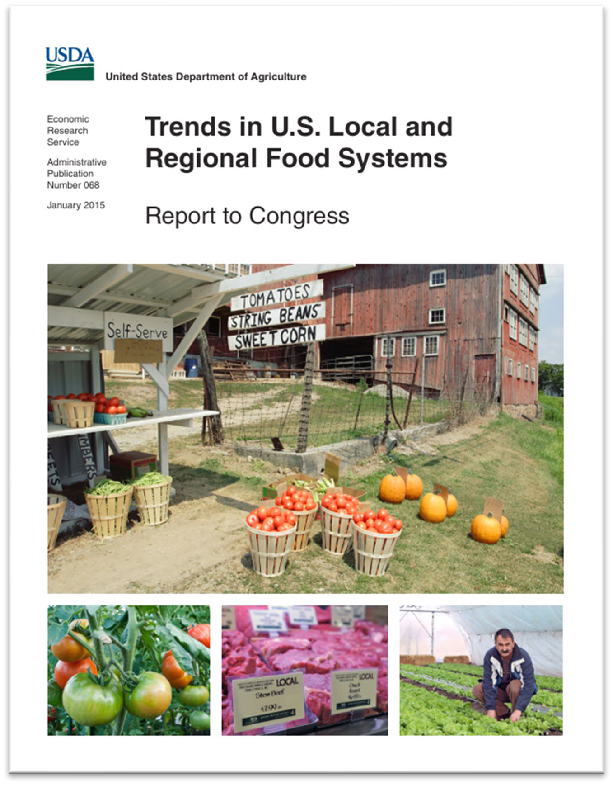
Co-authors
2025/26 Update to the Congressionally-mandated 2015 Trends in Local and Regional Food Systems Report
Katherine Lacy (USDA ERS) is the lead author.
Allie Bauman (Cornell) led the analysis of much of the USDA micro data used in this presentation.
https://www.ers.usda.gov/publications/pub-details?pubid=42807

Slide 3
Agenda
Why do we care about local and regional food markets?
What types of federal and state incentives are available?
What do we know about the trends in farm sales through local food markets?
Direct-to-consumer
Intermediated
Agritourism
Are sales through local food markets associated with “better” outcomes (survivability, profitability)?
What does this mean moving forward / in 2026?

Slide 4
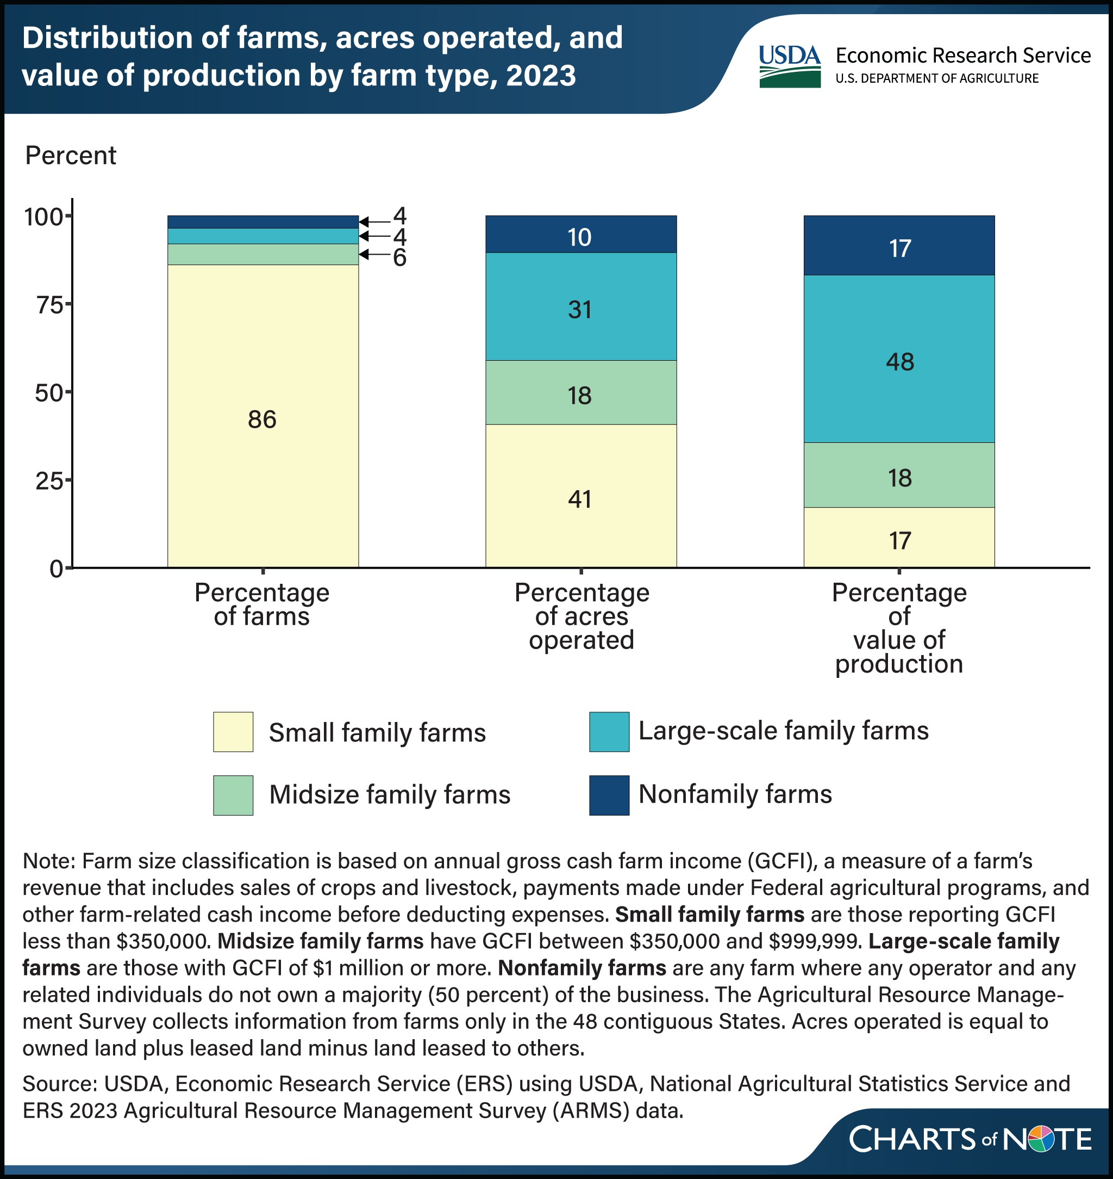
What’s the issue?
Most farms are small
Only 79% of farms in New York have sales >$100,000.
(USDA NASS 2022)
https://www.ers.usda.gov/data-products/charts-of-note/chart-detail?chartId=110693

Slide 5
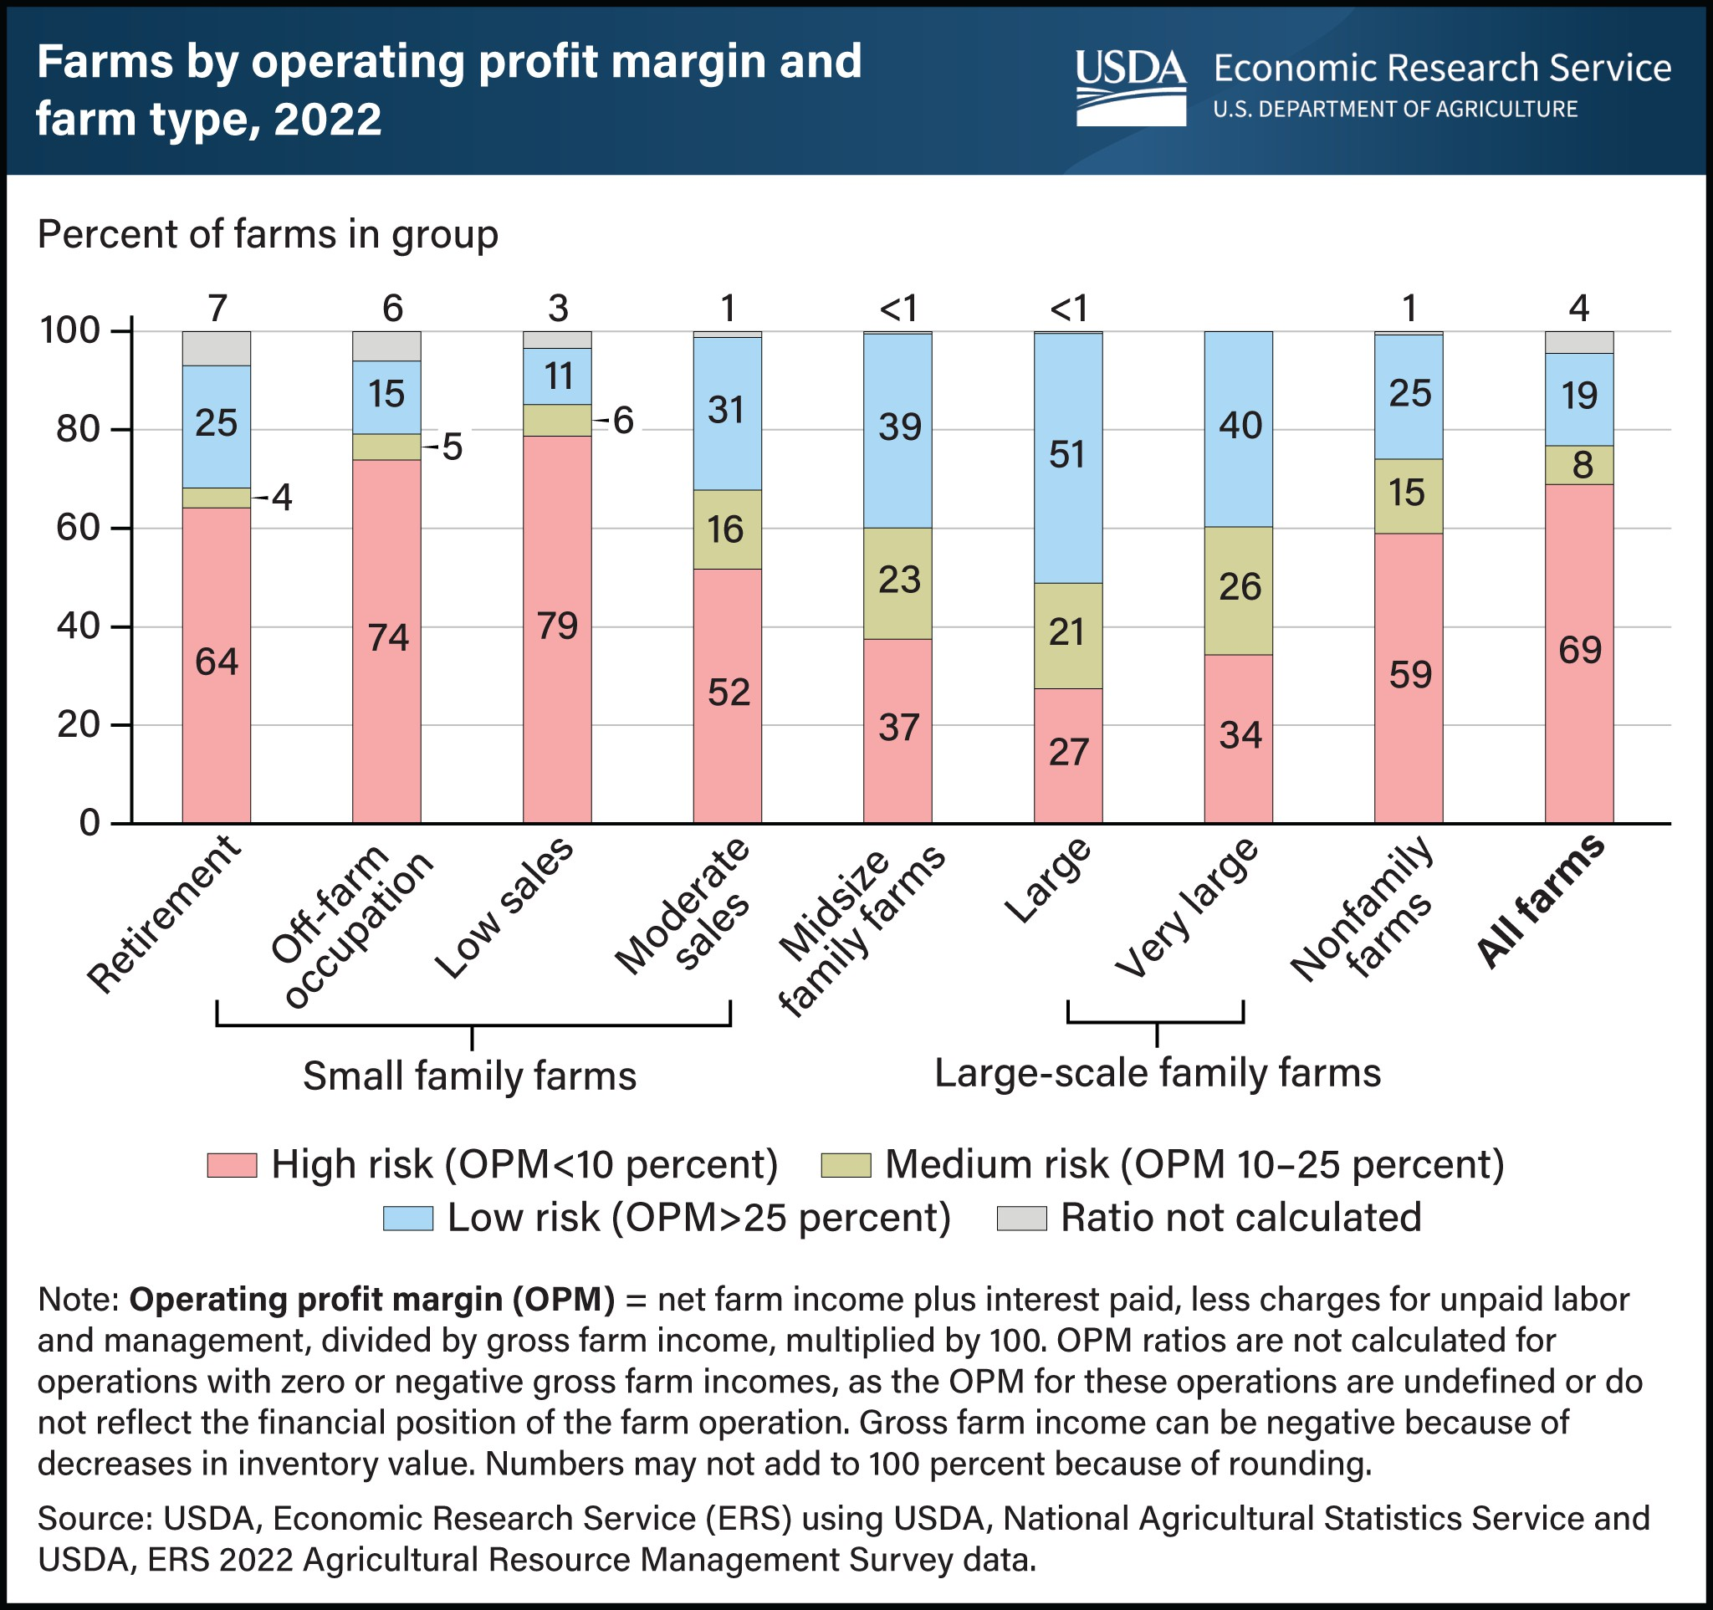
What’s the issue?
Most of these small farms are at high financial risk based on operating profit margin.
https://www.ers.usda.gov/data-products/charts-of-note/chart-detail?chartId=108317

Slide 6
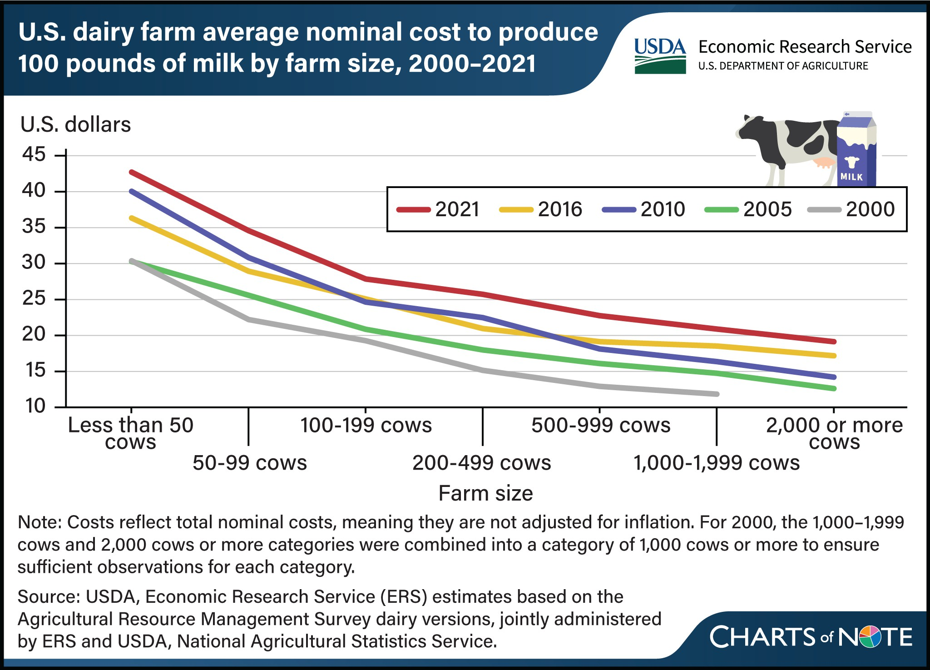
What’s the issue?
Small operations have higher per unit costs of production.
https://ers.usda.gov/data-products/charts-of-note/chart-detail?chartId=109818

Slide 7
What’s the issue?
Small operations have higher per unit costs of production
Need opportunities to differentiate!
https://ers.usda.gov/data-products/charts-of-note/chart-detail?chartId=109818

Slide 8
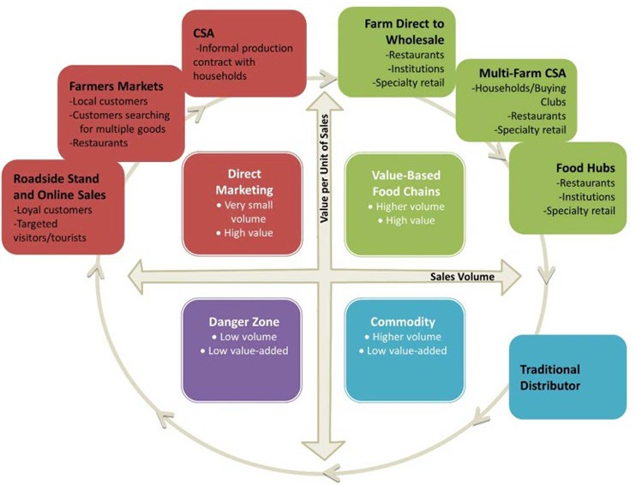

Classification of Local Food Business Models

Slide 9
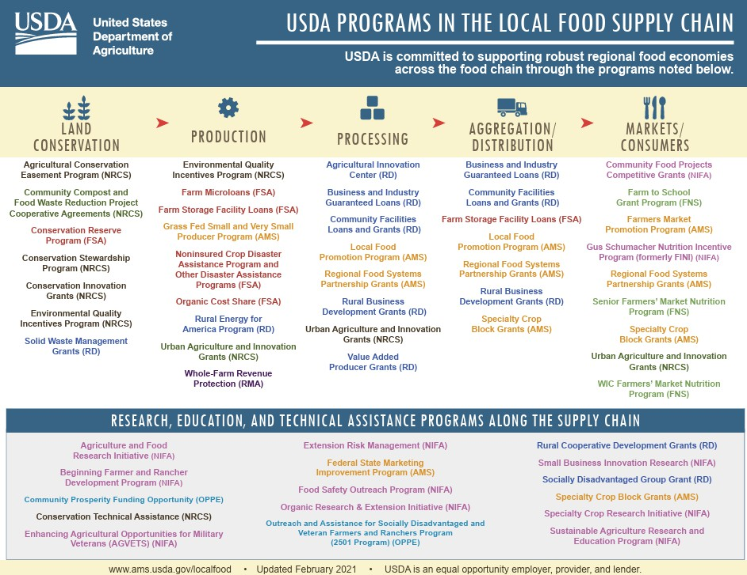
Historic investments in local food since the pandemic
This does not include a boost of $4.8B for school meal programs (2021-
2024), Regional Food Business Centers, Resilient Food Systems Infrastructure, etc.
https://www.usda.gov/about-usda/news/press-releases/2024/10/15/major-usda-investments-local-foods-strengthen-school-meals
https://www.ams.usda.gov/services/local-regional/food-sector/grants

Slide 10
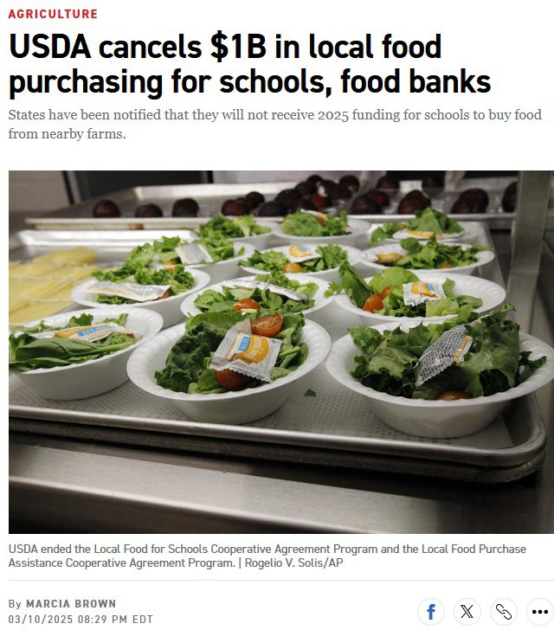

Some changes in the Trump administration
https://www.politico.com/news/2025/03/10/usda-cancels-local-food-purchasing-for-schools-food-banks-00222796

Slide 11

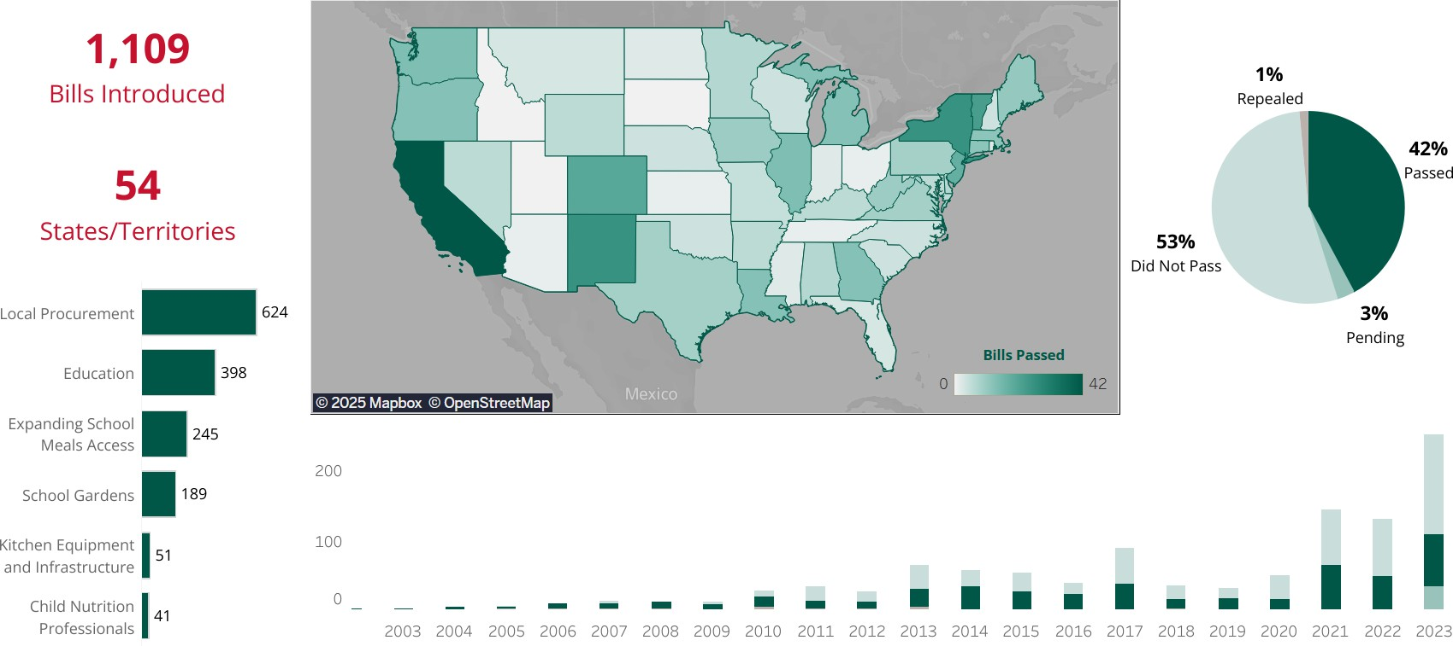
But also lots of support from philanthropy and many states
2002-2023 State Farm to School Policy Database
https://www.farmtoschool.org/policy/state-database

Slide 12
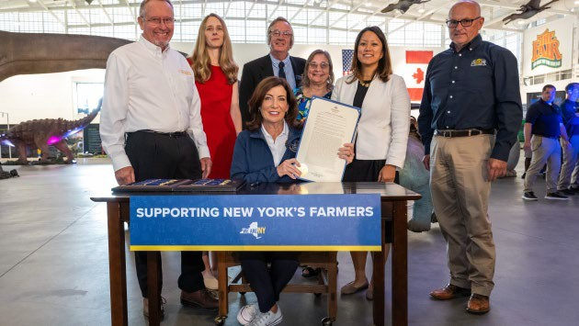
NYS Food Procurement Programs with Incentives / Requirements for NYS Products
Governor Hochul at the Great New York State Fair signing an Executive Order directing State agencies to increase the percentage of food sourced from New York farmers and producers. https://www.governor.ny.gov/programs/increasing-state-sourcing-local-foods

Slide 13
Historic investments in mid-scale infrastructure in NYS
Resilient Food Systems Infrastructure: $14.7M
Dairy Modernization Grant: $21.6M
Long Island Aquaculture Infrastructure Grants: $3M; Equipment: $1.2M
Business Builder Grants: $3.5M (NYS only; $14M total)
NYS Grown and Certified: $8.5M ($25M over 5 years)
Meat Processing Expansion: $4.3M
Food and Fiber Processing: $10M (not yet awarded)
Etc…
• + other (i.e., GrowNYC Wholesale Food Distribution Center)

Slide 14
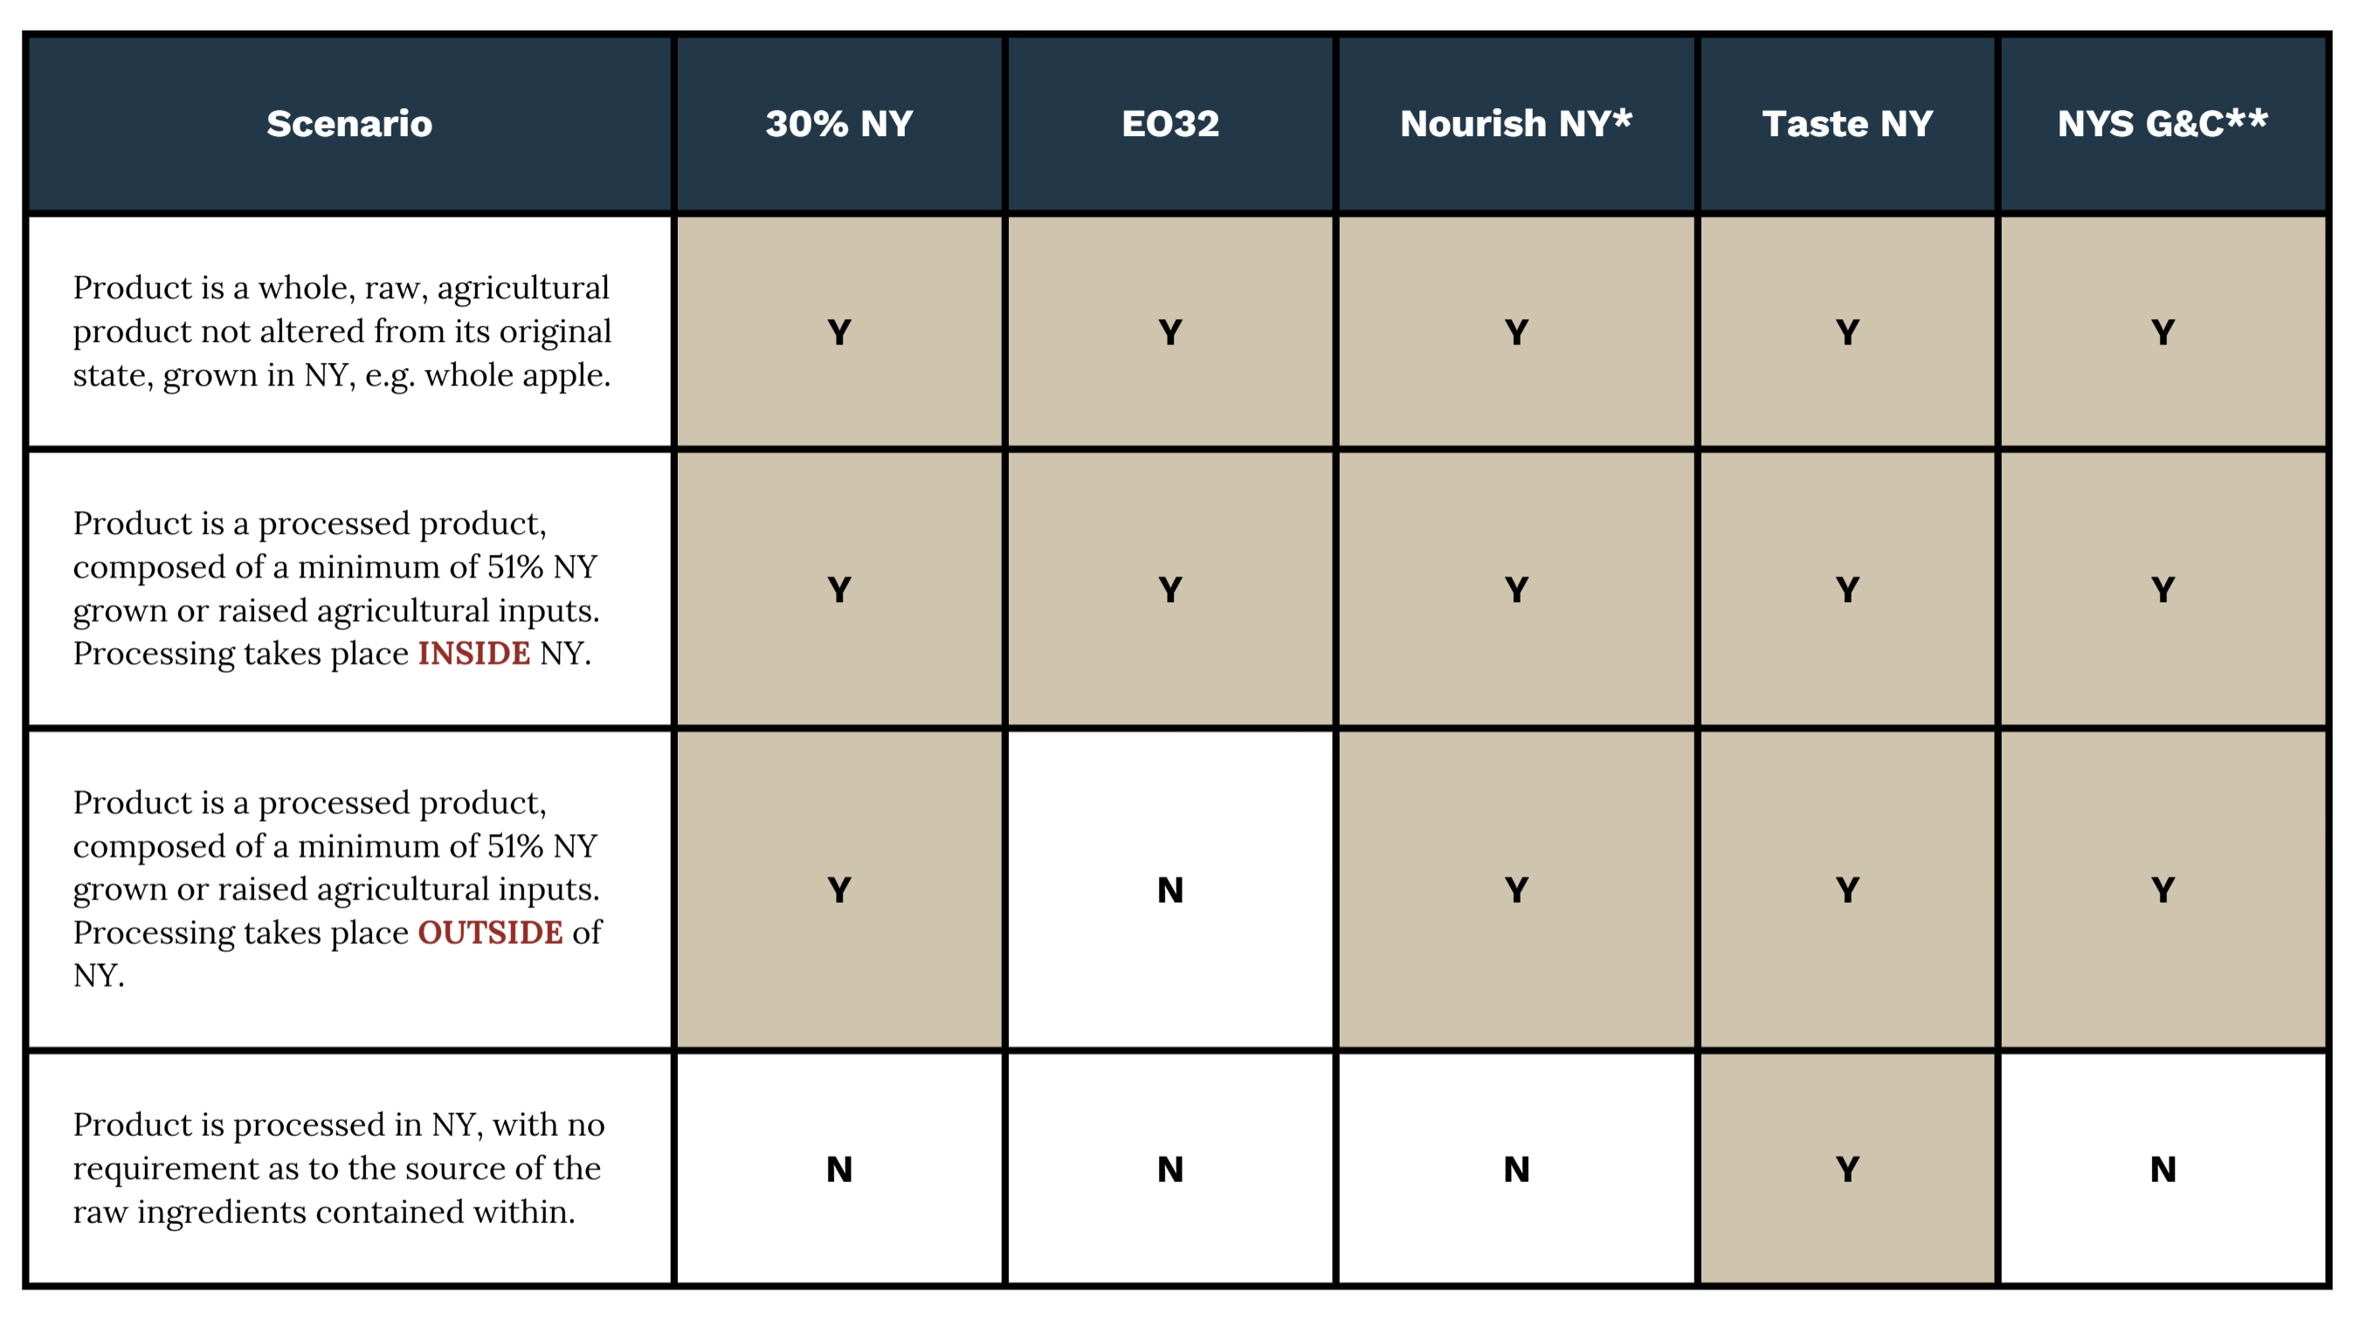
NY Food Procurement Programs and their ‘Local’ Definitions
*Nourish NY has additional nutritional standard requirements.
**NY Grown & Certified has additional requirements related to food safety and environmental stewardship.
Source: Cornell Cooperative Extension | Harvest New York, 2025

Slide 15
30% New York State Initiative
If school districts spend at least 30% of their lunch costs on eligible New York products, the following year the New York State reimbursement per lunch will increase from: $0.059/meal to $0.25/meal.
https://agriculture.ny.gov/30-percent-initiative

Slide 16
What do we know about the trends in farm sales through local food markets?

Slide 17
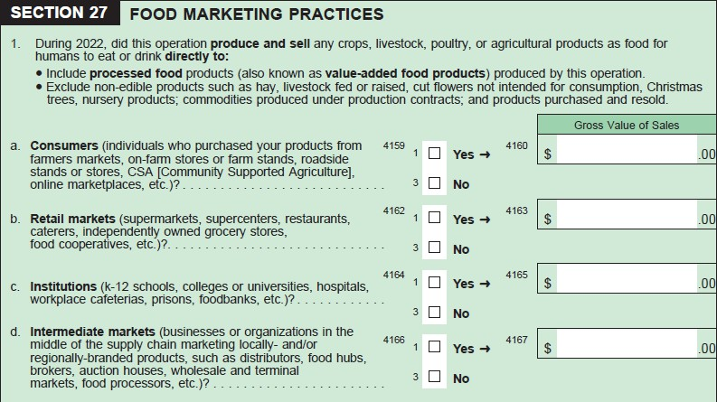
Quick definition
2022 Census of Agriculture:
Direct-to-Consumer Sales
Intermediated Sales

Slide 18
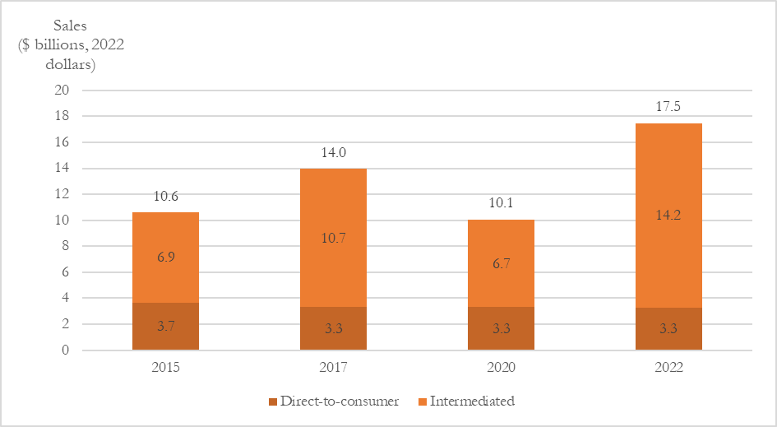
Nationally, most local food sales are through intermediated markets
Local food sales ($ billions, 2022 dollars) from 2015-2022 in direct to consumer and intermediate market channels
Note: Sales have been adjusted for inflation to reflect 2022 dollars using the gross domestic product (chain-type price index) from the Federal Reserve Economic Data (FRED).
Source: USDA, National Agricultural Statistics Service, 2017 and 2022 Census of Agriculture, Census of Agriculture and 2015 and 2020 Local Food Marketing Practices Survey.
Not for distribution or citation

Slide 19
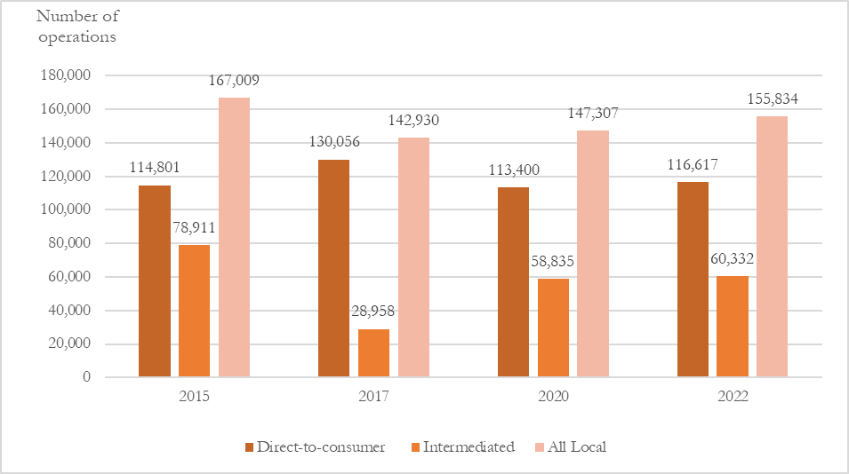
Nationally, most local food farms sell through DTC markets
Number of local food operations from 2015-2022 in direct to consumer and intermediate market channels
Note: Categories are not exclusive, if a farm sells through both DTC and intermediated market channels it will be counted in each but will only be counted once in the all local category. Number of intermediated operations in 2015 and 2020 was calculated by the author using the restricted access version of the Local Food Marketing Practices Survey and number of all local operations in 2017 and 2022 were calculated by the author using the restricted access Census of Agriculture data, remaining statistics were available in the public data.
Source: USDA, National Agricultural Statistics Service, 2017 and 2022 Census of Agriculture, Census of Agriculture and 2015 and 2020 Local Food Marketing Practices Survey.
Not for distribution or citation

Slide 20
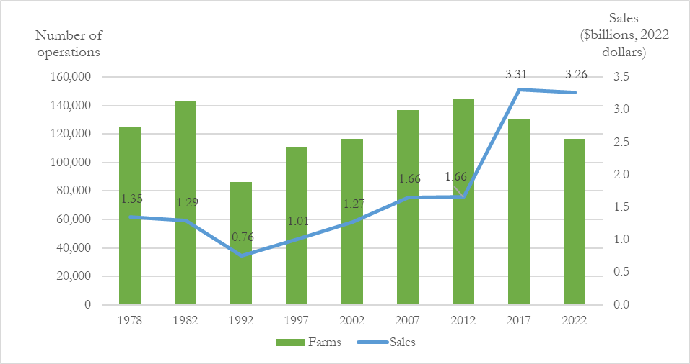
Nationally, the number of farms with DTC sales is declining, sales have stalled
DTC farms and sales ($billions, 2022 dollars) from 1978-2022
Note: Prior to 2007, unprocessed/value-added sales were neither explicitly included nor excluded. In 2007 and 2012, the survey asked for unprocessed sales only. In 2017 and 2022, the survey asks for both processed and unprocessed/value-added sales to be included. Local food data were not collected in 1987. Sales have been adjusted for inflation to reflect 2022 dollars using the gross domestic product (chain-type price index) from the Federal Reserve Economic Data (FRED).
Source: USDA, National Agricultural Statistics Service, 1978, 1982, 1992, 1997,
2002, 2007, 2012, 2017, and 2022 Census of
Agriculture.
Not for distribution of citation

Slide 21
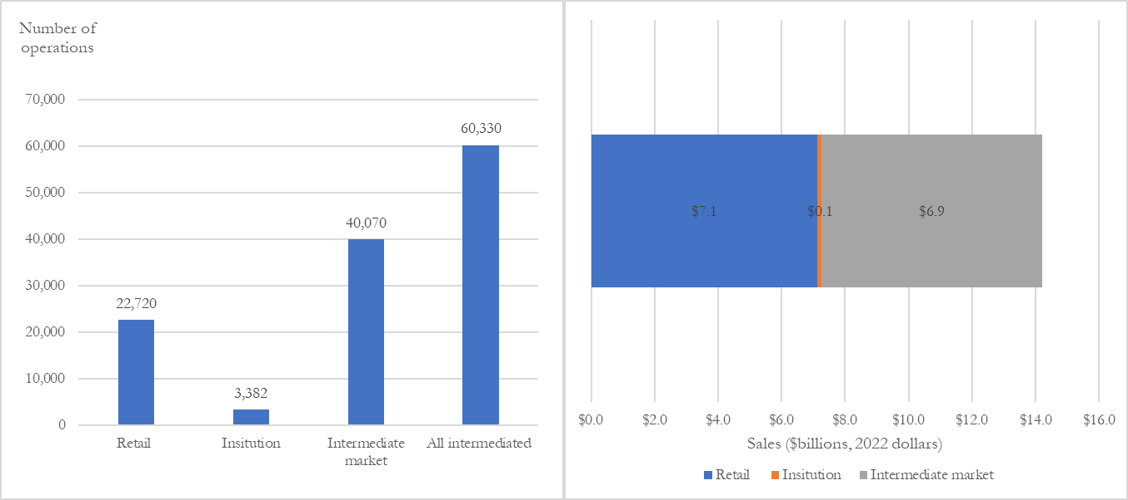
Nationally, intermediated sales between retail and intermediate markets (e.g., processors, distributors, wholesalers, food hubs)
Sales ($billions) and operations by intermediated market channel, 2022
Source: USDA, National Agricultural Statistics Service, 2022 Census of Agriculture, using the restricted access data and compiled by the author.
Not for distribution of citation

Slide 22
Nationally, most operations with local food sales also sell through commodity markets
69% (2017) 72% (2022)
of local food farms also had commodity sales
For those operations with local and commodity sales, local sales made up an average of 35% of total sales in both 2017 and 2022
Not for distribution or citation

Slide 23
Nationally, local food operations more likely to be in metro (urban) areas
Percent of operations in each rural-urban continuum code, 2022
DTC Intermediated
41
43
61
57
Source: USDA, National Agricultural Statistics Service, 2022 Census of Agriculture, USDA, Economic Research Service, 2023 Rural-Urban Continuum Codes.
Metro
Nonmetro
Metro
Nonmetro
Not for distribution or citation

Slide 24
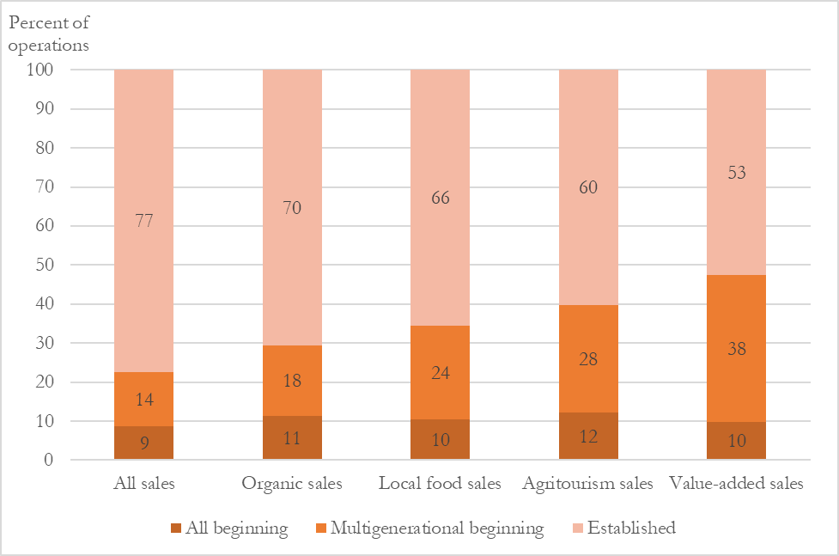
Nationally, local food markets are used by beginning operations (new and multigenerational)
Percent of operations with differentiated sales, 2022
Notes: All beginning (N = 443,426) = all operators having no more than 10 years of experience on any farm or ranch; any beginning (N = 186,690)= one or more but not all operators having no more than 10 years of experience on any farm or ranch; established (N = 1,270,371) = all operators having more than 10 years of experience on any farm or ranch.
Source: USDA, Economic Research Service based on USDA, National Agricultural Statistics Service, Census of Agriculture, 2022.
Not for distribution or citation

Slide 25
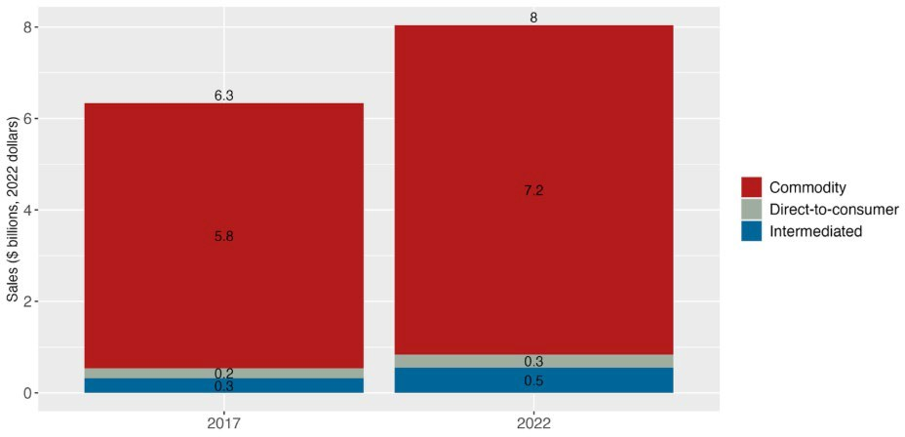
Ag sales through all market channels in New York, 2017 and 2022
In 2022 in New York, >10% of ALL ag sales were through local food markets
(note that this does not include agritourism revenue)
Source: U.S. Department of Agriculture, National Agricultural Statistics Service (USDA NASS), 2017 and 2022 Census of Agriculture public data.
Notes: Sales are presented in 2022 dollars using the gross domestic product implicit price deflator (Federal Reserve Bank of St. Louis). Direct-to-consumer sales include sales through farmers markets, on-farm stores or farm stands, roadside stands or stores, CSA, etc.
Intermediated sales include sales to retail markets (supermarkets, restaurants, grocery stores, caterers, etc.), institutions (k-12 schools, colleges or universities, hospitals, workplace cafeterias, prisons, food banks, etc.), and intermediate markets (businesses in the middle of the supply chain marketing locally or regionally branded products such as distributors, food hubs, brokers, auction houses, wholesale and terminal markets, food processors, etc.). Commodity sales are all other sales, as reported in the Census as market value of agricultural products sold.

Slide 26
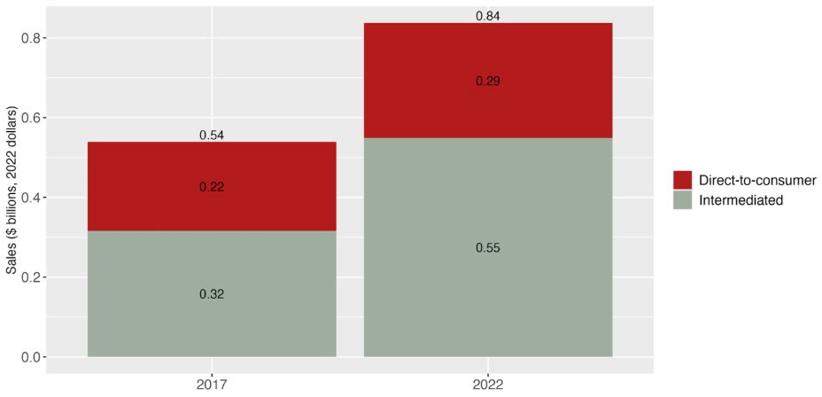
Sales through local food markets in New York by market channel, 2017 and 2022
Most local food market growth in NYS (2017-2022)
was through
intermediated markets: 72% growth!
Source: U.S. Department of Agriculture, National Agricultural Statistics Service (USDA NASS), 2017 and 2022 Census of Agriculture public data
Notes: Direct-to-consumer sales include sales through farmers markets, on-farm stores or farm stands, roadside stands or stores, CSA, etc. Intermediated sales include sales to retail markets (supermarkets, restaurants, grocery stores, caterers, etc.), institutions (k-12 schools, colleges or universities, hospitals, workplace cafeterias, prisons, food banks, etc.), and intermediate markets (businesses in the middle of the supply chain marketing locally or regionally branded products such as distributors, food hubs, brokers, auction houses, wholesale and terminal markets, food processors, etc.).

Slide 27
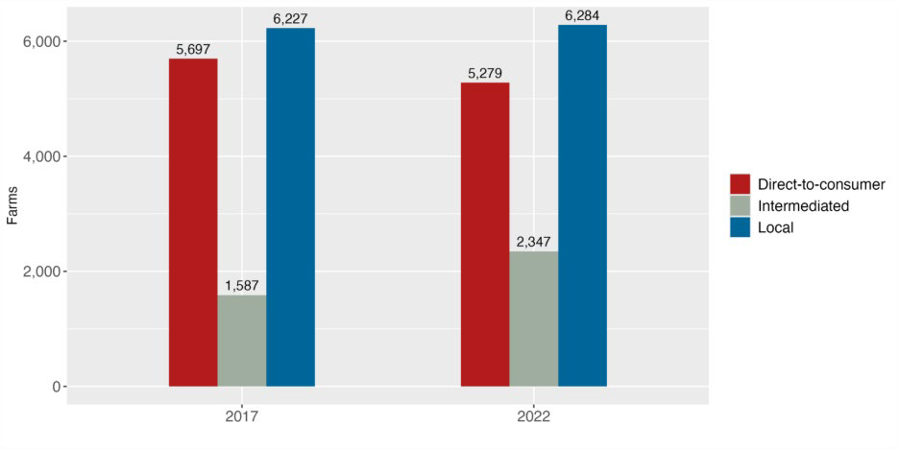
Farms with sales through local food markets in New York by market channel, 2017 and 2022
In 2022, in New York, most local food farms sell through direct-to-consumer markets, but the number declined
Source: U.S. Department of Agriculture, National Agricultural Statistics Service (USDA NASS), 2017 and 2022 Census of Agriculture, public and restricted access data compiled by the author.
Notes: Categories are not exclusive, if a farm sells through both direct-to-consumer and intermediated market channels it will be counted in each. Total number of farms selling through local food market channels is not reported in the public Census of Agriculture data, those data are reported using the restricted access data. Direct-to-consumer sales include sales through farmers markets, on-farm stores or farm stands, roadside stands or stores, CSA, etc. Intermediated sales include sales to retail markets (supermarkets, restaurants, grocery stores, caterers, etc.), institutions (k-12 schools, colleges or universities, hospitals, workplace cafeterias, prisons, food banks, etc.), and intermediate markets (businesses in the middle of the supply chain marketing locally or regionally branded products such as distributors, food hubs, brokers, auction houses, wholesale and terminal markets, food processors, etc.).

Slide 28
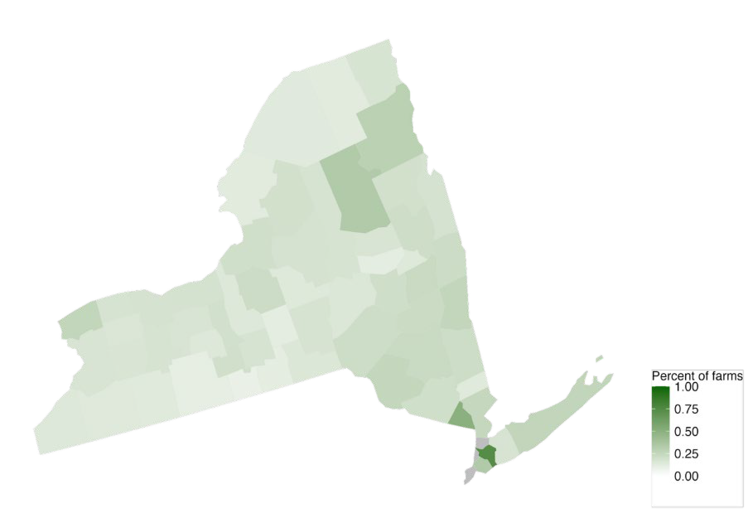
Share of farms using direct-to-consumer sales channels distributed across NYS
Percent of farms with sales through direct-to-consumer market channels in New York by county, 2022.
Source: U.S. Department of Agriculture, National Agricultural Statistics Service (USDA NASS), 2022 Census of Agriculture, public data.
Notes: We do not have number of farms selling through local food channels at the county-level, it is only available publicly as farms with sales through direct-to-consumer market channels and through intermediated market channel. Because these are not exclusive categories, we would double count if we add them. Direct-to-consumer sales include sales through farmers markets, on-farm stores or farm stands, roadside stands or stores, CSA, etc. Grey counties indicate data was not disclosed.

Slide 29

Farms proximate to NYC and Adirondacks more likely to use intermediated channels
Percent of farms with sales through
intermediated market channels in New York by county, 2022
Source: U.S. Department of Agriculture, National Agricultural Statistics Service (USDA NASS), 2022 Census of Agriculture, public data.
Notes: We do not have number of farms selling through local food channels at the county-level, it is
only available publicly as farms with sales through direct-to-consumer market channels and through
intermediated market channel. Because these are not exclusive categories, we would double count if
we add them. Intermediated sales include sales to retail markets (supermarkets, restaurants, grocery
stores, caterers, etc.), institutions (k-12 schools, colleges or universities, hospitals, workplace
cafeterias, prisons, food banks, etc.), and intermediate markets (businesses in the middle of the supply
chain marketing locally or regionally branded products such as distributors, food hubs, brokers, auction
houses, wholesale and terminal markets, food processors, etc.). Grey counties indicate data was not disclosed.

Slide 30
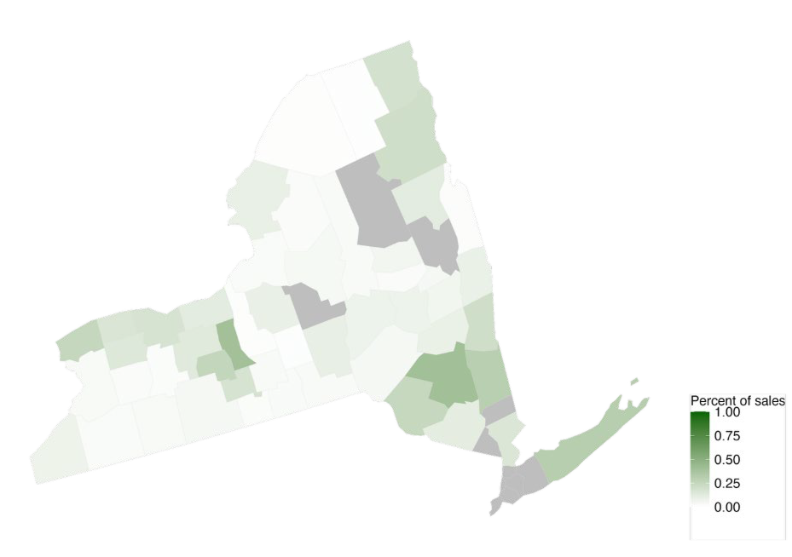
Some counties highly dependent on local sales as measured by share of total ag sales
Local sales as a percent of total sales in New York by county, 2022
Source: U.S. Department of Agriculture, National Agricultural Statistics Service (USDA NASS), 2022 Census of Agriculture, public data
Notes: Direct-to-consumer sales include sales through farmers markets, on-farm stores or farm stands, roadside stands or stores, CSA, etc. Intermediated sales include sales to retail markets (supermarkets, restaurants, grocery stores, caterers, etc.), institutions (k-12 schools, colleges or universities, hospitals, workplace cafeterias, prisons, food banks, etc.), and intermediate markets (businesses in the middle of the supply chain marketing locally or regionally branded products such as distributors, food hubs, brokers, auction houses, wholesale and terminal markets, food processors, etc.). Grey counties indicate data was not disclosed.

Slide 31
Agritourism in NYS
2017
826 farms
$36.85M
2022
947 farms
$55.52M

Slide 32
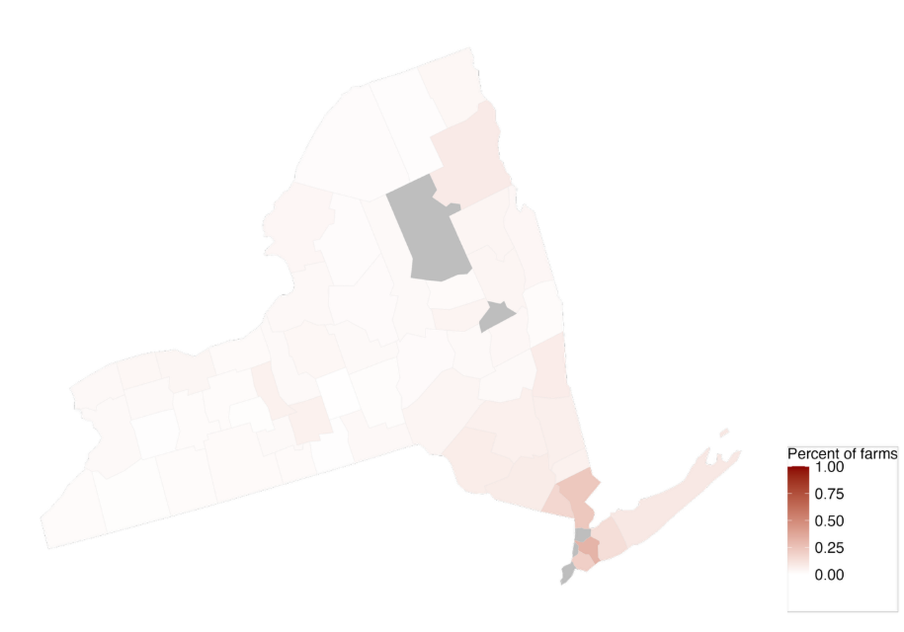
Farms proximate to NYC more likely to have agritourism income
Percent of farms with agritourism income in New York by county, 2022
Source: U.S. Department of Agriculture, National Agricultural Statistics Service (USDA NASS), 2022 Census of Agriculture, public data.
Notes: Agritourism includes recreational services such as farm tours, hay rides, hunting, fishing, etc. Grey counties indicate data was not disclosed.

Slide 33
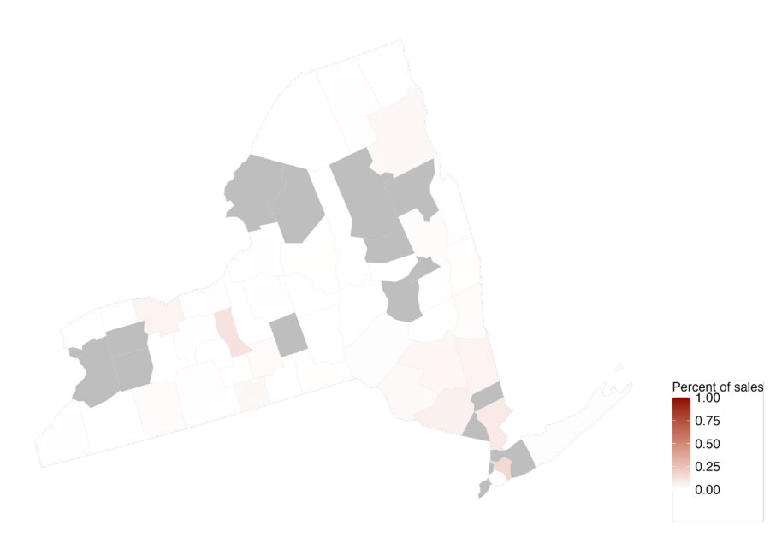
Agritourism income represents a relatively low share of total sales
Agritourism income as a percent of total sales in New York by county, 2022
Source: U.S. Department of Agriculture, National Agricultural Statistics Service (USDA NASS), 2022 Census of Agriculture, public data.
Notes: Agritourism includes recreational services such as farm tours, hay rides, hunting, fishing, etc. Grey counties indicate data was not disclosed.

Slide 34
“Local” Food Demand Related to NYS / NYC Priorities

Slide 35
30% New York State Initiative
92 SFAs have participated (in the last 7 years); 8.8% of SFAs.
They have collectively spent
>$35.8M on NY Food products.
Dairy is the largest component of the 30% reported expenditures.
https://harvestny.cce.cornell.edu/uploads/doc_262.pdf

Slide 36
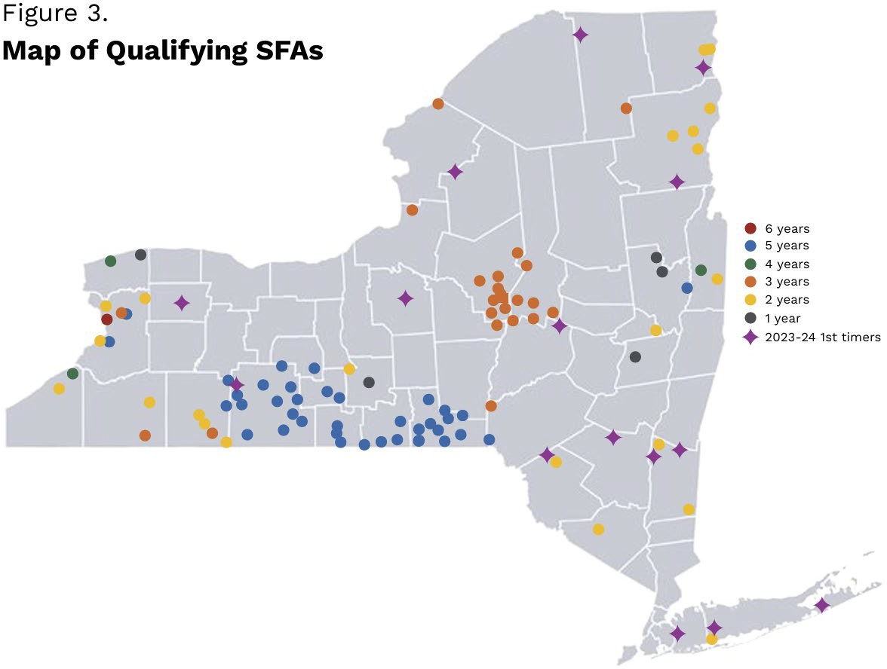
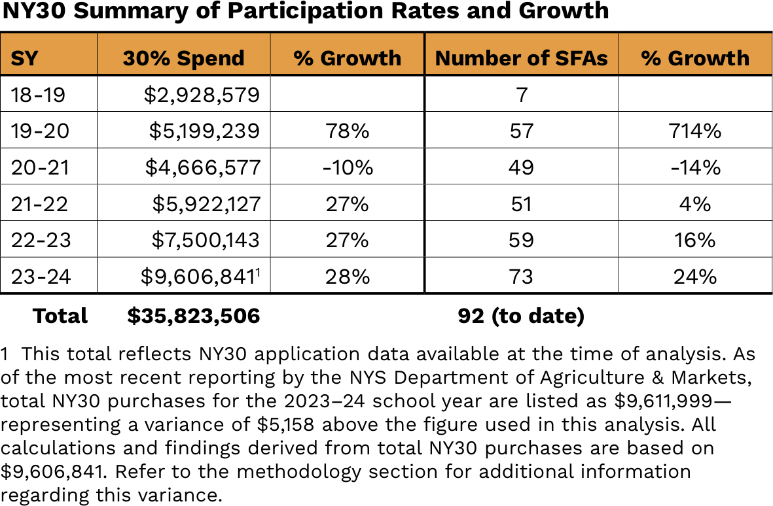
30% New York State Initiative
https://harvestny.cce.cornell.edu/uploads/doc_262.pdf

Slide 37
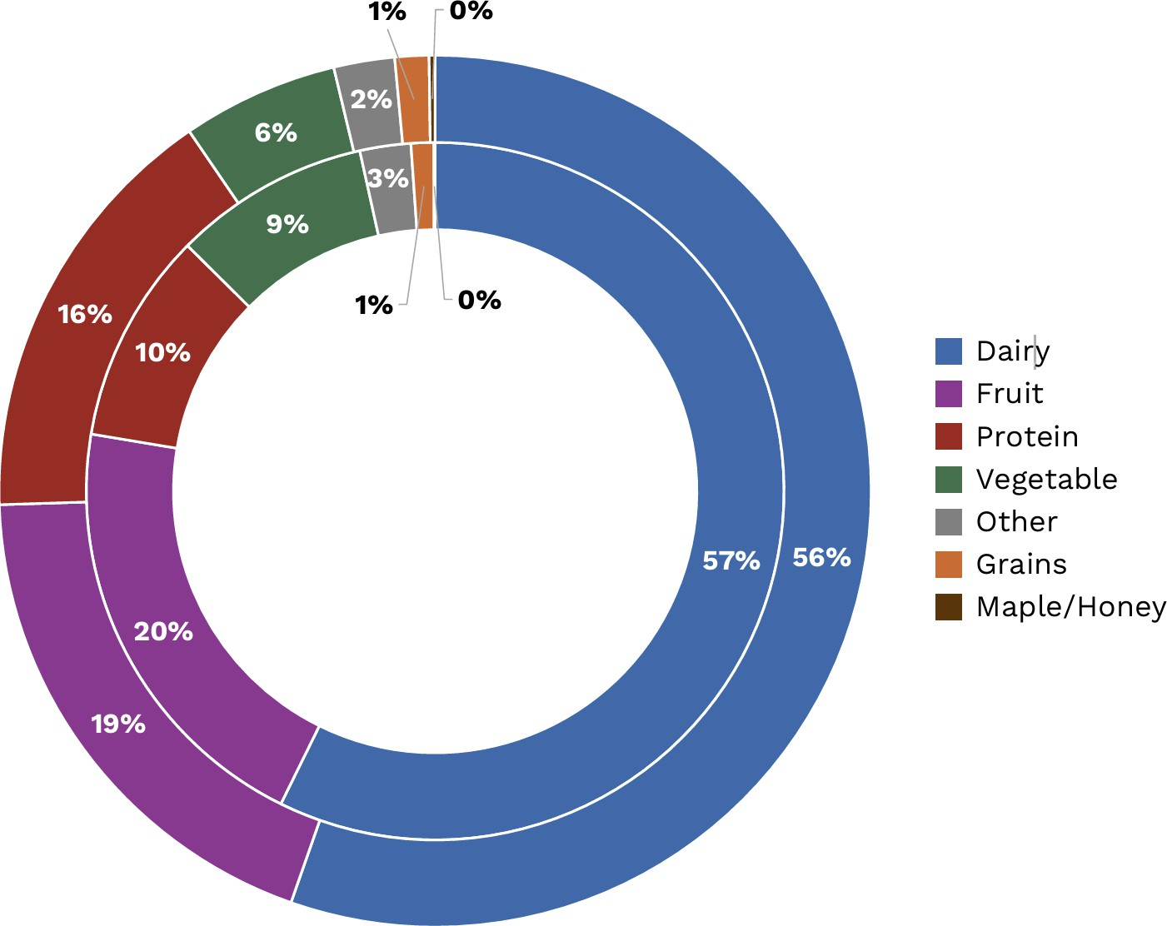
30% New York State Initiative
NY30 purchases by Food Industry Group (FIG) 2019-20 (inner, n=53) and 2023-24 (outer, N=73)
https://harvestny.cce.cornell.edu/uploads/doc_262.pdf

Slide 38
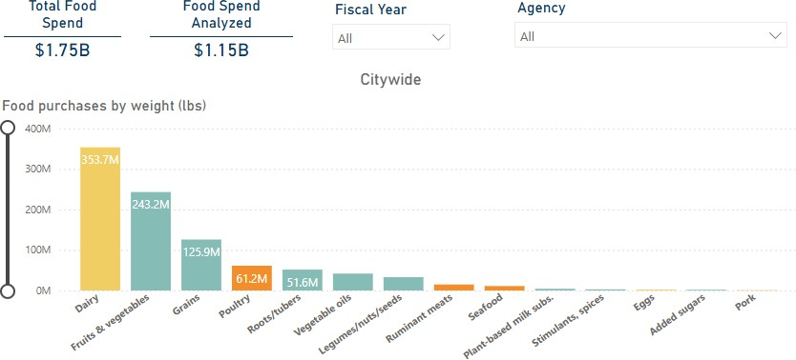
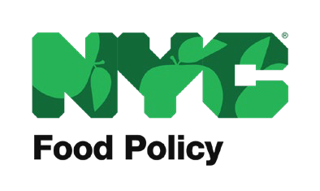
What food do NYC agencies buy?
2019-2023
https://www.nyc.gov/site/foodpolicy/good-food-purchasing/citywidedata.page

Slide 39
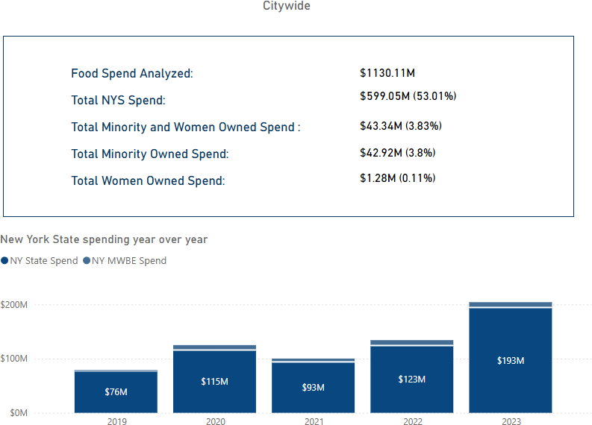
What food do NYC agencies buy?
2019-2023
The fine print:
NY State Spend is the total food spend on items that were either grown, processed, manufactured, or distributed by business enterprises located in NYS. NY MWBE Spend is the total food spend on items from NYC/NYS businesses that have M/WBE certifications as well as those that self-identify as minority- or women-owned.
https://www.nyc.gov/site/foodpolicy/good-food-purchasing/citywidedata.page

Slide 40
What do we know about farm impacts of selling through these markets?

Slide 41
Across all sales classes under $1M, local food sales associated with likelihood of survival
5-year survival rates (2017-2022) for operations with and without local food sales
Gross cash farm income in 2017 | Local sales in 2017 | No local sales in 2017
$0 to $74,999 | 0.546*** | 0.495
$75,000 to $349,999 | 0.637*** | 0.578
$350,000 to $999,999 | 0.672*** | 0.637
$1,000,000 or more | 0.732 | 0.738
Note: Statistics include weighted average survival rate across market channels.
Asterisks indicate statistically significant differences when comparing survival rates for operations with local food sales compared to operations with no local sales, p-value<0.01***, <0.05**, <0.1*.
Source: USDA, National Agricultural Statistics Service, 2017 and 2022 Census of Agriculture, Census of Agriculture, calculated using the restricted access data and compiled by the author.
Not for distribution or citation

Slide 42
Differentiated sales (including local food sales) is associated with higher probability of survival from 2017-2022
Type of operation | % higher change of survival compared to operations without differentiated sales
Established | 7%
Multigenerational beginning | 5%
All beginning | 4%
Notes: Results from a probit regression with farm business survival (1/0) as the outcome. Analysis conducted as part of the USDA, Economic Research Service report on Beginning Farmer and Rancher Operations.
Source: USDA, Economic Research Service based on USDA, National Agricultural Statistics Service, Census of Agriculture, 2017
and 2022.
Not for distribution or citation

Slide 43
Comparing profitability: Operating profit margin, 2022
Across all small- and mid-scale classes (GCFI<$1M), local food producers have significantly higher OPMs compared to those operations without local food sales.
Source: USDA, National Agricultural Statistics Service, 2022 Census of Agriculture, Census of Agriculture, calculated using the restricted access data and compiled by the author.
Not for distribution or citation

Slide 44
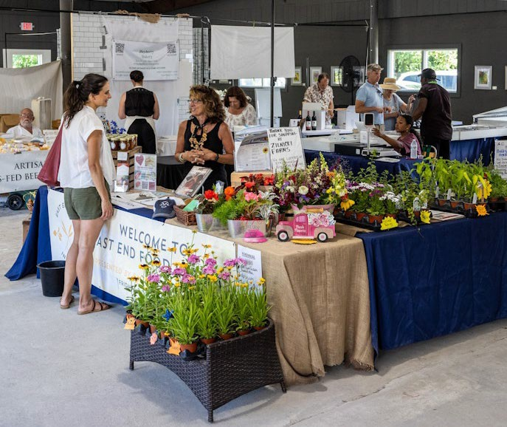
Importance of midscale infrastructure to support local food sales?
Resilient Food System Infrastructure (RFSI) Program:
“Provides funds for enhancing, growing and improving the mid-channel of the food supply chain.”
What’s the relationship between farm “success” and use of middle-of-the-supply chain infrastructure?
Photo credit: East End Food Hub https://www.eastendfood.org/food-hub

Slide 45
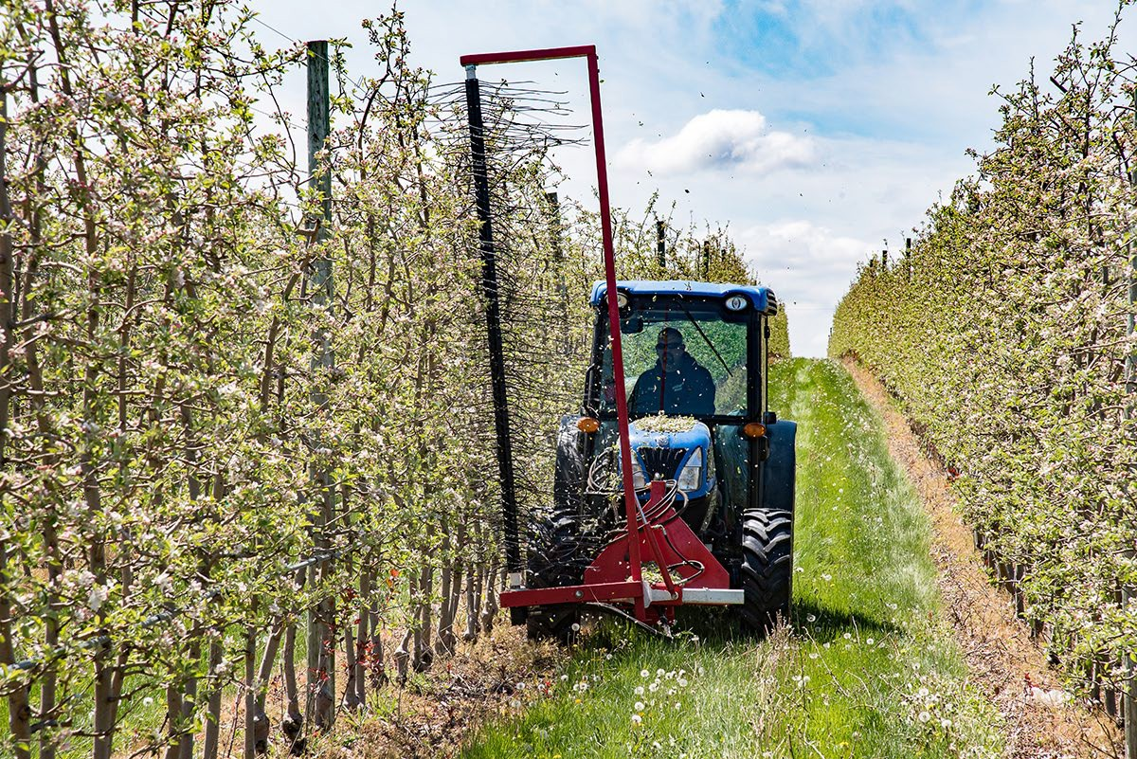
Results
Farms that Use Middle-of-the-Supply Chain Infrastructure

Slide 46
Results
Farms that Use Middle-of-the-Supply Chain Infrastructure
Key Takeaway: Overall, participation in intermediated markets and value-added sales was associated with higher survival rates for operations with GCFI < $1M.
Not for distribution or citation

Slide 47
Results: Survival Rates by Scale and Market Channel
Notes: Asterisks indicate statistically significant differences when comparing survival rates for operations with intermediated sales to operations without, p-value<0.01***,
<0.05**, <0.1*.
5-year survival rates
10-year survival rates
100%
100%
90%
77%
90%
80%
65%
75%
80%
70%*
70%
63%***
70%
63%***
65% _{63%}
Survival rate
60%
55%***
59%
Survival rate
60%
54%***
53%
50%
47%
50%
43%***
47%
40%
40%
33%
30%
30%
20%
20%
10%
10%
0%
0%
$0 to $74,999 $75,000 to $349,999
$350,000 to
$999,999
$1,000,000 or more
$0 to $74,999
$75,000 to $349,999
$350,000 to
$999,999
$1,000,000 or more
Intermediated sales No intermediated sales
Intermediated sales
No intermediated sales
Not for distribution or citation

Slide 48
Results: Survival Rates by Scale and Value-Added Sales
Notes: Asterisks indicate statistically significant differences when comparing survival rates for operations with intermediated sales to operations without, p-value<0.01***,
<0.05**, <0.1*.
5-year survival rates 10-year survival rates
100%
100%
90%
83%*
90%
80%
77%
80%
_{69%} 66%
69%
70%
67%***
70%
63%
58%
62%***
Survival rate
60%
57%***
Survival rate
60%
54%***
54%
50%
47%
50%
44%***
47%
40%
40%
33%
30%
30%
20%
20%
10%
10%
0%
0%
$0 to $74,999 $75,000 to $349,999
$350,000 to
$999,999
$1,000,000 or more
$0 to $74,999
$75,000 to $349,999
$350,000 to
$999,999
$1,000,000 or more
Value-added sales No value-added sales
Value-added sales
No value-added sales
Not for distribution or citation

Slide 49
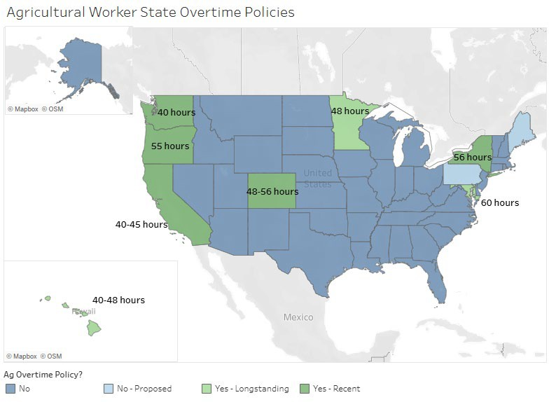
One note of caution…Labor
Labor expenditures as a % of total variable expense are
Now 52!
significantly higher for operations with local food sales. But, also have higher (on average) hourly wage rates.
As labor laws change, are local food operations more susceptible to negative impacts?
Source: Jablonski, B.B.R., A. Bauman, and D. Thilmany. 2021. Local food market orientation and labor intensity. Applied Economic Perspectives and Policy 43(3): 916-934.
Source: Hill (2024) www.alexandraehill.com/projects/3024

Slide 50
What are the opportunities in 2026?
Intermediated markets appear to be an opportunity not just to grow local sales, but potentially to also support commodity growers
Opportunities in agritourism, but labor is a concern
Pair market growth (demand-side investments) with workforce and business support

Slide 51
Thank you! Questions?
Becca Jablonski
Dyson School of Applied Economics and Management Cornell University
437 Warren Hall | Ithaca, NY
rb223@cornell.edu

