Slide 1

The Grape, and Wine Situation and Outlook 2026 and Research Update
Miguel I. Gómez, Allan F. Pinto, Bignyan Dai, Valeria Lavagi
Dyson School of Applied Economics and Management
Cornell University
Cornell Agribusiness Economic Outlook Conference
Ithaca, January 12, 2026

Slide 2
US Wine Industry –Lessons from 2025
IMPACT OF TRADE POLICIES
CLIMATE CHANGE CHALLENGES
SHIFT IN CONSUMER PREFERENCES
Economic pressures AND INFLATION
ADVANCEMENTS IN SUSTAINABLE PRACTICES
Notes:
Impact of the Second Trump Term on Trade
The reelection of Donald Trump introduced the new tariffs on European wine imports. This increased prices and decreased availability of imported wines in the U.S., while American wine exports faced retaliatory tariffs from the EU, reducing their competitiveness abroad. Domestic table wines still down, tariffs have not slowed imports
Climate Change Challenges
The wine industry continues to grapple with climate-related issues, including unpredictable weather patterns and natural disasters. These challenges affect grape production and quality, prompting producers to adopt more resilient and sustainable practices to mitigate the impact of climate change. SevenFifty Daily
Shifts in Consumer Preferences
There is a growing consumer interest in low-alcohol and non-alcoholic wines, driven by health consciousness and moderation trends. Producers are responding by innovating and expanding their offerings in the no- and low-alcohol (NOLO) category to meet this demand. SevenFifty Daily
Economic Pressures and Inflation
Inflation and economic uncertainties are influencing consumer spending habits, with a tendency towards more affordable wine options. This shift pressures producers and retailers to balance quality with price competitiveness to attract cost-conscious consumers. SevenFifty Daily
Advancements in Sustainable Practices
The industry is increasingly focusing on sustainability, with a rise in organic and biodynamic wine production. Consumers are more environmentally conscious, leading producers to adopt eco-friendly practices and certifications to appeal to this market segment. SevenFifty Daily
These trends highlight the dynamic nature
Consolidation remains a driving force in wholesale

Slide 3
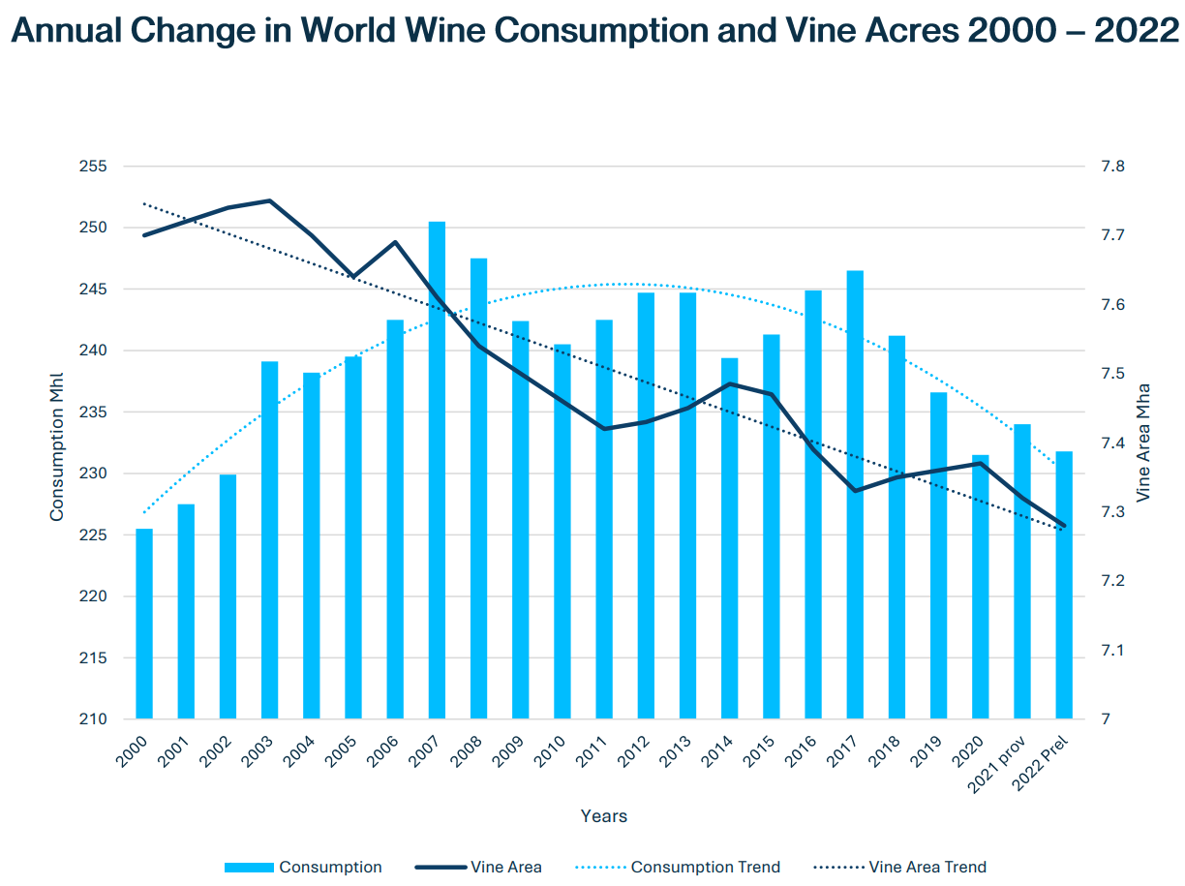
Source: State of Wine Industry Report 2024
Notes:
Global wine consumption has been on a decline since 2014, with only a brief pause in 2020, and vineyards are being reduced worldwide, while the anticipated boost from Chinese consumption has fallen due to a long-term decline following a crackdown on wealth display, leading to speculation about India as the next potential market.
The unit on Y axis (left side) is million hectoliter, a hectolitre (hL or hl) is volume measure and a metric unit equal to 100 litres

Slide 4
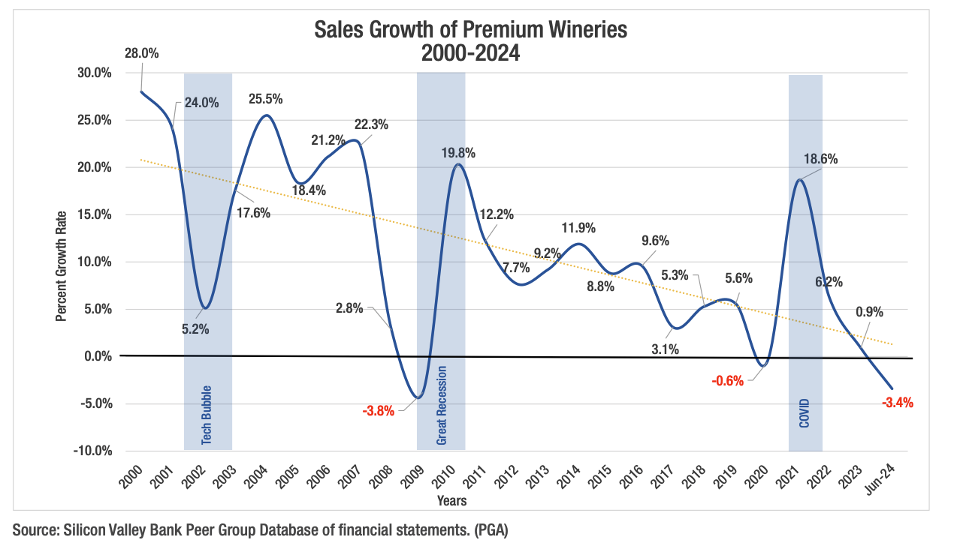
Notes:
Over the past several years, as industry sales have flagged, the data confirms that larger wine companies and growers producing lower-priced wine are having to work overtime. The small producer seemed somewhat insulated in the past, but that is changing.
Averages are, at times, misleading. To that point, the top quartile of premium wineries experienced an average of 22% revenue growth in 2024, while the bottom quartile experienced a 16% revenue decline.

Slide 5
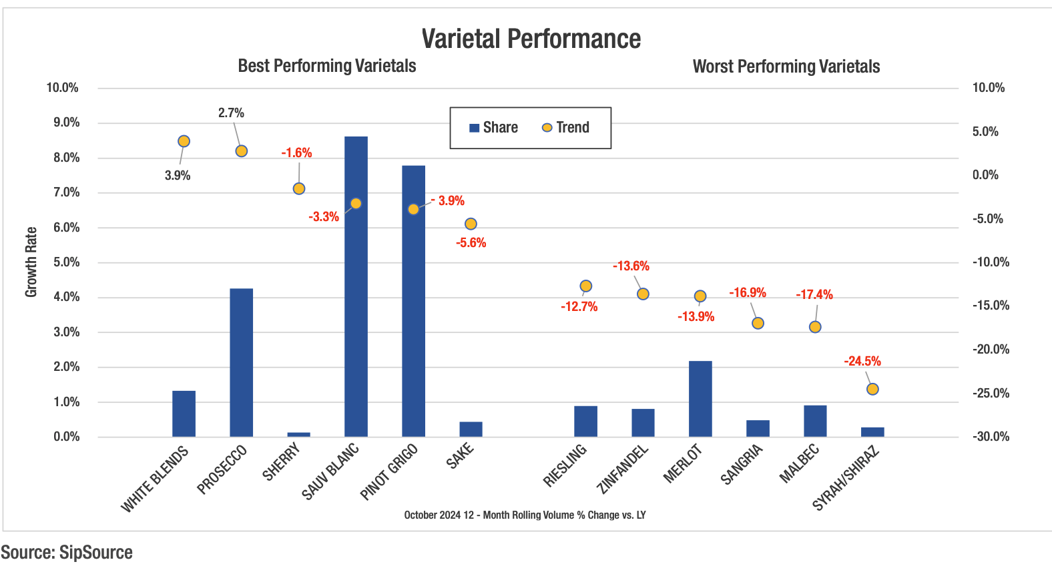
Notes:
Chart shows overall varietal depletions and share for on- and off-premise is largely negative. Some surprises are that white wine is now out-performing red-table wine. Prosecco, while slowing somewhat, is another positive growth story. Sauvignon blanc and pinot grigio are relatively better performers versus other wine varietals.
Of note is the lack of traditionally good performing varietals such as cabernet, chardonnay and pinot noir. Those varietals still occupy 30% of market share.
What do the better performing varietals by growth rate have in common? They are less expensive compared to many other varietals, easier to drink for entry-level consumers, and while the range is wide, white wine can carry lower alcohol than red wine.
Because prosecco can be viewed as a celebratory drink, it represents fun and is value-priced per serving, making it another potential entrance point for younger consumers who fueled the flavored sparkling water craze.

Slide 6
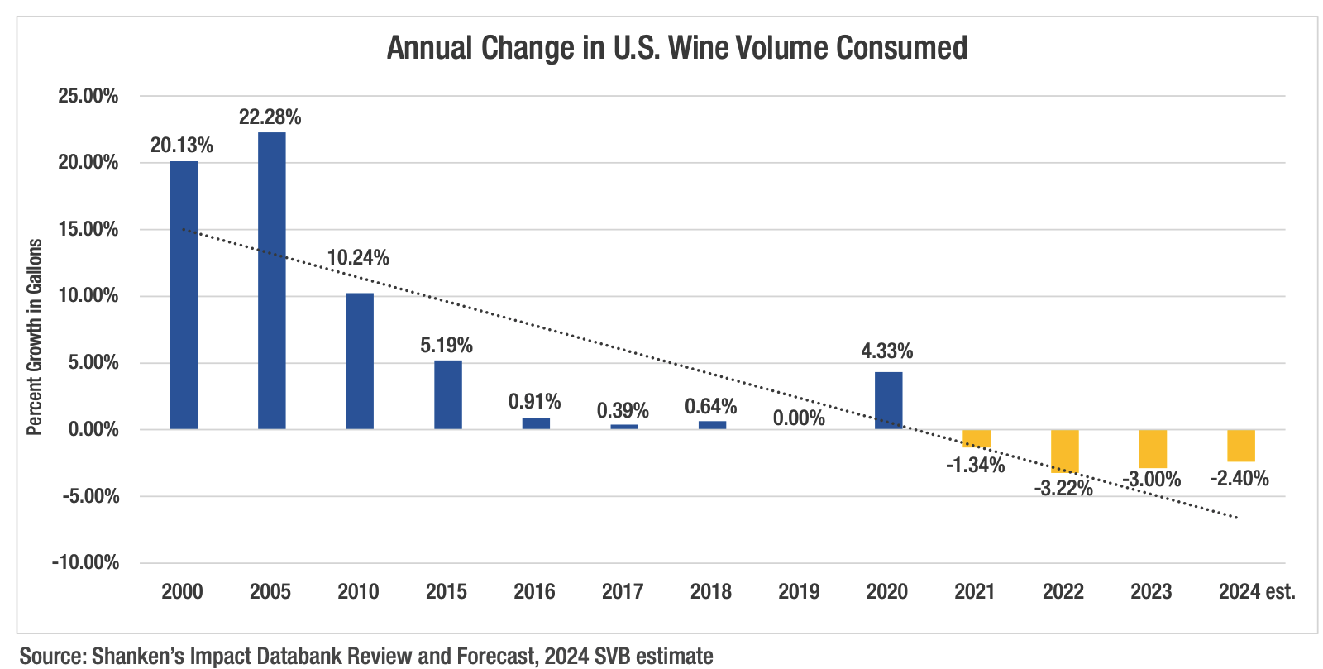
US wine sales declines
Notes:
According to Shanken, 2024 will mark the fourth year of negative volume growth for the wine category and the second time that the spirits market will surpass the wine market in total volume sales. In the US, full-category sales growth is declining and is forecasted to decline further by volume, according to almost every data source.
The post-COVID decline in wine and spirits consumption appears to be accelerating. More troubling for the beverage industry is that premium-priced products, once a sales driver, are underperforming overall sales. Moreover, the latest data from the Wine and Spirits Wholesalers of America (WSWA) indicated that the current trends will likely continue for the foreseeable future.

Slide 7
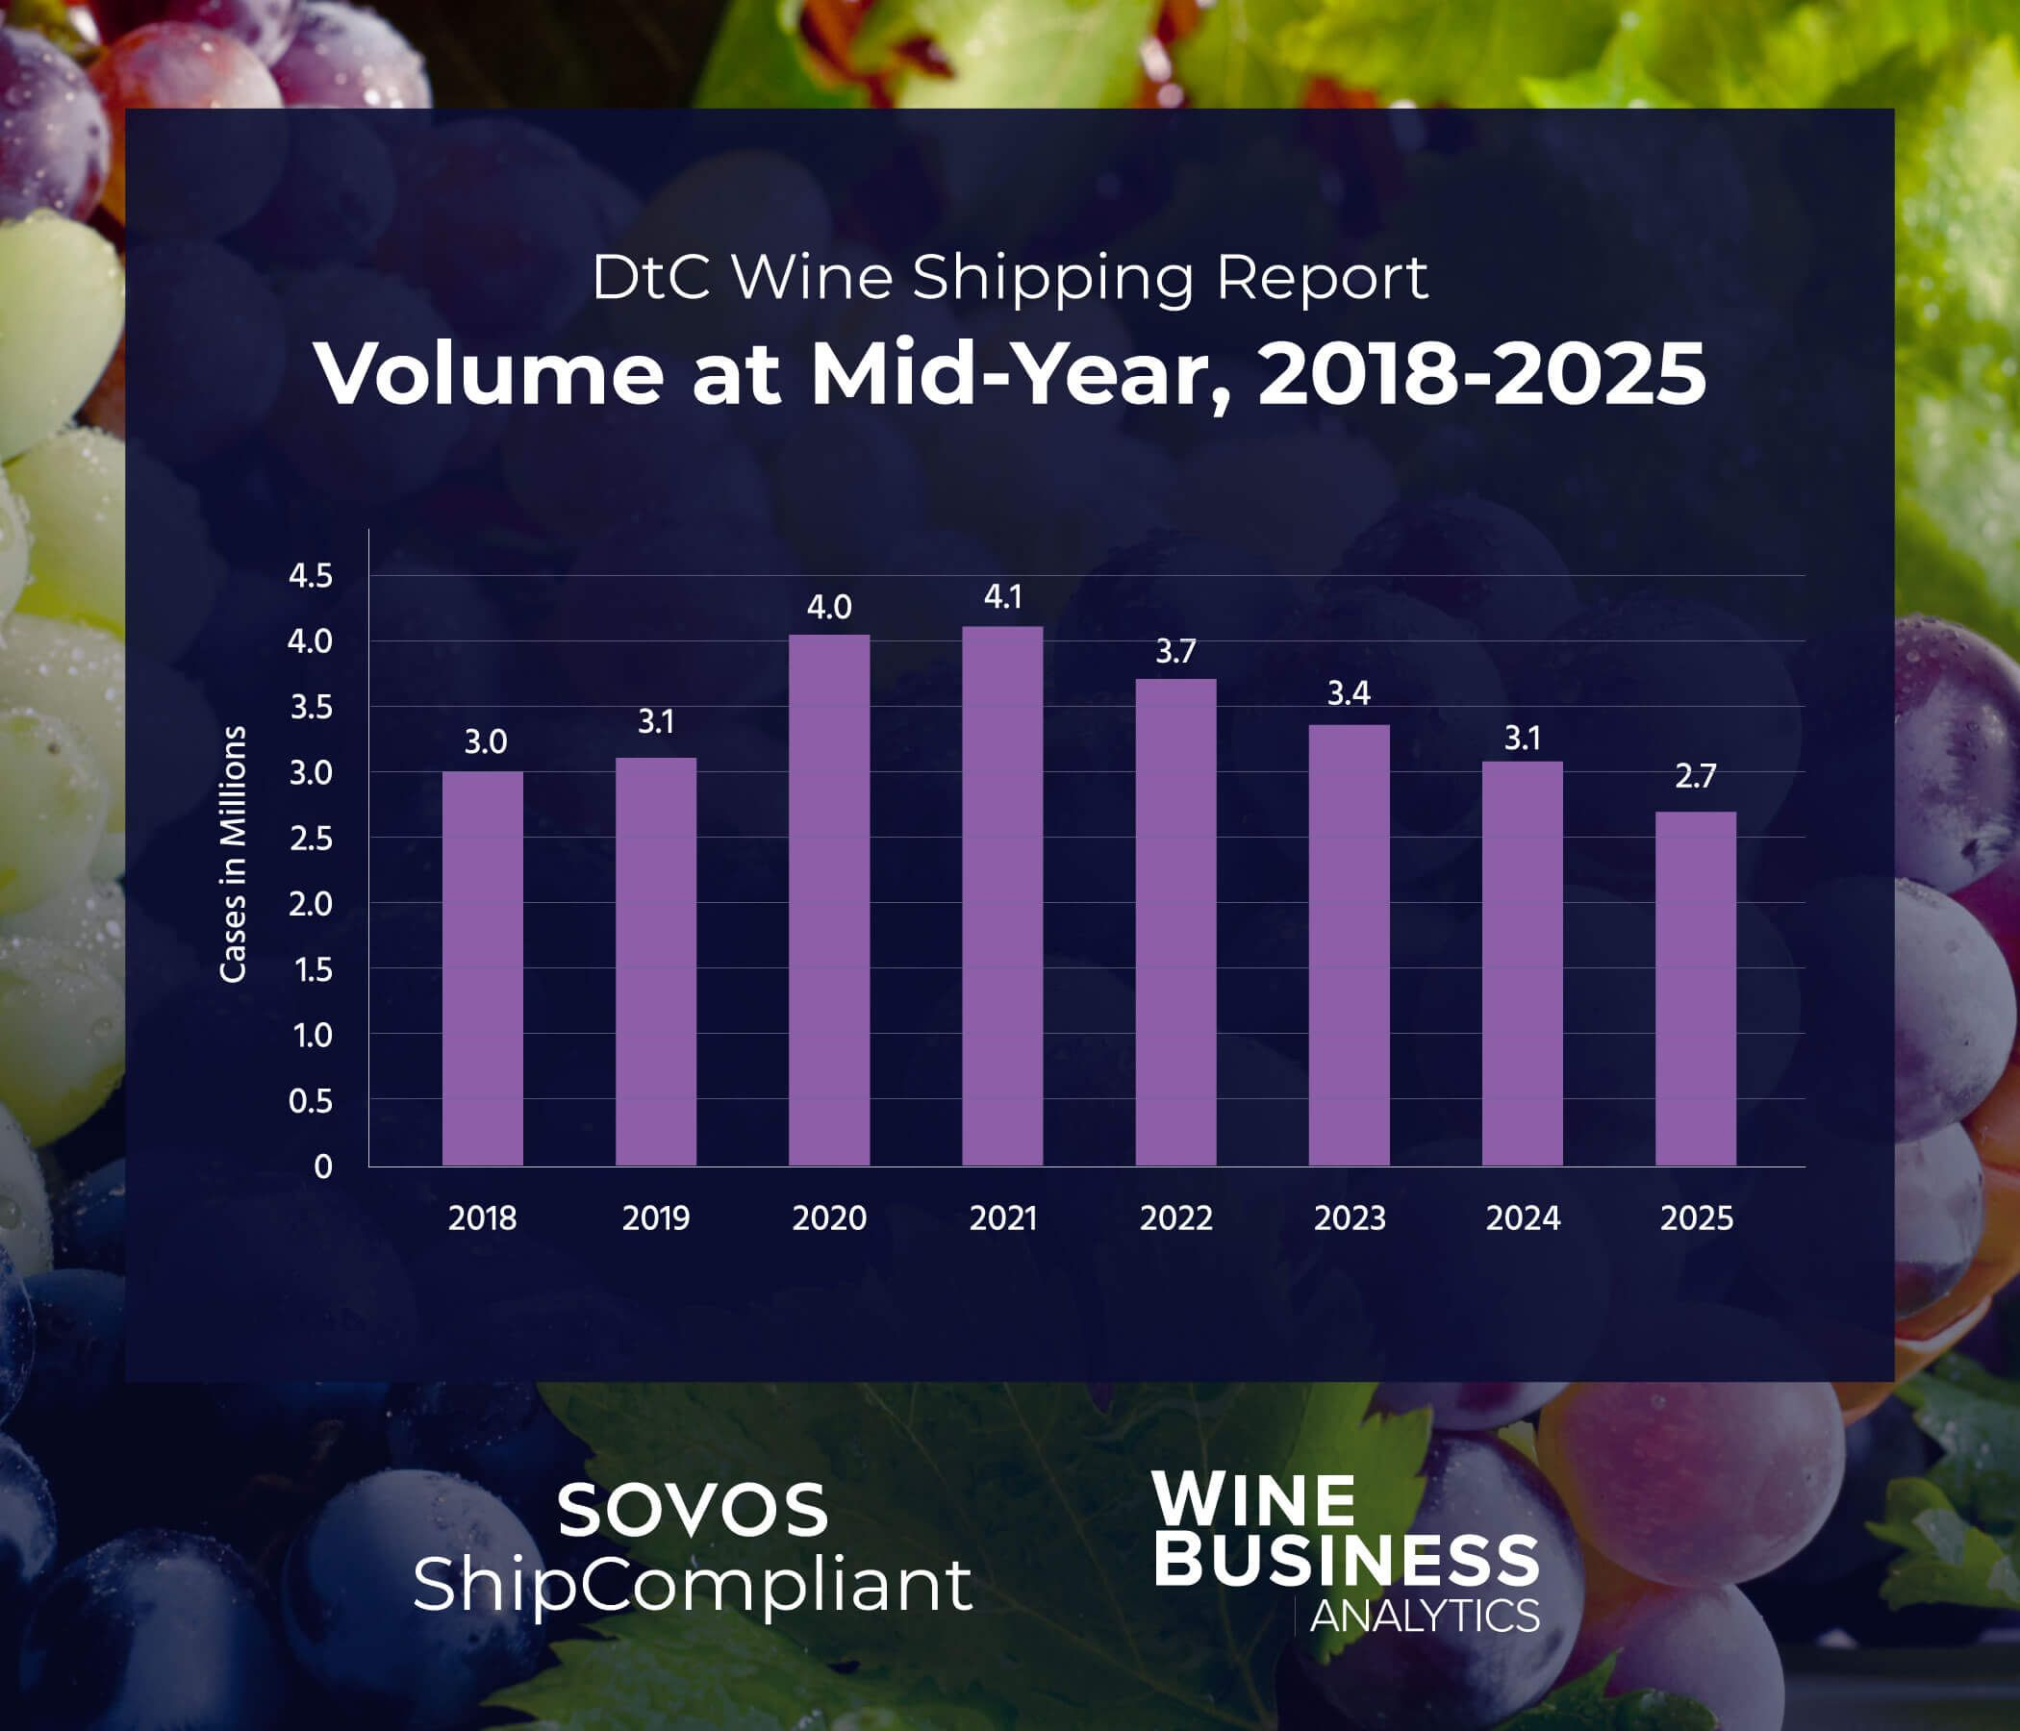
Source: https://sovos.com/blog/ship/2025-direct-to-consumer-wine-shipping-mid-year-report/
Notes:
The latest data for the U.S. wine DtC shipping market shows that market value and volume have continued the downward trend seen since 2022. Nationwide, shipment volume has declined by 12% for the January-June 2025 period, amounting to 2.7 million cases sold, while the overall value of these shipments has decreased by 6%, totaling $1.7 billion.

Slide 8
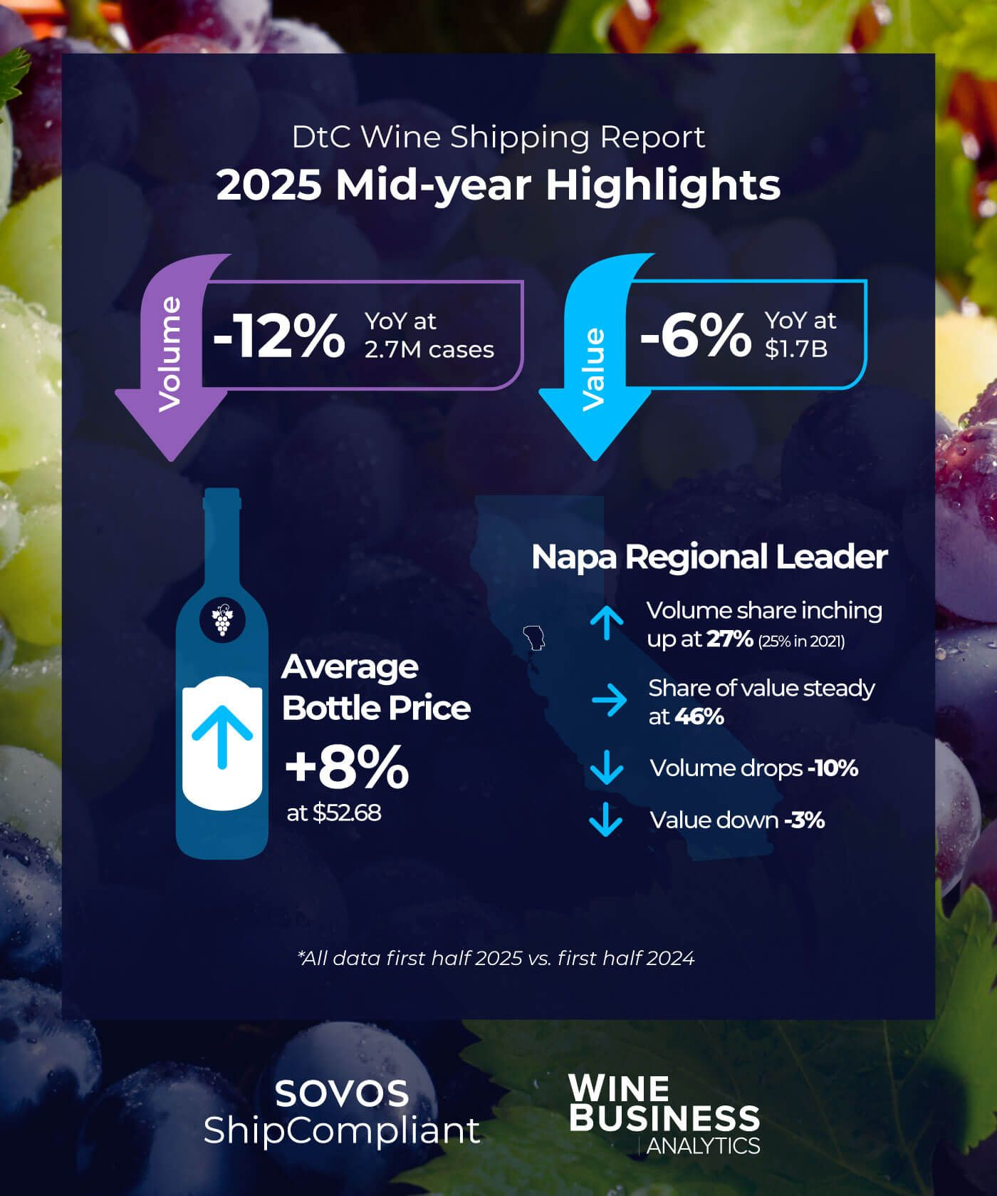
Notes:
The average price of a bottle shipped DtC has climbed to $52.68, an 8% year-over-year increase. Notably, the average price per bottle has increased by $14.38 since 2018, which is a 38% growth, outpacing the Consumer Price Index inflation.
This year’s rise is largely propelled by significant gains in several key regions. Notably, the Rest of California* segment experienced the largest percent change, up 14% to $32.12. Sonoma also posted a substantial increase, with its average bottle price climbing 9% to $37.96. Meanwhile, Napa continues to be the outlier, maintaining its position as the most expensive region, with its average bottle price nearing the $100 mark at $92.29, up 8% from last year. Napa’s elevated pricing pulls the overall national average upward, as it is the only region consistently above the average benchmark. In contrast, Oregon was the sole region to report a decline in average bottle price at the mid-year, dropping 3% to $49.43.

Slide 9
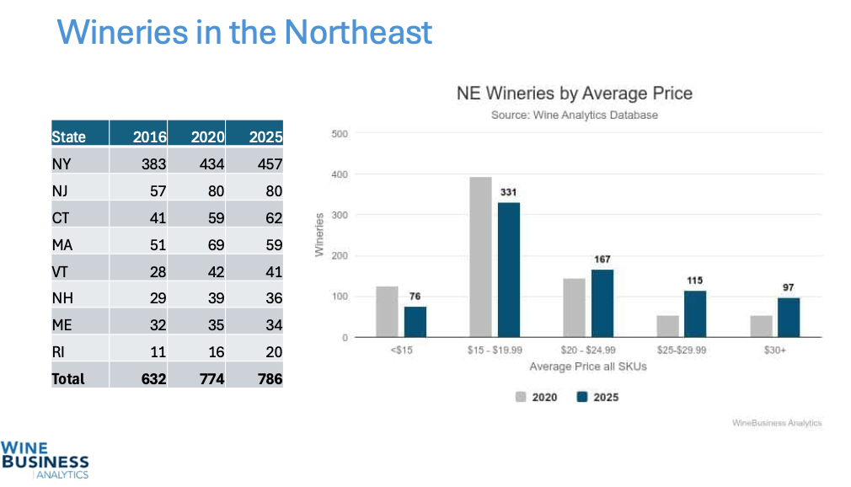

Slide 10
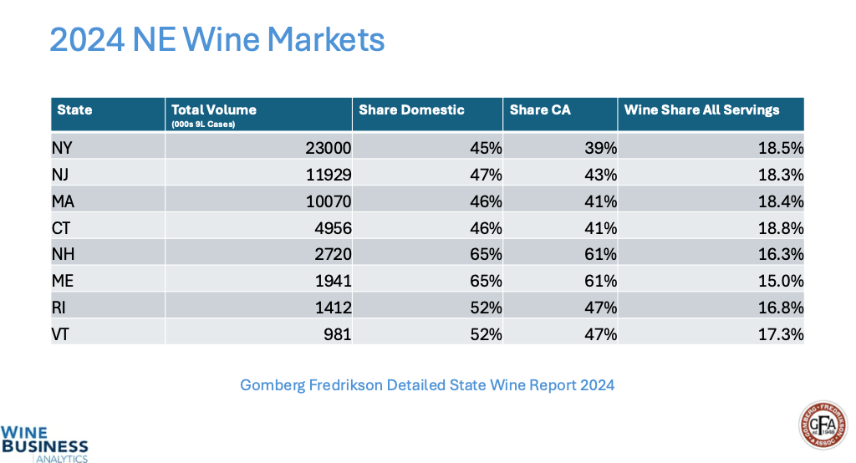

Slide 11
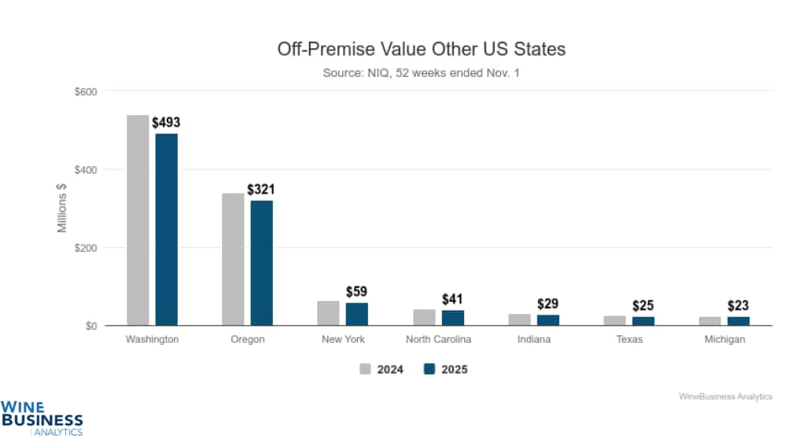

Slide 12
Outlook-Wine Industry 2026
Continued Premiumization & Quality Focus
Authenticity & Sustainability as Market Drivers
Greater Interest in Unique & Emerging Styles/Regions
Moderation & Low-Alcohol Innovation
Adaptation to Economic & Consumer Behavior Shifts
https://daily.sevenfifty.com/5-wine-industry-trends-to-watch-in-2025/
Notes:
Continued Premiumization & Quality Focus Wine consumers are increasingly opting to drink less but better, choosing higher-quality, terroir-driven, and story-rich wines over simple volume. This emphasis on quality over quantity is shaping both production and marketing strategies. Better Homes & Gardens
Authenticity & Sustainability as Market Drivers Buyers care more than ever about where and how wine is made — including eco-friendly practices, environmental footprint, and authentic narratives from producers. Sustainability (organic, biodynamic, regenerative) continues to be a major demand force. Better Homes & Gardens
Greater Interest in Unique & Emerging Styles/Regions Consumers and sommeliers are exploring beyond traditional classics, showing strong interest in emerging wine regions and lesser-known varietals that offer distinctive experiences. Examples include Mediterranean whites and underdog reds gaining traction. Better Homes & Gardens
Moderation & Low-Alcohol Innovation The trend toward mindful consumption continues: more no-/low-alcohol wines, lighter styles, and moderate ABV options are entering portfolios to meet health-conscious buyers where they are. Better Homes & Gardens
Adaptation to Economic & Consumer Behavior Shifts Broader macroeconomic pressures — cost sensitivity, inflation, and evolving spending habits — are influencing how producers price, position, and distribute their wines, balancing accessibility with quality. facebook.com
TL;DR for 2026 trends: • Drink better, not more — premium and distinctive wines win out. • Sustainability and authenticity aren’t just buzzwords; they shape purchasing decisions. • New lights — fresh grape varieties, regions, and styles are gaining ground. • Mindful consumption continues (low/alcohol alternatives). • Economic realities keep producers agile.

Slide 13
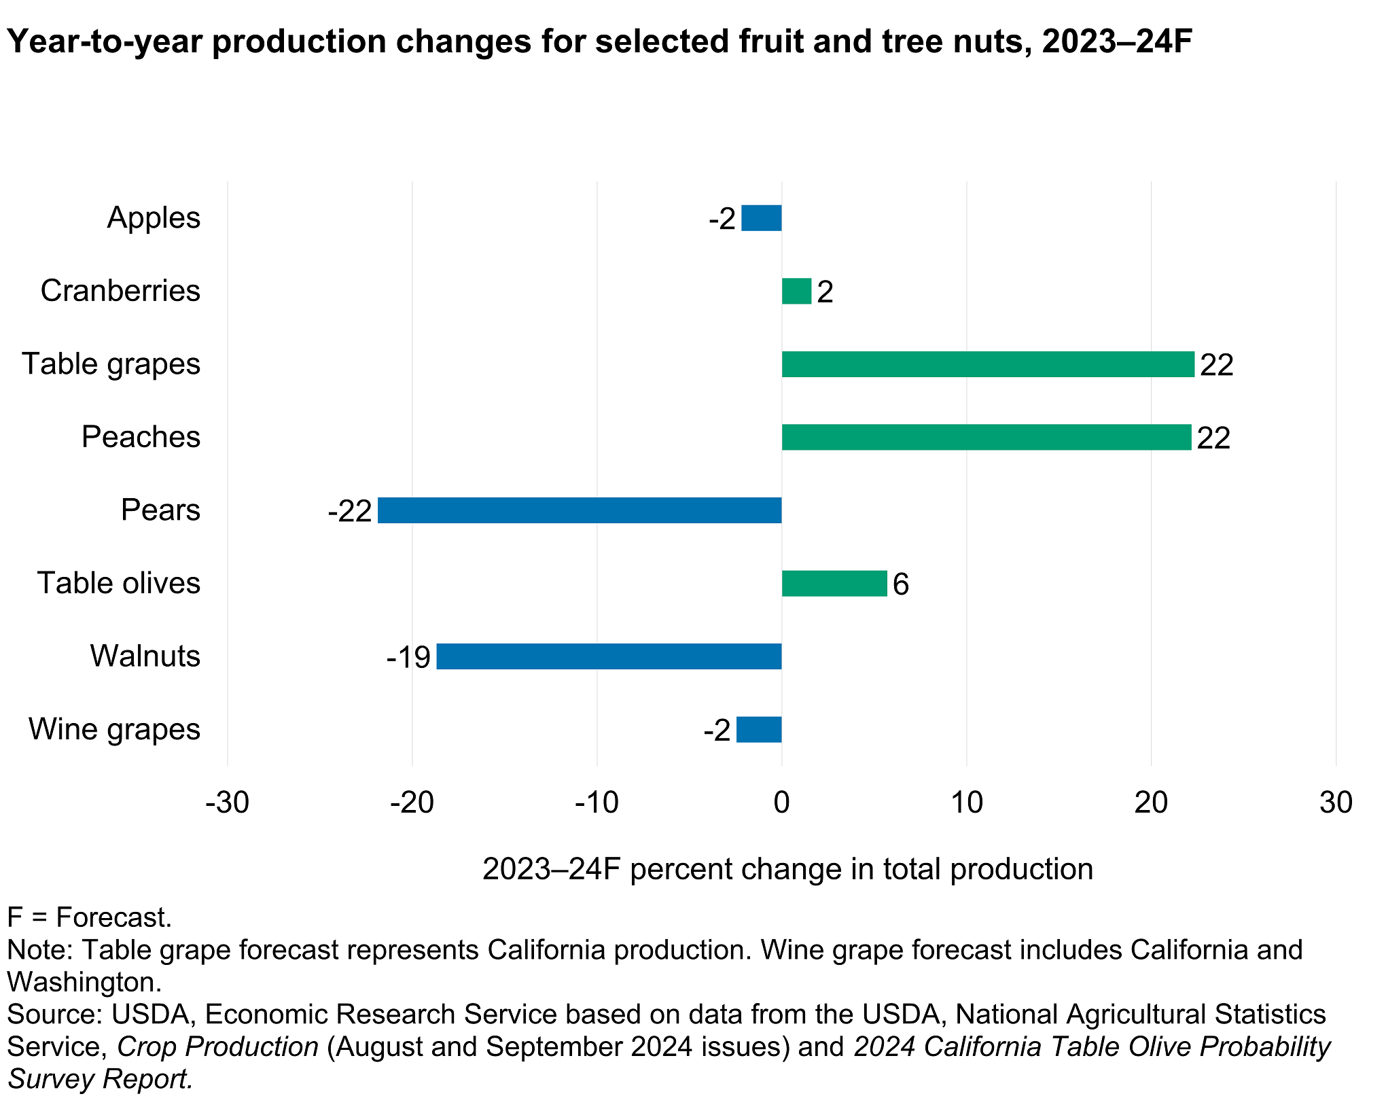
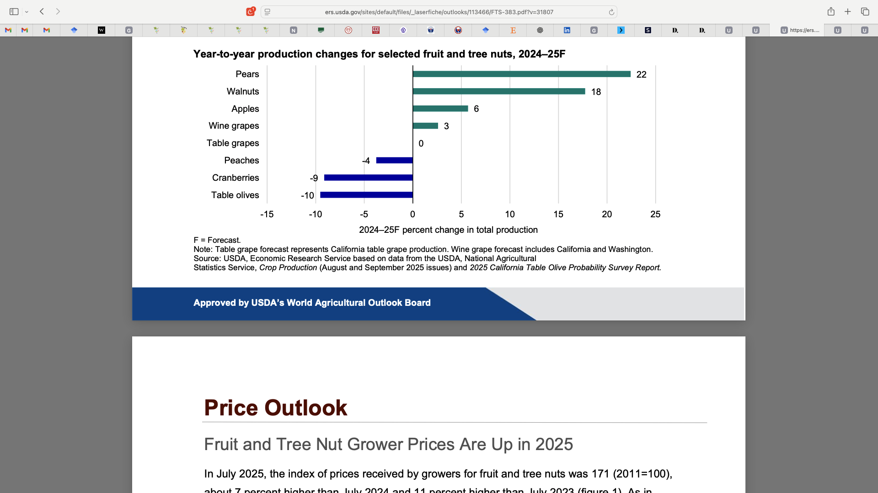
US Grapes Growing situation and outlook
Source: https://www.ers.usda.gov/topics/crops/fruit-and-tree-nuts/market-outlook

Slide 14
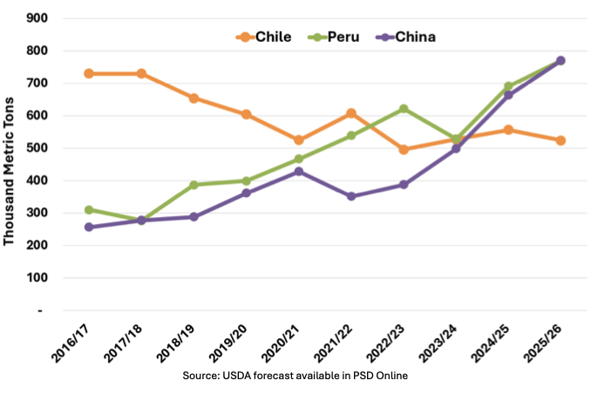
US Table Grapes export situation and outlook
Source: https://apps.fas.usda.gov/psdonline/circulars/fruit.pdf
Notes:
U.S. production is projected up nearly 200,000 tons in 2023 to 845,000 in 2024 as California makes a full recovery from last year’s damage from Hurricane Hilary. NASS surveyed industry and published a U.S. forecast for table grapes production in the August 2024 Crop Production report. Higher supplies are expected to push exports up 35 percent to 245,000 tons.
Imports are forecast down more than 30,000 tons to 760,000 on greater domestic production, but the United States is expected to remain the top table grape importer. In July 2024, USDA approved three regions in Chile to export table grapes to the United States via a systems approach instead of methyl bromide fumigation which should allow higher quality grapes to reach the U.S. market.
China table grape exports are forecast to grow 16 percent in marketing year 2025/26 (June 2025 – May 2026) to 770,000 metric tons (tons). If realized, China would match Peru as the top table grape exporter for the first time after surpassing Chile last year.

Slide 15
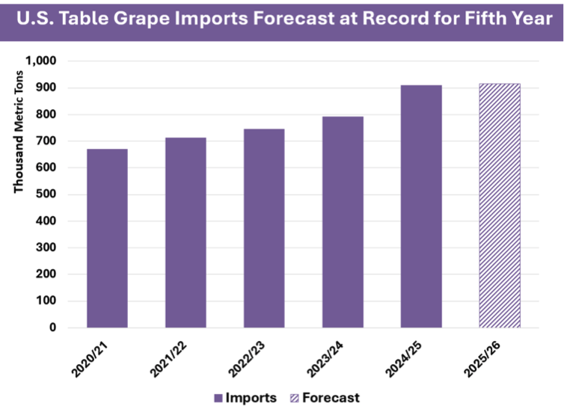
US Table Grapes import situation and outlook
Notes:
Global fresh table grape exports are forecast up slightly to 4.2 million tons as increased exports from top exporters China and Peru more than offset reductions from Chile and Mexico. U.S. imports are forecast up slightly to 915,000 tons, topping last year’s record level of imports.

Slide 16
Research Update: Cost of Establishment and Production of V. Vinifera Grapes in the Finger Lakes

Slide 17
Assumptions
Variable | Value
Land | 54 acres / 13,750 $/acre
Vineyard Layout | 9 ft x 6 ft spacing / $4.25 per plant
Varieties | Pinot Noir, Cabernet Franc, Chardonnay, and Riesling
Wage rates | $24 per hour –skilled labor / $21.70 per hour – unskilled labor
Machinery | $301,360 / $6,027 per acre
Buildings | $82,500 / $1,650 per acre
Assets | $/acre
Land | $11,200
Machinery & equipment | $6,027
Buildings (shop & tool shed) | $1,650
Vineyard establishment and development | $29,969
Total Investment per acre | $48,845

Slide 18
Grapes Yield and Prices
Variety | Year 3 | Year 4+
Pinot Noir | 1 tons/acre | 2.6 tons/acre
Cabernet Franc | 1 tons/acre | 3.3 tons/acre
Chardonnay | 1 tons/acre | 4 tons/acre
Riesling | 1 tons/acre | 4 tons/acre
Year | Pinot Noir | Cabernet Franc | Chardonnay | Riesling
2019 | $ 1,816 | $ 1,492 | $ 1,377 | $ 1,505
2020 | $ 1,933 | $ 1,630 | $ 1,381 | $ 1,519
2021 | $ 1,960 | $ 1,684 | $ 1,410 | $ 1,580
2022 | $ 1,900 | $ 1,773 | $ 1,539 | $ 1,625
2023 | $ 2,100 | $ 1,875 | $ 1,719 | $ 1,756
2024 | $ 2,067 | $ 1,8678 | $ 1,650 | $ 1,669
Mean | $ 1,978 | $ 1,720 | $ 1,513 | $ 1,609
Prices Used | $ 2,100 | $ 1,875 | $1,719 | $ 1,756

Slide 19
Costs and Returns for a Vineyard
Item |  | Pinot Noir | Cab. Franc | Chardonnay | Riesling
Receipts:
Yield target, tons per acre |  | 2.6 | 3.3 | 4 | 4
Price, $ per ton |  | $2,100 | $1,875 | $1,719 | $1,756
Total receipts |  | $5,460 | $6,188 | $6,876 | $7,024
Costs:
Variable Costs:
 | Growing (incl. crop insurance @$109/Ac) | $3,002 | $3,002 | $3,002 | $3,002
 | Cluster removal (Cab. Franc and P. Noir) | $70 | $70 | $0 | $0
 | Interest on operating capital | $45 | $45 | $45 | $45
 | Machine Harvesting ($95/ton) | $247 | $314 | $380 | $380
 | Trucking ($30/ton) | $78 | $99 | $120 | $120
Total variable costs |  | $3,442 | $3,529 | $3,547 | $3,547
 | (Optional) Bird control - sound* | $30 | $0 | $0 | $0
Fixed Costs:
 | Vineyard capital recovery | $1,904 | $1,904 | $1,904 | $1,904
 | Machinery and equipment capital recovery | $661 | $661 | $661 | $661
 | Buildings capital recovery | $84 | $84 | $84 | $84
 | Property taxes | $259 | $259 | $259 | $259
 | Land opportunity cost | $311 | $311 | $311 | $311
 | Office supplies, phone, etc. | $60 | $60 | $60 | $60
 | Insurance | $77 | $77 | $77 | $77
 | Management | $273 | $309 | $344 | $351
Total fixed costs |  | $3,629 | $3,665 | $3,699 | $3,707
Total costs |  | $7,071 | $7,195 | $7,246 | $7,254
Profit or loss |  | -$1,611 | -$1,007 | -$370 | -$230
Breakeven price ($ /ton) |  | $2,719 | $2,180 | $1,812 | $1,813
Breakeven yield (tons) |  | 3.4 | 3.9 | 4.2 | 4.1

Slide 21
Research Update: Economic Impact of Spotted Lanternfly on the NYS grape-wine industry

Slide 22
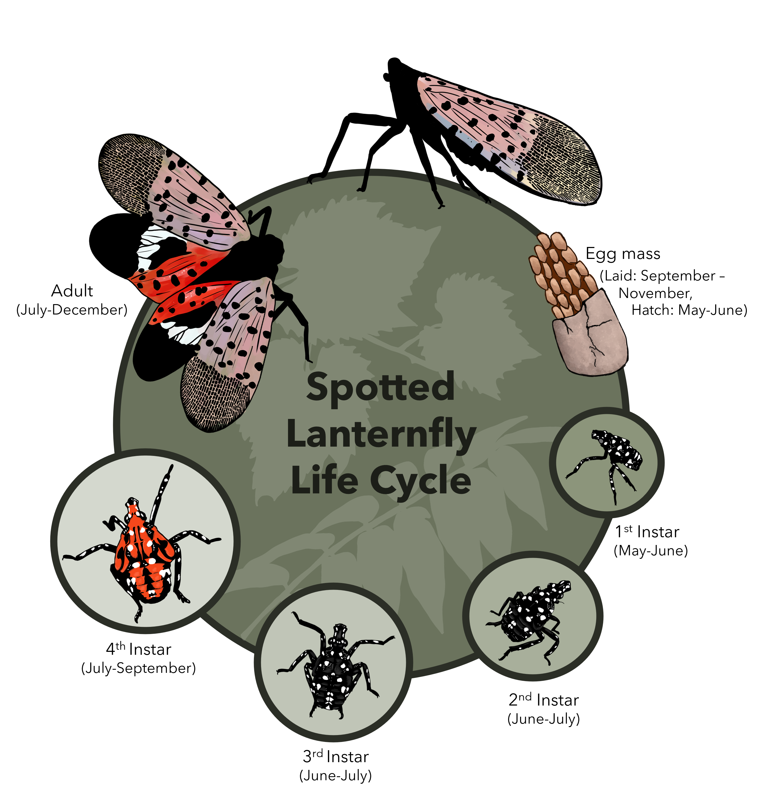
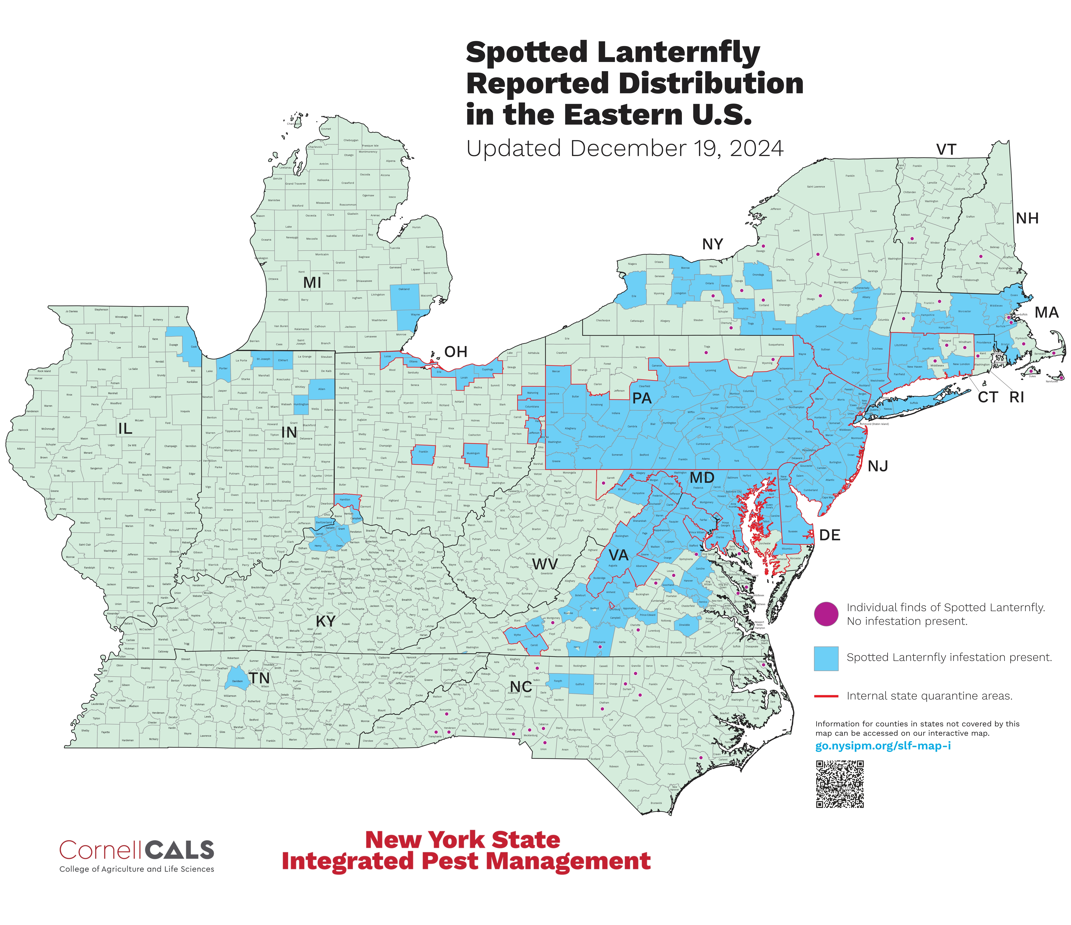
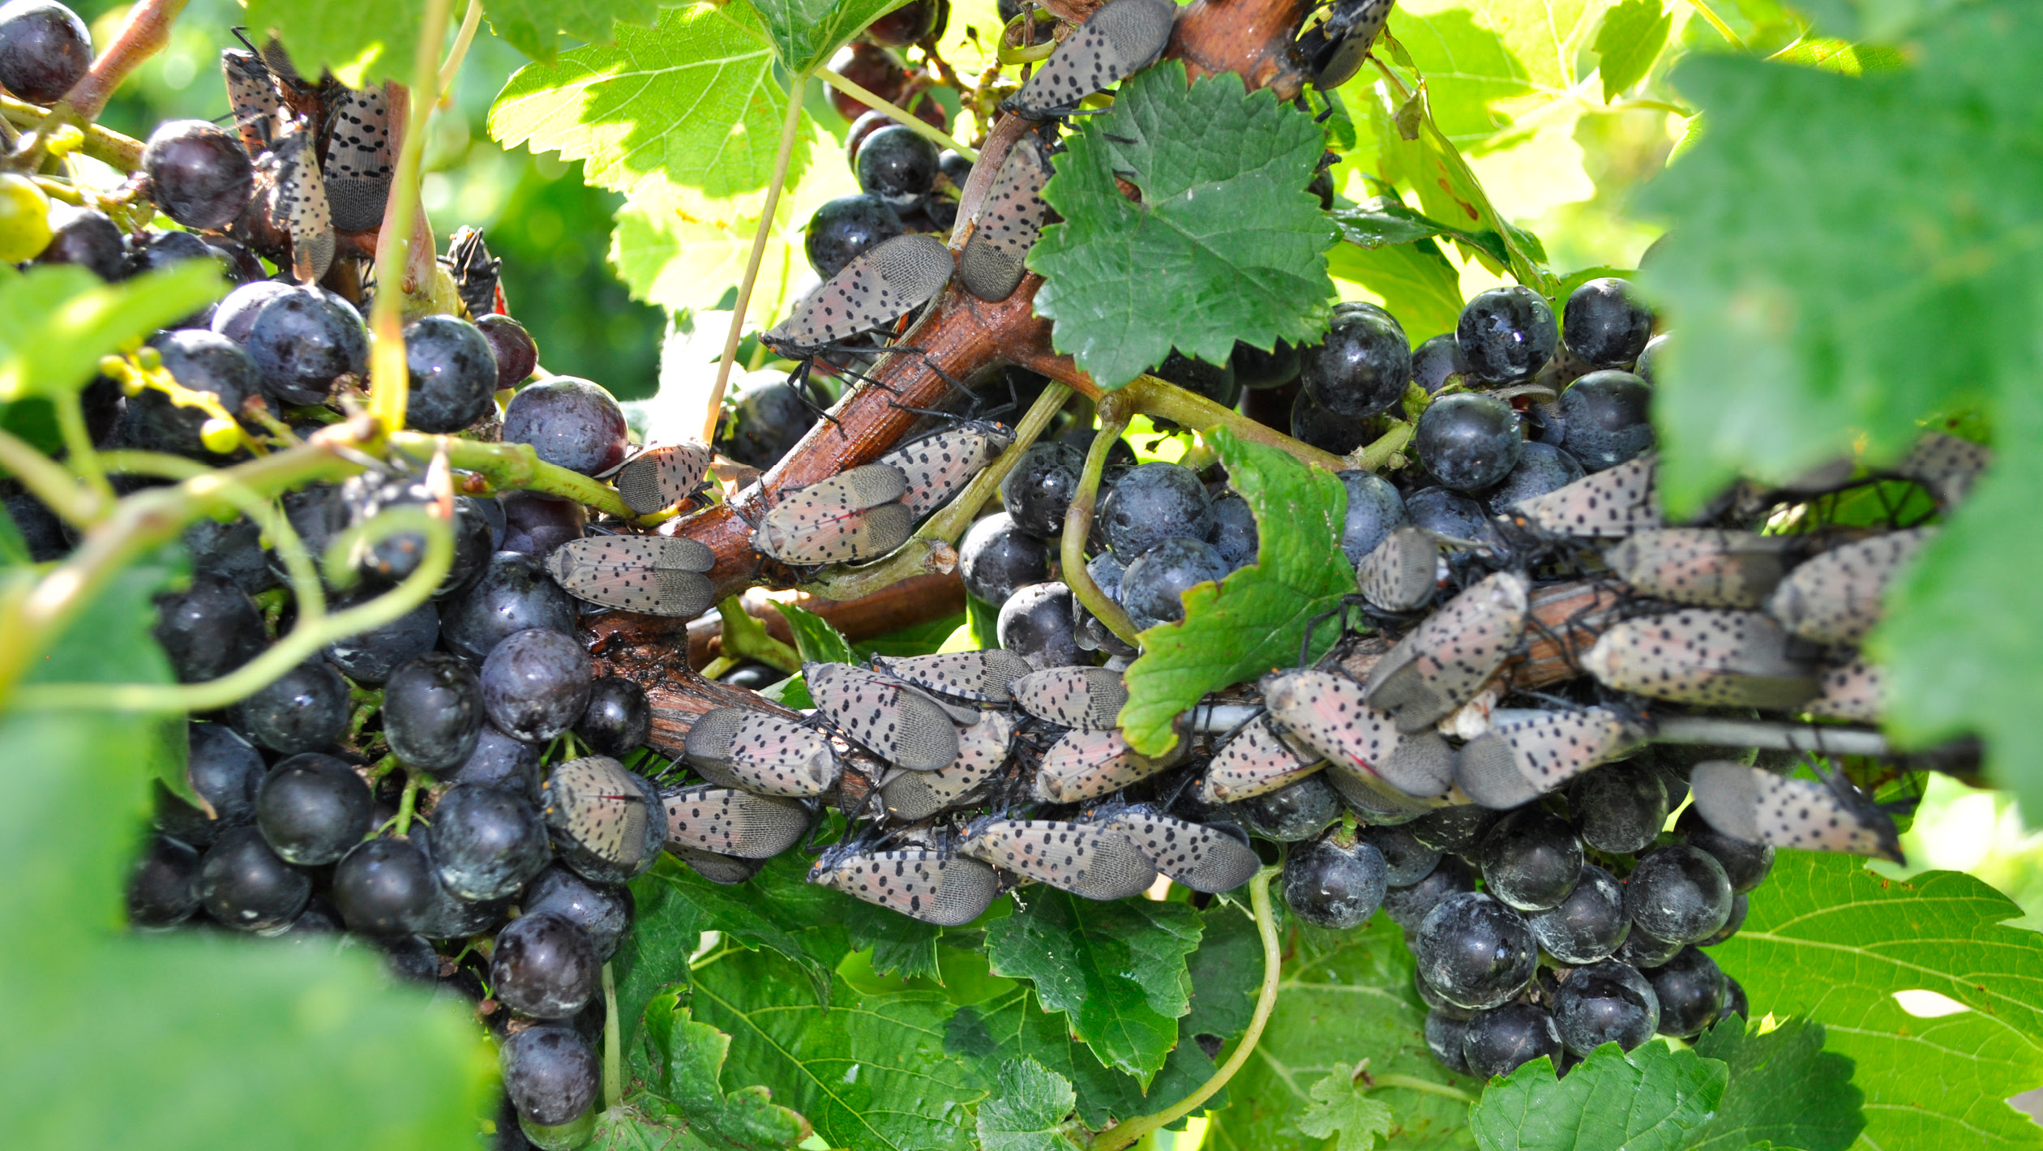
Spotted Lanternfly (SLF)

Slide 23
SLF Scenario Assumptions
Regions/places | Finger Lakes and Chautauqua-Lake Erie
Grapes varieties | Red: Pinot Noir, Cabernet Franc, Concord, Frontenac, and Marquette. White: Chardonnay and Riesling
Years for the analysis | 1st year, 2nd year, and subsequent years (3rd ,… n^{n})
Pesticides applications | Farmers do not increase applications to control for SLF
SLF feeding preferences | For this analysis, we assumed no preference or differential impact of SLF across Vitis species or grape varieties.
SLF impact | 1st year: Reduction in price (3%) 2nd year: Reduction in production (3%) and price (5%) Subsequent years: Reduction in production (8%) and price (10%)

Slide 24
SLF Potential
Economic Damage
Table 1. Potential total economic losses due to SLF infestation in the Finger Lakes, Lake Erie region, and NYS.
Region | Production (ton) | Value ($/ton) | Value lost after 1st year ($/ton) | Production lost in 2nd year (ton) | Value lost after 2nd year ($/ton) | Production lost in subsequent years (ton) | Value lost in subsequent years ($/ton)
Finger Lakes | 7,352 | 12,091,847 | 362,755 | 221 | 949,210 | 588 | 2,079,798
Lake Erie | 121,545 | 39,064,034 | 1,171,921 | 3,646 | 3,066,527 | 9,724 | 6,719,014
Total NYS | 128,897 | 51,155,882 | 1,534,676 | 3,867 | 4,015,737 | 10,210 | 8,798,812

Slide 25
Research Update: Economic Analysis of Exclusion Netting for SWD Management in Organic Blueberry Production

Slide 26
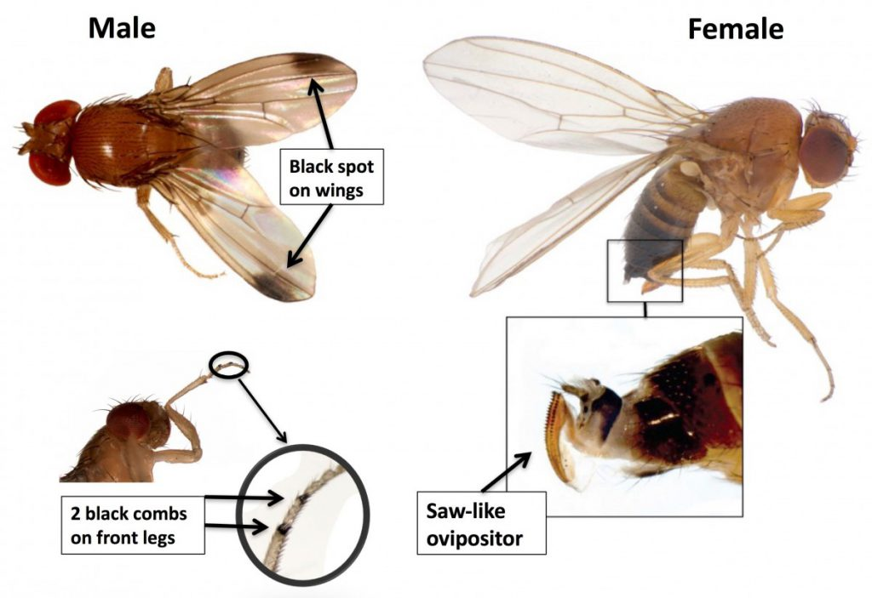
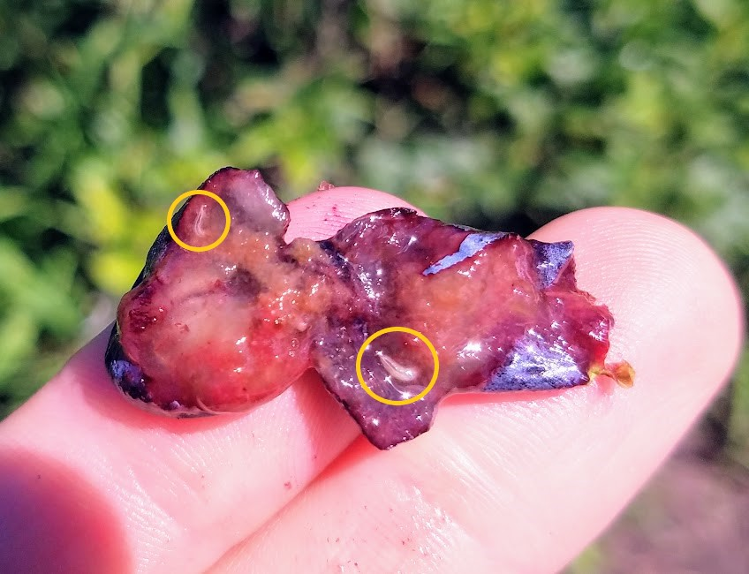
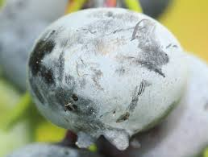
Spotted Wing Drosophila (SWD)
Spotted Wing Drosophila Identification
Infested Blueberry
Dark Spots are sign of Infested Blueberry

Slide 27
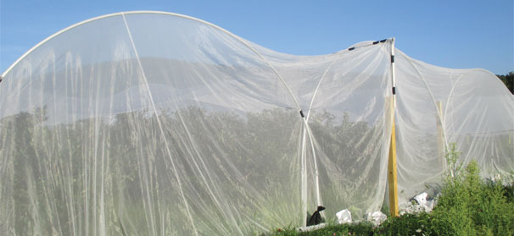
SWD Exclusion Netting

Slide 28
SWD Exclusion Netting
Parameter | Details
Price | - PYO: $7.01/kg - Wholesale: $11.07/kg - Retail: $13.16/kg Weighted Average Price (WP): $9.56/kg (50% direct, 50% indirect marketing) Additional scenarios for sensitivity analysis: - $7.01/kg (100% PYO) - $12.12/kg (100% indirect marketing).
Control Efficiency | - 10% yield loss due to SWD infestation with organic insecticides - Scenarios modeled for varying infestation rates: -- Low-risk scenario: 0.5% infestation -- High-risk scenario: 2% infestation (adverse conditions).
Cultivar Type | - Mid-season (Bluejay): July 7 – July 27 - Late-season (Elliott): July 27 – August 30 - Mixed cultivar (Bluejay and Elliott).

Slide 29
SWD Exclusion Netting
Comparison of organic insecticide and exclusion netting three control efficiency levels for mixed cultivar and even split of production ($9.56/kg) accumulated cash-flow.

Slide 30
Research Update: Sustainable Spotted Wing Drosophila Management

Slide 31

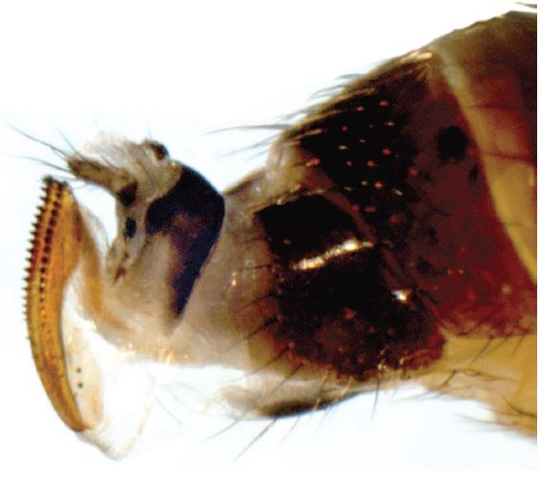
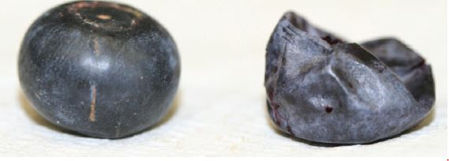
Sustainable Spotted Wing Drosophila Management
Spotted wing drosophila (SWD) is a devastating invasive pest of soft-skinned fruits
SWD has expanded its range to affect all major American fruit production region
Impacts:
Revenue loss of over $500 million for berry industry (Bolda et al. 2010)
Image sources:
https://spottedwing.org/
https://eorganic.org/node/23509
https://site.caes.uga.edu/blueberry/swd/

Slide 32
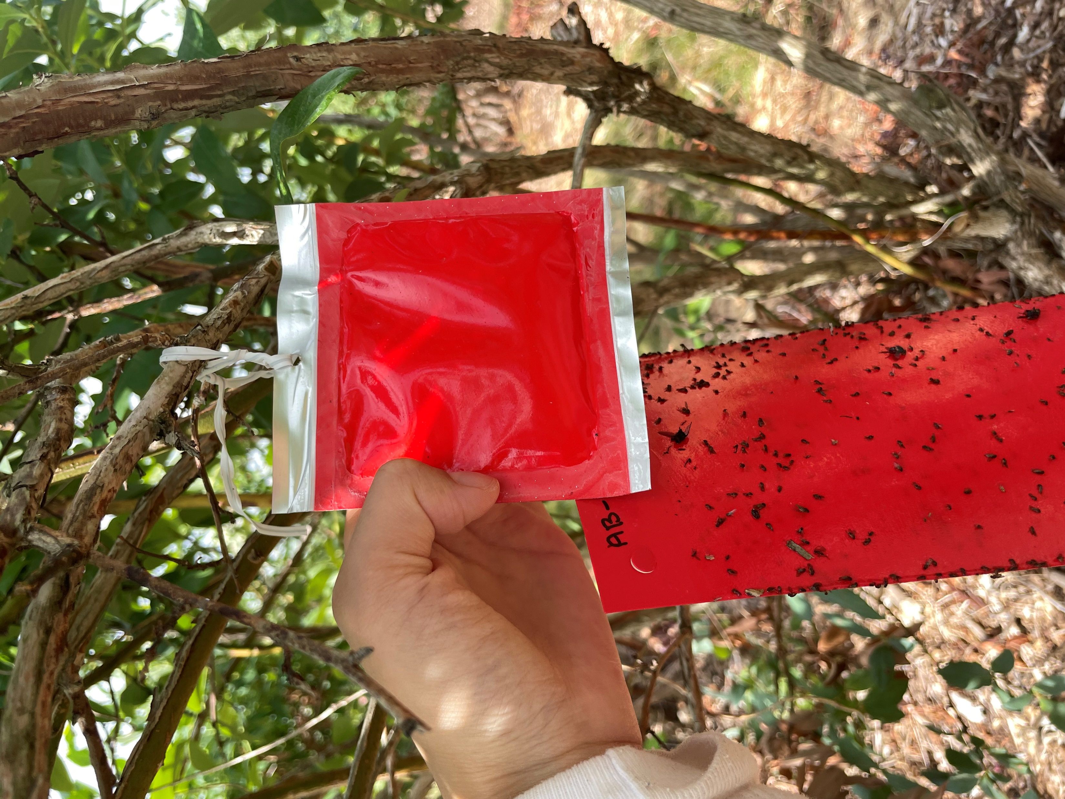
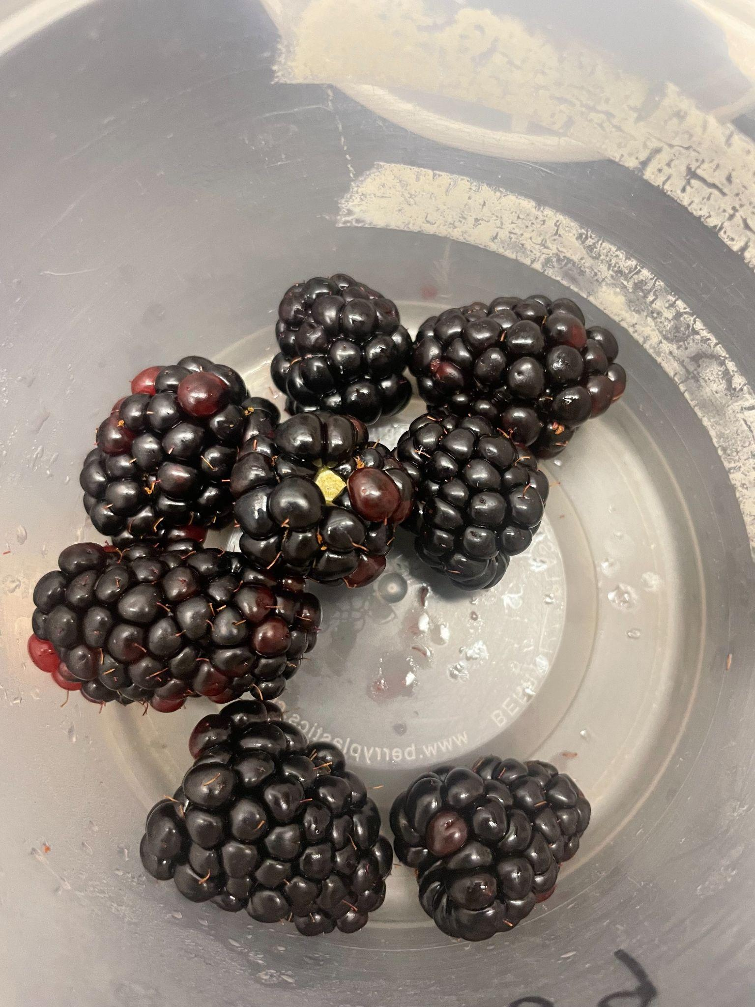
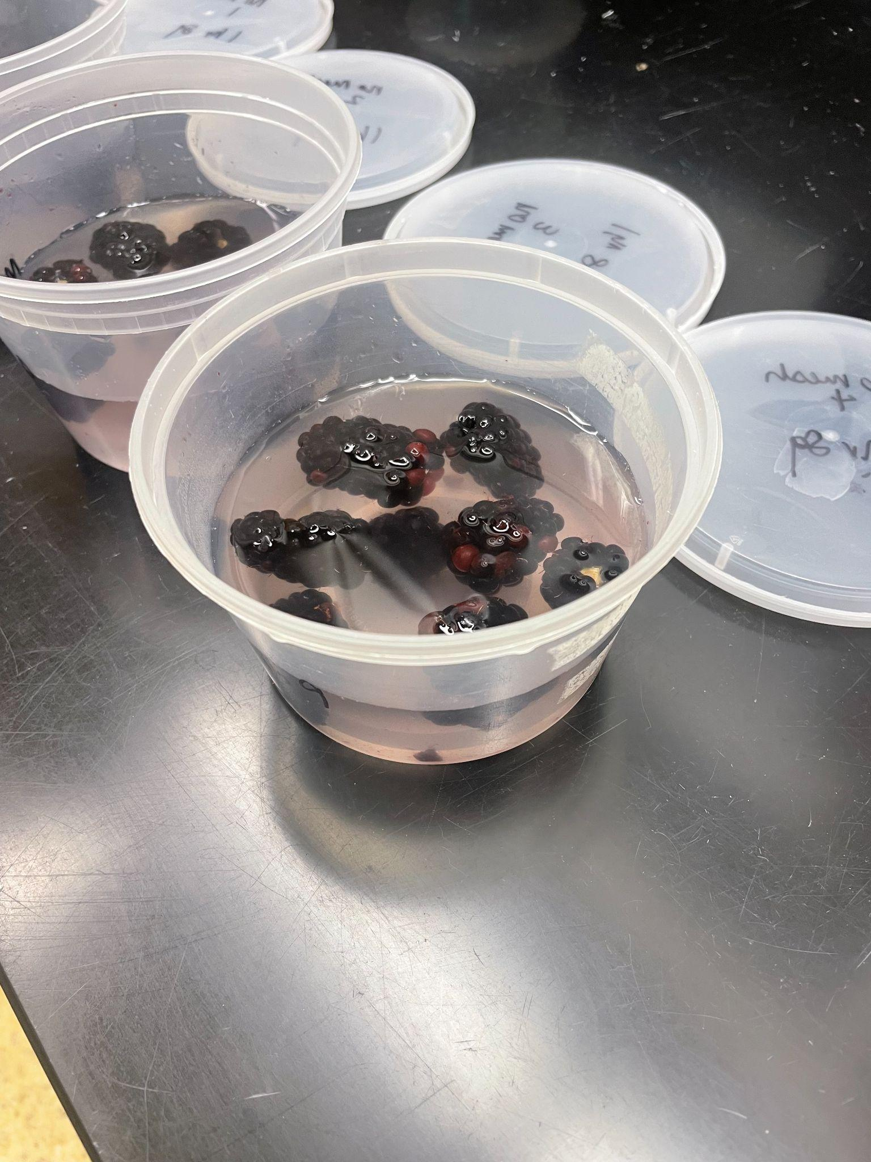
Sustainable pest control strategies for controlling SWD in New York State
Status quo: calendar-based insecticide applications
Integrated Pest Management strategy (IPM):
Monitoring-based spray strategies (i.e., Adult trapping and Fruit sampling)
We evaluate the economic performance of IPM strategies and develop decision tools
Figure 2. Fruit sampling
Figure 1. Adult trapping

Slide 33
The Economics of incorporating fruit sampling as a SWD control strategy—New York State
Assume the grower’s goal is to minimize the expected total costs:
For each strategy of interest, we calculate the distribution of total costs across 10,000 SWD population dynamics.
Data:
Estimated SWD population parameters: observed SWD adults from 63 sites from 21 counties in New York state over 10 years, and a Bayesian state-space model.
Economic data: yield, prices, costs, production, among others.
$Total costs=E\{\sum_{t=1}^{T}{Damag{e costs}_{t}+pest management costs_{t}\}}$

Slide 34
The Economics of incorporating fruit sampling as a SWD control strategy—1-acre conventional blueberry farm in New York
Key preliminary results:
The control strategies that incorporate fruit sampling exhibit the lowest average costs
Value of accurate monitoring information and reduced spray times
The status quo control strategy
generates a lower average yield damage than all monitoring-based strategies
The cost from the higher number of pesticide applications offsets the returns

Slide 35
Research Update: Estimating the Costs of a 10-acres Greenhouse for leafy greens Production

Slide 36
Control Environment Agriculture (CEA)
Parameter | Choice | Background/Justification
CEA Structure | Greenhouse | Year-round production
Crop | Lettuce, ready-to-eat | 3rd most consumed vegetable in the U.S. (behind potatoes and tomatoes); perishable crop benefits from being locally grown; consumer preference for ready-to-eat vegetables (no need to cook/process).
Size of Production Area | 10 acres in greenhouse | Economies of scale with a larger size greenhouse lead to overall lower production costs.
Degree of Automation | Automated production, semi-automated packaging | Automation reduces ongoing labor costs with higher upfront investment, balancing low-cost vegetables while providing local jobs.
Location of Operation | Jefferson County, NY | Rural location with affordable land and energy, and above-average unemployment rates.
Distribution Model | Grocery brands valued by cost-conscious shoppers and food-service/institutions | Products include 4 oz. clamshells of ready-to-eat lettuce priced at $2.99 for retail and bulk 3-lb. bags priced at $5.99 for food-service/institutions.
Labor Targets | Veterans and formerly incarcerated individuals | Collaboration with a local non-profit to provide job training and recruitment for most positions.

Slide 37
CEA Assumptions
Variable | Value
Weeks per year | 52
Ounce per kilogram | 35.274
Production area (ft² under greenhouse cover) | 435,600
Ounce per clamshell | 4
Space use efficiency | 90%
Pound per kilogram | 2.20462
Net production area (90% space use) ft² | 392,040
Pound per bag (lbs) | 3
Production in Year 1 | 50%
Kg production per year | 4,006,392
Production in Year 2 | 75%
Months per year factor | 12
Production in Year 3 | 90%
Market price for retail stores (4 oz) | $2.99
Percentage sold to retail | 0.7
Yield (fully operational) (kg/m²) | 110

Slide 38
CEA Profitability
Breakdown of production cost per kg

Slide 39
Research Update: Consumers willingness to pay for local food – Evidence from a laboratory auction in NYS for lettuce grown in Controlled Environments

Slide 40
Experiment Design
Table 1. Example of Information displayed in the First Treatment
Description | Product
 | Lettuce A | Lettuce B | Lettuce C | Lettuce D
Production system | Greenhouse | Field | Greenhouse | Field
Place of Origin | NYS | NYS | Out-of-state | Out-of-state
Table 2. Example of Information displayed in the Second Treatment
Attribute | Product
 | Lettuce A (Greenhouse grown in NYS) | Lettuce B (Field grown in NYS) | Lettuce C (Greenhouse grown out of state) | Lettuce D (Field grown out of state)
Market availability | Year round | 5 months of the year | Year round | 8-10 months of the year
Distance to market | 150 miles | 150 miles | 3000 miles | 3000 miles
Jobs created | 1 NYS | 1 NYS | 1 out of state | 1 out of state

Slide 41
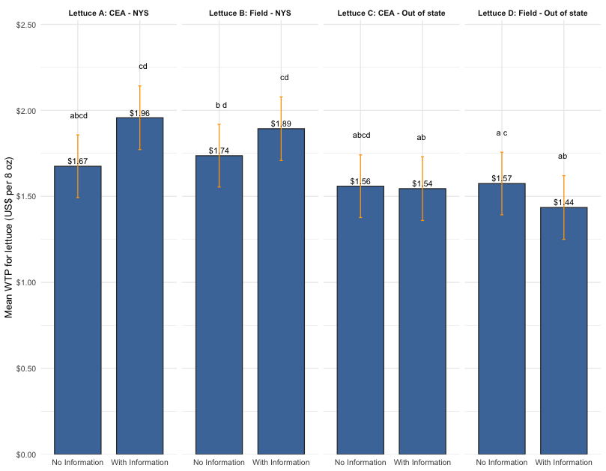
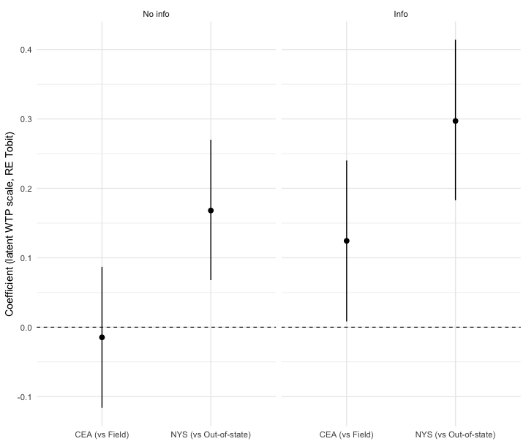
Figure 1. Mean WTP for lettuce (US $ per 8 oz).
Figure 2. Coefficient estimates and confidence intervals from RE Tobit model.

Slide 42
Table 4. Willingness to Pay Estimates Using Tobit Random Effects Models
Explanatory Variables | Tobit Model
Intercept | 1.639*** (0.821) | 1.693*** (0.842)
CEA | 0.029 (0.030) | -0.014 (0.052)
NYS | 0.305*** (0.030) | 0.169*** (0.053)
INFO | 0.081 (0.233) | -0.135 (0.236)
Interaction terms
CEA X NYS |  | -0.045 (0.058)
CEA X INFO |  | 0.124*** (0.059)
NYS X INFO |  | 0.297*** (0.059)
Demographic and purchasing habit
Gender | 0.589*** (0.263) | 0.597*** (0.267)
Primary shopper | -0.492*** (0.276) | -0.499*** (0.290)

Slide 43
Research Update: Economic Comparison of Conventional and Controlled Environment Agriculture (CEA) Supply Chains for Leaf Lettuce to US Cities

Slide 44
Assumption | CA Field | NY Field | WI Field | NY Greenhouse | WI Greenhouse
Scale of Operation | 5 acre | 1 acre | 1 acre | Mixed scales: soil-based (~200 m²); CEA facilities (~40,500 m² / ~10 acres) | Mixed scales: soil-based (~200 m²); CEA facilities (~40,500 m² / ~10 acres)
Production season | Seasonal | Seasonal | Seasonal | Year-round production | Year-round production
Distance to Market | 4,825 km to NYC 3,570 km to Madison | 300 km to NYC | 150 km to Madison | 300 km to NYC | 150 km to Madison
Automation treatment | Low Mechanization | Low Mechanization | Low Mechanization | Automated & Labor-intensive variants | Automated & Labor-intensive variants

Slide 45
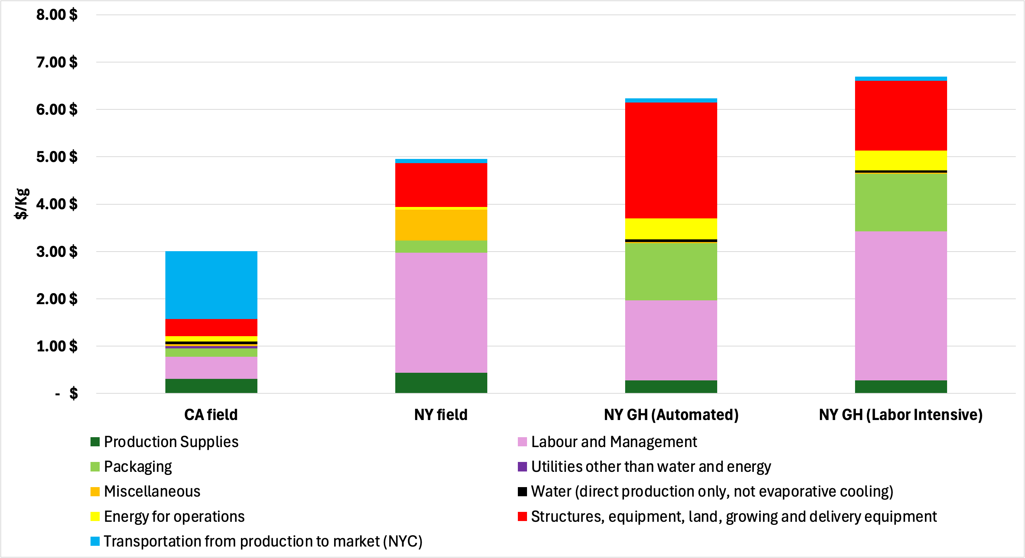
Cost Comparison Across Production Systems: California Field, New York Field, and New York Greenhouse
Notes:
CA Field: 1. Production Supplies = $0.31
2. Labour and Management = $0.46
3. Packaging = $0.18
4. Utilities other than Water and Energy = $0.05
5. Miscellaneous = $0.04
6. Water (direct production only, not evaporative cooling) = $0.06
7. Energy for operations = $0.11
8. Structures, equipment, land, growing and delivery equipment = $0.36
9. Transportation from production to market (NYC) = $1.43
10. TOTAL landed cost = $3.00
NY Field: 1. Production Supplies = $0.44
2. Labour and Management = $2.54
3. Packaging = $0.25
4. Utilities other than Water and Energy = $0.00
5. Miscellaneous = $0.66
6. Water (direct production only, not evaporative cooling) = $0.00
7. Energy for operations = $0.06
8. Structures, equipment, land, growing and delivery equipment = $0.92
9. Transportation from production to market (NYC) = $0.09
10. TOTAL landed cost = $5.02
NY GH (Automated): 1. Production Supplies = $0.28
2. Labour and Management = $1.68
3. Packaging = $1.21
4. Utilities other than Water and Energy = $0.00
5. Miscellaneous = $0.02
6. Water (direct production only, not evaporative cooling) = $0.05
7. Energy for operations = $0.44
8. Structures, equipment, land, growing and delivery equipment = $2.45
9. Transportation from production to market (NYC) = $0.15
10. TOTAL landed cost = $6.29
NY GH (Labor Intensive): 1. Production Supplies = $0.28
2. Labour and Management = $3.15
3. Packaging = $1.21
4. Utilities other than Water and Energy = $0.00
5. Miscellaneous = $0.02
6. Water (direct production only, not evaporative cooling) = $0.05
7. Energy for operations = $0.42
8. Structures, equipment, land, growing and delivery equipment = $1.47
9. Transportation from production to market (NYC) = $0.15
10. TOTAL landed cost = $6.75

Slide 46
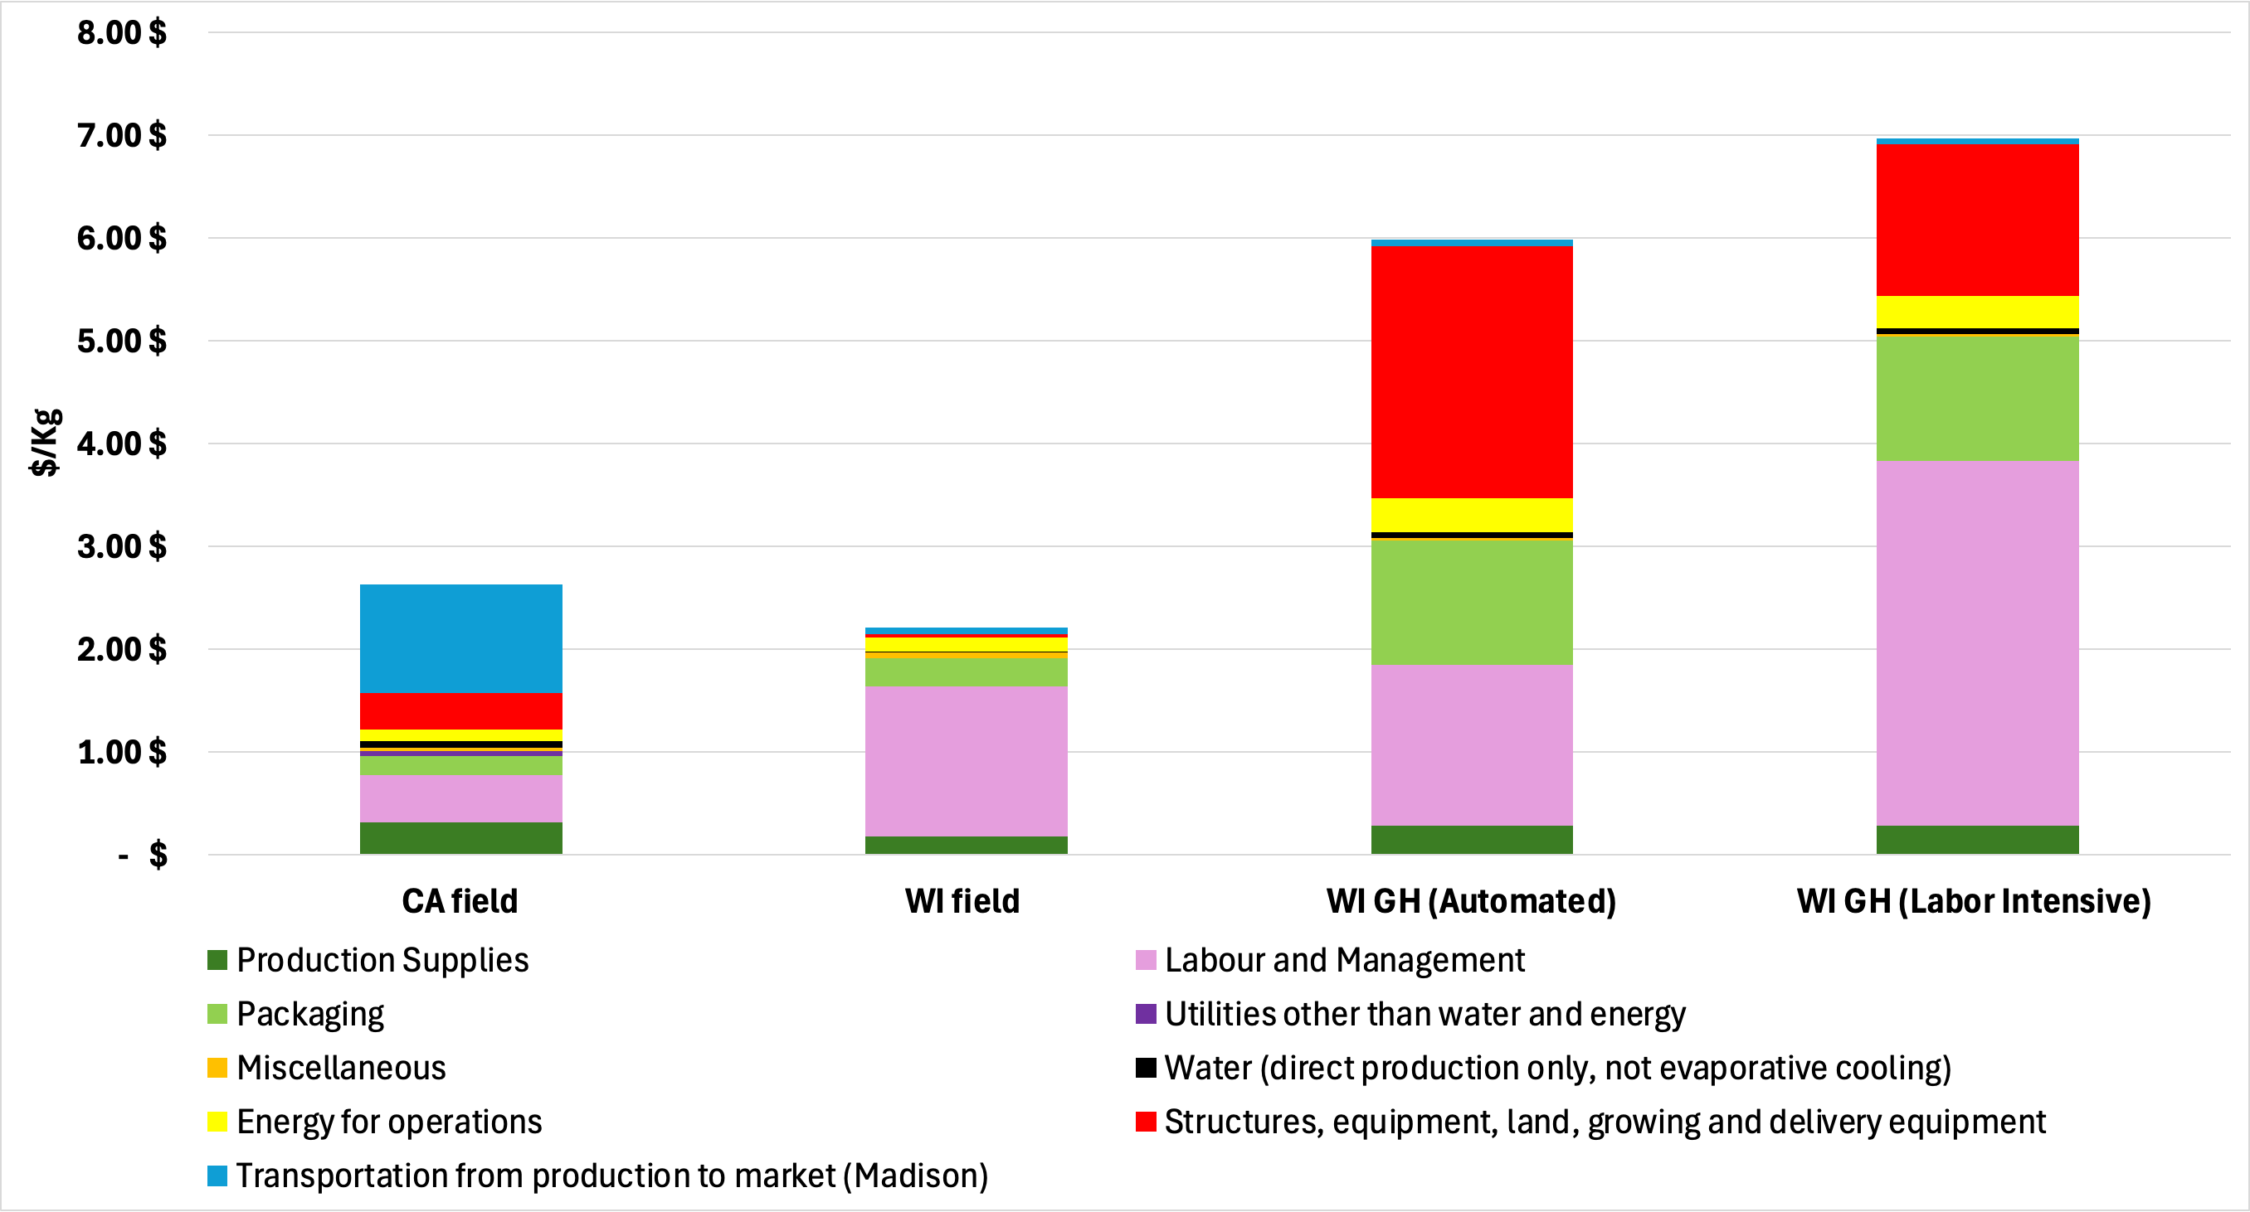
Cost Comparison Across Production Systems: California Field, Wisconsin Field, and Wisconsin Greenhouse
Notes:
CA Field (Same as previous slide except for transportation cost): 1. Production Supplies = $0.31
2. Labour and Management = $0.46
3. Packaging = $0.18
4. Utilities other than Water and Energy = $0.05
5. Miscellaneous = $0.04
6. Water (direct production only, not evaporative cooling) = $0.06
7. Energy for operations = $0.11
8. Structures, equipment, land, growing and delivery equipment = $0.36
9. Transportation from production to market (Madison) = $1.06
10. TOTAL landed cost = $2.63
WI Field: 1. Production Supplies = $0.18
2. Labour and Management = $1.46
3. Packaging = $0.28
4. Utilities other than Water and Energy = $0.00
5. Miscellaneous = $0.06
6. Water (direct production only, not evaporative cooling) = $0.01
7. Energy for operations = $0.13
8. Structures, equipment, land, growing and delivery equipment = $0.03
9. Transportation from production to market (Madison) = $0.06
10. TOTAL landed cost = $2.21
WI GH (Automated): 1. Production Supplies = $0.28
2. Labour and Management = $1.56
3. Packaging = $1.21
4. Utilities other than Water and Energy = $0.00
5. Miscellaneous = $0.02
6. Water (direct production only, not evaporative cooling) = $0.05
7. Energy for operations = $0.34
8. Structures, equipment, land, growing and delivery equipment = $2.45
9. Transportation from production to market (Madison) = $0.06
10. TOTAL landed cost = $5.98
WI GH (Labor Intensive): 1. Production Supplies = $0.28
2. Labour and Management = $3.55
3. Packaging = $1.21
4. Utilities other than Water and Energy = $0.00
5. Miscellaneous = $0.02
6. Water (direct production only, not evaporative cooling) = $0.05
7. Energy for operations = $0.32
8. Structures, equipment, land, growing and delivery equipment = $1.47
9. Transportation from production to market (Madison) = $0.06
10. TOTAL landed cost = $6.97

Slide 47
Thank you!!
Comments? Questions?
mig7@cornell.edu

