Slide 1

2026 Agricultural Labor Situation and Outlook
Richard Stup, Ph.D.
Director, Cornell Ag Workforce Development rstup@cornell.edu agworkforce.cals.cornell.edu

Slide 2
Key topics…
Immigration and border enforcement
H-2A program changes
Overtime changes and effects
Technology and labor efficiency

Slide 3
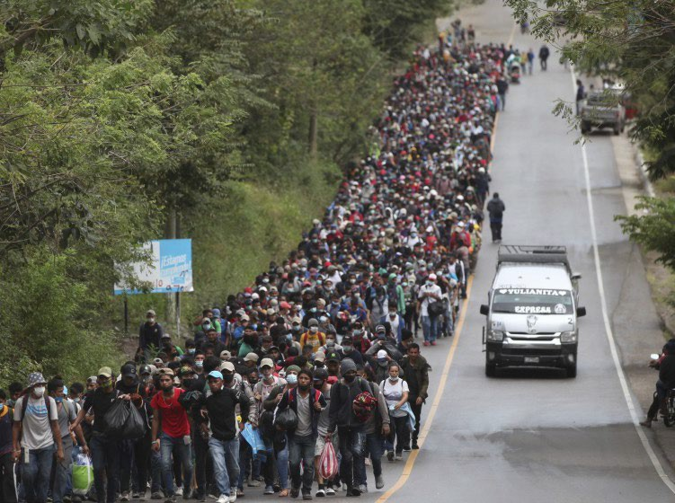

Southwest border is activity down radically
A few years ago…
Now…

Slide 4
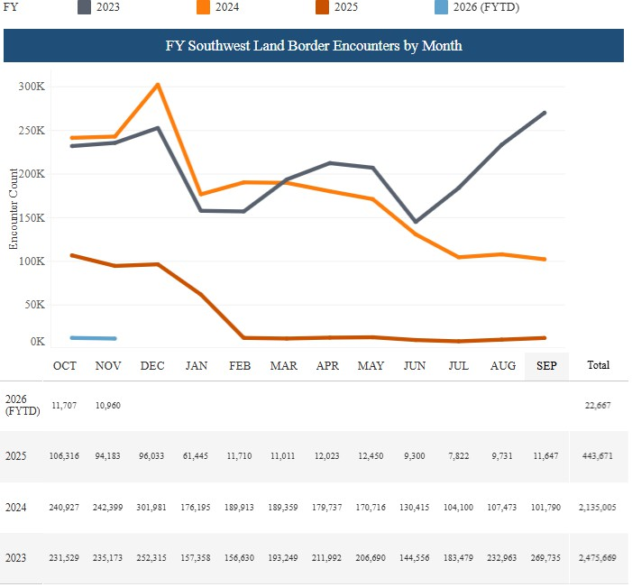
Total southwest border activity
All encounters by U.S. Border Patrol and Field Operations
Includes adults, families, and unaccompanied minors
Source: U.S. Customs and Border Protection

Slide 5
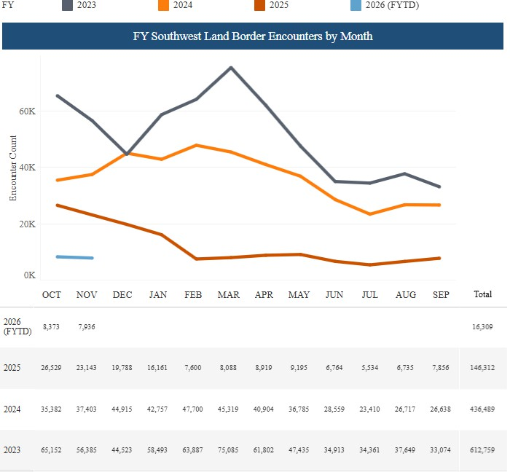
Economic southwest border activity
Single adults
Immigrants from Mexico and Guatemala
Source: U.S. Customs and Border Protection

Slide 6
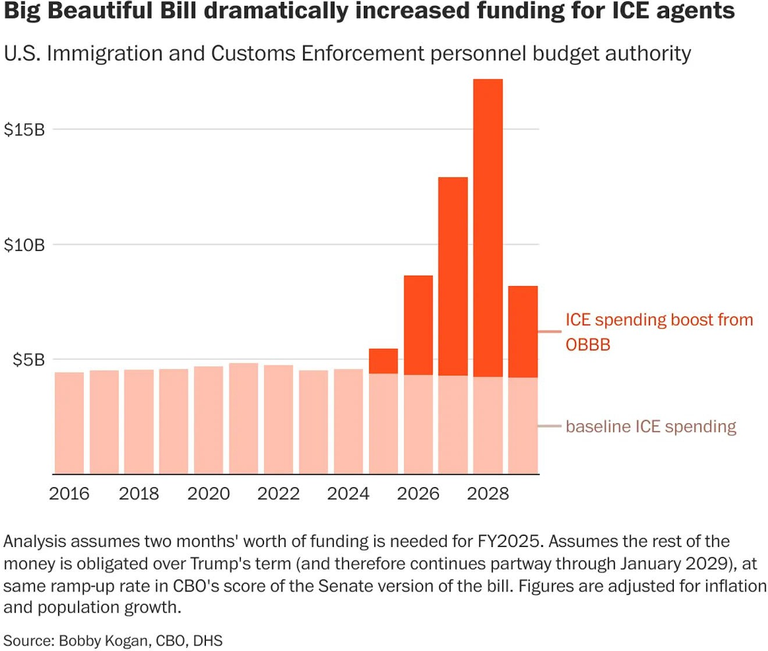
ICE budget and hiring dramatically expanded in new federal budget

Slide 7
The supply of unauthorized workers to farms through new immigration is stopped.

Slide 8

H-2A Program Changes

Slide 9

With 2023 NY Budget, increases occur Jan. 1
New York Minimum Wage
Location | 12/31/ 16 | 12/31/ 17 | 12/31/ 18 | 12/31/ 19 | 12/31/ 20 | 12/31/ 21 | 12/31/ 22 | 01/01/ 24 | 01/01/ 25 | 01/01/ 26 | 01/01/ 27
NYC - Big Employers (11 or more) | $11.00 | $13.00 | $15.00 | $15.00 | $15.00 | $15.00 | $15.00 | $16.00 | $16.50 | $17.00 | $17+
NYC - Small Employers (10 or less) | $10.50 | $12.00 | $13.50 | $15.00 | $15.00 | $15.00 | $15.00
Long Island & Westchester | $10.00 | $11.00 | $12.00 | $13.00 | $14.00 | $15.00 | $15.00
Remainder of New York State | $9.70 | $10.40 | $11.10 | $11.80 | $12.50 | $13.20 | $14.20 | $15.00 | $15.50 | $16.00 | $16+
*Starting Jan 1, 2027, the annual increases will be published by the Commissioner of Labor on or
before October 1. Annual increases will be tied to inflation, as measured by the consumer price index for the Northeast Region Urban Wage Earners and Clerical Workers (CPI-W).

Slide 10
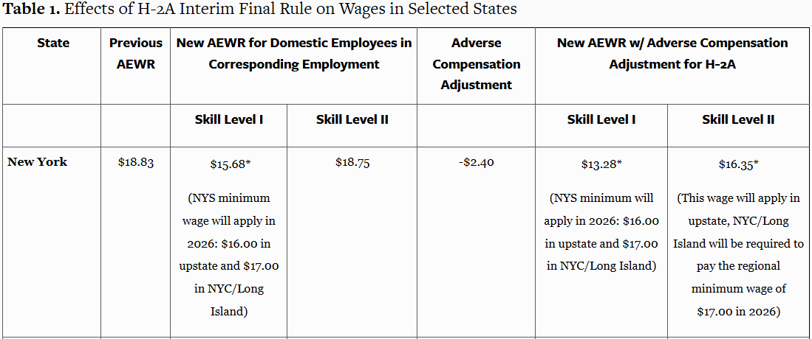
Administration made major changes to H-2A wages
Read details at our post: Major H-2A Wage Changes: Overview of New AEWR Methodology

Slide 11
Overtime Changes and Impacts
2022-2023,
threshold remains at 60 hours
January 1,
2024, threshold
moves to 56 hours
January 1,
2026, threshold
moves to 52 hours
January 1,
2028, threshold
moves to 48 hours
NY’s Planned Farm Labor Overtime Threshold Changes
January 1,
2030, threshold
moves to 44 hours
January 1,
2032, threshold
moves to 40 hours

Slide 12
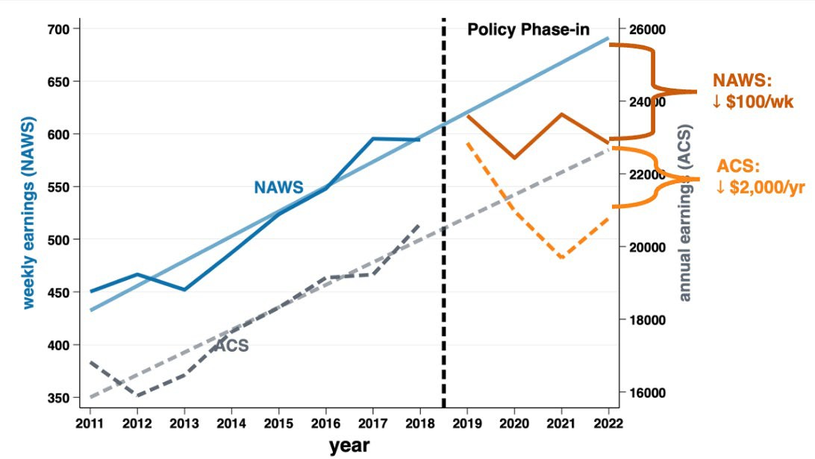
Overtime reduced crop worker hours and wages in California
Source: Dr. Alexandra Hill, UCal-Berkeley

Slide 13
New York’s Overtime Tax Credit encourages employers to offer and pay overtime
$28
Example Details:
Green pay is eligible for OT
Year 2027 so threshold is at 52 hours
Employee’s base pay is
$16/hour
OT premiums between 52 and 60 hours eligible for OT tax credit
No hours above 60 are eligible for credit
$24
tax credit
$20
$16
Pay
$12
$8
$4
$0
4 8 12 16 20 24 28 32 36 40 44 48 52 56 60 64
Hours Worked

Slide 14
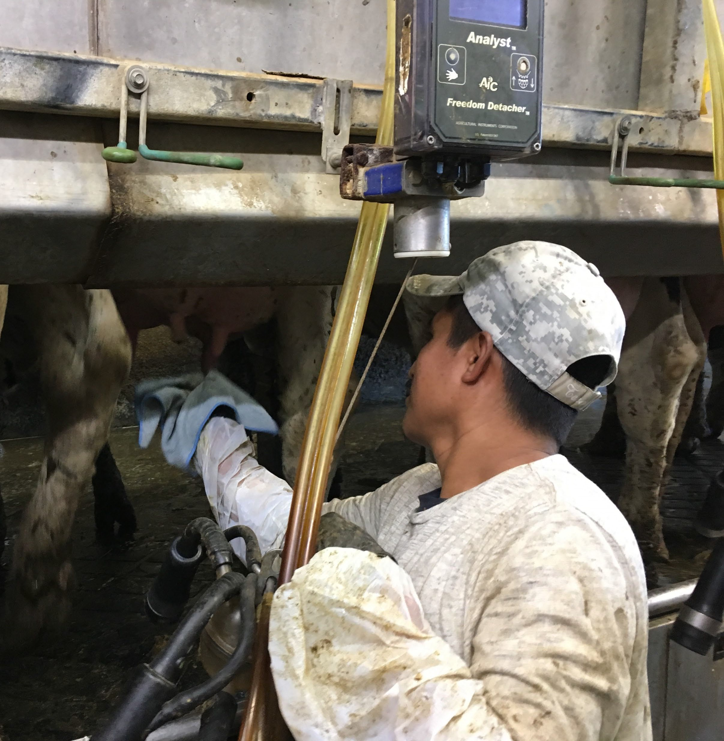
NY farm employers, are nervous about the OT tax credit continuing, and are attempting to reduce hours worked.

Slide 15
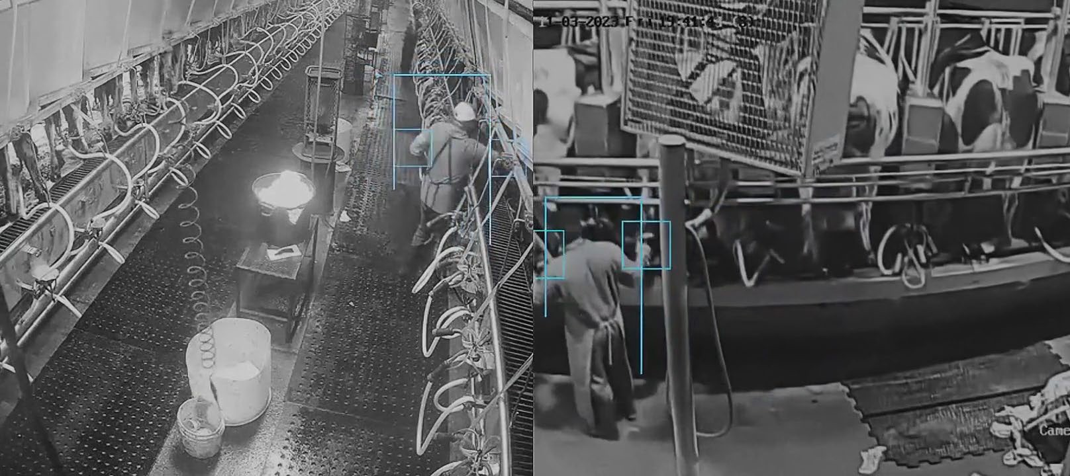
Automation and Artificial Intelligence (AI)
Not just about robots
Better application of available labor
Example: Cattle Care’s AI milking parlor management service

Slide 16
NY Farm Labor Outlook
Farm labor will continue to be scarce and costly.
Immigration enforcement will increase.
Employers will not successfully reduce hours worked.
Investments in automation and AI will increase.

Slide 17
Agricultural Supervisory Leadership
Online, engaged learning for farm managers. English/Spanish agworkforce.cals.cornell.edu
ASL101 | Transition to Supervisor: Making the mental transition to leadership. Our flagship course is offered every March. March 2026
ASL102 | Organizing Work for High-Quality Results: Create an efficient and high-performing workplace. Develop clear expectations and standard operating procedures. Delegate effectively. Diagnose and correct performance problems. June 2026
ASL103 | Managing Performance: Understand motivation. Harness the power of performance feedback and coaching. Build clear and effective workplace communications. Set safety expectations. Conduct effective performance improvements. January 2026
ASL104 | Staffing and Organizing Your Team: Develop job descriptions. Learn how to find potential employees, interview and select the right people. Implement new hire documentation, employment authorization, and onboarding: bringing new employees into the business successfully and productively. March 2026
ASL105 | Employee Development and Training: Identify training needs. Understand learning styles. Design and plan learning experiences that accommodate learner needs. Develop effective training skills and techniques. Evaluate learning results and training effectiveness. November 2025
ASL106 | Ethics and Employment Regulations: Implement responsible and ethical labor practices and understand why this matters for agriculture. Recognize and prevent sexual harassment. Understand and follow minimum wage and overtime laws. Implement Equal Employment Opportunity laws to prevent discrimination and harassment. Handle employee discipline and termination. November 2026

Slide 18
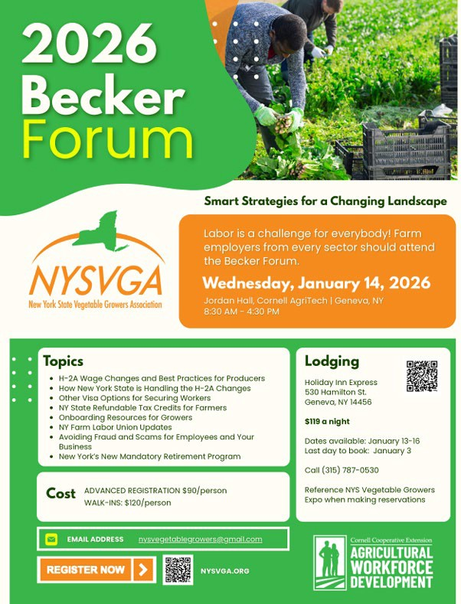
Becker Forum is Jan 14th
H-2A Wage Changes and Best Practices for Producers
How New York State is Handling the H-2A Changes
Other Visa Options for Securing Workers
NY State Refundable Tax Credits for Farmers
Onboarding Resources for Growers
NY Farm Labor Union Updates
Avoiding Fraud and Scams for Employees and Your Business
New York’s New Mandatory Retirement Savings Program
Register: https://nysvga.org/meeting-registration/

Slide 19
Thank you!
Questions?

