Slide 1
Concurrent Session B: Horticultural Outlook
201 Stocking Hall, 1:00 to 3:00 PM

Slide 2
Concurrent Session B: Horticultural Outlook
Situation and Outlook for Fruits and Vegetables (Brad Rickard)
Grape, Wine, & Ornamental Situation and Outlook (Miguel Gómez)

Slide 3
Situation and Outlook for
Fruits and Vegetables
Bradley Rickard
Dyson School of Applied Economics and Management
January 17, 2025

Slide 4
Overview
F&V Situation Reports
Key Outlook Issues
Food Inflation
Production costs
International trade
Research Updates:
Economics of Adaptation

Slide 5
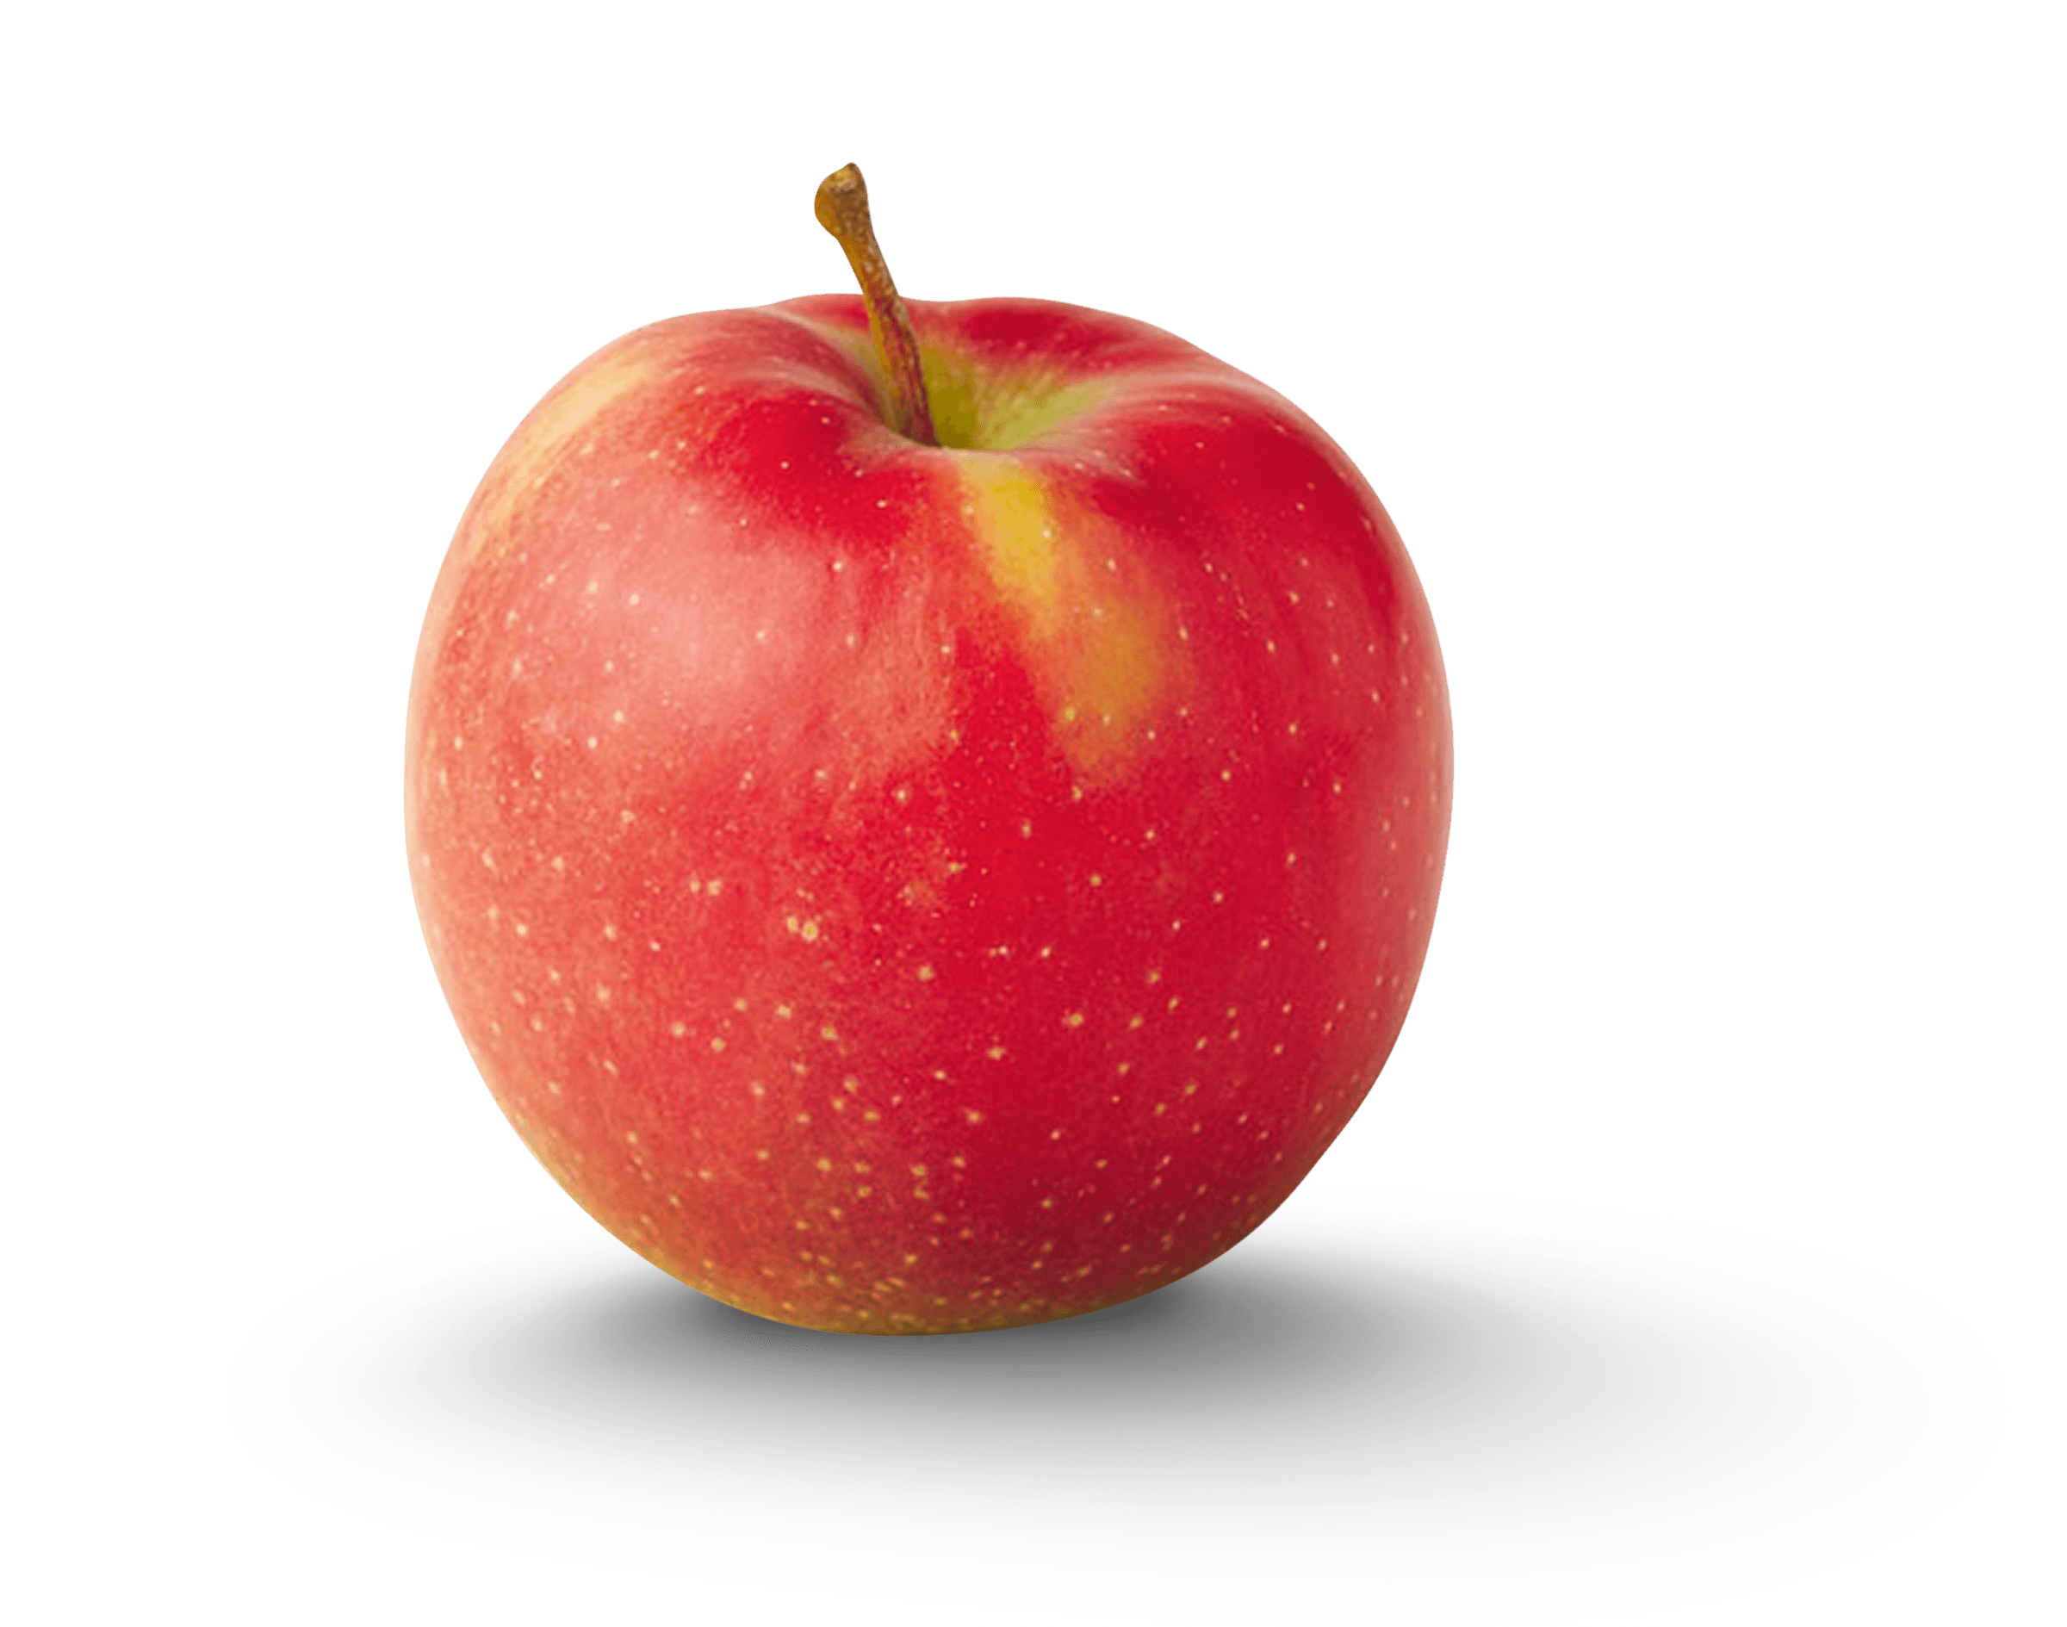
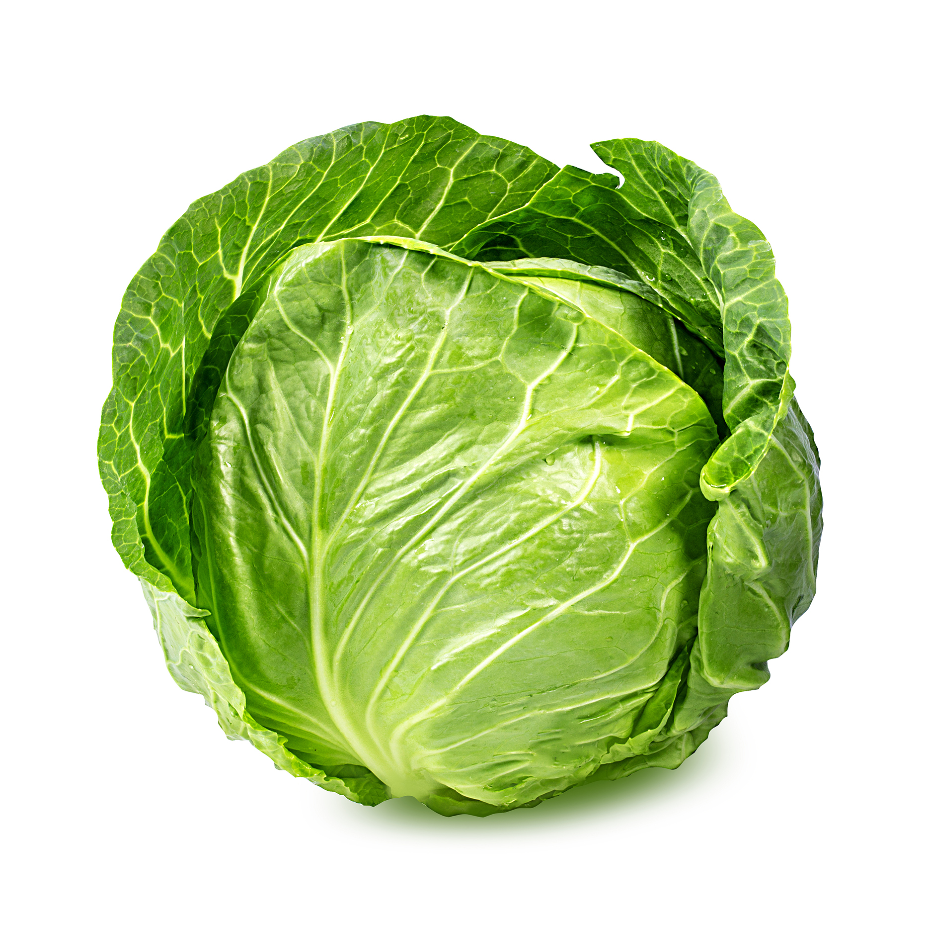
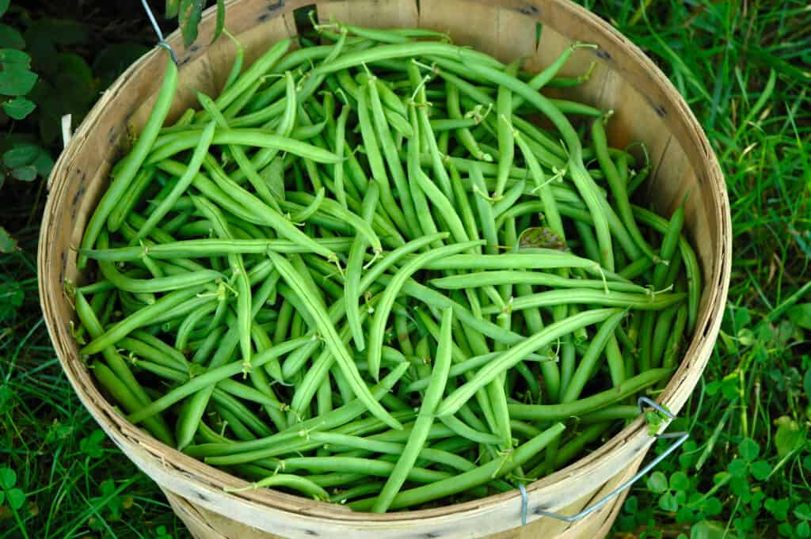
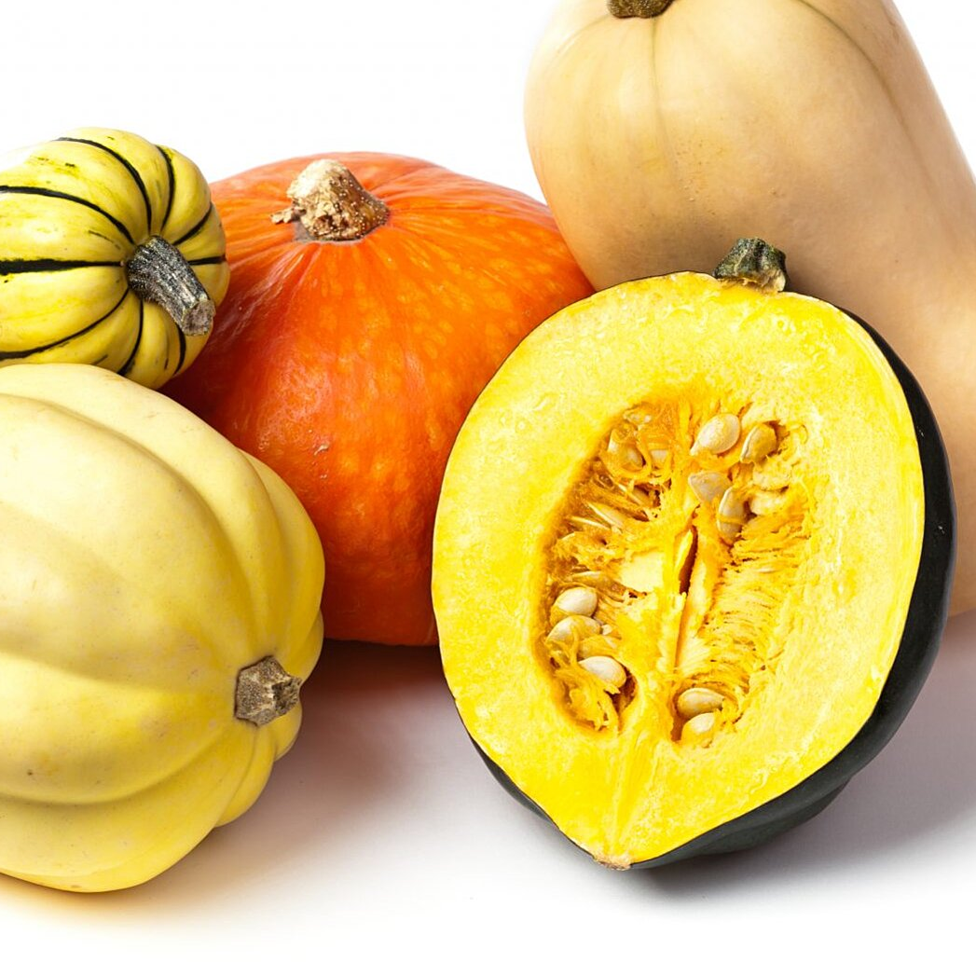
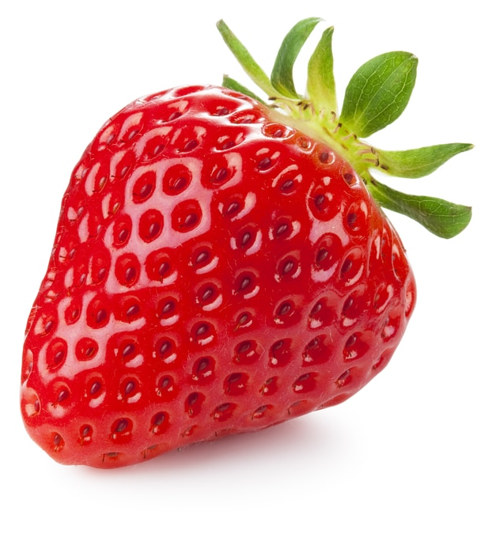
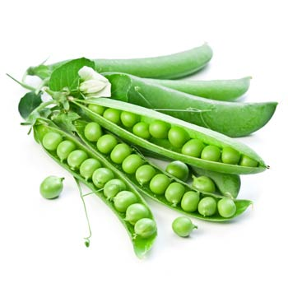
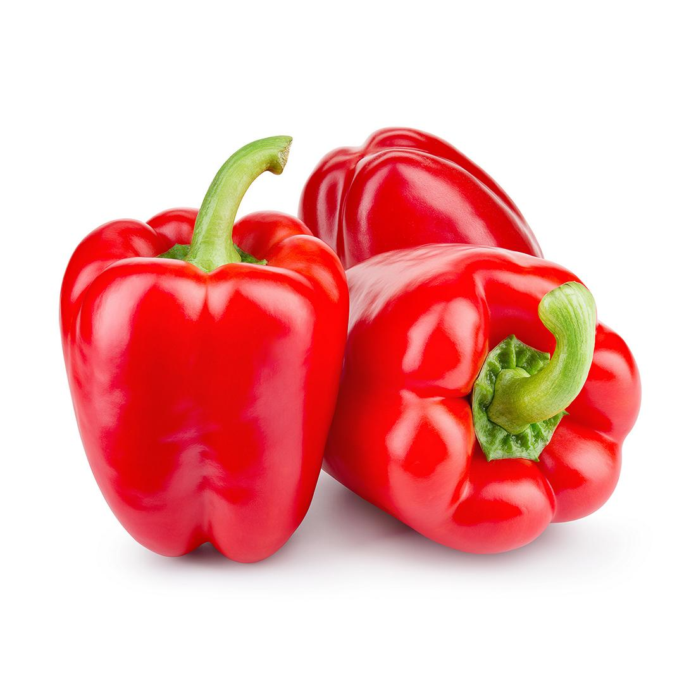
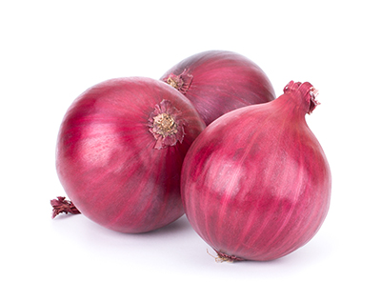
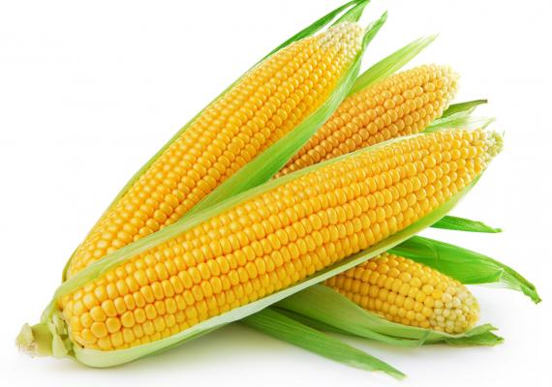
Fruit and vegetable production is important in the Northeast, and particularly NYS. Of course, we have a large population in the Northeast so consumption is important too. National importance for:

Slide 6
Fruit Production in the Northeast is important

Slide 7
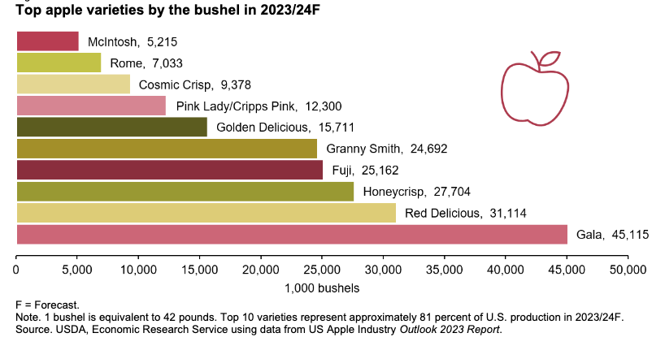

Slide 8
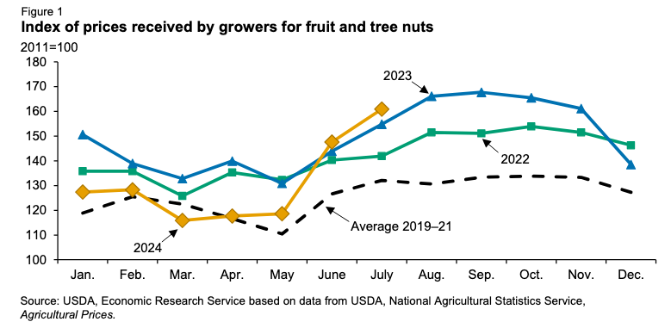
Overview of Recent Fruit Crop Price Trends

Slide 9
Fresh fruits – Consumer price index
(1982-84=100)
Source: U.S. Department of Labor, Bureau of Labor Statistics. CPI for All Urban Consumers

Slide 10
Processed and Frozen F&Vs Consumer price index (1997 =100)
Source: U.S. Department of Labor, Bureau of Labor Statistics. CPI for All Urban Consumers

Slide 11
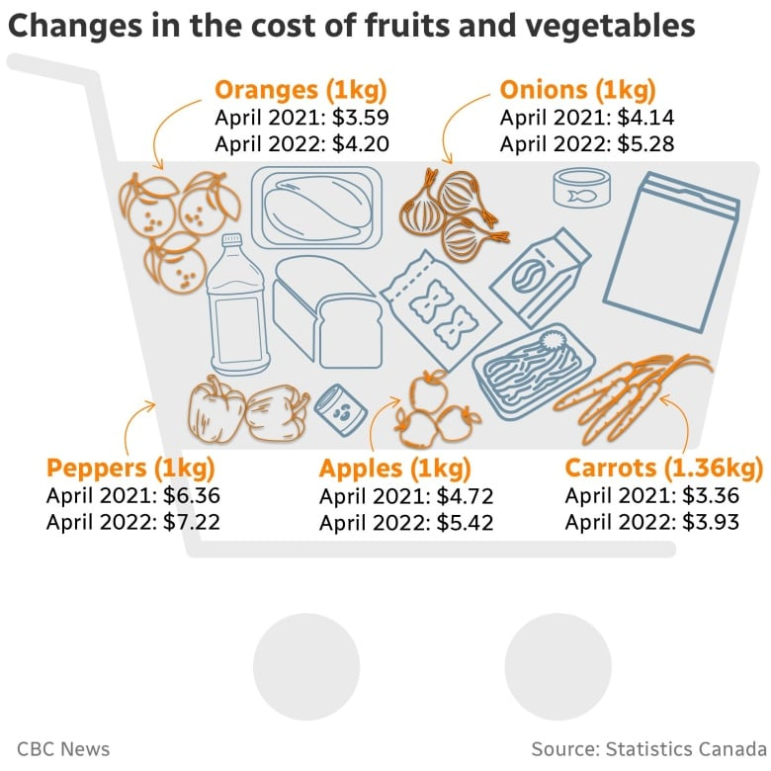
Outlook Issue: Consumer Price Trends
We have seen blame focused towards food retailers and food manufacturers for trying to gouge consumers…

Slide 12
Outlook Issue: Consumer Price Trends
During the past few years we have read much about food inflation, including some of the causes and consequences
Food price inflation is expected to ease in 2025 (greater easing at food retail/FAH relative to food service/FAFH)
The food manufacturing and food retailing sectors remain quite competitive. Some price shifts might be seen as opportunistic and remain “sticky” but much of the food increases/decreases are related costs for inputs/ingredients (e.g., labor, fuel, and materials)

Slide 13
Consumer Price Index item | Annual 2022 | Annual 2023 | 20-year historical average (2004–23) | Prediction interval 2025
 | Percent change |  |  | Percent change
 |  |  |  | Lower | Mid | Upper
All food | 9.9 | 5.8 | 3.0 | -1.2 | 1.9 | 5.2
Food away from home | 7.7 | 7.1 | 3.4 | 1.8 | 3.5 | 5.3
Food at home | 11.4 | 5.0 | 2.7 | -3.7 | 0.8 | 5.8
Meats, poultry, and fish | 9.6 | 2.0 | 3.3 | -3.0 | 2.8 | 9.0
Meats | 8.2 | 2.1 | 3.4 | -5.5 | 2.0 | 10.3
Beef and veal | 5.3 | 3.6 | 4.3 | -5.9 | 3.8 | 14.9
Pork | 8.7 | -1.2 | 2.5 | -8.4 | 0.0 | 9.4
Other meats | 14.2 | 4.5 | 2.8 | -2.5 | 1.7 | 6.0
Poultry | 14.6 | 3.1 | 3.0 | -2.6 | 1.7 | 6.2
Fish and seafood | 9.1 | 0.3 | 3.2 | -3.3 | 0.8 | 5.0
Eggs | 32.2 | 1.4 | 4.1 | -9.2 | 11.4 | 37.7
Dairy products | 12.0 | 4.0 | 2.5 | -4.6 | 0.8 | 6.4
Fats and oils | 18.5 | 9.0 | 3.6 | -6.9 | 0.1 | 8.0
Fruits and vegetables | 8.5 | 2.5 | 2.2 | -3.5 | 0.6 | 4.8
Fresh fruits and vegetables | 7.5 | 0.8 | 2.0 | -3.5 | 1.4 | 6.3
Fresh fruits | 7.9 | 0.7 | 2.0 | -4.2 | 1.7 | 7.9
Fresh vegetables | 7.0 | 0.9 | 2.1 | -5.3 | 0.2 | 6.2
Processed fruits and vegetables | 12.0 | 8.0 | 2.9 | -5.5 | -1.0 | 3.5
Sugar and sweets | 10.4 | 8.7 | 2.8 | -1.3 | 3.3 | 8.1
Cereals and bakery products | 13.0 | 8.4 | 2.9 | -6.6 | -1.6 | 3.7
Nonalcoholic beverages | 11.0 | 7.0 | 2.2 | -1.6 | 2.6 | 7.2
Other foods | 12.7 | 6.6 | 2.4 | -5.4 | -0.9 | 3.8

Slide 14
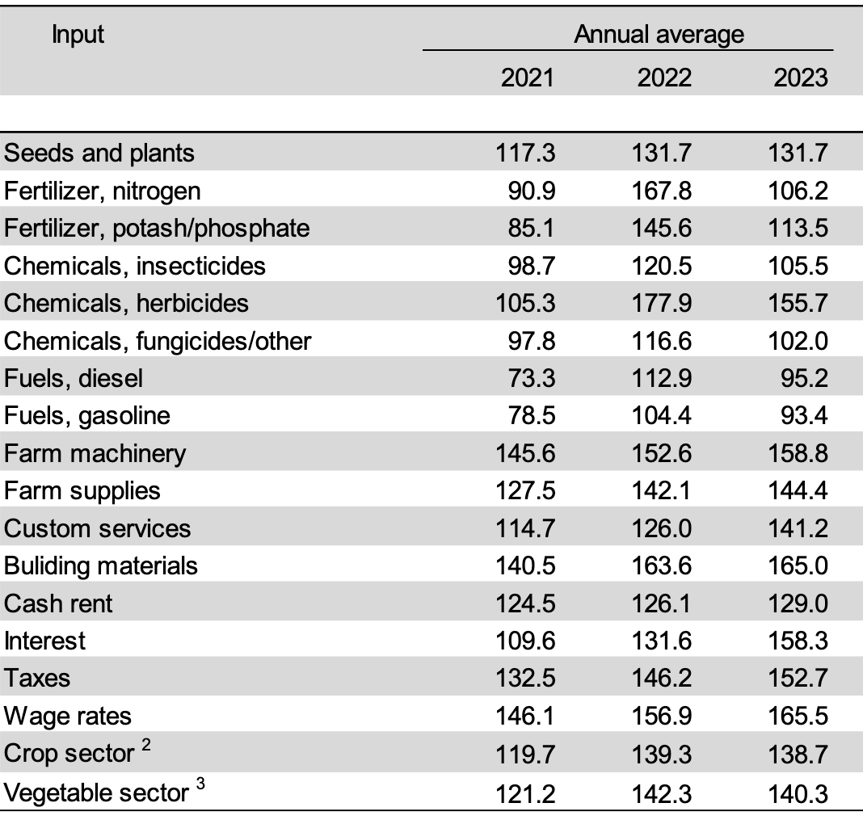

Slide 15
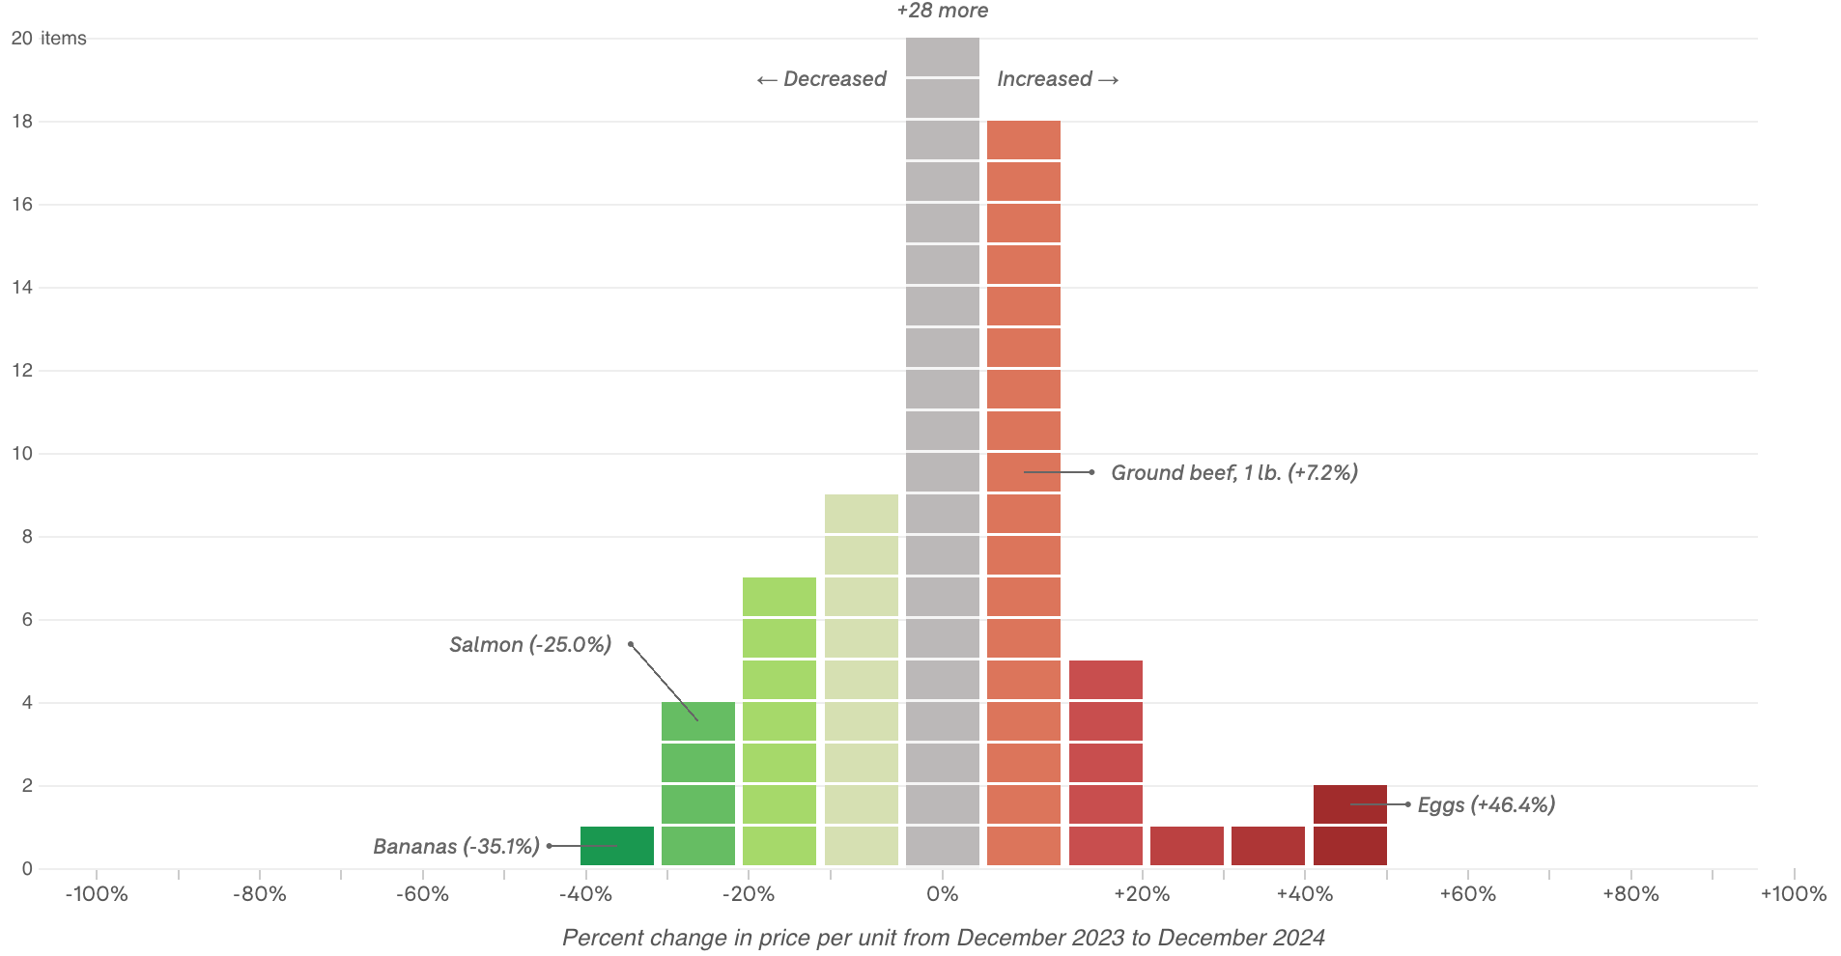
Price Inflation, 2023 to 2024

Slide 16
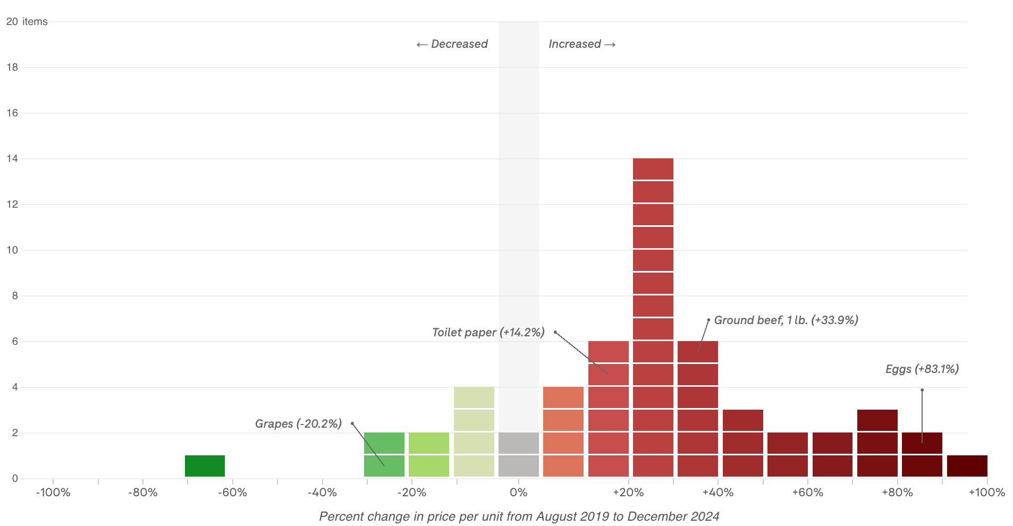
Price Inflation, 2019 to 2024

Slide 17
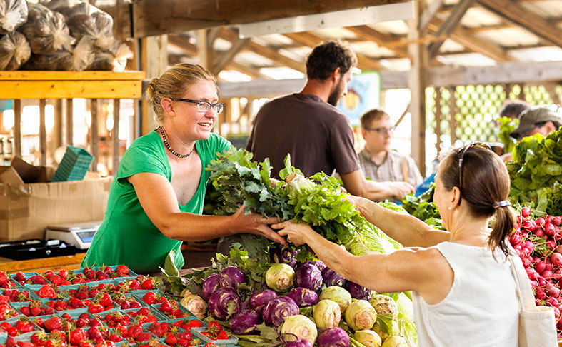
Vegetables
Image: https://statlerhotel.cornell.edu/explore/ithaca-farmers-market

Slide 18
Vegetable Production in the Northeast for selected crops

Slide 19
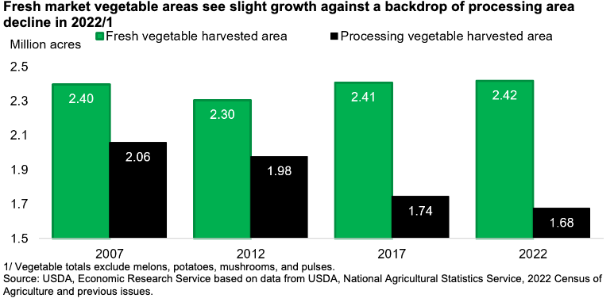
Vegetable Production 2007 to 2022 (Census)

Slide 20
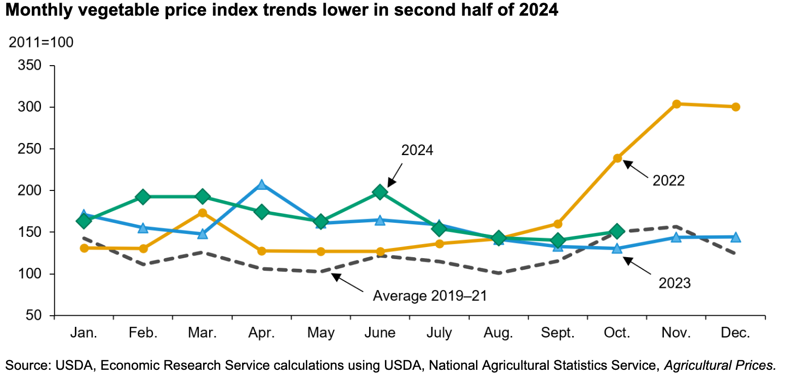
Vegetable Producer Prices and Seasonal Demand

Slide 21
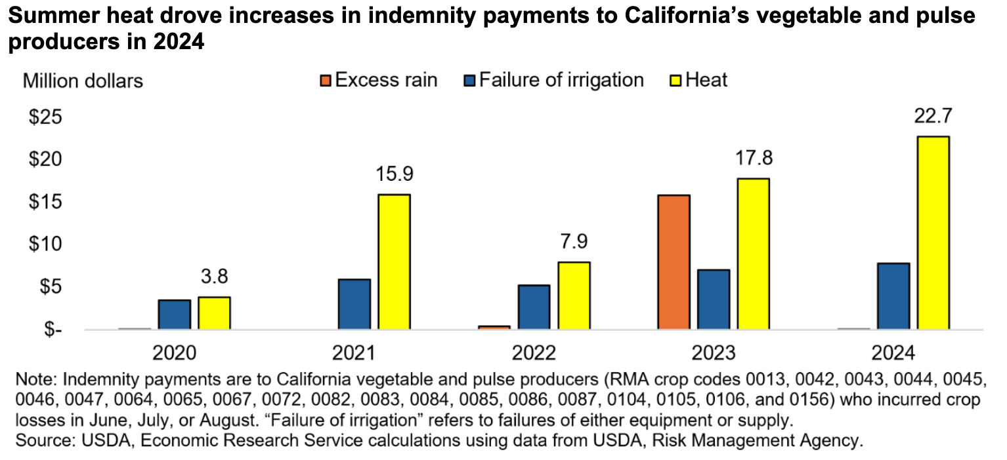
Vegetable Producer Prices and Weather (in CA)

Slide 22
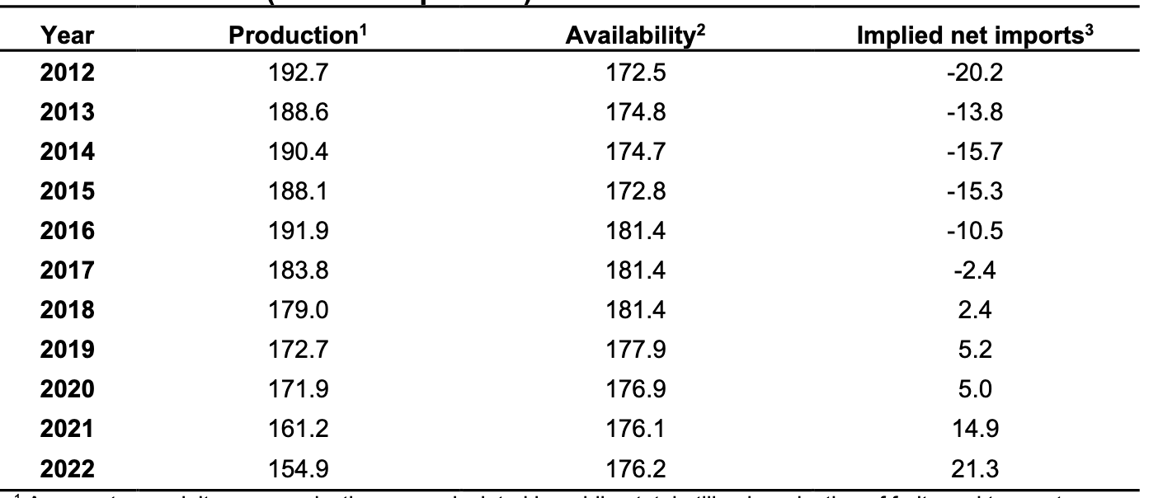
Outlook Issue: U.S. Vegetable Trade (billions pounds)

Slide 23
Outlook Issue: International Trade
We hear that there may be new tariffs placed on a variety of products imported into the United States, and this could likely affect vegetable imports
Quick Review
Tariffs increase cost of imported goods and then also raise prices of the similar products that are produced domestically
This is good for domestic producers facing import competition, but bad for domestic consumers that purchase these items
On net the benefits to producers are less than the additional costs to consumers

Slide 24
Climate change and fruit production:
To cover, adopt/select, or migrate?
Bradley RICKARD
Yu Ping CHANG
Alex SUSSKIND

Slide 25
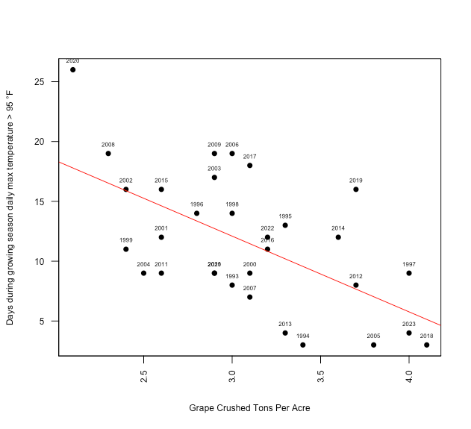
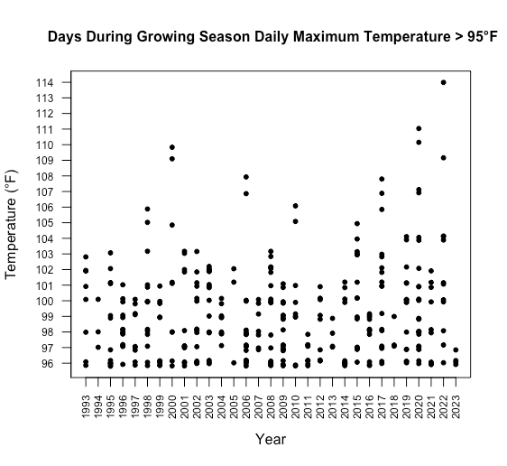
Motivation (Napa County and Cabernet Sauvignon)

Slide 26
Overview
This project started with a standard WTP experiment to examine consumer response to different climate change adaptation strategies
And then we decided to examine the financial implications of adaptation strategies for growers
The financial implications for adaptation strategies are mostly straightforward for most perennial fruit growers, but for winegrapes (and wine) the consumers are often very cognizant of the cultivar and the region of production, and might resist changes
Extreme temperature events have been shown to lower yields and/or lower fruit quality (lower prices)

Slide 27
Adaptation Strategies
Three Adaptation Strategies to manage high temperature events in winegrape production:
Employ technologies to Cover the fruit
Adopt/Select different cultivars/varieties
Migrate to new region

Slide 28
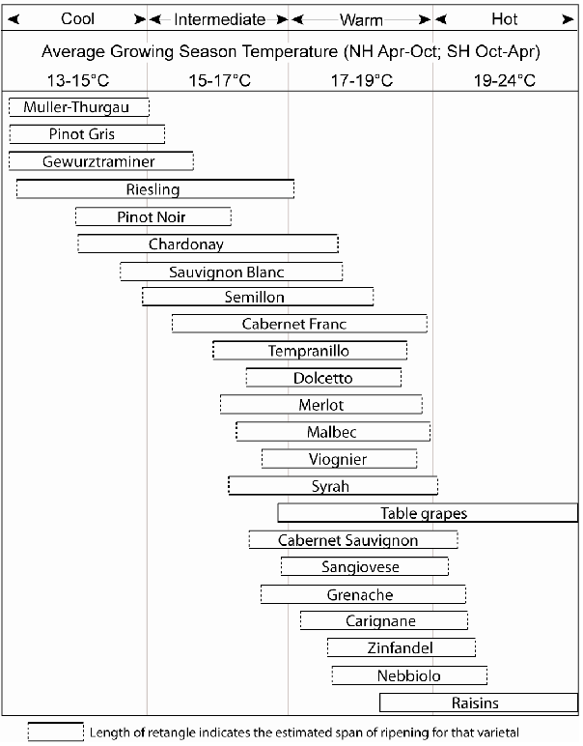
Climate-Maturity Groupings for Selected Varietals (source Jones 2012)

Slide 29
General Approach
NPV analysis that augments details provided in recent Cost of Production Studies published by the UCCE
Revenue and cost flows over a 30-year period
We simulate the effects of potential temperature events on yields in the revenue calculations
Consumer survey that elicits WTP for wines produced under the different adaptation strategies with/without information
We used the WTP details from the survey treatments to adjust prices for specific adaptation strategies

Slide 30
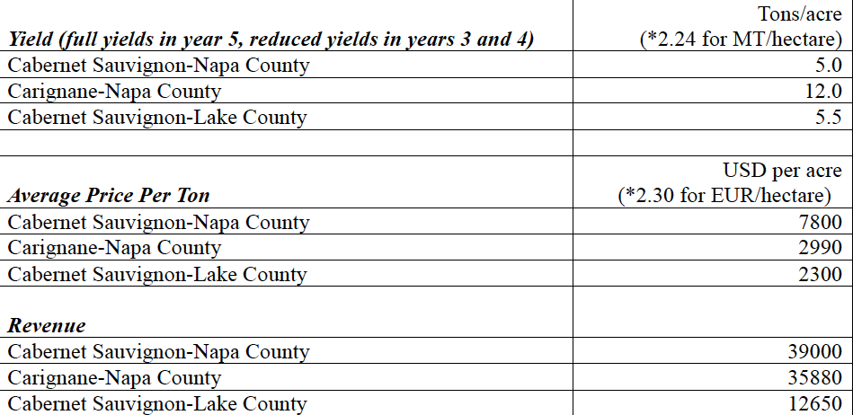
Some Key Parameters in the NPV Analysis

Slide 31
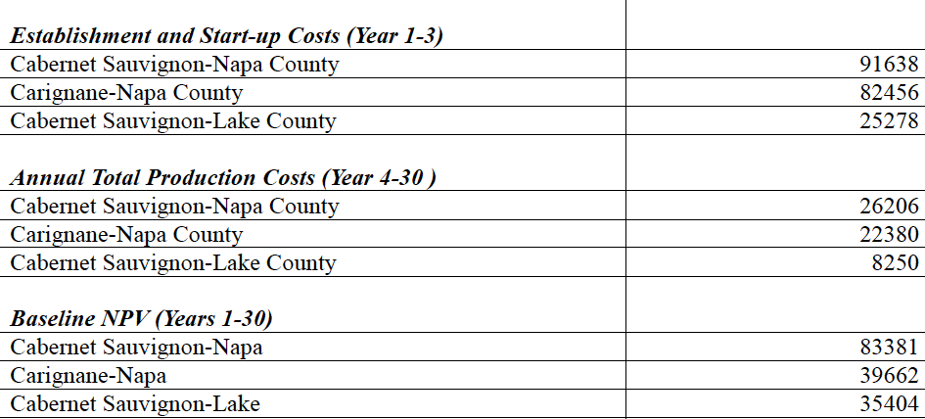
More Key Parameters in the NPV Analysis

Slide 32
Control Conditions and Treatments used in the Experiment

Slide 33
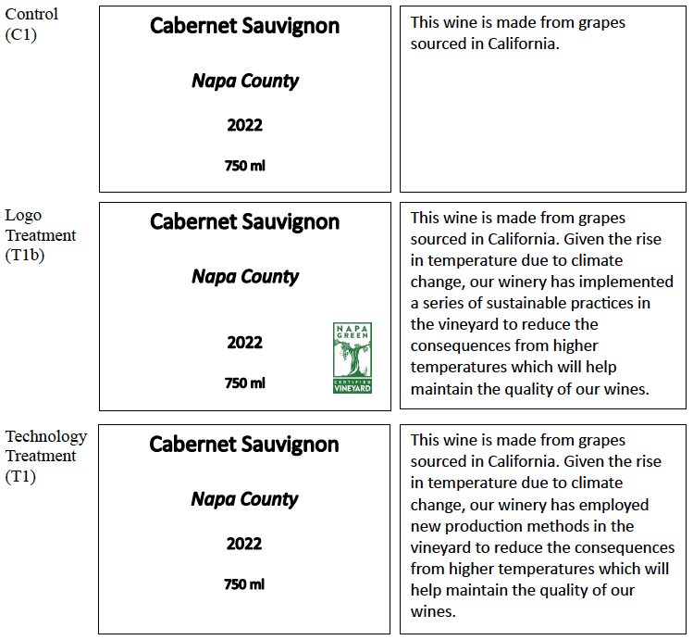
C1, T1, (and T1b) Labels
used
in
the
Survey

Slide 34
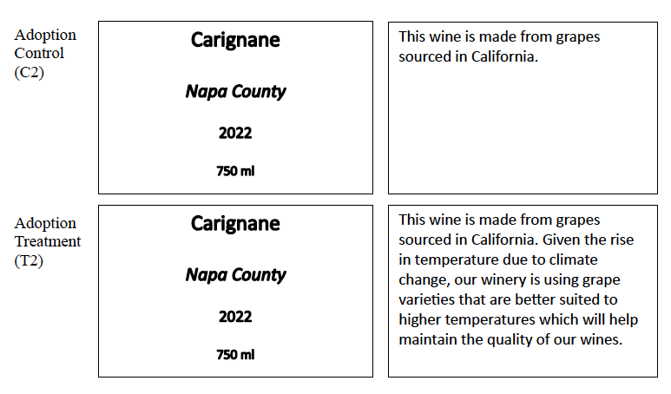
C2 and T2 Labels used in the Survey

Slide 35
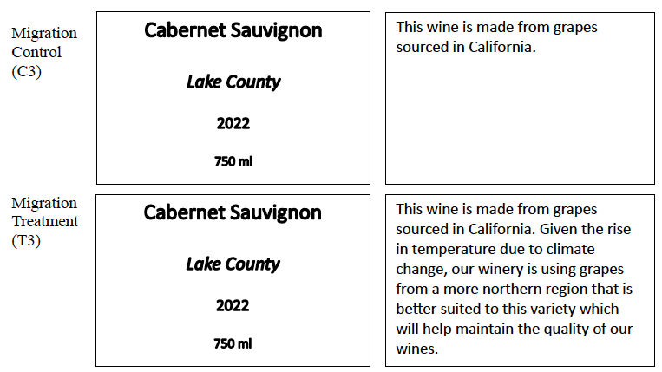
C3 and T3 Labels used in the Survey

Slide 36
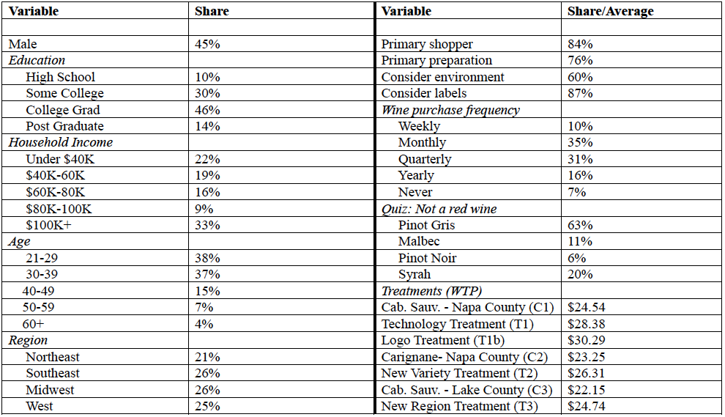
Summary Statistics from the Survey

Slide 37
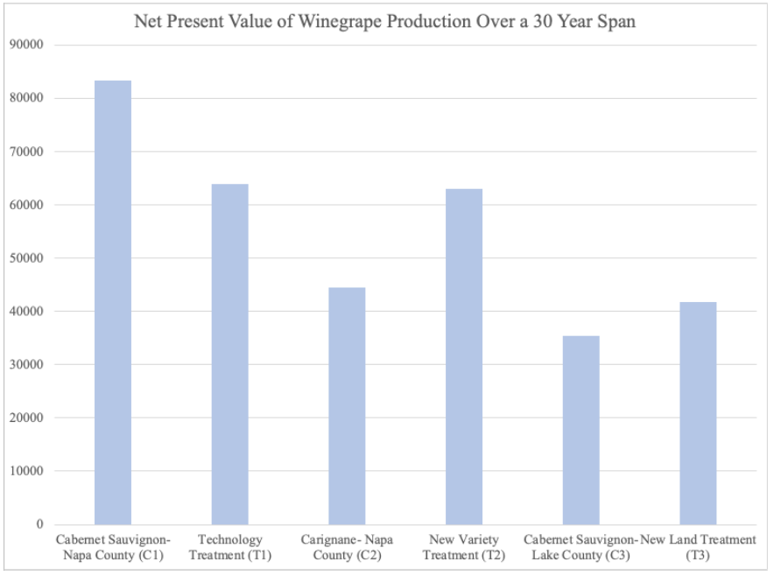
Preliminary NPV Results
(no extreme temperature events)

Slide 38
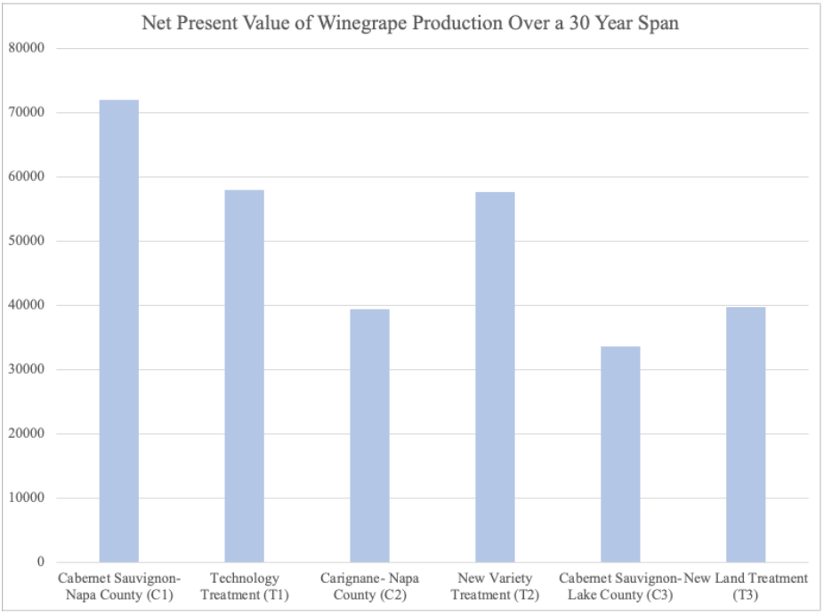
Preliminary NPV Results
(mild temperature events)

Slide 39
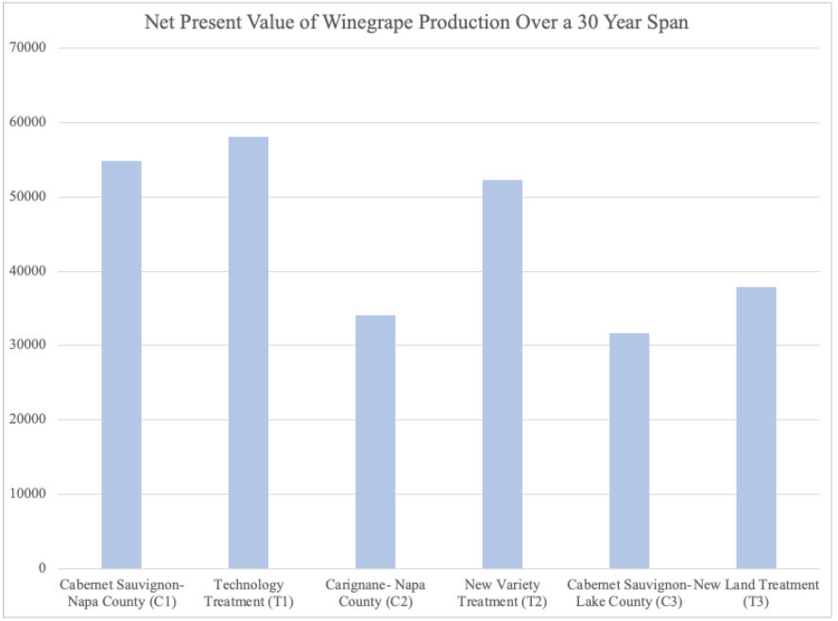
Preliminary NPV Results
(modest temperature events)

Slide 40
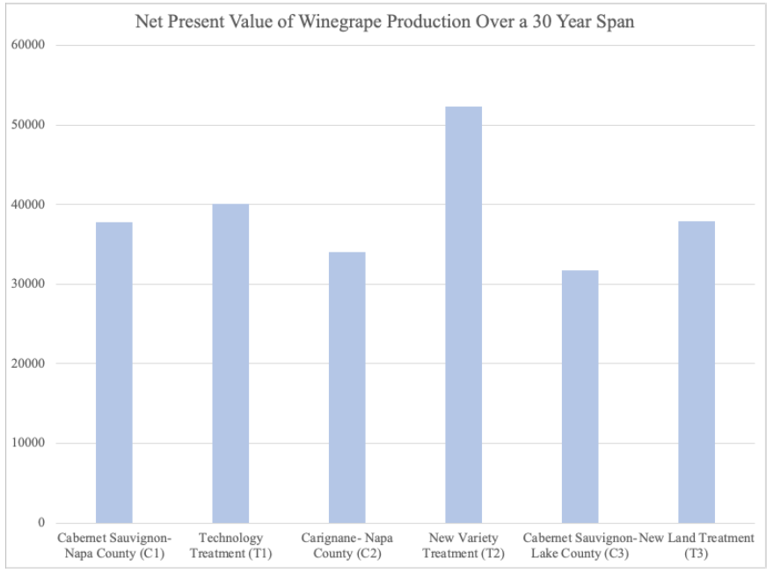
Preliminary NPV Results
(extreme temperature events)

Slide 41
Summary and Next Steps
Our preliminary results highlight that there may be positive financial implications associated with climate adaptation strategies
Extreme temperature events might be best managed with the adoption of different (heat-tolerant) cultivars
We also show cases when the use of sun shade technologies that protect the fruit (and doing nothing) might be best
Results ultimately depend on the effects to yields (magnitude and timing), the cost of the sun shade as well as consumer response to the strategy
Our survey results indicate that consumers are interested in all three adaptation tools

Slide 42
Thank you!
Questions or Comments?
Brad Rickard
607.255.7417
bjr83@cornell.edu

