Slide 1

The Grape, and Wine Situation and Outlook 2025 and Research Update
        Miguel I. Gómez, Jie Li, Allan F. Pinto, Kristen Park, Mauricio Guerra
        Dyson School of Applied Economics and Management
        Cornell University
        Cornell Agribusiness Economic Outlook Conference
        Ithaca, January 17, 2025

Slide 2
US Wine Industry –Lessons from 2024
Volume declines
Consumer exploration
Health and lifestyle impacts
Economic pressures
Oversupply challenges continue
Notes:
Volume Declines: U.S. wine market volumes fell by 5%, continuing multi-year downward trends.
Consumer Exploration: Younger demographics demonstrated loyalty challenges, exploring alternatives like craft beer, spirits, and seltzers.
Health and Lifestyle Impacts: Neo-prohibitionist messaging and “mindful drinking” trends reduced casual wine consumption.
Economic Pressures: Inflation and rising costs affected both consumer spending and operational efficiency for wineries.
Oversupply Challenges: Storage costs increased as excess inventory strained producers, particularly in entry-level segments.

Slide 3
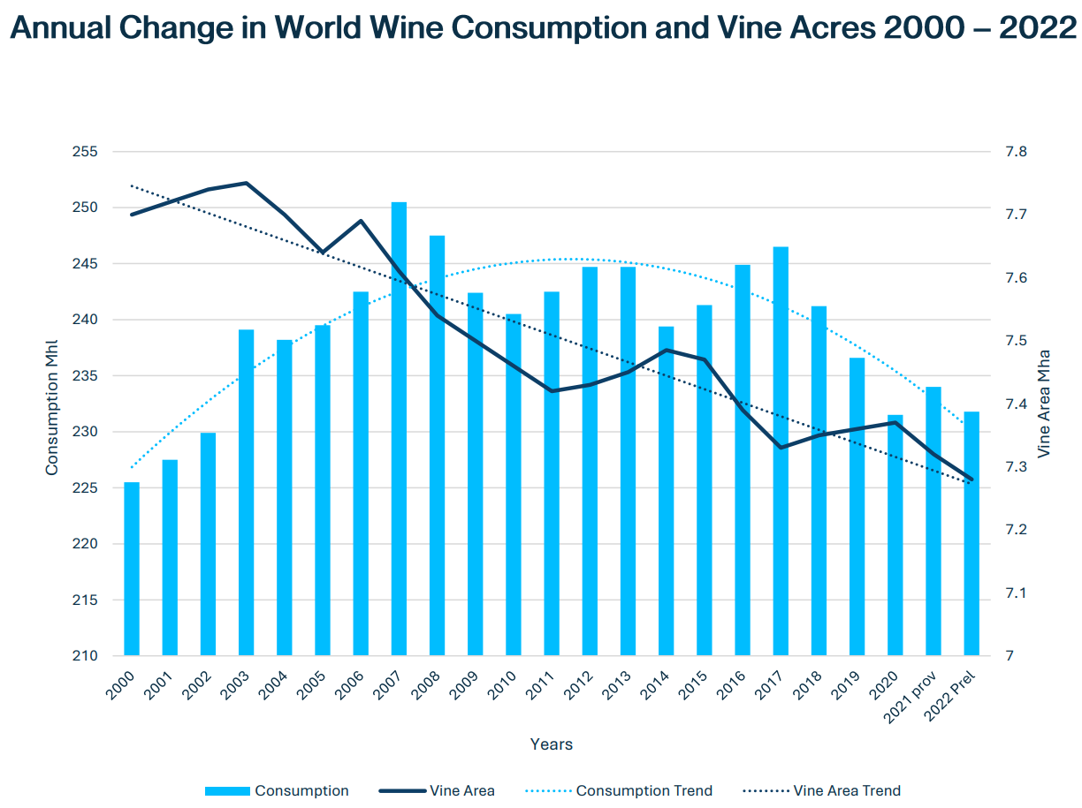
Source: State of Wine Industry Report 2024
Notes:
Global wine consumption has been on a decline since 2014, with only a brief pause in 2020, and vineyards are being reduced worldwide, while the anticipated boost from Chinese consumption has fallen due to a long-term decline following a crackdown on wealth display, leading to speculation about India as the next potential market.
The unit on Y axis (left side) is million hectoliter, a hectolitre (hL or hl) is volume measure and a metric unit equal to 100 litres

Slide 4
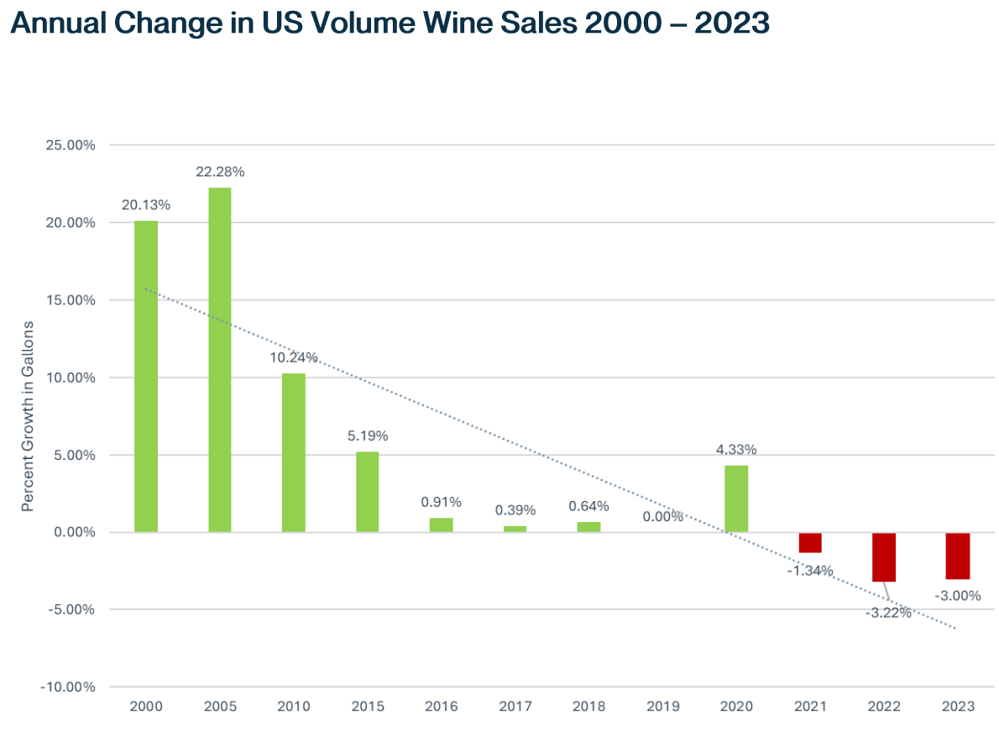
US wine sales declines
Source: State of Wine Industry Report 2024
Notes:
According to Shanken, 2023 will mark the third year of negative volume growth for the wine category and the first time in 45 years that the spirits market will surpass the wine market in total volume sales. In the US, full-category sales growth is declining and is forecasted to decline further by volume, according to almost every data source.

Slide 5
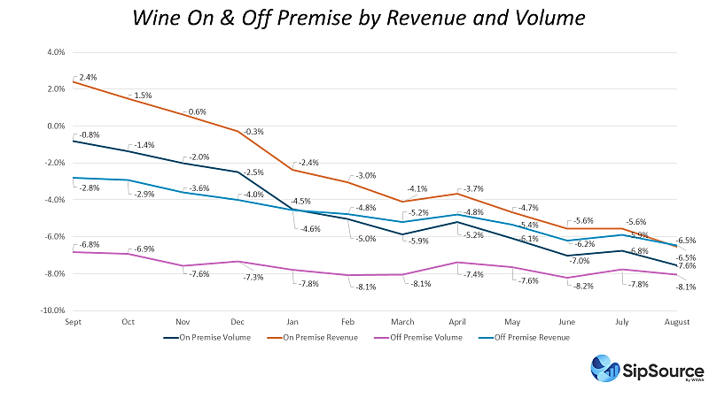

US wine sales cont. declined in 2024
Notes:
Wine off premise sale accounts for 36% and on premise sale accounts for 67% in 2022. From Sep. 2023 to August 2024, off and on premise wine sales decline each month with a slightly increase from March 2024 to April 2024.
The post-COVID decline in wine and spirits consumption appears to be accelerating. More troubling for the beverage industry is that premium-priced products, once a sales driver, are underperforming overall sales. Moreover, the latest data from the Wine and Spirits Wholesalers of America (WSWA) indicated that the current trends will likely continue for the foreseeable future.
The $8-$10.99 table wine price tier experienced a double-digit drop of 12.7% across combined on- and off-premise channels. changing consumption patterns, economic and inflationary pressures, and reduced shelf space” were all contributing factors.
However, Prosecco remains the top performer in the wine category. Prosecco's growth is moderate but still up +2.6% in the latest June-ending data.

Slide 6
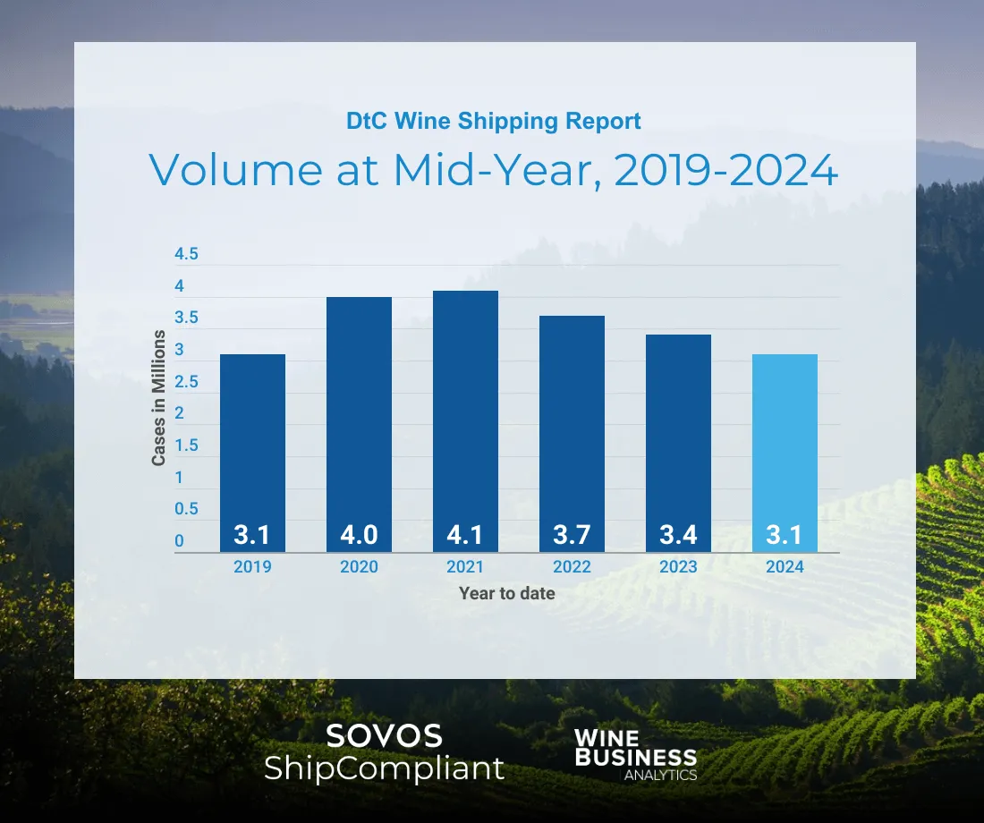
Source: https://sovos.com/blog/ship/2024-direct-to-consumer-wine-shipping-mid-year-report/
Notes:
The latest data for the U.S. wine DtC shipping market reveals shipment data trending downward. Nationwide, shipment volume has declined by 11% for the January-June 2024 period,
Miguel, slide 5 and 6 tell a similar story, so you do not need to present slide 6 if you do not have time.

Slide 7
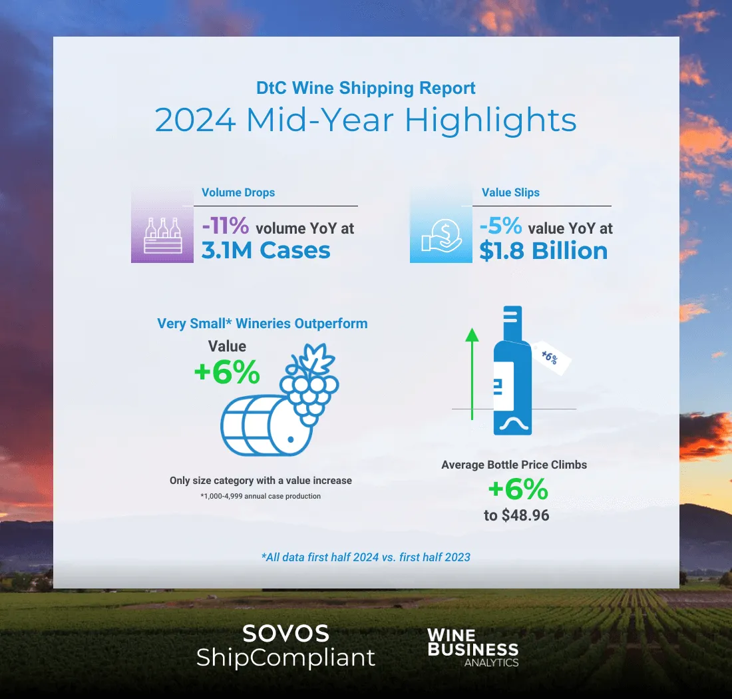
Source: https://sovos.com/blog/ship/2024-direct-to-consumer-wine-shipping-mid-year-report/
Notes:
The latest data for the U.S. wine DtC shipping market reveals shipment data trending downward. Nationwide, shipment volume has declined by 11% for the January-June 2024 period, amounting to 3.1 million in cases sold, while the overall value of these shipments has decreased by 5%, totaling $1.8 billion. Amidst these declines, the average bottle price has increased by 6%, reaching $48.96. All regions across the country experienced losses in both shipment volume and value, reflecting the broader challenges faced by the industry.

Slide 8
Outlook-Wine Industry 2025
Impact of trade policies
Climate change challenges
Shift in consumer preferences
Economic pressures and inflation
Advancements in sustainable practices
https://daily.sevenfifty.com/5-wine-industry-trends-to-watch-in-2025/
Notes:
Impact of the Second Trump Term on Trade
The reelection of Donald Trump introduces the possibility of new tariffs on European wine imports. This could lead to increased prices and decreased availability of imported wines in the U.S., while American wine exports may face retaliatory tariffs from the EU, potentially reducing their competitiveness abroad. SevenFifty Daily
Climate Change Challenges
The wine industry continues to grapple with climate-related issues, including unpredictable weather patterns and natural disasters. These challenges affect grape production and quality, prompting producers to adopt more resilient and sustainable practices to mitigate the impact of climate change. SevenFifty Daily
Shifts in Consumer Preferences
There is a growing consumer interest in low-alcohol and non-alcoholic wines, driven by health consciousness and moderation trends. Producers are responding by innovating and expanding their offerings in the no- and low-alcohol (NOLO) category to meet this demand. SevenFifty Daily
Economic Pressures and Inflation
Inflation and economic uncertainties are influencing consumer spending habits, with a tendency towards more affordable wine options. This shift pressures producers and retailers to balance quality with price competitiveness to attract cost-conscious consumers. SevenFifty Daily
Advancements in Sustainable Practices
The industry is increasingly focusing on sustainability, with a rise in organic and biodynamic wine production. Consumers are more environmentally conscious, leading producers to adopt eco-friendly practices and certifications to appeal to this market segment. SevenFifty Daily
These trends highlight the dynamic nature

Slide 9
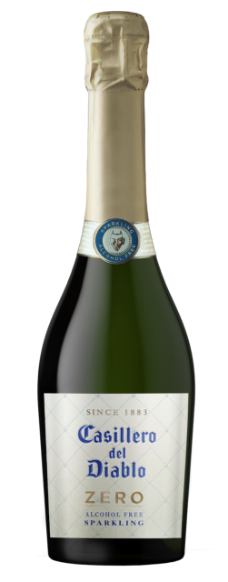
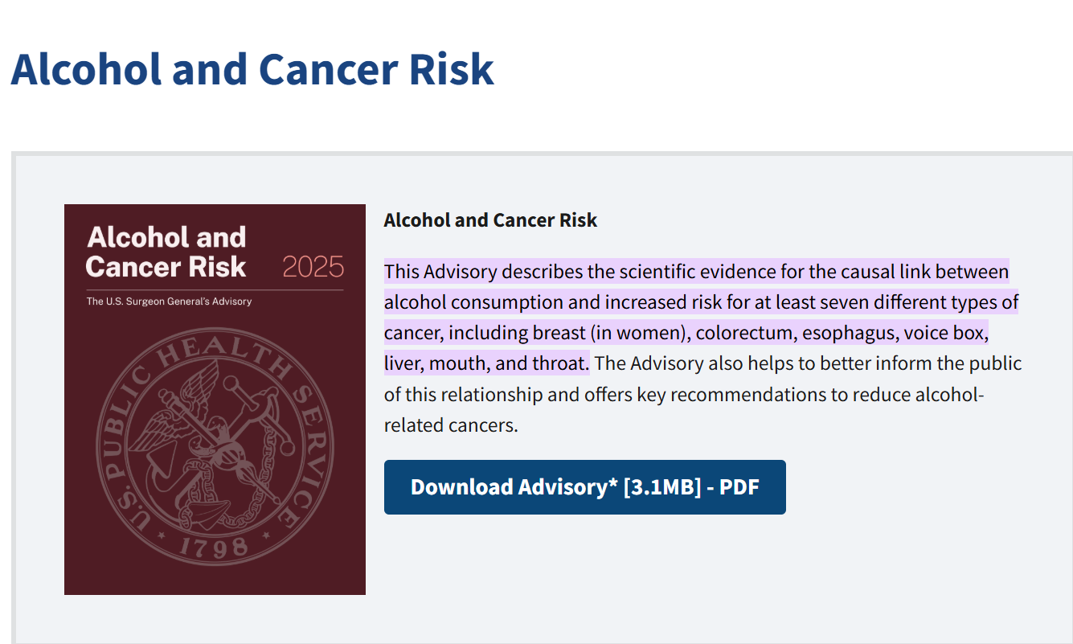
Low-alcohol wines for wellness-conscious consumers?
Notes:
https://www.thedrinksbusiness.com/2024/12/vina-concha-y-toro-enters-non-alcoholic-wine-into-uk-market/
Chilean wine brand Casillero del Diablo, owned by Concha y Toro, has launched its first alcohol-free wine in the UK market with the introduction of a de-alcoholised sparkling wine. Casillero del Diablo Zero is made from 100% early-harvested Chardonnay grapes sourced from the Central Valley of Chile.
The wine, which is gently de-alcoholised to retain the brand’s characteristic quality, is being released ahead of the festive season at a recommended retail price of £6 for a 75cl bottle.
This move marks a significant step for the brand as it expands into the growing no- and low-alcohol category, which has been gaining momentum in recent years across all alcoholic drinks, not just wine.

Slide 10
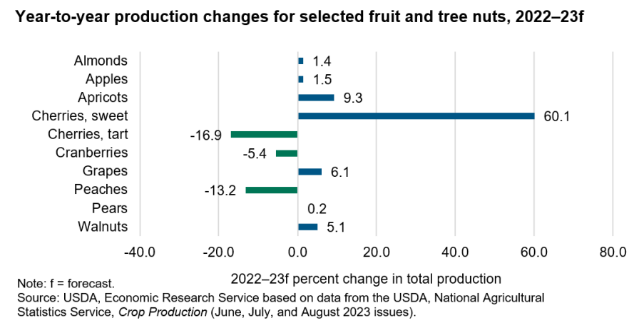
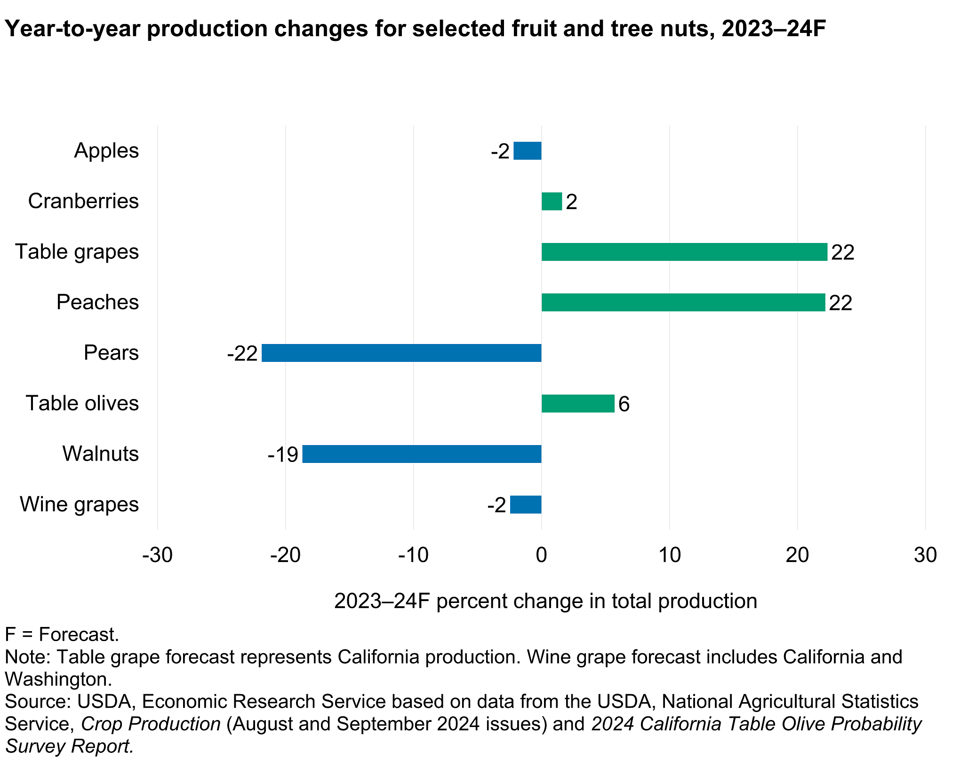
US Grapes Growing situation and outlook
Source: https://www.ers.usda.gov/topics/crops/fruit-and-tree-nuts/market-outlook

Slide 11
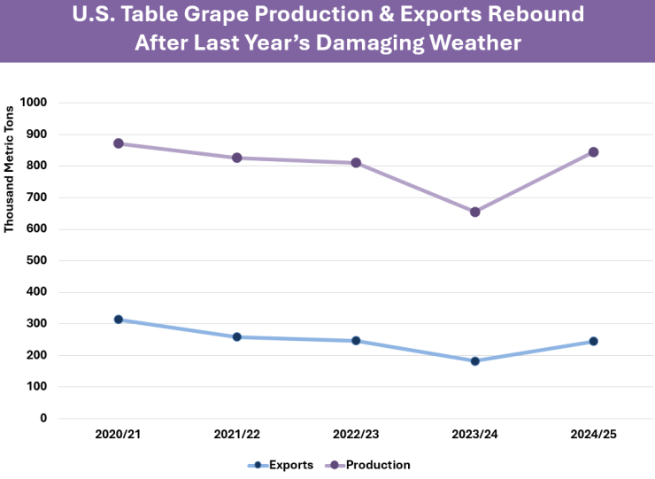
US Table Grapes growing situation and outlook
Source: https://apps.fas.usda.gov/psdonline/circulars/fruit.pdf
Notes:
U.S. production is projected up nearly 200,000 tons in 2023 to 845,000 in 2024 as California makes a full
recovery from last year’s damage from Hurricane Hilary. NASS surveyed industry and
published a U.S. forecast for table grapes production in the August 2024 Crop Production
report. Higher supplies are expected to push exports up 35 percent to 245,000 tons.
Imports are forecast down more than 30,000 tons to 760,000 on greater domestic
production, but the United States is expected to remain the top table grape importer. In
July 2024, USDA approved three regions in Chile to export table grapes to the United States
via a systems approach instead of methyl bromide fumigation which should allow higher
quality grapes to reach the U.S. market.

Slide 12
Research Update: Factors affecting grower adoption clean plant vines

Slide 13
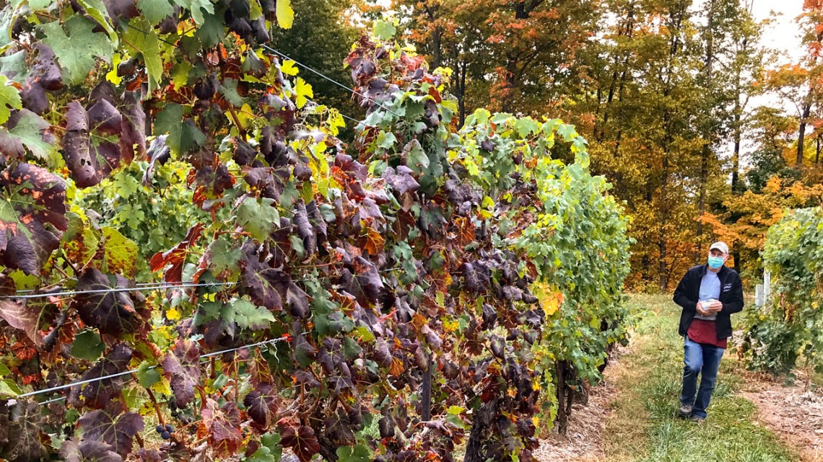
Viruses cost the grape industry billions annually if uncontrolled.
The National Clean Plant Network provides virus-tested vine stocks to reduce vineyard disease spread.
However, growers' adoption for virus-test vines is not as expected.

Slide 14
Investigating growers’ demand for clean grape plant material
Purpose of the study:
What are the factors (or attributes) that influence a grower’s adoption decision?
What is the demand among growers for clean plant material?
Why do (or do not) growers adopt?

Slide 15
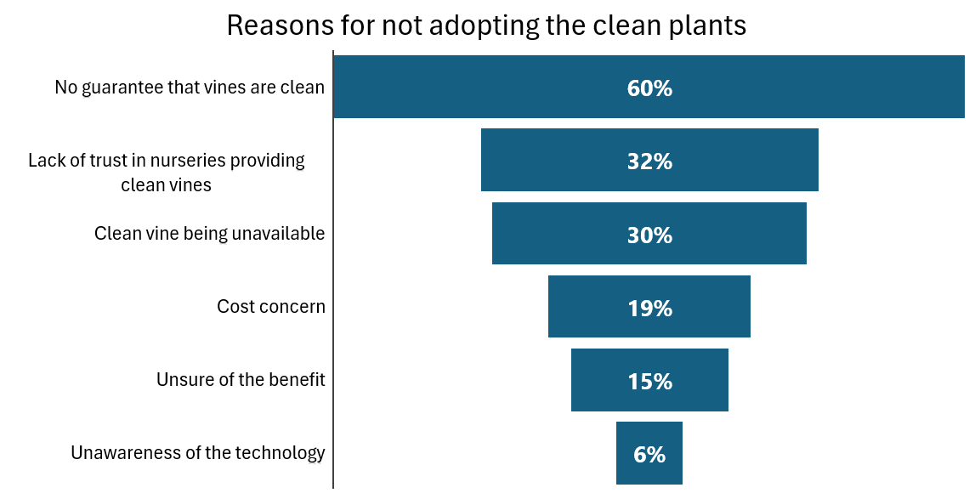

Slide 16
Quality and Trust in Certified Vines (35%)
Quality of Certified Vines (15%)
Nursery Trust and Standards (20%)
Cost and Economic Sustainability (30%)
Cost Concerns (20%)
Economic impace of virues (10%)
Virus Management and Spread (30%)
Virus Management Challenges
What they propose for future solutions
Environmental and Regional Challenges (5%)
What growers are concerned about

Slide 17

Main takeaway
The main barriers to adopting clean vines are no guarantees of cleanliness, lack of trust in nurseries, and limited availability.
Growers would pay high premium for clean vine ONLY IF the vines are clean.
Clear call with industry standard and certification program
Notes:
Certified vines are not always reliable, with issues like poor graft acceptance, trunk diseases, and inconsistencies in quality assurance.

Slide 18
Research Update: Economic Impact of Spotted Lanternfly on the NYS grape-wine industry

Slide 19
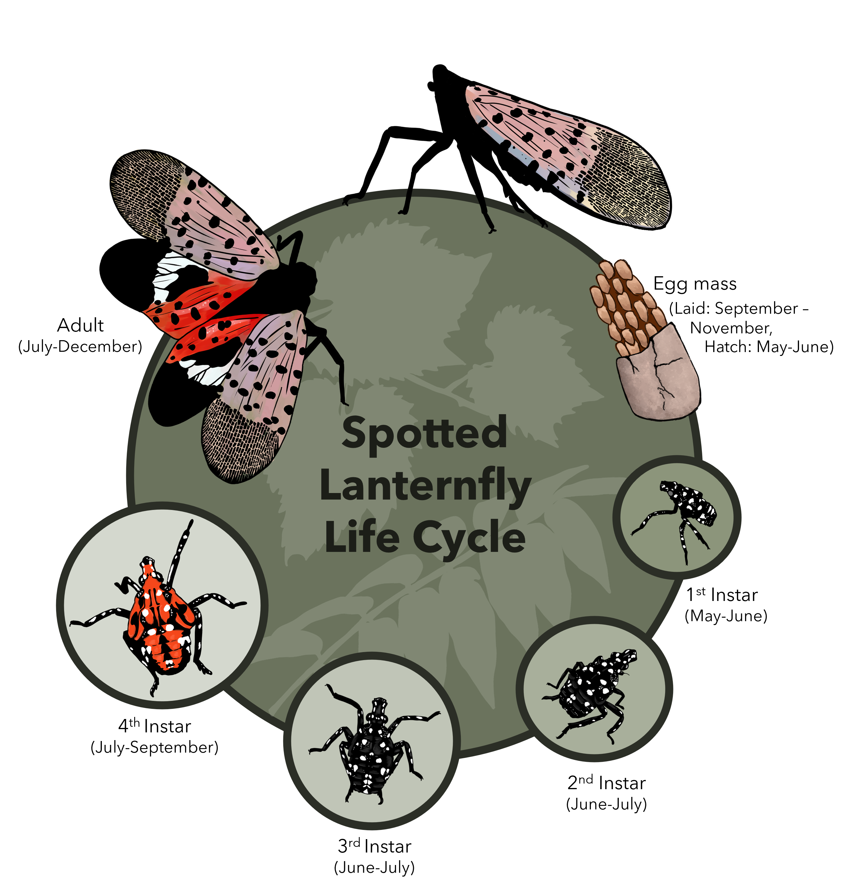
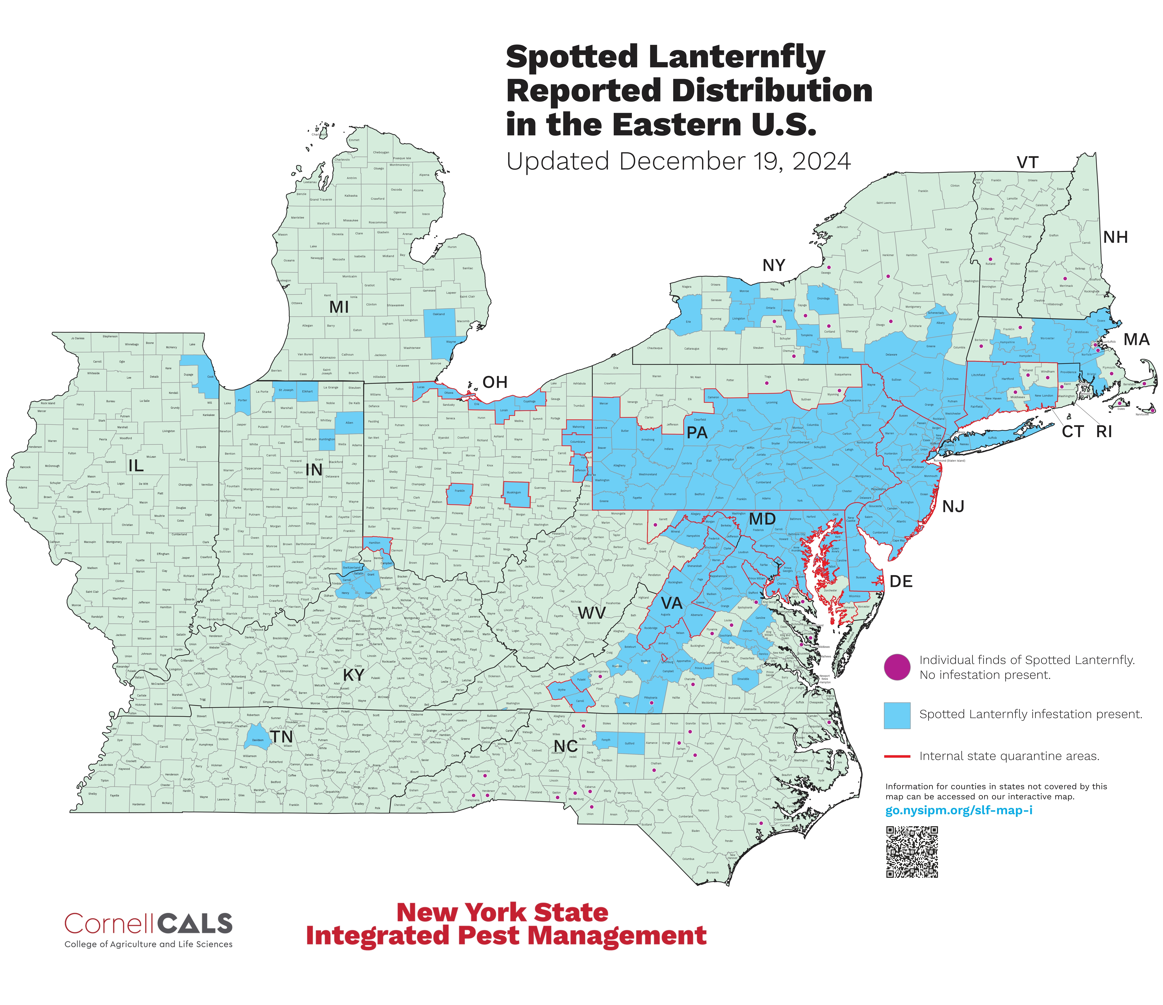
Spotted Lanternfly (SLF)

Slide 20
SLF Scenario Assumptions
Regions/places | Finger Lakes and Chautauqua-Lake Erie
Grapes varieties | Red: Pinot Noir, Cabernet Franc, Concord, Frontenac, and Marquette. White: Chardonnay and Riesling
Years for the analysis | 1st year, 2nd year, and subsequent years (3rd ,… n^{n})
Pesticides applications | Farmers do not increase applications to control for SLF
SLF feeding preferences | For this analysis, we assumed no preference or differential impact of SLF across Vitis species or grape varieties.
SLF impact | 1st year: Reduction in price (3%) 2nd year: Reduction in production (3%) and price (5%) Subsequent years: Reduction in production (8%) and price (10%)

Slide 21
SLF Potential
Economic Damage
Table 1. Potential total economic losses due to SLF infestation in the Finger Lakes, Lake Erie region, and NYS.
Region | Production (ton) | Value ($/ton) | Value lost after 1st year ($/ton) | Production lost in 2nd year (ton) | Value lost after 2nd year ($/ton) | Production lost in subsequent years (ton) | Value lost in subsequent years ($/ton)
Finger Lakes | 7,352 | 12,091,847 | 362,755 | 221 | 949,210 | 588 | 2,079,798
Lake Erie | 121,545 | 39,064,034 | 1,171,921 | 3,646 | 3,066,527 | 9,724 | 6,719,014
Total NYS | 128,897 | 51,155,882 | 1,534,676 | 3,867 | 4,015,737 | 10,210 | 8,798,812

Slide 22
Research Update: Apple Growers Preferences for Crop Load Technologies

Slide 23
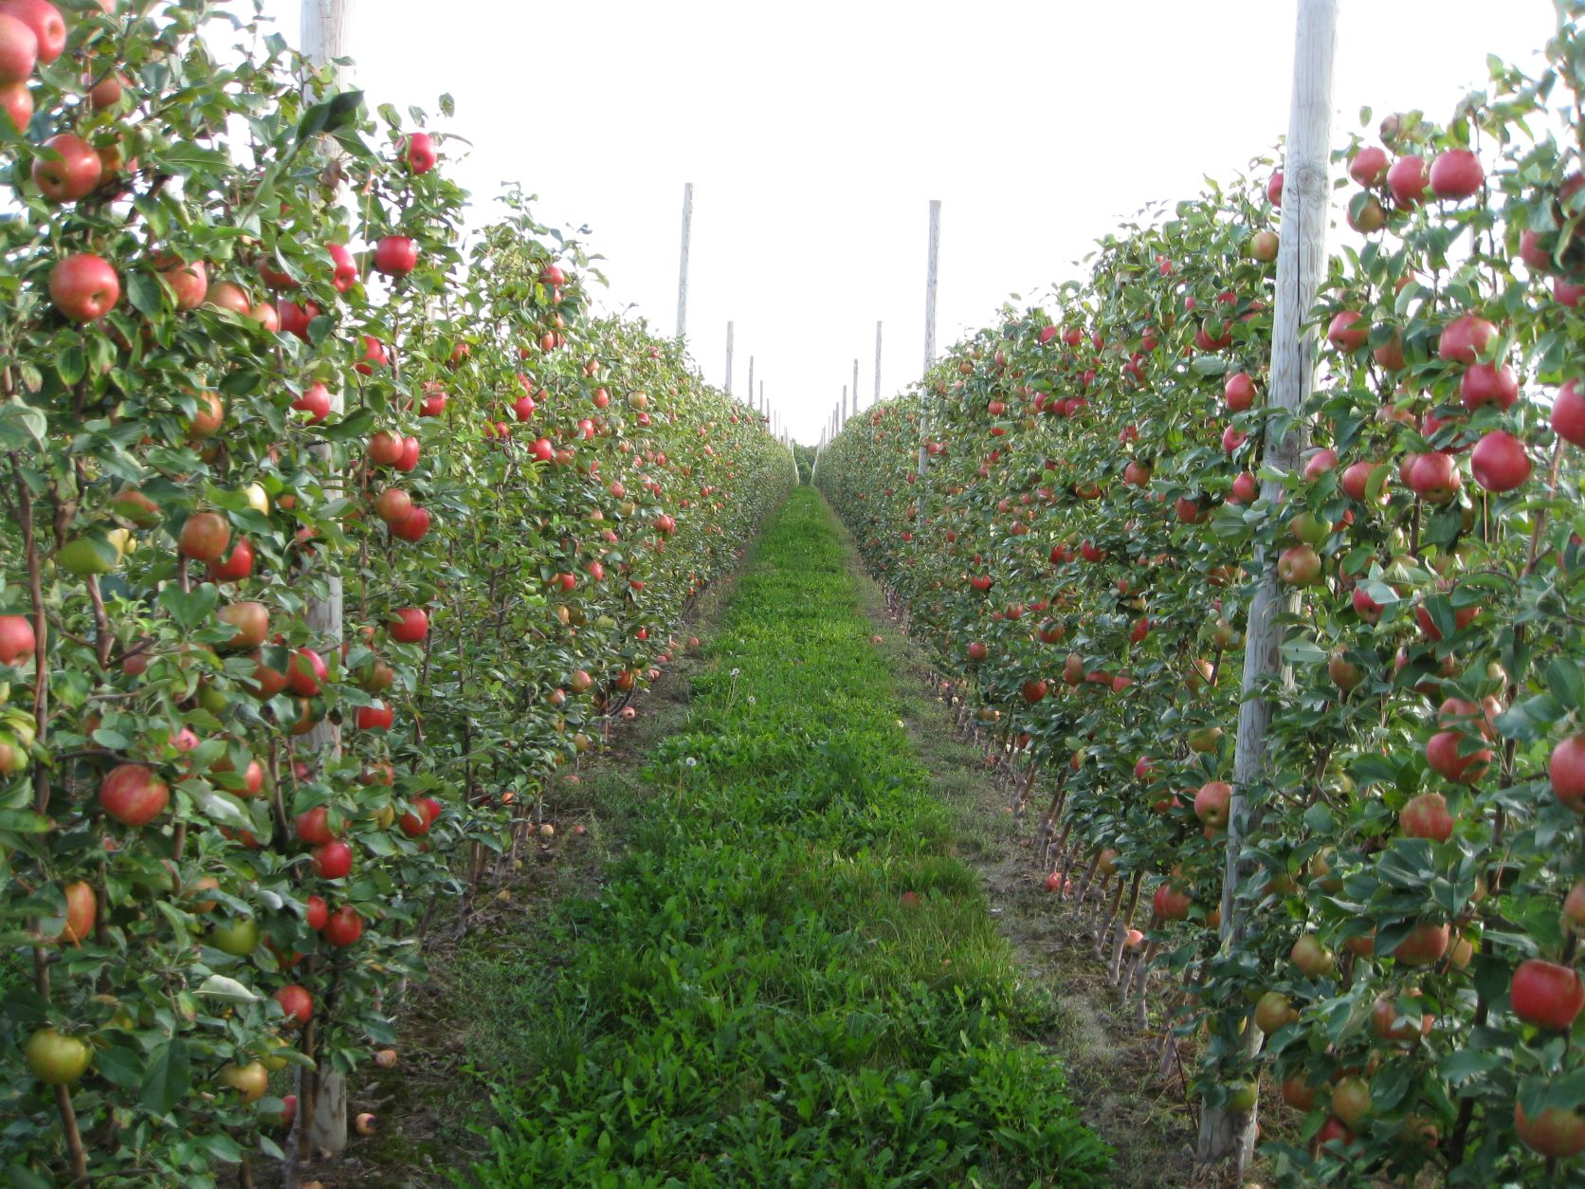
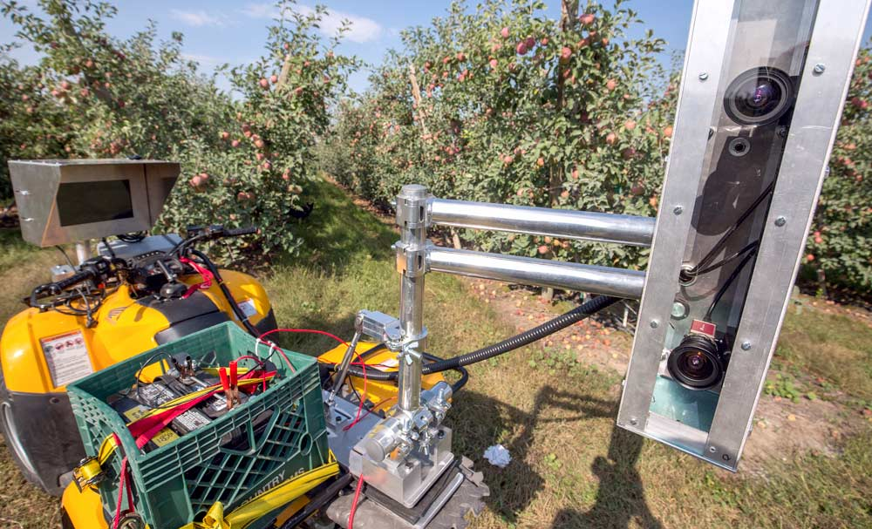

Topic:
Apple Growers Preferences for Crop Load Technologies
SCRI Precision Crop Load Management For Apples
Project Objective:
Add insight regarding grower behavior to identify effective ways to increase the adoption of Precision Crop Load Management Technologies in Apple Production
Research Question:
Which attributes of Apple crop load technology are important to growers’ adoption decisions

Slide 24
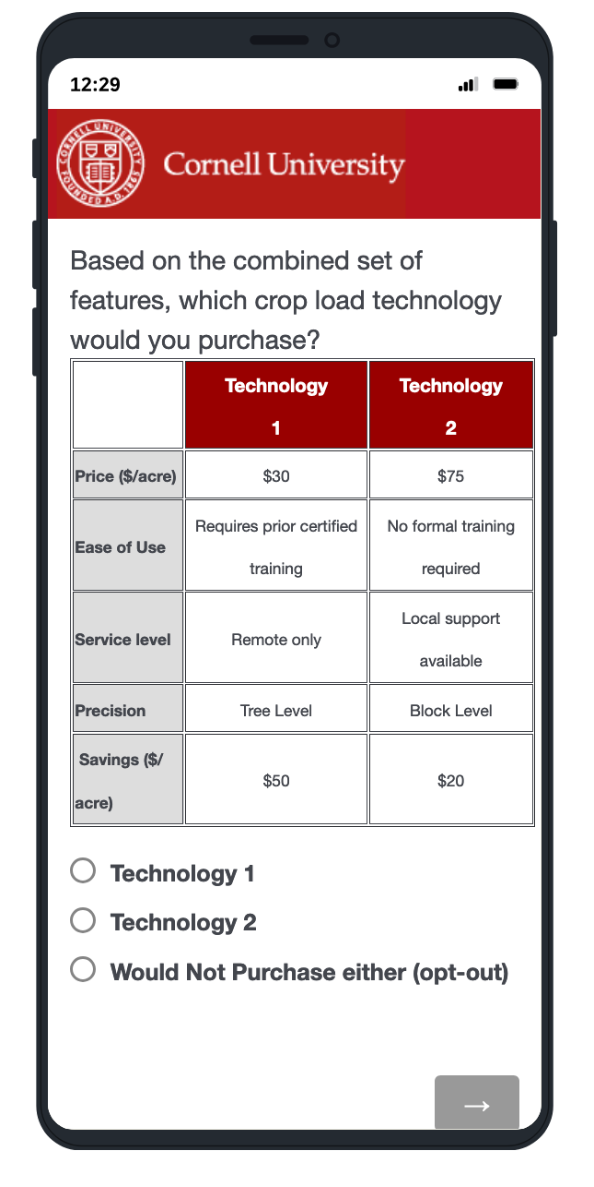
Method & Experimental Design:
Discrete Choice Experiment
Unlabeled D-Optimal Design balanced Fractional Factorial Design (2 blocks -randomly assigned by Qualtrics)
Attribute level combinations done using JMPTM.
8 Choice Sets (occasions per respondent)
Analyzed using Mixed Logit Model

Slide 25
Relative Attribute Importance
Results
WTP _{(willingness to pay)}
Attribute | Relative Importance
Service Availability | 50%
Ease of Use | 29%
Precision | 20%
Price | 1.2%
Savings | 0.9%
WTP for attribute level trade-offs | $ (USD) /Acre
WTP for having local service available relative to no service available | 41.5
WTP for local service available relative to online remote service only | 26.7
WTP for remote online service vs. no service available | 14.8
WTP for the Ease of Use of not requiring certified training to use the equipment | 23.5
WTP for having results at tree level precision vs. row level | 7.7
WTP for having results at tree level precision vs. block level | 16.2
WTP for having results at row vs. block level | 8.6

Slide 26

Implications
Prioritize Service availability
Simpler to Operate
Growers are willing to pay for it

Slide 27
Evaluating the Economic Impacts of Taste NY:
A Case Study of the Southern Tier Welcome Center Taste NY Store

Slide 28



Evaluating the Economic Impacts of Taste NY:
A Case Study of the Southern Tier Welcome Center Taste NY Store
Todd Schmit, Kristen Park, Jeffry Clausen, Jr., & Miguel Gómez
Charles H. Dyson School of Applied Economics and Management

Slide 29
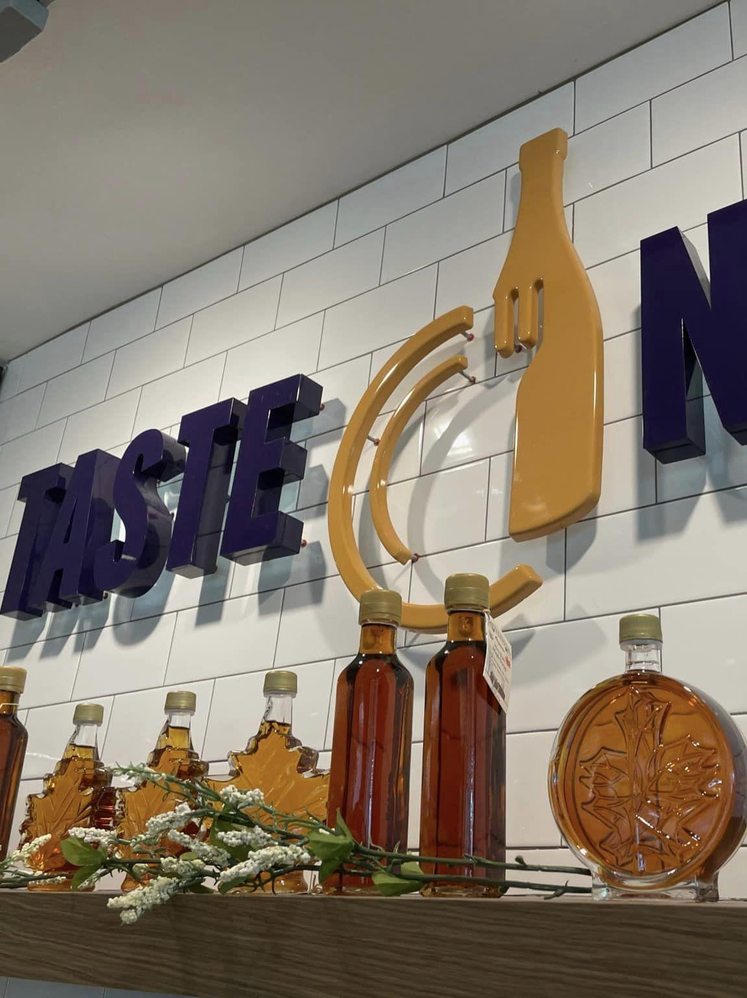
Research Objectives
Evaluate the benefits of Taste NY Southern Tier Welcome Center retail outlet to producers with products sold at the store.
Develop methodologies to assess the economic impact of local, Taste NY vendors on the local economy

Slide 30
Store Performance Indicators
Total store sales in 2022
$692,060
174K customer transactions
145 producers with 2022 product sales
representing 730 unique products sold
61 producers selling direct to the store
84 producers selling through wholesalers (7)

Slide 31
Performance Indicators
Store performance:
Supplier performance:
average gross margin
34.8%
average selling price
$6.35
average store sales per product
$948
average store purchases per producer¹
$2,797
average store purchases per supplier
$5,181
¹ Excludes wholesale and transport margins from producers selling through wholesalers.

Slide 32


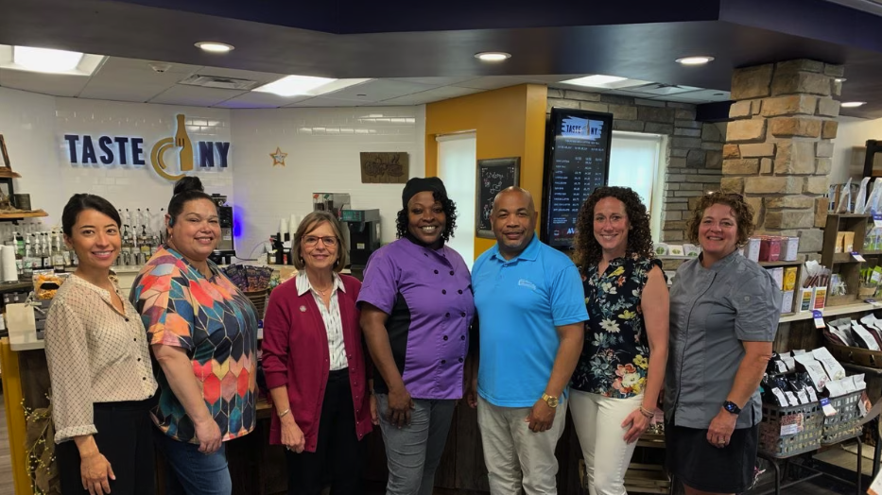
Additional Benefits
Taste NY stores can act as incubators for new producers and/or new products
The Southern Tier Welcome Center store provides significant educational programming, advice, and training beyond retail operations.
Aid to producers can include:
  packaging
  labels
  pricing
  other – tastings, event site to showcase products

Slide 33
Gross economic impacts of producer margin
Effect | Employment | Labor Income | Value Added | Output
Primary Ingredients Produced Outside NYS
Direct | 1.33 | 61,734 | 94,446 | 350,133
Indirect | 0.60 | 48,507 | 78,381 | 143,051
Induced | 0.39 | 29,999 | 53,519 | 80,981
Total | 2.32 | 140,239 | 226,346 | 574,164
Multiplier | 1.75 | 2.27 | 2.40 | 1.64
Primary Ingredients Produced Within NYS
Direct | 0.11 | 8,205 | 14,414 | 62,795
Indirect | 0.18 | 12,874 | 22,064 | 50,618
Induced | 0.07 | 5,743 | 10,245 | 15,502
Total | 0.36 | 26,822 | 46,723 | 128,915
Multiplier | 3.44 | 3.27 | 3.24 | 2.05

Slide 34
Benefit Cost Ratios and Reallocation Effects
Upper
Bound
Lower
Bound
BCR = 3.66
All sales are new demand
BCR = 1.17
50% of producers had no change in total sales volume (reallocation).
Overall, 25% increase in new demand.
BCR = 0.28
23% of increase in new sales specifically related to TNY.
Overall, 5.8% increase in new demand.
If, say, increased firm sales at farmers markets are due to the heightened visibility of the firm and their products through TNYs marketing efforts, this effect should be attributed to TNY. Similarly, product development through TNY that aided firms in accessing other local markets (e.g., grocery stores), can at least partially attributed to a TNY effect.

Slide 35
Thank you!!
Comments? Questions?
mig7@cornell.edu

Slide 36
SWD Exclusion Netting
Figure 1. Comparison of organic insecticide and exclusion netting three control efficiency levels for mixed cultivar and even split of production ($9.56/kg) accumulated cash-flow.

Slide 37
Control Environment Agriculture (CEA)
Parameter | Choice | Background/Justification
CEA Structure | Greenhouse | Year-round production, more affordable than indoor vertical farms, and aligned with regions with available land.
Crop | Lettuce, ready-to-eat | 3rd most consumed vegetable in the U.S. (behind potatoes and tomatoes); perishable crop benefits from being locally grown; consumer preference for ready-to-eat vegetables (no need to cook/process).
Size of Production Area | 10 acres in greenhouse | Economies of scale with a larger size greenhouse lead to overall lower production costs.
Degree of Automation | Automated production, semi-automated packaging | Automation reduces ongoing labor costs with higher upfront investment, balancing low-cost vegetables while providing local jobs.
Location of Operation | Jefferson County, NY | Rural location with affordable land and energy, and above-average unemployment rates.
Distribution Model | Grocery brands valued by cost-conscious shoppers and food-service/institutions | Products include 4 oz. clamshells of ready-to-eat lettuce priced at $2.99 for retail and bulk 3-lb. bags priced at $5.99 for food-service/institutions.
Labor Targets | Veterans and formerly incarcerated individuals | Collaboration with a local non-profit to provide job training and recruitment for most positions.

Slide 38
CEA Assumptions
Variable | Value
Weeks per year | 52
Ounce per kilogram | 35.274
Production area (ft² under greenhouse cover) | 435,600
Ounce per clamshell | 4
Space use efficiency | 90%
Pound per kilogram | 2.20462
Net production area (90% space use) ft² | 392,040
Pound per bag (lbs) | 3
Production in Year 1 | 50%
Kg production per year | 4,006,392
Production in Year 2 | 75%
Months per year factor | 12
Production in Year 3 | 90%
Market price for retail stores (4 oz) | $2.99
Percentage sold to retail | 0.7
Yield (fully operational) (kg/m²) | 110

Slide 39
CEA Profitability

Slide 40
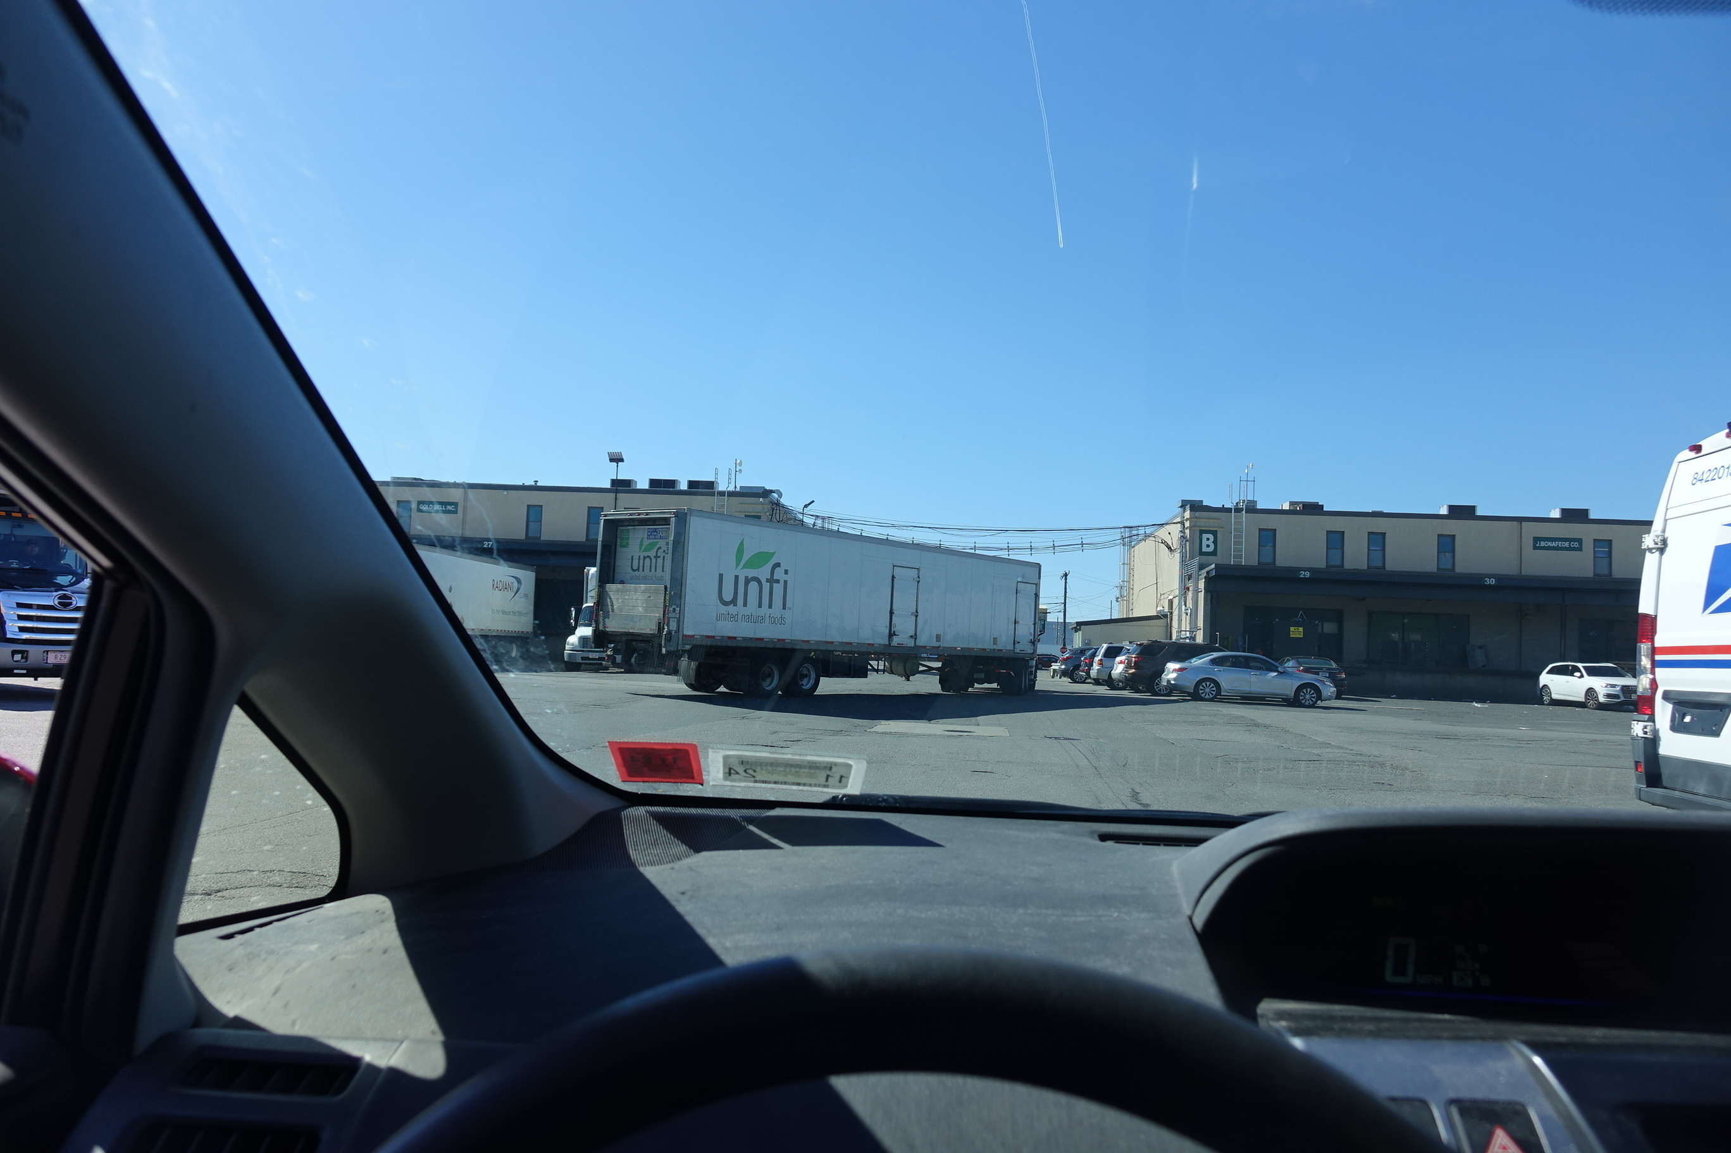
Wholesale Produce Markets:
On-Site Infrastructure Assessment
Kristen Park, Food Industry Management Program, Abigail B. Long, USDA-Local and Regional Food Distribution, Miguel Gómez, Food Industry Management Program
Notes:
USDA was directed by Congress to provide a report on infrastructure needs and supply chain shortfalls at wholesale produce markets. As a result, AMS Local and Regional Foods and Cornell have a cooperative agreement to study these markets.
Acknowledge team developed survey and the support of the NAPMM.

Slide 41
Why?
Public investment in infrastructure and transportation networks at wholesale produce markets has lagged,
  Outdated facility design and deferred maintenance,
  Transportation constraints that limit product movement to, from, and within the market, as the areas around them may have urbanized or transportation patterns may have changed.
Concerns post-covid about ability of the supply chain to
  Provide market access for producers and
  Ensure a safe and reliable supply chain
Notes:
Why is the study needed? Most of the current markets were built 50-100 years ago with support from public and civic leaders. While some have been maintained, there are some major infrastructures that need addressing.

Slide 42

Survey Highlights
Notes:
Governed by authorities or state departments with directives to support agricultural commerce in their regions
A few markets are held within the city government and operate closely with their urban food environment and have missions that align with the broader food community
Corporations or cooperatives made up of tenant wholesalers
I note these differences in ownership structure because I think it is relevant when we start talking about find the decision making and funding for improvements.
Dock improvements are by far the most common priority. As described it includes, “dock levelers, additional dock space, temperature controlled docks, etc.” We worked with the AMS architect to develop this list and the descriptions.
Building: exterior walls, roofs, flooring
Remember that a need mentioned by fewer people may be as great but in a different area, such as security.

Slide 43
Impacts of Infrastructure Needs on Business
Efficiency
Food safety requirements
Product quality
Ability to grow
Functional utilities
Centralized services
Notes:
When we interviewed the markets we asked how current infrastructure is impacting their tenants’ businesses. We heard many of the same themes, efficiency and handling, food safety, and maintaining product quality emerged as the leading issues.
If you remember this [dock] picture, you can see it all. Congestion, ambient temperatures. Somehow they are doing the dance every day, moving product in and out, but they know they can do better and want to do better and they want to be able to grow.
Many of them are also interested in centralizing some business services to make them more efficient. these include waste handling (packaging waste) and food waste and food recovery systems.

Slide 44
Conclusions
At a tipping point-need to improve efficiency and food safety compliance
  otherwise face loss of competitiveness and
  loss of customers
  critical now as need to integrate technology which is becoming more important for resiliency and competitiveness
Some may need help seeing a path forward
  some may lack owner assistance/support
  some may lack fundraising or development expertise
Notes:
Now may be a critical tipping point for markets. Those who do not have a plan for investments, need a plan. Food Safety Modernization Act impacts the whole supply chain. And suppliers need to be able to comply with customer food safety requirements. otherwise they are no longer competitive. They need improved efficiency and need to be able to integrate technology as needed.
Open for questions or comments…

