Slide 1




USDA’s Final Decision on Milk Pricing Under Federal Milk Marketing Orders
2025 Dyson Agricultural and Food Business Outlook
January 17, 2024
Chuck Nicholson
Associate Professor, UW-Madison

Slide 2
Agenda
What do FMMOs do?
Where are we in the process of changing milk pricing?
Why did we do this process?
What is in the Final Decision?
What will it mean for farm milk prices?
What are the next steps in the process?

Slide 3
Objectives of FMMOs
What do FMMOs do?
Original Legislation dates from1937, and it sets limits on what can be done with FMMOs
Objectives Include:
Promote orderly marketing in fluid (beverage) milk markets
Improve the income situation of dairy farmers
Supervise the terms of trade in milk markets to achieve more equality of bargaining power between producers and processors
Assure consumers of adequate supplies of quality milk at reasonable prices

Slide 4
Current Activities of FMMOs
What do FMMOs do?
Administer FMMOs and provide Order Statistics
  Classified pricing and pooling
  Collect dairy commodity prices
  Determine handler prices based on end products
  Establish minimum uniform prices across pool
  Weights and measures, component and volume audits
  Timely payments
  Market information

Slide 5
Current Activities of FMMOs
What do FMMOs do?
Administer FMMOs and provide Order Statistics
  Classified pricing and pooling
  Collect dairy commodity prices
  Determine handler prices based on end products
  Establish minimum uniform prices across pool
  Weights and measures, component and volume audits
  Timely payments
  Market information
Other Functions
Export certification services
Dairy Standards and Product grading
Administer the Fluid Milk Processor Promotion and the Dairy Research and Promotion programs (checkoffs)
Pandemic Market Volatility Assistance Program, Milk Donation Reimbursement Program, etc.

Slide 6
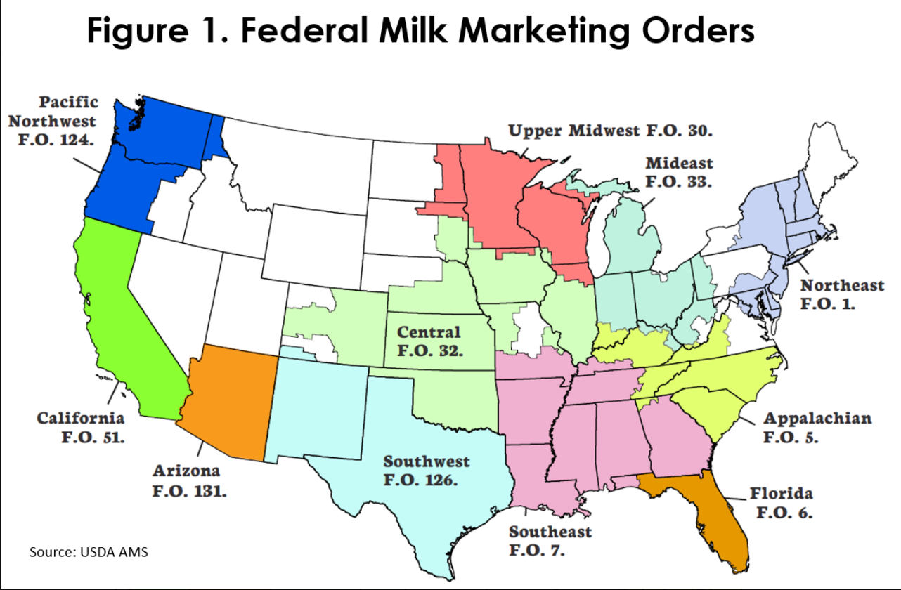
What do FMMOs do?
Not all farm milk is priced based on Federal Milk Marketing Orders
Not all farm milk sold in marketing areas
Milk buyers other than Class I in a regulated area can choose not to be regulated

Slide 7

We’re Nearing the End
Where are we in the process?
March 2023
Initial Request for Hearing on Make Allowances
June 2023
Additional Proposals Submitted to USDA
August 2023
USDA Hearing Begins
January 2024
USDA Hearing Ends
July 2024
USDA Issues Recommended Decision
November 2024
USDA Issues Final Decision
December 2024
Producer Referendum
January 2025
Results of Producer Referendum Announced
Month? 2025
Implementation of Pricing Changes

Slide 8
Why Federal Milk Marketing Order Hearings?
Why did we do this process?
Make Allowances were a key issue
Processors (and some cooperatives) argued that make allowances did not reflect current costs of making products
Make allowances in our current pricing formulas account for the costs of transforming milk into dairy products

Slide 9
Why Federal Milk Marketing Order Hearings?
Why did we do this process?
Symptoms of a problem:
De-pooling (less pooling)
Declines in premiums
Cooperative ‘re-blending’
Negative PPDs

Slide 10
Changes in Cheese Manufacturing Input Cost Index and Implied Premiums, 2016-2024
Why did we do this process?
PPI for Cheese Manufacturing from US Bureau of Labor Statistics (includes milk cost)
WI premium is Order 30 Mailbox Milk Price less Blend Price at Test, NY premiums as reported by NYDA&M

Slide 11
FMMOs Mandate Regulation of Class I Milk
Why did we do this process?
Buyers of farm milk making beverage products and selling in a FMMO marketing area MUST be regulated
  Must pay the minimum regulated price for that milk
Buyers of farm milk for other uses (like cheese) MAY be regulated if they choose to be
They choose to be when they can benefit from receiving money from the “pool” of dollars that is the value of farm milk across all uses to pay their producers
  They agree to pay the minimum regulated prices

Slide 12
Percentage of WI and MN Milk Pooled on Order 30, 2015-2024
Why did we do this process?
Downward trend in % of milk pooled
De-pooling
De-pooling means farm milk is not priced under FMMOs.
Typically, the price paid will be lower than the FMMO minimum.

Slide 13
Index of Milk Pooled, Northeast and Upper Midwest Orders, 2022-2025
Why did we do this process?

Slide 14
Key Elements of USDA’s Final Decision
What is in the Final Decision?
Increase Make Allowances for cheese, butter, NDM, dry whey
  Used in Class III and IV pricing
  $0.05 to $0.07 per lb increase
  Increase butterfat retention factor in cheese
Increase Class I differentials
  Increase in WI of about $1.20/cwt
  Retain $1.60/cwt minimum differential value
Change standard milk composition
  Protein 3.3% (up from 3.1%)
  Other Solids 6.0% (up from 5.9%)
  Nonfat Solids 9.3% (up from 9.0%)
Remove Cheese Barrels from Class III Pricing
Revert to “Higher of” Advanced Class III or Class IV Skim milk price for Class I Skim price
  Provisions to adjust the Class I price for ESL milk

Slide 15
Changes from Recommended Decision: Minimal
What is in the Final Decision?
Increased make allowances by $0.0015/lb for all products
Increased the make allowance for NDM by $0.0125/lb
Changes to 37 county Class I differential values (of 3108)
Implement changes to the composition of milk in 6 months rather than 12 months

Slide 16
Key Elements of USDA’s Final Decision
What is in the Final Decision?
Increase Make Allowances for cheese, butter, NDM, dry whey
  Used in Class III and IV pricing
  $0.05 to $0.07 per lb increase
  Increase butterfat retention factor in cheese
Make allowances in our current pricing formulas account for the costs of transforming milk into dairy products
Implications:
Minimum Component value in producer paychecks will be lower
  If milk is currently pooled
  Impacts on value of milk NOT currently pooled or subject to cooperative deducts
PPDs should be higher
  Value of milk above Class III component values
More milk will be pooled

Slide 17
Cheese Make Allowance Proposals
What is in the Final Decision?
*The butterfat recovery factor in cheese is also increased from 90% to 91%

Slide 18
Perspective on Make Allowances
What is in the Final Decision?
Consensus: Make allowance adjustments were needed
  Discussion is about how much adjustment was needed
Look backward with caution
  Changes in formulas will affect milk supply and demand
Impacts will play out over time—can’t just look at one year
Will over-order premiums return?
Less (maybe positive?) impact on farm milk not currently pooled or being re-blended by cooperatives

Slide 19
Key Elements of USDA’s Final Decision
What is in the Final Decision?
Increase Class I differentials
  Higher values in each county
  Increase in WI of about $1.20/cwt
  Retain $1.60/cwt minimum differential value
Class I differentials are the additional amount paid by buyers of milk for beverage use and provide incentives to move milk to deficit areas
Implications:
Increased value of the Order pool
  Increase in Statistical Uniform (Blend) Price, PPD, and All Milk Price
  Larger impact in orders with Class I utilization (more fluid milk processing)
Change in annual value at $1.24/cwt: $527 million/year
Decrease in Class I Utilization
Higher retail fluid milk prices
  $0.11/gallon

Slide 20
Justification for Class I Differentials
What is in the Final Decision?
“The differentials provide producers a financial incentive to supply the Class I market, which tends to be closer to the population centers, rather than delivering milk to a manufacturing plant typically closer to the farm.”
USDA Recommended Decision, p. 204

Slide 21
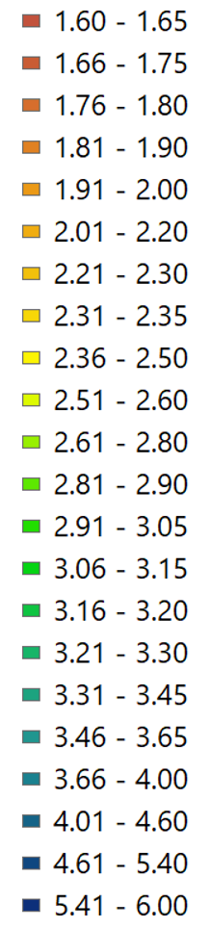
Current Class I Differentials
What is in the Final Decision?
Range of values
$1.60/cwt to $6.00/cwt
Last updated in 2008

Slide 22
Why this geographic pattern of Class I Differentials?
What is in the Final Decision?
WI/MN is “milk surplus”
CA is “milk surplus”
The southeastern US is “milk deficit”—incentives needed to supply or transport milk there

Slide 23
What determines the value of milk at a location?
What is in the Final Decision?
Farm milk supply (& components) at locations
Dairy product demand at locations (population)
Transportation costs
Plant locations
Plant capacity
Changes to any of these change the spatial milk values

Slide 24
How did the decision account for these factors?
What is in the Final Decision?
USDA adapted results from a large-scale spatial economic model of the US dairy supply chain
  United States Dairy Sector Simulator (USDSS)
  Originally developed at Cornell University and later at UW-Madison
USDSS minimizes the systemwide cost of:
  Assembling milk from farms to plants
  Making final and intermediate dairy products
  Transporting products to plants and locations of final demand
Indicates milk values at Class I plant locations
  USDA used results from May 2021 analysis of milk values

Slide 25
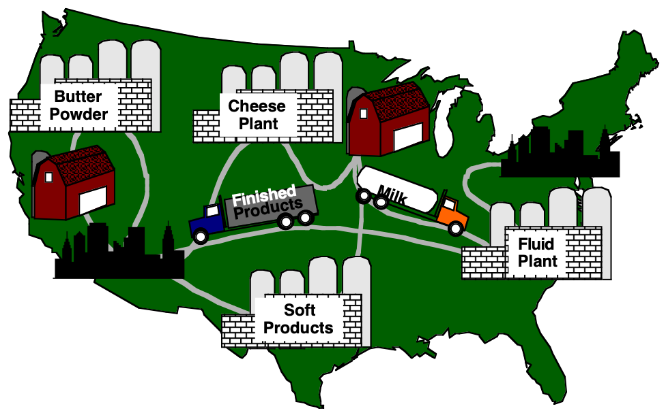
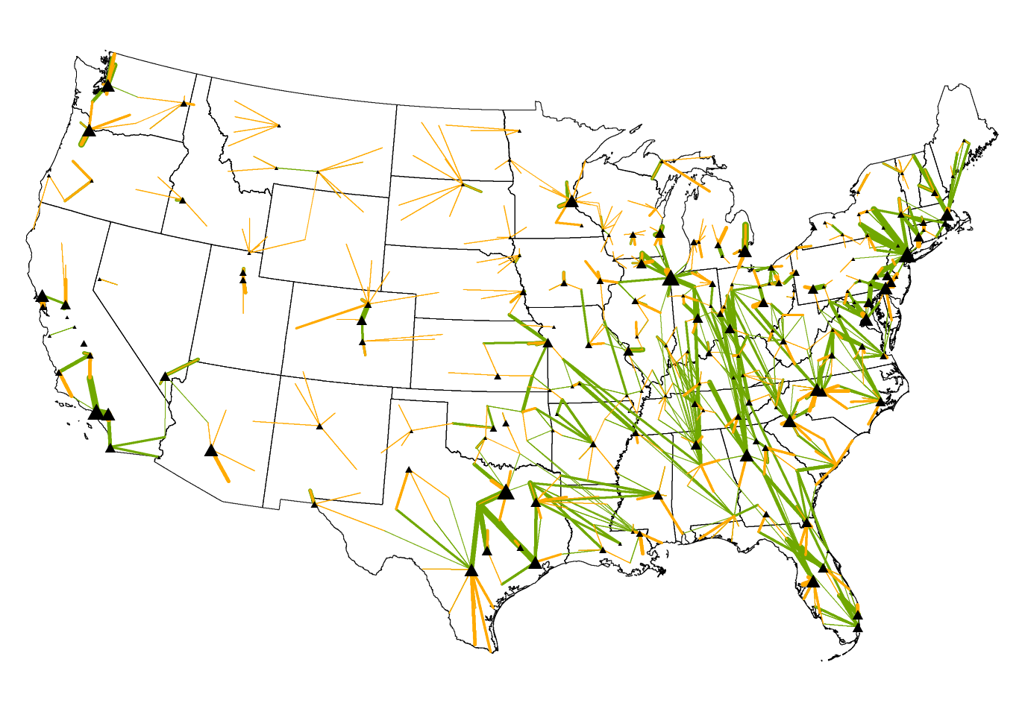
USDSS: Diagram and Representative Results
What is in the Final Decision?
Example of Results for Milk Assembly at Fluid Plants and Packaged Milk Distribution
Simplified Representation of USDSS Model

Slide 26
Estimated Differences Between Spatial Values of Milk and Current Class I Differentials
What is in the Final Decision?
October 2021 Data
WI Difference: $1.70/cwt
Largest Difference $3.10/cwt

Slide 27
What are the Changes to Class I Differentials?
What is in the Final Decision?
$0.00-$0.50/cwt
$0.70 - $1.60/cwt
Current: $2.63/cwt
Proposed: $3.87/cwt
Average value of proposed change $1.24/cwt
$1.70 - $2.60/cwt

Slide 28
Perspective on Differentials
What is in the Final Decision?
Consensus: Adjustments to differentials were needed
Comments to USDA express concerns about values chosen in particular locations
How much producer value from higher make allowance can be returned through higher Class I?

Slide 29
Key Elements of USDA’s Recommended Decision
What is in the Final Decision?
Change standard milk composition
  Protein 3.3% (up from 3.1%)
  Other Solids 6.0% (up from 5.9%)
  Nonfat Solids 9.3% (up from 9.0%)
These composition values are used in the formulas to price Class III and Class IV Milk
Implications:
Increases the reported Class III and IV prices
No direct impact on pay prices in orders with multiple component pricing

Slide 30
Key Elements of USDA’s Recommended Decision
What is in the Final Decision?
Remove Cheese Barrels from Class III Pricing
Currently, both 40-lb blocks and barrels are surveyed to determine the cheese price used in Class III pricing formulas
Implications:
Less variability in cheese prices and Class III prices
Small increase in cheese prices (historically)
  $0.02/lb (2014-2024)
Small increase in Class III price (historically)

Slide 31
Key Elements of USDA’s Recommended Decision
What is in the Final Decision?
Revert to “Higher of” Advanced Class III or Class IV Skim milk price for Class I Skim price
Currently, the “average of” plus $0.74/cwt is used to price Class I milk
Implications:
More variation in Class I price
Higher Class I price (historically)
  $0.11/cwt (2000-2024)

Slide 32
Key Elements of USDA’s Recommended Decision
What is in the Final Decision?
  Provisions to adjust the Class I price for Extended Shelf Life (ESL) milk
  Allow adjustment over time between “higher of” and “average of” for ESL
Currently, ESL milk is priced as Class I milk
Implications:
Changes the timing of pricing for ESL compared to rest of Class I milk
Same overall average price for ESL and other Class I milk

Slide 33
Likely Impacts of USDA’s Final Decision
What will the Final Decision mean for farm milk prices?
Proposed Change | Impacts for Farm Milk Prices
Increased make allowances | Reduced minimum component values for milk pooled, especially early after changes implemented
Increased Class I differentials | Modest increases in PPDs and pay prices for pooled milk
Change in milk composition | Limited impacts on component values or pay prices
Remove Barrels from surveyed milk price | Modest impacts on average Class III component values, but less variability
“Higher of” rather than “Average of” + $0.74/cwt | Modest impacts on PPD values and “blend” prices for pooled milk
Adjustments to ESL milk pricing | Limited impacts on PPD values or ”blend prices” over longer time horizon
Impacts on prices for milk that is not pooled or that received cooperative deducts are less clear
Return of modest milk price premiums over time?

Slide 34
Impacts of Make Allowance Changes on Prices
What will the Final Decision mean for farm milk prices?
Change standard milk composition
Protein 3.3% (up from 3.1%)
Other Solids 6.0% (up from 5.9%)
Nonfat Solids 9.3% (up from 9.0%)
Note: This is for milk that is currently pooled.
If milk is not currently pooled or is re-blended, the impacts will be smaller and could be positive.

Slide 35
Impacts of the Proposed Changes: Pooled vs Non-Pooled Milk, January to November 2024
What will the Final Decision mean for farm milk prices?
We can calculate potential changes to pooled milk, but we are less certain about impacts on 25%-50% of WI milk not being pooled now
Non-Pooled Milk price is estimated based on value of pooled milk at Class III Components + PPD and the Wisconsin All Milk Price

Slide 36
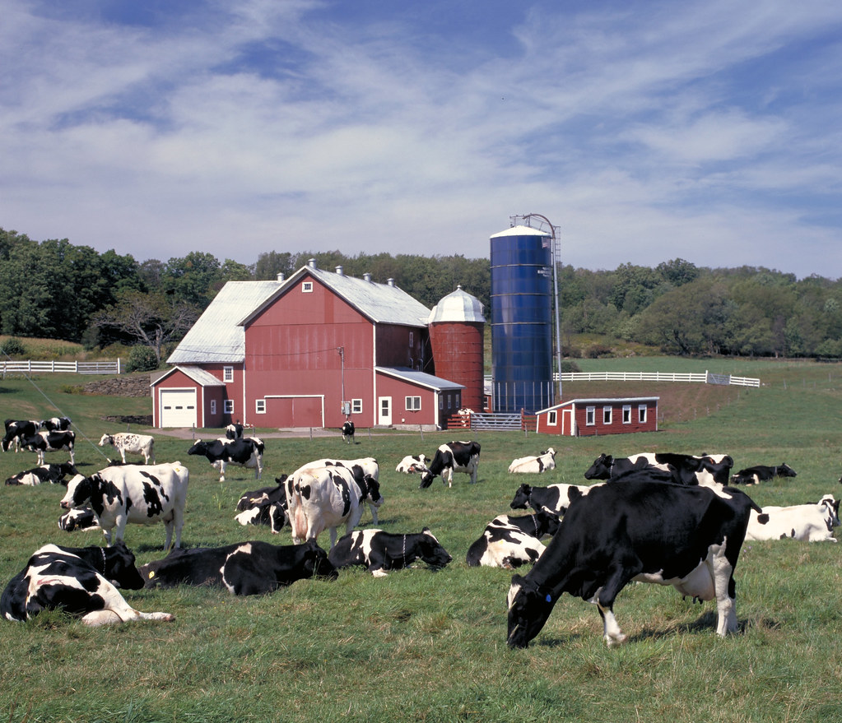
Impacts of Recommended Decision on Farm Milk Prices…
What will the Final Decision mean for farm milk prices?
Will depend on all of the changes in the Recommended Decision
  We have considered them separately for clarity
Will vary by Order
  Utilization of milk
  Multiple Component Pricing versus Skim-Butterfat Orders
Will vary over time
  Supply, demand and prices will evolve in response to the changes

Slide 37
What Happens Over Time?
What will the Final Decision mean for farm milk prices?
Increased
Make Allowance
Lower Farm Milk Price (pooled milk)
More Milk Pooled
Increased Demand Farm Milk for Cheese
Adjustments to
Milk Production
Offsetting Positive Effect on Farm Pay Price
Milk Supply Demand Balance Affected
Pressure for Premiums

Slide 38
Impacts of Recommended Decision on Farm Milk Prices from Dynamic Modeling, 2024 to 2028
What will the Final Decision mean for farm milk prices?

Slide 39
Producer Referendum
What are the next steps?
Dairy farmers had the opportunity to vote on whether to:
Adopt the order with the changes in the Final Decision
OR
Terminate the order (no FMMO pricing)
Maintaining the current provisions of the order was NOT an option
Voting was by Order, not for the whole system

Slide 40
Issue: Better Off With the Order or Without It?
Not whether like or don’t like the proposed changes
What are the next steps?
Voting out the order would:
Eliminate beneficial aspects of the Order not directly related to milk pricing, including auditing, testing, market information
  Unless otherwise replaced with appropriate legislation
Likely result in farm milk prices approximating Class III components
  This is the experience of the Western Order, terminated in 2004
  Opportunities to pool milk on other Orders are limited
Would eliminate payment of the PPD
  Averaged $0.29/cwt from January 2022 to date in Upper Midwest
  Averaged $2.85/cwt in Northeast Order

Slide 41
Referendum Process
What are the next steps?
The USDA the Final Decision specified the details of the voting process, including:
The representative month that counts for eligibility
  January 2024
The timing of the vote
  Date requirements for ballots to be postmarked by December 31, 2024 and received by USDA by January 15, 2025

Slide 42
Referendum Process: Bloc Voting by Cooperatives
What are the next steps?
Because Cooperatives are considered producers under FMMOs, they were allowed to bloc vote on behalf of all their members
The coop must provide USDA with certification of the resolution authorizing the vote at the time ballots are submitted
If the cooperative does not bloc vote, its members may cast individual ballots

Slide 43
Referendum Process: Voting Threshold
What are the next steps?
To amend the Order (with the provisions of the Final Decision)
2/3 of the voting producers must approve
OR
2/3 of the milk volume represented by voting producers must approve
Under bloc voting, cooperatives may cast a unanimous ballot for all their membership who are eligible, which contributes towards the 2/3 of voting producers or milk volume
USDA will first count producers, then milk volume if needed
Info video at: https://www.youtube.com/watch?v=PFuEBmy6_uM

Slide 44
Additional
Online Resources
Dairy Markets and Policy Program Website:
https://dairymarkets.org
“Information Letters” on:
Overview of Changes Proposed in USDA Federal Milk Marketing Order Recommended Decision
Proposed Changes to Product Make Allowances in the Recommended Decision and Potential Farm Milk Price Impacts
Proposed Changes to Class I Differentials in the Recommended Decision and Potential Farm Milk Price Impacts
Federal Milk Marketing Order Functions
Proposed Changes in Milk Composition, Surveyed Commodity Products, and Base Class I Skim Milk Price in the Recommended Decision and Potential Farm Milk Price Impacts
Potential Implications of the Termination of Order 30 for Farm Milk Prices

Slide 45
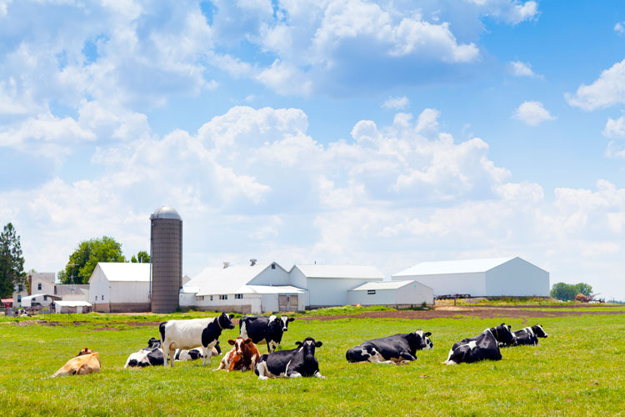
Thank you for your attention!
Chuck Nicholson
University of Wisconsin-Madison
Email: cfnicholson@wisc.edu
Source: Hoard’s Dairyman

