Slide 1
2025 US Dairy Situation & Outlook
Christopher A. Wolf
E.V. Baker Professor of Agricultural Economics
Dyson School of Applied Economics and Management
Cornell University
January 17, 2025

Slide 3
Income Over Feed Cost Margin

Slide 4
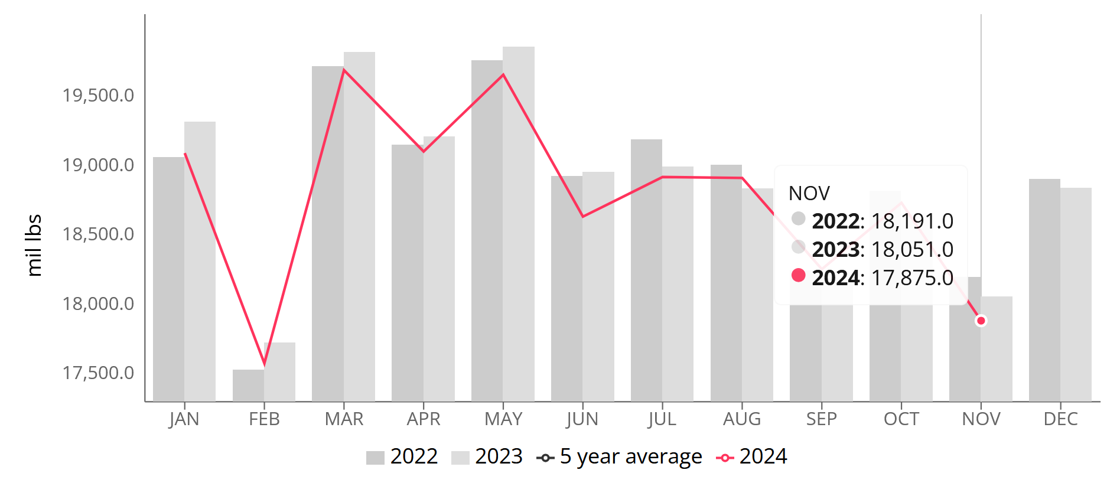
US Milk Production
Nov 2024
-0.1% YoY
Source: UDM

Slide 5
US Average Butterfat Test
+1.47% YoY
in 2024

Slide 6
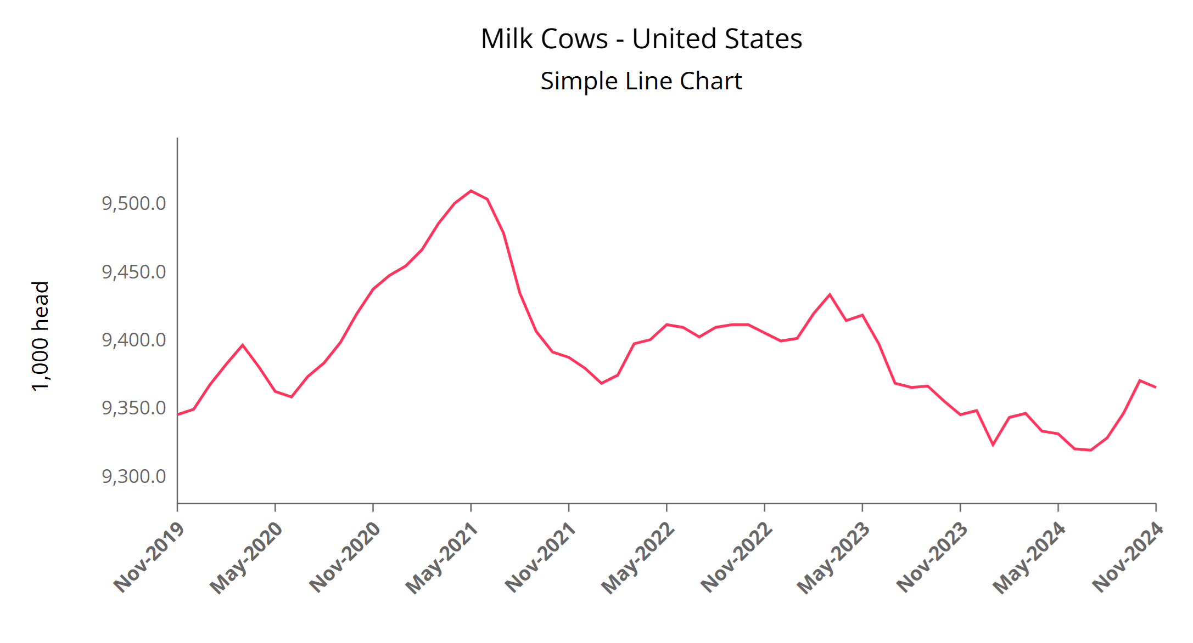
US Milk Cows
December 2024 9.365 million
+20,000 YoY
Source: UDM

Slide 7
Weekly Dairy Cow Slaughter
2024 -11.9% vs 2023
Source: UDM

Slide 8
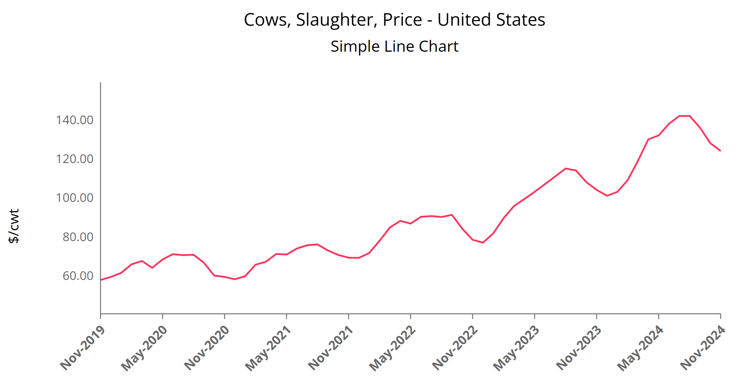
Source: UDM

Slide 9
Factors to Watch
Demand
Trade issues
Domestic economy
New plants
Supply
Disease
Labor
Weather
New plants

Slide 10
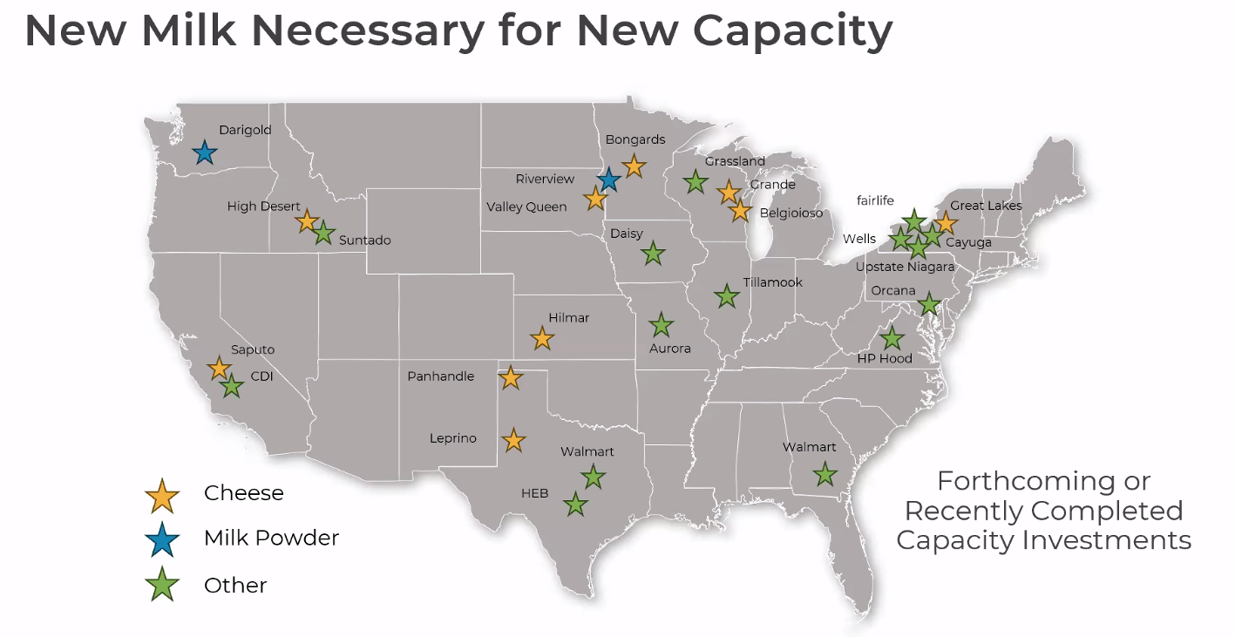
Source: NMPF

Slide 11
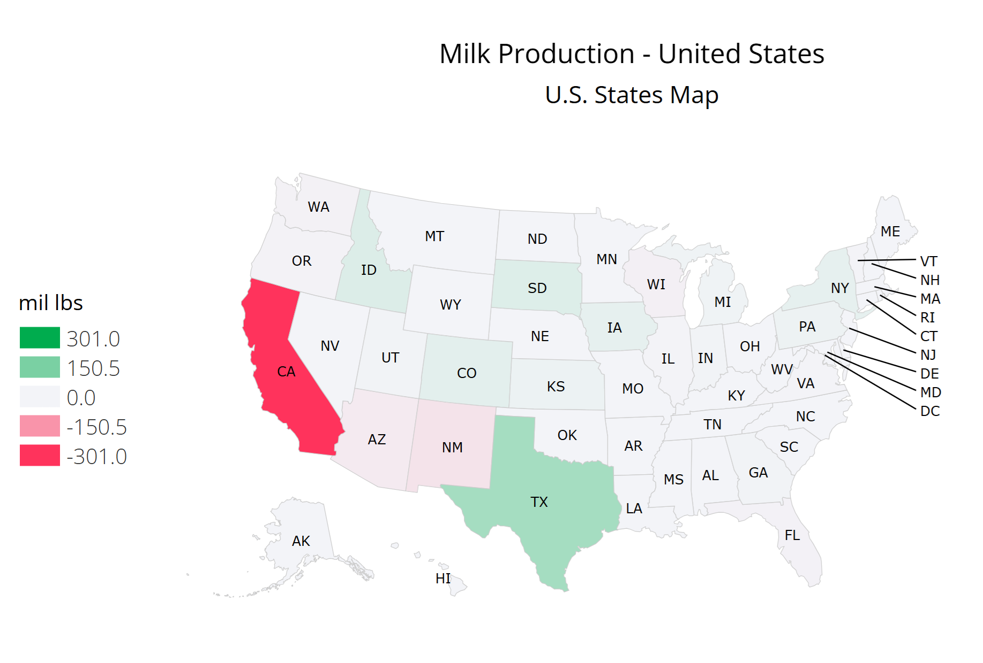
California -9.2% YoY Nov’24
Cow numbers unchanged
All due to milk/cow

Slide 12
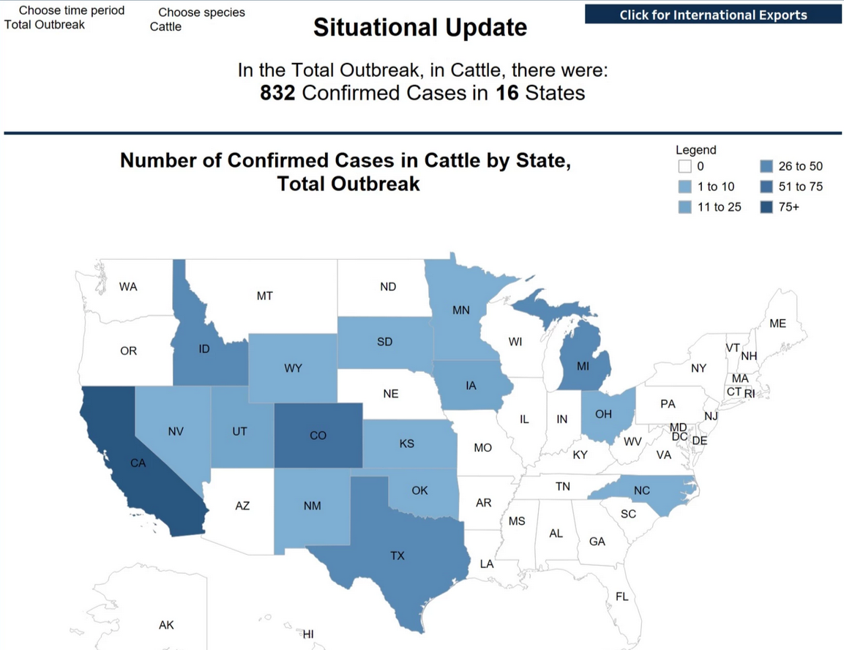

Slide 13
Highly Pathogenic Avian Influenza
As of December 12th, Highly Pathogenic Avian Influenza (HPAI) was confirmed in 16 States and 832 dairy herds. However, since the beginning of December, out of the 832 herds, HPAI has been detected in 143 herds, located in California (142) and Nevada (1). The affected cows and herds are quarantined until they recover. Once they recover, most cows return to producing milk.
On December 6, USDA announced its National Milk Testing Strategy (NMTS) and a new Federal Order requiring that raw (unpasteurized) milk samples be collected nationwide from any entity responsible for a dairy farm, bulk milk transporter, bulk milk transfer station, or dairy processing facility that sends or holds milk intended for pasteurization and shared with the USDA for testing. The new Federal Order complements the USDA’s Federal Order issued on April 24 that required mandatory testing for lactating dairy cows prior to interstate movement and mandated the reporting of positive influenza A test results in livestock.

Slide 14
Milk/Cow (lbs)

Slide 15
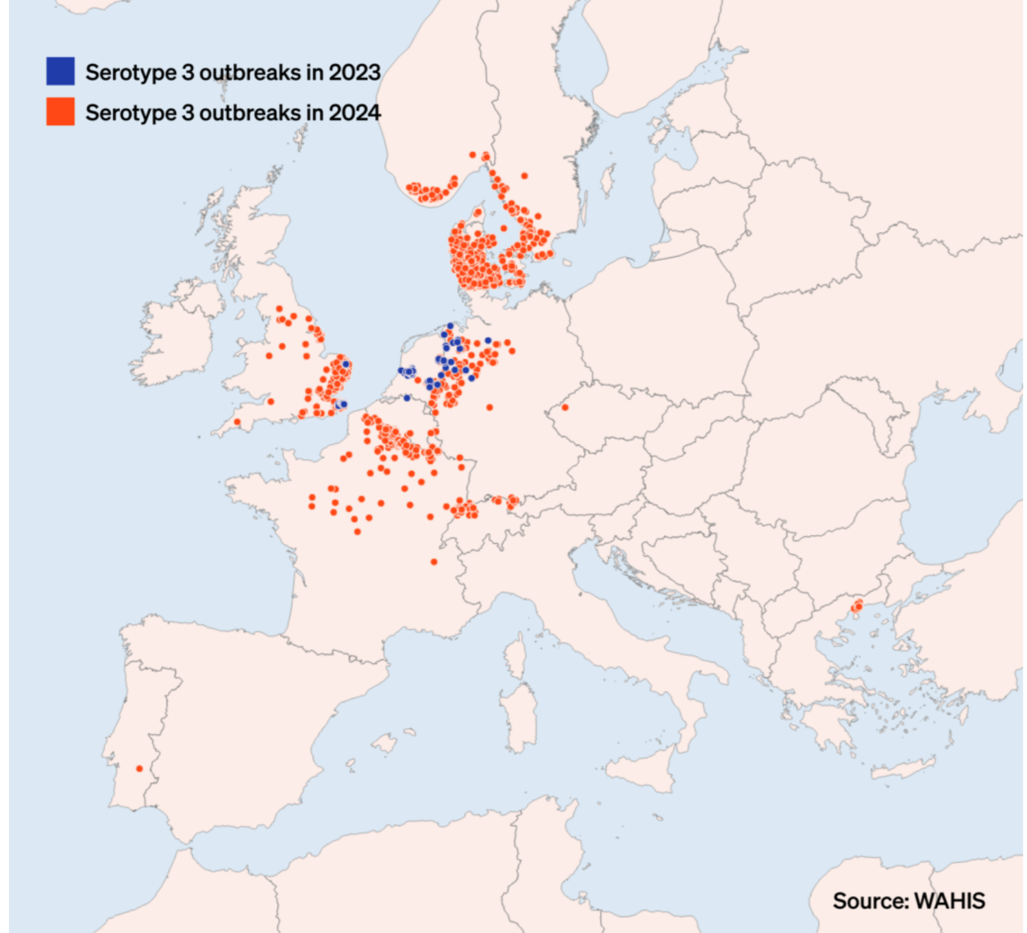
Bluetongue in Europe
Virus spread by biting midges
About 30 known variants
Affects ruminants
Milk loss 2 lb/day
for 10 weeks

Slide 16
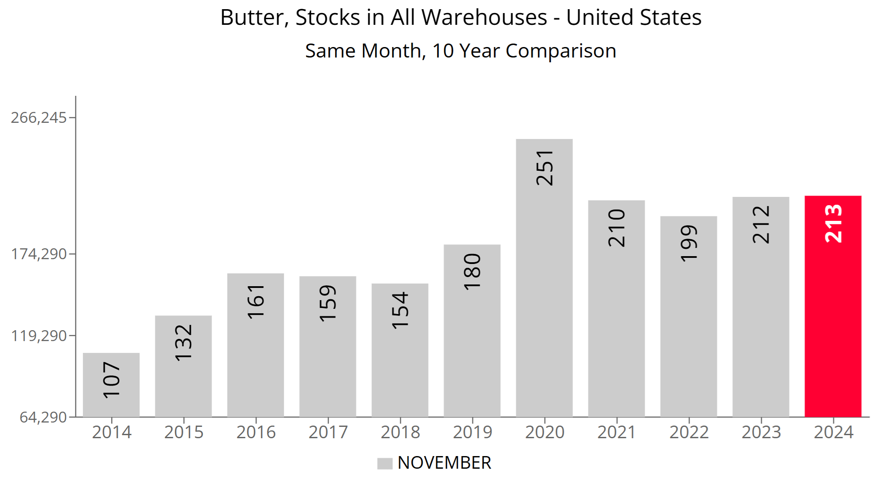
Butter Stocks
Source: UDM

Slide 17
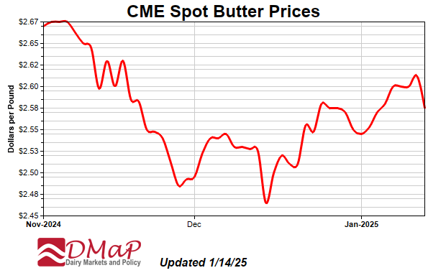

Slide 18
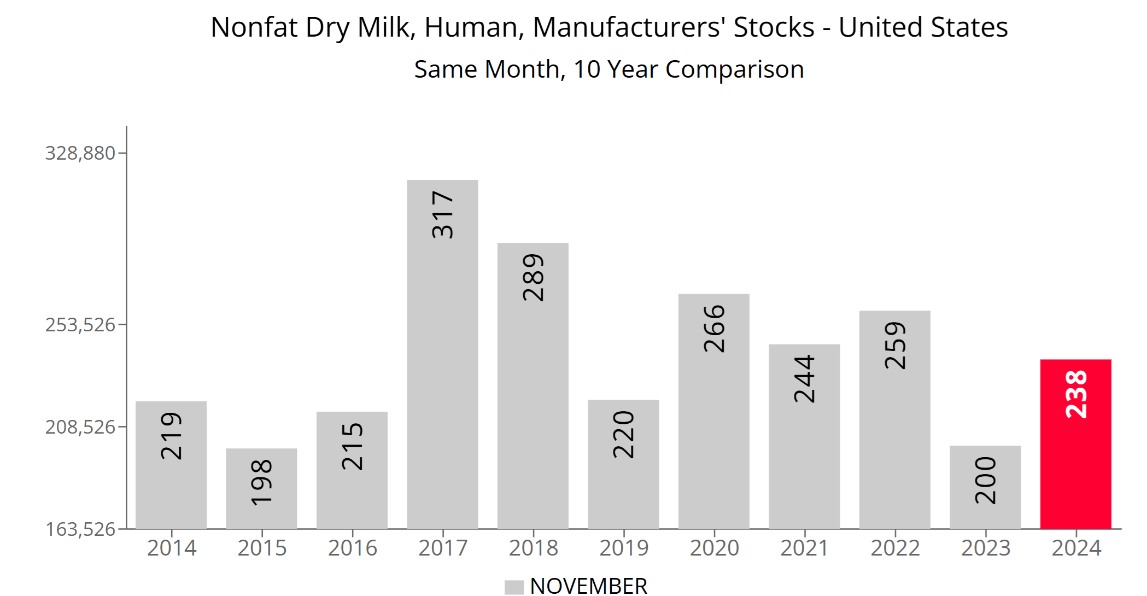

Slide 19
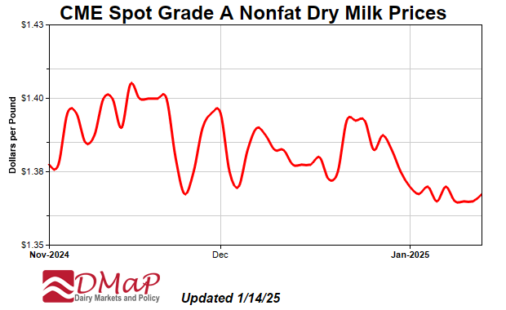

Slide 20
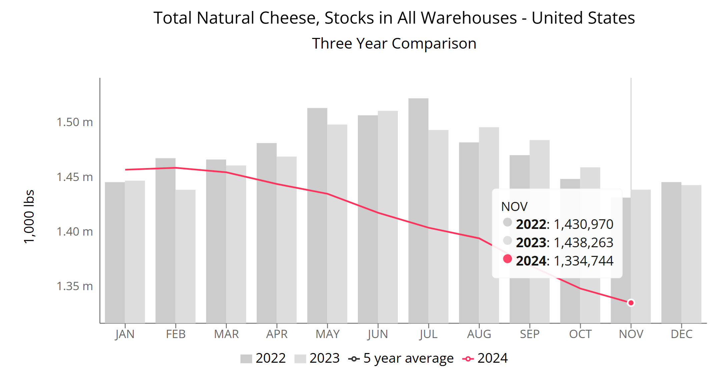
Natural Cheese Stocks
November -7.2% YoY
Source: UDM

Slide 21
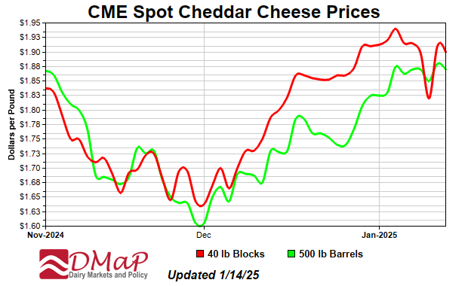

Slide 22
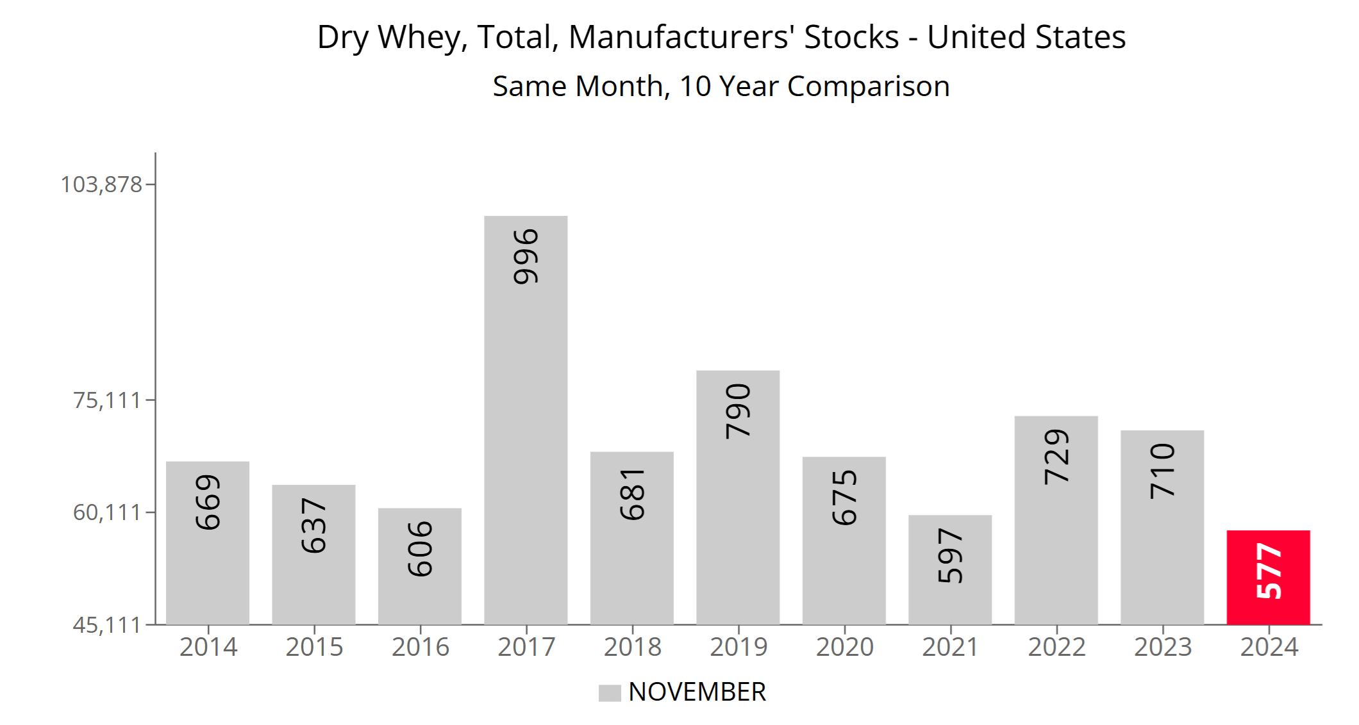
November -18.7% YoY

Slide 23
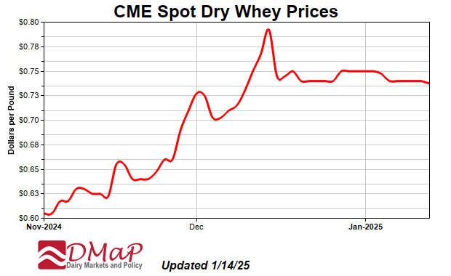

Slide 24
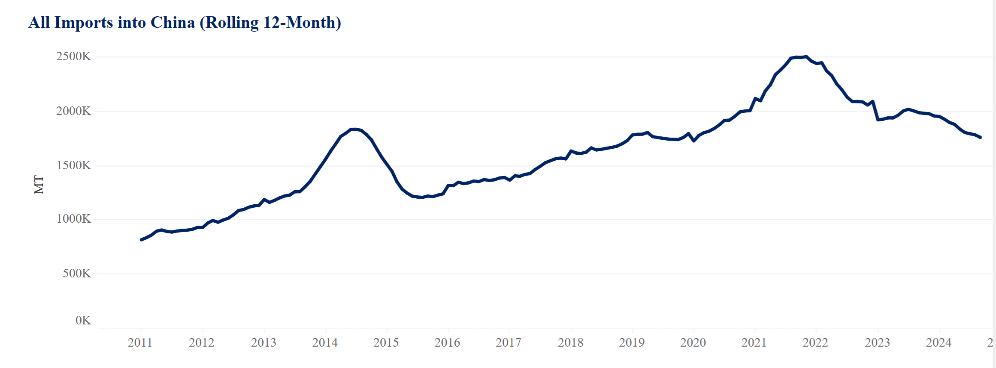
Source: USDEC

Slide 25
US Dairy Exports in North America
43% of US dairy exports to Mexico and Canada

Slide 26
Tariffs and Trade Wars

Slide 27
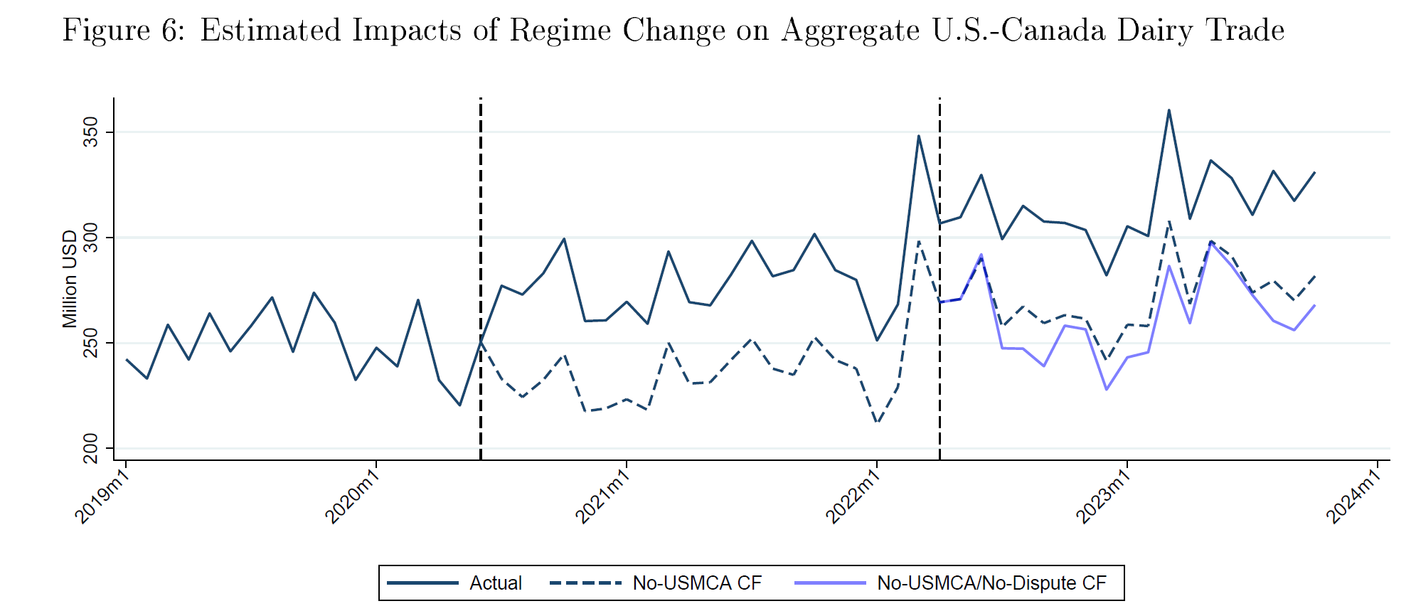
Impact of Canada TRQ Dispute

Slide 28
US Dairy Exports

Slide 29
US Dairy and Ag Exports

Slide 30
US Dairy, Ag and Total Exports

Slide 31
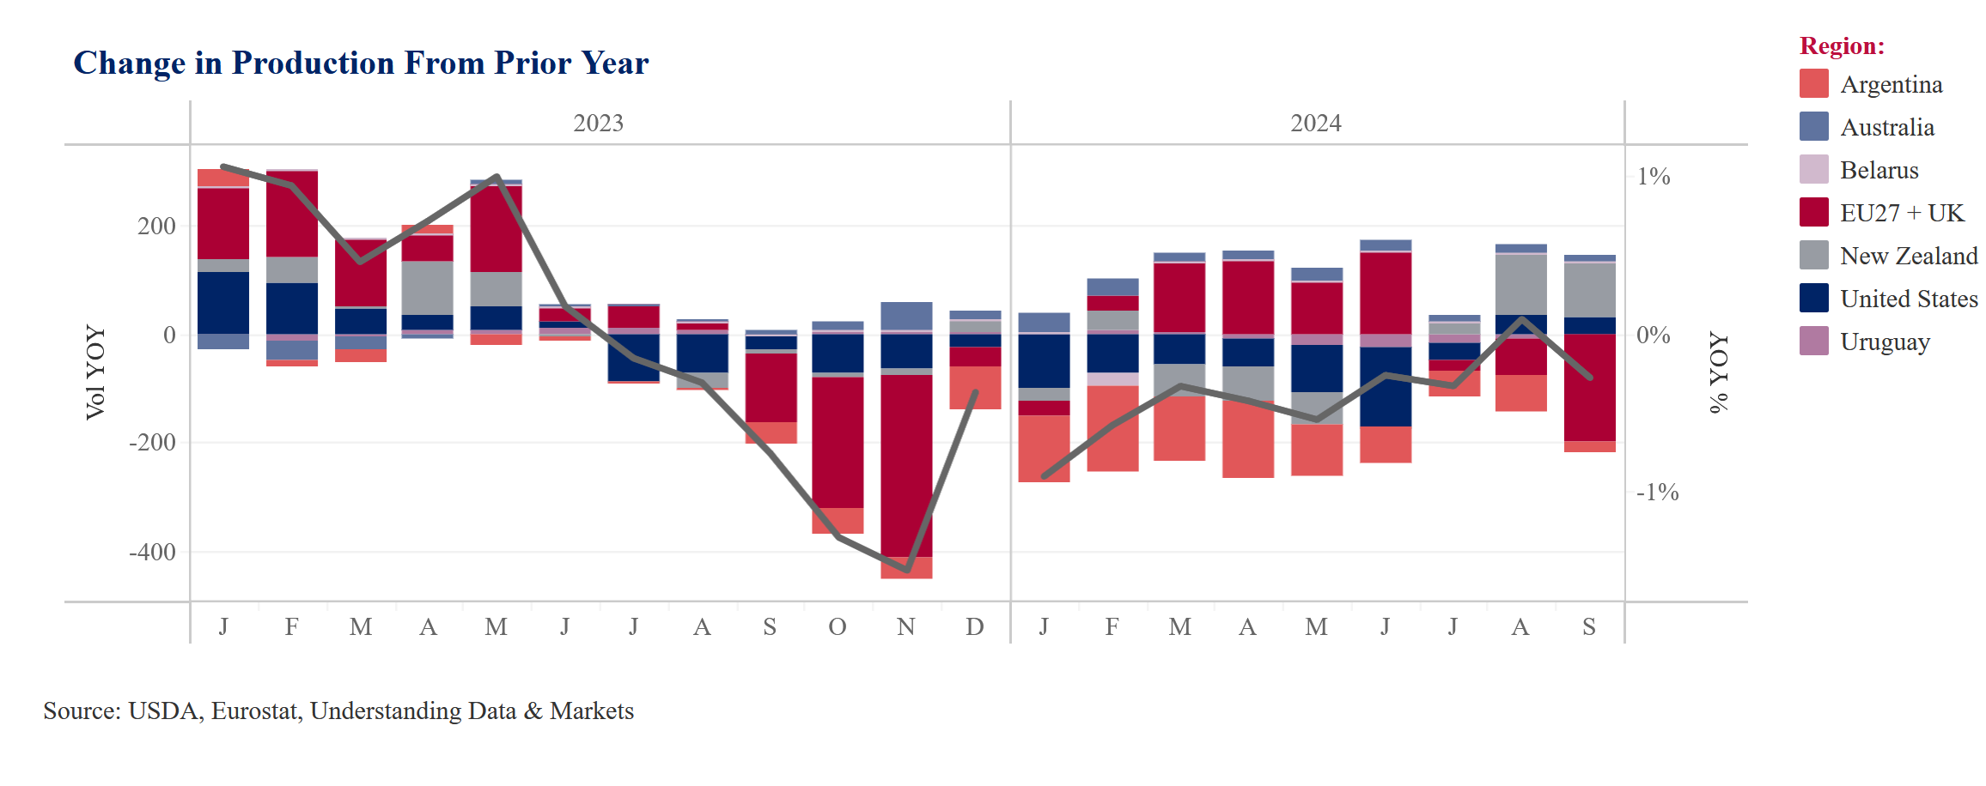
Major Exporter Milk Production

Slide 32
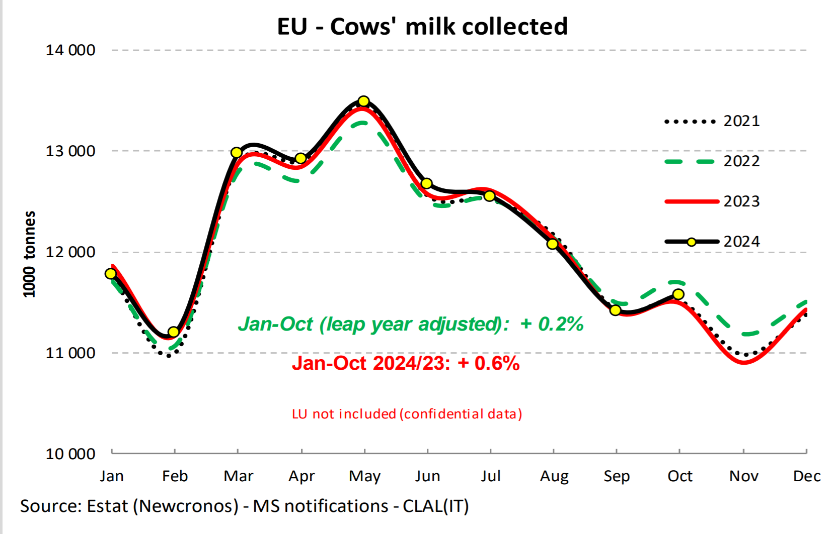
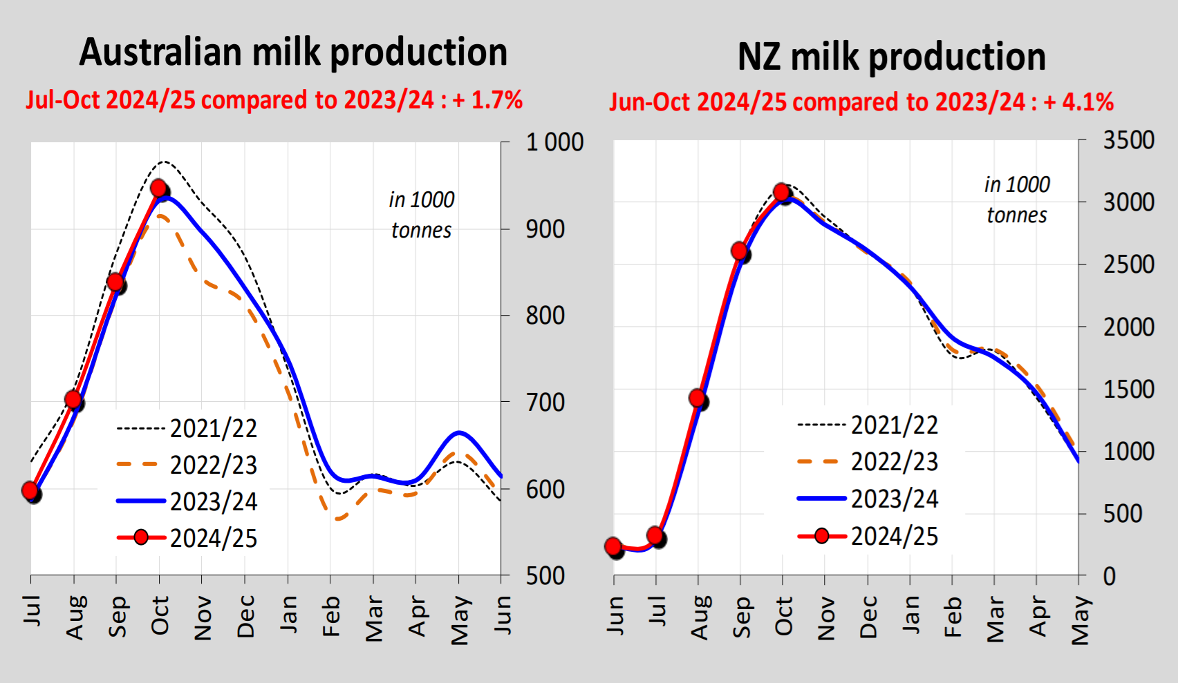

Slide 33
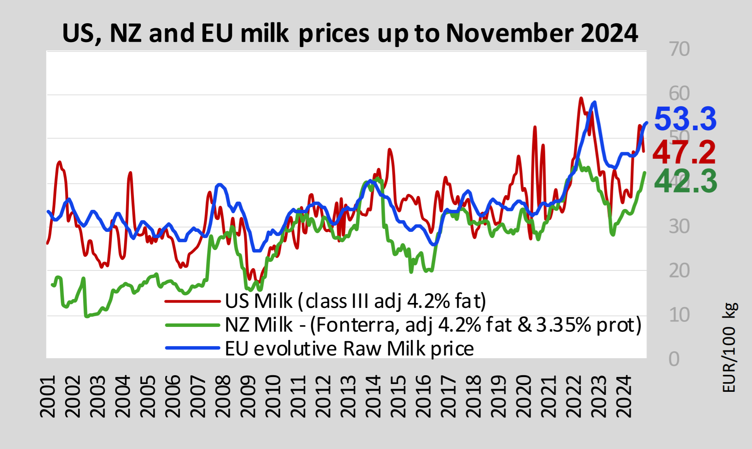
Source: EU Milk Observatory

Slide 35
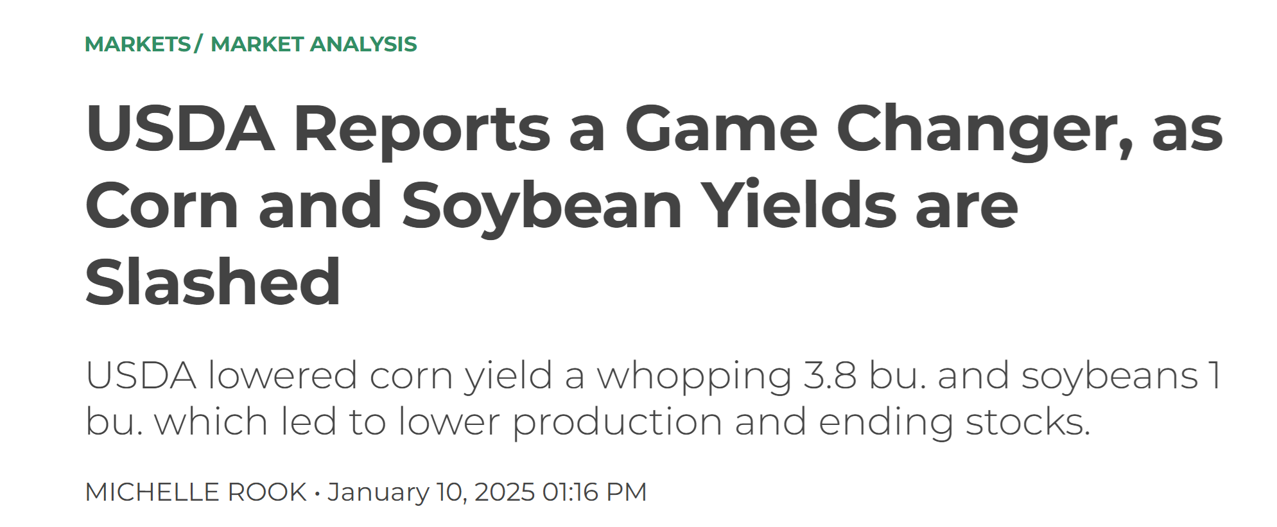
Corn Market Adjustment
January 10, 2025

Slide 36
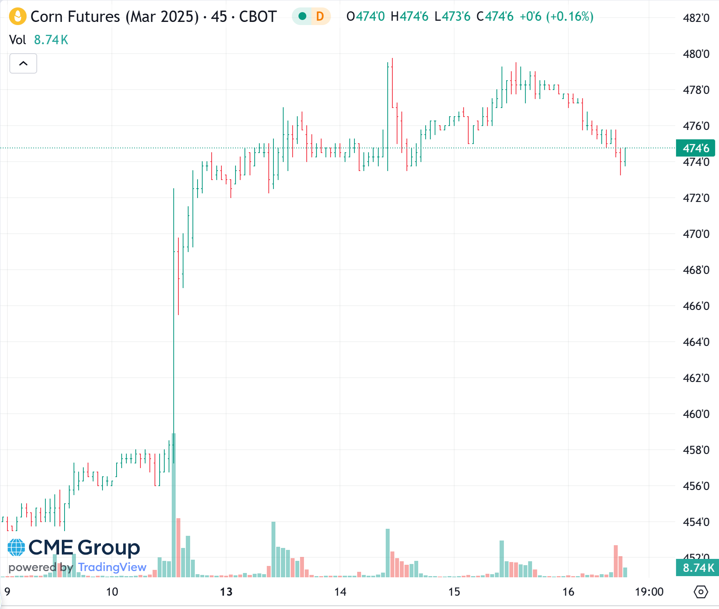

Slide 37
Forecast Prices January 2024 WASDE and Jan 16 Futures
Commodity | 2022/23 | 2023/24 | 2024/25F | ‘25 futures
Corn | $6.54/bu | $4.55/bu | $4.25/bu | $4.40/bu
Soybeans | $14.20/bu | $12.40/bu | $10.20/bu | $10.03/bu
Soybean meal | $452/ton | $384/ton | $310/ton | $316/ton
 | 2023 | 2024 | 2025F | 2025F
All Milk | $20.60/cwt | $22.65/cwt | $23.05/cwt | $21.92/cwt
Class III | $17.02/cwt | $18.90/cwt | $19.70/cwt | $19.42/cwt
Class IV | $19.12/cwt | $20.75/cwt | $20.80/cwt | $21.42/cwt

Slide 38
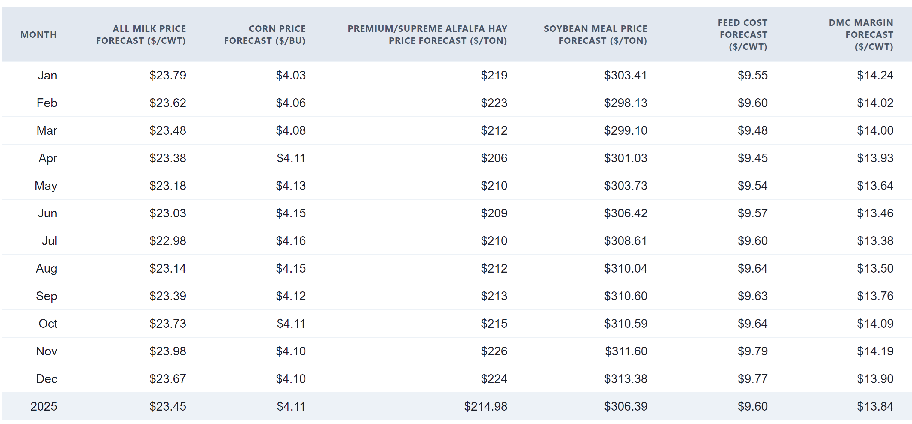
DMC Forecast

Slide 39
DMC Margin Forecasts

Slide 40
Thank You
Chris Wolf
cwolf@cornell.edu

