Slide 1

The Economics of Technology Adoption for Fruit and Vegetable Growers
Wendong Zhang
Assistant Professor, Dyson School of Applied Economics and Management, Cornell University;
wendongz@cornell.edu
(607) 254-3231
https://wendongzhang.weebly.com/
January 20, 2023
Dyson School 2023 Agricultural and Food Business Outlook Conference
Notes:
Insert any pre-title text in the text box at the top (ie. “Presented by…”)
Insert the presentation title in the second text box with the largest text
Insert the speaker’s name and/or the month, day and year of the presentation.
Delete any text boxes you didn’t use.

Slide 2
Research & Extension Program Themes
  Theme I: Agriculture & the Environment; Grower Decision Making
  Theme II: Land Value, Land Ownership, Land Tenure, Land Use
  Theme III: Chinese Agriculture & its Global Trade Implications
  Other Useful information:
    Appointment: 50% Research & 50% Extension
    Joined Cornell Dyson School & Cornell Cooperative Extension in July 2022
    Faculty Affiliate, Cornell Institute for China Economic Research (CICER)
    Faculty Fellow, Cornell Atkinson Center for a Sustainable Future
    Led Iowa land value survey; co-founded the ISU China Ag Center
    New Projects in New York State
      Ag & Solar; Agrivoltaics (joint with David Kay and Rich Stedman)
      Floodplain paddy rice farming (joint with Jenny Kao-Kniffin and Susan McCouch)
      Carbon credits for dairy farmers (joint with Chris Wolf)
      US Northeast Land Value & Rent Trends (joint with ASFMRA Northeast Chapter)

Slide 3

Story #1: Mesotunnels for Organic Cucurbit Production in New York, Kentucky and Ohio
https://www.cucurbit.plantpath.iastate.edu/ USDA NIFA OREI Project
Collaborators: Sarah Pethybridge (Cornell AgriTech), David Gonthier (U Kentucky), Mark Gleason (Iowa St)

Slide 4
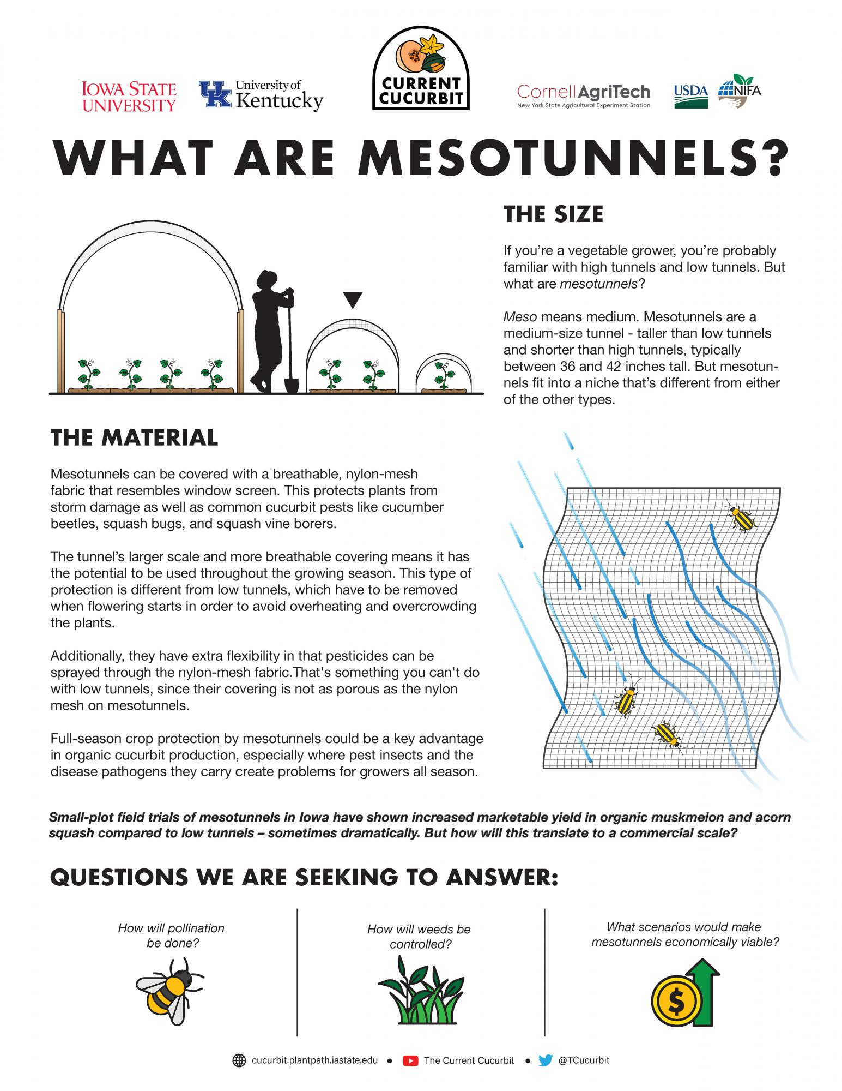
Nylon fine-mesh covers

Slide 5
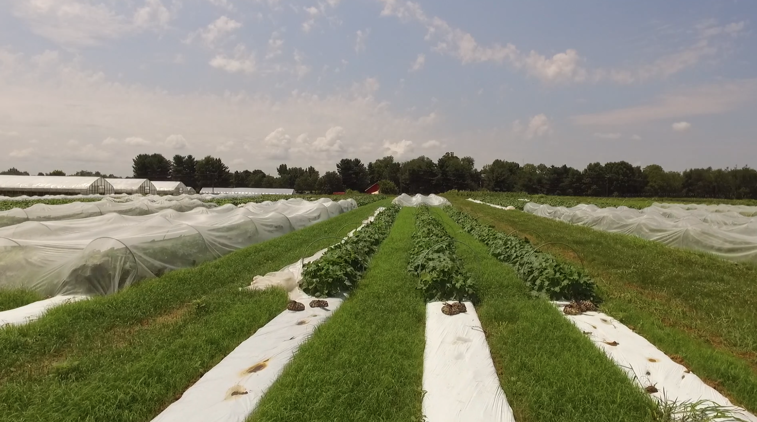
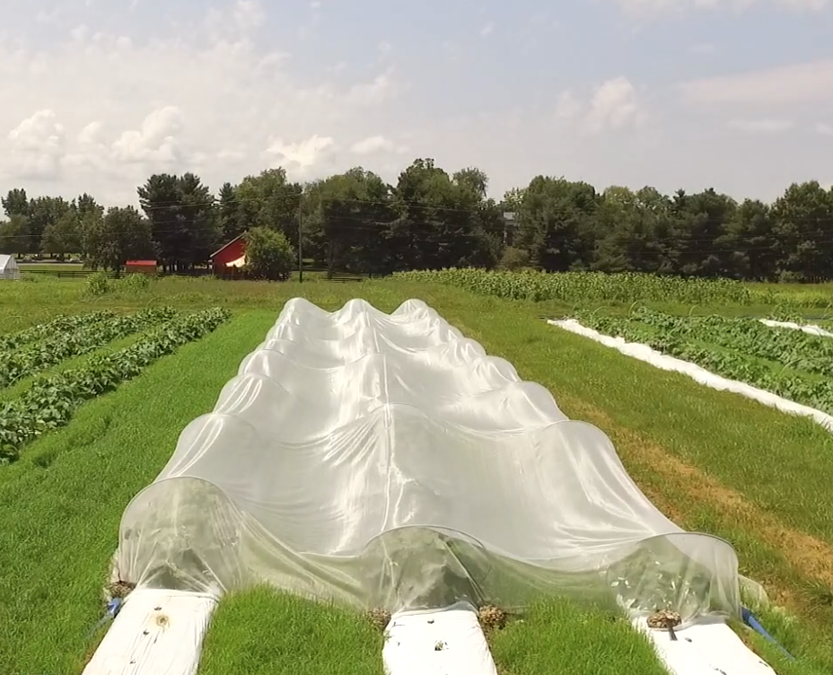
Mesotunnel protection system
Electrical conduit hoops
ProtekNet 60 gram fine-mesh netting
Weights: Rock-bags, sand-bags, or filled layflat

Slide 6
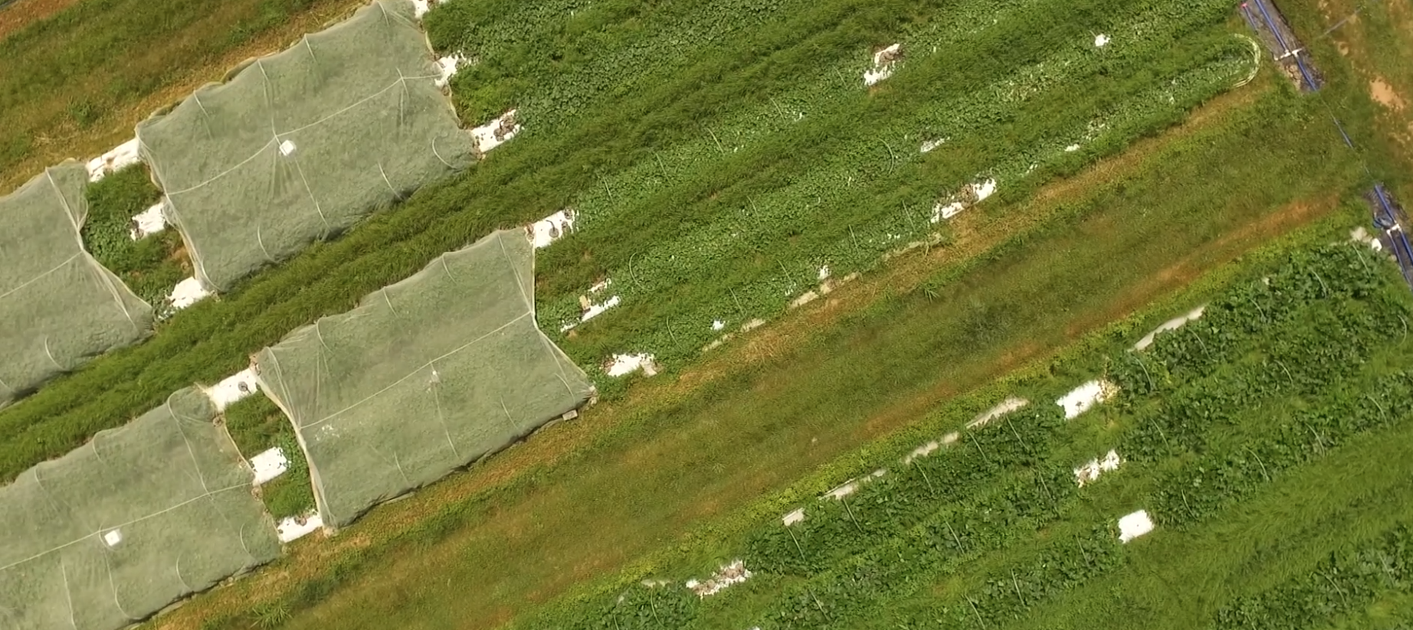
Kentucky Pollination treatments during flowering
with stocked bumble bees
Notes:
Blueberry, blackberry raspberry

Slide 7
On-off-on strategy
On-off-on
Nets on
Nets off
Nets on
Early development
Flowering
Fruit development
Cucurbit development timeline

Slide 8
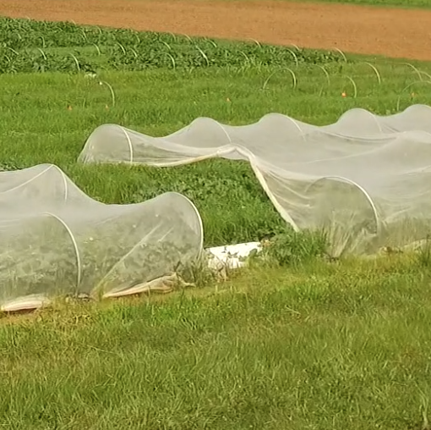
Open-ends strategy
On-off-on
Nets on
Nets on, ends open
Nets on
Early development
Flowering
Fruit development
Cucurbit development timeline

Slide 9
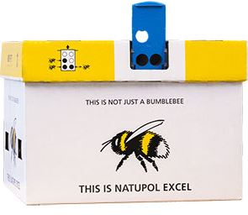
Full-season, with commercial bumble bees
Full-season
Nets on
Nets on
Nets on
Early development
Flowering
Fruit development
Cucurbit development timeline

Slide 10
Mesotunnels increase marketable yield by 30% in University of Kentucky trials
1000 x fruit per acre
Organic
Insecticides
Meso-
tunnels
Fiske, Bessin, Williams, Gonthier. In prep.

Slide 11
Costs of mesotunnel vs organic pesticide management
Kentucky – acorn squash
 | Items | Control | Only Spray | Only Mesotunnel | Mesotunnel + Spray
 | Mesotunnel | $ - | $ - | $ 3,153 | $ 3,153
Materials ($) | Insecticide spray | $ - | $ 2,661 | $ - | $ 2,605
 | Other | $ 144 | $ 144 | $ 144 | $ 144
 | Mesotunnel | 0 | 0 | 7173 | 7173
Labor (min) | Insecticide spray | 0 | 4658 | 0 | 3105
 | Other | 1672 | 1672 | 1672 | 1672
Total Material Cost ($) |  | $ 144 | $ 2,805 | $ 3,296 | $ 5,902
Total Labor Cost ($) |  | $ 324 | $ 1,556 | $ 1,815 | $ 2,746
Total Cost ($) |  | $ 326 | $ 4,361 | $ 5,111 | $ 8,648
*Preliminary results, not all field prep costs included, some costs are annualized

Slide 12
Mesotunnel profitability – acorn squash
1-Acre | Control | Spray only | Meso-tunnel | Meso-tunnel +spray
Selling Price ($/lb) | $ 1.77 | $ 1.77 | $ 1.77 | $ 1.77
Total Cost ($) | $ 326 | $ 4,361 | $ 5,111 | $ 8,648
Revenue ($) | $ 18,234 | $ 15,926 | $ 25,073 | $ 24,744
Profit ($) | $ 17,908 | $ 11,565 | $ 19,962 | $ 16,096

Slide 13
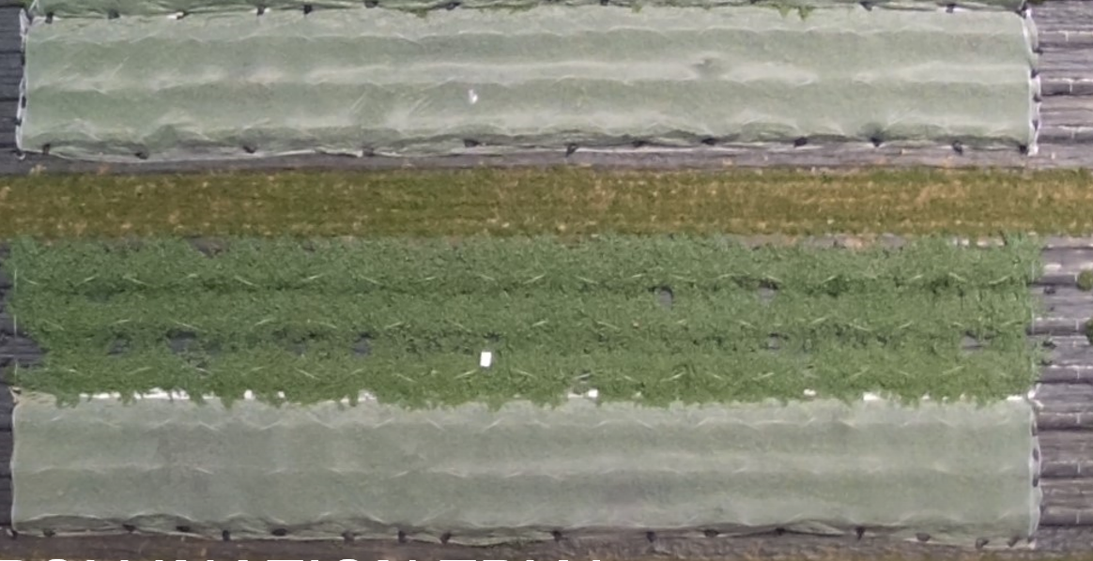
NY AgriTech Pollination Trials
2022 Muskmelon Yield Results
Marketable Fruit | On/Off/On | Open Ends | Full Season Mesotunnel with Bumblebee Hive
Number of marketable fruit (both harvests) | 167.8 | 20.0 | 19.8
Total marketable fruit weight (both harvests; lb.) | 862 | 115 | 117
Kellie Damann and Sarah Pethybridge

Slide 14
New York AgriTech Pollination Trials
Just having bumblebee hive is not enough – needs other pollinators
Variables | On/Off/On | Open Ends | Bumblebee Hive | LSD | P =
Week 4
Bumblebees | 2.3 a | 0 b | 3.5 a | 2.4 | 0.031
Hoverflies | 4.3 | 0.3 | 1.8 | - | 0.136 (ns)
Other bees | 4.5 a | 0.3 b | 0.3 b | 3.4 | 0.032
Other pollinators | 3.5 a | 0 b | 0 b | 2.4 | 0.017
Pollinators on the flowers | 6 a | 0 b | 2 b | 3.5 | 0.014
Flower number | 535 a | 448 ab | 335 b | 123.4 | 0.021
Week 5
Bumblebees | 6.2 | 1.3 | 7.5 | - | 0.375 (ns)
Hoverflies | 29 a | 4.3 b | 3 b | 7.1 | <0.001
Other bees | 43.2 a | 6.8 b | 0.5 b | 16.3 | 0.001
Other pollinators | 21.8 a | 3.8 b | 0.3 b | 8.7 | 0.002
Pollinators on the flowers | 43.8 a | 6.2 b | 5.5 b | 17.9 | 0.003
Flower number | 876 | 734 | 730 | - | 0.093 (ns)

Slide 15
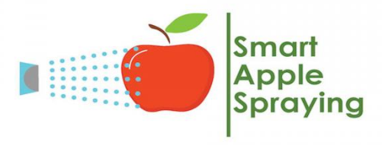
Story #2: Intelligent Sprayers for Apple Orchards in Ohio and Iowa
https://www.smartapplespray.plantpath.iastate.edu/
USDA NIFA – CPPM Project
Collaborators: Heping Zhu (USDA-ARS), Melanie Ivey (Ohio St), Mark Gleason (Iowa St)

Slide 16
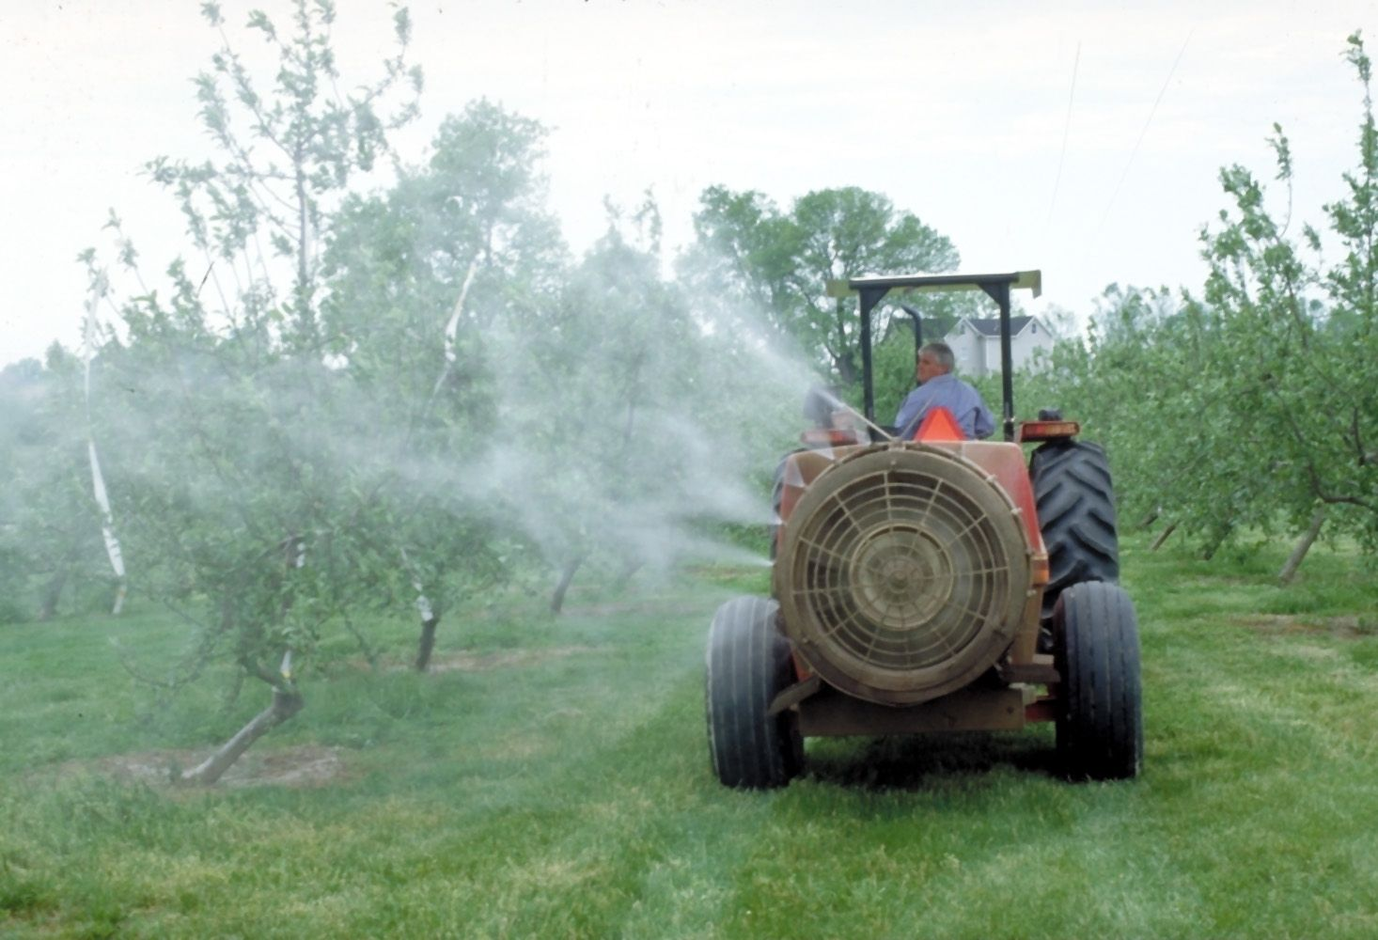
Airblast sprayer – the standard since 1950s
Positives:
Effective against pests and diseases.
Technology is familiar.
Negatives:
Prone to spray drift.
Much of the spray misses target.

Slide 17
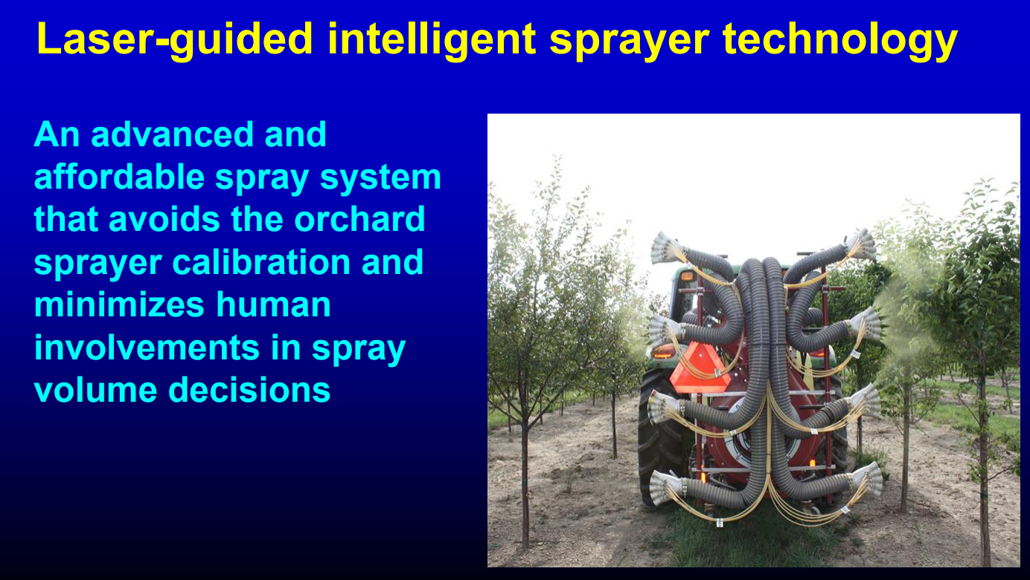
Inventor: Dr. Heping Zhu, USDA ARS, Wooster, OH
Commercially available at Smart Apply, Inc. in Indianapolis, IN

Slide 18
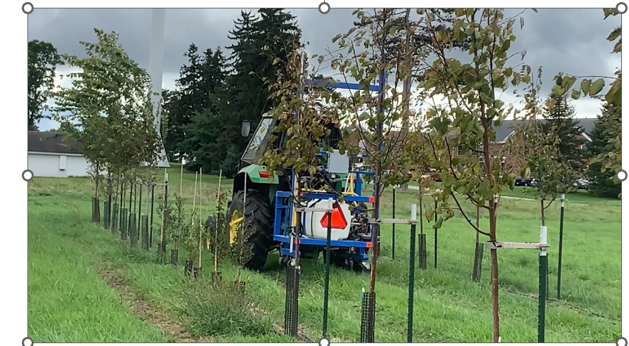
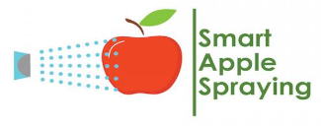

Intelligent Sprayer in Action
https://www.smartapplespray.plantpath.iastate.edu/
Video credit: Heping Zhu, Wooster, OH

Slide 19
Intelligent Sprayer saved 30-60% per spray vs. airblast.

Slide 20
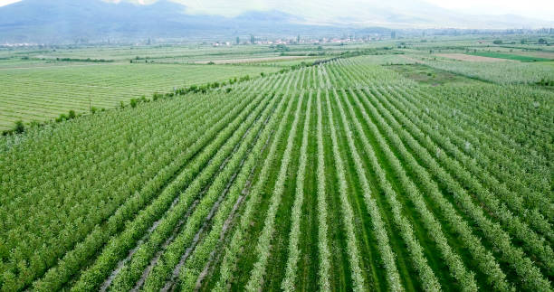
Intelligent Sprayer save refilling trips
Cover 30-50% more orchard with the same spray volume.
Less drift
Less labor costs
Intelligent
Standard

Slide 21
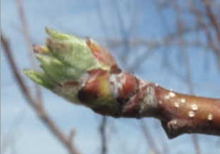
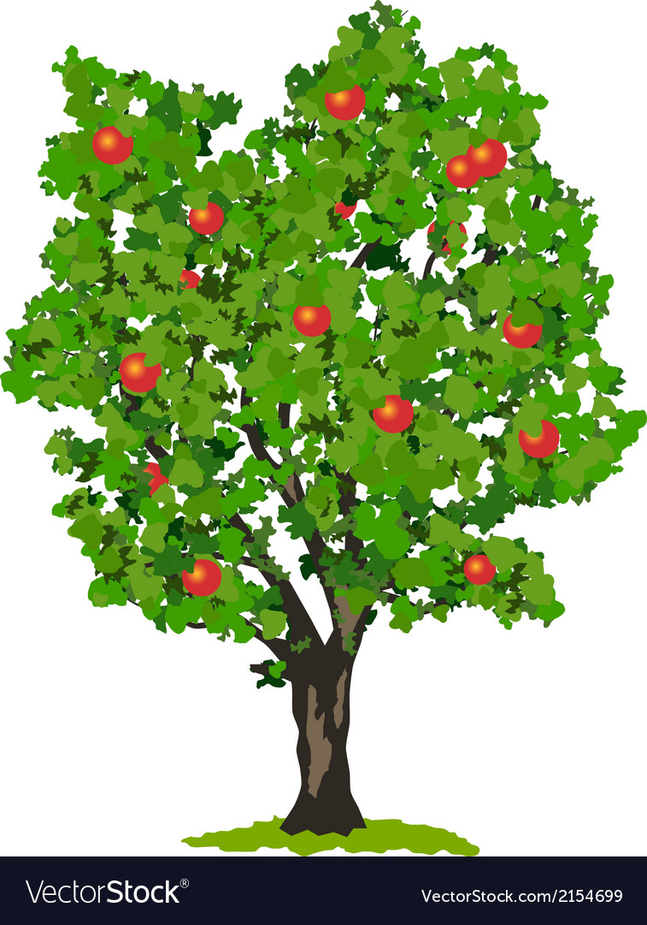
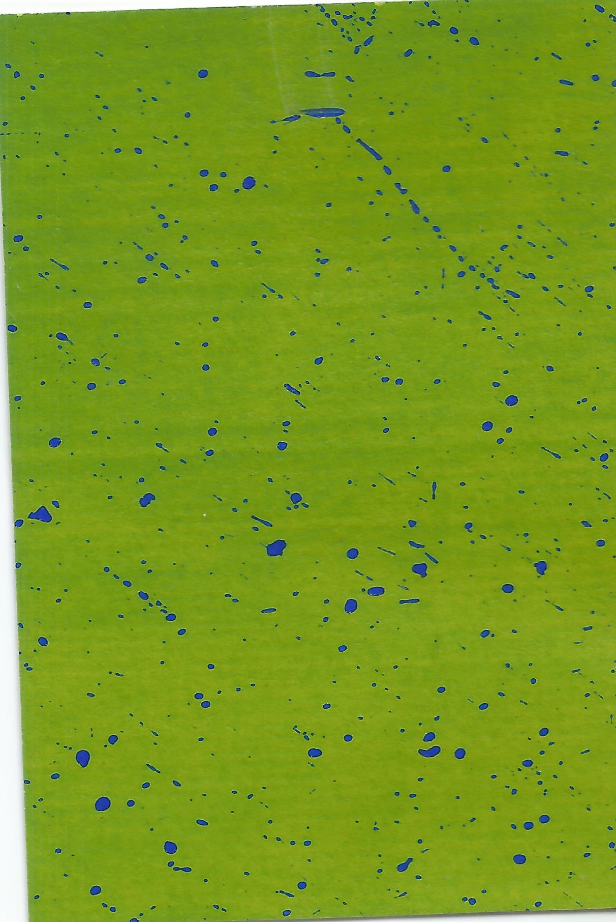
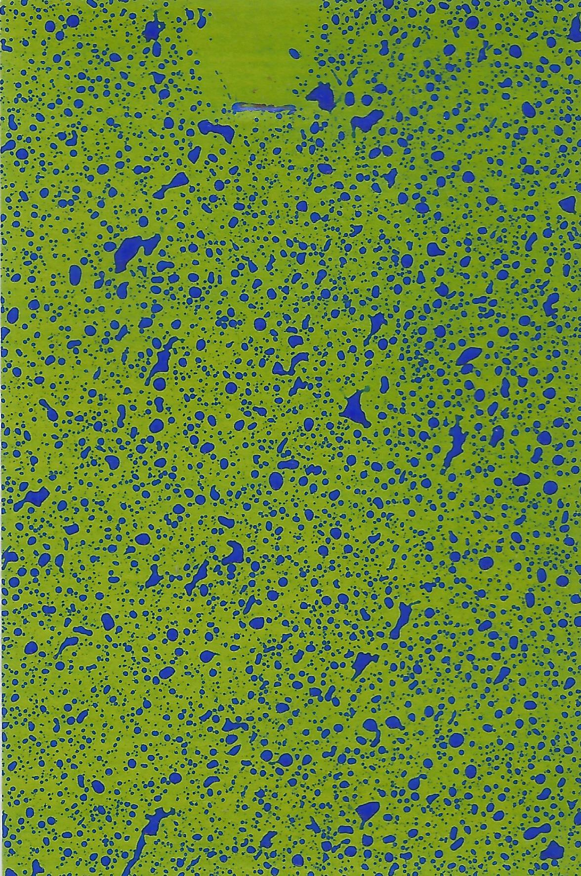
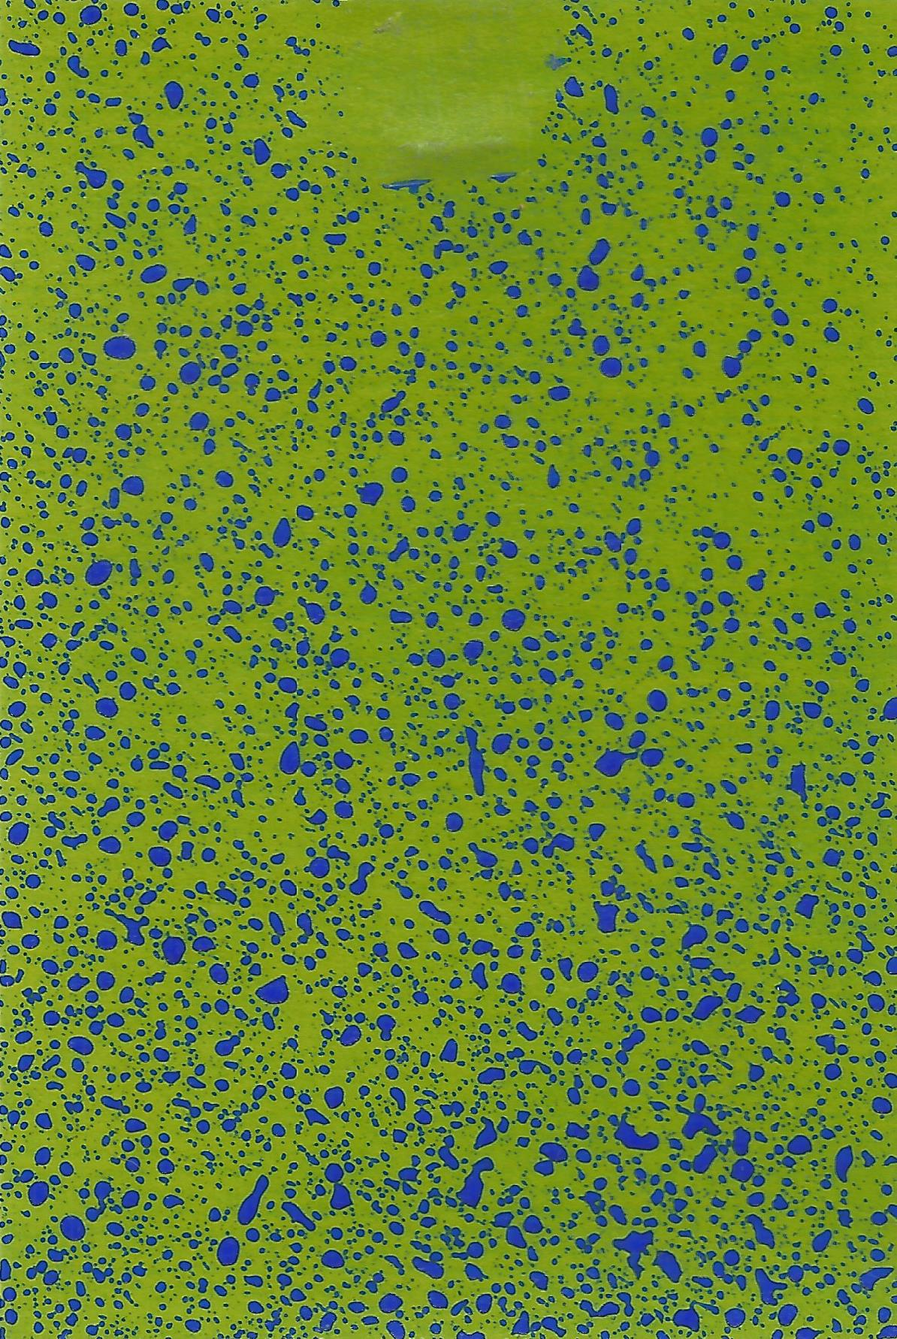
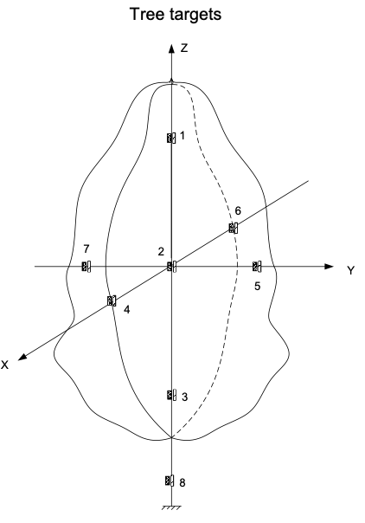
Spray Coverage (2021)
Equivalent coverage
Intelligent
(0.06 fl oz/ft3)
3%
Intelligent
(0.09 fl oz/ft3)
25%
Standard
(100 gal/A) 25%

Slide 22
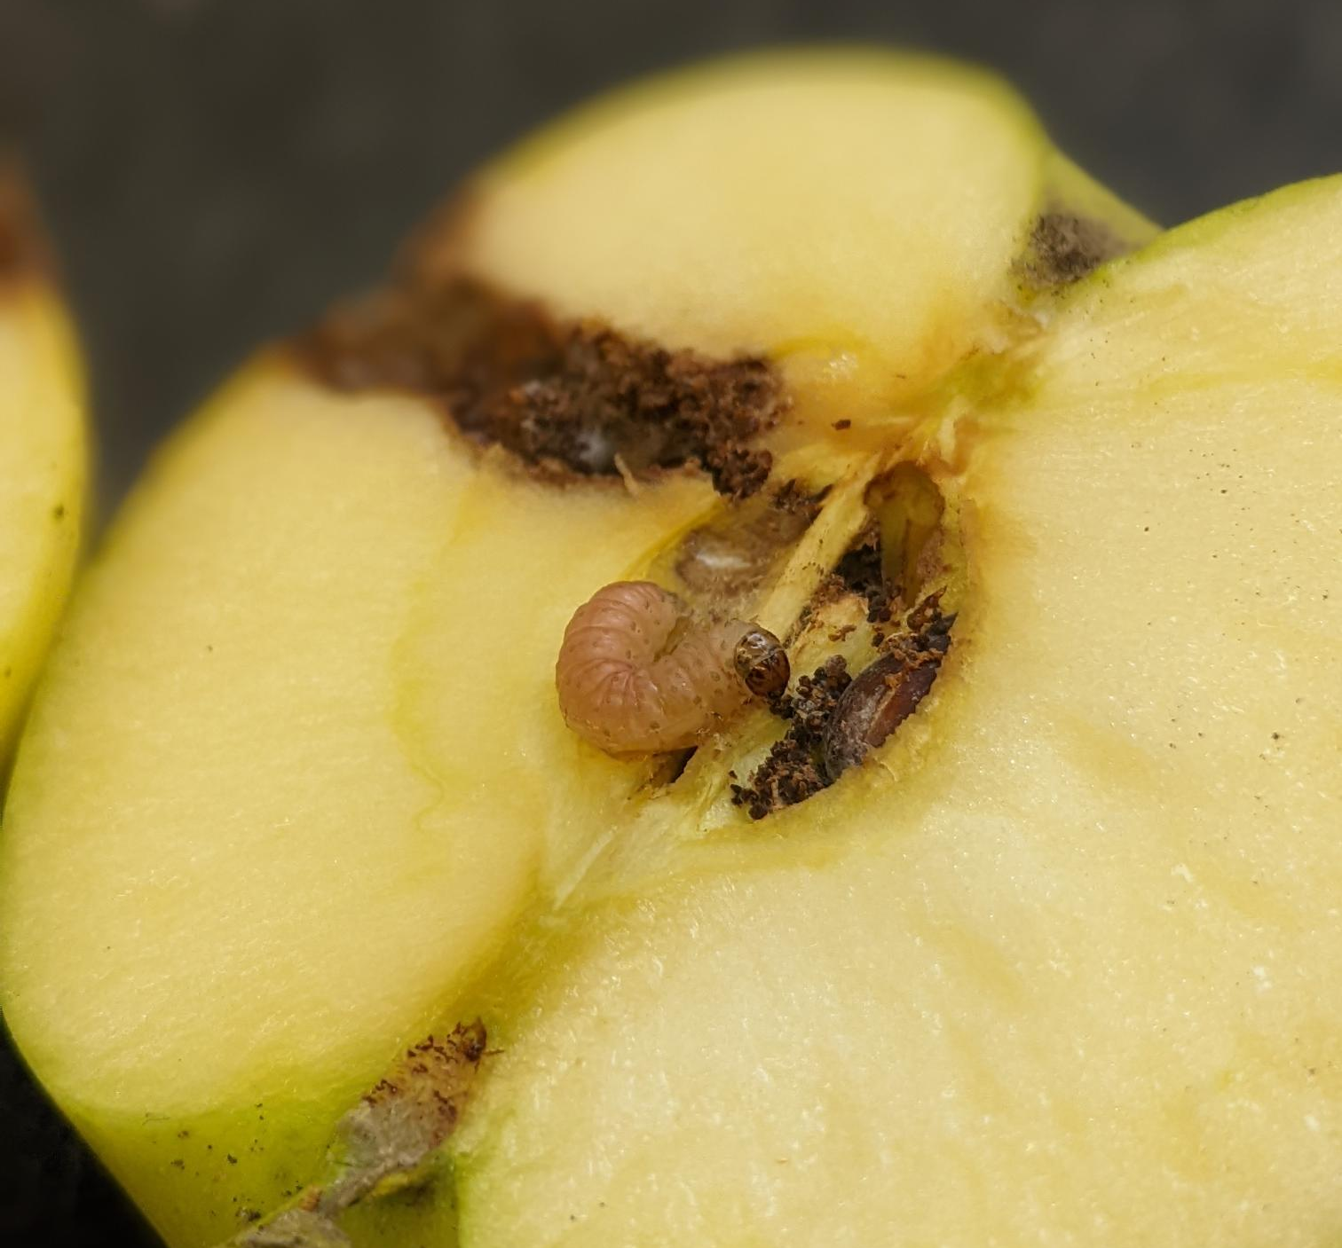
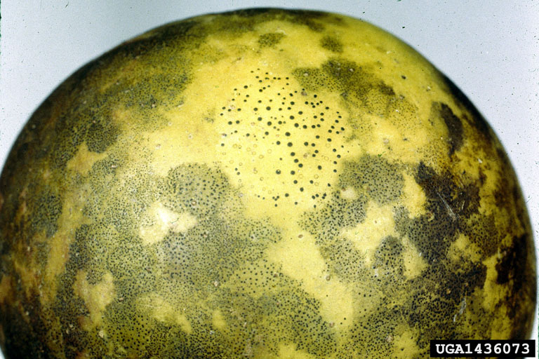
What about pest and disease control?
Iowa: equivalent control in 3 dry years
Ohio commercial orchard: equivalent control for 3 years

Slide 23
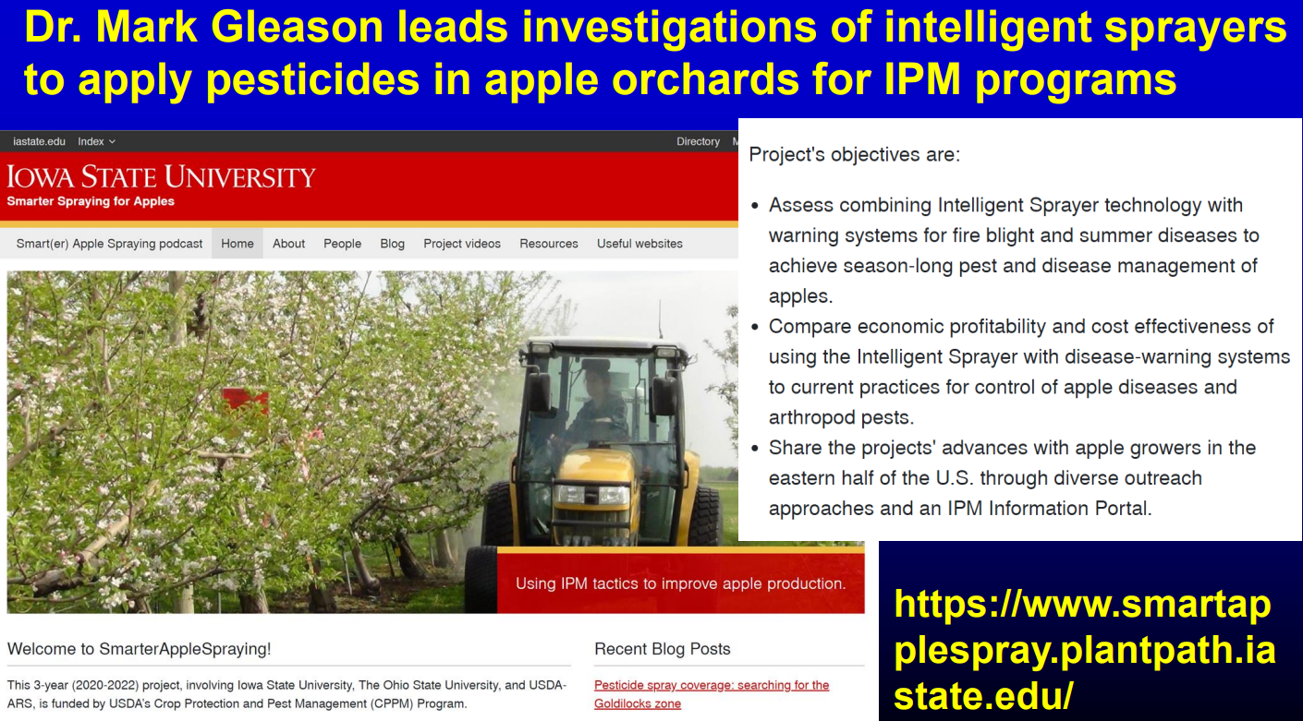

Slide 24
Story #3: Vegetable Production in My Hometown in China

Slide 25
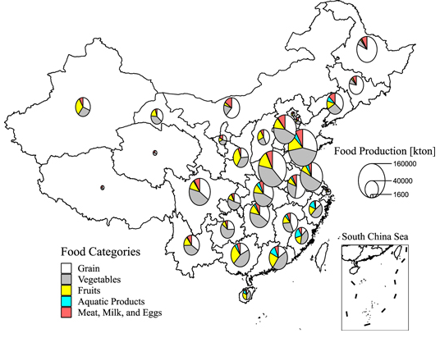
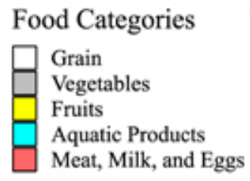
Food Production in China, 2018
https://iopscience.iop.org/article/10.1088/2515-7620/abd622

Slide 26
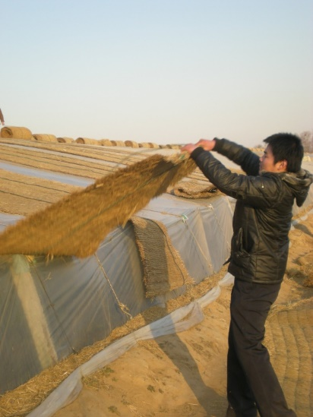
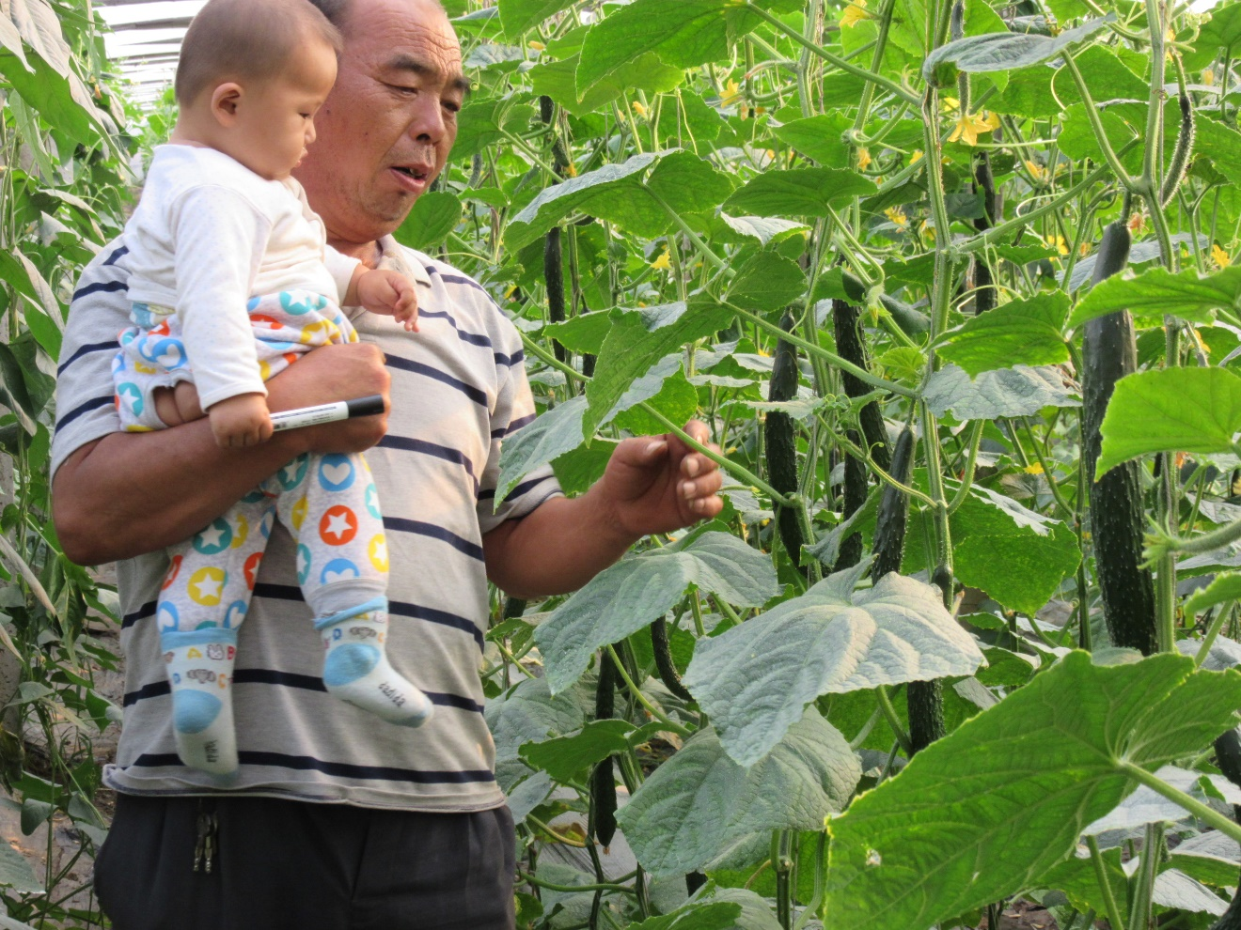
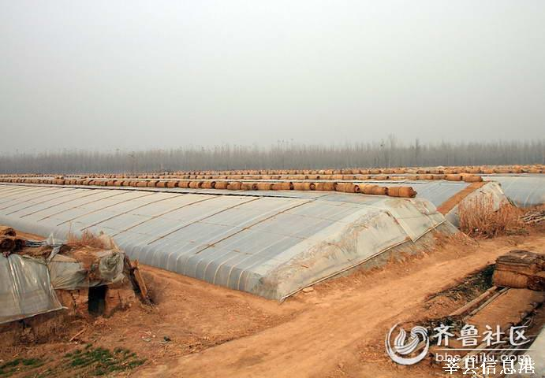
Agricultural transformation in my hometown
Greenhouse – plastic film - Shandong Province

Slide 27
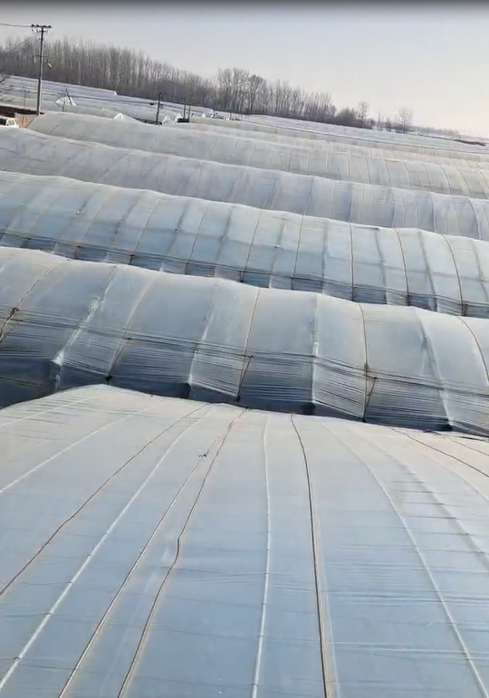
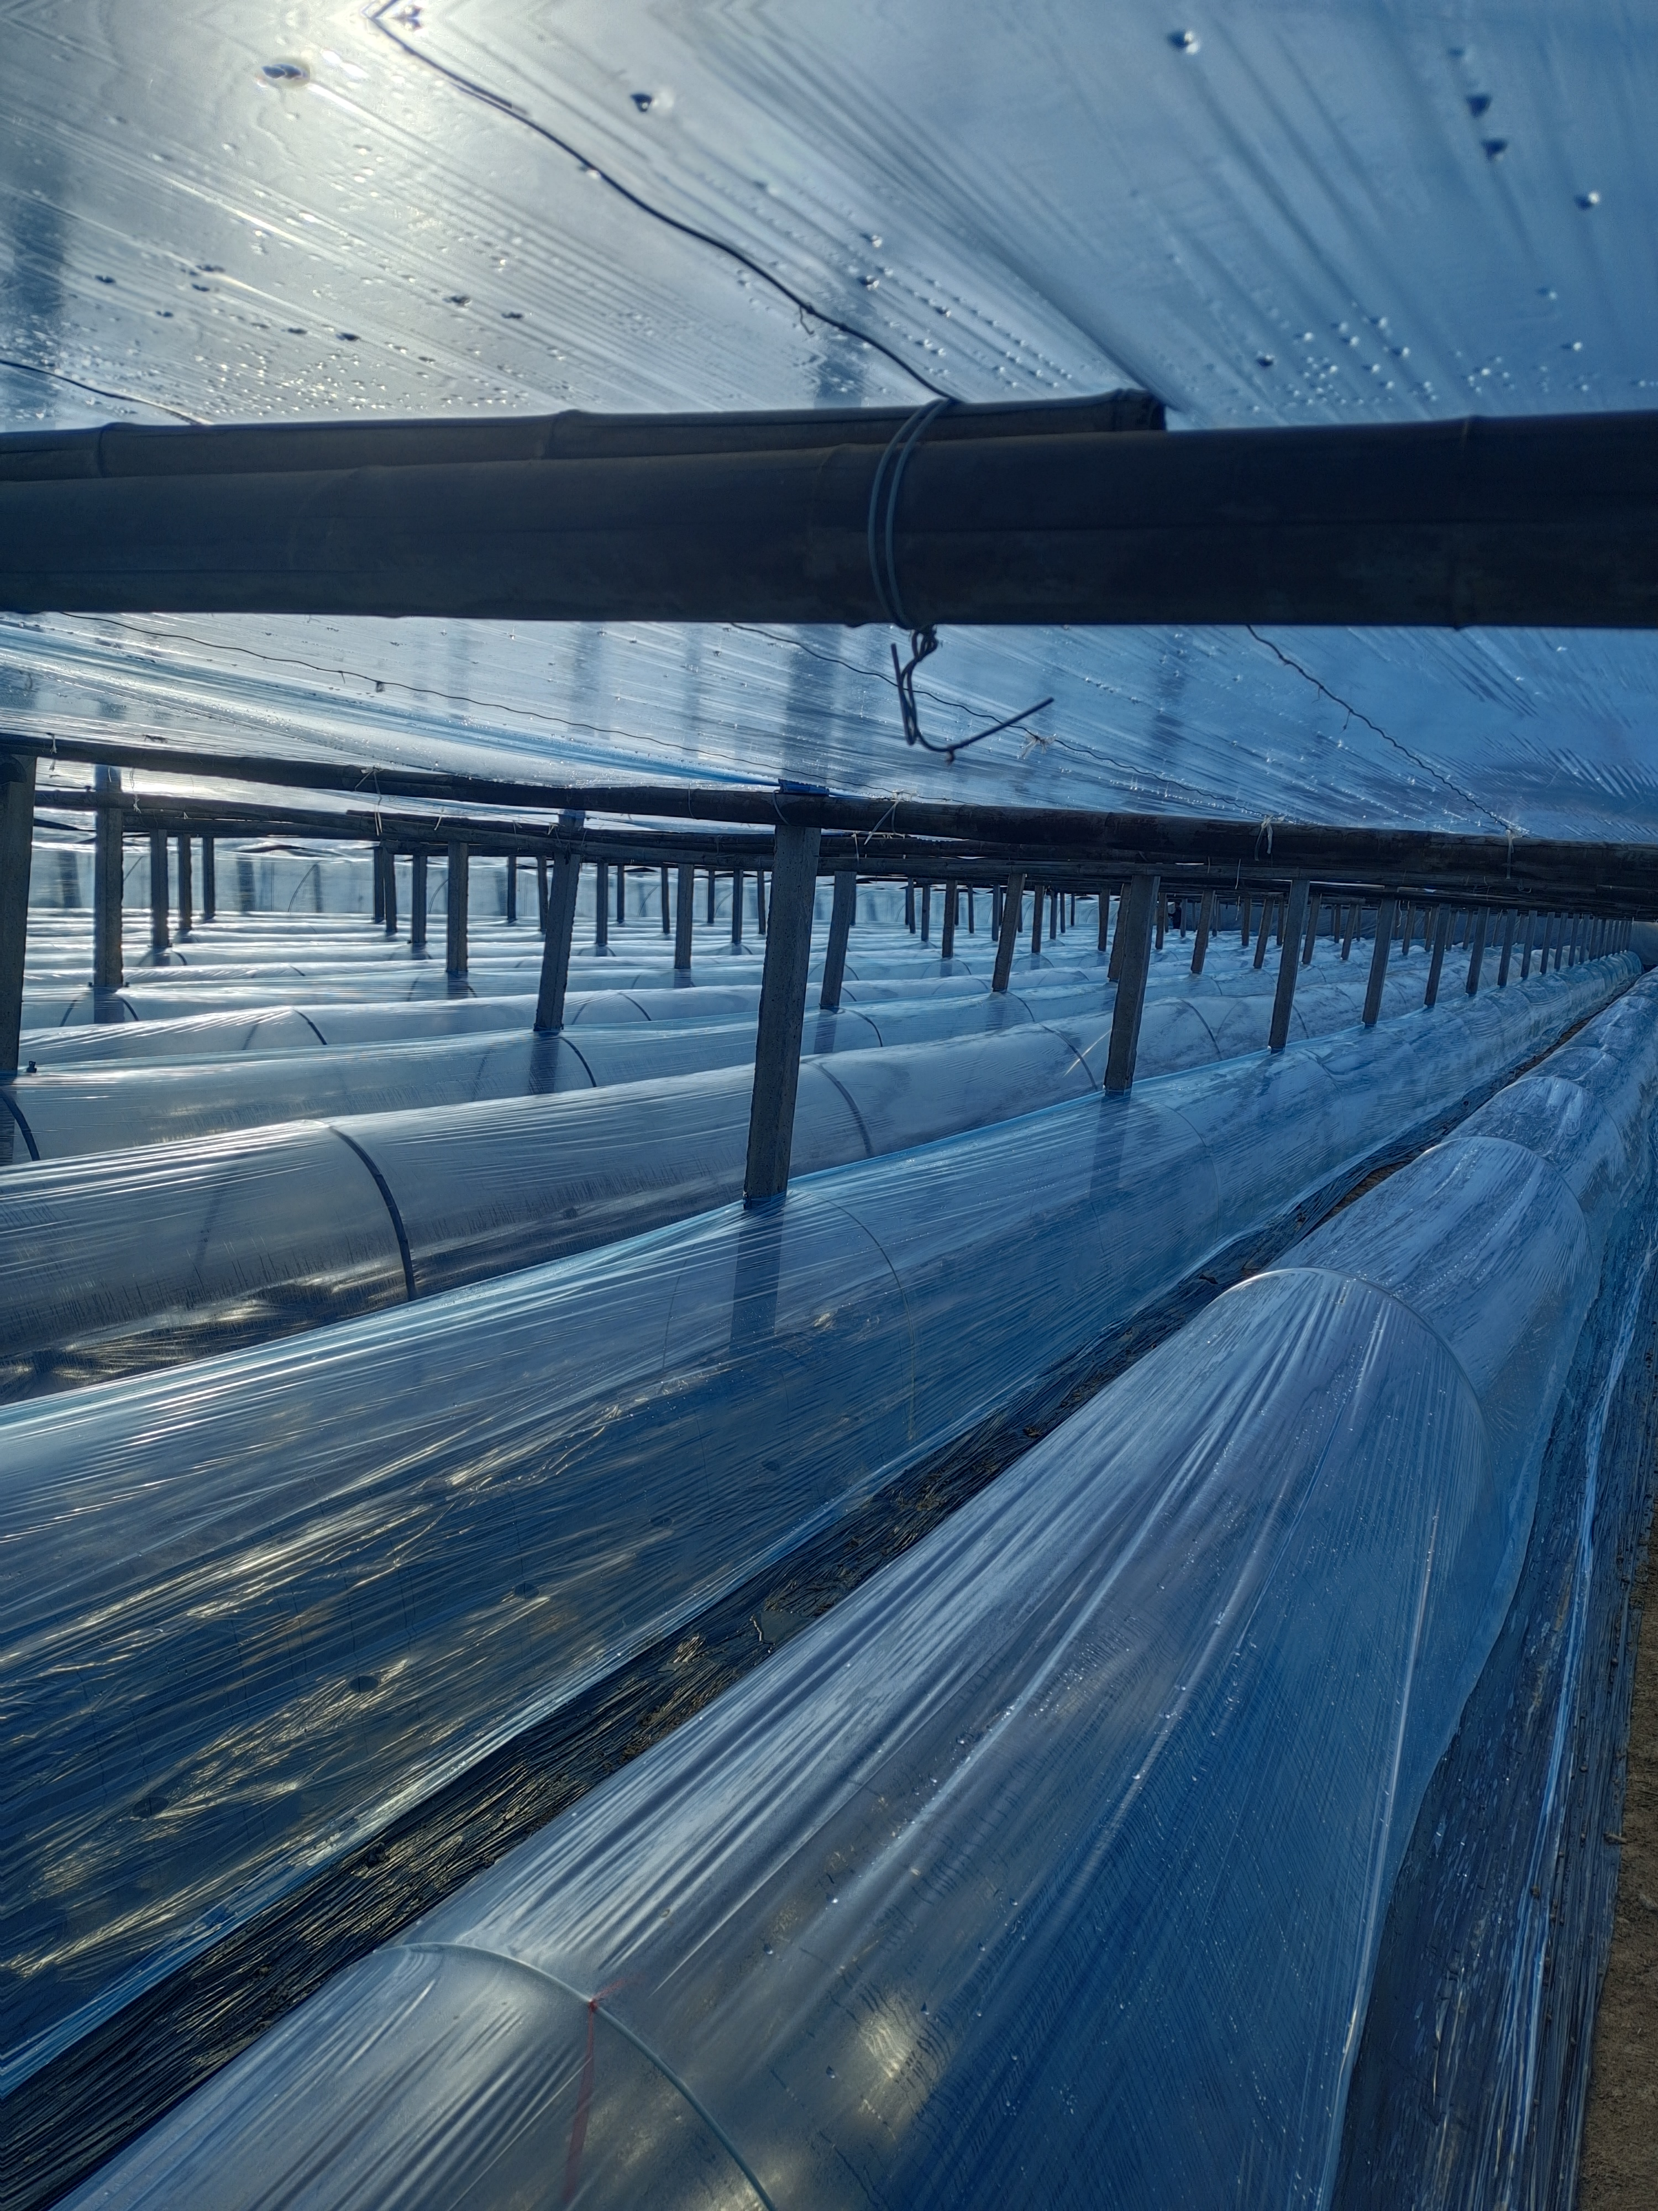
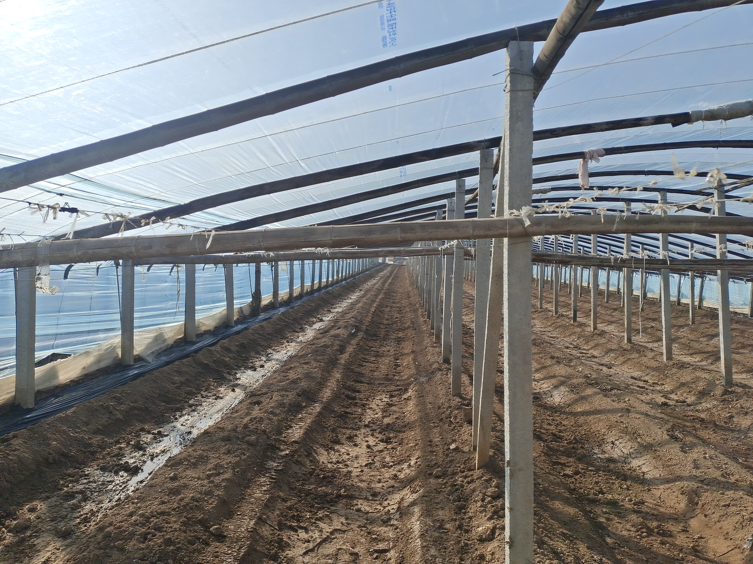
Now the high-tunnel production system has been upgraded

Slide 28

Years of the Rabbit include 2023, 2011, 1999, 1987, 1975, 1963, 1951, 1939, 1927
New Year starts on
Jan 22nd, 2023

Slide 29
Thank you!
Wendong Zhang wendongz@cornell.edu
https://wendongzhang.weebly.com/
Notes:
You should not have to make any edits to this slide.

Slide 30
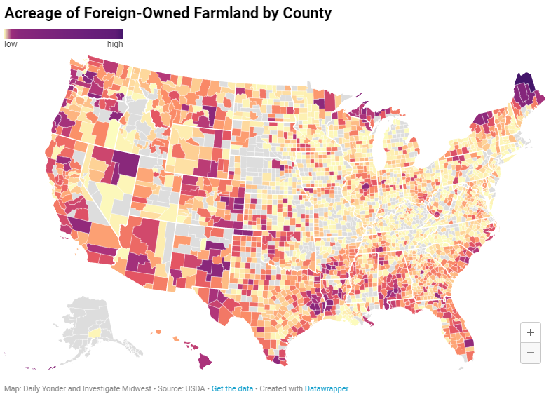
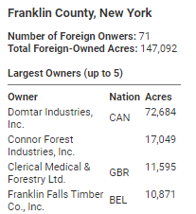
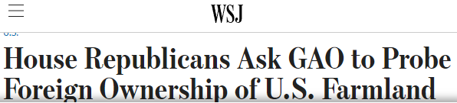
https://investigatemidwest.org/2022/04/19/foreign-investment-in-us-cropland-nearly-triples-in-past-decade-usda-data-shows/

Slide 31
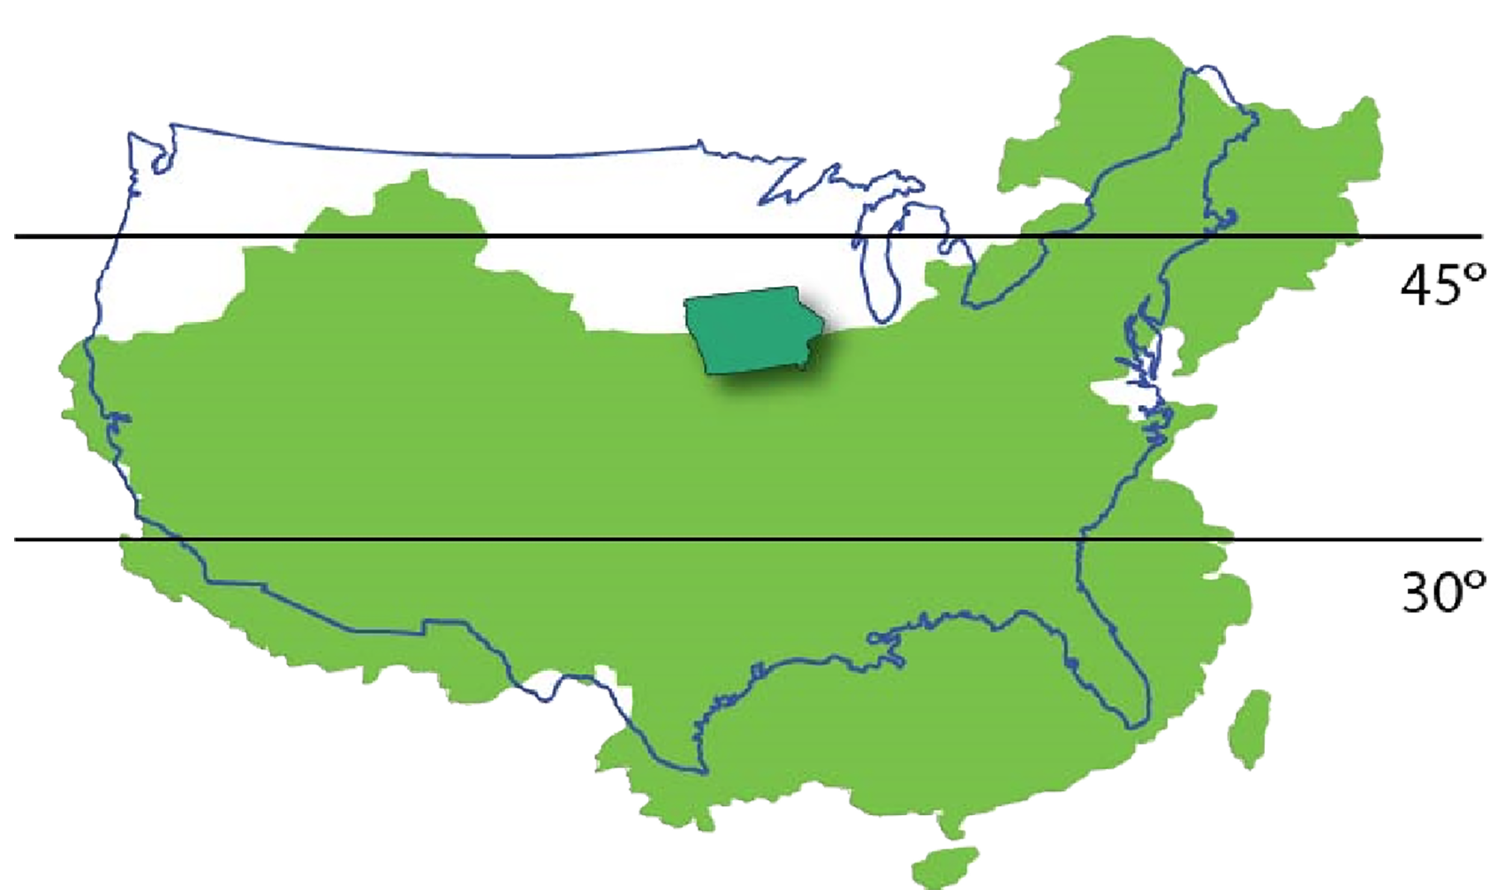
Commodity Agriculture is Comparative Advantage for U.S., not China

Slide 32
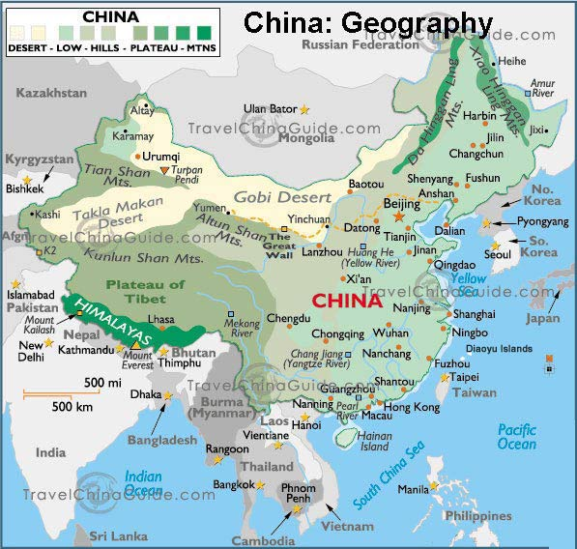
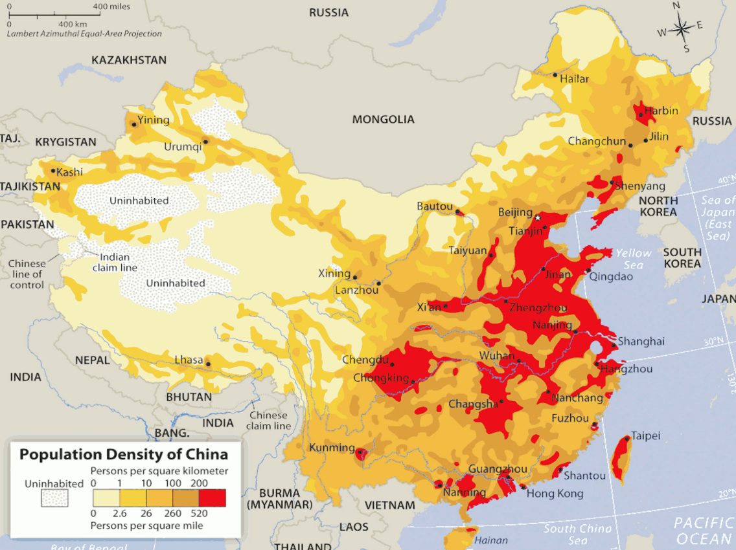

Slide 33
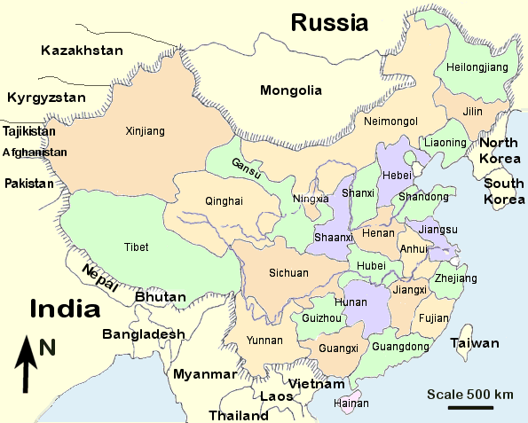
China’s Provinces

Slide 34

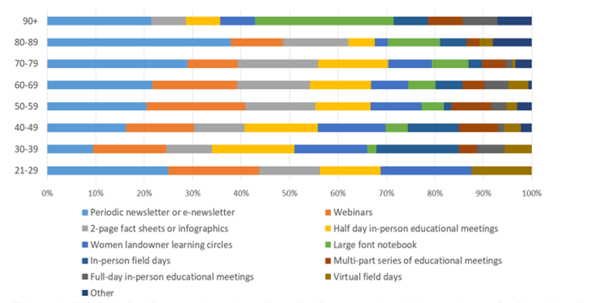


Extension Work on Conservation

