Slide 1
The Outlook for the Economy in 2023
Steven Kyle
Cornell University
January 20, 2023

Slide 2
The Pandemic Isn’t Over Yet (Again) …….
Here in the USA we have not seen peaks in Covid like we did in the past couple of years
However, that is far from true in the rest of the world, particularly China
Also, we are still navigating the aftermath of the shutdowns/reactivations during Covid and our economic policy responses to it

Slide 3
Predictions and Flying Guesses
The statistics I like to predict were not designed for a pandemic economy - Nevertheless, I am an economist and will predict anyway!
As always, I first grade myself on my predictions from a year ago and then make new predictions for next year at the end of my talk
I don’t pretend to know what kinds of unpredictable events might occur – including what our President and Congress might do

Slide 4
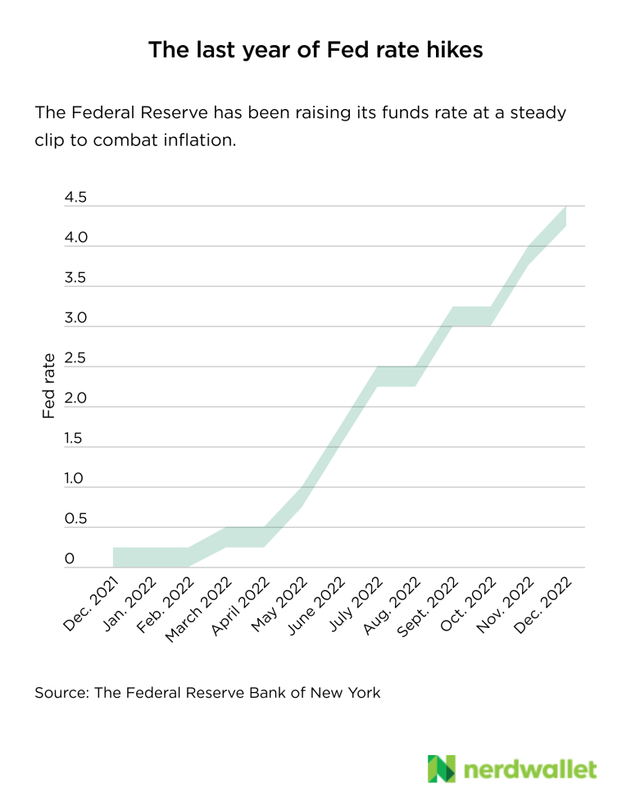
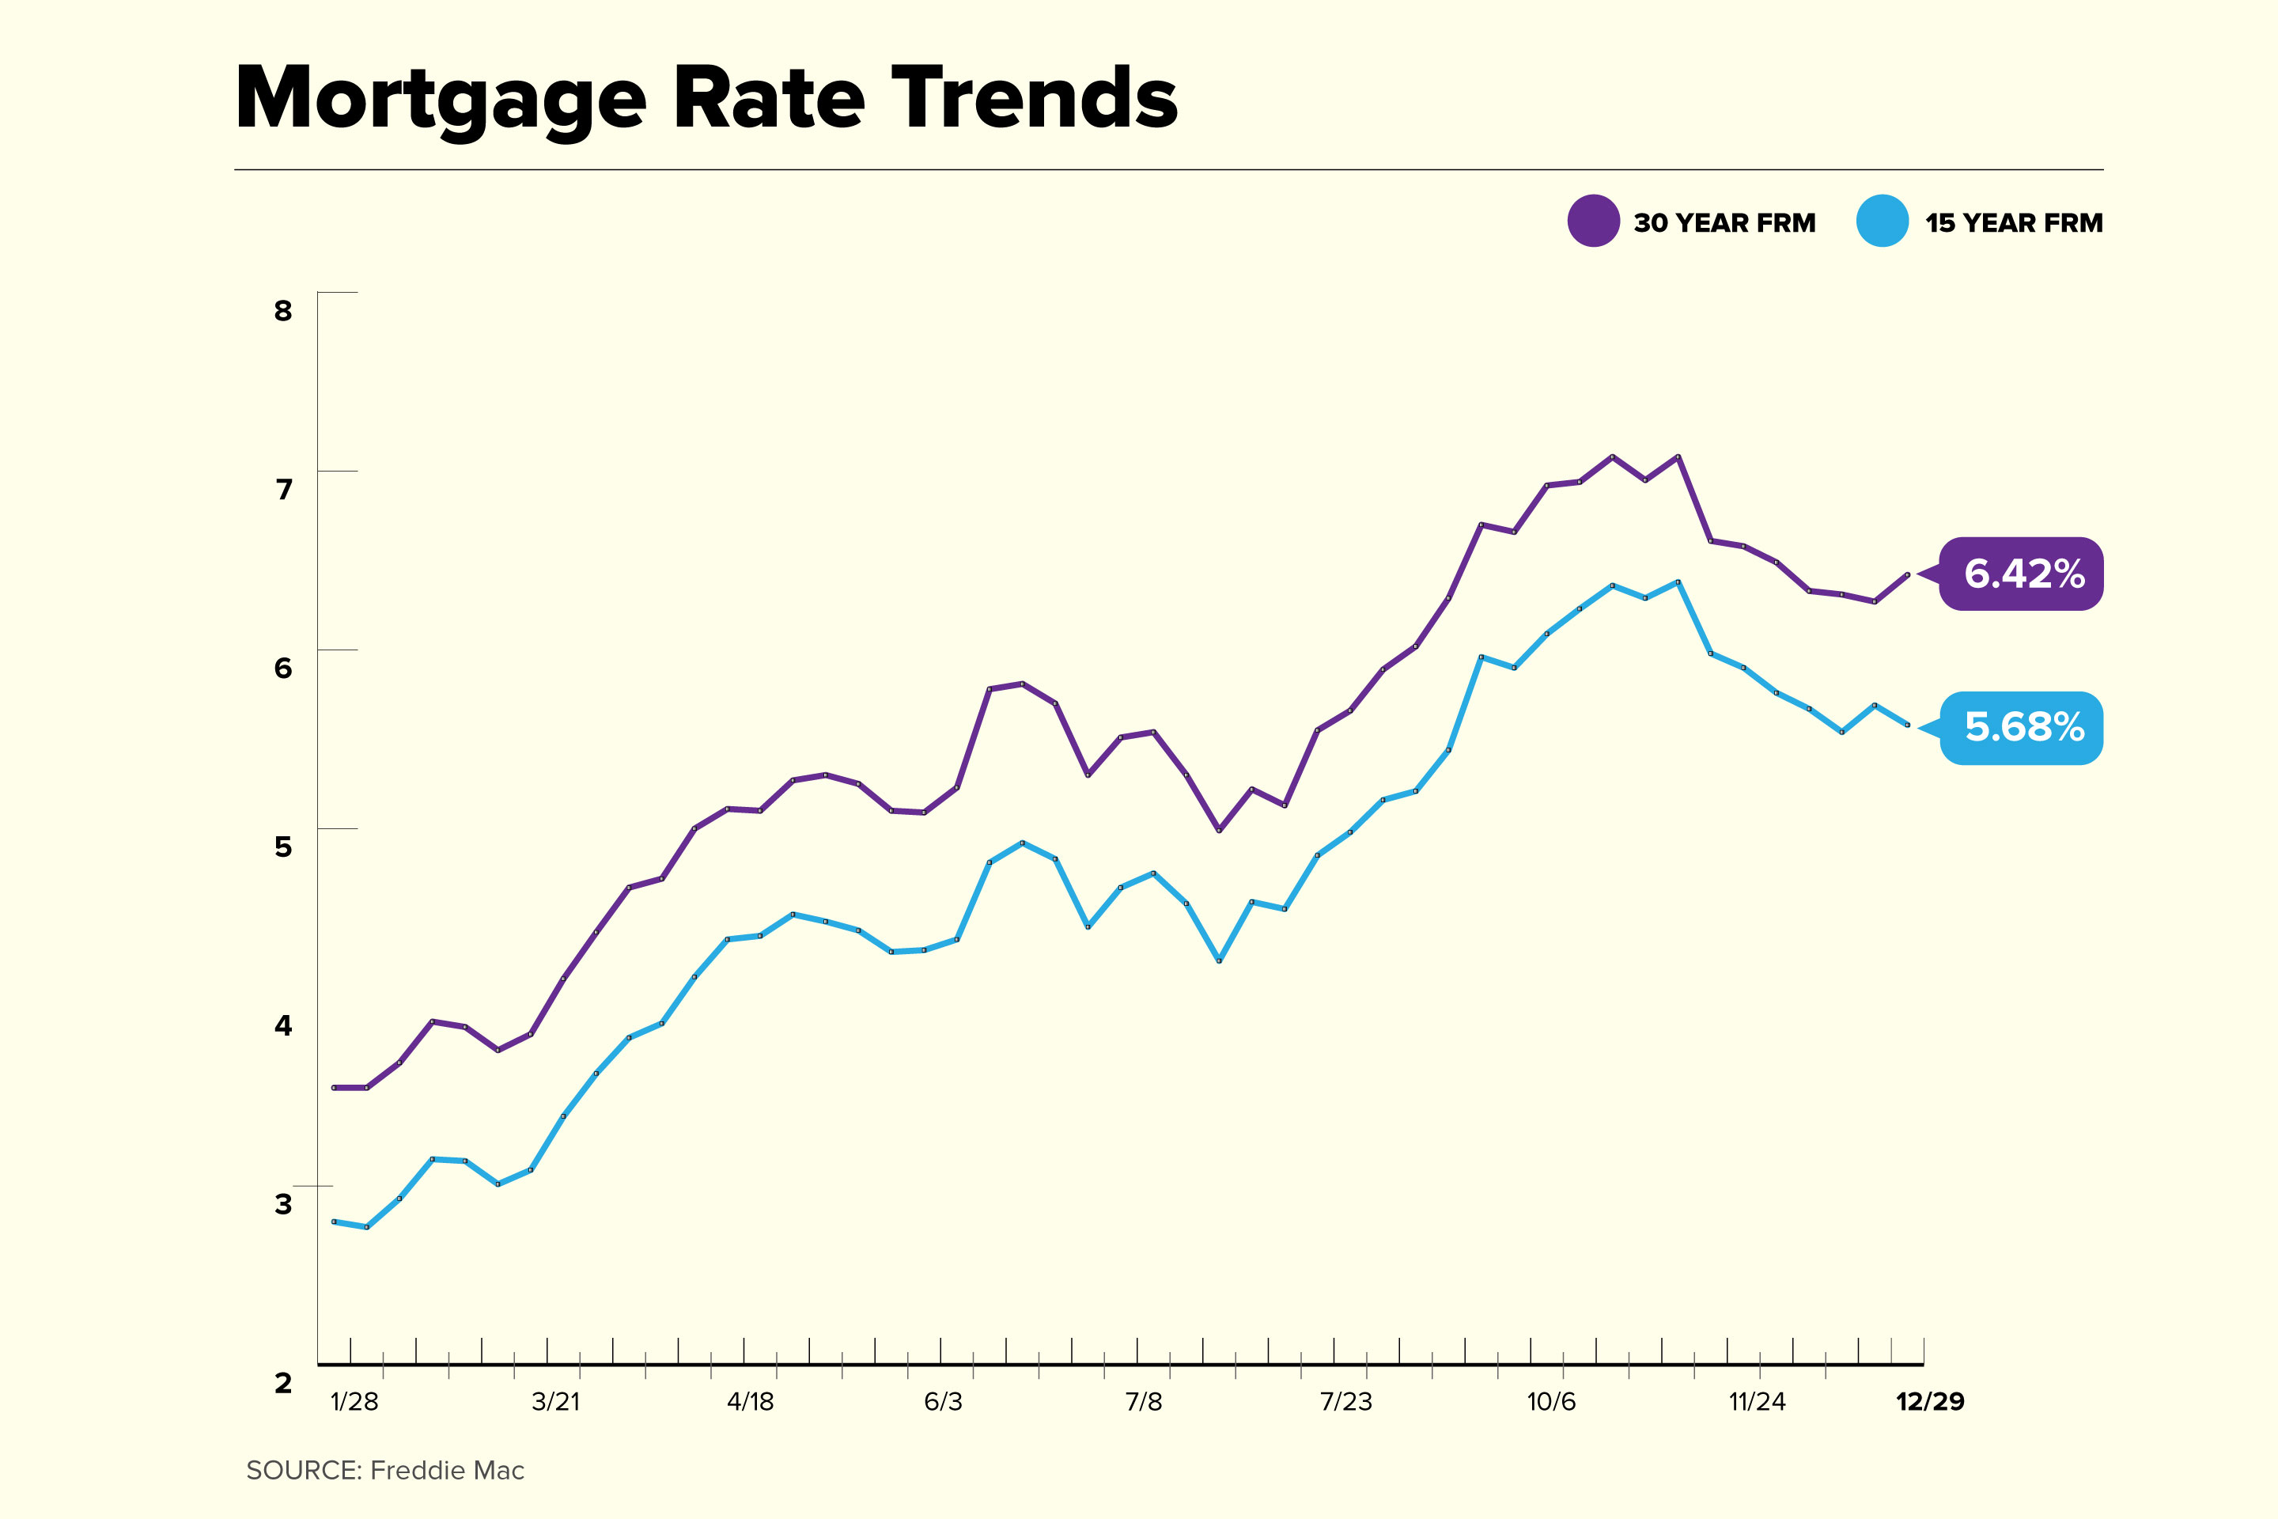
Interest Rates
“Interest rates are easy: They will go up starting this Spring. But I would be surprised if they were higher than 1.5% at the end of the year …”
https://money.com/current-mortgage-rates/

Slide 5
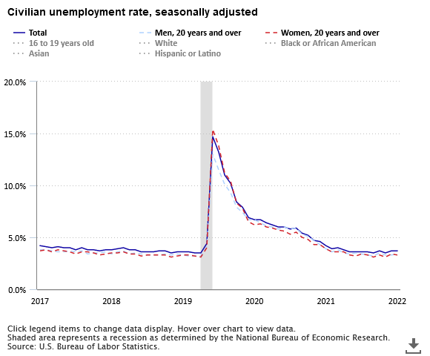
How About Unemployment?
I said a year ago “Unemployment: 3.5-4% by year end (i.e. not far from where we are now)” - That looks pretty good right now!
https://www.bls.gov/opub/ted/2022/unemployment-rate-3-7-percent-in-november-2022.htm

Slide 6
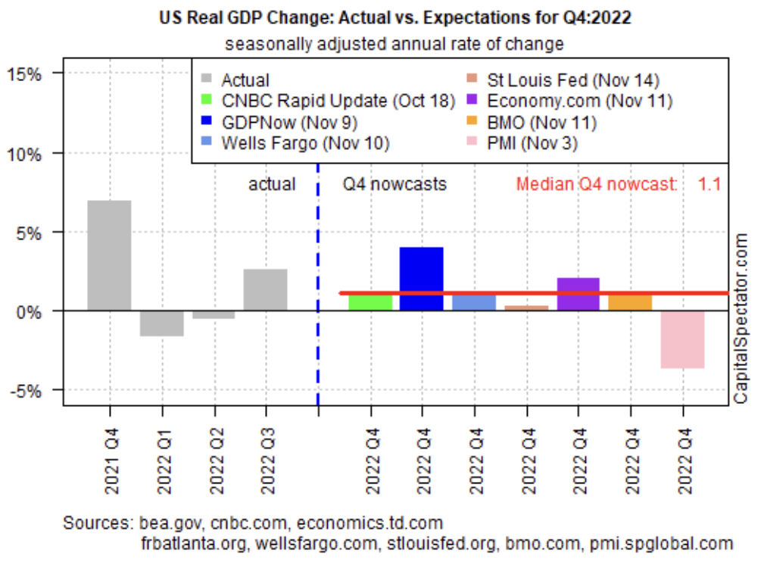
GDP Growth?
I said “GDP: 3.5-4% “ Way too optimistic, GDP growth likely to come in around 2% for the year

Slide 7
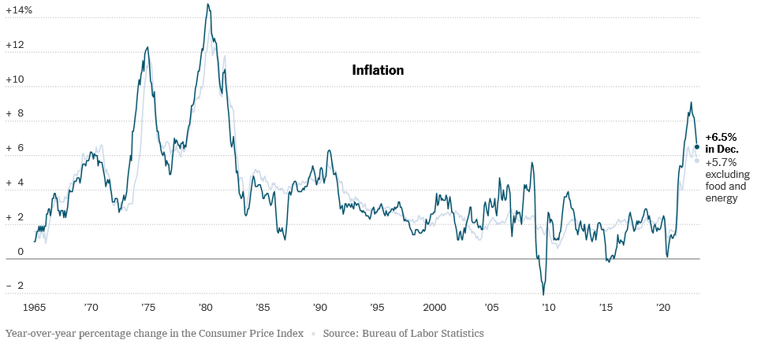
Inflation: I said “4-5%” but the year-end number was 6.5%
https://www.nytimes.com/live/2023/01/12/business/december-cpi-inflation-report

Slide 8
So What is My Grade?
Even though I have influence with the prof, that wasn’t very good
The only thing that was accurate was unemployment – Everything else was far off from reality
But I certainly should get a passing grade for being willing to make a public prediction and getting at least SOME of it right
So, a C+. Still counts toward graduation but won’t look good either

Slide 9
What Went Wrong?
The root of all of my forecasting woes this year is inflation together with the policy response of the Federal Reserve
Inflation spiked and the Fed switched to a massively contractionary policy
That, together with the end of Federal pandemic assistance programs at the end of 2021 meant a double whammy
But the economy has proven pretty resilient - GDP has ended the year in positive territory and employment is booming even now.

Slide 10
And two big ones that couldn’t really be predicted
Russia invades Ukraine! This has generated problems in both oil markets and world grain markets.
If we were predicting on the basis of politicians doing things that are in their interest then Putin seems to be an exception. He has made a historic mistake and continues to insist on it
This uncertainty applies to 2023 as well. Will Putin still be in charge next week? Will the Ukrainians end this?
Note that the world price of oil determines our domestic price and it hasn’t been under any sort of US control since 1973
Many many supply chains are still located in China and have been unreliable through 2022 as covid has surged

Slide 11
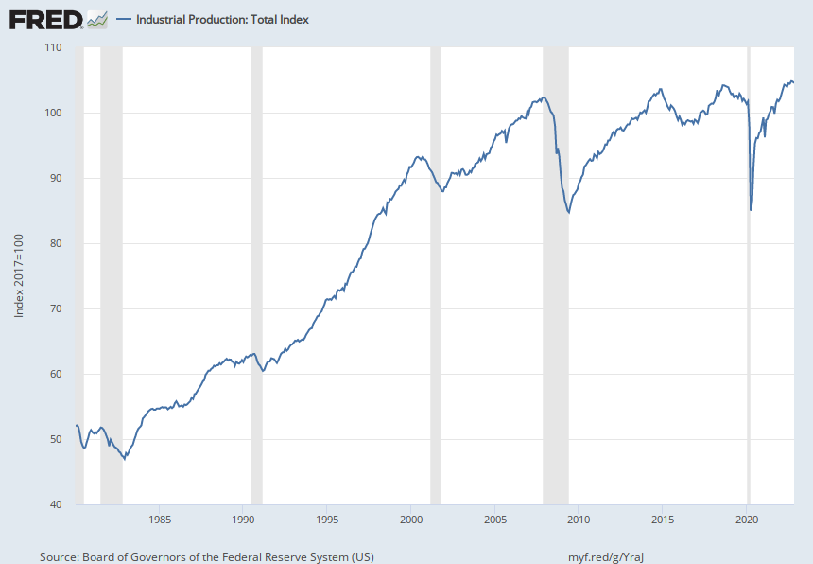
Current Conditions - Industrial Production
Is that a peak we are seeing?
Notes:
Source: Board of Governors of the Federal Reserve System (US) Release: G.17 Industrial Production and Capacity Utilization Units: Index 2017=100, Seasonally Adjusted Frequency: Monthly The industrial production (IP) index measures the real output of all relevant establishments located in the United States, regardless of their ownership, but not those located in U.S. territories.For more information, see the explanatory notes issued by the Board of Governors. For recent updates, see the announcements issued by the Board of GovernorsSource Code: IP.B50001.S Board of Governors of the Federal Reserve System (US), Industrial Production: Total Index [INDPRO], retrieved from FRED, Federal Reserve Bank of St. Louis; https://fred.stlouisfed.org/series/INDPRO, January 4, 2023.

Slide 12
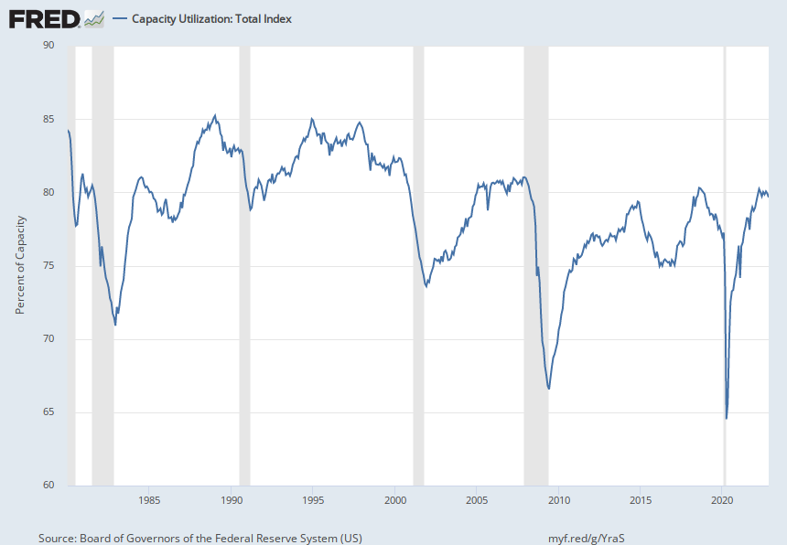
Capacity Utilization Right Around 80%
Another peak?
Notes:
Source: Board of Governors of the Federal Reserve System (US) Release: G.17 Industrial Production and Capacity Utilization Units: Percent of Capacity, Seasonally Adjusted Frequency: Monthly For a given industry, the capacity utilization rate is equal to an output index divided by a capacity index. The Federal Reserve Board's capacity indexes attempt to capture the concept of sustainable maximum output-the greatest level of output a plant can maintain within the framework of a realistic work schedule, after factoring in normal downtime and assuming sufficient availability of inputs to operate the capital in place.For more information, see the explanatory notes issued by the Board of Governors. For recent updates, see the announcements issued by the Board of GovernorsSource Code: CAPUTL.B50001.S Board of Governors of the Federal Reserve System (US), Capacity Utilization: Total Index [TCU], retrieved from FRED, Federal Reserve Bank of St. Louis; https://fred.stlouisfed.org/series/TCU, January 4, 2023.

Slide 13
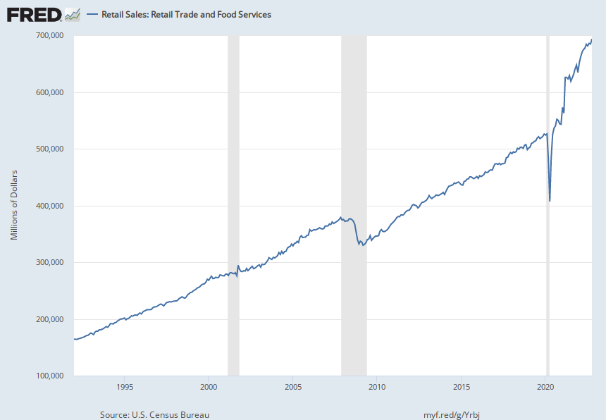
Retail Sales Have Been the Powerhouse of the Recovery
Maybe a slowdown but not very obvious
Notes:
Source: U.S. Census Bureau Release: Monthly Retail Trade and Food Services Units: Millions of Dollars, Seasonally Adjusted Frequency: Monthly The most recent month's value of the advance estimate based on data from a subsample of firms from the larger Monthly Retail Trade Survey is available at https://fred.stlouisfed.org/series/RSAFS Information about the Monthly Retail Trade Survey can be found on the Census website at https://www.census.gov/retail/mrts/about_the_surveys.html U.S. Census Bureau, Retail Sales: Retail Trade and Food Services [MRTSSM44X72USS], retrieved from FRED, Federal Reserve Bank of St. Louis; https://fred.stlouisfed.org/series/MRTSSM44X72USS, January 4, 2023.

Slide 14
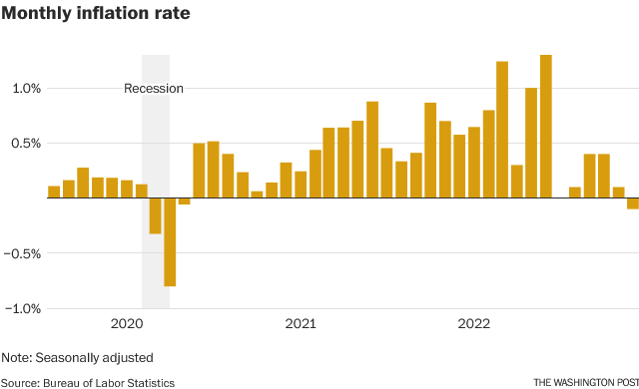
CPI Inflation – 6.5% on an annual basis
but actually now negative month to month
https://www.washingtonpost.com/business/2023/01/12/cpi-report-december-inflation/
Notes:
Source: U.S. Bureau of Labor Statistics Release: Consumer Price Index Units: Index 1982-1984=100, Seasonally Adjusted Frequency: Monthly The Consumer Price Index for All Urban Consumers: All Items (CPIAUCSL) is a price index of a basket of goods and services paid by urban consumers. Percent changes in the price index measure the inflation rate between any two time periods. The most common inflation metric is the percent change from one year ago. It can also represent the buying habits of urban consumers. This particular index includes roughly 88 percent of the total population, accounting for wage earners, clerical workers, technical workers, self-employed, short-term workers, unemployed, retirees, and those not in the labor force. The CPIs are based on prices for food, clothing, shelter, and fuels; transportation fares; service fees (e.g., water and sewer service); and sales taxes. Prices are collected monthly from about 4,000 housing units and approximately 26,000 retail establishments across 87 urban areas. To calculate the index, price changes are averaged with weights representing their importance in the spending of the particular group. The index measures price changes (as a percent change) from a predetermined reference date. In addition to the original unadjusted index distributed, the Bureau of Labor Statistics also releases a seasonally adjusted index. The unadjusted series reflects all factors that may influence a change in prices. However, it can be very useful to look at the seasonally adjusted CPI, which removes the effects of seasonal changes, such as weather, school year, production cycles, and holidays. The CPI can be used to recognize periods of inflation and deflation. Significant increases in the CPI within a short time frame might indicate a period of inflation, and significant decreases in CPI within a short time frame might indicate a period of deflation. However, because the CPI includes volatile food and oil prices, it might not be a reliable measure of inflationary and deflationary periods. For a more accurate detection, the core CPI (CPILFESL) is often used. When using the CPI, please note that it is not applicable to all consumers and should not be used to determine relative living costs. Additionally, the CPI is a statistical measure vulnerable to sampling error since it is based on a sample of prices and not the complete average. For more information on the consumer price indexes, see: Bureau of Economic Analysis. "CPI Detailed Report." 2013. Handbook of Methods Understanding the CPI: Frequently Asked Questions U.S. Bureau of Labor Statistics, Consumer Price Index for All Urban Consumers: All Items in U.S. City Average [CPIAUCSL], retrieved from FRED, Federal Reserve Bank of St. Louis; https://fred.stlouisfed.org/series/CPIAUCSL, January 3, 2023.

Slide 15
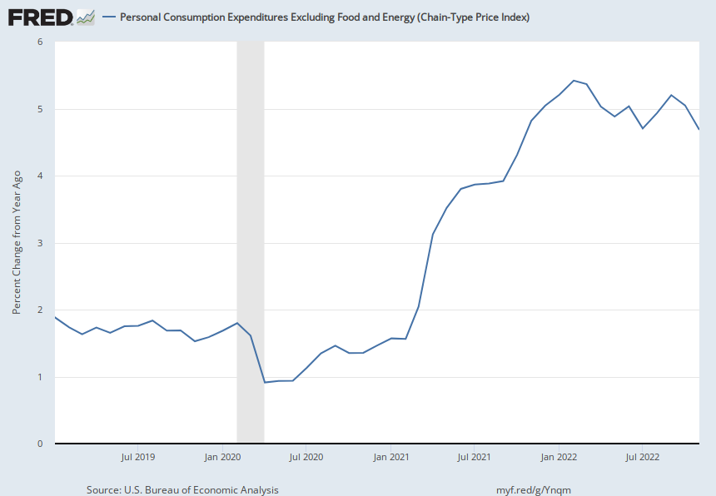
Core Inflation in Personal Consumption Expenditures
This is the one the Fed watches and which they want to be around 2%
Notes:
Source: U.S. Bureau of Economic Analysis Release: Personal Income and Outlays Units: Index 2012=100, Seasonally Adjusted Frequency: Monthly BEA Account Code: DPCCRG The Personal Consumption Expenditures Price Index is a measure of the prices that people living in the United States, or those buying on their behalf, pay for goods and services. The change in the PCE price index is known for capturing inflation (or deflation) across a wide range of consumer expenses and reflecting changes in consumer behavior. For example, if car prices rise, car sales may decline while bicycle sales increase. The PCE Price Index is produced by the Bureau of Economic Analysis (BEA), which revises previously published PCE data to reflect updated information or new methodology, providing consistency across decades of data that's valuable for researchers. They also offer the series as a Chain-Type index and excluding food and energy products, as above. The PCE price index less food excluding food and energy is used primarily for macroeconomic analysis and forecasting future values of the PCE price index. The PCE Price Index is similar to the Bureau of Labor Statistics' consumer price index for urban consumers. The two indexes, which have their own purposes and uses, are constructed differently, resulting in different inflation rates. For more information on the PCE price index, see: U.S. Bureau of Economic Analysis, Guide to the National Income and Product Accounts of the United States (NIPA) U.S. Bureau of Economic Analysis, Personal Consumption Expenditures Price Index U.S. Bureau of Economic Analysis, Prices & Inflation U.S. Bureau of Labor Statistics, Differences between the Consumer Price Index and the Personal Consumption Expenditure Price Index U.S. Bureau of Economic Analysis, Personal Consumption Expenditures Excluding Food and Energy (Chain-Type Price Index) [PCEPILFE], retrieved from FRED, Federal Reserve Bank of St. Louis; https://fred.stlouisfed.org/series/PCEPILFE, January 3, 2023.

Slide 16
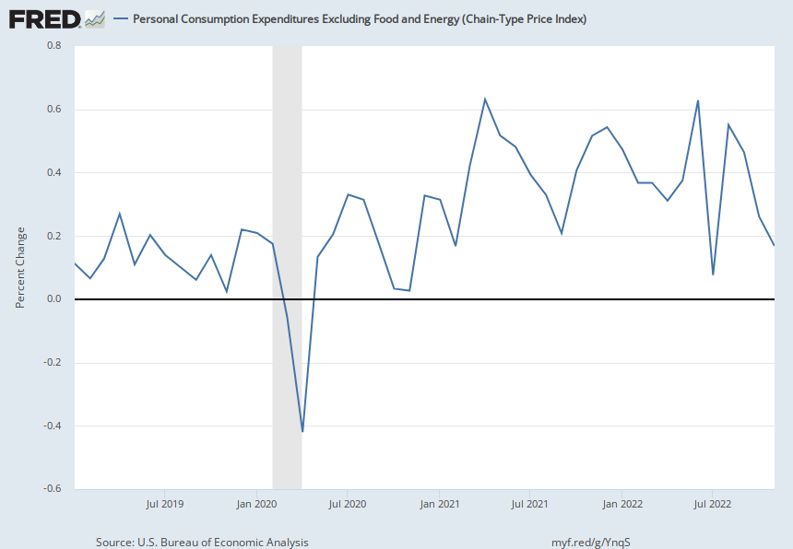
Core PCE on a Monthly Basis – Ignore the breathless reports based on the last move!!!
Notes:
Source: U.S. Bureau of Economic Analysis Release: Personal Income and Outlays Units: Index 2012=100, Seasonally Adjusted Frequency: Monthly BEA Account Code: DPCCRG The Personal Consumption Expenditures Price Index is a measure of the prices that people living in the United States, or those buying on their behalf, pay for goods and services. The change in the PCE price index is known for capturing inflation (or deflation) across a wide range of consumer expenses and reflecting changes in consumer behavior. For example, if car prices rise, car sales may decline while bicycle sales increase. The PCE Price Index is produced by the Bureau of Economic Analysis (BEA), which revises previously published PCE data to reflect updated information or new methodology, providing consistency across decades of data that's valuable for researchers. They also offer the series as a Chain-Type index and excluding food and energy products, as above. The PCE price index less food excluding food and energy is used primarily for macroeconomic analysis and forecasting future values of the PCE price index. The PCE Price Index is similar to the Bureau of Labor Statistics' consumer price index for urban consumers. The two indexes, which have their own purposes and uses, are constructed differently, resulting in different inflation rates. For more information on the PCE price index, see: U.S. Bureau of Economic Analysis, Guide to the National Income and Product Accounts of the United States (NIPA) U.S. Bureau of Economic Analysis, Personal Consumption Expenditures Price Index U.S. Bureau of Economic Analysis, Prices & Inflation U.S. Bureau of Labor Statistics, Differences between the Consumer Price Index and the Personal Consumption Expenditure Price Index U.S. Bureau of Economic Analysis, Personal Consumption Expenditures Excluding Food and Energy (Chain-Type Price Index) [PCEPILFE], retrieved from FRED, Federal Reserve Bank of St. Louis; https://fred.stlouisfed.org/series/PCEPILFE, January 3, 2023.

Slide 17
Two Opposing Views on Inflation
It’s Transitory!
It was inevitable that there would be some bottlenecks and supply issues as the economy reactivated
Policy implication - Don’t overreact, it will go away on its own
It’s Too Much Spending!
Ex post we can say that this was at least part of the problem
Silly to pick one part of spending or taxes to blame (favorite is the child tax credit but you could as easily blame defense spending or tax cuts or whatever else you don’t like)
It’s like blaming the mashed potatoes instead of the ice cream for your extra 5 pounds after the holidays

Slide 18
Steve Kyle says: “Both can be true at the same time!”
First, there were undoubtedly supply chain issues and just as undoubtedly, they would get sorted out
Cars are an excellent example of this
Second, yes, the aggregate of spending and taxes proved to be more than an inflation hawk would have wanted
But in addition to the silliness of picking your least favorite budget item to heap blame on, ask yourself what choice we had?
We had to run the risk of some inflation to keep people (many of them children) from literally starving
Third, war in Ukraine has had a strong effect on both oil and food markets

Slide 19
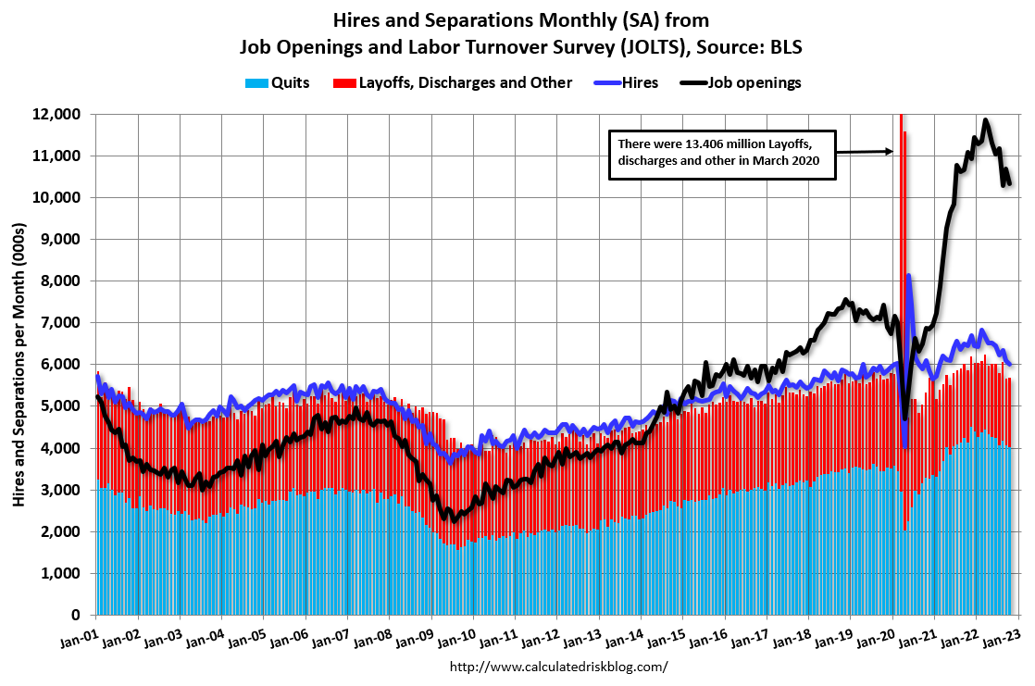
The Labor Market continues to be red hot even though some cooling is evident

Slide 20
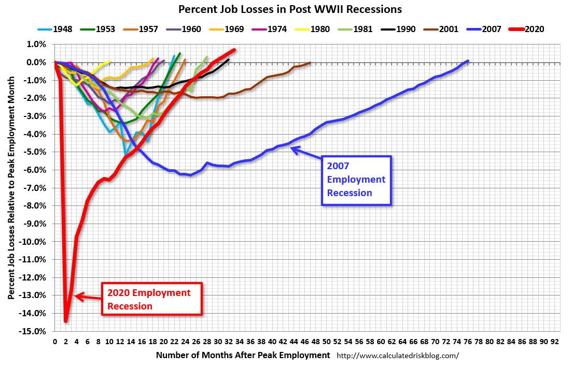
We have already replaced all the jobs lost in the lockdowns (and then some)

Slide 21
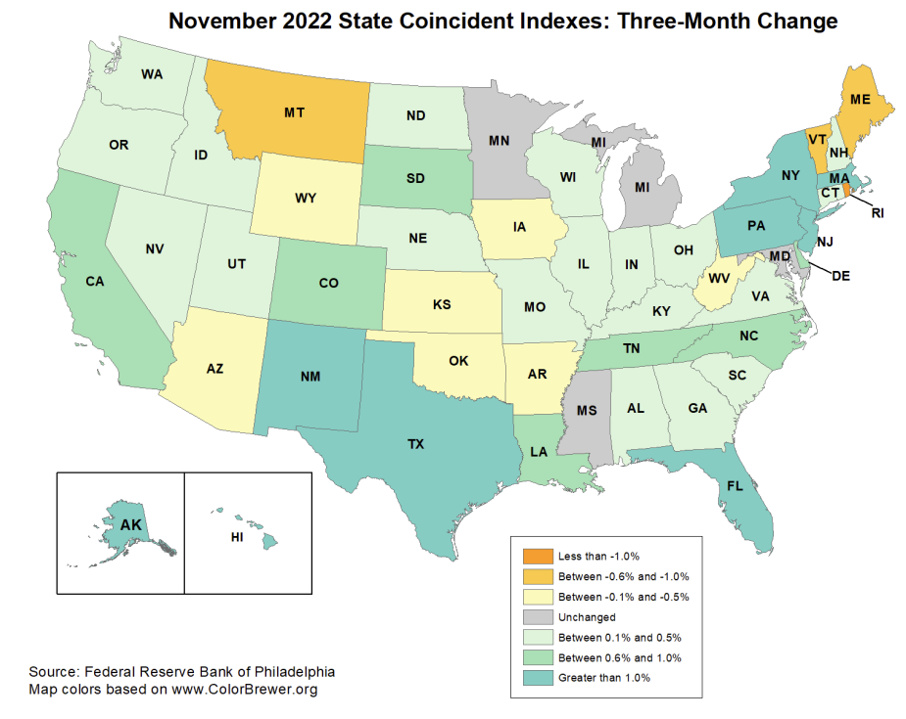
Overall state level
economic growth
picture still looks OK
though weakening

Slide 22
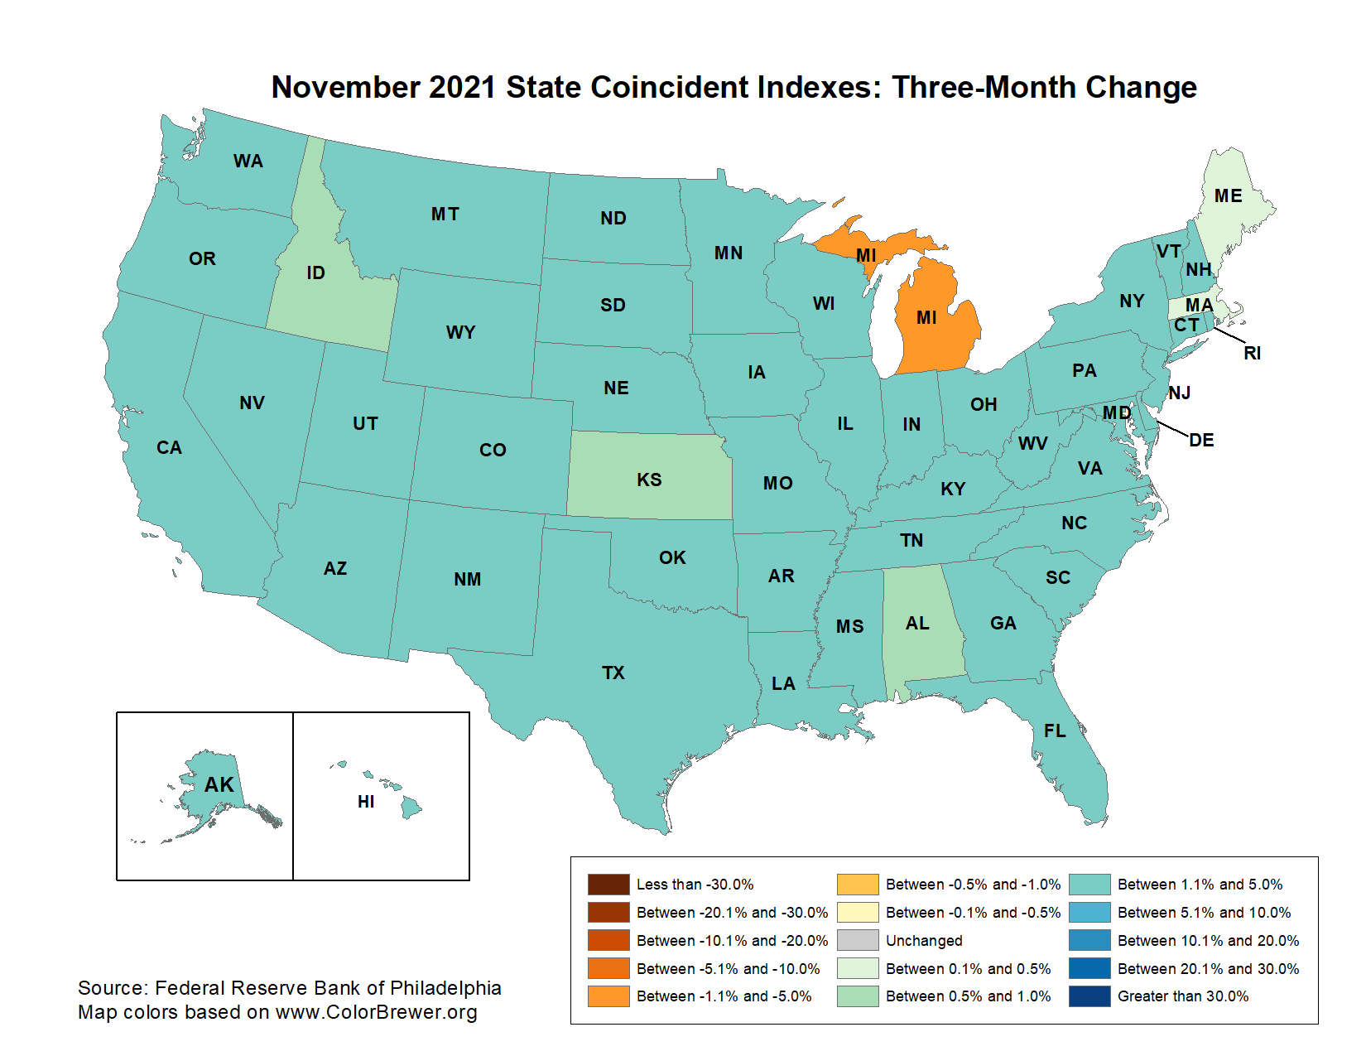
Though Definitely Worse Than a Year Ago

Slide 23
Policy Response to All of This ……..
Congress has passed major infrastructure and climate action bills
All fully funded but will have some stimulative effect
Don’t expect a single thing to get through Congress this year
The Fed has essentially freaked out and is determined to “demonstrate credibility” by swiftly jacking up interest rates to squash inflation as quickly as possible
However, most of the sectors with high inflation are NOT the ones that are most interest sensitive
This means they will have to clamp down pretty hard before seeing the results they want

Slide 24
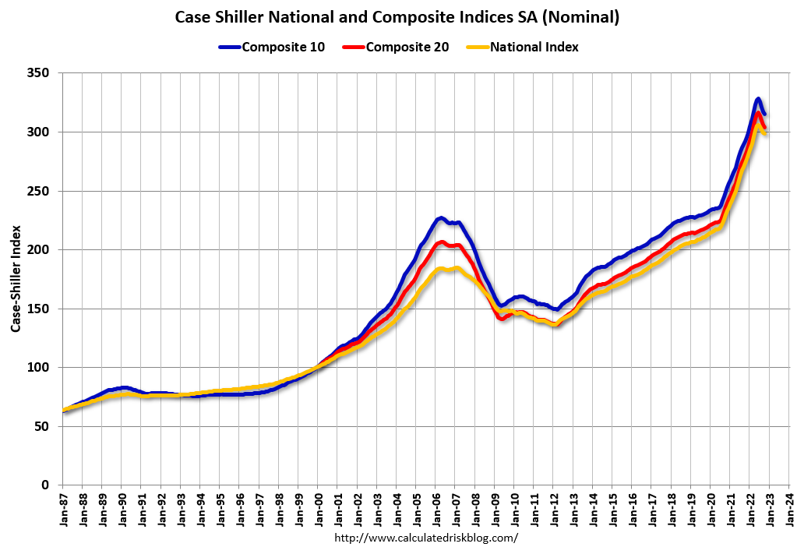
Housing has already responded – Both nominal and real prices have started down

Slide 25
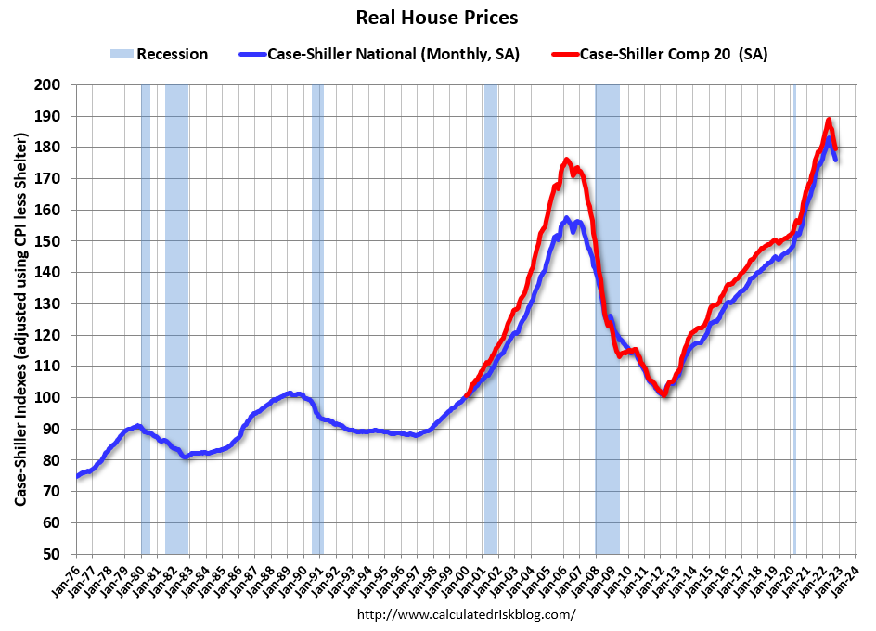

Slide 26
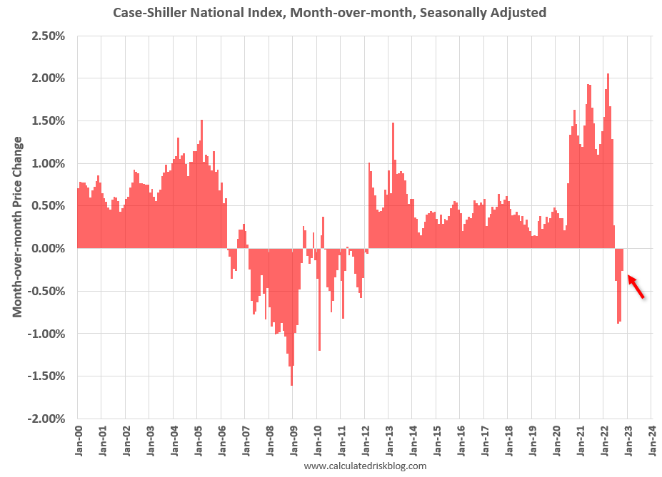

Slide 27
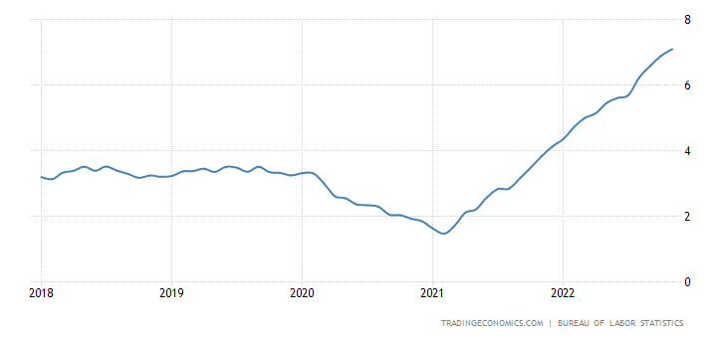
Inflation in Rents Have Hit Hard While Accounting for Approx. 1/3 of CPI
Except for Office Space – Lots more remote workers now
https://tradingeconomics.com/united-states/rent-inflation

Slide 28
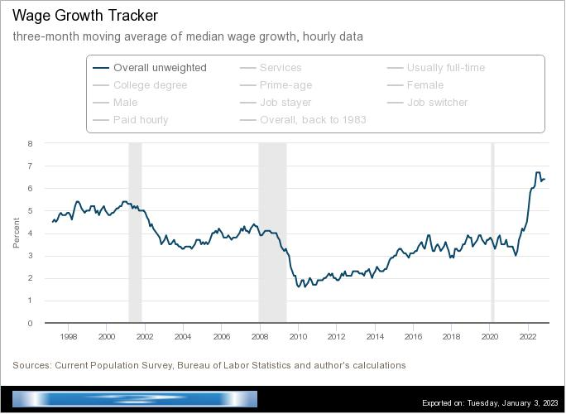
But Wage Growth is Continuing to be Strong
Fed has said they are watching this
Hard to see consumer spending falling drastically if people have lots of money in their pockets
https://www.atlantafed.org/chcs/wage-growth-tracker

Slide 29
How much to worry about higher wages?
They are typically interpreted as an early sign of inflation to come and could contribute to a rise in persistent inflation
On the other hand, real wages have been stagnant for literally decades and some degree of catching up was bound to occur sooner or later
Some signs of wage compression (i.e. lower wages rising more than higher brackets)
If the Fed says they are watching this, then believe them

Slide 30
Recession Likely This Year but Strong Consumer Spending Could Moderate It
Hard to see how the inflation rate can come down quickly without a recession and the Fed has made a point of saying they are not done yet
The odds of hitting the “sweet spot” of a “soft landing” were never high but dropped dramatically with onset of Ukraine war and the spike in inflation
You don’t get a decrease in wage growth unless labor market conditions are considerably less overheated than right now
Could there be an outbreak of world peace, widespread viral remission, and policy agreement among Democrats and Republicans? Well, sure ….

Slide 31
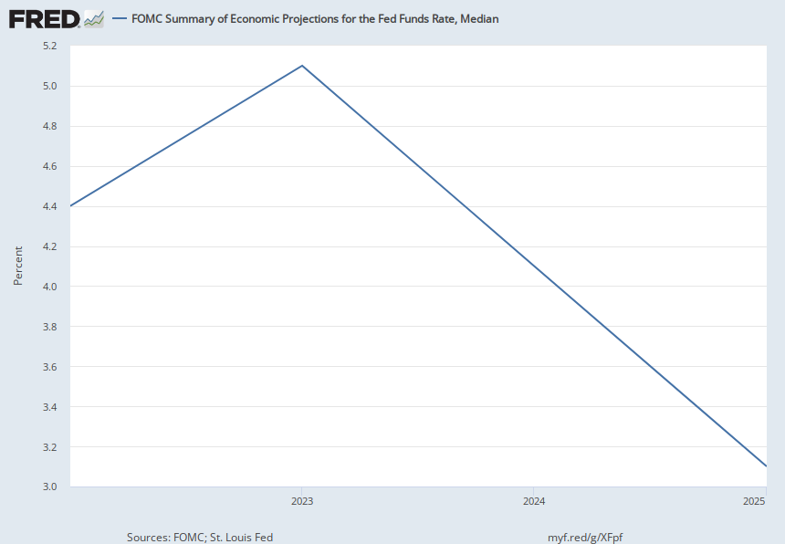
The Fed’s Own Prediction of the Likely Path of Interest Rates
Notes:
Source: U.S. Federal Open Market Committee Source: Federal Reserve Bank of St. Louis Release: Summary of Economic Projections Units: Percent, Not Seasonally Adjusted Frequency: Annual The projections for the federal funds rate are the value of the midpoint of the projected appropriate target range for the federal funds rate or the projected appropriate target level for the federal funds rate at the end of the specified calendar year or over the longer run. Each participant's projections are based on his or her assessment of appropriate monetary policy. The range for each variable in a given year includes all participants' projections, from lowest to highest, for that variable in the given year. This series represents the median value of the range forecast established by the Federal Open Market Committee. For each period, the median is the middle projection when the projections are arranged from lowest to highest. When the number of projections is even, the median is the average of the two middle projections.Digitized originals of this release can be found at https://fraser.stlouisfed.org/publication/?pid=677. U.S. Federal Open Market Committee and Federal Reserve Bank of St. Louis, FOMC Summary of Economic Projections for the Fed Funds Rate, Median [FEDTARMD], retrieved from FRED, Federal Reserve Bank of St. Louis; https://fred.stlouisfed.org/series/FEDTARMD, October 18, 2021.

Slide 32
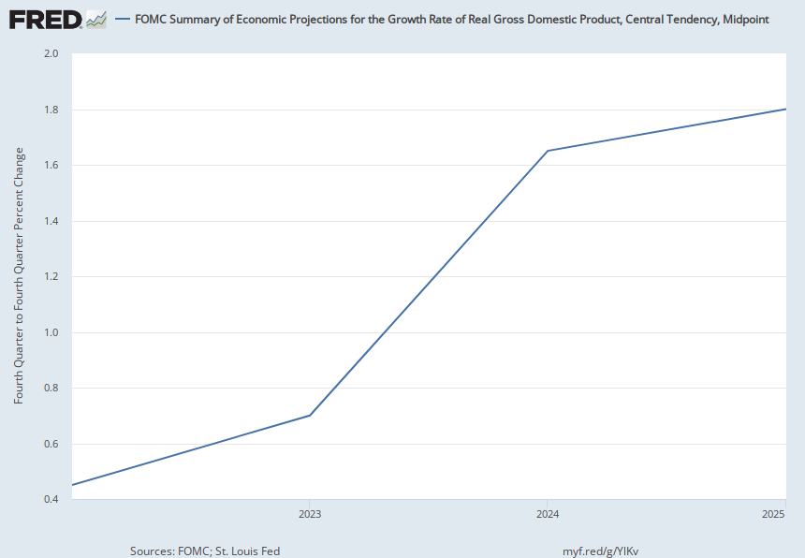
The FOMC’s Predictions for Real GDP
Notes:
Source: U.S. Federal Open Market Committee Source: Federal Reserve Bank of St. Louis Release: Summary of Economic Projections Units: Fourth Quarter to Fourth Quarter Percent Change, Not Seasonally Adjusted Frequency: Annual Projections of real gross domestic product growth are fourth-quarter growth rates, that is, percentage changes from the fourth quarter of the prior year to the fourth quarter of the indicated year. Each participant's projections are based on his or her assessment of appropriate monetary policy. The range for each variable in a given year includes all participants' projections, from lowest to highest, for that variable in the given year; the central tendencies exclude the three highest and three lowest projections for each year. This series represents the midpoint of the central tendency forecast's high and low values established by the Federal Open Market Committee.Digitized originals of this release can be found at https://fraser.stlouisfed.org/publication/?pid=677. U.S. Federal Open Market Committee and Federal Reserve Bank of St. Louis, FOMC Summary of Economic Projections for the Growth Rate of Real Gross Domestic Product, Central Tendency, Midpoint [GDPC1CTM], retrieved from FRED, Federal Reserve Bank of St. Louis; https://fred.stlouisfed.org/series/GDPC1CTM, January 4, 2023.

Slide 33
Recession Prediction - Indicators
Remember, even the definition of a recession isn’t written in stone
Several have been suggested
None is 100%
“… predicted 9 of the last 5 recessions”

Slide 34
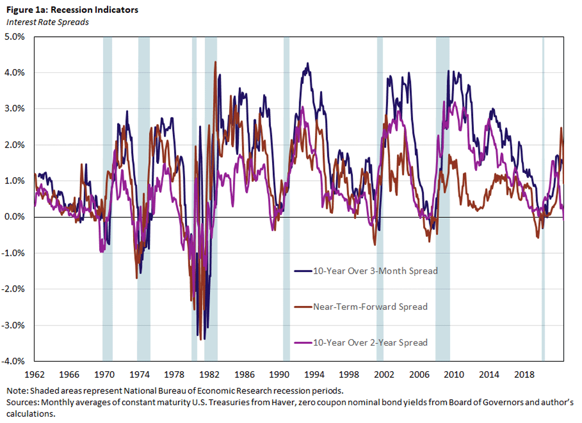
Yield Curve Inversions – When long rates are less than short rates
https://www.richmondfed.org/publications/research/economic_brief/2022/eb_22-30

Slide 35
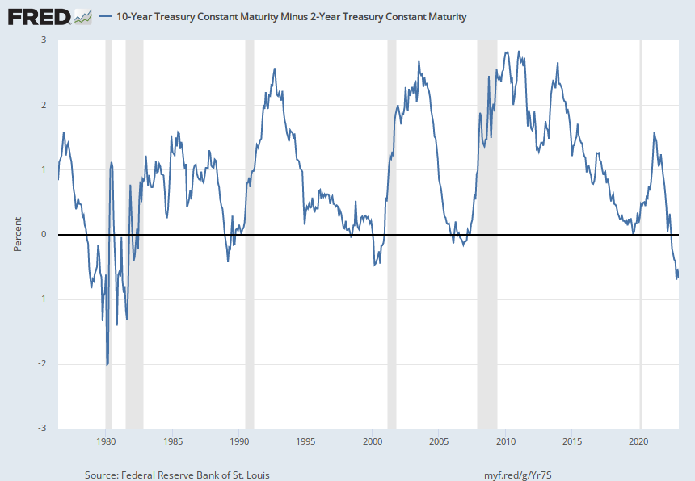
10 year bond minus 2 year is the most commonly cited of these
(Uh oh)
Notes:
Source: Federal Reserve Bank of St. Louis Release: Interest Rate Spreads Units: Percent, Not Seasonally Adjusted Frequency: Daily Starting with the update on June 21, 2019, the Treasury bond data used in calculating interest rate spreads is obtained directly from the U.S. Treasury Department. Series is calculated as the spread between 10-Year Treasury Constant Maturity (BC_10YEAR) and 2-Year Treasury Constant Maturity (BC_2YEAR). Both underlying series are published at the U.S. Treasury Department. Federal Reserve Bank of St. Louis, 10-Year Treasury Constant Maturity Minus 2-Year Treasury Constant Maturity [T10Y2Y], retrieved from FRED, Federal Reserve Bank of St. Louis; https://fred.stlouisfed.org/series/T10Y2Y, January 4, 2023.

Slide 36
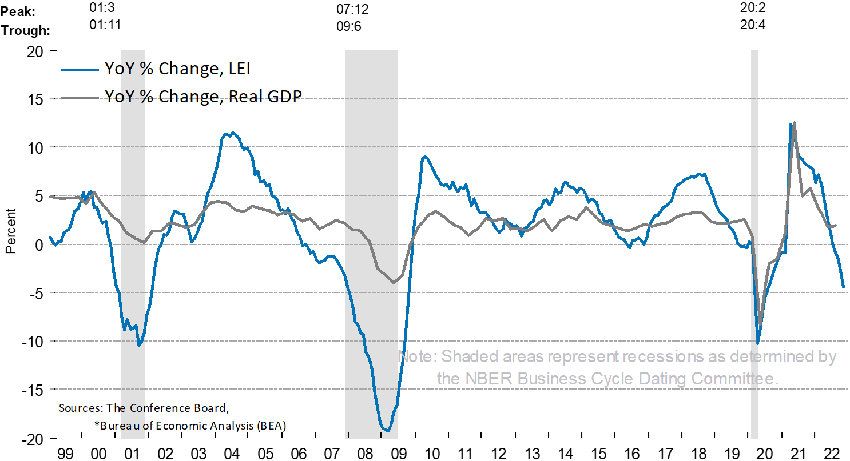
Conference Board’s Index of Leading Indicators
https://www.conference-board.org/topics/us-leading-indicators

Slide 37
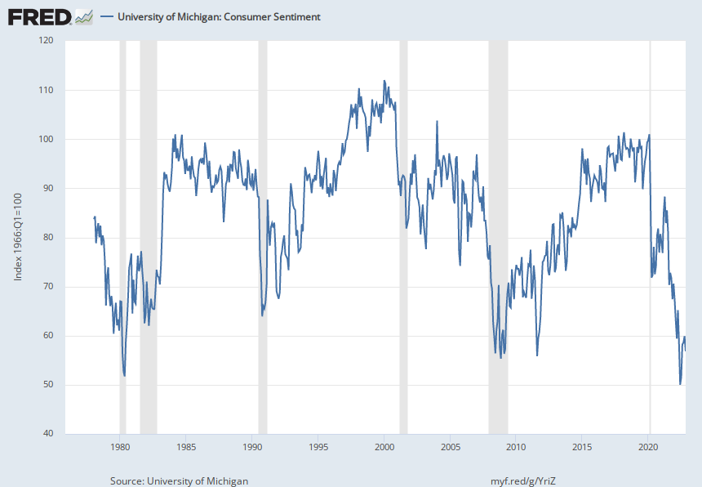
Michigan Consumer Sentiment
Notes:
Source: University of Michigan Release: Surveys of Consumers Units: Index 1966:Q1=100, Not Seasonally Adjusted Frequency: Monthly At the request of the source, the data is delayed by 1 month. To obtain historical data prior to January 1978, please see FRED data series UMCSENT1.This data should be cited as follows: "Surveys of Consumers, University of Michigan, University of Michigan: Consumer Sentiment © [UMCSENT], retrieved from FRED, Federal Reserve Bank of St. Louis, (Accessed on date)"Copyright, 2016, Surveys of Consumers, University of Michigan. Reprinted with permission. University of Michigan, University of Michigan: Consumer Sentiment [UMCSENT], retrieved from FRED, Federal Reserve Bank of St. Louis; https://fred.stlouisfed.org/series/UMCSENT, January 4, 2023.

Slide 38
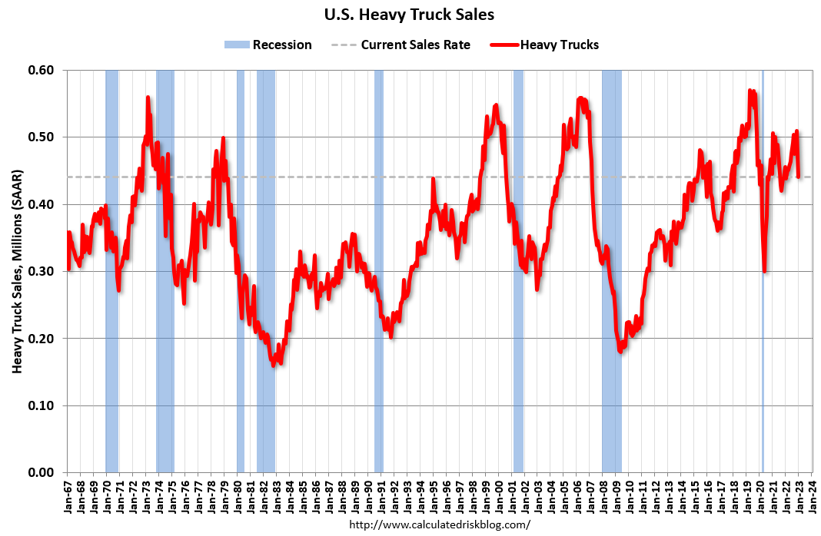
On the Other Hand, Some Forward Looking Indicators Don’t Look So Bad ….

Slide 39
Predictions
Inflation is the one most publicly worried about: It it is likely to continue trending lower as suppy chain problems get solved and the Fed’s campaign continues. I am guessing it will be near 4 - 4.5%
Interest rates are easy: They will continue up, at least for a while. But I would be surprised if they were higher than 5% at the end of the year.
Employment: Could be as high as 5% by year end
GDP: 0-1% (This assumes a short recession)

Slide 40
Potential Wild Cards?
Covid (especially if it mucks up supply chains from China yet again)
Chinese Economy Craters
A major economic/political event to which we cannot respond because Congress can’t function normally
Debt ceiling
On the other hand, the war in Ukraine could end, harvests could be good, or consumer spending could continue strong even in spite of the Fed

Slide 44
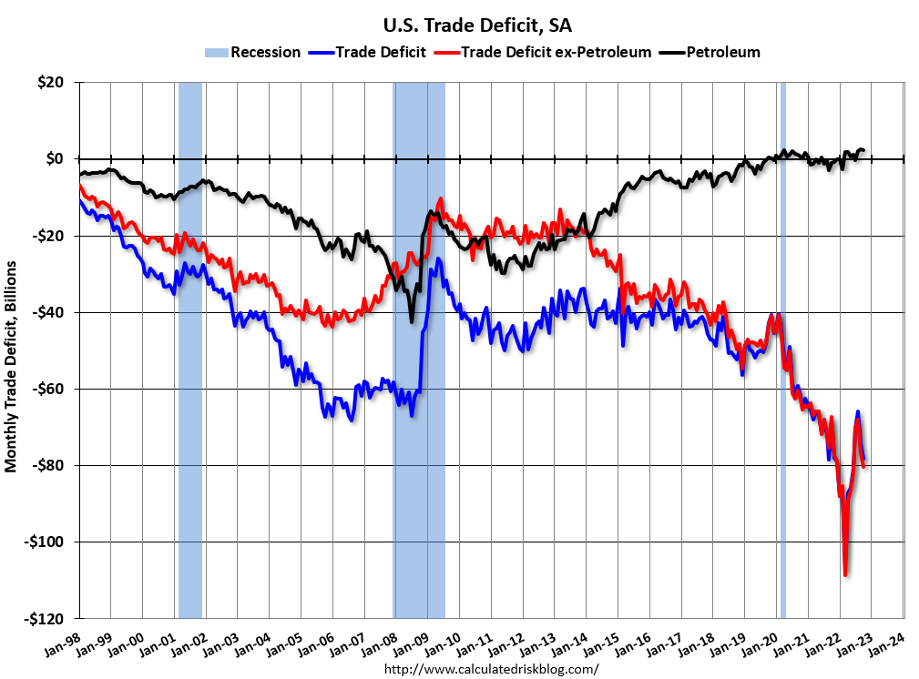

Slide 45
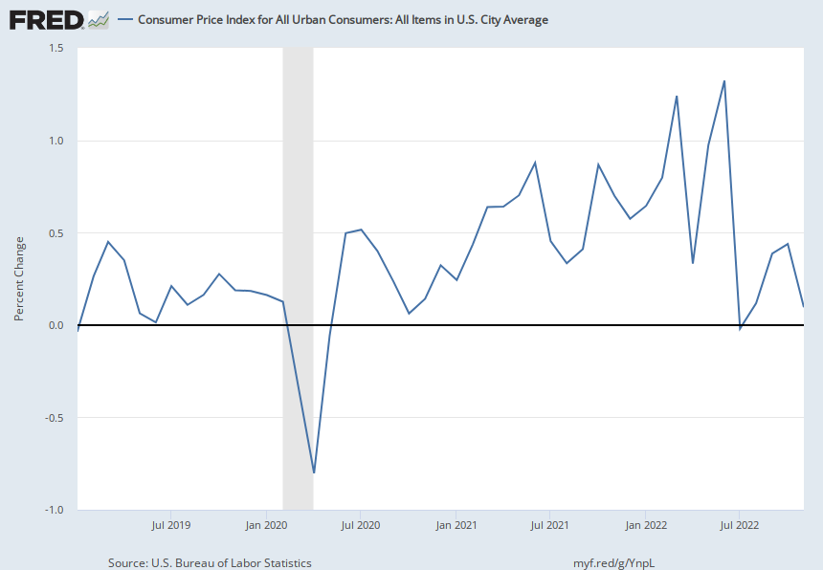
Monthly CPI Inflation
Notes:
Source: U.S. Bureau of Labor Statistics Release: Consumer Price Index Units: Index 1982-1984=100, Seasonally Adjusted Frequency: Monthly The Consumer Price Index for All Urban Consumers: All Items (CPIAUCSL) is a price index of a basket of goods and services paid by urban consumers. Percent changes in the price index measure the inflation rate between any two time periods. The most common inflation metric is the percent change from one year ago. It can also represent the buying habits of urban consumers. This particular index includes roughly 88 percent of the total population, accounting for wage earners, clerical workers, technical workers, self-employed, short-term workers, unemployed, retirees, and those not in the labor force. The CPIs are based on prices for food, clothing, shelter, and fuels; transportation fares; service fees (e.g., water and sewer service); and sales taxes. Prices are collected monthly from about 4,000 housing units and approximately 26,000 retail establishments across 87 urban areas. To calculate the index, price changes are averaged with weights representing their importance in the spending of the particular group. The index measures price changes (as a percent change) from a predetermined reference date. In addition to the original unadjusted index distributed, the Bureau of Labor Statistics also releases a seasonally adjusted index. The unadjusted series reflects all factors that may influence a change in prices. However, it can be very useful to look at the seasonally adjusted CPI, which removes the effects of seasonal changes, such as weather, school year, production cycles, and holidays. The CPI can be used to recognize periods of inflation and deflation. Significant increases in the CPI within a short time frame might indicate a period of inflation, and significant decreases in CPI within a short time frame might indicate a period of deflation. However, because the CPI includes volatile food and oil prices, it might not be a reliable measure of inflationary and deflationary periods. For a more accurate detection, the core CPI (CPILFESL) is often used. When using the CPI, please note that it is not applicable to all consumers and should not be used to determine relative living costs. Additionally, the CPI is a statistical measure vulnerable to sampling error since it is based on a sample of prices and not the complete average. For more information on the consumer price indexes, see: Bureau of Economic Analysis. "CPI Detailed Report." 2013. Handbook of Methods Understanding the CPI: Frequently Asked Questions U.S. Bureau of Labor Statistics, Consumer Price Index for All Urban Consumers: All Items in U.S. City Average [CPIAUCSL], retrieved from FRED, Federal Reserve Bank of St. Louis; https://fred.stlouisfed.org/series/CPIAUCSL, January 3, 2023.

Slide 46
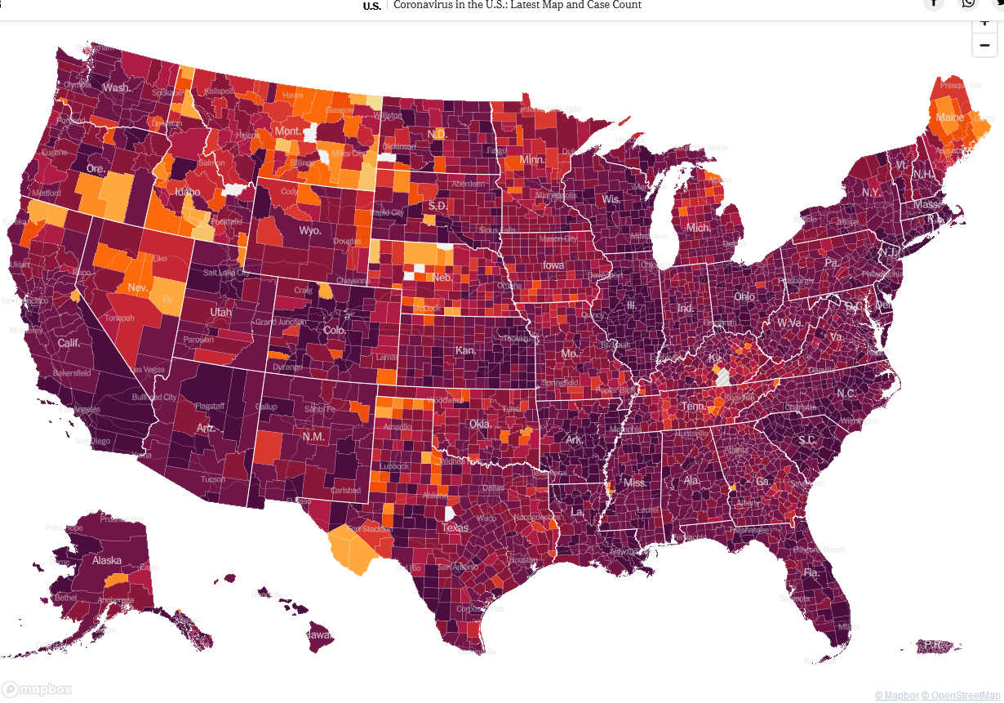
The Covid Infection Map a Year Ago

Slide 47
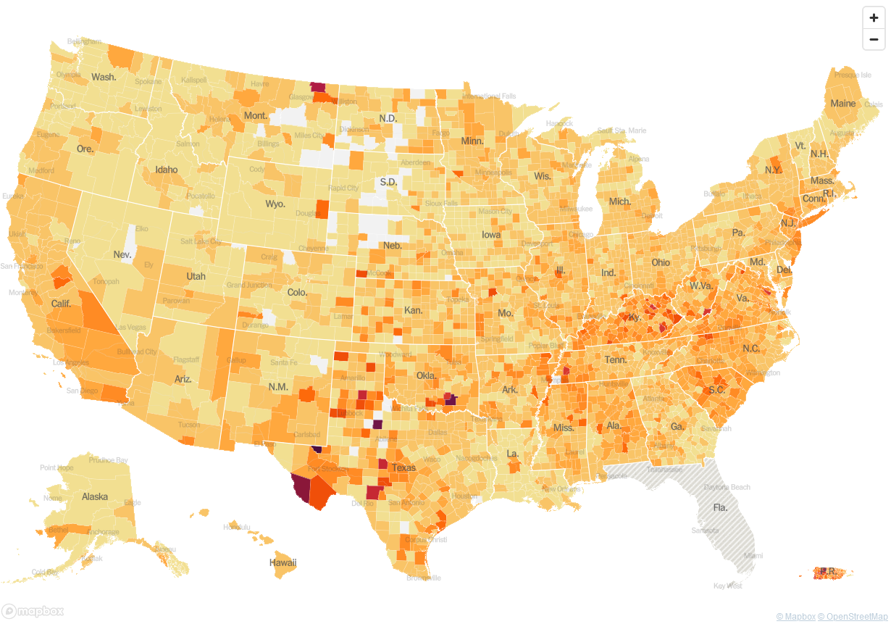
The Covid Infection Map Now

