Slide 1
2023 NY Agricultural Workforce Outlook
Richard Stup, Ph.D.
Director, Cornell Agricultural Workforce Development
rstup@cornell.edu
agworkforce.cals.cornell.edu

Slide 2
Agenda
The Big Picture
Labor markets
Who’s in the farm workforce?
Immigration
Growth of H-2A
New York Issues
Wage trends
Overtime and its implications
Research: NY Farm Workforce in Transition
Outlook

Slide 3
Labor Markets

Slide 4
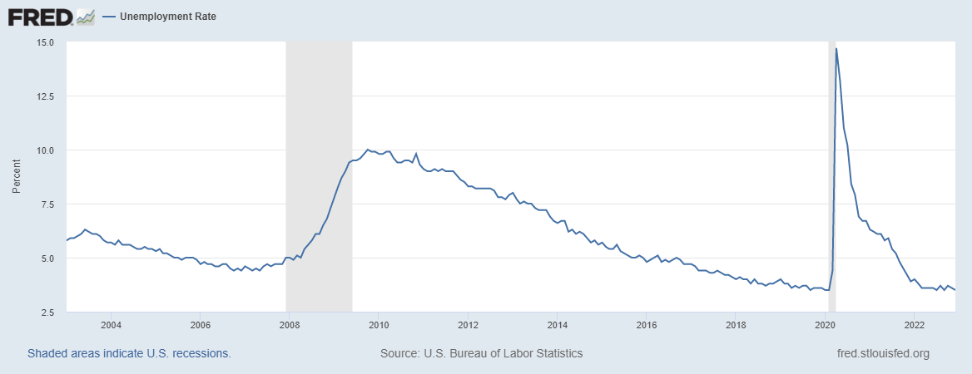
U.S. Unemployment Since 2003
Notes:
Unemployment rate
The unemployment rate represents the number of unemployed people as a percentage of the labor force (the labor force is the sum of the employed and unemployed).
The unemployment rate is calculated as: (Unemployed ÷ Labor Force) x 100.
Not in the labor force, In the Current Population Survey, people are classified as not in the labor force if:
they were not employed during the survey reference week and
they had not actively looked for work (or been on temporary layoff) in the last 4 weeks
In other words, people not in the labor force are those who do not meet the criteria to be classified as either employed or unemployed, as defined above.

Slide 5
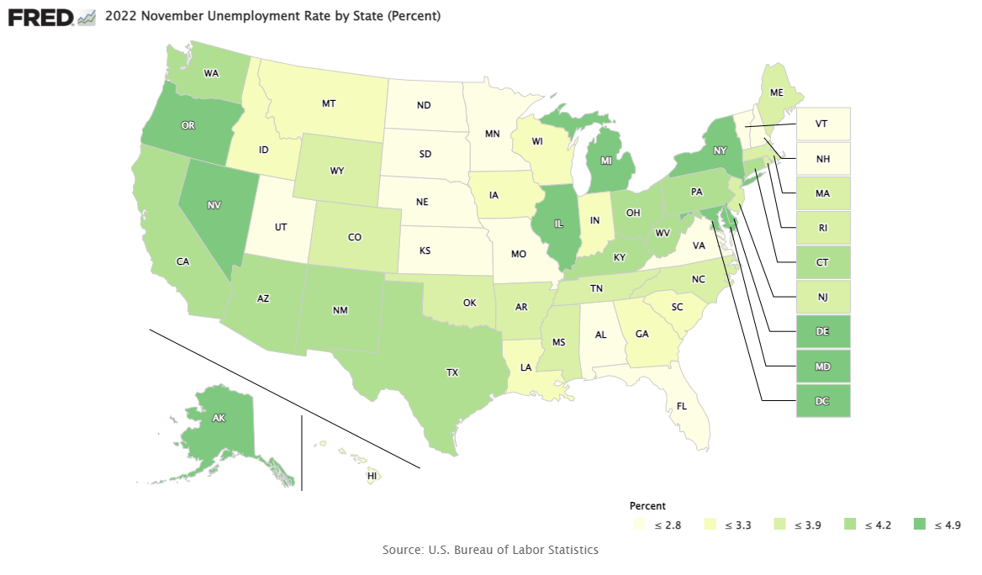
Unemployment by State
Notes:
New York at 4.3%

Slide 6
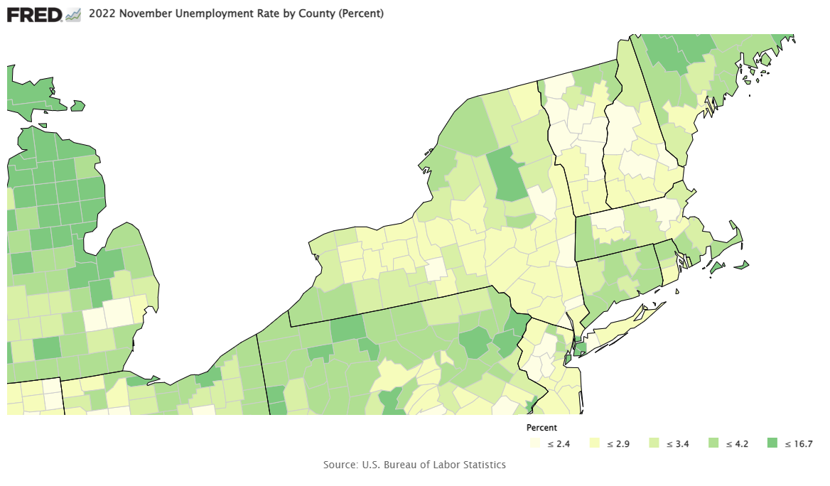
Unemployment in New York

Slide 7
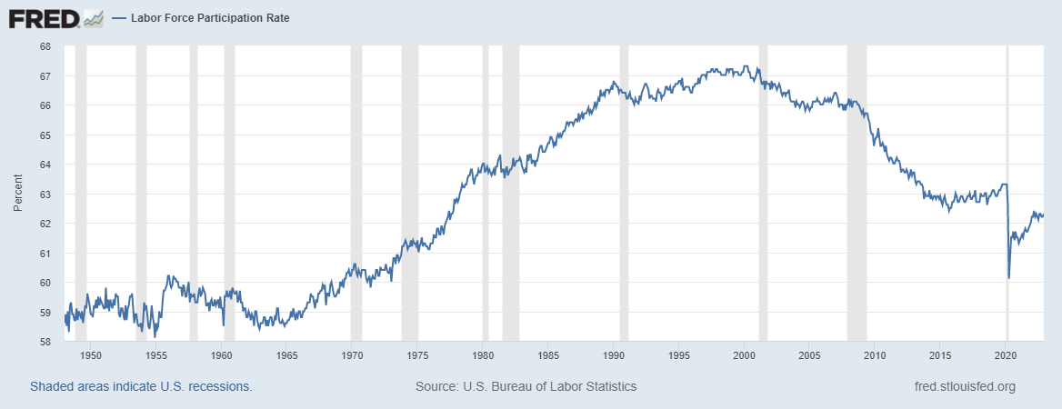
U.S. Labor Force Participation Rate Since 1948
Notes:
The labor force participation rate is the percentage of the civilian noninstitutional population 16 years and older that is working or actively looking for work. It is an important labor market measure because it represents the relative amount of labor resources available for the production of goods and services.

Slide 8
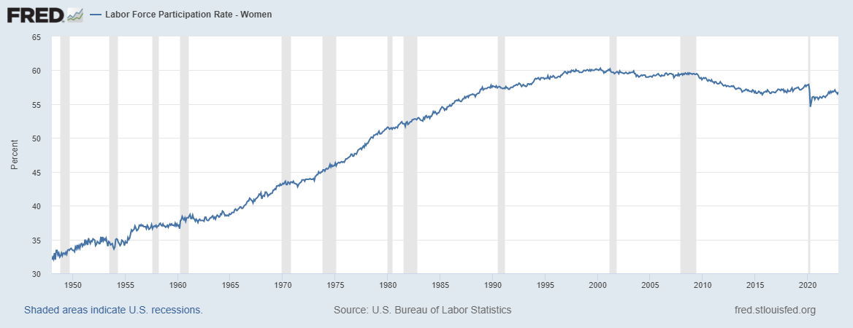
Labor Force Participation Among Women

Slide 9
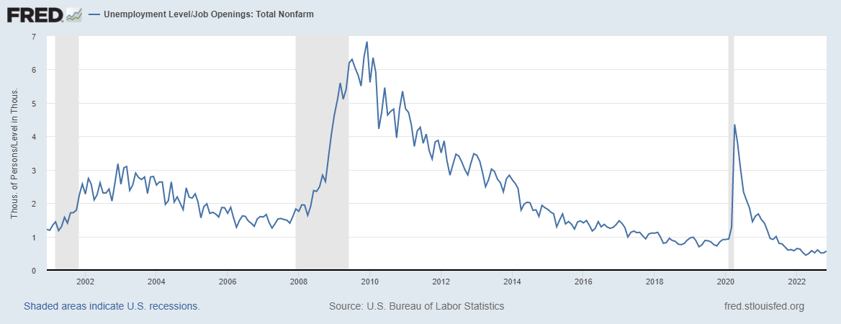
Still More Job Openings Than Unemployed People in the U.S.
Notes:
Link: https://fred.stlouisfed.org/graph/?g=p9aA
The November 2022 number is .566 meaning there were almost twice as many job openings as there were unemployed people

Slide 10
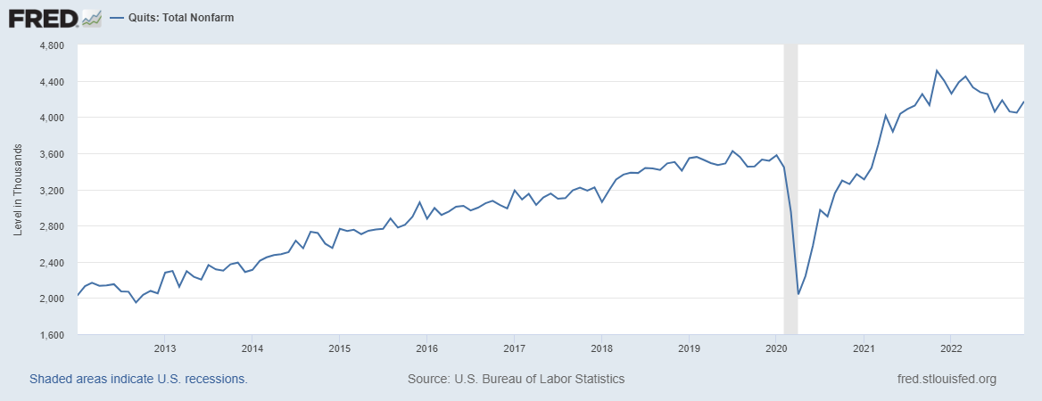
Workers Still Confident in Finding Jobs
Notes:
(2) The quits rate is the number of quits during the entire month as a percent of total employment.
1.5 quits/month = 18% turnover rate
3 quits/month = 36% turnover rate

Slide 11
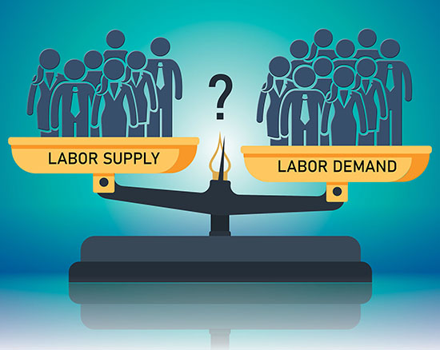
The markets are telling us that labor is tight and employees know it!

Slide 12
Who Makes Up New York’s Farm Workforce?

Slide 13
Today’s Farm Workforce
Farmers and their family members are still important, across all sectors and regions of the country.
A large population of long-term, settled immigrants, mostly Hispanic, and many are still unauthorized to work in the U.S.
A large population of local, U.S. citizens in rural communities across the country. (This group is largely ignored or forgotten in farm labor policy debates.)
A smaller population of more recent immigrants, both authorized and unauthorized.
The rapidly growing population of foreign, temporary guest workers in the H-2A program.

Slide 14
New York’s Hired Farm Workforce
NAICS Category | # Operations with Hired Employees | # Hired Employees | Percent of Total
Fruit and Tree Nut Farming 1113 | 1022 | 13,535 | 24.3%
Dairy Cattle and Milk Production 11212 | 2025 | 11,960 | 21.5%
Vegetable and Melon Farming 1112 | 828 | 8,218 | 14.8%
Greenhouse, Nursery, and Floriculture Production 1114 | 824 | 7,548 | 13.6%
Other Crop Farming (including Hay) 1119 | 1691 | 5,465 | 9.8%
Aquaculture and Other Animal Production 1125 and 1129 | 989 | 3,715 | 6.7%
Oilseed and Grain Farming 1111 | 606 | 2,036 | 3.7%
Beef Cattle Ranching and Farming 112111 | 665 | 1,577 | 2.8%
Poultry and Egg Production 1123 | 71 | 1,023 | 1.8%
Sheep and Goat Farming 1124 | 169 | 381 | 0.7%
Hog and Pig Farming 1122 | 35 | 90 | 0.2%
Cattle Feedlots 112112 | 2025 | 88 | 0.2%
Total | 10950 | 55,636 | 100%
There were 16,728 operations with unpaid workers and 40,258 unpaid workers.
Down from 60,944 in 2012
Source: 2017 Census of Agriculture
Notes:
Huge focus on the immigrant workforce but New York’s industry is very diverse.

Slide 15
Unauthorized Immigration

Slide 16
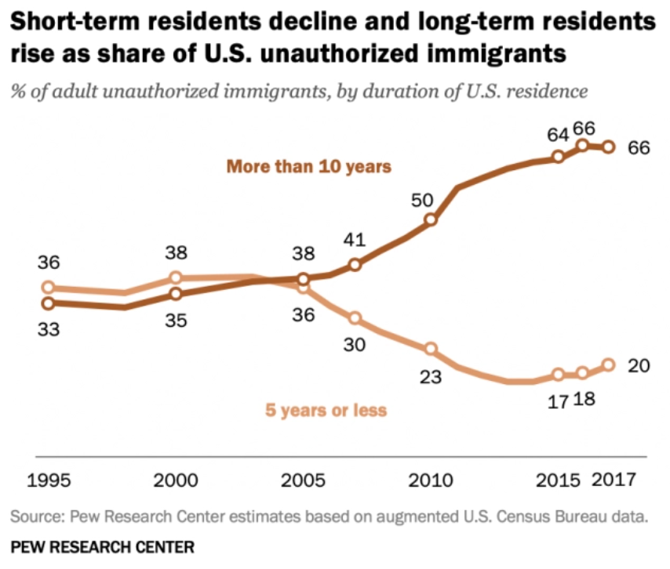
Most Unauthorized Immigrants Are Now Long-Term U.S. Residents

Slide 17
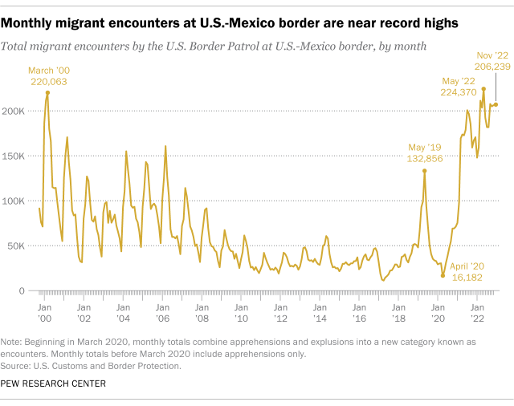
High Activity at the U.S.-Mexico Border

Slide 18
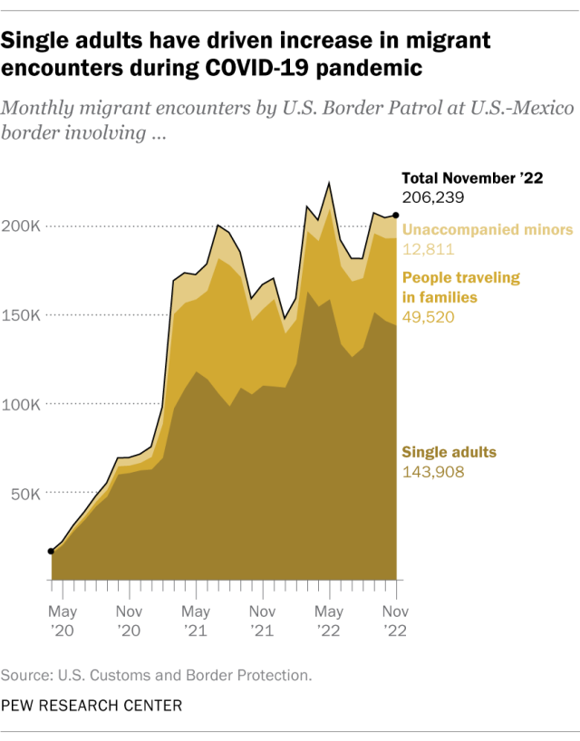
Changing Border Activity

Slide 19
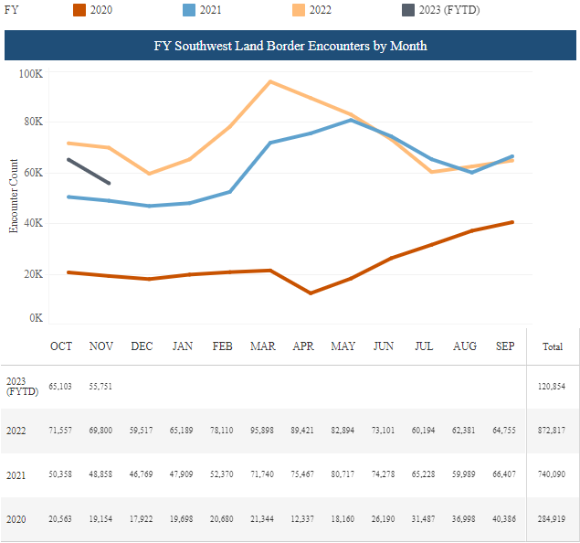
Border Encounters with Single Adults from Mexico or Guatemala
Source: U.S. Customs and Border Protection
Notes:
I narrowed the data down to look at the activity that we know is largely about finding work in the U.S. Single adults coming from Mexico and Guatemala. You might think that this would translate into more unauthorized workers showing up on farms.
https://www.cbp.gov/newsroom/stats/southwest-land-border-encounter

Slide 20
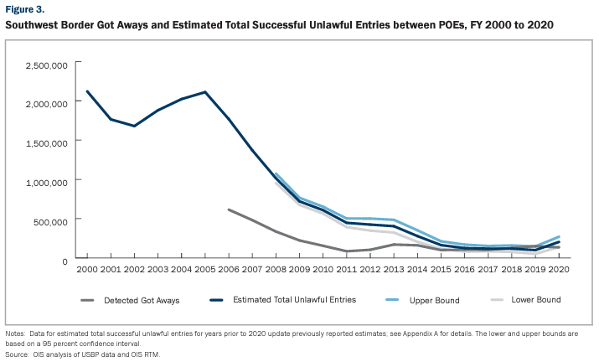
Estimated Successful Border Crossings
Source: Department of Homeland Security Border Security Metrics Report August 5, 2020
Notes:
Border enforcement got much tougher starting under Obama and then under Trump.

Slide 21
U.S. Farm Workforce Policy Reform
Farm Workforce Modernization Act (FWMA) passed in the House during the last Congress.
Earned legalization for ag workers and 5-year visas
H-2A program opened to year-round employment
Never taken up in the Senate, failed to get into yearend budget bill.
All legislative prospects appear cut off at this time.

Slide 22
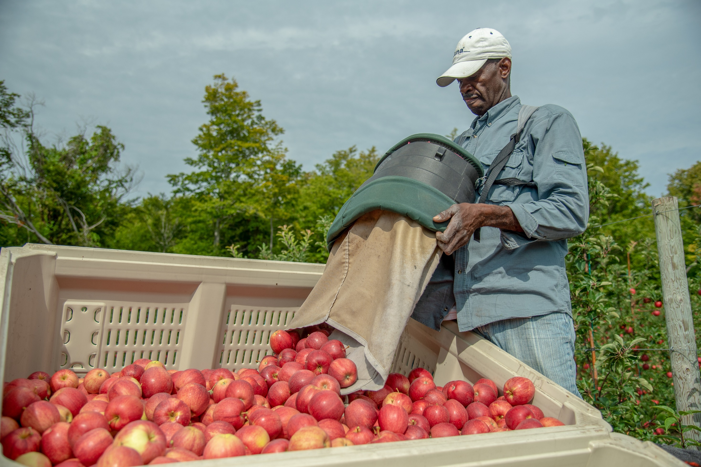
With the flow of unauthorized labor cut off, H-2A filled the gap.

Slide 23
Growth in Certified H-2A Positions

Slide 24
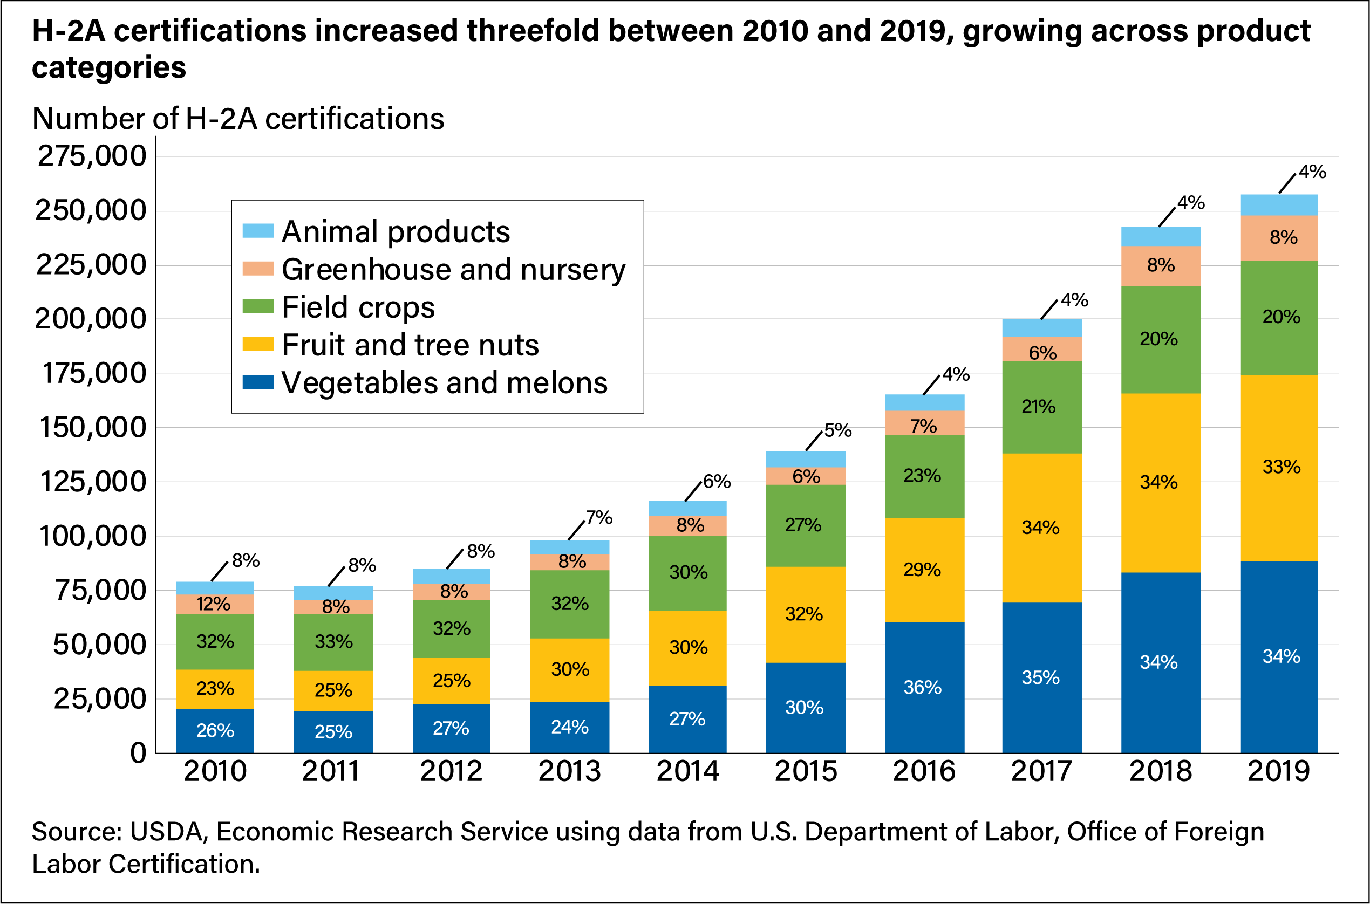
U.S. H-2A Growth by Crop

Slide 25
New York H-2A Positions Certified

Slide 26
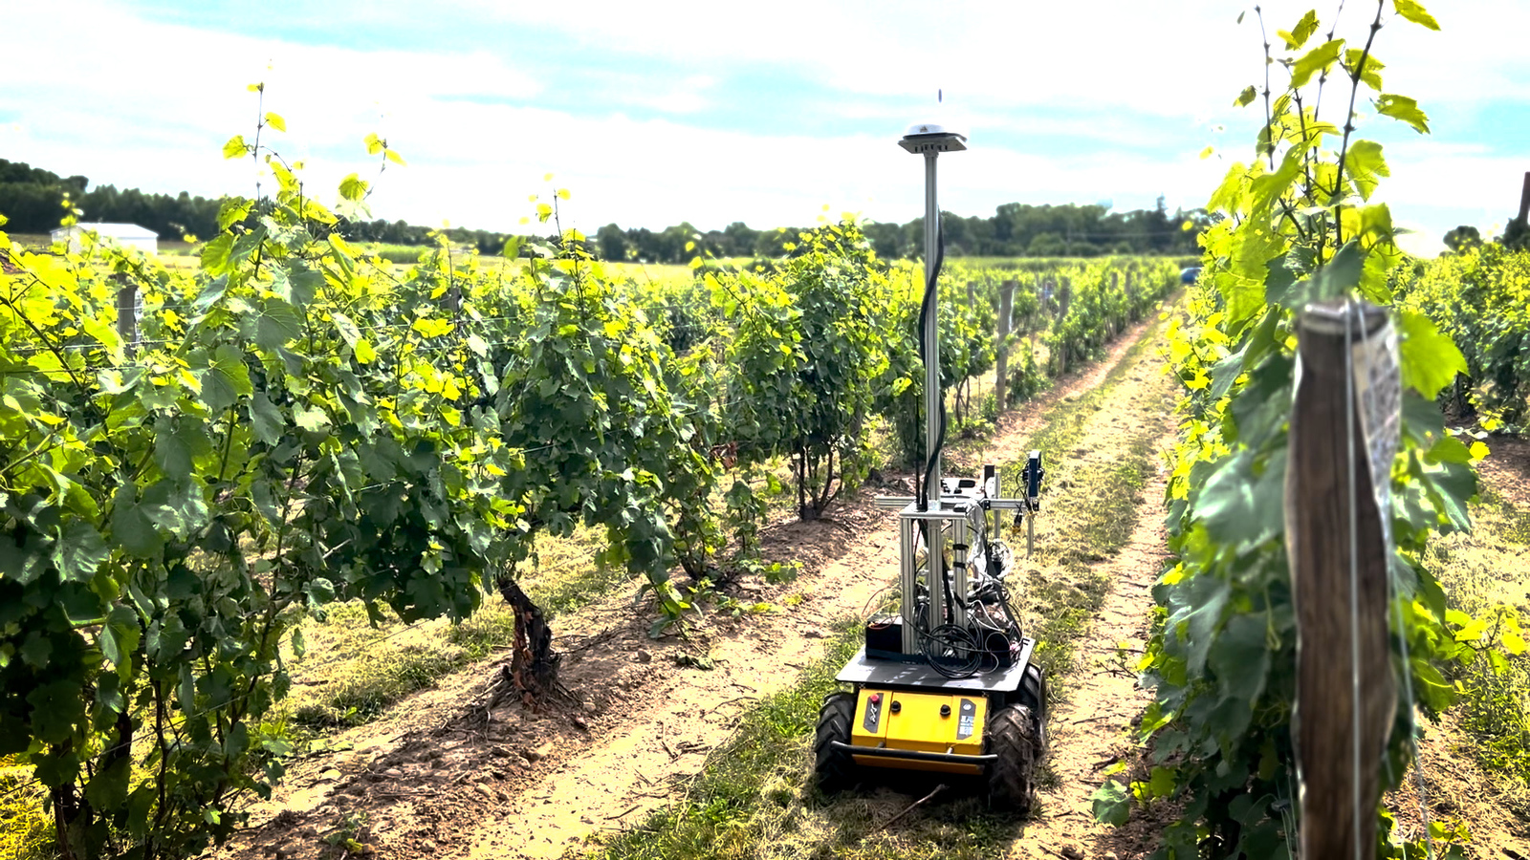
Automation Outlook
Smarter use of labor
Machine learning

Slide 27
Technology to Augment Labor

Slide 28
Compensation

Slide 29
New York Minimum Wage
Location | 12/31/16 | 12/31/17 | 12/31/18 | 12/31/19 | 12/31/20 | 12/31/21 | 12/31/22
NYC - Big Employers (11 or more) | $11.00 | $13.00 | $15.00
NYC - Small Employers (10 or less) | $10.50 | $12.00 | $13.50 | $15.00
Long Island & Westchester | $10.00 | $11.00 | $12.00 | $13.00 | $14.00 | $15.00
Remainder of New York State Workers | $9.70 | $10.40 | $11.10 | $11.80 | $12.50 | $13.20* | 14.20*
$.70
$.70
$.70
$.70
$.70
$.70
$1.00
*Future increases will be based on an indexed schedule to be set by the Director of the Division of the Budget in consultation with the Department of Labor following an annual review of the impact.
Notes:
I was predicting a $.70 min wage increase last year but the state went for a full dollar. I predict that next year they will raise it the remaining $.80.

Slide 30
Wage Compression
Minimum wage establishes the entry level.
Existing employees' wages are usually higher and are also pushed up.

Slide 31
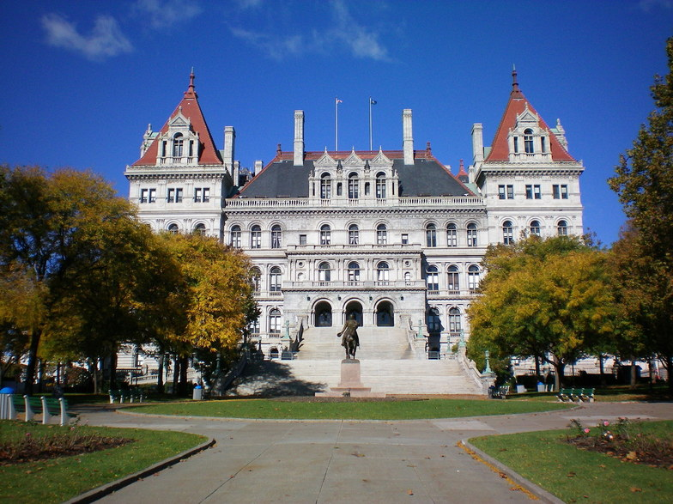
Proposed Minimum Wage Changes
Legislation proposed in the NY legislature (S3062D) calls for:
In NYC, “raising the minimum wage to $21.25 an hour by 2026”
“the minimum wage in the remainder of the state should also eventually catch up with the statewide rate, but at a slower pace since wages and costs are lower there.”
“automatically adjusted or ‘indexed’ each year so that it doesn't fall behind again” (Index based on inflation and worker productivity.)

Slide 32
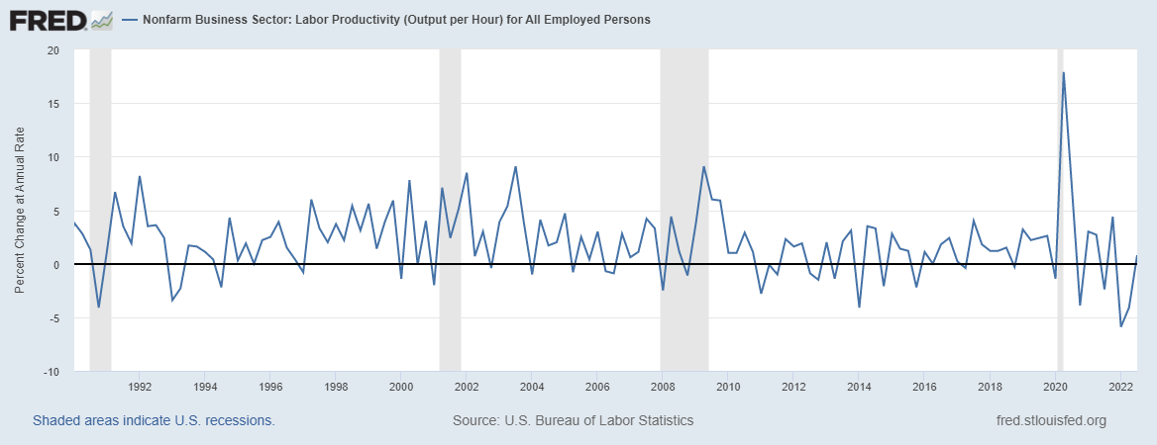
% Change in Labor Productivity

Slide 33
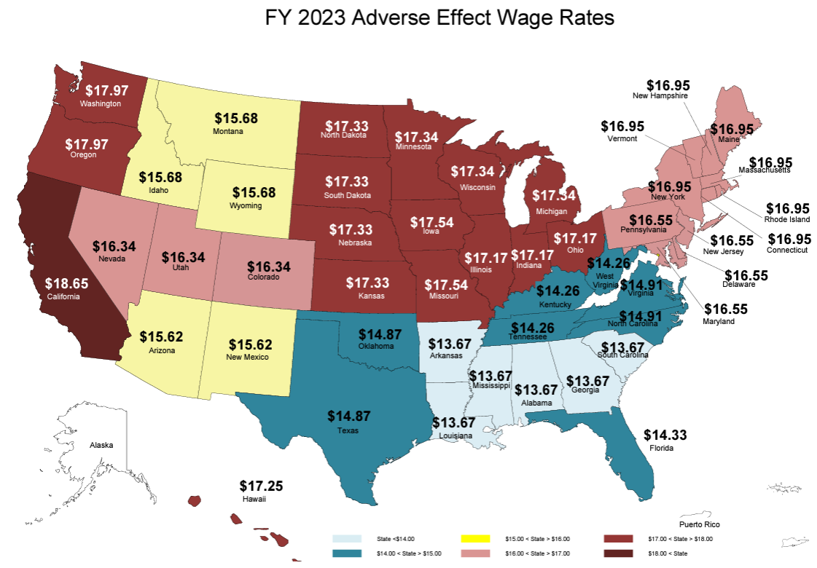
2023 AEWR

Slide 34
H-2A Adverse Effect Wage Rate (AEWR)
2022 AEWR Increase in Select States
 | 2022 | % Increase | 2021
New York | 15.66 | 4.5% | 14.99
Pennsylvania | 15.54 | 10.6% | 14.05
Michigan | 15.37 | 4.4% | 14.72
Washington | 17.41 | 6.5% | 16.34
California | 17.51 | 9.1% | 16.05
Florida | 12.41 | 2.7% | 12.08
North Carolina | 14.16 | 7.7% | 13.15
U.S. Department of Labor seeks to change wage setting method for farms jobs involving tasks such as trucking and construction.
Would use wages from Bureau of Labor Statistics for farm workers doing jobs such as “truck drivers, farm supervisors and managers, construction workers, and many occupations in contract employment.”

Slide 35
Overtime and the NY Wage Board

Slide 36
New York Farm Labor Overtime Saga
2019 Gov. Cuomo signs FLFLPA
January 1, 2020 FLFLPA takes effect initiating 60- hour overtime threshold for farm labor
August-September 2020 Wage Board hearings via Zoom
December 2020 Multiple Wage Board meetings yield recommendation to continue 60-hour threshold for one year
December 15, 2021 Commissioner of Labor schedules Wage Board hearings in January 2022
Wage Board votes and recommends changes to Commissioner of Labor
Commissioner of Labor and Governor implement any changes to overtime threshold
February 2020, Wage Board holds one in-person hearing before COVID-19
January 2022 Wage Board hearings via Zoom
Wage Board & NYSDOL prepared final report

Slide 37
Proposed Overtime Threshold Changes
January 1, 2032, threshold moves to 40 hours
January 1, 2024, threshold moves to 56 hours
January 1, 2030, threshold moves to 44 hours
January 1, 2028, threshold moves to 48 hours
January 1, 2026, threshold moves to 52 hours
2022-2023, threshold remains at 60 hours

Slide 38
Farm Workforce Retention Credit
Since 2017 the state has offered a tax credit to farm employers that they can receive for each farm worker employed.
$250 in 2017 and was up to $600 for 2021.
Now doubled to $1,200 per eligible farm employee who worked at least 500 hours.

Slide 39
NY Farm Employer Overtime Tax Credit
Corporations, sole proprietorships, LLCs and partnerships are eligible.
Farm wineries and cideries who derive more than 50% of their income from beverage sales will need to follow special rules.
Only “farm laborers” as defined in NY labor law are eligible employees.
Eligible overtime hours include those in any calendar week that exceed the overtime threshold set by the commissioner of labor, up to 60 hours in a week.
Only the overtime premium is reimbursable through the tax credit.
Employers allowed to take 118% of the eligible overtime compensation to cover additional costs.
Advance payments of tax credits for overtime premiums paid from January 1st to July 31st are possible, remainder at tax time.
There is no sunset provision in the law.

Slide 40
Credits Cover Eligible Overtime Premiums
Green pay is eligible for OT tax credit
Example Details:
Year 2027 so threshold is at 52 hours
Employee’s base pay is $16/hour
OT premiums between 52 and 60 hours eligible for OT tax credit
No hours above 60 are eligible for credit
Notes:
Blue area is paid for by the employer. Green area is eligible for OT tax credit.

Slide 41
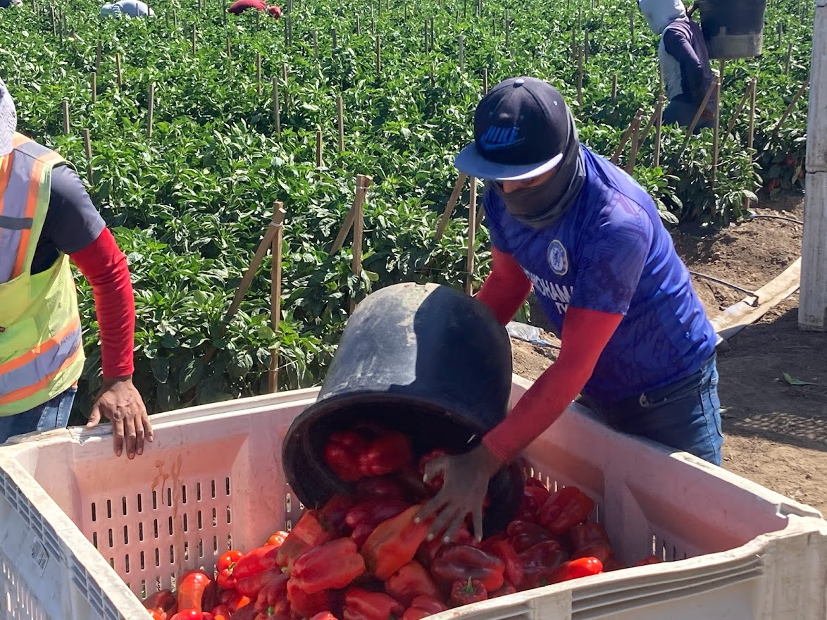
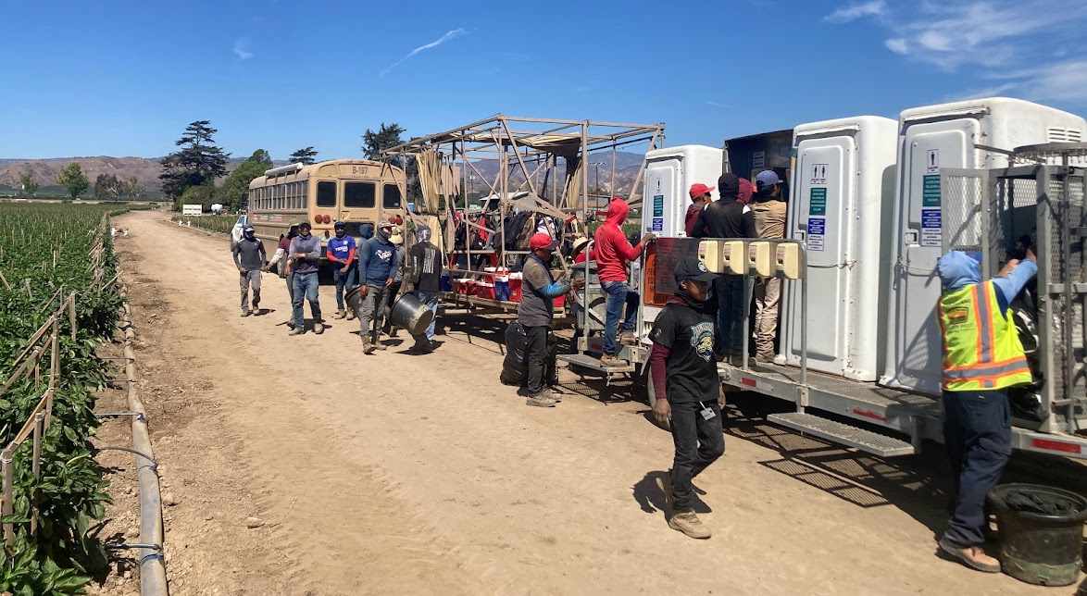
California OT
40 hours/week
8 hours/day

Slide 42
What Will Be the Effect of a Declining OT Threshold and Refundable Tax Credit?
Employ the minimum number of workers,
who will work close to 60 hours/week.
New York farm employees will actually get overtime pay because of the tax credit.
Will they be the highest paid farm employees in the U.S.?

Slide 43
New York Farm Workforce in Transition Research
Supported by:
USDA
New York State Agriculture & Markets
Farm Credit East
Northeast Dairy Producers Association

Slide 44
Changes Made in 2019-2020 to Reduce Labor Needs or Increase Productivity
 | Dairy (n=74) |  | Specialty Crop (n=65)
Changes | Count | Percent | Count | Percent
Other | 40 | 54% | 26 | 40%
Better training of employees to increase performance. | 29 | 39% | 20 | 31%
Eliminated any tasks and procedures that were not absolutely necessary. | 22 | 30% | 32 | 49%
Increased use of custom farming services. | 20 | 27% | 1 | 2%
Better training of supervisors and managers to improve leadership skills. | 19 | 26% | 18 | 28%
Adjusted break times such as lunch to reduce non-working time. | 18 | 24% | 9 | 14%
Delayed or canceled planned capital investments. | 17 | 23% | 22 | 34%
We made no changes. | 14 | 19% | 13 | 20%
Outsourced production tasks to others (Example: a dairy farm using a customer heifer grower). | 11 | 15% | 8 | 12%
Expanded farm enterprise(s). | 10 | 14% | 2 | 3%
Downsized or exited farm enterprise(s). (Example: switch from fruit crops to grain crops) | 3 | 4% | 15 | 23%
Notes:
“Other” items included: 1. investment in machinery, eqpt, technology, etc., 2. scale back or reduce operations, 3. hired more employees, 4. tighter management

Slide 45
Plans For Scale (Size) Of Farming Operations in the Next 2 to 4 Years
 | Dairy (n=74) |  | Specialty Crop (n=65)
Plans | Count | Percent | Count | Percent
Increase scale | 19 | 26% | 8 | 12%
Stay the same | 43 | 58% | 25 | 38%
Decrease scale | 8 | 11% | 24 | 37%
Discontinue farming | 16 | 22% | 7 | 11%
Other | 43 | 58% | 38 | 58%
Labor markets and regulations do not significantly affect these plans | 2 | 3% | 4 | 6%
Notes:
“Other” items included: 1. “It depends on what NYS happens with labor and market factors,” and 2. improve efficiency, 3. change or discontinue operations

Slide 46
Plans in the Next 2 to 4 Years to Increase Labor Productivity or Efficiency in Farming Operations
 | Dairy (n=74) |  | Specialty Crop (n=65)
Plans | Count | Percent | Count | Percent
None. | 6 | 8% | 8 | 12%
Invest time and money in better organizing work procedures and human resource management. | 29 | 39% | 17 | 26%
Invest time and money in developing leadership skills of farm supervisors and managers. | 31 | 42% | 17 | 26%
Invest time and money in employee training and development. | 28 | 38% | 16 | 25%
Invest in machinery, equipment, or technology to increase the productivity of employees. (Examples: updated field machinery or dairy computer software to automate decisions). | 50 | 68% | 37 | 57%
Invest in machinery, equipment, or technology to replace some employees. (Example: robotics). | 32 | 43% | 24 | 37%
Moderate changes to production strategies or business model to reduce labor use. (Example: growing different vegetable crops that require less labor.) | 21 | 28% | 29 | 45%
Major changes to production strategies or business model to reduce overall use of labor (Example: exit dairy or fruit production to focus only on mechanized cropping.) | 13 | 18% | 12 | 18%
Expand operations | 16 | 22% | 4 | 6%
Other | 24 | 32% | 11 | 17%
Notes:
Farms are looking for technology solutions
Moderate changes planned by specialty crop operations: change crop selections, move to less labor intensive crops, reduce crop diversity, mechanize, focus only on the most profitable crops

Slide 47
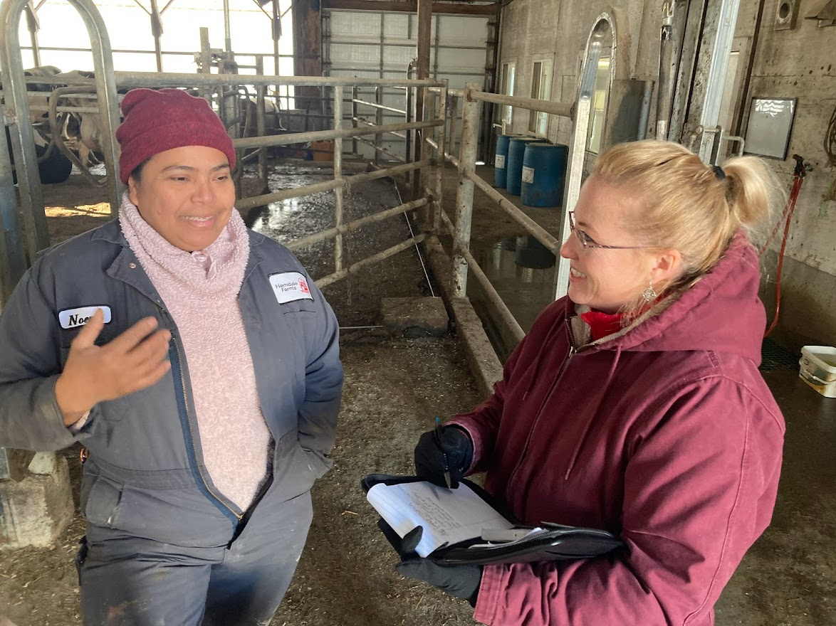
Outlook
Agricultural labor remains scarce.
Wages continue to climb from both market and regulatory pressure.
H-2A participation and certified positions continue growth.
Federal farm labor policy remains unchanged.
60 hours/week becomes the new normal in New York.
Producers invest in developing people.
Producers invest in technology and plans to increase labor efficiency.

