Slide 1
2023 Dairy Price Outlook—
Spotlight on Demand, Inflation & Regulation
Cornell Dyson School Agricultural and Food Business Outlook Conference, January 20th
Mark Stephenson, Director of Dairy Policy Analysis, UW-Madison–Retired

Slide 2
Factors impacting milk price forecast
Domestic Demand
  Impacts of inflation and questions about recession
Domestic Supply
  High costs of production including feed, labor and interest rates.
  Impactful weather trends
Export Demand
  Shift in products?
Export Competition
  What can EU and Oceania do?
Changes to Federal milk pricing regulations
Dairy Outlook

Slide 3
Steady trend in domestic demand.
Domestic Demand

Slide 4
American cheese lead cheese growth
Domestic Demand

Slide 5
Fluid sales returned to its depressing trend
Domestic Demand

Slide 6
Dairy cow numbers displayed modest growth
Milk Supply

Slide 7
So did milk per cow
Milk Supply

Slide 8
Milk production is back in positive territory
Milk Supply

Slide 9
3 big gains, 2 big losses, but the “ups” carry the day
Percent change over the first 11 months of the year.
Milk Supply

Slide 10
Drought is still an issue
Milk Supply

Slide 11
Components matter to manufacturing
Milk Supply

Slide 12
Exports continue to grow customer base
(and with emphasis on some new products too)
Export Demand

Slide 13
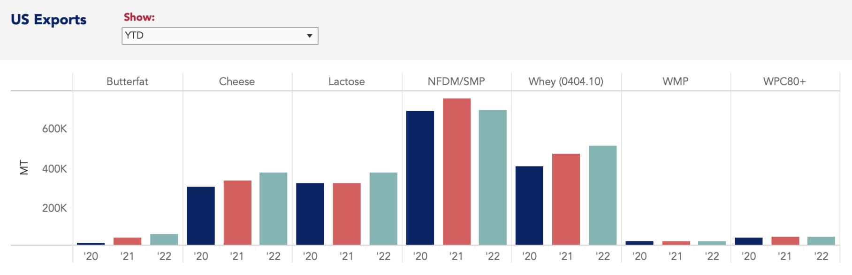
Increasing product exports except for SMP
Source: USDEC
Export Demand

Slide 14
Competition for exports
Export Competition

Slide 15
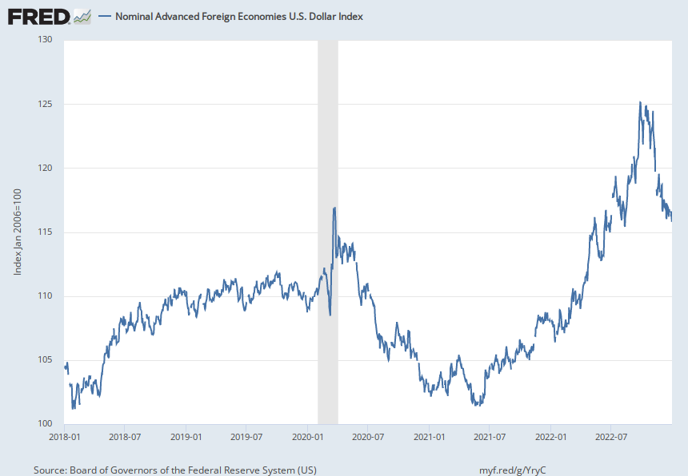
Dollar value is weakening—which is good
Export Friction

Slide 16
U.S. powder prices are reasonably competitive
Export Friction

Slide 17
U.S. cheese prices are surprisingly competitive
Export Friction

Slide 18
Oceania is selling butter
Export Friction

Slide 19
Inflation is improving but not where it needs to be yet
Macro economy

Slide 20
We’ve been meeting inflation at the expense of savings
Macro economy

Slide 21
We’ve also accommodated inflation with credit
Macro economy

Slide 22
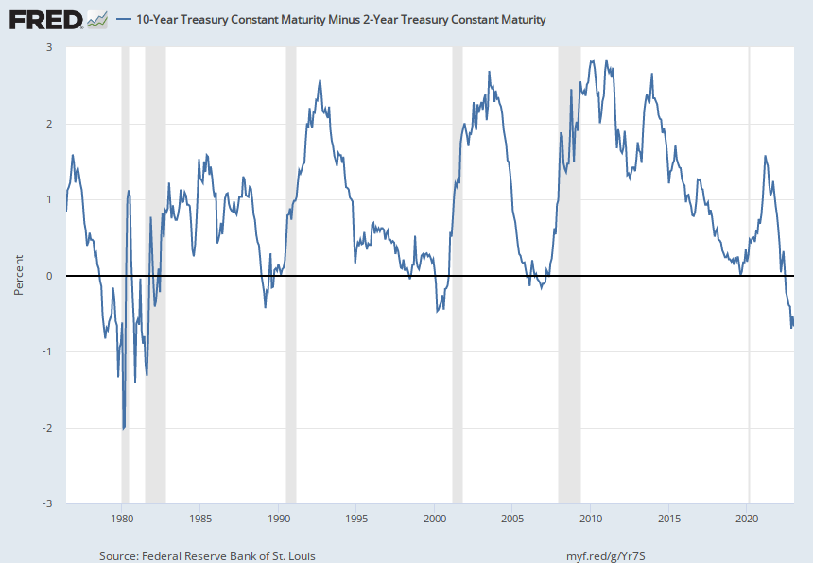
We have an inverted yield curve
Macro economy

Slide 23
What does the GDT index tell us?
Price Forecasts

Slide 24
What does the GDT index tell us?
Price Forecasts

Slide 25
CME futures based forecast
Forecast Milk Prices

Slide 26
In summary…
Domestic demand has held up surprisingly well in the face of inflation
Consumers have bought a year’s worth of inflation from savings and credit cards—this is not a long-term strategy
I am concerned about the probability of a recession
  What will consumer strategy be under this scenario
Milk production has been cautious but there is new plant capacity being planned and under construction
High milk prices have yielded decent margins for most producers in 2022. I’m not sure the same thing will be the case in 2023.
Expect milk prices to be $4.50 to $5.50 lower this year.
Dairy Summary

Slide 27
Regulatory Changes?
Mark Stephenson, Director of Dairy Policy Analysis, UW-Madison

Slide 28
Ingredient & Product Streams
Ingredients
Milk
Cheese
Sweet Cream
Whey
Dried Whey
Let’s survey the market price for these products and back into a milk price.
Whey Cream
WPC
We want to price this.
Permeate
Butter
Lactose

Slide 29
Product Price Formulas
Butterfat Price = (Butter price - 0.1715) x 1.211
Make Allowance - What does it cost you to transform milk into 1 pound of butter?
Yield Factor - How many pounds of butter can you make from 1 pound of butterfat?

Slide 30
Product Price Formulas
Dairy producers want a small make allowance and a large yield factor
Dairy processors want a large make allowance and a small yield factor
How do you determine the correct parameter values?

Slide 31
Make allowances must be changed
Dairy producers will want an offset from lower regulated prices
They may look for increased Class I differentials
  burden on fluid milk
They may want to walk back the change from “the higher of” to “the average of”
  burden on fluid milk
They may want to update component values in “standard milk”
  no impact on manufacturing milk because you are already paying for pounds of components
  burden on fluid milk under “skim milk pricing factors”

Slide 32
Observations…
Classified Pricing and Pooling are blunt tools in an increasingly sophisticated market place.
Negative PPDs were not the problem, they were a symptom
We will have a Federal Order hearing—probably this year
One of the big questions will be the “scope” of the hearing.
Next question is can we fix the problems using a Federal Order hearing, or will it require congressional action?
  Looks like congressional action maybe an oxymoron for the year ahead

