Slide 1
Concurrent Session B: Horticultural Outlook
201 Stocking Hall, 1:00 to 3:00 PM

Slide 2
Concurrent Session B: Horticultural Outlook
Situation and Outlook for Fruits and Vegetables (Brad Rickard and Rebecca Chang)
Grape, Wine, & Ornamental Situation and Outlook (Jie Li)
**Economics of New Production Technologies for F&V Growers (Wendong Zhang)

Slide 3
Situation and Outlook for
Fruits and Vegetables
Bradley Rickard and Rebecca Chang
Dyson School of Applied Economics and Management
January 20, 2023

Slide 4
Overview
F&V Situation Reports
Key Outlook Issues
Research Update: Category Additions, Supermarket Sales, and Implications for Produce

Slide 5
Fruit Production in the Northeast is important

Slide 8
Apple acres, yields, and production 2018-22
Bearing Acreage (acres) |  |  |  |  |  |  | Yield Per Acre (lbs)
State | 2018 | 2019 | 2020 | 2021 | 2022 |  | State | 2018 | 2019 | 2020 | 2021 | 2022
CALIFORNIA | 12,400 | 12,800 | 12,000 | 11,700 | - |  | CALIFORNIA | 20,000 | 20,200 | 19,200 | 18,500 | -
MICHIGAN | 32,000 | 32,000 | 31,500 | 30,500 | - |  | MICHIGAN | 32,300 | 33,100 | 31,800 | 21,500 | -
NEW YORK | 42,000 | 44,000 | 44,000 | 44,000 | - |  | NEW YORK | 33,200 | 30,000 | 31,500 | 30,500 | -
OREGON | 5,000 | 5,000 | 5,000 | 5,000 | - |  | OREGON | 34,000 | 30,000 | 35,000 | 31,100 | -
PENNSYLVANIA | 19,500 | 19,500 | 19,500 | 19,000 | - |  | PENNSYLVANIA | 25,000 | 26,000 | 21,400 | 29,300 | -
VIRGINIA | 9,700 | 9,500 | 8,800 | 8,000 | - |  | VIRGINIA | 21,000 | 20,000 | 18,500 | 20,500 | -
WASHINGTON | 170,000 | 172,000 | 175,000 | 172,000 | - |  | WASHINGTON | 39,400 | 44,200 | 39,500 | 39,300 | -
Total Production (million lbs) |  |  |  |  |  |  | Utilized Production (million lbs)
State | 2018 | 2019 | 2020 | 2021 | 2022 |  | State | 2018 | 2019 | 2020 | 2021 | 2022
CALIFORNIA | 248 | 259 | 230 | 216 | 240 |  | CALIFORNIA | 243 | 256 | 228 | 212 | -
MICHIGAN | 1,035 | 1,060 | 1,000 | 656 | 1,100 |  | MICHIGAN | 1,034 | 1,059 | 999 | 655 | -
NEW YORK | 1,395 | 1,320 | 1,385 | 1,340 | 1,450 |  | NEW YORK | 1,377 | 1,319 | 1,384 | 1,329 | -
OREGON | 170 | 150 | 175 | 156 | 175 |  | OREGON | 169 | 148 | 174 | 154 | -
PENNSYLVANIA | 488 | 507 | 417 | 557 | 460 |  | PENNSYLVANIA | 484 | 506 | 417 | 556 | -
VIRGINIA | 204 | 190 | 163 | 164 | 185 |  | VIRGINIA | 202 | 188 | 161 | 162 | -
WASHINGTON | 6,700 | 7,600 | 6,915 | 6,760 | 6,500 |  | WASHINGTON | 6,365 | 7,220 | 6,569 | 6,490 | -

Slide 9
Overview of Recent Fruit Crop Price Trends

Slide 10
Fresh fruits – Consumer price index (1982-84=100)
Source: U.S. Department of Labor, Bureau of Labor Statistics. CPI for All Urban Consumers

Slide 11
Processed and Frozen F&Vs Consumer price index (1997 =100)
Source: U.S. Department of Labor, Bureau of Labor Statistics. CPI for All Urban Consumers

Slide 12
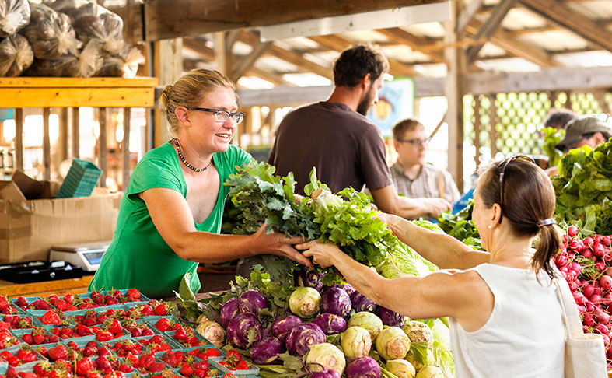
Vegetables
Image: https://statlerhotel.cornell.edu/explore/ithaca-farmers-market

Slide 13
Vegetable Production in the Northeast for selected crops

Slide 14
Northeast Vegetable Production 2021
Source: USDA-NASS, Agricultural Statistics, 2022. Available at: https://downloads.usda.library.cornell.edu/usda-esmis/files/j3860694x/z890sn81j/cv43pq78m/Ag_Stats_2020_Complete_Publication.pdf

Slide 15
Consumer Price Indices, Fresh and Frozen Vegetables 2020-2022
Source: U.S. Bureau of Labor Statistics, Consumer Price Index, 2022. Available at: https://www.bls.gov/cpi/

Slide 16
Vegetable Producer Prices and Seasonal Demand
Source: U.S. Bureau of Labor Statistics, Consumer Price Index, 2022. Available at: https://www.bls.gov/cpi/

Slide 17
Key Outlook Issues, Food inflation
Food Inflation in 2022
Non-trivial! 13% FAH, 8% FAFH
F&V inflation is relatively low compared to poultry, eggs, carbs
Should be good for F&V sales?
Due to rising costs for all inputs, bird flu, and perhaps money supply

Slide 18
Consumer Price Index item | Year-over-year September 2021 to September 2022 | Year-to-date avg. 2021 to avg. 2022 | Annual 2020 | Annual 2021
 | Percent change | Percent change | Percent change | Percent change
All food | 11.2 | 8.7 | 3.4 | 3.9
Food away from home | 8.5 | 6.4 | 3.4 | 4.5
Food at home | 13.0 | 10.1 | 3.5 | 3.5
Meats, poultry, and fish | 7.7 | 9.2 | 6.3 | 6.8
Meats | 4.7 | 8.1 | 7.4 | 7.7
Beef and veal | -1.1 | 5.9 | 9.6 | 9.3
Pork | 6.7 | 8.6 | 6.3 | 8.6
Other meats | 15.5 | 12.3 | 4.4 | 2.9
Poultry | 17.2 | 13.5 | 5.6 | 5.1
Fish and seafood | 8.0 | 8.8 | 3.3 | 5.4
Eggs | 30.5 | 24.4 | 4.3 | 4.5
Dairy products | 15.9 | 10.3 | 4.4 | 1.4
Fats and oils | 21.6 | 15.8 | 1.3 | 4.6
Fruits and vegetables | 10.4 | 7.8 | 1.4 | 3.3
Fresh fruits and vegetables | 8.7 | 7.0 | 0.8 | 3.3
Fresh fruits | 8.2 | 8.1 | -0.8 | 5.5
Fresh vegetables | 9.2 | 5.7 | 2.6 | 1.1
Processed fruits and vegetables | 16.0 | 10.3 | 3.5 | 2.9
Sugar and sweets | 14.4 | 8.8 | 3.3 | 3.0
Cereals and bakery products | 16.2 | 11.1 | 2.2 | 2.3
Nonalcoholic beverages | 12.9 | 9.5 | 3.6 | 2.8
Other foods | 15.2 | 11.2 | 3.1 | 2.2

Slide 19
Key Outlook Issues, Food sales by channel

Slide 20
Key Outlook Issues, Alcohol sales and produce
Alcohol Sales (AAH, AAFH) pre- and post-COVID

Slide 21
Research Update: Category Additions, Supermarket Sales, and Implications for Produce

Slide 22
Category Additions (or subtractions)
What happens when a food retailer expands or even introduces a new category (or drops a category)?
Are there any positive/negative spillovers into other categories… the co-purchasing patterns.
Traditional complements (burgers and cheese)
Incidental complements (milk and bread)?
This is not something that happens very often in practice

Slide 23
Three questions today
1. Did beer sales increase in CO in 2019 (as a result of the change in BIGS law)?
2. Did total grocery store sales increase in 2019?
3. What happened to sales in other categories (not beer) in grocery stores?

Slide 24
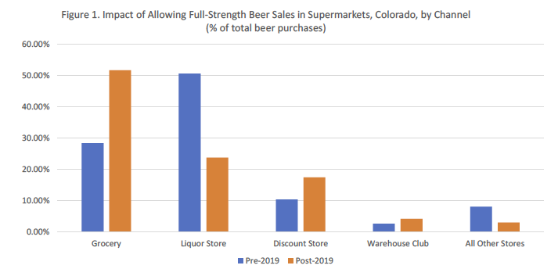
Grocery stores are selling more beer!

Slide 25
Second question:
Did grocery store sales increase?
Here we use two datasets to examine i) store sales and ii) household expenditures
We compare stores and households across time (2019 vs 2017 & 2018) and across space (Colorado vs Arizona and Minnesota)
We also focus on the beer-purchasing households to see if they react more/less strongly to the change in the law
And we focus on the top 10 categories in the grocery store (not including beer)
To understand the effects outside of the beer category

Slide 26
Top 10 supermarket categories
Fresh produce
Bread and baked goods
Snacks
Cheese
Meat
Deli meat
Prepared foods/Sauces
Frozen dinners
Milk
Soda

Slide 27
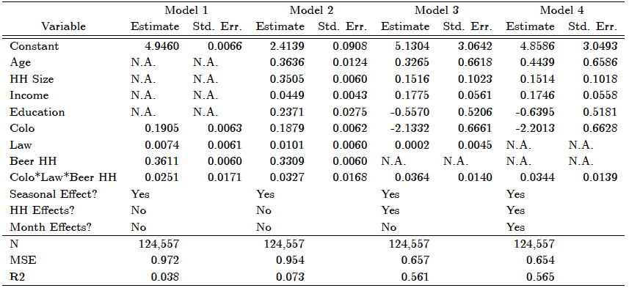
Effect among beer purchasing households for top ten categories

Slide 28
Third question:
What happened in the non-beer categories?
Again we use the two datasets and compare stores and households across time (2019 vs 2017 & 2018) and across space (Colorado vs Arizona and Minnesota)
Our results show whether category sales (stores) or expenditures (by households) increase relative to the increase in beer sales/expenditures
Traditional complements (burgers and cheese)
Incidental complements (milk and bread)?

Slide 29
Effect on expenditures among beer purchasing households for top ten categories (not including beer)
Fresh produce
Bread and baked goods
Snacks
Cheese
Meat
Deli meat
Prepared foods/Sauces
Frozen dinners
Milk
Soda

Slide 30
Why do we see an increase in
produce purchases in CO?
Produce isn’t typically thought of as a traditional complement to beer
It is also not clear if produce might be considered as an incidental complement to beer either
Additional models examine how the change in the law (in Colorado in 2019) affected consumers’ frequency of grocery store visits

Slide 31
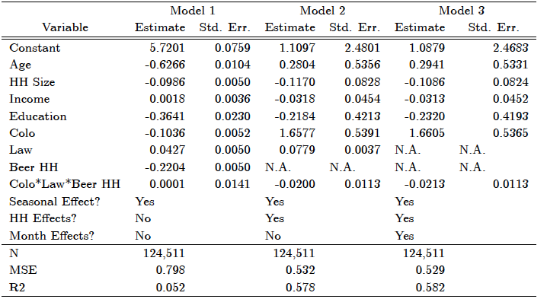
Effect on interpurchase timing of grocery store visits among beer purchasing households for top ten categories
(not including beer)
Survey Goals

Slide 32
Summary and Key Takeaways
The law that allowed beer to be sold in grocery stores in CO in 2019 has increased beer sales and total grocery sales (net of beer sales)
It has also increased sales for the more perishable categories including produce
This appears to be due to an increase in frequency of visits to supermarkets
Introducing beer has been proposed in many different states in recent years, so this is not isolated to CO
And CO just passed a plebiscite (Prop 125) that will allow wine to be sold in grocery stores starting in March 2023

Slide 33
Thank you!
Questions or Comments?
Brad Rickard
607.255.7417
bjr83@cornell.edu

