Slide 1
Virus Economics
or
The Outlook for the Economy in 2021

Slide 2
Pandemics Are Natural Disasters Not Recessions
(though the longer they go on the more they start to look like one)
Much of the language of business cycle analysis has been used to describe economic effects of virus shutdowns
  “Recessions”
  “Stimulus”
But the past year is not like any normal business cycle
  Workers are NOT unemployed because businesses laid them off due to declining business activity – they were ordered home from what was an economy near the peak of the business cycle
  But as this grinds on, more and more businesses go under, making the recovery longer and more like recessions from the recent past

Slide 3
How Do We Deal With a Natural Disaster?
The first need in any disaster is to aid those affected to make sure they are safe, fed, and healthy
  In an earthquake or a hurricane the affected areas are obvious and the needs are equally obvious
  Also, the acute phase of these disasters typically lasts only a day or two at the most (or even a few minutes in the case of an earthquake)
  Everything thereafter is “recovery”

Slide 4
How is the current crisis different?
It is extended over an indefinite period
It affects EVERYONE (at least potentially)
The needs of the sick are clear – They need medical care
The needs of the rest of us are also pretty clear - Everyone needs to be able to eat and have a place to be for the duration

Slide 5
Reactivation of the Economy
Note Well!! - There is no way any kind of stimulus can return the economy to its previous levels as long as the economy (or large parts of it) is shut down by government decree and everyone is told to stay in their homes
But the relief payments DO have a stimulative effect as recipients spend money on necessities and other items
Key danger: Many businesses will go broke before business recovers
  How to keep them viable for the future?
  How to keep workers “attached” to their jobs?

Slide 6
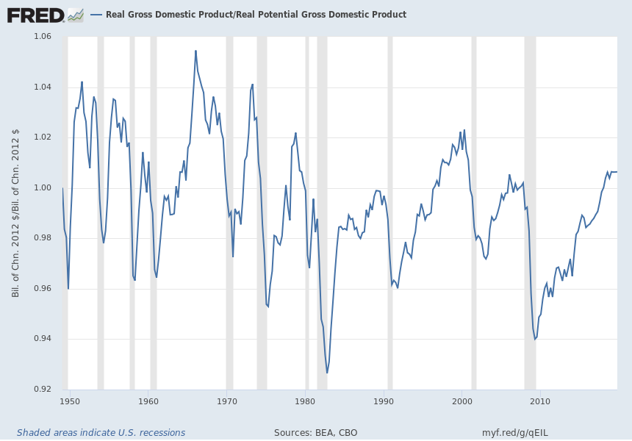
So Where Were We in Terms of the Business Cycle?
Real GDP/Potential GDP Right Before the Virus Shutdowns
Showed in the Data (April 7)
Notes:
Source:
U.S. Congressional Budget Office
Release:
Budget and Economic Outlook
Units:
Billions of Chained 2012 Dollars, Not Seasonally Adjusted
Frequency:
Quarterly
Real potential GDP is the CBO’s estimate of the output the economy would produce with a high rate of use of its capital and labor resources. The data is adjusted to remove the effects of inflation.
U.S. Congressional Budget Office,
Real Potential Gross Domestic Product [GDPPOT],
retrieved from FRED,
Federal Reserve Bank of St. Louis;
https://fred.stlouisfed.org/series/GDPPOT,
April 7, 2020.
Source:
U.S. Bureau of Economic Analysis
Release:
Gross Domestic Product
Units:
Billions of Chained 2012 Dollars, Seasonally Adjusted Annual Rate
Frequency:
Quarterly
BEA Account Code: A191RXReal gross domestic product is the inflation adjusted value of the goods and services produced by labor and property located in the United States.For more information see the Guide to the National Income and Product Accounts of the United States (NIPA). For more information, please visit the Bureau of Economic Analysis.
U.S. Bureau of Economic Analysis,
Real Gross Domestic Product [GDPC1],
retrieved from FRED,
Federal Reserve Bank of St. Louis;
https://fred.stlouisfed.org/series/GDPC1,
April 7, 2020.

Slide 7
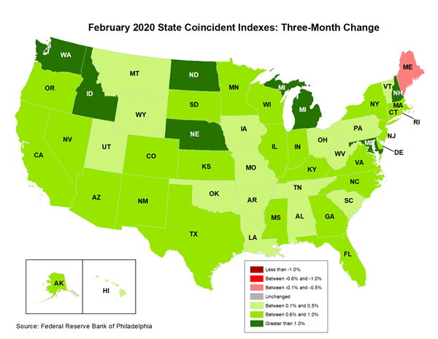
This is what it looked like in February

Slide 8
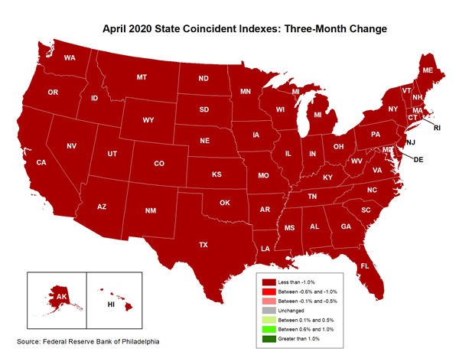
That Looked Amazingly Good –
But Look at April’s Map!

Slide 9
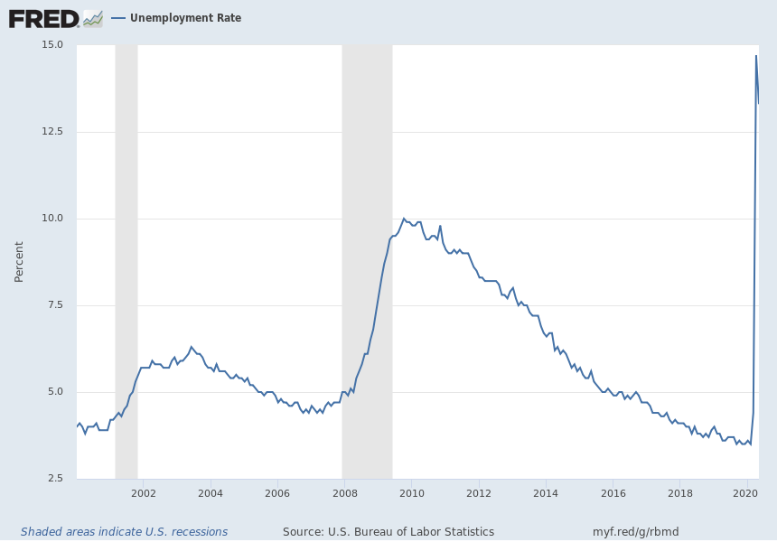
“Everyone Go Home and Stay There”
June 9, 2020
Notes:
Source:
U.S. Bureau of Labor Statistics
Release:
Employment Situation
Units:
Percent, Seasonally Adjusted
Frequency:
Monthly
The unemployment rate represents the number of unemployed as a percentage of the labor force. Labor force data are restricted to people 16 years of age and older, who currently reside in 1 of the 50 states or the District of Columbia, who do not reside in institutions (e.g., penal and mental facilities, homes for the aged), and who are not on active duty in the Armed Forces.
This rate is also defined as the U-3 measure of labor underutilization.
The series comes from the 'Current Population Survey (Household Survey)'
The source code is: LNS14000000
U.S. Bureau of Labor Statistics,
Unemployment Rate [UNRATE],
retrieved from FRED,
Federal Reserve Bank of St. Louis;
https://fred.stlouisfed.org/series/UNRATE,
June 9, 2020.

Slide 10
Substantial, but less than complete recovery since last Spring
Retail sales rebounded fast after assistance programs in late Spring. Nevertheless, we are still well below previous peaks
Unemployment still very high (though the usual stats don’t show the extent of it)
Latest labor market reports show softening of recovery (new jobless claims close to 1 million/week are not encouraging)

Slide 11
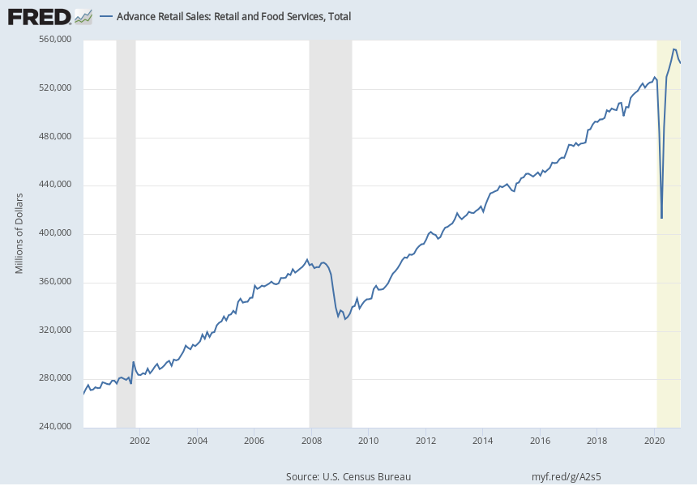
Retail Sales Bounce Back
Notes:
Source:
U.S. Census Bureau
Release:
Advance Monthly Sales for Retail and Food Services
Units:
Millions of Dollars, Seasonally Adjusted
Frequency:
Monthly
The value for the most recent month is an advance estimate that is based on data from a subsample of firms from the larger Monthly Retail Trade Survey. The advance estimate will be superseded in following months by revised estimates derived from the larger Monthly Retail Trade Survey. The associated series from the Monthly Retail Trade Survey is available at https://fred.stlouisfed.org/series/MRTSSM44X72USS Information about the Advance Monthly Retail Sales Survey can be found on the Census website at https://www.census.gov/retail/marts/about_the_surveys.html
U.S. Census Bureau,
Advance Retail Sales: Retail and Food Services, Total [RSAFS],
retrieved from FRED,
Federal Reserve Bank of St. Louis;
https://fred.stlouisfed.org/series/RSAFS,
January 16, 2021.

Slide 12
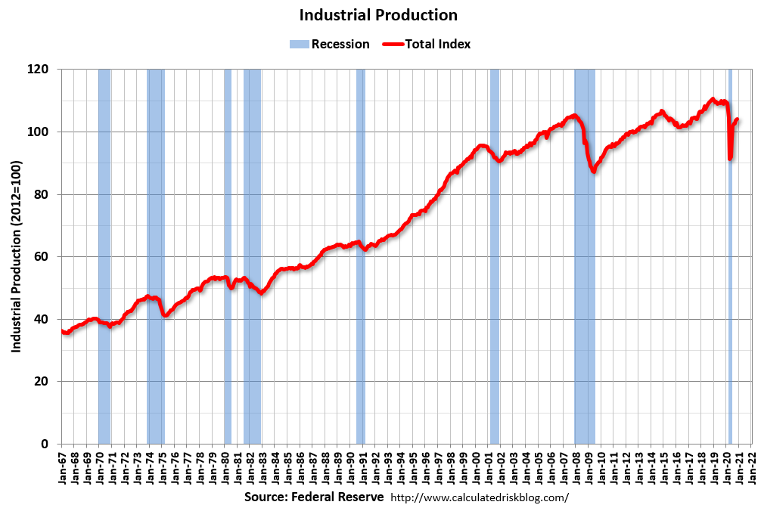
Industrial production:
Recovery but not
to previous peak…

Slide 13
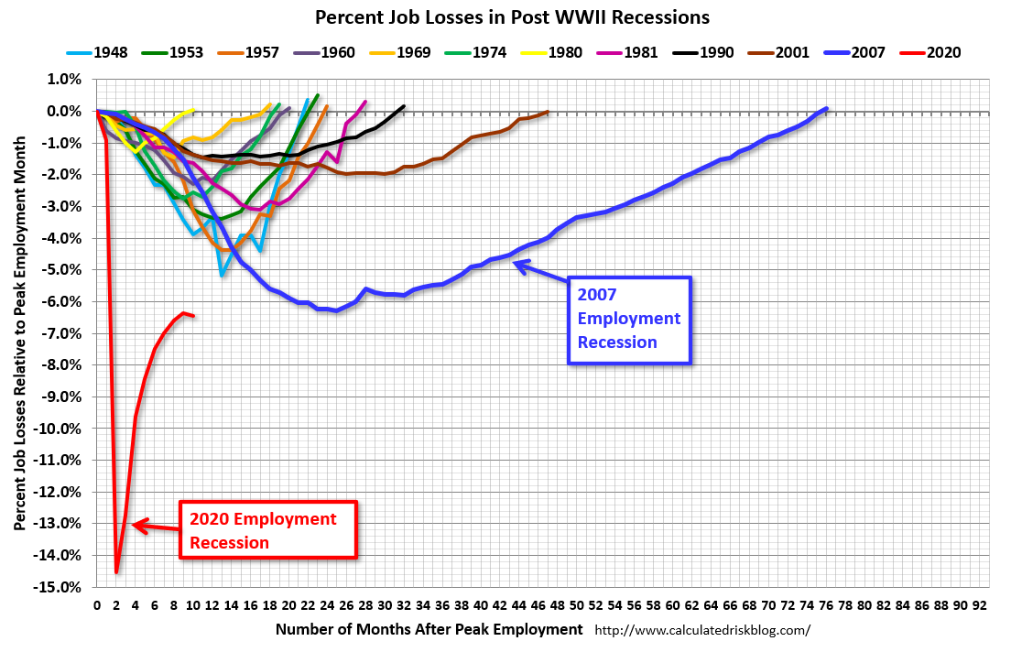

Slide 14
Most Recent Philadelphia Fed Coincident Index (for November)

Slide 15
So what now? …………
We know that vaccination will be widespread by some point in 2021
How quickly will we grow after that?
Can economic policy speed it up?

Slide 16
What We Do Now Determines Both the Starting Point for Post-Vaccine Recovery and the Speed
We have been trying to “freeze” the economy so as to allow a rapid recovery based on already-existing businesses with already-on-the-payroll workers
But the more businesses go under, the slower the recovery will be as new businesses need to be formed, recruit labor, etc. rather than being a going concern ready to go immediately

Slide 17
The Role of Economic Policy
With GDP still well under its potential and millions still un- or under-employed there is clearly a need for fiscal stimulus once we get people vaccinated
The government can rev up the economy with low interest rates and government spending to rapidly re-employ workers and spark the demand that businesses need to get going again

Slide 18
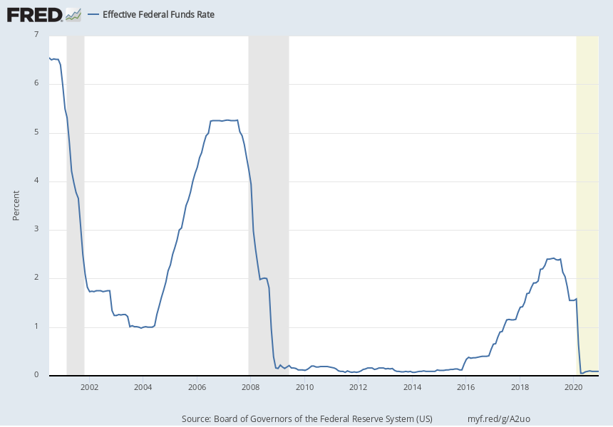
Monetary Policy is Already as Expansionary as It Can Get

Slide 19
Fiscal Policy
After a massive deficit financed program in the Spring, fiscal policy has tightened since then as the pandemic continues and new spending has been limited
Now that Democrats control the Senate there is a very strong likelihood of substantial new spending
This will speed up our recovery

Slide 20
This Is Exactly the Kind of Situation Where Deficit Spending Can Help
We now have zero interest rates (ZERO!!) and huge slack in the economy with millions unemployed and capacity utilization in the mid 70’s
We also have a lot of unavoidable infrastructure projects that need investment (bridges, schools, health infrastructure, etc.)
Did I mention interest rates are zero? That means there is no cost to spending the money now rather than later (when the needed investment will also be bigger as well)

Slide 21
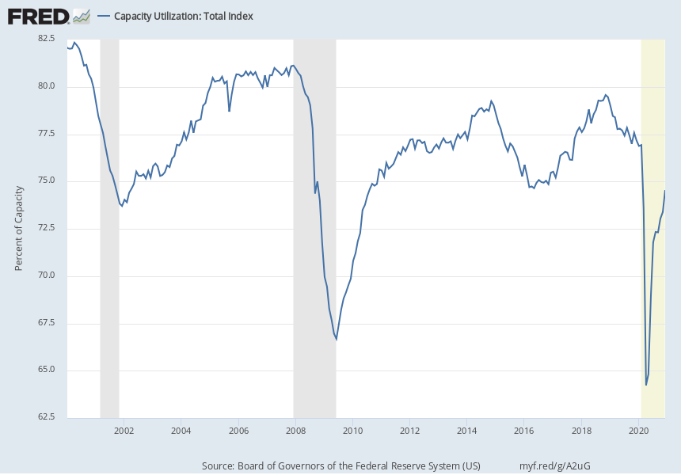
Capacity Utilization in the Low 70’s – Not a Constraint
Notes:
Source:
Board of Governors of the Federal Reserve System (US)
Release:
G.17 Industrial Production and Capacity Utilization
Units:
Percent of Capacity, Seasonally Adjusted
Frequency:
Monthly
Capacity Utilization: Total Industry (TCU) is the percentage of resources used by corporations and factories to produce goods in manufacturing, mining, and electric and gas utilities for all facilities located in the United States (excluding those in U.S. territories).(1) We can also think of capacity utilization as how much capacity is being used from the total available capacity to produce demanded finished products.Capacity utilization indexes are constructed for 71 industries in manufacturing, 16 in mining, and 2 in utilities. (1) Physical data on capacity utilization are primarily compiled from trade sources and government sources, such as the U.S. Geological Survey and the U.S. Energy Information Administration.(1) When physical data are unavailable, capacity utilization data are compiled from the U.S. Census Bureau’s Quarterly Survey of Plant Capacity Utilization, which provides data for almost 70 percent of total industry capacity.(1) Additionally, the capacity index is developed on a monthly basis, designed to be consistent with the production index.(1)According to the Board of Governors of the Federal Reserve System, the capacity index tries to conceptualize the idea of sustainable maximum output, which is defined as the highest level of output a plant can sustain within the confines of its resources. The Board of Governors defines the seasonally adjusted capacity utilization rate as the output index divided by the capacity index. The capacity utilization rate can also implicitly describe how efficiently the factors of production (inputs in the production process) are being used. (1) It sheds light on how much more firms can produce without additional costs. Additionally, this rate gives manufacturers some idea as to how much consumer demand they will be able to meet in the future.The Federal Reserve strives to construct a capacity index consistent with time by using different relevant data sources.(1) Developing an index that is reasonable given the time period is the primary aim for this index, but there are still some difficulties. Extensive technological and structural changes have and will continue to occur, affecting the degree of tightness the Federal Reserve index of capacity utilization will represent.(2) In addition, each series of capacity utilization is flawed by commission; therefore, they should be used with caution.(2)References(1) Board of Governors of the Federal Reserve System. “Industrial Production and Capacity Utilization.” Statistical release G.17;. May 15, 2013.(2) Bauer, Paul W. and Deily, Mary E. “A User’s Guide to Capacity- Utilization Measures.” Economic Commentary. Federal Reserve Bank of Cleveland, July 1, 1988; https://www.clevelandfed.org/newsroom-and-events/publications/economic-commentary/economic-commentary-archives/1988-economic-commentaries/ec-19880701-a-users-guide-to-capacity-utilization-measures.aspx.
Board of Governors of the Federal Reserve System (US),
Capacity Utilization: Total Index [TCU],
retrieved from FRED,
Federal Reserve Bank of St. Louis;
https://fred.stlouisfed.org/series/TCU,
January 16, 2021.

Slide 22
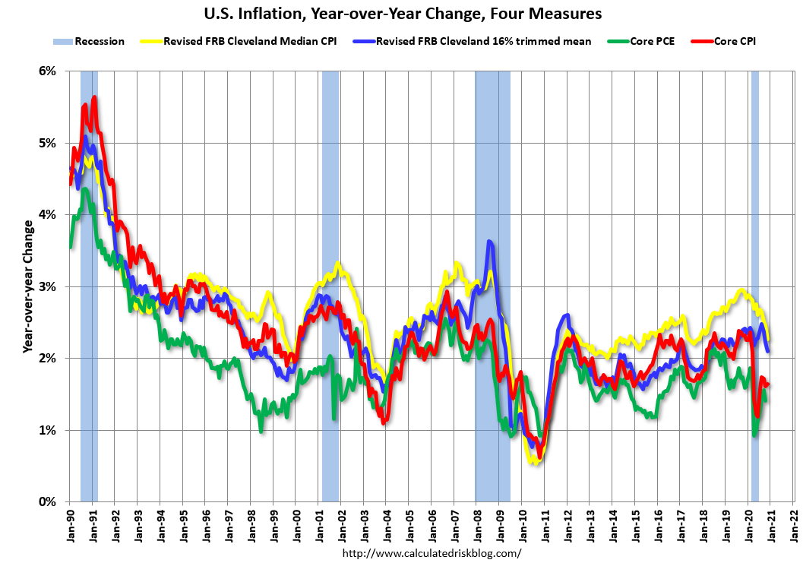
Inflation Well Under Control

Slide 23
Will Excessive Debt be a Danger???
No.
Nobody in financial markets is worried about the US being able to service its debt
  If there were, you wouldn’t be able to buy 30 year bonds at anywhere near 2%
We will do more to reduce Debt/GDP right now by increasing GDP than by trying to reduce debt by cutting spending
  Cutting spending drastically might reduce debt but it will also decrease GDP at the same time because of the contractionary effects of doing so

Slide 24
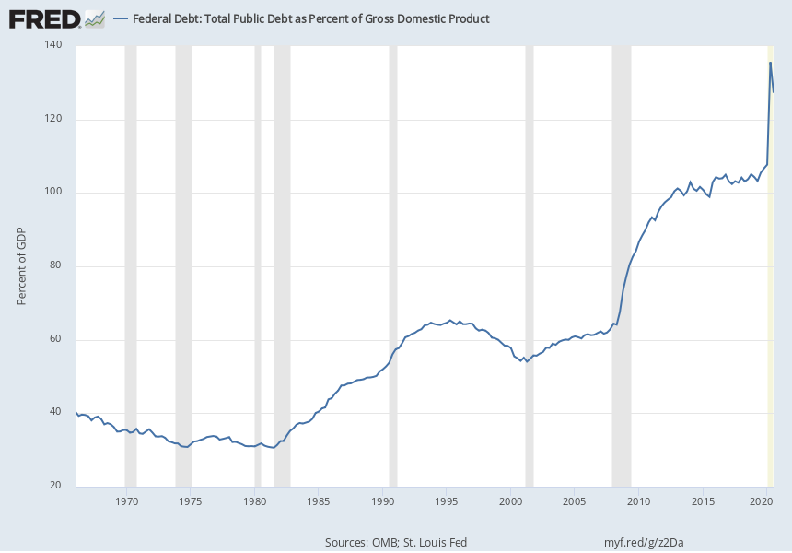
A Sharp Increase in Debt/GDP But a Manageable One
Notes:
Source:
U.S. Office of Management and Budget
Source:
Federal Reserve Bank of St. Louis
Release:
Debt to Gross Domestic Product Ratios
Units:
Percent of GDP, Seasonally Adjusted
Frequency:
Quarterly
Federal Debt: Total Public Debt as Percent of Gross Domestic Product (GFDEGDQ188S) was first constructed by the Federal Reserve Bank of St. Louis in October 2012. It is calculated using Federal Government Debt: Total Public Debt (GFDEBTN) and Gross Domestic Product, 1 Decimal (GDP):GFDEGDQ188S = ((GFDEBTN/1000)/GDP)*100GFDEBTN/1000 transforms GFDEBTN from millions of dollars to billions of dollars.
U.S. Office of Management and Budget and Federal Reserve Bank of St. Louis,
Federal Debt: Total Public Debt as Percent of Gross Domestic Product [GFDEGDQ188S],
retrieved from FRED,
Federal Reserve Bank of St. Louis;
https://fred.stlouisfed.org/series/GFDEGDQ188S,
January 15, 2021.

Slide 25
Trump Could Have Won the Election If ……
He had simply agreed to Nancy Pelosi’s massive $2.9 trillion dollar package last May (or even supported increasing it, posing as the defender of the people)
Very possibly this package was bigger than necessary
But there is no question it would have revved up the economy substantially, even in the middle of a pandemic – But the conservative orthodoxy of austerity prevented doing this

Slide 26
Housing Market
Backlog of foreclosed houses gone when pandemic started
Nominal house prices were clearly above previous peak
Now, with COVID shutdown related evictions and foreclosures we are in a very different situation
On the other hand, low interest rates are spurring a buying binge
Very unequal distribution of pain and gain in the housing market

Slide 27
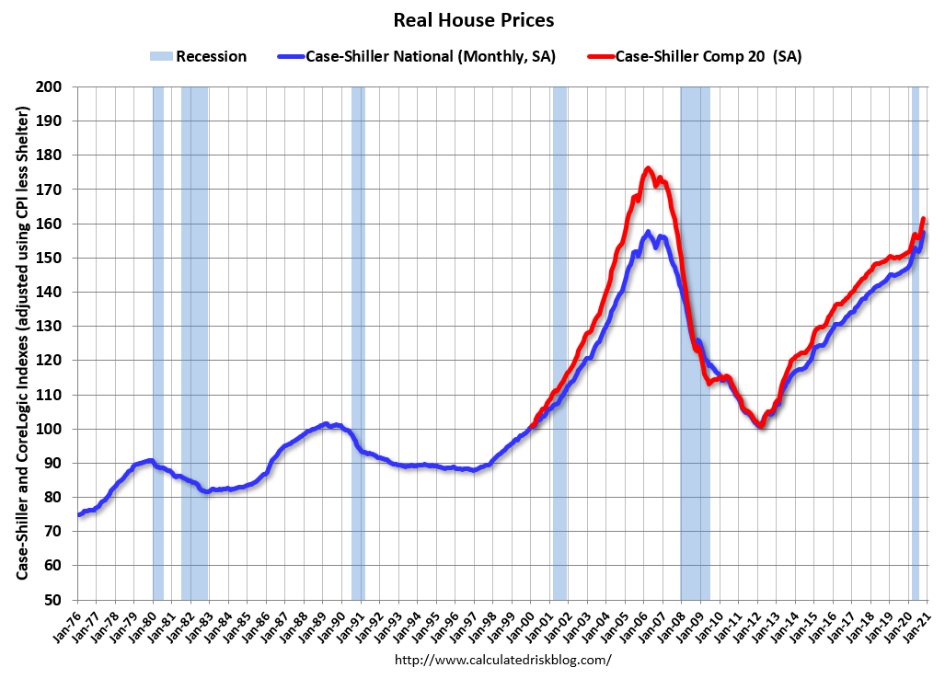

Slide 28
So Where Will We Be by Year End – 2021 ???
2021 will be good year !!!
  Even if we don’t recover completely this year, the second half will nevertheless be so much better than the previous 18 months it will feel fantastic
Short run relief spending and longer run investment and jobs programs will buoy the economy
  I would go for a large infrastructure program including roads, health care infrastructure, schools and the environment

Slide 29
Predictions and Flying Guesses
The statistics I like to predict were not designed for 2020 and 2021 - Nevertheless, I am an economist and will predict anyway!
Inflation is easiest: It will stay around the Fed target of 2%
Interest rates are also easy: They will stay at rock bottom
Employment: Under 5% ???
GDP: 6% ???

