Slide 1
The Grape, Wine, & Ornamental Situation and Outlook 2021
        Miguel I. Gómez
        Dyson School of Applied Economics and Management
        Cornell University
        Cornell Agribusiness Economic Outlook Conference
        Ithaca, January 25, 2021

Slide 2
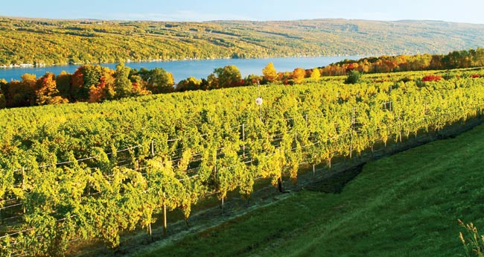
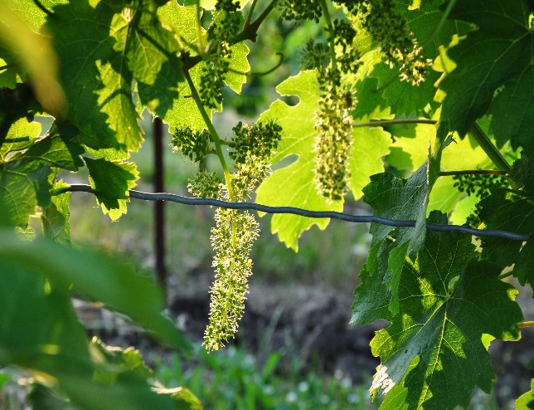
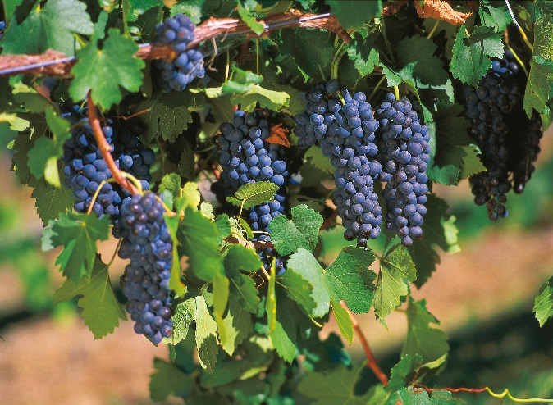

Situation & Outlook for Grapes and Wine
Notes:
Specialty crops are an important component of New York State’s agricultural economy.

Slide 3
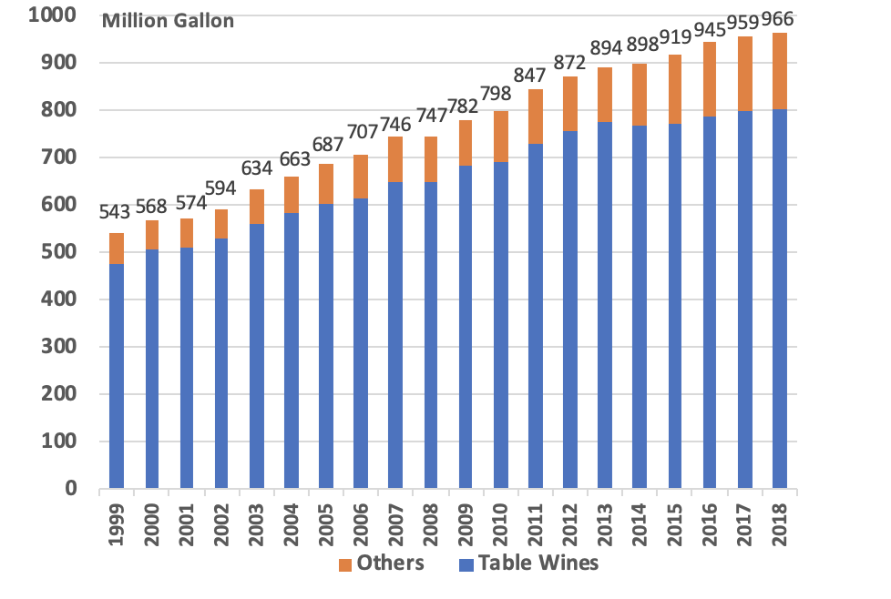
Total Wine Consumption, U.S. 1999-2018
Source: Wine Institute, 2020

Slide 4
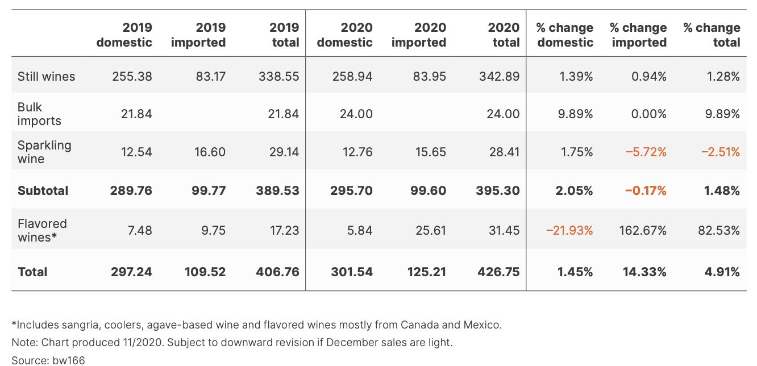
Overview – Wine (2020)
Preliminary US wine market volume
9-liter equivalent cases (in thousands)
Source: State of the Wine Industry, 2021
Notes:
https://www.svb.com/globalassets/trendsandinsights/reports/wine/sotwi-2021/svb-state-of-the-us-wine-report-2021.pdf

Slide 5
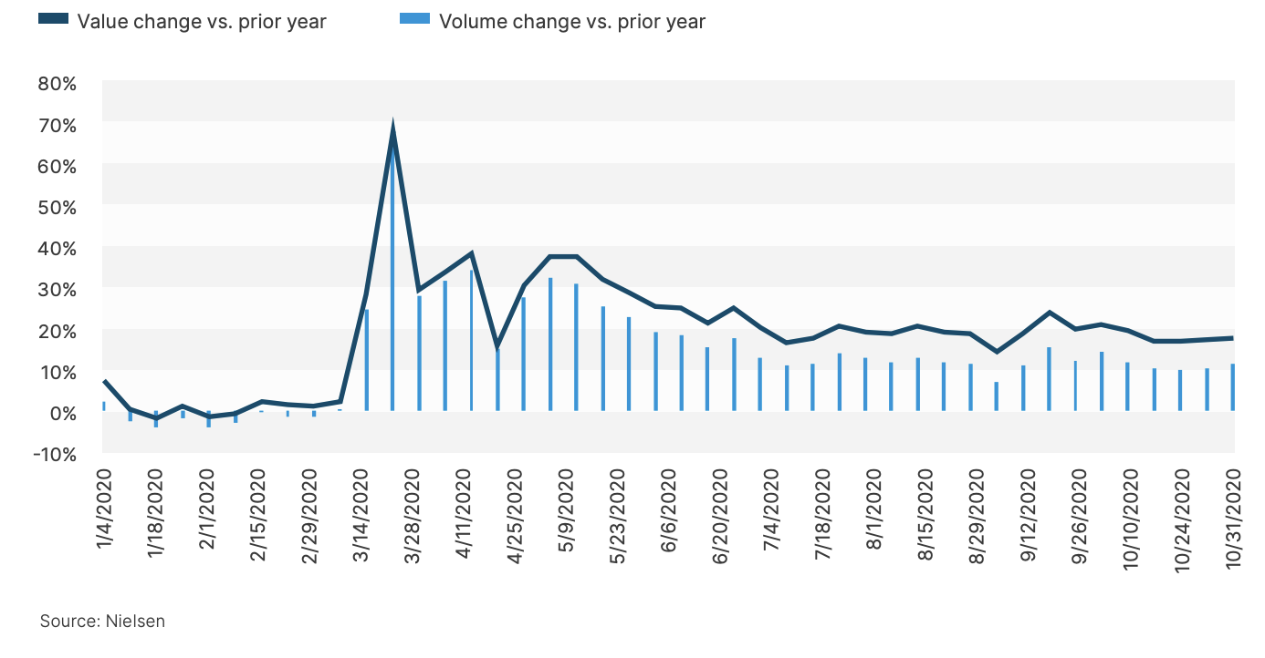
Overview – Wine (2020)
Off-premise volume and value changes in 2020 vs. prior year
Source: State of the Wine Industry, 2021
Notes:
https://www.svb.com/globalassets/trendsandinsights/reports/wine/sotwi-2021/svb-state-of-the-us-wine-report-2021.pdf

Slide 6
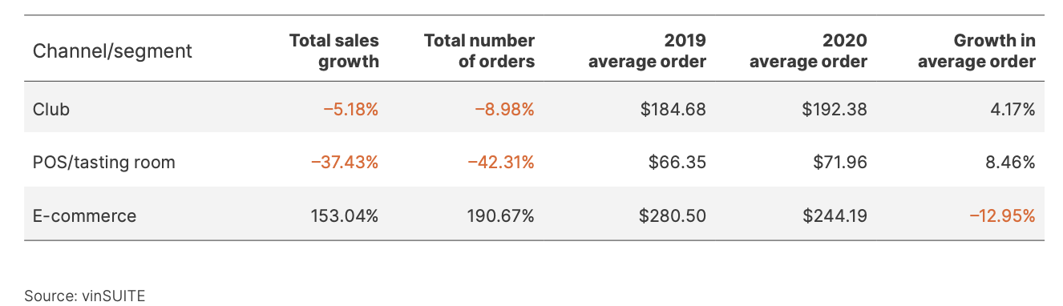
Overview – Wine (2020)
Growth in direct Channels 2019-2020
Source: State of the Wine Industry, 2021
Notes:
https://www.svb.com/globalassets/trendsandinsights/reports/wine/sotwi-2021/svb-state-of-the-us-wine-report-2021.pdf
there were some membership drops from the club and total orders were lower on average by 9 percent (according to vinSUITE data backed by hundreds of thousands of transactions), the average order increased by 4 percent and total club sales did much better than anyone dared to dream.

Slide 7
Overview – Wine (2020)
Source: State of the Wine Industry, 2021
Notes:
https://www.svb.com/globalassets/trendsandinsights/reports/wine/sotwi-2021/svb-state-of-the-us-wine-report-2021.pdf
there were some membership drops from the club and total orders were lower on average by 9 percent (according to vinSUITE data backed by hundreds of thousands of transactions), the average order increased by 4 percent and total club sales did much better than anyone dared to dream.

Slide 8
Overview – Wine (2020)
Source: State of the Wine Industry, 2021
Notes:
https://www.svb.com/globalassets/trendsandinsights/reports/wine/sotwi-2021/svb-state-of-the-us-wine-report-2021.pdf
there were some membership drops from the club and total orders were lower on average by 9 percent (according to vinSUITE data backed by hundreds of thousands of transactions), the average order increased by 4 percent and total club sales did much better than anyone dared to dream.

Slide 9
Overview – Wine (2020)
E-commerce trends in alcohol
Explosive growth in COVID-19 period
Source: State of the Wine Industry, 2021
Notes:
https://www.svb.com/globalassets/trendsandinsights/reports/wine/sotwi-2021/svb-state-of-the-us-wine-report-2021.pdf
there were some membership drops from the club and total orders were lower on average by 9 percent (according to vinSUITE data backed by hundreds of thousands of transactions), the average order increased by 4 percent and total club sales did much better than anyone dared to dream.

Slide 10
Overview – Wine (2020)
US Population by Age
Source: State of the Wine Industry, 2021
Notes:
https://www.svb.com/globalassets/trendsandinsights/reports/wine/sotwi-2021/svb-state-of-the-us-wine-report-2021.pdf
there were some membership drops from the club and total orders were lower on average by 9 percent (according to vinSUITE data backed by hundreds of thousands of transactions), the average order increased by 4 percent and total club sales did much better than anyone dared to dream.

Slide 11
Overview – Wine (2020)
Wine consumption by cohort
Source: State of the Wine Industry, 2021
Notes:
https://www.svb.com/globalassets/trendsandinsights/reports/wine/sotwi-2021/svb-state-of-the-us-wine-report-2021.pdf
there were some membership drops from the club and total orders were lower on average by 9 percent (according to vinSUITE data backed by hundreds of thousands of transactions), the average order increased by 4 percent and total club sales did much better than anyone dared to dream.

Slide 12
NY Wine Industry Economic Impact
 | 2017 (WineAmerica Study) | 2019 (New York Wine & Grape Foundation Study)
Wineries | 450 | 471
Jobs | 62,450 | 71,950
Wages | $2.38 billion | $2.79 billion
Tourist Visits | 4.5 million | 4.71 million
Tourism Expenditures | $1.8 billion | $1.33 billion
Direct Economic Impact | $5.53 billion | $6.65 billion
Source: New York Wine & Grape Foundation report, 2020
Notes:
https://www.winebusiness.com/news/?go=getArticle&dataId=225416

Slide 13
Outlook – New York Grapes (2021)
NY reported the best quality of all reporting regions, with a warmer and drier growing season than average
Grape quality is high across the board for the base wines with slightly better flavor concentration than last year
2016 is the comparison year most people point to because it was also hot and dry. In 2020, most people harvested most varieties a lot earlier than in 2016
Acids being plenty high (possible exception: those 20 brix Concords)
Source: Veraison to Harvest, 2020
Notes:
https://grapesandwine.cals.cornell.edu/sites/grapesandwine.cals.cornell.edu/files/shared/Veraison%20to%20Harvest%202020%20%238.pdf
https://www.svb.com/globalassets/trendsandinsights/reports/wine/sotwi-2021/svb-state-of-the-us-wine-report-2021.pdf

Slide 14
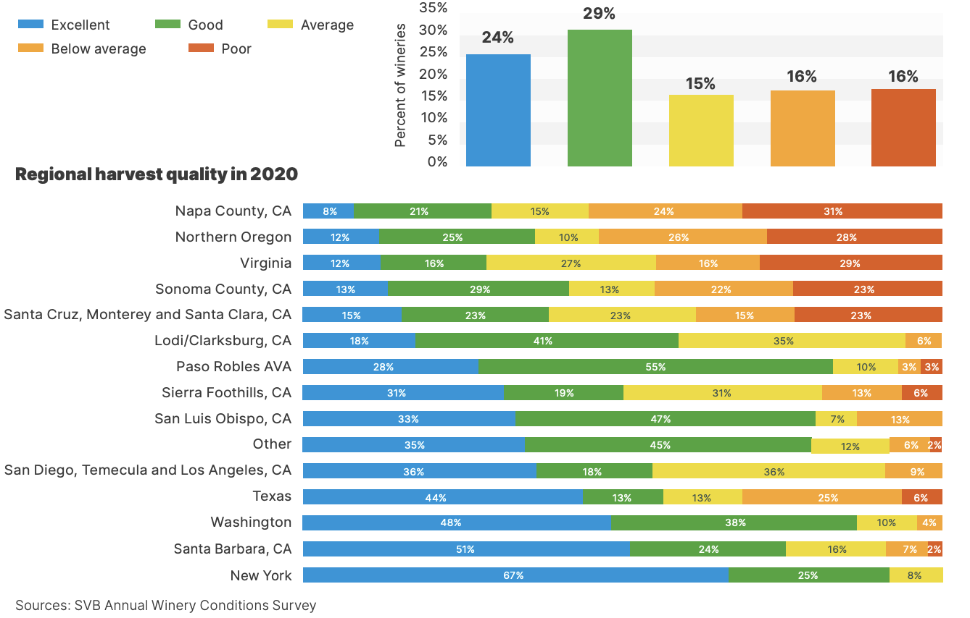
Outlook – U.S. Grapes (2021)
Harvest quality in 2020
Source: : State of the Wine Industry, 2021
Notes:
Source: https://www.svb.com/globalassets/trendsandinsights/reports/wine/sotwi-2021/svb-state-of-the-us-wine-report-2021.pdf

Slide 15
Outlook – U.S. Grapes (2021)
Total U.S. grape crop (raisins, wine, table, and juice grapes) to be up 4% (a 10% increase in grape production in Washington State and a 4% increase in California).
NASS predicts the 2020/21 crop of table-type grapes to be 2,700 million pounds, up 14% from the previous season.
Imports from May-July were down 12% from the same period a year ago.
Table grape exports from May through July 2020 were down almost 9% from the same period last year
Source: : fruit and Tree Nuts Outlook from ERS 2020
Notes:
Source: fruit and Tree Nuts Outlook from ERS 2020
https://www.ers.usda.gov/webdocs/outlooks/99458/fts-371.pdf?v=8666.8
https://www.svb.com/globalassets/trendsandinsights/reports/wine/sotwi-2021/svb-state-of-the-us-wine-report-2021.pdf
The decline in exports is probably due to some combination of problems: low supply early in the season; some decline in demand; tariffs in major export markets; and shutdowns or slowdowns associated with COVID-19.

Slide 16
Outlook – U.S. Wines (2021)
Overall wine sales will be sluggish until business restrictions are lifted, but wine sales will gather momentum through the year.
Growth in tasting room sales
Direct-to-consumer models will focus on COVID-era strategies
Off-premise will show positive year-over-year growth rates
Wine sales through the restaurant will see a material recovery, but not recover to pre-COVID levels in 2021
Overall pricing should hold in both off- and on-premise sales
Source: State of the Wine Industry, 2021
Notes:
https://www.svb.com/globalassets/trendsandinsights/reports/wine/sotwi-2021/svb-state-of-the-us-wine-report-2021.pdf
For the sake of scenario planning in hospitality businesses, we are predicting we’ll have a 25 percent reopening by April 15, a 50 percent reopening by June 15, a 75 percent reopening by August 15 and full reopening by October 15.
CA will have crushed 3.3 million tons, which would be the smallest harvest since 2011

Slide 17

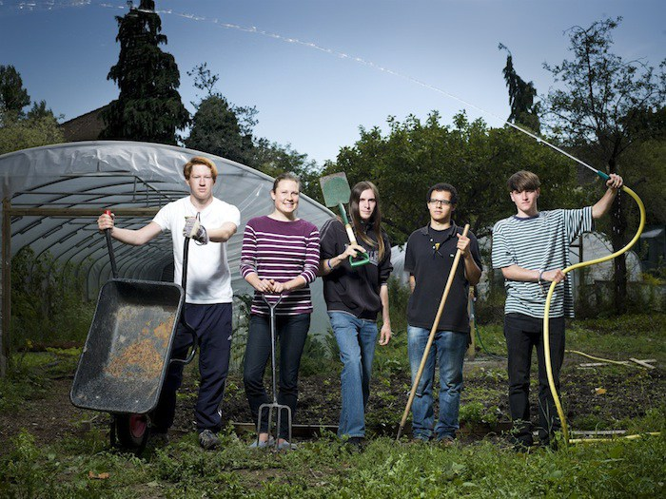
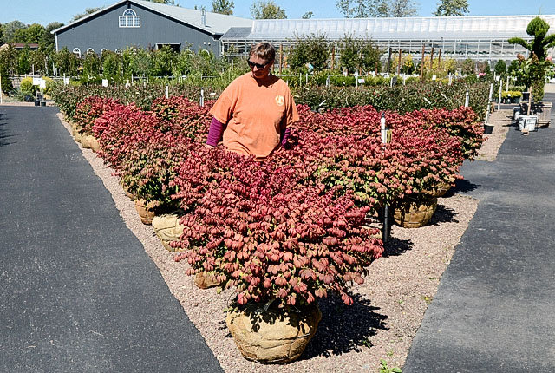

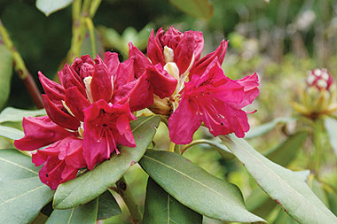
Ornamental Crops: Situation and Outlook

Slide 18
Floriculture products in New York
Wholesale value decreased in 2019

Slide 19
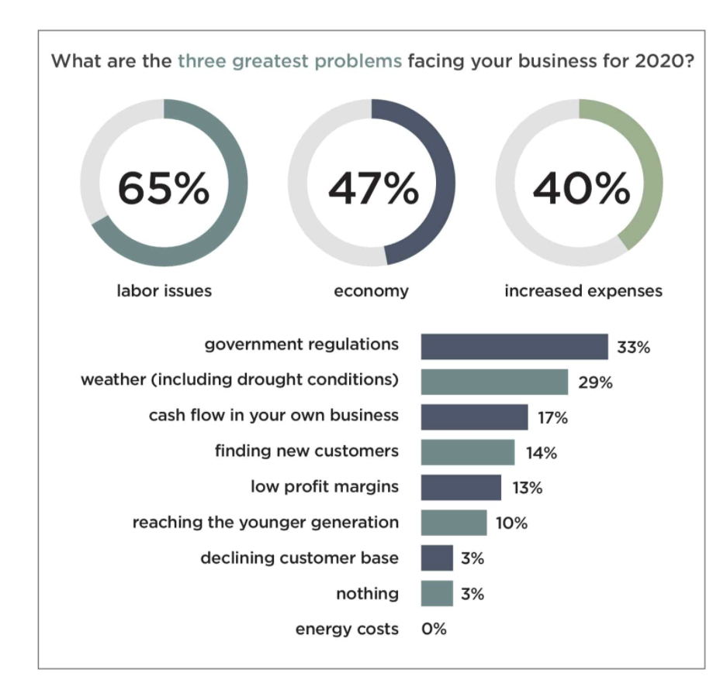
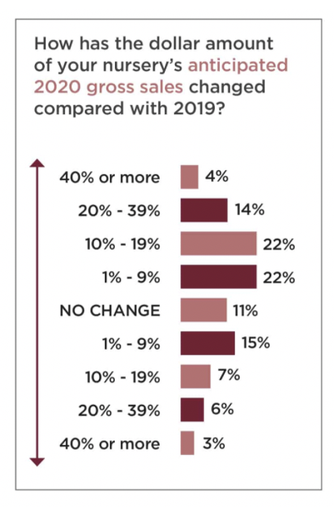
Nursery Crops: 2020 Outlook
Source: Nursery Management’s 2020 State of the Industry Report
Notes:
https://www.nurserymag.com/article/2020-state-of-the-industry-report/

Slide 20
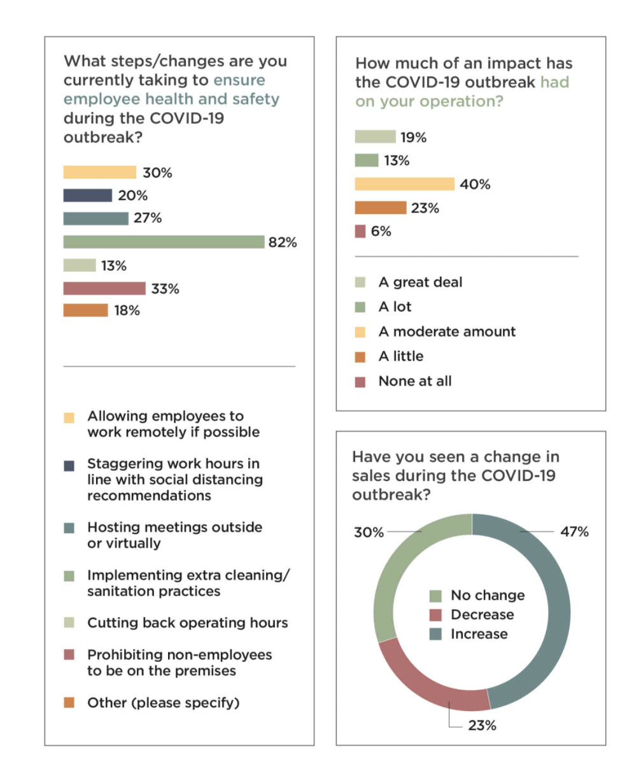
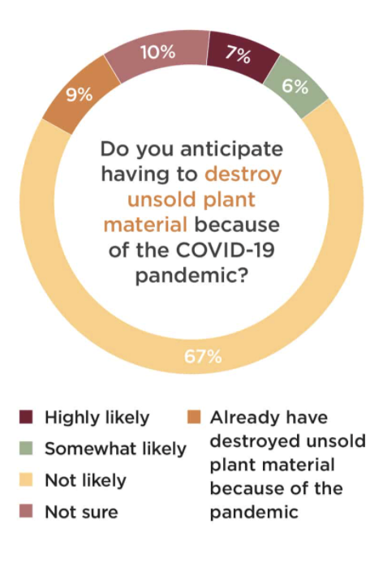
Nursery Crops: 2020 COVID
Source: Nursery Management’s 2020 State of the Industry Report
Notes:
https://www.nurserymag.com/article/2020-state-of-the-industry-report/

Slide 21
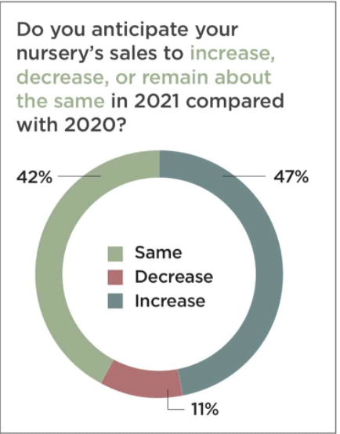
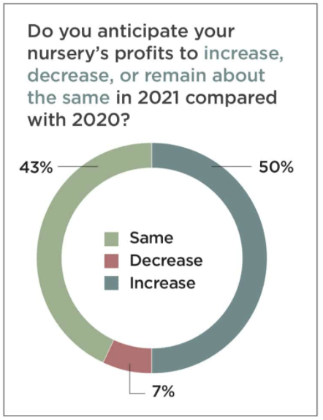
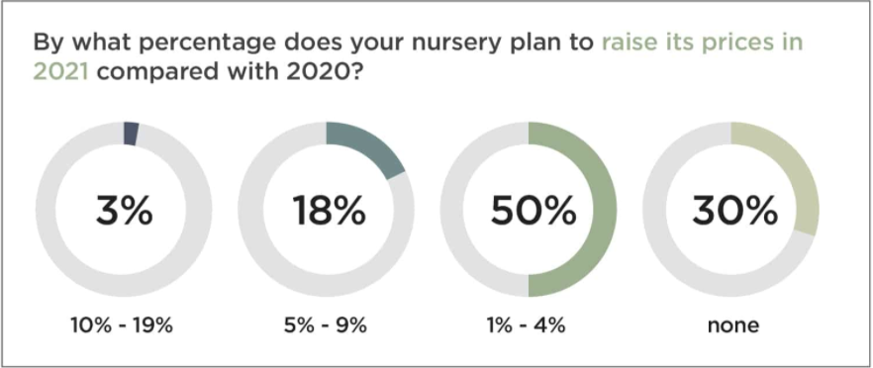
Nursery Crops: 2021 Outlook
Source: Nursery Management’s 2020 State of the Industry Report
Notes:
https://www.nurserymag.com/article/2020-state-of-the-industry-report/

Slide 22
Research Updates

Slide 23
The COVID-19 pandemic, customer satisfaction, and sales performance in NYS wine tasting rooms
Trent J. Davis & Miguel I. Gómez
Charles H. Dyson School of Applied Economics and Management
Cornell University

Slide 24
COVID-19 and Hospitality
Hospitality sector one of the hardest hit industries
  Upwards 58% of all restaurants/bars mandated or voluntarily closed at some point
  460,000+ jobs lost as of March, 2020
New York State (NYS) has mandated significant changes to tasting room protocols to mitigate COVID-19 spread
  Limited customer capacity
  Physical distancing
  More robust cleaning/disinfection
  Employee screening

Slide 25
Finger Lakes Tasting Rooms
Many changes in tasting room protocols due to NYS mandate
  Outdoor seating
  Limited capacity
  Reservation systems
  Shift to table service
    Similar to ”wine bars”
Tasting rooms can account for upwards of 50% of direct-to-consumer sales
Tasting room protocols can have a significant impact on customer satisfaction and customer purchasing decisions

Slide 26
Changes to the Tasting Experience
 | Before COVID-19 Protocol | Current Protocol
How to order | Predetermined flights | Individually, only order what you want
Price | Predetermined tasting fee | Each wine has its own price, no predetermined fee
Amount poured | About 1oz | 2.5/5 oz depending on order
Time spent at winery | 15 – 30min | 45-90 min
Style of service | Stand up around a bar/table | Sit down service, resembles a restaurant

Slide 27
Research Objectives
This study evaluates how the changes to the tasting room protocol due to the COVID-19 pandemic may impact:
  Customer satisfaction (CS)
  Customer’s opinions of changes to the tasting room
  Sales performance
Specifically, using factor analysis we find the major drivers of overall CS
  How the CS factors relate to opinions of the new tasting protocols
  How the CS factors impact different measures of sales performance

Slide 28
Experimental Design - Data
239 surveys collected at 2 wineries in the FLX over a 10-day period in October 2020
Survey asked to rank 24 tasting room protocol attributes from
  Below my expectations
  Met my expectations
  Exceeded my expectations
Demographic questions, customers’ concern for COVID-19, and if customers made a reservation were asked
Sales receipts were attached to completed surveys to track
  $ spent on tasting
  $ spent on bottles
  Bottles purchased

Slide 29
Experimental Design - Model
Factor analysis to identify factors driving CS
Discrete choice analysis
  CS factors on overall CS
  True/false statements regarding tasting room changes
  Decision to purchase a bottle
OLS regression analysis
  $ spent on wine tasting
  $ spent on bottles

Slide 30
Results – CS Factors and Overall CS
Logistic analysis of overall CS
Variable (Factor) | Coefficient | SE
Staff Interactions | 0.967*** | 0.250
Wine Tasting | 0.838*** | 0.322
Ambience | 0.588* | 0.315
COVID-19 Precautions | 0.762*** | 0.245
Constant | 1.945*** | 0.319
Log Likelihood | -50.014 | -
No. of Observations | 141 | -
All four CS factors are significant
Two most important CS factors:
  Staff Interactions
  Wine Tasting

Slide 31
Results – Selected Opinions on Tasting Room Changes
Descriptive Statistics of Dependent Variables
Variable | Description | Mean (or % if indicated) |  | Observations
(1) Prefer making a reservation | True | 46% |  | 237
 | False | 23%
 | Indifferent | 31%
(2) Prefer table service | True | 80% |  | 237
 | False | 8%
 | Indifferent | 12%
Question 1 Results – Significant variables
+ Staff Interactions CS Factor
+ Reservation made
+ COVID-19 Concern
Question 2 Results – Significant variables
+ Staff Interactions CS Factor

Slide 32
Results – Sales Performance
Descriptive Statistics of Sales Variables
Variable | Description | Mean (or % if indicated) | SD | Observations
Consumption | Dollars spent at winery for in-person consumption | $30.77 | 18.16 | 238
Bottle Value | Dollars spent at winery on bottles to take with | $97.98 | 147.88 | 239
Bottle Purchased | Yes | 80% |  | 239
 | No | 20%
$ On Tasting – Significant variables
+ Wine Tasting CS Factor
+ Reservation made
- COVID-19 Precautions CS Factor
$ Bottle Value – Significant variables
+ Wine Tasting CS Factor
+ Age
- COVID-19 Concern
Bottle Purchased– Significant variables
+ Wine Tasting CS Factor
+ COVID-19 Concern
- Reservation made

Slide 33
Discussion
Four significant CS factors were found, listed in order of importance
  Staff Interactions
  Wine Tasting
  COVID-19 Precautions
  Ambience
Majority of customers (80%) prefer table service styled tastings
Majority of customers (77%) prefer, or are indifferent to, making a reservation
Increasing customers’ view of the Wine Tasting factor increases the amount spent on the tasting, bottles, and increases probability of buying a bottle
Customers who make reservations spend more on tastings

Slide 34
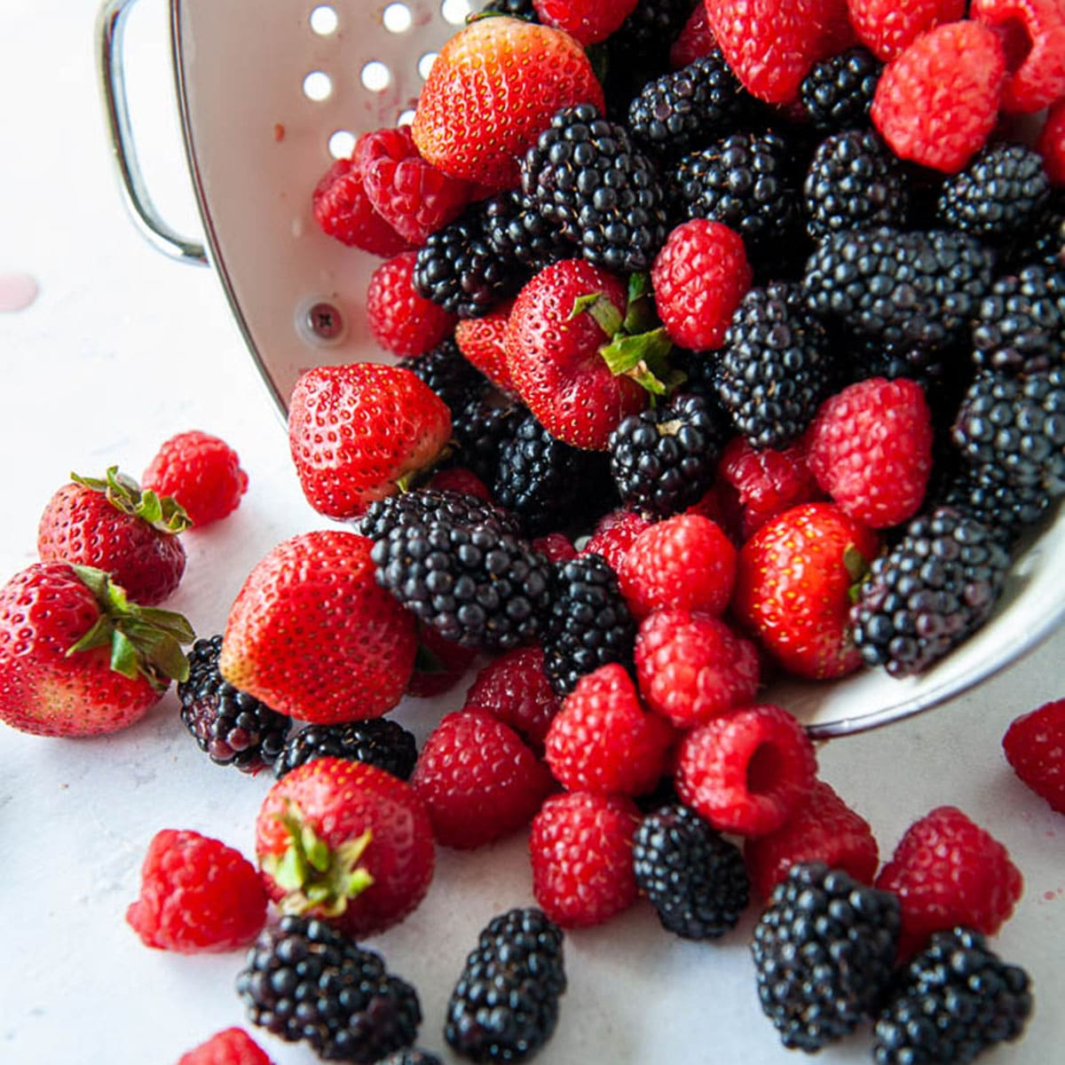

Customer Satisfaction and Sales Performance in U-pick Berry Operations
Zoey Yang, Miguel I. Gómez & Rebecca Wasserman
Dyson School of Applied Economics and Management
Cornell University

Slide 35
U-Pick vs. Other Channels
Source: “2018 New York State Berry Market Analysis: Pricing Information of Local Berries.” Davis, Gómez, Pritts, Dyson School Extension Bulletin 19-02

Slide 36
Research Objects
This study evaluates drivers of Customer Satisfaction in U-pick operations and links between customer satisfaction and sales performance
Reasons for Satisfying Customers:
  Cost of attracting a new customer is 5 times the cost of retaining one
  Average company loses 10% customers a year
  Reductions in customer defection increases profits
  Customer profitability tends to increase over time

Slide 37
Experimental Data
Customer Satisfaction Survey in 4 U-Pick berry farms in New York State
Data collected from June/2019 through August/2019
About 350 responses in total
Shoppers provided information on
Scores of 17 attributes about their experiences
Purchase and re-purchase intentions
Reasons for visiting the berry farm
Demographics

Slide 38
Summary Statistics
Variables | Description | Mean (or % if indicated) | SD
Overall CS | Overall customer satisfaction (where 1=poor to 5=excellent) | 4.71 | 0.49
Purchase | Percent of customers who purchased berries | 97% | 0.16
Amount | Average amount spent at u-pick farm | 26.58 | 17.61
First-time farm | Percent of customers visiting farm for first time | 22% | 0.41
Comeback this year | Percent of customers who said they will come back this year | 84% | 0.36
Comeback next year | Percent of customers who said they will come back next year | 99% | 0.11
Number of people | Number of other people customers come with | 2.51 | 0.71
Have young child | Percent of customers who brought children under 10 | 40% | 0.49
Female |  | 72%
Male |  | 28%
Age | Average customer age | 49 | 15.21
Note: n = 312; for variables with percentage mean, answer with 1 is yes and otherwise is no.

Slide 39
Results: Consumer Satisfaction Drivers
Factor 1: Experience | Taste of U-Pick berries Availability of berry variety information Quality of U-Pick berries U-Pick berry prices Forms of accepted payment Information upon entry
Factor 2: Retailing | Cleanliness of the farm Helpfulness of staff Ease of checkout process Friendliness of staff
Factor 3: Convenience | Ease of finding the farm Farm location Finding information to plan your visit Ease of parking

Slide 40
Results: Amount Spending Drivers
Change in one unit of corresponding variables resulting from an additional dollar increase in amount spend
Note: ﻿∗ p-value < .10. ∗∗ p-value < .05. ∗∗∗ p-value < .01.

Slide 41
Conclusion and Future Research
U-Pick operations doing a great job making visitors happy, but performance can be improved further
Strong links between Customer Satisfaction and U-Pick Berry farm sales
Three drivers of customer satisfaction in a U-Pick Berry farm visit (Experience, Retailing, Location)
Systematic monitoring/analysis of CS and sales provide information for tactical and strategic decisions

Slide 42
Thank you for your attention!
QUESTIONS?
        Miguel I. Gomez
        Dyson School of Applied Economics and Management
        Cornell University
        mig7@cornell.edu
        475A Warren Hall

