Slide 1
In Foodservice
Michele Lefebvre, RDN, CDN
Director, Nutrition
Cornell Dining
Giovanni Sogari, PhD
Visiting Scholar
University of Parma

Slide 2
For Review Today
About Cornell Dining
Menus of Change Program
Blended Burger – Operational
Blended Burger - Study

Slide 3
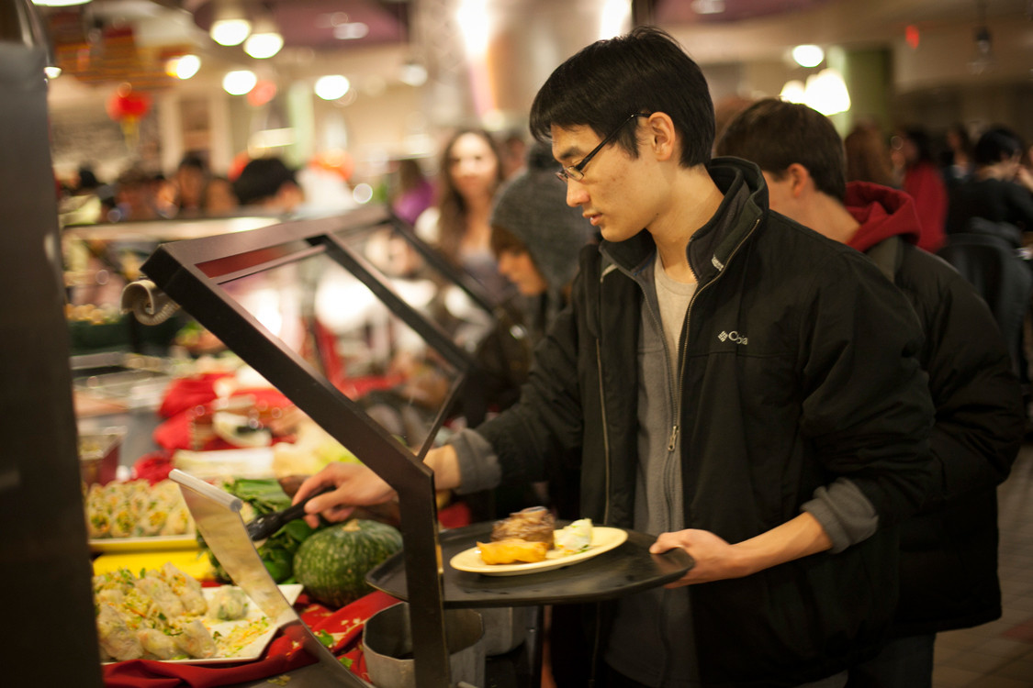
Who is
Cornell Dining?

Slide 4
Cornell Dining
Facts and Figures
>22,000
10,552
358/22
28 locations
400/600
Cornell Dining serves over 22,000 meals per day during the semester.
Cornell Dining has over 10,000 students on meal plan.
Cornell Dining is open 358 days per year and 22 hours per day.
Cornell Dining operates 28 locations – and they can be found in just over 1 square mile, on campus.
Cornell Dining has almost 400 full time staff and 600 student staff.

Slide 5
Notes:
By now, Menus of Change should be a Cornell Dining standard verbiage. If you are new or don’t recall, Menus of Change is a collaborative with other colleges and universities in the business of creating healthy, sustainable, and delicious food choices.

Slide 6
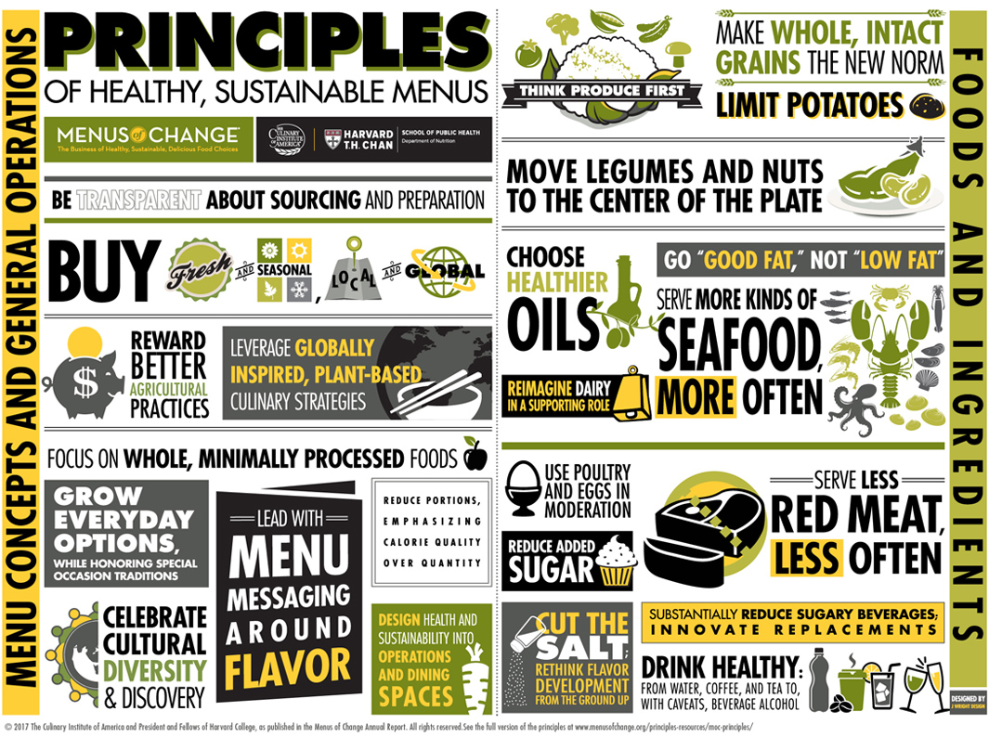

Slide 7
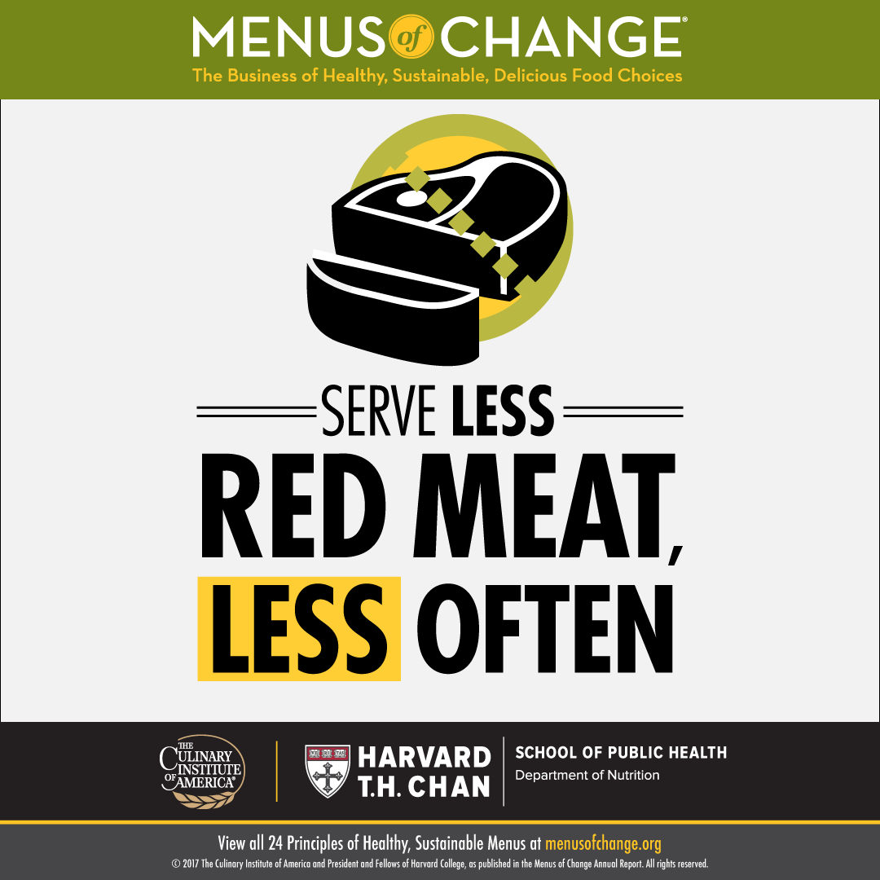

Slide 8
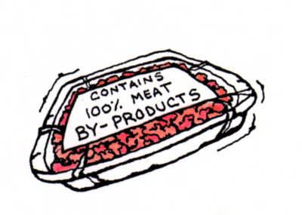
In 2016
145,253
51,173 lb

Slide 9
A Better Choice
Better for Flavor
Better for Health
Better for Sustainability
Better for Cost

Slide 11
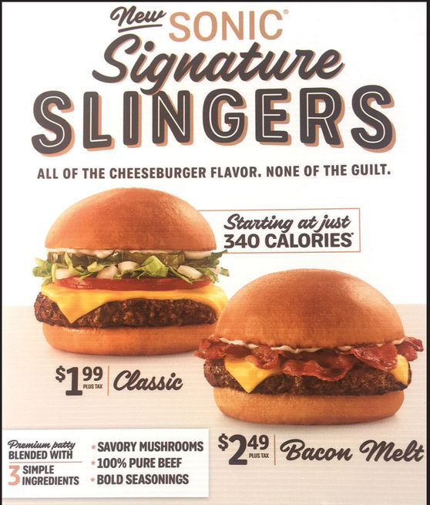
Notes:
2018

Slide 12
Key Operational Issues
Controlling Moisture
Processing of Blended Beef
Mushroom Type & Cost
Notes:
Why did we choose risley?
Where are burgers served?

Slide 13
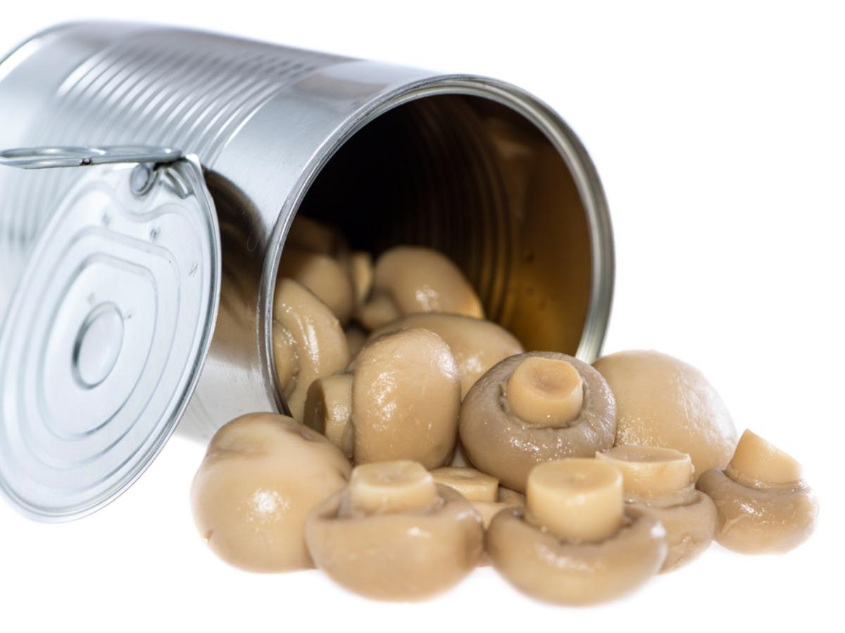
Mushroom Type & Cost
Button Mushrooms
Portabella Mushrooms
Crimini Mushrooms
Canned Mushrooms
IQF (Individually Quick Frozen)

Slide 14
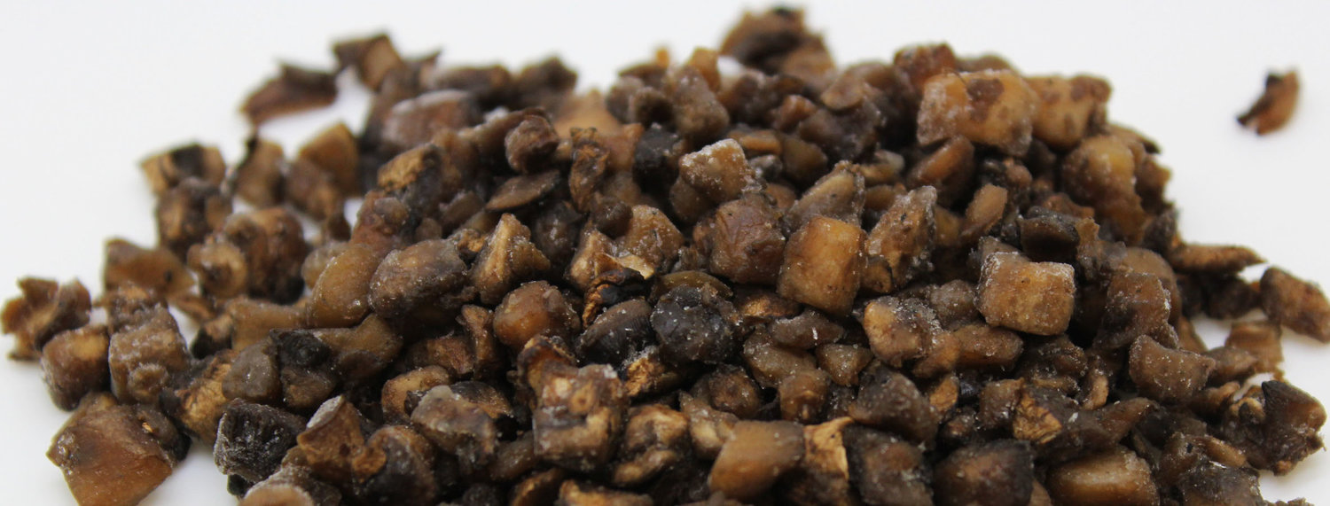
Controlling Moisture
Raw mushrooms
Blanched mushrooms
Blanched, pressed mushrooms
Canned, pressed mushrooms
Roasted, high heat mushrooms
Reduced Moisture, IQF mushrooms

Slide 15
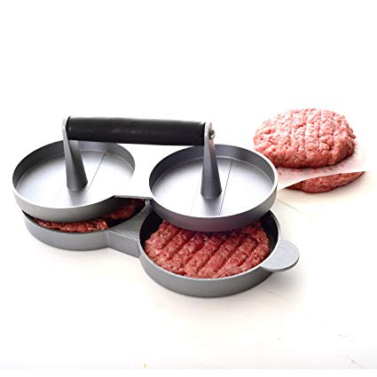
Processing of Blended Beef
Internally
Labor Costs
Consistency
Holding
Externally
Beef processing
Mushroom processing

Slide 16
In 2018
122,022
47,508 lb

Slide 17
Two year change:
15%
7%

Slide 18
